Slide 1


Affordable Housing Development 101 & GoNoGo
Paige Waldock
Project Manager
Cahdco / CCOC
Luke Winspear
Toolbox+ Coordinator
Cahdco / CCOC
Notes:
Paige

Slide 2
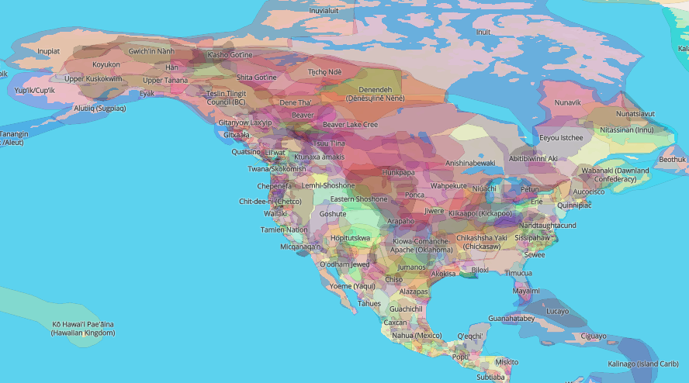
Land Acknowledgement
From coast to coast to coast, we acknowledge the ancestral and unceded territory of all the Inuit, Métis, and First Nations people that call this land home.
Cahdco is located on the unceded territory of the Algonquin Anishnaabeg People.
Native-Land.ca | Our home on native land
2

Slide 3
Session’s Schedule
Affordable Housing Development: the Basics
GoNoGo Game

Slide 4

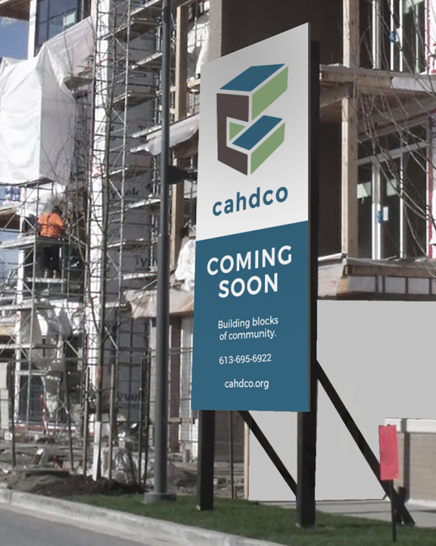
Cahdco
Non-profit real estate developer
Develop affordable rental housing & home ownership
Sister corporation to CCOC
Consultant to non-profits, co-ops & charities
4

Slide 5
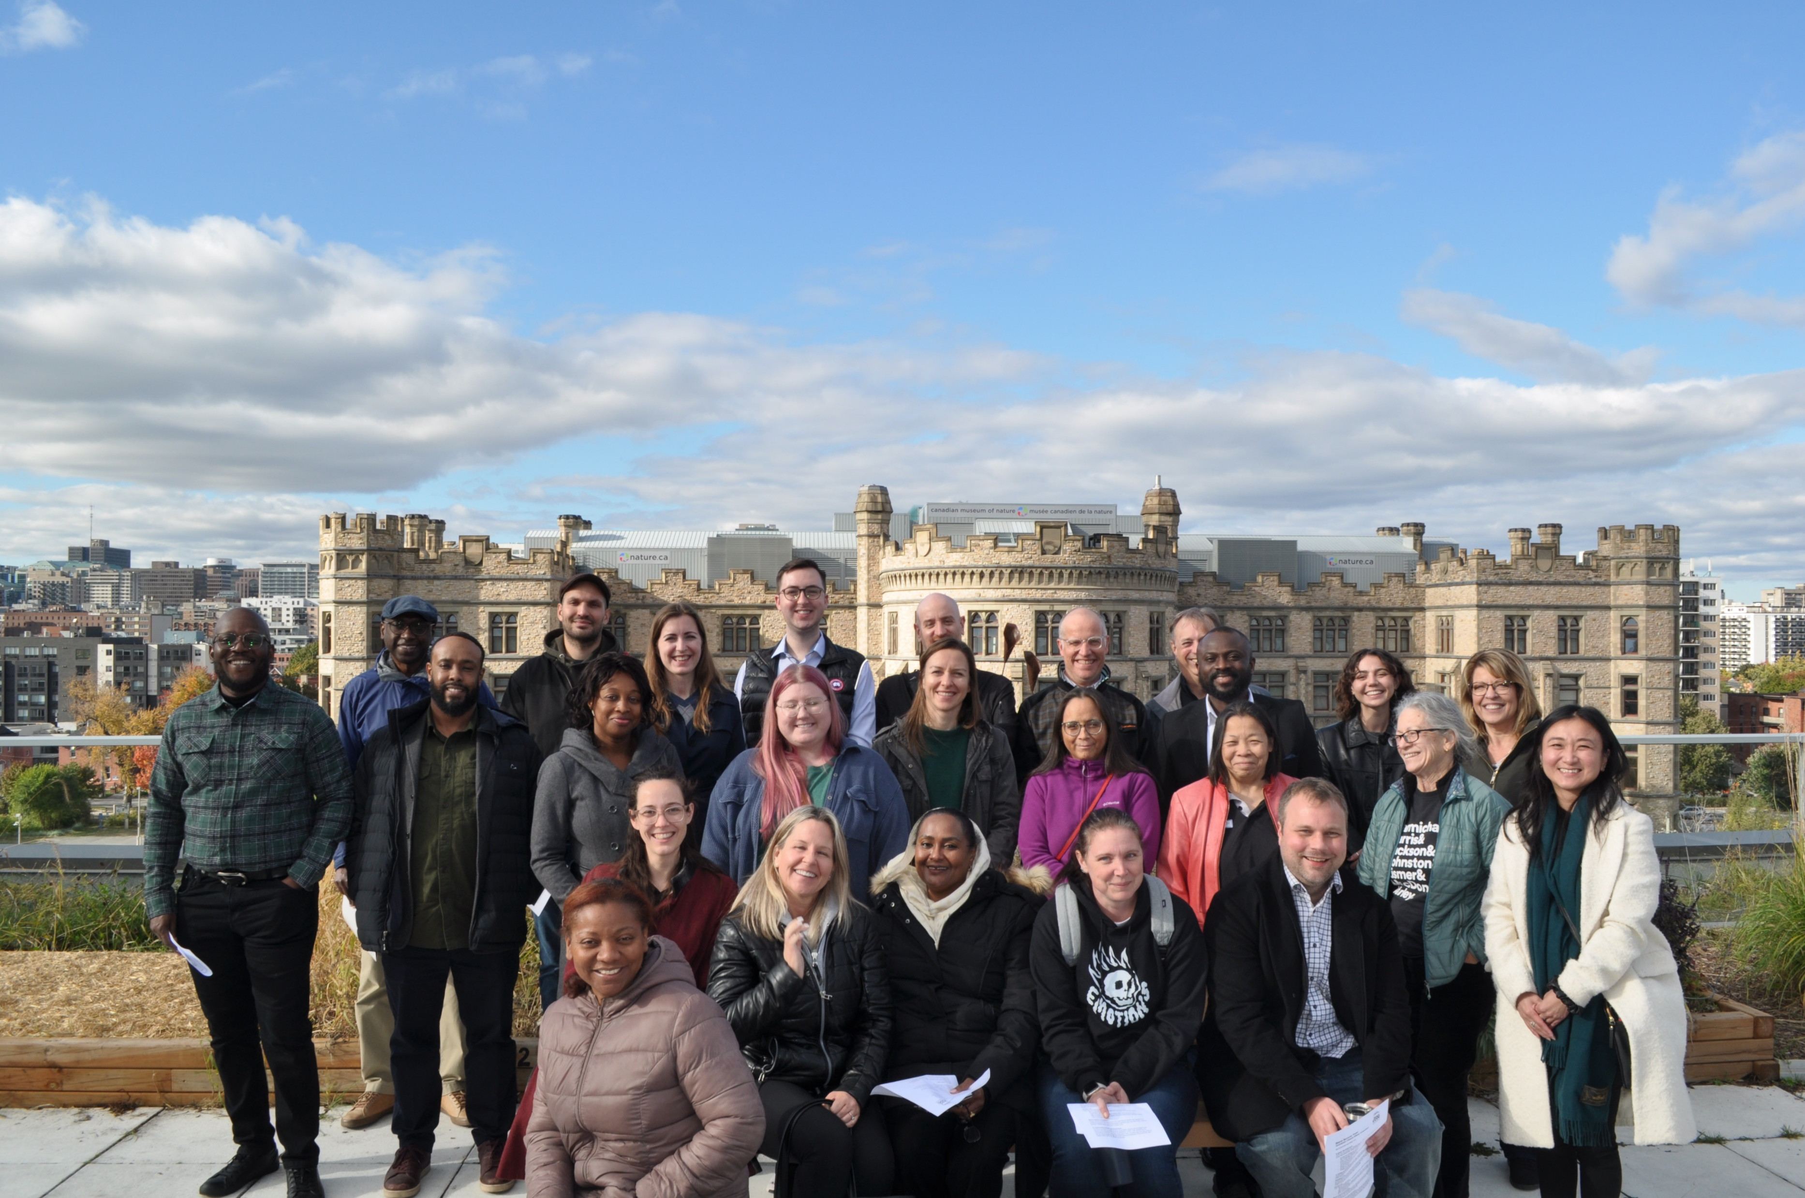

Coaching and mentorship to increase the amount of affordable housing development corporations and their capacity to create affordable housing in Canada

Slide 6
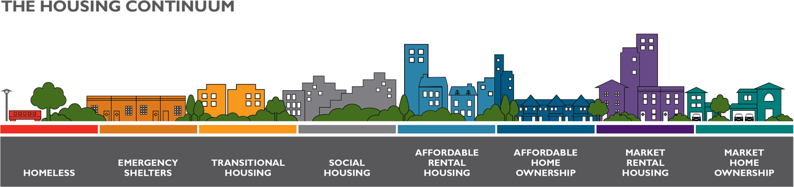
Types of Housing
CMHC Housing Continuum
Notes:
Mozghan

Slide 7
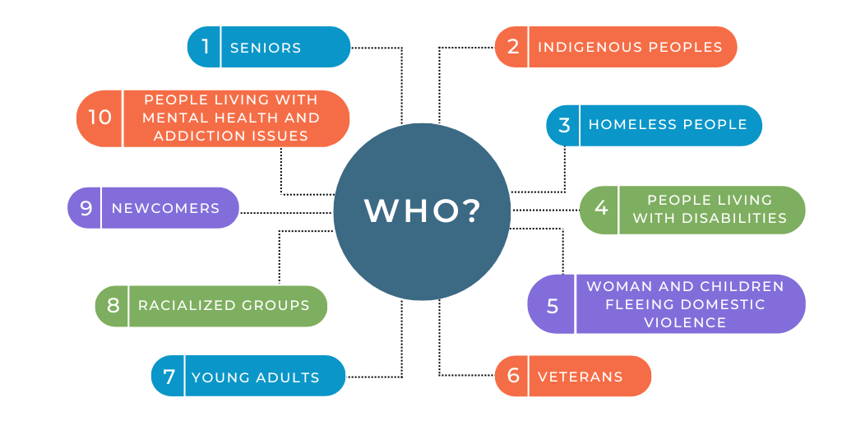
Who Lives in Affordable Housing?

Slide 8
Housing Affordability
Housing Affordability = a household’s ability to afford a home. Often measured as no more than 30% of gross household income
Ottawa Rental Statistics for a One-Bedroom unit (2021)
Household Income for Affordability
N/A
N/A
$40,960
$49,440
$51,200
Source: CMHC Housing Market Information Portal
Notes:
Mozghan

Slide 9



Project Types
Retrofit/Renovation
Acquisition
New Development
Notes:
Mozghan

Slide 10
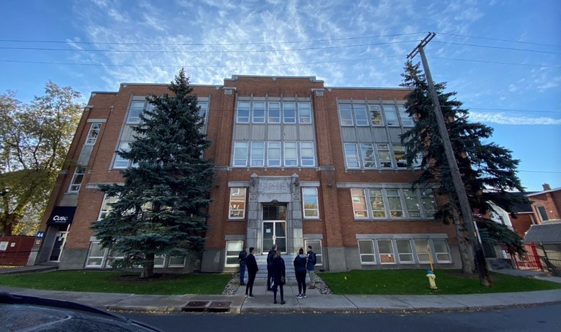
Project Types
Retrofit / Renovation
Cornerstone Eccles
Supportive Housing for Women
Notes:
Mozghan

Slide 11
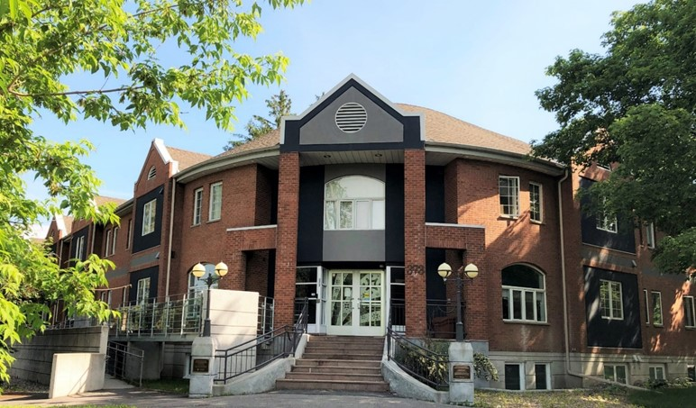
Project Types
Acquisition
Cornerstone Princeton
Supportive Housing for Women
Notes:
Mozghan

Slide 12
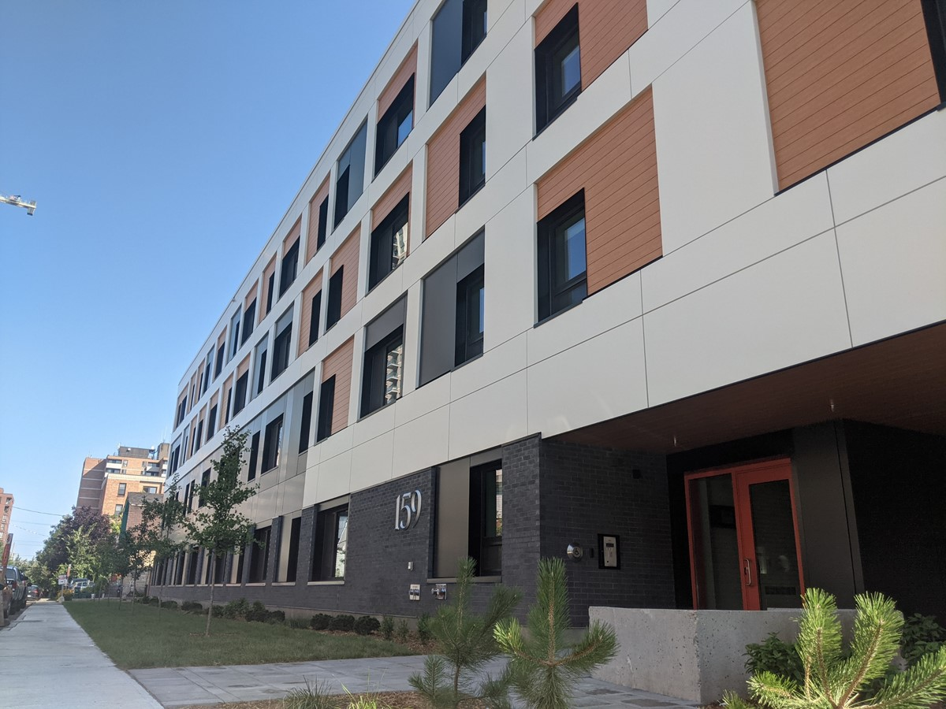
Project Types
New Development
CCOC Forward
Mixed Income Housing
Notes:
Mozghan

Slide 13





Project Components
Capital
Land
Capacity
Projects
=
Notes:
Mozghan

Slide 14
Roles and Responsibilities
1
Land Owner
5
Community Partners
2
Housing Provider
6
Support Services
3
Project Team
7
Funders & Lenders
4
Property Manager
8
Regulators
Notes:
Mozghan

Slide 15
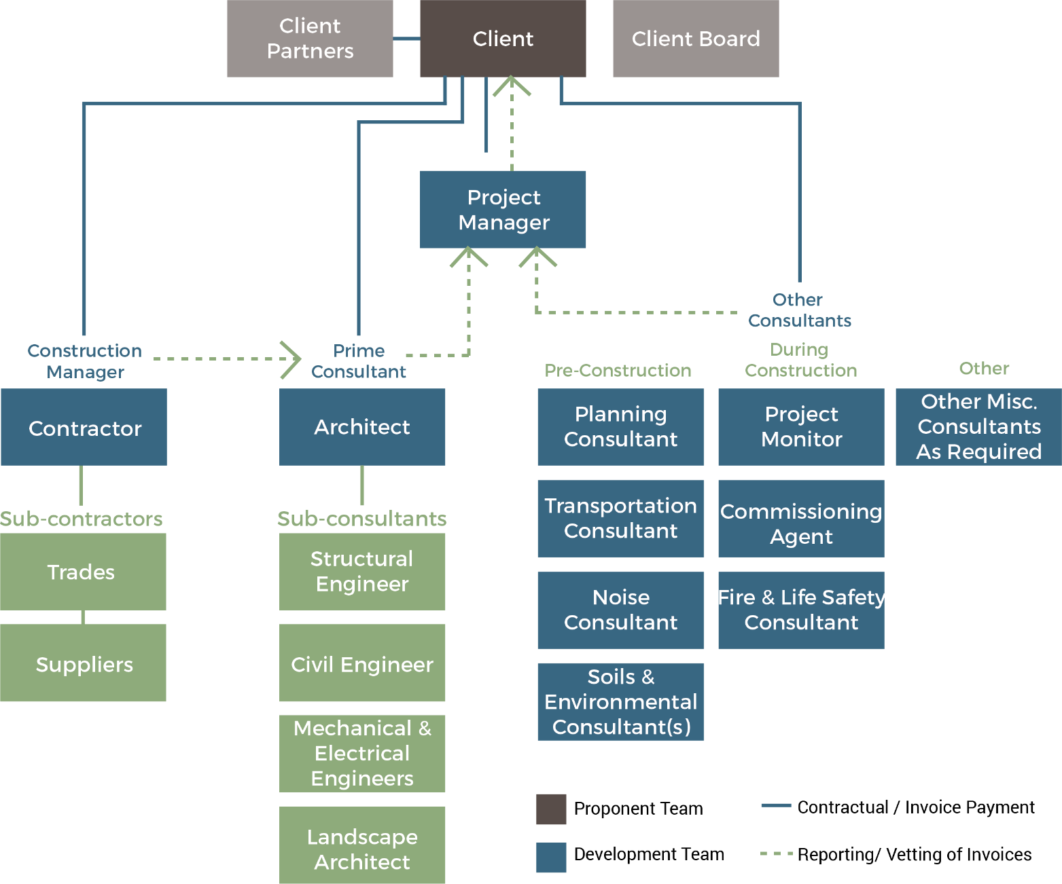
Project Team
Notes:
Mozghan

Slide 16
Real Estate Development Stages
Development
4 months – 12+ months
Operations
20 – 50+ years
Design Analysis
and Feasibility
2 months – 2+ years
Construction
12-18 months
Notes:
Mozghan

Slide 17
Design Analysis and Feasibility
Design Analysis and Feasibility
Identify and select site
Preliminary architectural massing and design concept
Planning investigation: zoning and site plan
Draft capital budget
Draft operating budget
Identify and secure sources of funding and/or financing
Business case: Go or No go decision
Design
Development
Construction
Operations
Notes:
Mozghan

Slide 18
The Feasibility Cycle
Concept
Costing the Concept
Identifying Financial Sources
Housing Provider & Site Criteria
Capital & Operating Budgets
Organizational
Capacity
Notes:
Paige

Slide 19





Capital Budget
Costs
Sources
Land Costs
Gov. Grants
Partnerships
Soft Costs
Hard Costs
Financing
Equity
Notes:
Paige

Slide 20
Revenue
Expenses
Net Operating Income (NOI)
Debt Financing
Operating Budget
Rent revenue
Rent supplements
Canadian Housing Benefit
Parking
Laundry
Maintenance
Capital reserves
Utilities
Property tax
Staff/admin costs
Insurance
$1,000
$400
$600
40%
Notes:
Paige

Slide 21
Refinement
Concept
Costing the Concept
Identifying Financial Sources
Client & Site Criteria
Capital & Operating Budgets
Organizational
Capacity
Notes:
Paige

Slide 22
Takeaways
F I N A N C I A L
All projects need capital, land, and capacity
All projects need grants, financing, and equity
  To receive financing you need a viable operating budget
The capacity of the team is key
Notes:
Paige

Slide 23
F I N A N C I A L
Questions?

Slide 24
Welcome to Gonogo!
Rules and How to Play

Slide 25
Game’s Mission
Develop a project concept and a feasibility study for an affordable housing development project.
Apply for the project’s main funding source and receive a grant to win the game.

Slide 26
Phases
Pre-Feasibility
Examine your Concept Form
Feasibility
Complete Feasibility Form
Draw Strategy Cards
Funding Award
Build Project Team
Apply for Grant Funding
Pitch you Project
Achieve Financial Viability

Slide 27
Objectives
Examine your Concept form
Build a Team
Pre-Feasibility
Feasibility
Complete Feasibility form

Slide 28
Build a Team
  Architect
  Planner
  Housing Operator
  Construction Manager
  Financial Officer
Each team member should strive to fulfill the objectives of their roles, but as a team you must rely on each other in order to complete your own tasks.

Slide 29
Objectives
Complete Feasibility form
Draw Strategy Cards
Apply for Funding
Complete Feasibility form
Feasibility
Feasibility

Slide 30

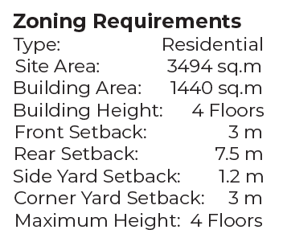
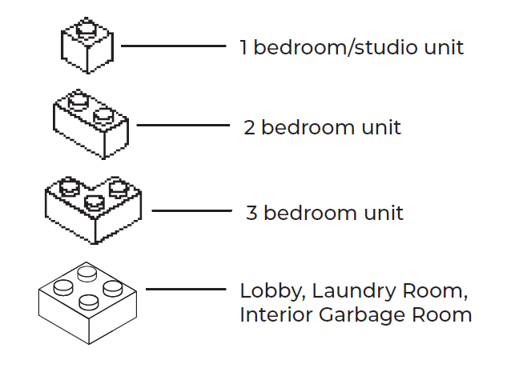
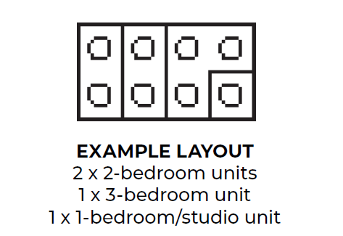
Architect
Zoning
Scale and Unit Count
Massing

Slide 31
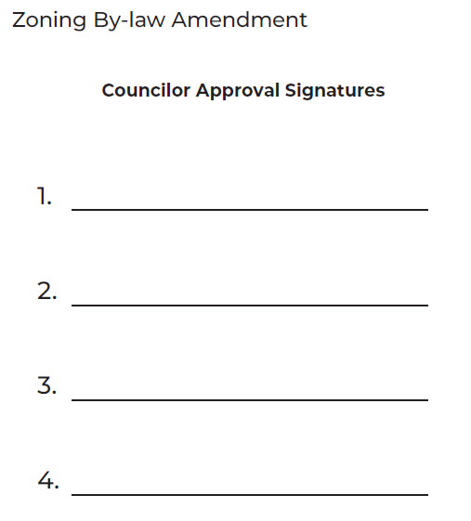
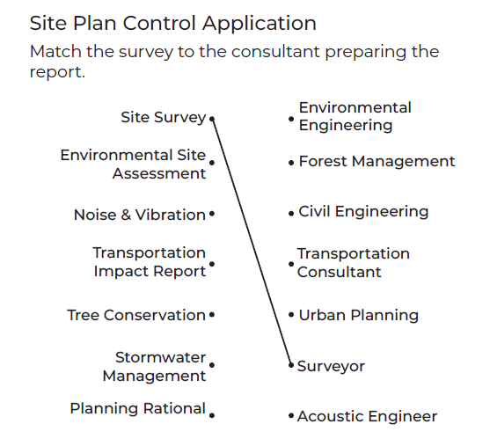
Planner
ZBLA/Councillor Role
Site Plan Control
Approval

Slide 32

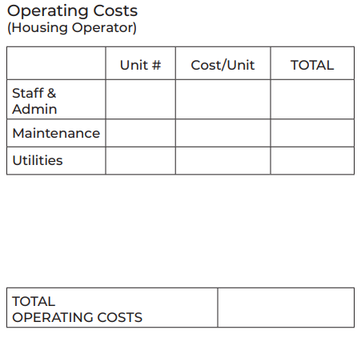
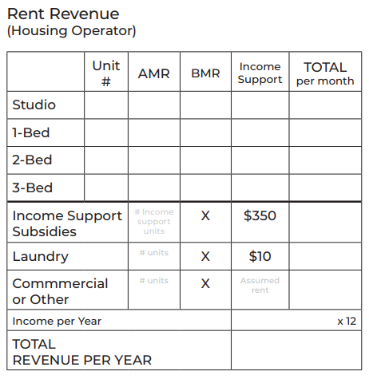
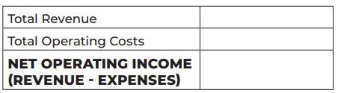
Housing Operator
Operating Costs
Rent Revenue
Net Operating Income

Slide 33
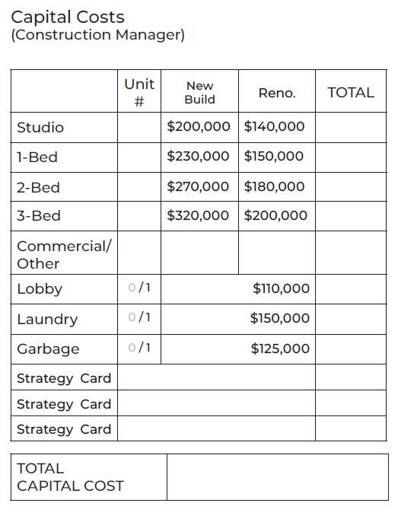

Construction Manager
Strategy Cards
Construction Costs
3 x
Site

Slide 34

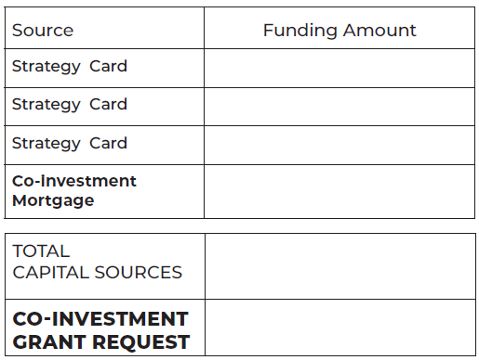

Financial Officer
Interest Rate
Strategy Cards
Capital Sources
3 x
Funding

Slide 35
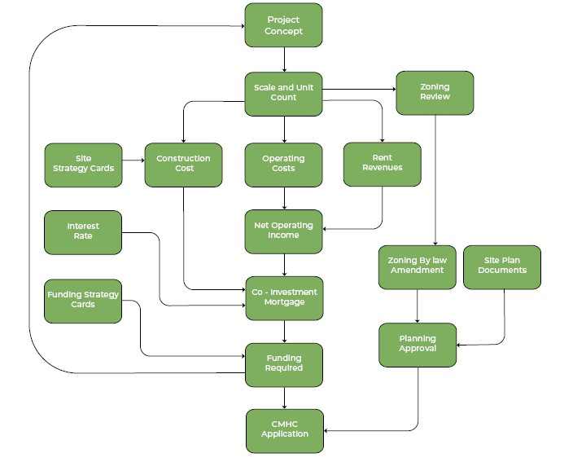

Slide 36
Objectives
Complete Feasibility form
Pitch you Project
Achieve Financial Viability
Funding
Feasibility
Funding Pitch
What
Grant Request ($)
Why (Value)

Slide 37
Name of the location of the site Card
Place Pictures of the Legos HERE
Duplicate Slide if Needed

Slide 38
Results!
Funding announcement(s) from CMHC

Slide 39

Receive the latest news about our webinars, workshops, useful tools you can use for your projects and more!
Register to our Toolbox+ Newsletter today!

Slide 40
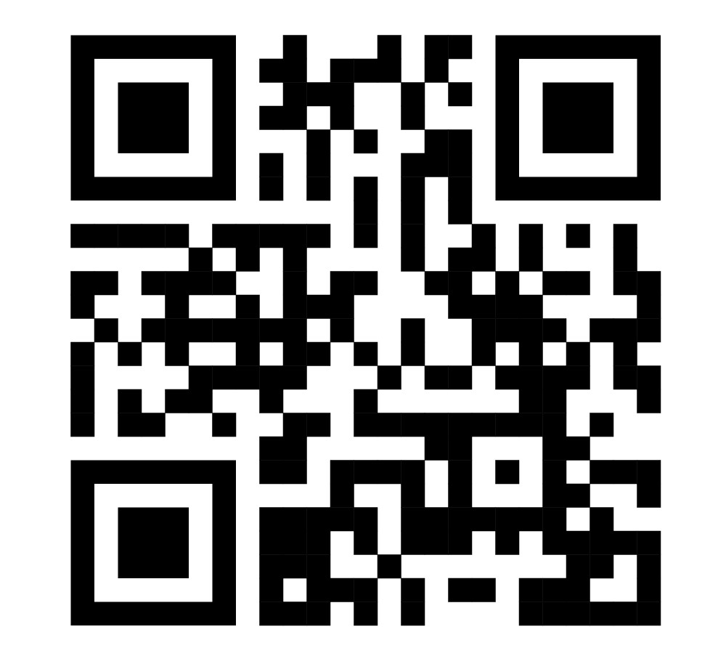
If you would like to know more about our Toolbox+ Programs, you can find more information here:

Slide 41


Thank you!
Paige Waldock
Luke Winspear
Project Manager
Cahdco / CCOC
paige.waldock@cahdco.org
Toolbox+ Coordinator
Cahdco / CCOC
luke.winspear@cahdco.org
41

