Slide 1

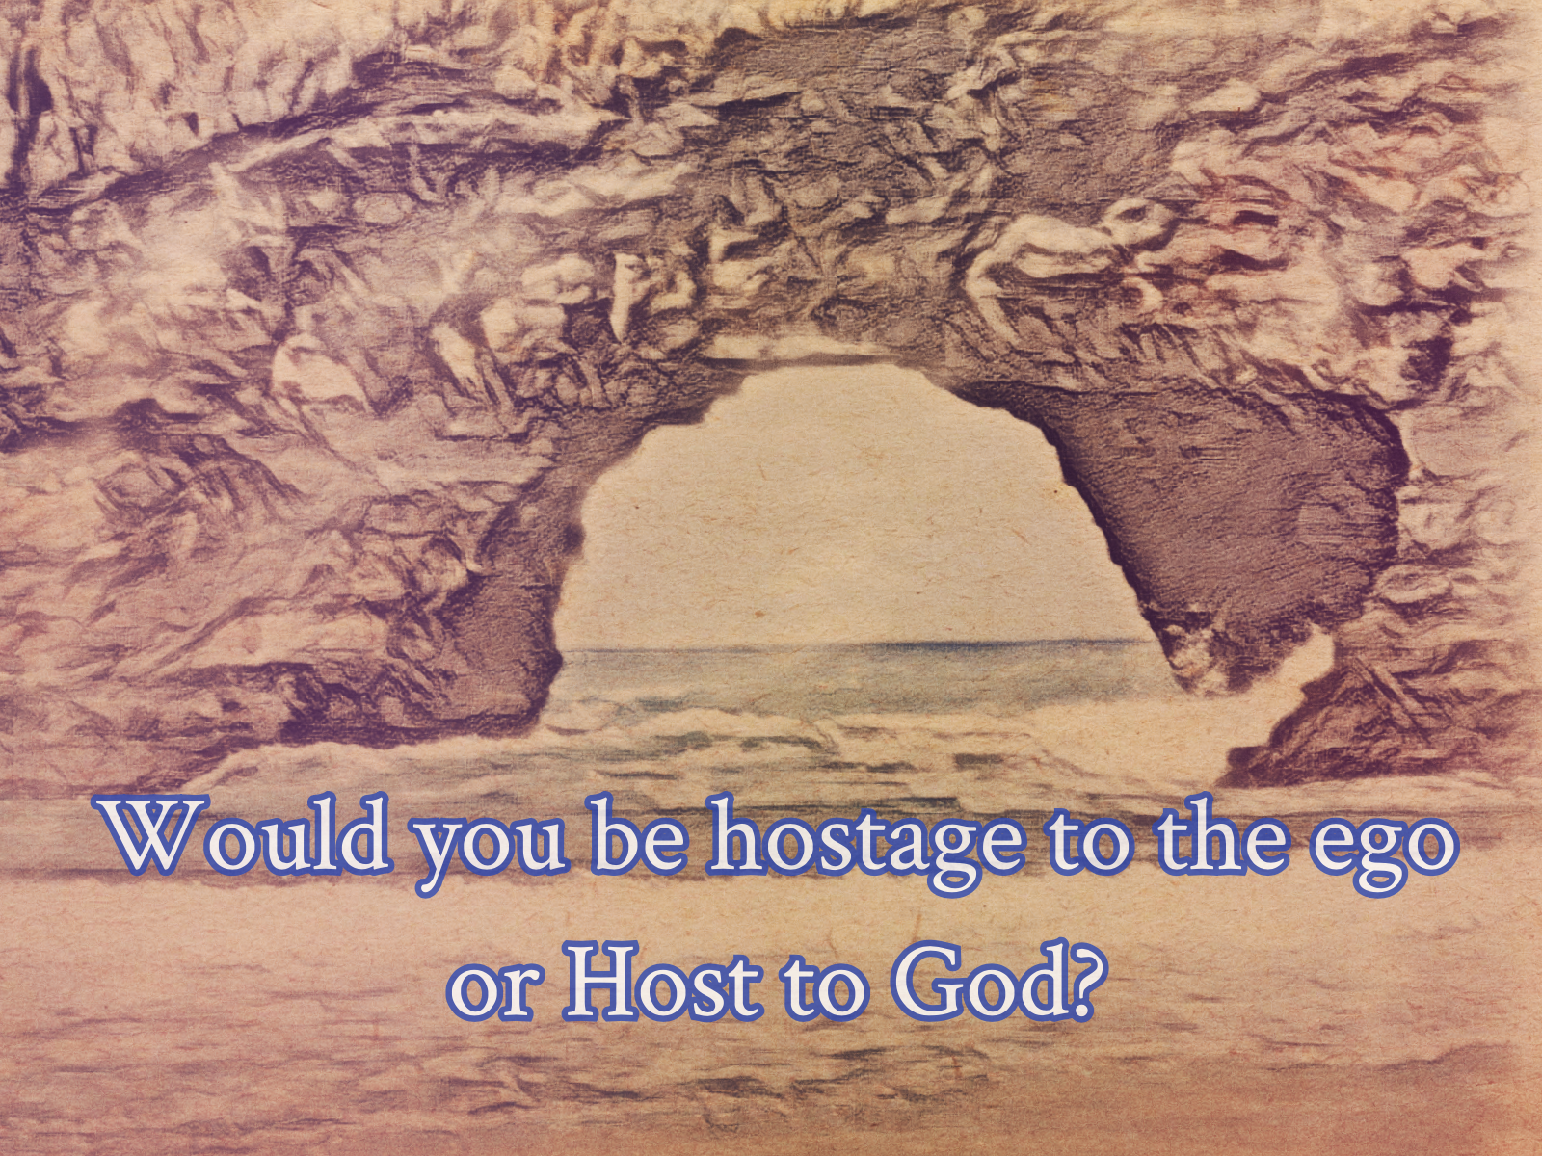



God OR THE Ego
Daniel Shai
Chapter 11
A Course in Miracles CE

Slide 2
I. Your place in God’s Mind
“Nothing alive is fatherless, for life is creation” (1:6). Creation proceeds from parent to child. If I am alive, I have a parent, a father. But… I am confused about who my father is. This question must be answered clearly, for my decisions and their results are always determined by whether I believe the ego created me, or God did. Could it be the ego? How could it be, if I made the ego? This would be a circular creation, in which I make my father and my father makes me. No, my Father is He Who created me, and I did (and do) not create Him in return. But, I create like Him in return. That is His will. He created me so that He would not be alone. And He is not alone, for I am still His Son, and He is still my Father.
In this section, Jesus encourages me to go straight into the center of the ego’s thought system, so I may discover it rests on meaninglessness (the idea that it is my father is utterly meaningless). The deeper I go, the darker and more obscure it becomes. But I do not go alone. Jesus will give me the lamp and go with me. As I look upon the ego’s thought system honestly, seeing it as it is, I will see that “the dark stone of terror on which it rests” really is nothing at all.
Healing is a cornerstone of the Holy Spirit’s thought system. In it lies the beginning of knowledge, the rebuilding of God’s thought-system of light. As I restore others to their place in the Mind of God, I restore myself. Jesus makes a point that I (or any brother) cannot be anywhere except in the Mind of God, because it is infinite and limitless - i.e. everywhere. How can I be outside of His universe, when there is nothing outside of it?
I have a place in God’s Mind forever. All I need do is look upon the glory of His creation and see that He has kept it for me. That means I reclaim my place in God’s Mind by granting my brother his place.
It is absolutely gorgeous when Jesus restates his famous words from the gospels in a different manner: Rather than, “I and my Father are one”, he tells me: “I and my Father are one with you.” This is now a statement of inclusion. I am inspired to extend this to my brothers, by repeating within as I look upon them: “I and my Father are one with you. No part of God can be lost to Him.” This is a wonderful way to grant my brother his (rightful) place in God.

Slide 3
II. Healing as the recognition of your will
My Father’s will is my own. That will is to create, or to share. To share is to know, because as I share what is in me, I come to know what is in me (When you express something, you learn that it was in you. Think of a work of art, or even a mood). The Holy Spirit remembers God’s will for me. I often do not want to listen because I do not realize it is my own will.
The reason I don’t know my own will is because I denied that I am God’s Son. That is why the previous section made it so clear to me that I am. The Holy Spirit is my ticket out of this situation, because He remembers my will, because He knows God’s. Sometimes what He tells me can seem like it’s not my own will but coming from without me. This is only because I don’t recognize my own will. God (and the Holy Spirit) is incapable of coercion. God gave His own will to me, and being like Him and sharing His will, how can I be in conflict (of wills) with Him?
The fear of God’s will - because I believe it is not my own (I think I want to be above Him) - is my whole sickness and fear, as it holds me in a state in which I do not want to know (to be in knowledge). To not know is to be in darkness. In other words, to deny the light and that it is in me.
I know not what I do, because I do not understand myself. (And I know not what I want, because I have forgotten my will). Healing, then, is a lesson in understanding. Healing is the will to make whole, and when this is my will, I listen to the Holy Spirit. As I give miracles and accept healing thoughts - from my own mind or my brother - I learn that I am God’s Son, and thus heal. But when I attack, I cannot know my own will because I separate rather than share (love), which means unite/join. With every attack thought I accept into my mind, I learn what I am not, and learn to misunderstand God. But all I need is small willingness to make whole (heal), because the Holy Spirit works with what He’s got, meaning He takes my small will and makes it whole with His Own complete will. And this is so, because I have indeed started the journey with a tiny will, and the Holy Spirit has made it bigger and bigger, because He has taught me where truth, love and peace really lie. The more I hear His will for me, the more I remember my own.

Slide 4
III. The dark companions
The whole section is about a single question: Who will you choose as your guest on the journey: the dark comforters or God’s Comforter? This is really the same question as the powerful one that Jesus asks in the middle of the section: “Would you be hostage to the ego or host to God?” (4:1).
We think that inviting the ego to be our guest means choosing a life that’s for us, where we get to pursue what makes us happy. But that’s not how it turns out. The journey is hard and lonely (8:3). Yes, we have companions along the way; we have comforters. But they are fear and grief (8:4). These are the “dark companions” who are supposed to alleviate our loneliness (8:6). They are the only ones we can turn to for comfort. You can see why Jesus calls this “the dark journey” (8:5). Is this a journey that we have been on?
Even while this is our journey, however, there is good news. Our true Comforter, the Holy Spirit, is still with us. We don’t hear Him, but He always goes with us, patiently waiting, “for He cannot leave a part of God” (2:4). And our chosen guest, the ego, “is nothing whether you invite it or not” (4:4). So the journey we are on is actually an illusion (9:5). We can’t really lose our way; God makes sure of that (9:3). When we wander off the path, we enter an unreal land and traverse it on an unreal journey. When we return to the path, which we inevitably do, it’s as if our detour never happened.
Sooner or later, we’ll decide we’ve had enough of the dark journey. It’s just too hard. In our weariness, we will at last turn to God’s Comforter. Unlike the dark comforters, He can really comfort us. He can give us true rest. Fear and grief can’t give us rest, and we can’t give rest to ourselves. How could we, when we are the ones who have made ourselves weary?
We need, then, to invite God’s Comforter to be our Guest on the journey. To invite Him is to turn toward the light (9:6). He will take us on a journey of light, in which the great light surrounds us and shines out from us (8:7). Imagine walking in a light so great that the dark companions—fear and grief—are nowhere to be seen. Who wouldn’t want that kind of a journey?

Slide 5
III. The dark companions
What is our role in this? How do we consent to this journey?
First, we offer the Holy Spirit just a little place in our mind. If we do, He will fill it with light. The little spark in our mind (which seems to have something to do with pure thought, clear sight, and understanding) will grow and sweep us out of darkness. “Think like Him ever so slightly, and the little spark becomes a blazing light that fills your mind, so that He becomes your only Guest” (1:5).
Second, we need to refuse to let the dark companions (fear and grief) enter our mind. “Walk in light and do not see the dark companions” (8:6). “Never let them enter the mind of God’s Son” (10:1). We need to see our mind as inside God’s temple and then “Guard carefully His temple” (11:6). This doesn’t mean we force out of our mind legitimate fear and grief; it means we realize there is no legitimate fear and grief, and thereby shine away these shadowy companions.
Third, we need to invite all our brothers into God’s temple with us. We need to “accept the whole Sonship and bless it with the light [our] Father gave it” (12:4). Once we’ve banished our dark companions, we need to replace them with real companions, which are all our brothers.
Once we are so filled with light and entirely free of any trace of darkness, our mind, incredibly, will be as pure as God’s (11:5). And then we can enter His presence and finally discover what He wills for us, what has been waiting for us throughout all of our weary journeying. Jesus can’t tell us what this will be like, but even his hints are deeply thrilling: “O my children, if you knew what God wills for you…!” (6:6).
Given that the endpoint of the journey is unbounded, eternal joy, we should ask ourselves the question the Workbook asks us about this same journey: “Could any way be holier, or more deserving of your effort, of your love and of your full intent?” (W-155.12:3).

Slide 6
Iv. God’s blameless son
This sections begins with the most incredible and unforgettable definition for ‘soul’: The Sonship is my soul. It is not a private, separate thing. When I reject (hate) a brother, I have rejected a part of my very soul. I have thus denied him, myself and God.
Each one should look at the Sonship as his own soul. How could anything but love be when we do?
When I cut a brother off from my light, I am endarkening my own mind. All are included in my light, for my light is theirs, and His. It is the Son’s because it is the Father’s (God gives everything, i.e. Himself).
With the new understanding of ‘soul’ I can now easily understand why when I blame my brothers, I have blamed myself. To blame God’s Son is to blame myself, and vice versa. I cannot be separate from my brothers. It is 100% true that only I deprive myself, every time I refuse to extend love. I must guard against all forms of denial of this truth (we love to make excuses that something external is the cause of our deprivation). I must undo blame completely (not blame others or myself - to blame myself is to blame another) for my own sake (the word ‘my’ here does not refer to me as a separate entity, but as God’s Son, for I cannot be separate from the whole).
The only thing I am ever looking at is God’s Son. The Sonship. The whole. To see the Son is to see the Father. The Kingdom is simply inseparable perfectly united. (This is Christ vision). See this, and it is the end of separation.

Slide 7
v. The “dynamics” of the ego
I can’t ignore my illusions, I have to look at them, “for not looking is the way they are protected.” I need not be afraid because illusions cannot be dangerous, and because I will be looking at them with Jesus, calmly, with the lamp that will dispel them.
As I look upon the ego’s thought system in this safe manner, the first lesson I learn with Jesus is that the ego’s goal is autonomy — being independent of God. It wants me to think that there is at all such a thing as “ego dynamics” to examine, because if there is, it implies the ego has its own power, separate from God, since “dynamics” implies the power to do. The ego has no power to do anything: All power is of God.
Why, then, should I fear the ego if it cannot do anything? It cannot produce any real effects! Only delusions. What this means, is that all the harm that seemed to ever come to me is simply untrue. Everything that the ego made — all its illusions — stem from the central belief that it can be autonomous, separate from God, self-existing; that it can have power apart from God. This premise is so false and unnatural, that how could I believe anything that comes out of it?
Do I want there to be a power other than God’s? I have to really ask myself. If I do, I am identified with the ego, who thinks autonomy is freedom. But the belief in autonomy is actually costing me the knowledge of my dependence on God, where my true freedom lies. I am autonomous with God: There is nothing but us, creating as one, freely and joyously. That, as I already know, is my true will.

Slide 8
v. The “dynamics” of the ego
Heard from the ego, dependence sounds bad. But deep within I long for God: I long to be like a child, depending on my Parent, Who has created an environment which is natural for me, and in which I am absolutely joyous and absent conflict. It’s Home. The ego takes this longing, and tries to fulfill this longing in all the wrong ways (trying to be autonomous, separate, independent, do it on my own, worldly success/self-made man) and thus replace God. The ego always attacks on behalf of separation.
The ego doesn’t want me to see one very important thing: That I am afraid of it. That means it weakens me. Yet it claims that it gives me power. If I realize that it actually diminishes my power, would I still have any allegiance to it at all?
Why am I afraid? Because with the ego I believe I can be harmed. But all it produces are illusions based on the fallacy of separation. Am I afraid of illusions? Could they have an real effects? Why should I believe the ego’s voice if it instills fear in me? If I let go of fear, there is nothing separating me from God. It will make me afraid about releasing fear, because it is a basic threat to its dream of autonomy. I would not accept the cost of fear if I recognized it. It belittles me. It contracts me. It is a self-made prison. It is the belief that attack has power, and that truth can be attacked. This means I am afraid of myself, because I think I can attack myself and destroy myself. That is at the depth of my fear, and it is why I defend myself (because I believe in attack), rather than let go of the fear and realize there is nothing to defend against.
Only God’s purpose can be accomplished, not the ego’s. It is already accomplished. I’m merely fighting windmills. My autonomy comes from identifying with Him. Only this is happiness. The ego will tell me its autonomy leads to happiness, but the ego’s “joy” is my misery. The ego leads only to fear; this I must see clearly. Is fear joy?
Surely I know that love is joy, and seeing the obvious conclusion of following ego or HS, I must choose HS and return to God. Could the choice between fear and love really be hard? In God am I completely protected, and no attack can come to me at all - and therefore, no fear. The love of God, in which no dreams of attack exist, is my will.

Slide 9
vI. Selecting perception’s witnesses
The ego analyzes — separates out — in order to not see truth; the Holy Spirit accepts truth. The ego breaks wholeness apart and judges each part separately. It makes up its own meaning for everything & for the relationships between things. It is, thus, inconsistent in meaning. It believes consistency is impossible, so it thinks truth is meaningless because it is consistent. Ego’s truth is inconsistency. Inconsistency is error, and so for the ego error is truth. It demonstrates and justifies this constantly, by making real every mistake it sees, thus “proving” that there is no consistent truth. To the ego, reality is unpredictable, it is chaos.
Consistence: Overlooking error: My brother always loves and is lovable no matter what s/he seems to say or do.
Inconsistency: Making error real: My brother didn’t do what he was supposed to do (in my mind), so s/he is in error.

Slide 10
vI. Selecting perception’s witnesses
Like in the section Sickness as a False Witness in chapter 8, we are told here as well that when we want to believe something, even if it is not true, we distort what we hear and see to fit what we want reality to be - rather than perceiving it as it is. Those who want to listen to the ego believe its witnesses, which testify for the ego’s story of reality, as fragmented, full of differences, better and worse, worthy and unworthy, guilty and innocent, etc. Everything has a different meaning, and thus the ego’s “reality” is complex, detailed, confusing and inconsistent.
“Can the ego teach truly while it overlooks truth? Can it perceive what it has denied? Its witnesses do attest to its denial, but hardly to what it has denied. The ego looks straight at the Father and does not see Him, for it has denied His Son.”
“Would you remember the Father? Accept His Son and you will remember Him. Nothing can demonstrate that His Son is unworthy, for nothing can prove that a lie is true. What you see of His Son through the eyes of the ego is a demonstration that His Son does not exist, yet where the Son is the Father must be. Accept what God does not deny, and He will demonstrate its truth. The witnesses for God stand in His light and behold what He created. Their silence is the sign that they have beheld God’s Son, and in the presence of Christ they need demonstrate nothing, for Christ speaks to them of Himself and of His Father. They are silent because Christ speaks to them, and it is His words that they speak.”

Slide 11
vI. Selecting perception’s witnesses
This is reminiscent of the famous Tao quote: “Those who know do not speak. Those who speak do not know.” The ego’s attempts to demonstrate and convince that its version of reality is true, is a sure sign it isn’t. Those who behold the unbroken Son of God behind all forms and mistakes of the world, simply know. They need not demonstrate the reality they behold, because it is true. The ego constantly tries to demonstrate brokenness because it is not true. When I know unworthiness cannot be, brokenness is impossible, I am silent and calm, resting in the truth. No amount of lies can sway me. No amount of the ego trying to prove that what is not true is true can change the truth.
“Every brother you meet becomes a witness for Christ or for the ego, depending on what you perceive in him. Everyone convinces you of what you want to perceive, and of the reality of the kingdom you have chosen for your vigilance. Everything you perceive is a witness to the thought system you want to be true. Every brother has the power to release you, if you will to be free. You cannot accept false witness of him unless you have evoked false witnesses against him. If he speaks not of Christ to you, you spoke not of Christ to him. You hear but your own voice, and if Christ speaks through you, you will hear Him.”

Slide 12
vI. Selecting perception’s witnesses
The ego’s perception is selective. It must be, because the ego cannot afford to see wholeness, it has to pick it apart. Let me not listen to its witnesses, which testify for brokenness, for separation; which make a picture of chaos, in which everything is different from everything else, separated and unto itself. Let me leave fragmented perception behind, and accept wholeness with the Holy Spirit, not analyze with the ego. Wholeness - or totality - cannot be analyzed. Only accepted, for having listened to the ego I have denied it. I need to deny the ego instead, and accept the whole Son. When I look with wholeness, I will see wholeness, and thus my brother becomes my witness for wholeness because I see it in him. I will see what I want to see, what I want to be true. Wholeness or separation? That is the question. And if I see the first, my brother will release me as I release him. If I speak from wholeness, I will hear the truth. And as I see truly, I see that my brother’s mistakes are unreal. I will overlook error and see the truth. Thus I will find that truth is entirely consistent, and I will perceive meaning - not chaos.

Slide 13
vII. Believing the resurrection
“It is impossible not to believe what you see, but it is equally impossible to see what you do not believe.”Experience leads to beliefs. Once beliefs are fixed, perception stabilizes. Therefore, what I believe, I see. Said another way, what experience has led me to believe, I see.
Jesus said, “Blessed are ye who have not seen and still believe,” because those who believe in the resurrection will see it. The resurrection is the complete triumph of Christ over the ego, not through attack, but through transcendence - by rising above the ego and all its works and ascending to the Father.
So let me not wait to see in order to believe: Let me believe in order to see. It is a matter of what I want to believe, what I want to experience: Would I join in the resurrection or the crucifixion? In condemnation or forgiveness? Bind myself to the world or ascend to the Father? These questions are the same and are answered together.
Awareness without interpretation is impossible. What I perceive is my interpretation. When I do not perceive the resurrection, or anything this Course teaches, it is because I am interpreting against it, and therefore do not believe it - which means I cannot see it, and therefore do not accept it.
The resurrection has been accomplished (despite my interpreting against it) for it is the will of God, which knows no time and no exceptions. To come to know it, I must make no exceptions myself - meaning, I must not see unworthiness in any brother, for if I see it in him, I must perceive it in myself. He lives in me as I live in him. Everyone lives in me, as I live in everyone. We ascend to the Father together, for we were together in the beginning, now, and ever. Such is our nature as our Father created us.

Slide 14
vII. Believing the resurrection
The power of my devotion as a Son of God determines to which God I will give power over me: The god of crucifixion which I made, or the God of the resurrection. In the name of the god of crucifixion I crucify myself and my brothers, believing my power is born out of sacrifice and pain. The God of the resurrection demands nothing - not crucifying myself or anyone, and not obedience, because it implies submission. He merely wills for me the gladness of freedom.
“You live in me because you live in God. And everyone lives in you, as you live in everyone” (4:2-3). Jesus did not die, because he lives in me. This means no one ever dies, because we live in each other, in God. Loss is impossible.
The belief in God’s Son is deserving of punishment (which Jesus describes as nailing him to the cross and placing a crown of thorns on his forehead) is impossible, because “God does not judge His blameless Son.” I cannot crucify and assign to death God’s Son, because God has given him (me) eternal life. The Son is innocent and eternal, for that is God’s will, which cannot die — meaning it cannot be changed. At best I can think the Son sinned, but this is but a dream of crucifixion.
I already am awake, redeemed. There is a sense in which Jesus’ awakening was everyone’s, because his recognition of truth was not a private affair, being that truth is not private. He recognized all of us when he woke to the truth. Now I must not awake or be redeemed, but simply recognize that I already am. I do that by sharing redemption with the Son of God, by allowing Jesus’ works through me (miracles). I do it by bringing to the Sonship only the awareness that the Son of God is saved, and nothing else is possible.

Slide 15
vIII. The real world
When I look only upon the eternal, I will see the real world. “Every loving thought that the Son of God ever had is eternal” (2:2). So when I perceive loving thoughts only, I will see the real world.
The Holy Spirit has saved for me all that is true - all that is loving and good - out of what I have made. When I perceive only with Him, that is salvation, because it is the perception of truth alone - no longer the confusion of truth and illusion.
To perceive this way — to perceive the real world — I need the willingness to perceive nothing else. In such a case, I will perceive only goodness, and be in a state of mind in which opposites do not exist. This will remind me of Heaven. It will be a state in which I recognize the difference between what I have created and what I have made, and this perception will be so swift, because being so close to knowledge (and remembering my true place and identity in Heaven), the real world will be swiftly translated into knowledge, and vanish from my mind.
The process is: The world I now perceive becomes the real world as I learn to see only truly, and ends not in destruction but in translation into Heaven.

Slide 16
IX. Asking for God’s answer
I am like a little child—I don’t understand what I see and need to ask what it means. This is humbling, and my ego might not like being compared to a child. In the Course, children are not perfect and innocent and idealized as the thing to aspire to be. Being compared to a child is one of Jesus’ ways to get me to understand that I do not know what anything means and what it is for. I also do not perceive my own best interests.
But I am not without a Guide. I have misinterpreted my brothers, seeing them as monsters to fear, yet the Holy Spirit will guide me not to be deceived in them, by teaching me what/who they really are. I need merely ask for the answer, if it is the answer that I want and not the problem.
Salvation is replacing fear with truth. There is no fear in truth, for there is no fear in love. However, I am afraid to ask the Holy Spirit for guidance, for I fear what He might demand of me. Yet He only gives and never takes. He shares with me all the goodness that God gave me. I really must understand that asking Him to tell me — a) what to see in a given situation with a brother and b) what to do in a specific situation — is the way to be wholly without fear, and therefore happy.
I can also ask Him for a brother, and give God’s answer to him - not only through my correct perception of him, but with the Holy Spirit speaking through me to him (similar to how Helen asked for Bill… “This is not a selfish gift”).
When I perceive offense in my brothers, I need to pluck it from my mind; otherwise, I am condemning Christ, in whom there is no offense. I must reach a state in which I recognize only loving thoughts in my brothers, and thus I will see (with the Holy Spirit) the real world, in which there is no sickness (no separation and division). Let me, then, ask for God’s answer and share it with my brothers (see it in them) so that I may keep it. The beauty of my brother, after all, is not his alone, for no one is alone: He shares it with me, and seeing it in him, I find it in myself.

