Slide 1
Exploring AI’s Role in Fostering Creativity and Imagination in CBET, Kenya.
Presentation.
Presenter: David Otieno Omollo
Institution: Kisii University
Date: 25th April, 2026

Slide 2
Abstract
This paper examines the role of Artificial intelligence (AI) in fostering creativity and imagination in Competency-Based Education and Training (CBET), Kenya. Grounded in Constructivists Theory, Humanistic Learning Theory and Adult Learning Principles (PALS), the study explores how AI-powered teaching strategies enhance learners’ creativity and imagination in CBET, Kenya. The study adopts mixed-method research design. A conceptual framework is developed positioning AI-powered teaching strategies as independent variables, creativity and imagination as the dependent variables, learner engagement as mediating variable and PALs as moderating variable. The article proposes research methodology involving CBET institutions across Kenya using modified PALs instrument and creativity assessment tools. The study argues that AI integration significantly enhances imagination and creativity development while supporting CBET competency acquisition, and can transform Kenya’s education system.. However, challenges such as digital inequality, teacher readiness, and ethical concerns are critical.
Keywords: Artificial Intelligence; CBET; Creativity; Imagination; Kenya; Teaching Strategies

Slide 3
Introduction
Artificial Intelligence is rapidly transforming education systems globally by enabling adaptive, personalized, and learner-centered instruction. In Kenya, the Competency-Based Education and Training (CBET) framework emphasizes skill acquisition, creativity, and problem-solving. However, traditional instructional approaches still dominate many classrooms, limiting creativity development.
(UNESCO, 2024; World Bank, 2023)
⬇

Slide 4
Problem Statement
Despite ongoing CBET reforms, creativity and imagination, which are essential for preparing leaners to navigate complex real-world challenges, remain underdeveloped due to limited integration of AI technologies and outdated pedagogical practices. There is, therefore, a need for innovation in pedagogy.
The study focuses on how AI can be intentionally used to improve creativity and and imagination in CBET learning environments.

Slide 5
Research Objectives
The study will be guided by the following research objectives:
i) To Examine the role of AI in fostering creativity in CBET
ii) To Examine the the role of AI in fostering imagination in CBET
Iii) To analyze pedagogical transformation using AI tools
iv) To develop a conceptual framework for AI-CBET integration

Slide 6
Theoretical Framework
The study is grounded in four theories namely:
-Humanistic Learning Theory (by Carl Rodgers, 1950)
-Constructivist Learning Theory (by Jean Piaget and Lev. Vygotsky)
-Creativity support theory (by Ben Shneiderman, 2007)
-Principles of Adult Learning, PALs, (by Gary, J. Conti, 1978)
The Four theories explain how AI and pedagogy interact to create environments that foster creativity and imagination leading to competency development, can help enhance creativity and learning in CBET.
(Knoweles et al., 2022; Piaget, 2022; UNESCO, 2024)

Slide 7
Humanistic Learning Theory (Carl Rodgers, 1950)
Focuses on the whole learner: emotions, self-concept, motivation and personal growth potential and self-actualization. AI supports individualized learning that respects learners potential and emotional development.
It fits the current study in the following ways:
AI-powered tools such as adaptive learning systems, reflective chatbots support self-paced, personalized learning, aligning learner’s needs and interests
It encourages interpersonal skills such as self-awareness, self-regulation and intrinsic motivation
Ai can provide non-judgmental feedback, promoting confidence and creativity
It acts as the foundation for learner-centredness and explains how AI supports personal meaning-making and self-directed learning which is key to creativity and imagination and decision-making

Slide 8
Constructivist Learning Theory ( Jean Piaget and Lev. Vygotsky )
This theory posits that learners actively construct knowledge through exploration, interaction, reflection and problem-solving. Ai enhances exploration through simulation and adaptive systems.
AI offers digital environment where learners engage in creative experimentation and reflective thinking which align strongly with constructive principles.
-The theory supports CBET emphasis on learner-centred, hands-on and problem-based learning
-AI tools such as virtual labs ,simulation, generative systems provide platforms for learners to construct imaginative and creative solutions besides enabling personalized learning pathways that strengthen individual creativity.
AI, therefore, becomes a constructivists enabler of imaginative and creative learning within CBET since it supports experiential learning.
It supports collaborative learning such as AI-supported group tasks thus enhancing interpersonal skills
It encourages learners to explore , experiment, and solve real-world problems . This builds creativity and decision-making ability

Slide 9
Creativity Support Theory (Ben Shneiderman, 2007)
The theory posits that digital tools enhance creativity when they support idea generation, exploration, iteration, and expressions.
AI technologies expand learners’ ideation capacity through generative content, interactive simulations and creative scaffolding all of which align perfectly with this theory.
The theory is relevant to the study in the following ways:
-AI acts as a creativity partner e.g. idea generation tools, design assistants, coding platforms
Ai supports divergent-thinking, imagination, and innovation
AI helps learners visualize ideas, prototype solutions and iterate quickly
-AI tools offer cognitive augmentations that expand imagination
-AI enables learners to generate multiple creative alternatives quickly
-Supports creative problem-solving competencies key to CBET.
The theory, thus provide foundation for understanding how AI-enabled system can structure learning environments that cultivate creativity and imagination.

Slide 10
Principles of Adult Learning, PALs (Gary, J. Conti, 1978)
PALs emphasizes self-directed learning aligning with CBETs competency-based approach. These can be supported by AI system through personalization.
Learning task can be contextualized to real situations eg sustainability challenges
Encourages problem-solving and decision-making
Serves as operational bridge between theory and practice
Helps measure how AI-powered strategies align with effective reaching practices via PALs instruments.
(Knoweles et al., 2022).

Slide 11
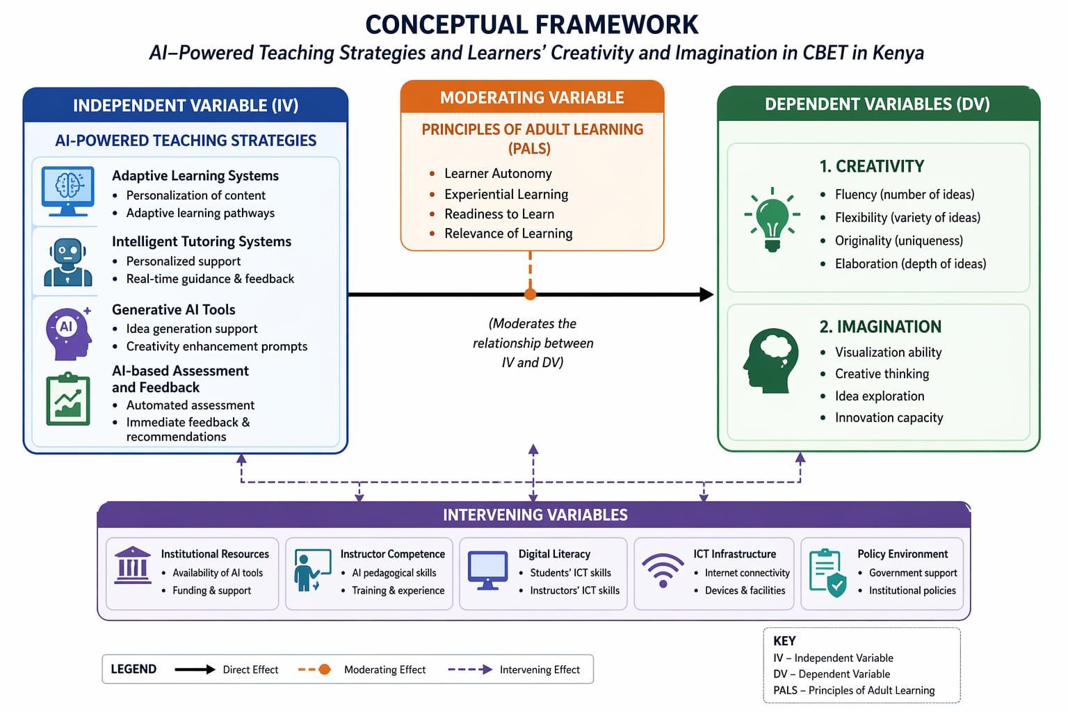
Conceptual Framework
C

Slide 12
Conceptual Framework
Conceptual framework integrates the variable as follows: AI-powered teaching strategies as independent variables, creativity and imagination as the dependent variables, learner engagement as mediating variable and PALs as moderating variable.
The framework proposes that AI influences creativity and imagination through learner engagement, while PALs strengthen or weakens this relationship depending on the level of implementation.

Slide 13
Integrated Theoretical Position
The theories are interconnected:
Humanistic Learning Theory focuses on who the learner is; motivation and self-concepts
Constructivist Theory: explains how learning occurs ; active, experiential learning
Creativity support Theory: Explains how innovation is enhanced ; Ai as a creative partner
PALs: Defines how teaching should be designed and evaluated.
By combining the four theories, the study recognizes that:
-AI enhances learners‘ ability to imagine, explore and create solutions
-learners construct knowledge creatively through meaningful interactions with AI tools
-CBET relies on experiential, creative and competency-driven learning.
The tetra theoretical lens positions AI not only as a technological tool but also as a catalyst for creative and imaginative competency development within Kenya’s CBET framework.

Slide 14
Research Design
The paper adopts a mixed-method approach, specifically a convergent parallel design where quantitative and qualitative data are collected concurrently, analyzed separately, and then integrated. This will, hopefully, provide both beadth and depth, increasing the validity of findings through triangulation.
It is grounded in a pragmatic research paradigm which allows integration of positivist and interpretivist approaches

Slide 15
Target Population
CBET learners and instructors in Kenya technical and vocational institutions.
Stratified random sampling will be used to ensure representation across regions and disciplines
Sample random sampling for selecting learners
Purposive sampling for selecting instructors and key informants

Slide 16
Data Collection Instruments
-Modified PALs
-Creativity Assessment Questionnaire
-AI Usage Survey
-Semi-structured interview guides

Slide 17
Data Analysis
Quantitative data will be analyzed using using descriptive statistics (frequency, means and standard deviations), and inferential statistics (Pearson correlation and multiple regression analysis) to assess relationship between variables and. to determine contributions of each AI teaching strategy.
Qualitative data will be analyzed using Thematic Analysis to identify patterns and insights.

Slide 18
Background of CBET
-CBET shifts education from memorization to practical skill development aligned with real-world needs.
It focuses on equipping learners with practical, measurable competencies that directly align with industry and societal needs
-Its key principles include:
-Competency-Based approach
-Focus on skills and applications
.Learner-centered education
.Project and inquiry-based learning
.Mastery of skills before progress
.Emphasis on creativity, innovation and problem-solving
.Flexible learning pathways
.Grounded in real-world projects and applied problem-solving (KICD, 2023)
(

Slide 19
Background and Context cont…..
The Rise of AI in Education:
-AI systems personalize instruction and support real-time learning and feedback.
AI is rapidly transforming educational ecosystems through technologies that allow learners to experiment, iterate and explore imaginative ideas faster than ever before:
-These include:
.Generative AI for text, images and multimedia
.Adaptive learning platforms that personalize learning
.Intelligent tutoring systems offering real-time support
.Learning analytics that guide decision-making
.Automated assessment tools that reduce teacher workload
.Virtual and augmented realities that enable immersive learning

Slide 20
Why Creativity and Imagination Matters in Kenya’s CBET
Creativity involves generating multiple solutions and thinking beyond conventional answers
(Runco & Acar , 2022; UNESCO, 2024) while imagination involves vision capacity, creative thinking, idea exploration and innovation capacity
Enables problem-solving and innovation
Drives economic competitiveness
Essential for technical, vocational, and geneal education
Aligns with Kenya’s education reform goals
-Government initiatives supporting digital learning include:
Digital Literacy programmes (DLP)
Edtech innovation hubs
AI discussions within MoE.
AI encourages learners to explore multiple solutions and refine ideas quickly.

Slide 21
What AI Brings to Learning
Generative tools such as texts, images, videos, chatbots, learning analytics, generative AI and audio
Personalized learning system
Intelligent tutoring system
Automated assessment tool
Simulation and virtual learning environment
Digital Assistance and chatbots

Slide 22
AI as a catalyst for Creativity and Imagination
AI strengthens CBET by connecting theory with practicals, simulated experiences
AI enhances creativity through:
-Idea generation and divergent thinking: generating multiple ideas/solution paths,
-Exploration of multiple perspectives/stimulating creative exploration
-Offering alternative representations of concepts
-Reducing cognitive loads
-Rapid iteration and feedback
-Creative assistance e.g. prototyping, design and writing, providing models, prompts, and inspiration
( OECD, 2023)

Slide 23
Mechanism of AI-Enhanced Imagination
Multi-modal creativity e.g. music, media, code, art etc.
Generative AI can assist in writing, music composition, visual art, design and creative problem-solving
Scenario-building tools
AI-driven story-telling
Simulations enabling experimentation
Virtual and augmented learning environments
AI-powered VR/AR allow learners to: explore virtual labs, visualize abstract concepts, design prototypes and rehearse real-world scenarios which help build imaginative capacities and creative confidence in learners

Slide 24
Opportunities in Kenya’s CBET
Enhances creative design in TVET programs: Using AI-supported creative tools-generative design and predictive modeling.
eg hands-on virtual experiences help build imaginative thinking and creative problem-solving ability
Provides personalized creative pathways/learning paths: adjusts content to learners’ needs
Improves creative assessments and feedback
AI-driven evaluation tools can: analyze performance tasks, assess prototypes, track creativity indicators over time
Facilitates creative expressions:
enables learners to: create digital arts, generate musical composition,design products, write stories/scripts, build games/animations

Slide 25
Opportunities in Kenya’s CBET Cont….
Enhances practical skills through simulations
.Brings abstract/distant concepts to life eg visualization of crop cycles and emergency scenarios
Supports project-based and inquiry-based learning:
. provides data for project research, creative solutions/prototypes, supports iterative design cycles and enables rapid experimentation
Reduces teacher workload hence more time for creative facilitation:
.AI Automation allows teachers to: focus on creative facilitation,mentor students, design rich project-based tasks, support learners autonomy

Slide 26
Opportunities in Kenya’s CBET Cont...
Inclusion of learners with special needs:
.AI offers assistive technologies e.g. speech-to-text tools, screen readers, personalized and adaptive interfaces ensure inclusive creativity development
Strengthened digital Literacy Competencies:
.AI integration aligns with Kenya’s Digital transformation agenda, preparing learners for future professions and creative industries

Slide 27
AI CBET Contexts: Examples
Agriculture: AI for farm design simulations
Hospitality: Virtual service simulations
Fashion design: AI image generations for style exploration
ICT: Coding assistants and algorithm exploration
Engineering: AI-assisted prototyping , CAD modeling

Slide 28
AI and Teacher Empowerment
Teachers shift from content delivery to guiding learners through AI enhanced environments.
AI helps teachers by:
-Offering differentiated instructions
-Automating grading and assessment
-Providing real-time learner analytics (though this requires AI literacy, continuous professional development and, ethical and pedagogical alignment.

Slide 29
AI Risks and Challenges
Low teacher-preparedness
Digital divide/Unequal access
Cultural misalignment of global AI models
Ethical issues: data privacy, over-reliance and bias in algorthms
Infrastructure gaps e.g. internet, power, devices etc.
Possible decline in original creativity if misused
Responsible AI use

Slide 30
AI Safeguards and Ethical Use
Ethical frameworks are necessary to ensure sage AI integrationsin education systems.
Promote responsible AI use
Train learners in critical evaluation of AI outputs
Encourage human AI collaboration (Not substitution)
Clear national and institutional policy guidelines
Ensure privacy and data security

Slide 31
Implications for Educators
Integrate AI into-project-based learning
Encourage Critical Reflections on AI output
Foster experimentation, prototyping and iteration
Use AI to facilitate creativity I.e. for brainstorming and simulation

Slide 32
Implication for Institutions
Invest in digital infrastructure
Provide AI competency training
Establish AI learning hubs
Integrate AI into curriculum materials
Establish AI ethical use framework
Collaborate with EdTech industry and researchers

Slide 33
Implications for Policymakers
Develop AI literacy benchmarks
Invest in equitable digital transformation
Develop National AI-in-Education Strategy
Create guidelines for responsible AI use
Support innovation labs in schools and TVET institutions

Slide 34
Recommendations
Integrate generative AI into creative coursework
Develop inclusive digital ecosystems
Support research and Pilot projects across Kenya
Combine AI-based and human assessment
Build teacher AI competencies
Promote human-AI collaborative creativity
Support pilot research programs on AI-enhanced creativity in Kenyan-contexts
Introduce blended assessment models, combining AI analytics with human judgments

Slide 35
Conclusion
Potential of AI in fostering creativity and imagination is highest when it is used to support human activities
AI presents powerful transformative opportunities for creativity and imagination in Kenya’s CBET systems: support divergent thinking, enables immersive learning, provides rapid feedback, and facilitate complex creative tasks
Success depends on: pedagogical alignment , teacher capacity, ethical use, and inclusive access
AI-enabled creativity can help Kenya develop innovative , future-ready learners an real-time problem-solvers

Slide 36
References
Aditya, D., & Otermans, P. C. (2025). AI for teacher training, personalised support to mitigate crowded classrooms, and youth upskilling: The potential of AI in Kenya. Journal of the Kenya National Commission for UNESCO, 5(2). https://doi.org/10.62049/jkncu.v5i2.341
Ayanwale, M. A., Frimpong, E. K., Opesemowo, O. A. G., et al. (2025). Exploring factors that support pre-service teachers’ engagement in learning artificial intelligence. Journal for STEM Education Research, 8, 199–229. https://doi.org/10.1007/s41979-024-00121-4
Kiarie, N. (2025). Integrating AI-based image analysis for objective assessment in CBET practical examinations. Journal of the Kenya National Commission for UNESCO, 5(2). https://doi.org/10.62049/jkncu.v5i2.333
6. Sanusi, I. T., Fundi, M., Sunday, S., & Oyelere, M. A. (2024). Advancing AI education: Assessing Kenyan in-service teachers’ preparedness for integrating AI in competence-based curriculum. ScienceDirect. https://www.sciencedirect.com/science/article/pii/S2451958824000459

Slide 37
References cont…….
Wanakuta, H., Walker, N. B., & Khan, A. (2025). AI opportunities in human-centered design education. Journal of the Kenya National Commission for UNESCO, 5(2). https://doi.org/10.62049/jkncu.v5i2.281

Slide 38
Thank You
Contact: David Otieno Omollo
Kisii University
CIM department
P.O. Box 408-40200
Kisii, Kenya
Email address: davidomollodoof@gmail.com
Institution: Kisii University

