Slide 1


Academic Integrity in the AI Age
Policy & Practice: Moving from Punishment to Restoration
RESPONSIBILITY
Presented By:
Mercy M. Njue

Slide 2

The Big Question
When students misuse AI in our classrooms, are we building systems that punish them—or communities that help them learn and grow from it?

Slide 3
What’s Happening in Our Universities?
Brief glance at current practices in Kenya and abroad.

Slide 4
Case Study #1
Vanderbilt University, USA
When AI Didn’t Break a Rule, But Broke Trust
After a tragic school shooting in another part of the country, a professor sent an email to their class to comfort them, acknowledge what had happened, and show care. But later, it came out that part of that message had been written using ChatGPT.
Now, this is important; using AI was not against any rule.
However, students reacted negatively. They said the message felt impersonal. Some said it felt inauthentic. Others questioned why AI was used in such a sensitive moment. To them, the problem was not misconduct. The problem was trust.
When the professor realized the impact, they acknowledged it, apologized, and reflected openly on their decision.
This case shows that even when AI use is allowed and no rule is broken, trust can still be damaged.

Slide 5
Case Study #2
University of Cape Town, SA
When Detection Fails
UCT chose to stop using AI detection tools such as Turnitin’s AI detection feature, based on concerns about the reliability of these tools and the potential risks they posed to fairness and trust in academic processes.
University communications highlighted that AI detection systems can produce incorrect results and may wrongly flag students. As a result, relying on such tools could undermine trust between students and educators.
Instead of focusing on detection, the university emphasized the need for better assessment design, AI literacy, and human judgment in evaluating student work.
This case demonstrates that academic integrity in the AI age cannot rely solely on technological enforcement, but must be grounded in trust, fairness, and thoughtful educational practice.

Slide 6
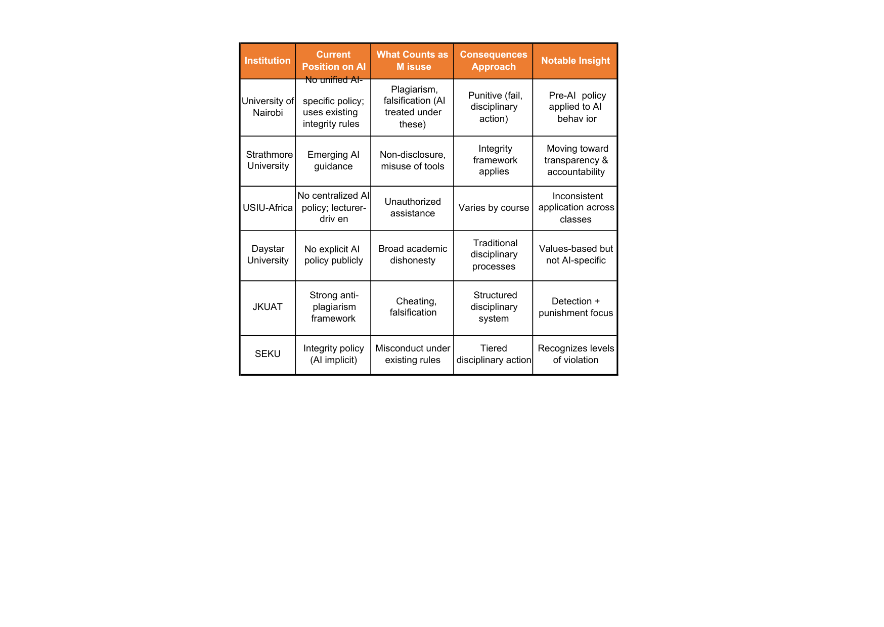
Comparative Analysis:
Selection of Kenyan Universities

Slide 7

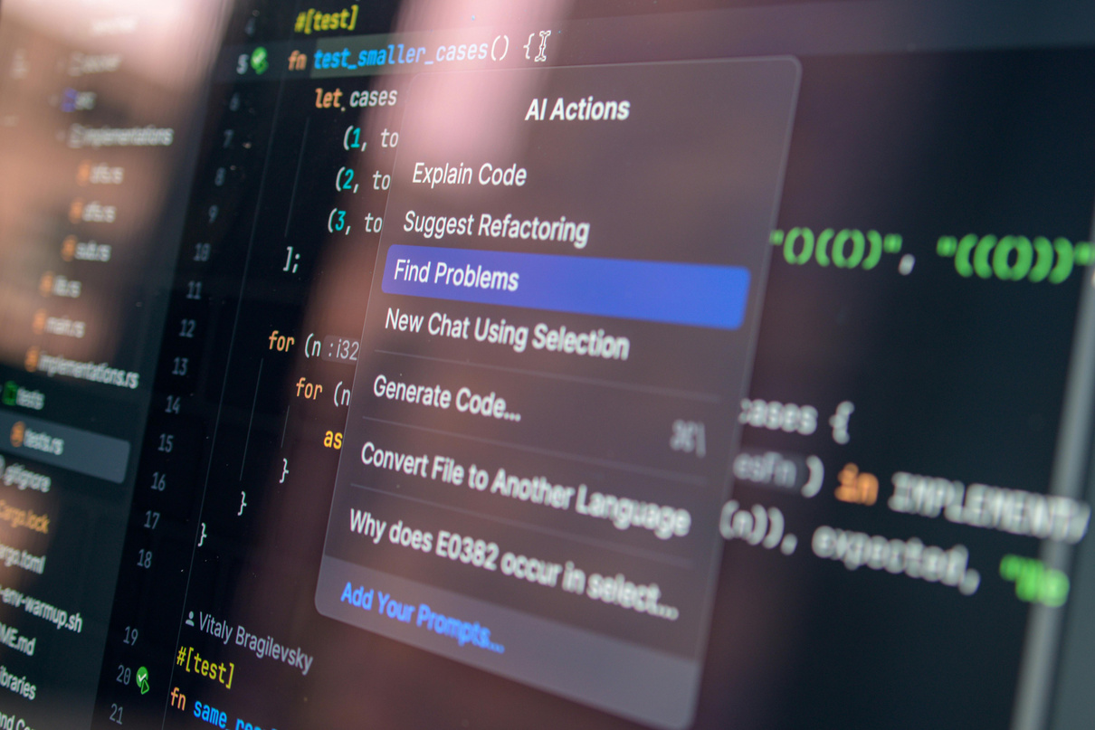

Our reality
Students are using new tools, including AI.
Lecturers are interpreting old rules.
And everyone is trying to make sense of what counts as “cheating”

Slide 8
The Policy Oxymoron
We are enforcing clarity in ambiguous AI - Use policy
Unclear Policies
Uneven expectations
Inconsistent enforcement
Clear punishments
When students are not always facing the same rules (even within the same institution), it creates confusion about what is actually acceptable.

Slide 9

Punishment
How does our response through punishment affect the student’s future learning?
Run through Turnitin / AI detector
High AI score → assumed misconduct
Student is penalised
Avoid detection
Hidden AI use
Compliance mindset
Notes:
Punishment answers the question: ‘How do we stop this behaviour?’
But education in the AI age must also answer: ‘What should replace this behaviour?’”

Slide 10
What does innovative practice look like?
It shifts from detecting AI misuse to developing responsible AI use
Make expectations around AI use clear, so students know what responsible use actually looks like in practice.
Focus less on catching mistakes and more on helping students think through their decisions and grow from them.
Include short reflections in assignments, giving students space to explain their process and any support they used.
Work with instructors to ensure a shared understanding, so expectations are applied consistently and fairly.

Slide 11

Response shifts from punishment → understanding & trust building
How does our response through restoration affect the student’s future learning?
Ask for AI disclosure
Focus on reflection
Do an oral check
Offer guided correction
Honest disclosure
Learning how to think, not just produce
Responsible decision-making

Slide 12

In five years, which policy and practice will produce graduates who can responsibly use AI in the workplace?

Slide 13

The Ubuntu Lens
I am because we are
Academic integrity is about trust, not just rules.
Misconduct is not just rule-breaking—it affects the trust of the whole learning community.
Punishment is faster and protects systems BUT restoration takes more time and builds people.

Slide 14
If your own use of AI was judged the way student work is judged today, would you be seen as innovative or guilty of misconduct?
Personal Reflection

Slide 15
What is one change you will make in how you respond to AI misuse so that students grow in integrity—not just compliance?
Personal Reflection

Slide 16
In five years, AI will still be here. The question is: will students use it responsibly because of us—or carefully despite us?
Personal Reflection

Slide 17
Kenyan Universities
Academic Integrity Policies
University of Nairobi. (n.d.). Examination regulations and academic integrity guidelines. https://www.uonbi.ac.ke
Strathmore University. (n.d.). Academic integrity policy. https://www.strathmore.edu
United States International University-Africa. (n.d.). Academic integrity policy. https://www.usiu.ac.ke
Daystar University. (n.d.). Academic policies and student handbook. https://www.daystar.ac.ke
Jomo Kenyatta University of Agriculture and Technology. (n.d.). Academic regulations and examination rules. https://www.jkuat.ac.ke
South Eastern Kenya University. (n.d.). Academic regulations and student handbook. https://www.seku.ac.ke

Slide 18
References
Associated Press. (2023, February 22). Vanderbilt apologizes for ChatGPT-generated email about Michigan State shooting. CBS News. UCT chose to stop using AI detection tools such as Turnitin’s AI detection feature, based on concerns about the reliability of these tools and the potential risks they posed to fairness and trust in academic processes.
University communications highlighted that AI detection systems can produce incorrect results and may wrongly flag students. As a result, relying on such tools could undermine trust between students and educators.
Instead of focusing on detection, the university emphasized the need for better assessment design, AI literacy, and human judgment in evaluating student work.
This case demonstrates that academic integrity in the AI age cannot rely solely on technological enforcement, but must be grounded in trust, fairness, and thoughtful educational practice.
The Vanderbilt Hustler. (2023, February 17). Peabody EDI office responds to MSU shooting with email written using ChatGPT. UCT chose to stop using AI detection tools such as Turnitin’s AI detection feature, based on concerns about the reliability of these tools and the potential risks they posed to fairness and trust in academic processes.

Slide 19

Thank you.

