Slide 1
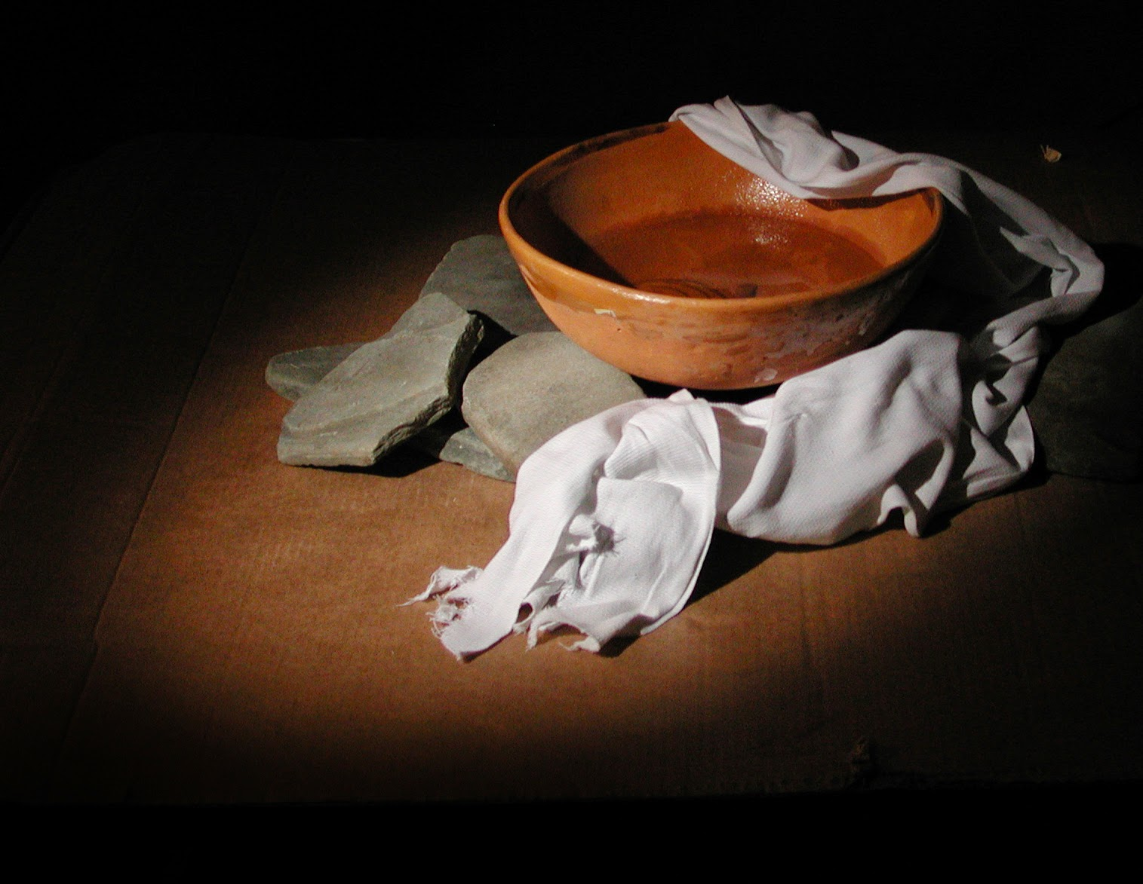
iSERVE
John 13:1-15

Slide 2
“Before the Passover Festival, Jesus knew that His hour had come to depart from this world to the Father. Having loved His own who were in the world, He loved them to the end.2 Now by the time of supper, the Devil had already put it into the heart of Judas, Simon Iscariot’s son, to betray Him.

Slide 3
3 Jesus knew that the Father had given everything into His hands, that He had come from God, and that He was going back to God. 4 So He got up from supper, laid aside His robe, took a towel, and tied it around Himself.

Slide 4
⁵ Next, He poured water into a basin and began to wash His disciples’ feet and to dry them with the towel tied around Him.
⁶ He came to Simon Peter, who asked Him, “Lord, are You going to wash my feet?”

Slide 5
⁷ Jesus answered him, “What I’m doing you don’t understand now, but afterward you will know.”
⁸ “You will never wash my feet—ever!” Peter said.
Jesus replied, “If I don’t wash you, you have no part with Me.”

Slide 6
9 Simon Peter said to Him, “Lord, not only my feet, but also my hands and my head.”
10 “One who has bathed,” Jesus told him, “doesn’t need to wash anything except his feet, but he is completely clean. You are clean, but not all of you.”

Slide 7
11 For He knew who would betray Him. This is why He said, “You are not all clean.”
12 When Jesus had washed their feet and put on His robe, He reclined again and said to them, “Do you know what I have done for you? 13 You call Me Teacher and Lord. This is well said, for I am.

Slide 8
14 So if I, your Lord and Teacher, have washed your feet, you also ought to wash one another’s feet. 15 For I have given you an example that you also should do just as I have done for you.

Slide 9
16 “I assure you: A slave is not greater than his master, and a messenger is not greater than the one who sent him. 17 If you know these things, you are blessed if you do them.

Slide 10
THE BIG IDEA
We must die to self to serve like Christ. debemos morir a sí mismos para servir como Cristo.

Slide 11
HOW DO WE SERVE LIKE JESUS?
1 Serve with the right MOTIVATION.
Sirva con la motivación correcta

Slide 12
HOW DO WE SERVE LIKE JESUS?
2 Serve with the right ATTITUDE.
Sirva con la actitud correcta

Slide 13
HOW DO WE SERVE LIKE JESUS?
3 Serve with the right WISDOM.
Sirva con la sabiduria correcta

Slide 14
ISERVE TEAMS
1. Outreach
2. First impressions
3. Worship
4. Tech
5. Follow up
6. Children’s
7. Small Groups and missions

