Slide 1

PSALM 42:1-11

Slide 2
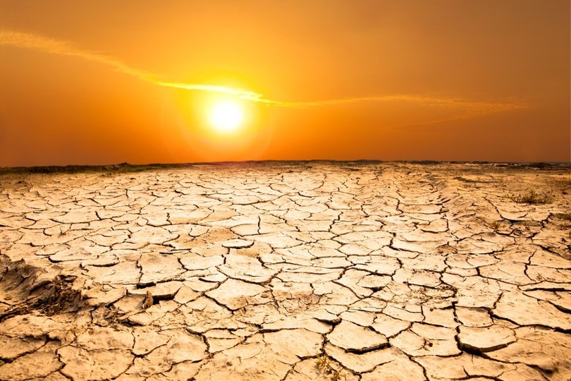
PSALM 42:1-11
As a deer longs for streams of water, so I long for You, God.
2 I thirst for God, the living God. When can I come and appear before God?
3 My tears have been my food day and night, while all day long people say to me, “Where is your God?”

Slide 3
I remember this as I pour out my heart: how I walked with many,
leading the festive procession to the house of God, with joyful and thankful shouts.
5 Why am I so depressed? Why this turmoil within me?
Put your hope in God, for I will still praise Him, my Savior and my God.

Slide 4
I am deeply depressed;
therefore I remember You from the land of Jordan and the peaks of Hermon, from Mount Mizar.
7 Deep calls to deep in the roar of Your waterfalls; all Your breakers and Your billows have swept over me.

Slide 5
The Lord will send His faithful love by day; His song will be with me in the night—a prayer to the God of my life.
9 I will say to God, my rock,
“Why have You forgotten me?
Why must I go about in sorrow
because of the enemy’s oppression?”

Slide 6
My adversaries taunt me, as if crushing my bones, while all day long they say to me,
“Where is your God?”
11 Why am I so depressed? Why this turmoil within me?
Put your hope in God, for I will still praise Him, my Savior and my God.

Slide 7
THE BIG IDEA
All God’s people experience spiritual droughts.
Todo el pueblo de Dios experimenta sequías espirituales.

Slide 8
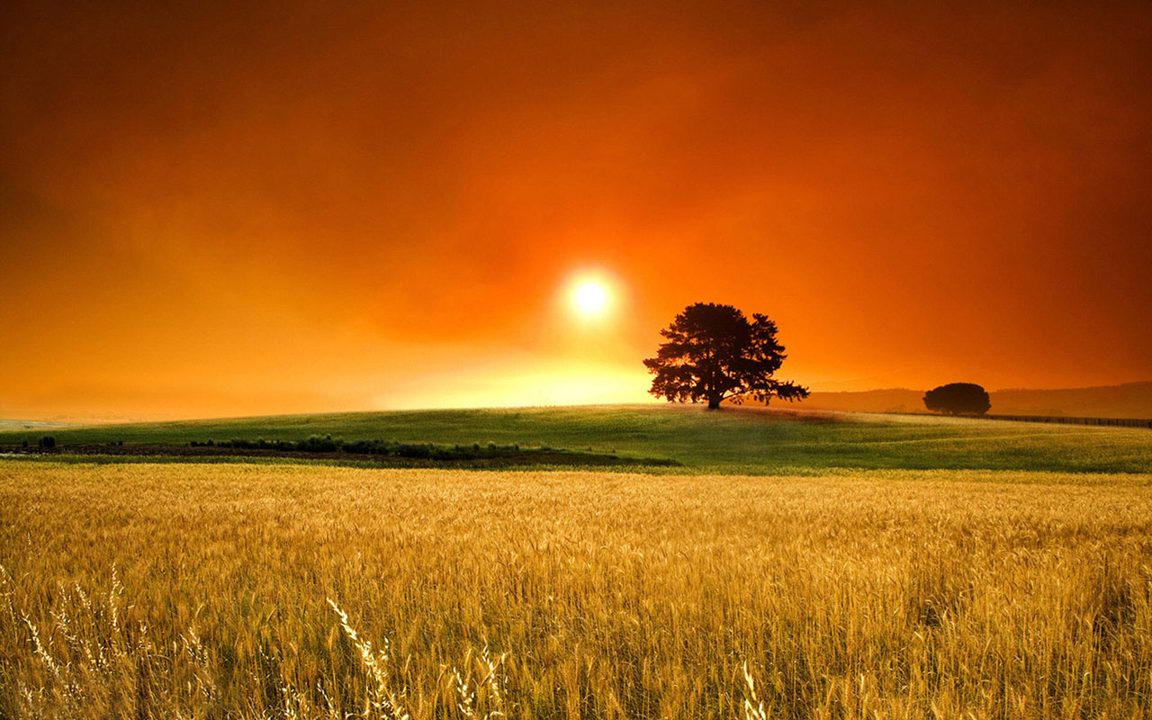
Four Keys to Overcoming Spiritual Droughts.
1. Seek God.
Busca a Dios.

Slide 9
Four Keys to Overcoming Spiritual Droughts.
2. Remember who you are.
Recuerda quien eres.

Slide 10
Four Keys to Overcoming Spiritual Droughts.
3. Get your praise on.
Recibe tu reconocimiento

Slide 11
Four Keys to Overcoming Spiritual Droughts.
4. Dig in.
Cavar en

Slide 12
PSALM 42:1-11

