Slide 1
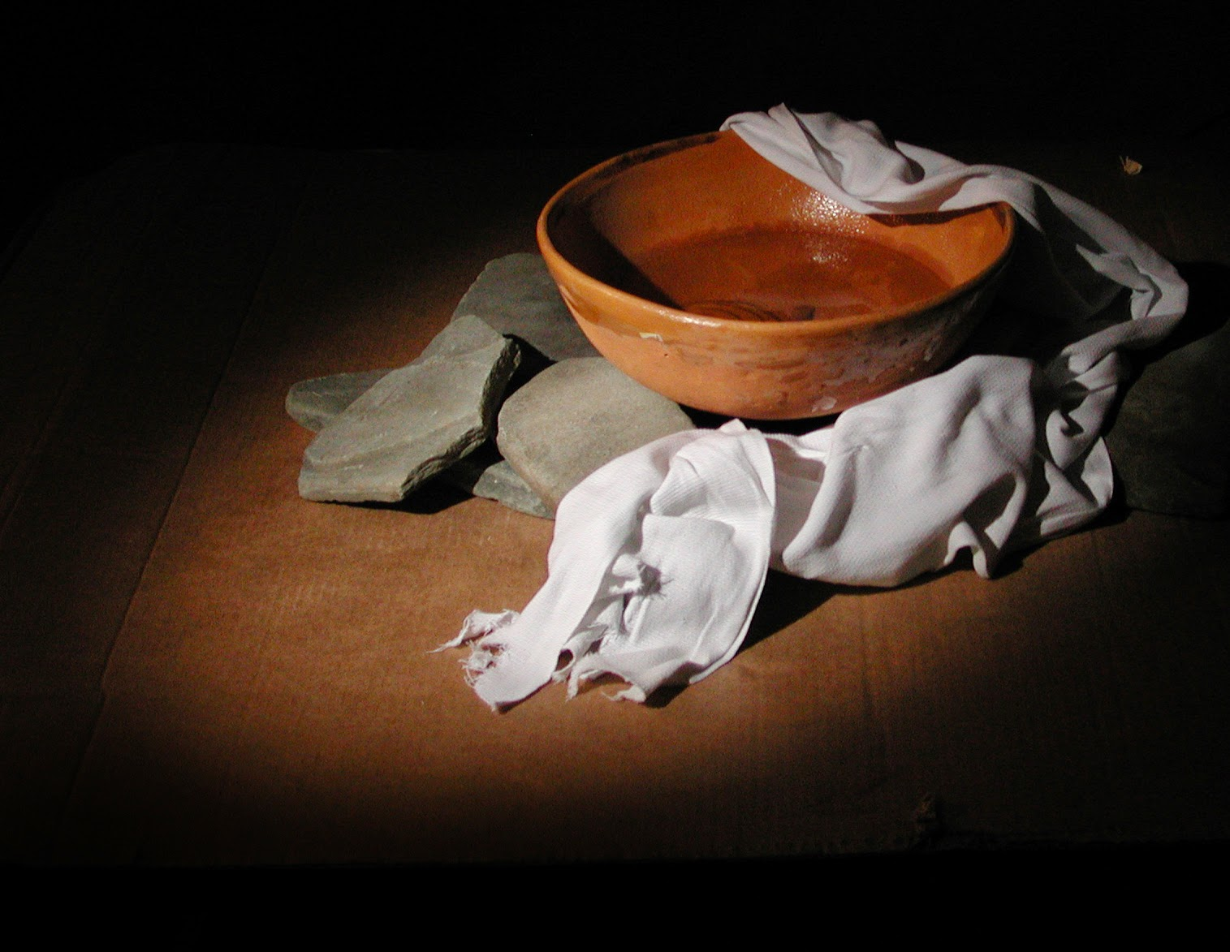
iSERVE
PART 2
1 Peter 4:7-11

Slide 2
“Now the end of all things is near; therefore, be serious and disciplined for prayer. 8 Above all, maintain an intense love for each other, since love covers a multitude of sins..

Slide 3
9 Be hospitable to one another without complaining. 10 Based on the gift each one has received, use it to serve others, as good managers of the varied grace of God.

Slide 4
11 If anyone speaks, it should be as one who speaks God’s words; if anyone serves, it should be from the strength God provides, so that God may be glorified through Jesus Christ in everything. To Him belong the glory and the power forever and ever. Amen.

Slide 5
THE BIG IDEA
Serving others glorifies God.
(Servir a otros glorifica a Dios.)

Slide 6
3 WAYS TO SERVE
1 Serve in your GIFT.
(Sirva en su regalo)

Slide 7
3 WAYS TO SERVE
2 Serve as a GOOD MANAGER.
(Servir como buen gestor)

Slide 8
3 WAYS TO SERVE
3 Serve with the STRENGTH OF GOD.
(Servir con la fuerza de Dios)

Slide 9
ISERVE TEAMS
1. Outreach
2. First impressions
3. Worship
4. Tech
5. Follow up
6. Children’s
7. Small Groups and missions

