Slide 1
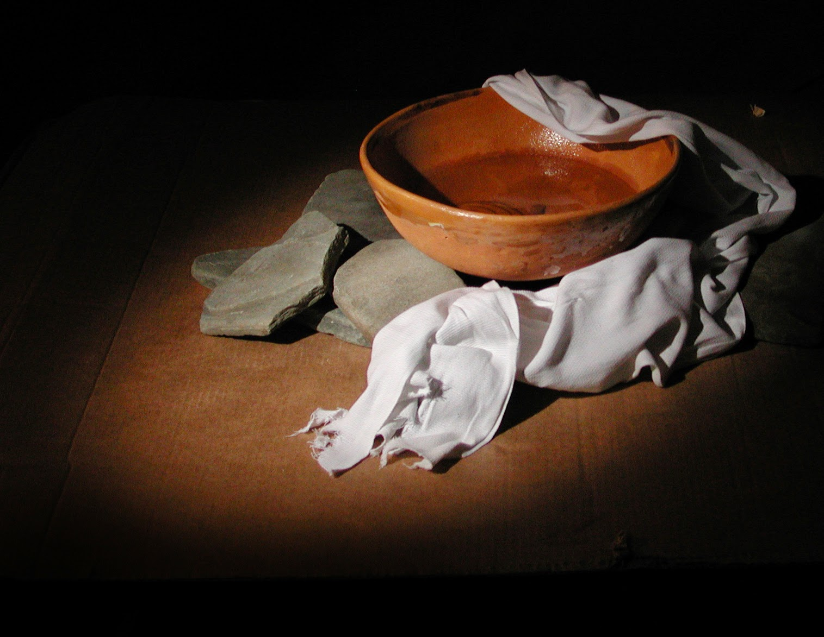
iSERVE
PART 3
Matthew 5:11-16

Slide 2
“You are blessed when they insult and persecute you and falsely say every kind of evil against you because of Me. 12 Be glad and rejoice, because your reward is great in heaven. For that is how they persecuted the prophets who were before you.

Slide 3
“You are the salt of the earth. But if the salt should lose its taste, how can it be made salty? It’s no longer good for anything but to be thrown out and trampled on by men.

Slide 4
14 “You are the light of the world. A city situated on a hill cannot be hidden. 15 No one lights a lamp and puts it under a basket, but rather on a lampstand, and it gives light for all who are in the house.

Slide 5
16 In the same way, let your light shine before men, so that they may see your good works and give glory to your Father in heaven.”

Slide 6
THE BIG IDEA
When you serve you become a reflection of the Light of Jesus. .
(Cuando te sirven te conviertes en un reflejo de la luz de Jesús.)

Slide 7
2 Illustrations
1. YOU ARE THE SALT OF THE EARTH .
(Eres la sal de la tierra)

Slide 8
2 Illustrations
2. YOU ARE THE LIGHT OF THE WORLD.
(Tú eres la luz del mundo)

Slide 9
3 Facts about the Light
1. A city on a hill cannot be hidden.
(una ciudad en una colina no puede ocultar la luz)

Slide 10
3 Facts about the Light
2. Don’t hide the lamp.
(no escondas la lámpara)

Slide 11
3 Facts about the Light
3. The purpose of the light.
(El propósito de la luz)

Slide 12
iSERVE
PART 3
Matthew 5:11-16

