Slide 1
Cover crops

Slide 2
Josh Kraft
Assistant Professor of Agriculture at Truman State University
Kirksville, MO
Jkraft@truman.edu
Grad school in IN, organic cannabis growth systems
Teach in Cannabis and Natural Medicines major
Includes being main instructor for Cannabis Cultivation
Previously, consulted with grows in MI for ~6 years

Slide 3
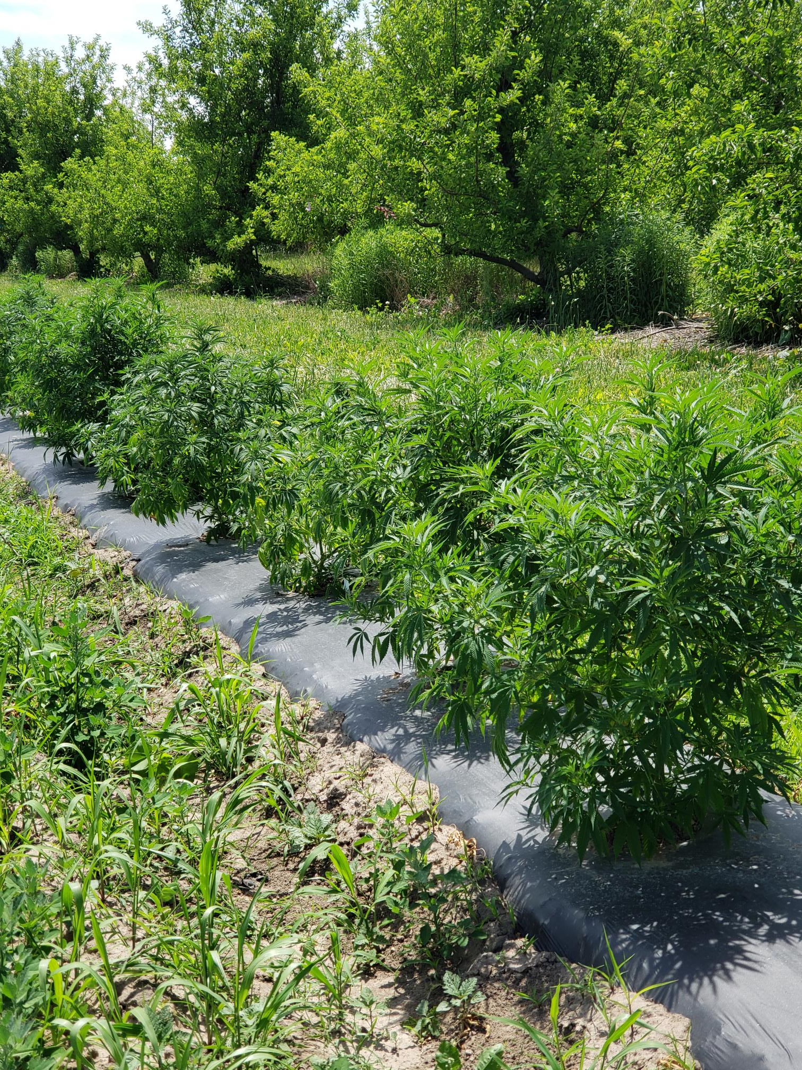
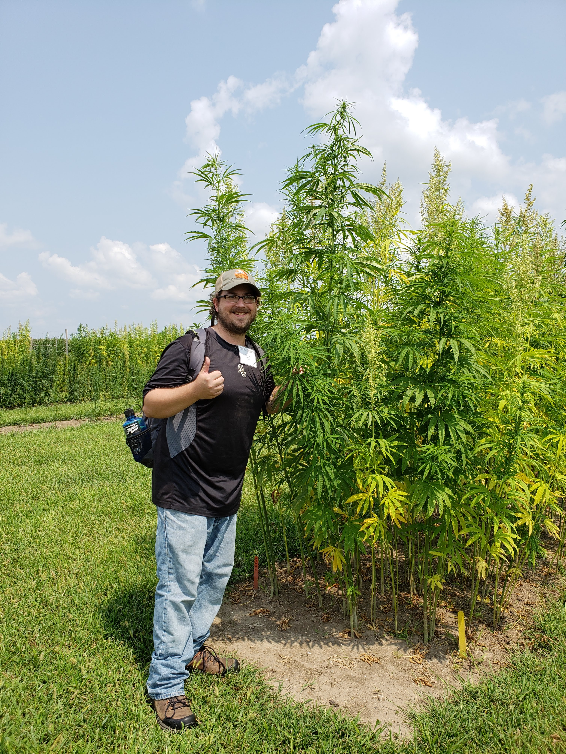
Notes:
Worked with cannabinoid, fiber, seed, and multi-use varieties. 6 years of consulting for rec and med growers in MI. One of the advantages of my position is that my University paycheck pays the bills, which means I can devote time to helping small farmers at no cost.

Slide 4
What are cover crops
Cover crops are simply plants growing in a space (intentionally) while not growing a cash crop
Generally, they also serve a function
Weed suppression, soil health, nutrients, living roots in soil, build organic matter, water management
Common options include clover, rye, vetch, oats, buckwheat
However, it can be literally any plant. The above are just well-researched

Slide 5
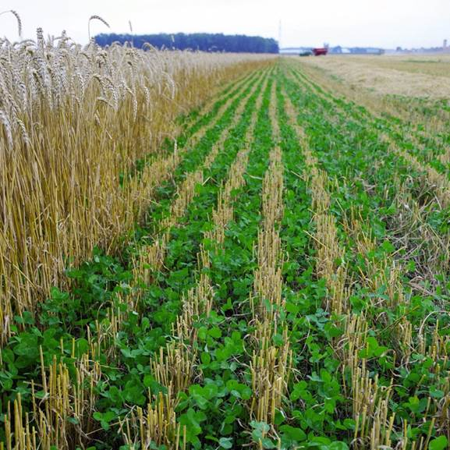
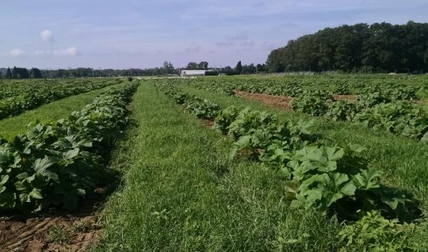
Left: Clover cover crop in wheat. Clover will help to replenish soil nitrogen content and helps discourage the germination of weeds.
Above: Grass cover crop between planting rows. This type of cover can help decrease weeds and provide habitat for beneficial insects (free pest control!)

Slide 6
How cover crops work
Cover crops work through a few different mechanisms
But results can be tied to the amount of biomass produced
Weed control: Cover crops occupy the niche that weeds would otherwise inhabit
Niche: A Set of resources and space an organism occupies
Soil health: Living plants exude compounds through their roots that feed soil microbes, increase organic matter, and can also partner with nitrogen-producing microbes
Water management: Increased organic matter acts as a sponge, holding water and releasing it when necessary
Also, increased OM improves nutrient retention and soil texture

Slide 7
How cc work cntd
As CC tissue breaks down, it releases stored nutrients to the soil
And provide food for soil biota
Residue can be an essential management tool -> decrease loss of surface moisture
Attract pollinators and beneficial insects
Increase diversity, increase habitat and food sources, and attract predator insects to control pest populations
Leverage principles of ecology to control weeds, pests, and soil health that promote long-term productivity and sustainability

Slide 8
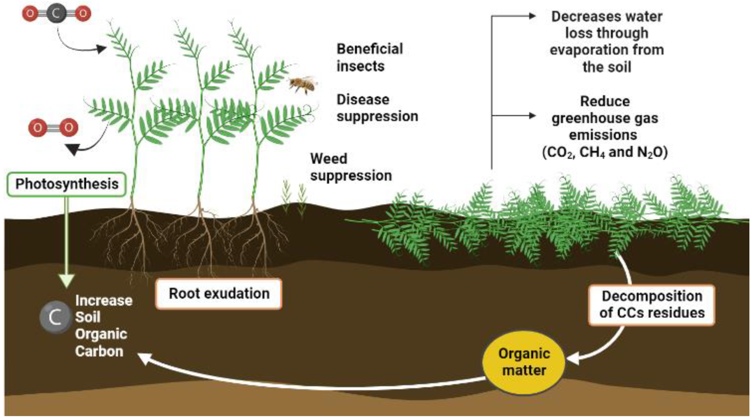

Slide 9
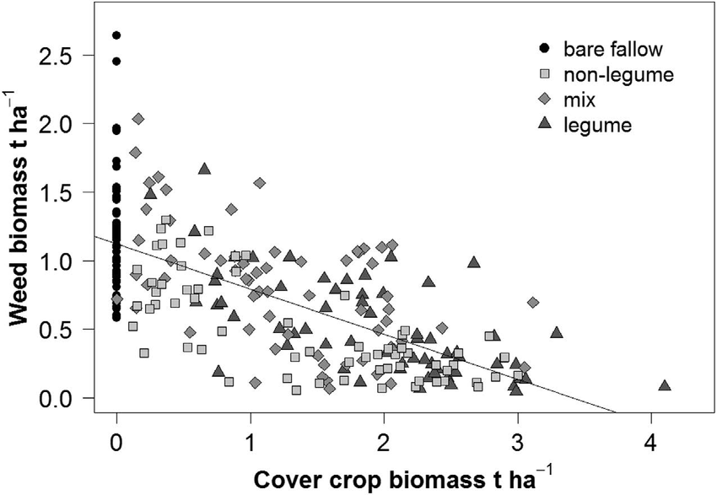
No cover
Cover crops can help reduce weed biomass, but generally more cover crop biomass results in more weed suppression
Increasing cover

Slide 10
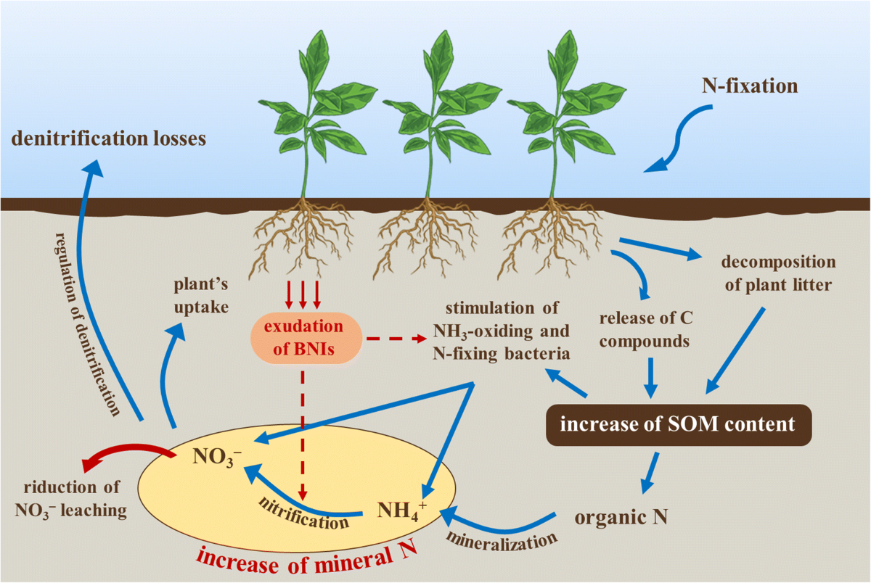
Different mechanisms related to nutrient and organic matter management in cover crops.
Similar to weed control, increasing the biomass of cover crops generally increases nitrogen production.

Slide 11
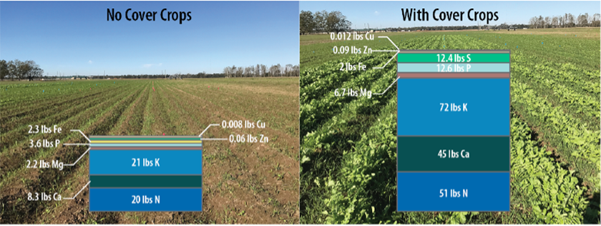
Addition of cover crops increases nutrient cycling and retention making soil more fertile

Slide 12
Planting
Cover crops are easy to plant!
Prepare your seedbed and plant as usual, can broadcast seed, or if large, can use machinery
Generally, plant when crops aren’t growing
However, can grow simultaneously. Be sure to give main crop a few weeks to establish before to reduce competition and yield loss
Note: CC are usually thought of as large scale agriculture, but use at home will improve gardens and container growing as well

Slide 13
Terminating
Cover crops can be terminated a variety of ways
Breaking the stem with a 2x4 attached to a rope (think making crop circles)
Herbicide application
Tarping
Want to terminate BEFORE plants begin to set seed
After termination, LEAVE THE RESIDUE
Longer term benefits to weed suppression and soil OM

Slide 14
Getting the most from your cover
Cover cropping is a game of biomass production and residue management
High biomass production helps maximize our benefits
Residue management helps to lengthen the time we see benefits
Choosing the correct cover for the job
But don’t be afraid to mix CC, does not have to be just a single species planting
Grasses generally good for weed suppression/soil OM
Legumes good for N fixation
Brassicas good for scavenging, soil “cleaning”, OM
Find a goal and make your selection based on accomplishing the goal

Slide 15
Popular CC options
Cereal rye – produces lots of carbon-rich biomass, creates an excellent straw for weed suppression. Can impede the growth of grass crops like Corn or Wheat
Oats and Vetch – Oats are there to support vetch growth. Vetch is a legume that fixes nitrogen and can increase soil OM.
Clover – Legume, fixes nitrogen and can aid in OM and weed suppression
Buckwheat – Fast growing, helps prevent weeds, improves soil health, and scavenges phosphorus.
Tillage radish, sunn hemp, field pea, mustard also well studied choices plus many more!

Slide 16
Sources for more information
SARE Practical Guide to Cover Crops and Crop Rotations
https://practicalfarmers.org/programs/cover-crops/
https://www.sare.org/resources/ - Free e-books. Maybe the best source available right now
https://rodaleinstitute.org/why-organic/organic-farming-practices/cover-crops/
If you have any questions, please feel free to reach out to me at Jkraft@truman.edu

