Slide 1
HAPPY HALLOWEEN !!! FEDERAL CONTRACTING HORROR STORIES
OCTOBER 28, 2021
11:30 Introduction by
NCMA JAX President - Michael Scuteri
11:40 – Presentation – James Krause
JAMES E. KRAUSE, FEDERAL CONTRACTS ATTORNEY

Slide 2
QUESTIONS? Please post your Questions in the Chat Section We will discuss questions as time allows
JAMES E. KRAUSE
FEDERAL CONTRACTS ATTORNEY

Slide 3
COVID 19
Welcome to the world of COVID.
How bad is it?
Does anyone really know?

Slide 4
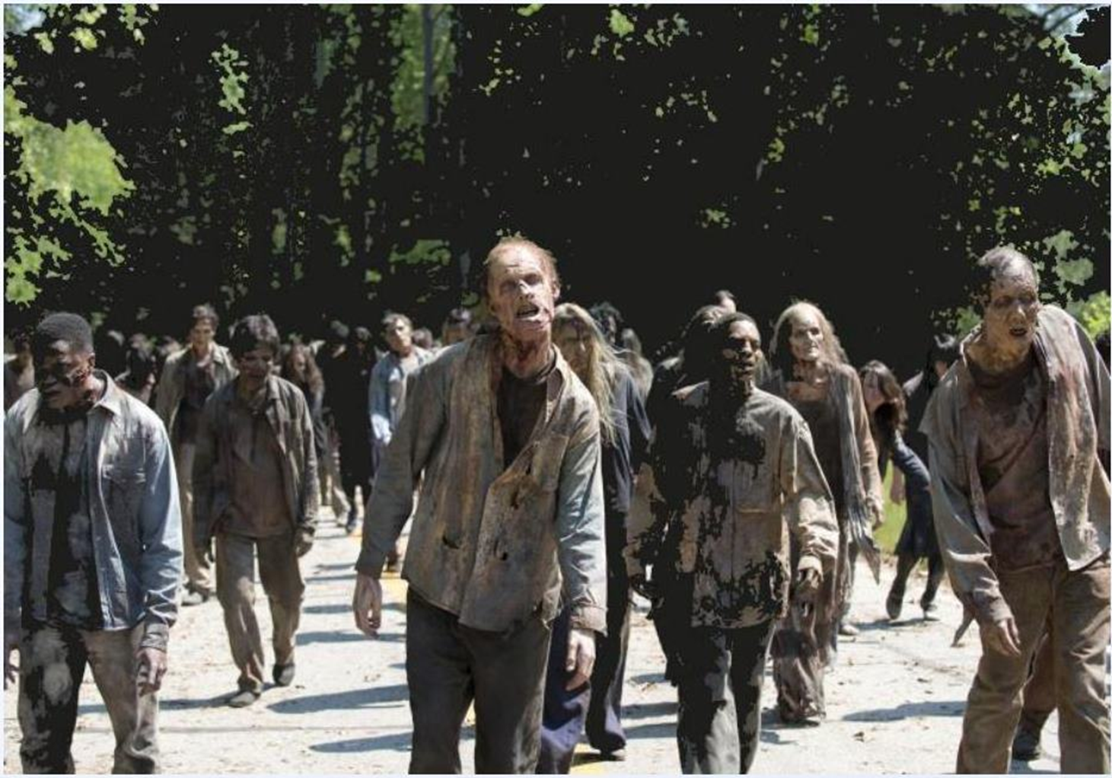
COVID 19

Slide 5
COVID 19
COVID Contractor Questions
THE BIG QUESTION -
Who is going to pay for the costs of implementing COVID requirements for existing Contracts?
NEXT QUESTION
COVID Order is open ended – other requirements will be “updated” or added at government discretion.
How can a Contractor guess what new requirements will be added to COVID requirements when attempting to provide Proposals?

Slide 6
COVID 19
COVID Contractor Questions
What do I do?
Why do I have to sign a bilateral modification for COVID?
My subcontractors won't get vaccinated -
My employees don't want to wear masks - How do I keep track of who's vaccinated - Why do contractors have to take keep track of who’s vaccinated - How do I get a religious or medical exemption - If I work at home, do I have to get vaccinated -
If my subcontractors say they are complying, can I rely on their word -
What is the penalty for noncompliance?
How do I social distance when we're building a construction project?

Slide 7
COVID 19
COVID contractor issues - Working under the new requirements
Required vaccinations, documentation and proof
Face masks
Restricted access to work sites
Limited access to buildings and bases
Control partial worksite to avoid interaction and intermingling
Personnel and subcontractor compliance
Materials and Shipping shortages
Additional and updated compliance orders and regulations
New federal compliance person required – COVID coordinator
Subcontractor and supplier compliance with COVID executive orders

Slide 8
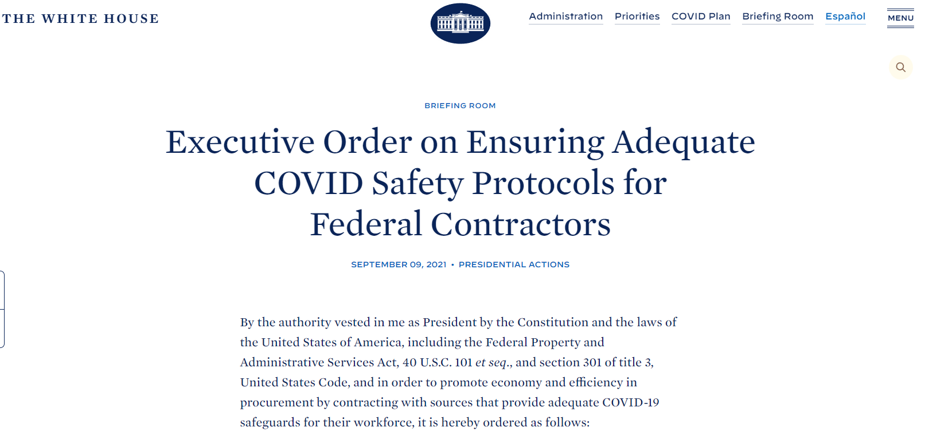
COVID 19
EXECUTIVE ORDER 14042
SEPTEMBER 9, 2021

Slide 9
COVID 19
Executive Order on Ensuring Adequate COVID Safety Protocols for Federal Contractors
September 9, 2021
Section 1. Policy. This order promotes economy and efficiency in Federal procurement by ensuring that the parties that contract with the Federal Government provide adequate COVID-19 safeguards to their workers performing on or in connection with a Federal Government contract or contract-like instrument as described in section 5(a) of this order.
. . .
Accordingly, ensuring that Federal contractors and subcontractors are adequately protected from COVID-19 will bolster economy and efficiency in Federal procurement.

Slide 10
COVID 19
Executive Order on Ensuring Adequate COVID Safety Protocols for Federal Contractors
Sec. 2. Providing for Adequate COVID-19 Safety Protocols for Federal Contractors and Subcontractors. (a) Executive departments and agencies, including independent establishments subject to the Federal Property and Administrative Services Act, 40 U.S.C. 102(4)(A) (agencies), shall, to the extent permitted by law, ensure that contracts and contract-like instruments (as described in section 5(a) of this order) include a clause that the contractor and any subcontractors (at any tier) shall incorporate into lower-tier subcontracts. . . .
Accordingly, ensuring that Federal contractors and subcontractors are adequately protected from COVID-19 will bolster economy and efficiency in Federal procurement.

Slide 11
COVID 19
Executive Order on Ensuring Adequate COVID Safety Protocols for Federal Contractors
Sec. 2. Providing for Adequate COVID-19 Safety Protocols for Federal Contractors and Subcontractors. (b) By September 24, 2021, the Safer Federal Workforce Task Force (Task Force) shall, as part of its issuance of Task Force Guidance,
Provide definitions of relevant terms for contractors and subcontractors,
Explanations of protocols required of contractors and subcontractors to comply with workplace safety guidance, and
Any exceptions to Task Force Guidance that apply to contractor and subcontractor workplace locations and individuals in those locations working on or in connection with a Federal Government contract or contract-like instrument (as described in section 5(a) of this order).

Slide 12
COVID 19
Executive Order on Ensuring Adequate COVID Safety Protocols for Federal Contractors
https://www.saferfederalworkforce.gov/new/
(d) Nothing in this order shall excuse noncompliance with any applicable State law or municipal ordinance establishing more protective safety protocols than those established under this order or with any more protective Federal law, regulation, or agency instructions for contractor or subcontractor employees working at a Federal building or a federally controlled workplace

Slide 13
COVID 19
Executive Order on Ensuring Adequate COVID Safety Protocols for Federal Contractors
Sec. 5. Applicability. (a) This order shall apply to any new contract; new contract-like instrument; new solicitation for a contract or contract-like instrument; extension or renewal of an existing contract or contract-like instrument; and exercise of an option on an existing contract or contract-like instrument, if:
(i) it is a procurement contract or contract-like instrument for services, construction, or a leasehold interest in real property;
(ii) it is a contract or contract-like instrument for services covered by the Service Contract Act, 41 U.S.C. 6701 et seq.;

Slide 14
COVID 19
Executive Order on Ensuring Adequate COVID Safety Protocols for Federal Contractors
Sec. 6. Effective Date. (a) Except as provided in subsection (b) of this section, this order is effective immediately and shall apply to new contracts; new contract-like instruments; new solicitations for contracts or contract-like instruments; extensions or renewals of existing contracts or contract-like instruments; and exercises of options on existing contracts or contract-like instruments, as described in section 5(a) of this order, where the relevant contract or contract-like instrument will be entered into, the relevant contract or contract-like instrument will be extended or renewed, or the relevant option will be exercised, on or after:
(i) October 15, 2021, consistent with the effective date for the action taken by the Federal Acquisition Regulatory Council pursuant to section 3(a) of this order; or
(ii) for contracts and contract-like instruments that are not subject to the Federal Acquisition Regulation and where an agency action is taken pursuant to section 3(b) of this order, October 15, 2021, consistent with the effective date for such action.

Slide 15
COVID 19
Safer Federal Workforce Task Force
SEPTEMBER 24, 2021
COVID-19 Workplace Safety:
Guidance for Federal Contractors and Subcontractors
Issued September 24, 2021
Introduction
On September 9, President Biden announced his Path Out of the Pandemic: COVID-19 Action Plan. One of the main goals of this science-based plan is to get more people vaccinated.
As part of that plan, the President signed Executive Order 14042, Ensuring Adequate COVID Safety Protocols for Federal Contractors, (“the order”) which directs executive departments and agencies . . . to ensure that covered contracts and contract-like instruments include a clause (“the clause”) that the contractor and any subcontractors (at any tier) shall incorporate into lower-tier subcontracts.

Slide 16
COVID 19
Guidance for Federal Contractors and Subcontractors
WHAT IS A CONTRACT OR CONTRACT LIKE INSTRUMENT?
That proposed rule defines a contract or contract-like instrument as an agreement between two or more parties creating obligations that are enforceable or otherwise recognizable at law. This definition includes, but is not limited to, a mutually binding legal relationship obligating one party to furnish services (including construction) and another party to pay for them.
The term contract includes all contracts and any subcontracts of any tier thereunder, whether negotiated or advertised, including any procurement actions, lease agreements, cooperative agreements, provider agreements, intergovernmental service agreements, service agreements, licenses, permits, or any other type of agreement, regardless of nomenclature, type, or particular form, and whether entered into verbally or in writing.

Slide 17
COVID 19
Guidance for Federal Contractors and Subcontractors
WHAT IS A CONTRACT OR CONTRACT LIKE INSTRUMENT?
Contracts may be the result of competitive bidding or awarded to a single source under applicable authority to do so.
In addition to bilateral instruments, contracts include, but are not limited to, awards and notices of awards; job orders or task letters issued under basic ordering agreements; letter contracts; orders, such as purchase orders, under which the contract becomes effective by written acceptance or performance; exercised contract options; and bilateral contract modifications.

Slide 18
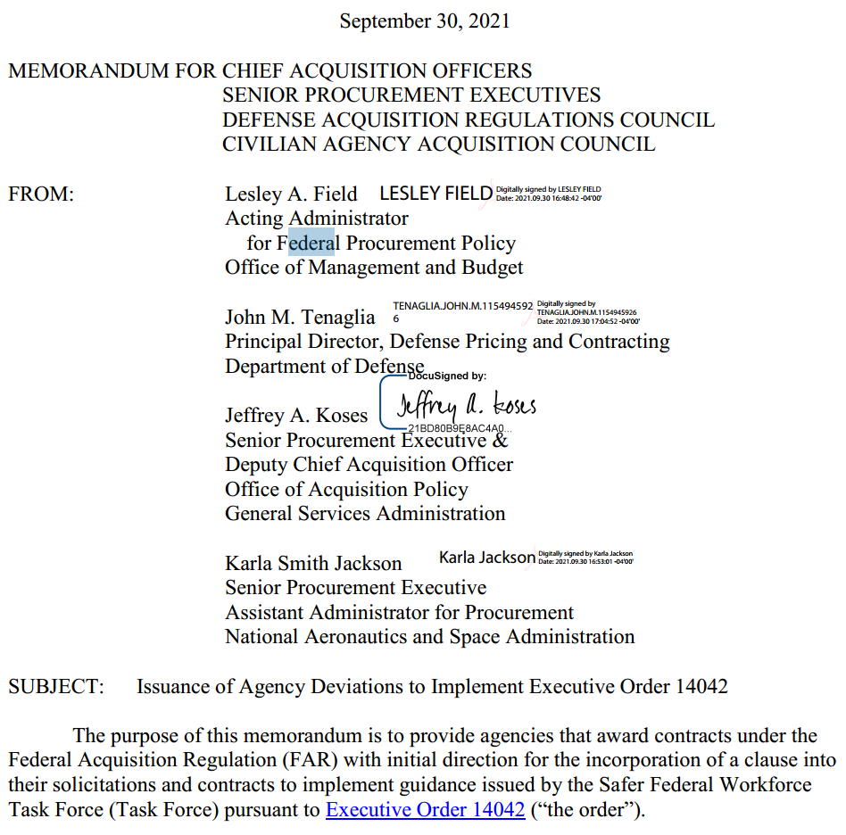
COVID 19

Slide 19
COVID 19
MEMORANDUM SEPTEMBER 30, 2021
On September 24, 2021, the Task Force issued guidance to implement the order, COVID-19 Workplace Safety: Guidance for Federal Contractors and Subcontractors. The Task Force guidance requires:
• All covered contractor employees to be fully vaccinated for COVID-19 by December 8, 2021, except in limited circumstances where an employee is legally entitled to an accommodation;
• All individuals, including covered contractor employees and visitors, to comply with published Centers for Disease Control and Prevention guidance for masking and physical distancing at a covered contractor workplace, as discussed in the Task Force guidance; and
• Covered contractors to designate a person or persons to coordinate implementation of and compliance with the Task Force guidance and the required workplace safety protocols at covered contractor workplaces.

Slide 20
COVID 19
MEMORANDUM SEPTEMBER 30, 2021
Section 3(a) of the order directs the Federal Acquisition Regulatory Council (FAR Council) to develop a contract clause requiring contractors and subcontractors at any tier to comply with all guidance for contractor or subcontractor workplace locations published by the Task Force and to provide initial policy direction to acquisition offices for use of the clause by
recommending that agencies exercise their authority under FAR subpart 1.4., Deviations from the FAR.

Slide 21
COVID 19
MEMORANDUM SEPTEMBER 30, 2021
1. Applicability and effective dates. In accordance with section 5 of the order, agencies are required to include an implementing clause in solicitations and contracts for services, including construction, in accordance with the following dates specified in section 6 of the order:
• new contracts awarded on or after November 14 from solicitations issued before October 15
• new solicitations issued on or after October 15 and contracts awarded pursuant to those solicitations
• extensions or renewals of existing contracts and orders awarded on or after October 15, 2021; and
• options on existing contracts and orders exercised on or after October 15, 2021.

Slide 22
COVID 19
FAR 52.223-99 ENSURING ADEQUATE COVID-19
SAFETY PROTOCOLS FOR FEDERAL CONTRACTORS (OCT 2021) (DEVIATION)
Definition. . .
Authority. This clause implements Executive Order 14042, Ensuring Adequate COVID Safety Protocols for Federal Contractors, dated September 9, 2021 (published in the Federal Register on September 14, 2021, 86 FR 50985).
(c) Compliance. The Contractor shall comply with all guidance, including guidance conveyed through Frequently Asked Questions, as amended during the performance of this contract, for contractor or subcontractor workplace locations published by the Safer Federal Workforce Task Force (Task Force Guidance) at https:/www.saferfederalworkforce.gov/contractors/
(d) Subcontracts. The Contractor shall include the substance of this clause, including this paragraph (d), in subcontracts at any tier that exceed the simplified acquisition threshold, as defined in Federal Acquisition Regulation 2.101 on the date of subcontract award, and are for services, including construction, performed in whole or in part within the United States or its outlying areas.
(End of clause)

Slide 23
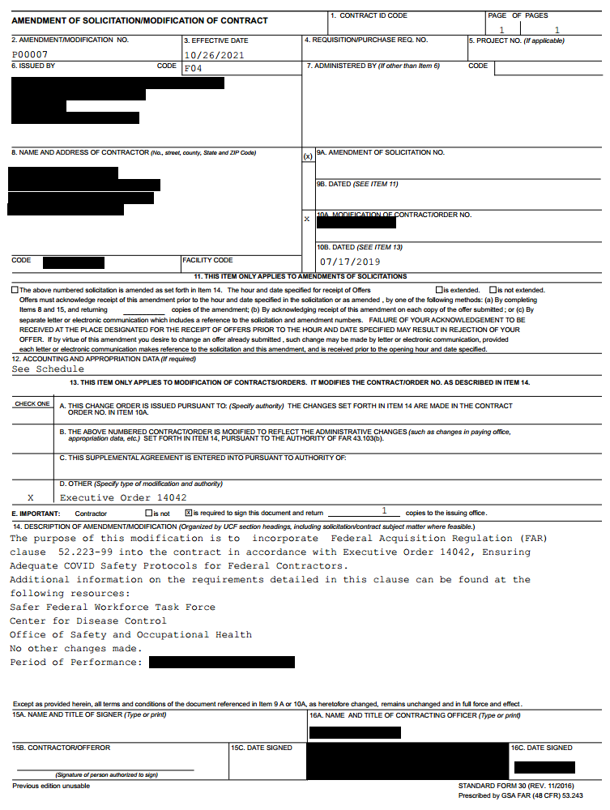

Slide 24
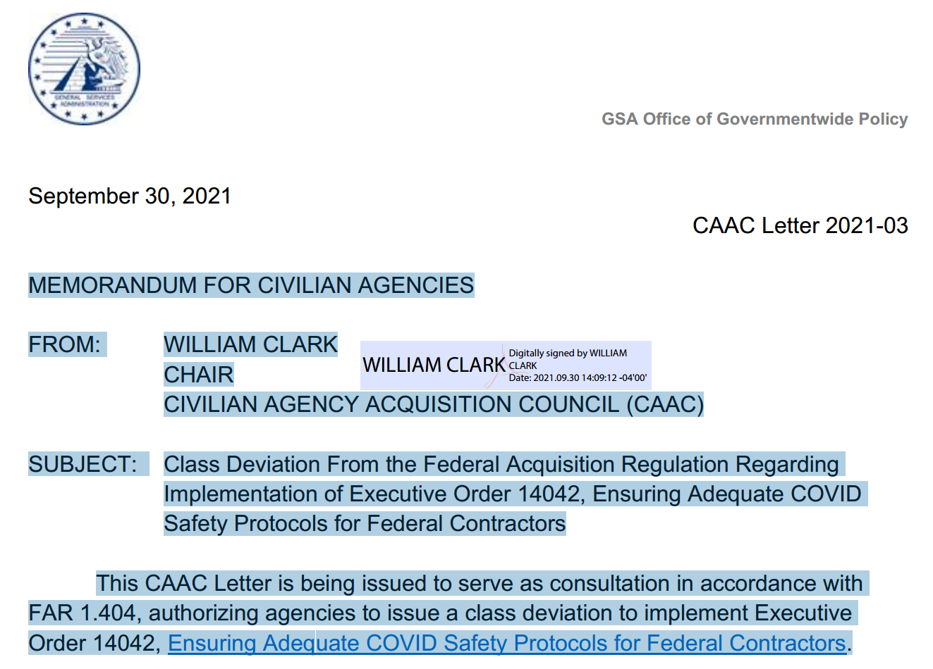
COVID 19

Slide 25
COVID 19
GUIDANCE on Ensuring Adequate COVID Safety Protocols for Federal Contractors
https://www.saferfederalworkforce.gov/
The Safer Federal Workforce Task Force is led by the White House COVID-19 Response Team, the General Services Administration (GSA), and the Office of Personnel Management (OPM). Task Force members include: the Centers for Disease Control and Prevention (CDC), the Department of Veterans Affairs (VA), the Federal Emergency Management Agency (FEMA), the Federal Protective Service (FPS), the Office of Management and Budget (OMB), and the United States Secret Service (USSS).

Slide 26
COVID 19
GUIDANCE on Ensuring Adequate COVID Safety Protocols for Federal Contractors
https://www.saferfederalworkforce.gov/
Covered contractors must ensure that all covered contractor employees are fully vaccinated for COVID-19, unless the employee is legally entitled to an accommodation. Covered contractor employees must be fully vaccinated no later than December 8, 2021.
After that date, all covered contractor employees must be fully vaccinated by the first day of the period of performance on a newly awarded covered contract, and by the first day of the period of performance on an exercised option or extended or renewed contract when the clause has been incorporated into the covered contract.

Slide 27
COVID 19
GUIDANCE on Ensuring Adequate COVID Safety Protocols for Federal Contractors
The covered contractor must review its covered employees’
documentation to prove vaccination status. Covered contractors must require covered contractor employees to show or provide their employer with one of the following documents:
a copy of the record of immunization from a health care provider or pharmacy,
a copy of the COVID-19 Vaccination Record Card (CDC Form MLS-319813_r, published on September 3, 2020),
a copy of medical records documenting the vaccination,
a copy of immunization records from a public health or State immunization information system, or a
copy of any other official documentation verifying vaccination with information on the vaccine name, date(s) of administration, and the name of health care professional or clinic site administering vaccine.
Covered contractors may allow covered contractor employees to show or provide to their employer a digital copy of such records, including, for example, a digital photograph, scanned image, or PDF of such a record.

Slide 28
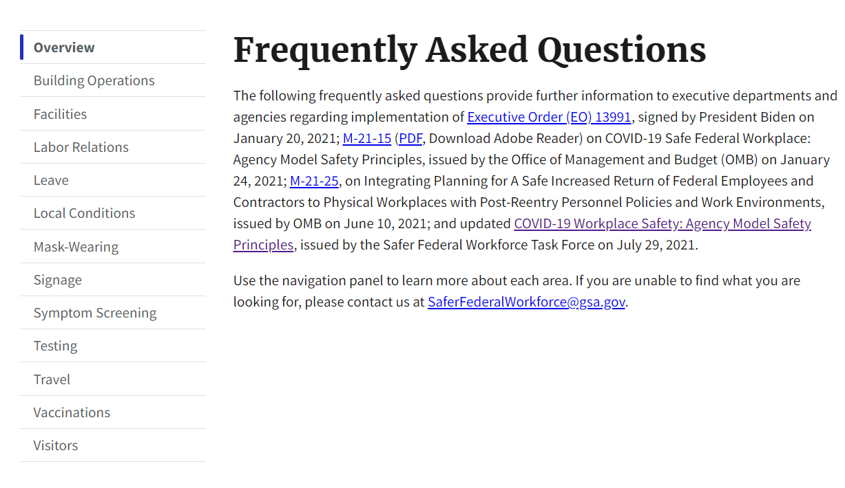
COVID 19
SAFER WEBSITE FOR COVID GUIDANCE
https://www.saferfederalworkforce.gov/faq/

Slide 29
COVID 19
GUIDANCE on Ensuring Adequate COVID Safety Protocols for Federal Contractors
https://www.saferfederalworkforce.gov/new/
Safer Federal Workforce Task Force
COVID-19 Workplace Safety: Agency Model Safety Principles
Last Updated September 13, 2021 (Previously Updated July 29, 2021)
Recent Updates
• Federal Executive Branch employees must be fully vaccinated, except in limited circumstances where an employee is legally entitled to a reasonable accommodation. Agencies must work expeditiously so that their employees are fully vaccinated as quickly as possible and by no later than November 22, 2021.
• With the government-wide adoption and implementation of these vaccination requirements, agencies are no longer required to establish a screening testing program for employees or onsite contractor employees who are not fully vaccinated, although they may do so.
• The President has announced that Federal contractor employees will be required to be vaccinated. Prior to being contractually required to be vaccinated, onsite contractor employees who are not fully vaccinated and are not part of an agency testing program must provide proof of a negative COVID-19 test from no later than the previous 3 days prior to entry to a Federal building.

Slide 30
COVID 19
GUIDANCE on Ensuring Adequate COVID Safety Protocols for Federal Contractors
Q: Can agencies incorporate vaccination requirements into contracts that are not covered by Executive Order 14042 (Ensuring Adequate COVID Safety Protocols for Contractors)?
A: Yes. Agencies are strongly encouraged to incorporate vaccination requirements into contracts that are not covered by Executive Order 14042, consistent with applicable law. This might include, for example, incorporating vaccination requirements into contracts in advance of when they are otherwise required by the Executive Order or incorporating requirements into contracts that are not covered by the Executive Order, such as contracts under the Simplified Acquisition Threshold. Implementation of such additional requirements should generally follow the Safer Federal Workforce Task Force’s guidance for implementing the vaccination requirement in Executive Order 14042.

Slide 31
COVID 19
GUIDANCE on Ensuring Adequate COVID Safety Protocols for Federal Contractors
Q: Should agencies inquire regarding the vaccination status of onsite contractor employees?
A: Prior to contractor employees being subject to a contractual requirement to be vaccinated, agencies need to ask about the vaccination status of those onsite contractor employees. Onsite contractor employees must attest to the truthfulness of the response they provide. If an onsite contractor employee chooses not to provide a response, they will be treated as not fully vaccinated for the purpose of agency safety protocols. In requesting this information, agencies should comply with any applicable federal laws, including requirements under the Privacy Act and the Paperwork Reduction Act.

Slide 32
COVID 19
GUIDANCE on Ensuring Adequate COVID Safety Protocols for Federal Contractors
Q: How does this Guidance apply to covered contractor employees who are authorized under the covered contract to perform work remotely from their residence?
A: An individual working on a covered contract from their residence is a covered contractor employee, and must comply with the vaccination requirement for covered contractor employees, even if the employee never works at either a covered contractor workplace or Federal workplace during t he performance of the contract. A covered contractor employee’s residence is not a covered contractor workplace, so while in the residence the individual need not comply with requirements for covered contractor workplaces, including those related to masking and physical distancing, even while working on a covered contract.

Slide 33
COVID 19
HOW DO THE NEW FEDERAL COVID REQUIREMENTS APPLY TO THE REAL WORLD OF FEDERAL CONTRACTING?

Slide 34
COVID 19
COVID Contractor Questions
THE BIG QUESTION -
Who is going to pay for the costs of implementing COVID requirements for existing Contracts?
NEXT QUESTION
COVID Order is open ended – other requirements will be “updated” or added at government discretion.
How can a Contractor guess what new requirements will be added to COVID requirements when attempting to provide FFP Contracts?

Slide 35
COVID 19
Sovereign Immunity
Without regard to the terms or conditions of any federal contract, the United States cannot be held liable for its public acts, as a sovereign, when:
The government is acting in its sovereign capacity; and
The government’s action generally affects the public, and is not directed solely toward any specific individual or company.
“[W]hen the Government interferes by sovereign act with the performance of a contract to which the Government is a party, the Government will not be held liable for breach of contract.
The test for determining whether a Governmental action is a sovereign act is whether the action was taken in the national interest and had “public and general” application.”
Derivative sovereign immunity may protect a government contractor from suit when:
the United States would be immune from suit if the claims had been brought against it,
the contractor performed services for the sovereign under a validly-awarded contract, and
the contractor adhered to the terms of its contract.

Slide 36
COVID 19
STANDARD FAR CLAUSES STILL APPLY
As an example, here are several FAR Clauses that might apply to the Contractor’s particular needs to recover COVID damages:
“Stop Work” or “Suspension of Work” clauses, such as FAR 52.242-14 -15, require the contractor to stop or suspend performance for a certain period of time if directed by the Contracting Officer.
“Changes” clauses, such as FAR 52.243-1, allow for equitable adjustments in both price and schedule if the Contracting Officer orders a change.
“Force Majeure” or “Excusable Delay” clauses, such as FAR 52.249-14, protect the contractor against termination for delays in performance that are outside of the contractor’s negligence, fault, or control.
“Continuation of Essential Contractor Services” clauses, including DFARS 252.237-7023 and 252.237-7024; contractors performing work that has been designated as “mission essential functions” must develop plans for the continued performance of the designated services during periods of crisis.

Slide 37
COVID 19
CHANGES CLAUSE
Under the standard Changes clauses, contracting officers have a substantial amount of discretion to order additive or deductive changes.
Due to COVID related problems, including quarantine, access, safety reasons, etc., contracting officers could make changes in performance, products or materials to include:
changes [i]n the specifications,
changes [i]n the manner or method of performance,
changes [i]n Government-furnished property or services, or
[d]irecting acceleration in the performance of the work.
52.243-4 (a).
If the order comes as an express “written order designated or indicated to be a change order” the contractor should notify the government in writing of any cost or schedule impact within thirty days of receipt of the order.

Slide 38
COVID 19
CHANGES CLAUSE
For changes in scope of work, use the Changes clause.
Where COVID, the government’s actions in response to COVID, delays of other prime contractors, or a quarantine restriction results in an express or a constructive change in the work, the contractor should base the claim on the Changes clause.
Where there are scope changes that result in delays, the cost of delays arising from the change are recoverable under the Changes clause.

Slide 39
COVID 19
CHANGES CLAUSE - CONSTRUCTIVE
A common government stance is to claim changes based on implementing COVID requirements are not a change to the Contract.
Where the change is provided to the contractor as a “clarification” or in the form of a written or oral “direction, instruction, interpretation, or determination” and is not identified as a Change Order, the contracting officer may claim he/she is simply clarifying the existing obligations of the contractor and not implementing a change in the scope.
This is likely a constructive change under 52.243-4(b)
Notify the Contracting Officer that their “clarification” (order) amounts to a change order under the clause.
The contractor has a thirty-day period to perfect its right to an equitable adjustment, measured from the time it writes to the Contracting Officer identifying and converting the clarification into a change order. FAR 52.243(e).
For constructive changes, there is a 20 day look back period that alleges to limit the contractor’s right to recover costs to the 20 days immediately prior to the notice of the right to an equitable adjustment. 52.243(d).

Slide 40
COVID 19
STOP WORK ORDER
“[T]he Contracting Officer may, at any time, by written order to the Contractor, require the Contractor to stop all, or any part, of the work called for by this contract for a period of 90 days after the order is delivered to the Contractor, and for any further period to which the parties may agree.” 52.242-15(a).
The contractor is required to comply with a stop work order, and to mitigate damages as possible.

Slide 41
COVID 19
STOP WORK ORDER
Assuming the government cancels the stop work order and the contractor resumes the work, the government is obligated to make an equitable adjustment in the time for delivery in the contract price. 52.242-15 (b)(1)-(3).
Time extensions are typically determined by a critical path Time Impact Analysis of the construction activities.
As with all changes, interferences, hindrances and delays of any type, the contractor should change accounting cost codes and separate costs associated with the stop work order. This includes demobilization and safety work efforts, mitigation expenses, and remobilization costs.

Slide 42
COVID 19
STOP WORK ORDER
The contractor must assert its right to the equitable adjustment within 30 days after the end of the work stoppage.
The Contracting Officer’s has a duty to review the issue and make an adjustment in the contract time and cost of performance. 52.242-15(b)(2).
If the stop work order is not cancelled and the work is terminated for the convenience of the government, the contractor is entitled to reasonable costs resulting from the stop work order in its termination settlement proposal. 52.242-15(c).
In addition, if the stop work order is not cancelled and the work is terminated for default, the contractor is still entitled to an equitable adjustment for reasonable costs resulting from the stop work order. 52.242-15(d).

Slide 43
COVID 19
SUSPENSION OF WORK
The Contracting Officer may “order the Contractor, in writing, to suspend, delay, or interrupt all or any part of the work of the contract for a period of time that the Contracting Officer determines appropriate for the convenience of the Government.” 52.242-14(a).
Under Suspension, the contractor is entitled to an increase in the cost of performance of the contract (excluding profit) necessarily caused by the unreasonable suspension, delay, or interruption.
Note that Profit is not included in suspension
Constructive suspension occurs when the Contracting Officer does not issue such a written order affirmatively suspending the work, but some other act or failure to act by the Contracting Officer results in a suspension, delay or interruption for an unreasonable period.

Slide 44
COVID 19
SUSPENSION OF WORK
When its work is suspended, the contractor should give notice promptly because subpart (c) of the clause limits the recovery of costs incurred more than 20 days before the contractor notifies the Contracting Officer of the act or failure to act causing the suspension (delay). 52.242-14(c).

Slide 45
COVID 19
PRACTICAL CONSIDERATIONS
Real world concerns
Contractors and Subcontractors refusing to work under federal requirements and are quitting federal Contracting. Questions from industry as to whether new COVID restrictions are legal. Two exceptions (accommodations) to COVID vaccination requirements - medical or religious.
Unrealistic duties placed on contractors to force compliance with new COVID requirements.
Contractors may be in violation of various laws by forcing compliance requirements with both employees and subcontractors. Large concern whether federal government will pay for additional damages caused by compliance requirements.

Slide 46
COVID 19
LESSONS (WHICH WILL PROBABLY BE) LEARNED:
Contractors will incur damages due to the impacts of Federal COVID-19 requirements. Below are a few suggestions to working with Contracting Officers to recover damages:
Thoroughly review all existing contracts to determine any clauses providing potential relief.
DOCUMENT and maintain detailed written records and communications for any performance delays.
Completely and obsessively document any and all excess costs incurred as a result of contract changes directed by the Government.
Pay attention to all notice periods. Prepare and timely submit requests for equitable adjustments where appropriate.
Communicate IN WRITING with contracting officers regarding any questions, issues, necessary contract modification(s)

Slide 47
COVID 19
LESSONS (WHICH WILL PROBABLY BE) LEARNED:
Contractors will incur damages due to the impacts of Federal COVID-19 requirements.
It appears the Government contracting personnel do not have funds to pay for this COVID initiative.
There is no discussion or guidance about increases in costs to the government due to contractor damages, and how the government will react to reasonable requests for equitable adjustment.
This leaves a gap that will probably involve contracting officers and contractors engaging in unnecessary and antagonistic disagreements over payment for government COVID requirements.
Unfortunately, this will probably have to wait to be sorted out by the Courts.

Slide 48
PRACTICAL CONSIDERATIONS
WORKING TOGETHER
BOTH SIDES HAVE THE SAME GOAL – A SUCCESSFUL CONTRACT.
BOTH SIDES HAVE A DUTY TO COOPERATE.
BE PROFESSIONAL AND COURTEOUS
EFFECTIVE EFFICIENT COMMUNICATIONS IS KEY.
DO NOT MISTAKE COURTESY OR FRIENDLINESS AS AGREEMENT, ASSENT, DIRECTION, OR CHANGE TO PERFORMANCE.
BE THOROUGH. DON’T LET MISUNDERSTANDINGS OR VAGUE QUESTIONS AND ANSWERS GET IN THE WAY OF PERFORMING YOUR CONTRACT.

Slide 49
DISCLAIMER
All rights are reserved. These materials are designed to provide general information on the seminar topic presented and are provided with the understanding that the publisher is not engaged in rendering any legal or professional services.
Although these materials are prepared by professionals, they should not be used as a substitute for professional services. If legal or other professional advice is required, the services of a professional should be sought.

