Slide 1
Introduction and DCAA Overview

Slide 2
DCAA Overview
Established in 1965 by transferring the existing contract audit functions from each of the military services into a single contract audit agency (DoD Directive 5105.36)
Oversight of 9,000 contractors every year and averages more than 3,400 audit reports which examine more than $350 billion of contractor costs

Slide 3
Agency Mission
Together with our acquisition partners, we increase warfighter capabilities by delivering high-quality audits and financial services to achieve fair and reasonable prices that protect taxpayer dollars.

Slide 4
Defense Contract Audit Agency
Approximately 4,600 employees located at over 300 offices throughout the United States and overseas
Responsibilities and Duties:
Auditors - Perform all needed contract audits for DoD
Financial Liaison Advisor (FLA) - Provide accounting and financial advisory services to DoD (and civilian agencies when requested) acquisition and contract administration components during all contract phases:
Preaward
Contract execution
Settlement (contract closing)

Slide 5
Department of Defense Organization
Secretary of Defense
Deputy Sec of Defense
Department
of Army
Procurement
Department
of Navy
Procurement
Department
of Air Force
Procurement
Under Secretary
(A & S)
DCMA
Under Secretary
(Comptroller)
DCAA
Inspector General
Our placement under the DoD Comptroller assures our independence from offices that have procurement responsibility within the services.

Slide 6
Legend
Director’s Office
Headquarters
Regions
Corp. Audit Directorates
Director
Anita Bales
Deputy Director
Joe Bentz
Chief of Staff
Inspector General
General Counsel
Operations
Eastern Region
Corporate Audit Directorate
Northrop Grumman
Human Capital and Resource Management
Central Region
Corporate Audit Directorate
Boeing
Policy and Plans
Western Region
Corporate Audit Directorate
General Dynamics /
Raytheon Technologies
(GD/RT)
Integrity & Quality Assurance
Field Detachment
Corporate Audit Directorate
Lockheed Martin / BAE

Slide 7
Defense Contract Audit Agency
3 Regions, Field Detachment, 4 Corporate Audit Directorates
Alaska
CAD - Boeing, Honeywell: St. Louis, MO
CAD –GDRT:
Lowell, MA
Washington
Maine
Vermont -
Montana
North Dakota
Minnesota
Upstate
New York
New Hampshire
Massachusetts
Wisconsin
Downstate
New York -
Rhode Island
Oregon
South Dakota
Michigan
Connecticut -
Idaho
Pennsylvania
Wyoming
New Jersey
Iowa
Ohio
Delaware
Washington DC
Nebraska
Indiana
West
Virginia
Maryland
Nevada
Illinois
Field Detachment
Virginia -
Utah
Colorado
Kansas
Kentucky -
Hawaii
Missouri
North Carolina -
CAD - Northrop Grumman: McLean, VA
California
Tennessee -
Oklahoma
Arkansas
South Carolina -
Western Region: La Palma, CA
Arizona
New Mexico
Georgia
Mississippi
Alabama
Texas
Louisiana
Europe
Western
Central Region: Irving, TX
Florida
Eastern Region: Smyrna, GA
North Asia
Central
CAD - Lockheed Martin/BAE:
Ft. Worth, TX
Puerto
Rico
Eastern
South Asia
Field Detachment - 351 not shown above

Slide 10
DCAA Services Throughout Phases of an Award
Pre-Award
Throughout
Completion
Accounting System
Proposal Review
- Labor Rates
- Indirect Rates
- Materials
- ODC
Annual Incurred Cost Reviews
Real Time Labor and Material
CAS Compliance
Business Systems
Provisional Billing Rates/Vouchers
Progress Payments
Truth in Negotiations
Special Contracting/ Award Officer requests
Final Voucher
Terminations

Slide 11
Available Presentations
Accounting System Requirements
Contract Briefs
Incurred Cost Submissions
Monitoring Subcontracts
Proposal Adequacy
Provisional Billing Rates
Public Vouchers
Real-time Labor Evaluations
Audit Process

Slide 12
DCAA Internet Resources www.dcaa.mil
Audit Process Overview – Information for Contractors Manual
DCAA Preaward Accounting System Checklist
DoD Contract Proposal Adequacy Checklist
DoD Forward Pricing Rate Adequacy Checklist
DCAA Incurred Cost Adequacy Checklist
Incurred Cost Electronically (ICE) Model
Links to Acquisition Regulations
Small Business Seminar Slides

Slide 13
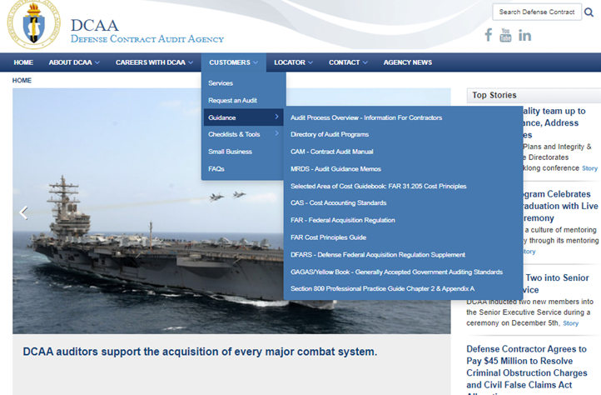

Slide 14
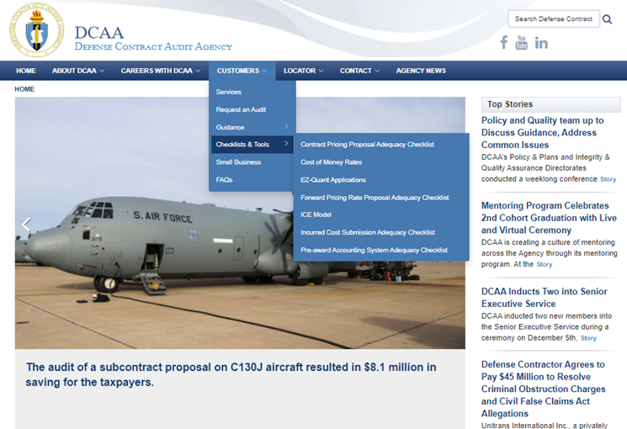

Slide 15
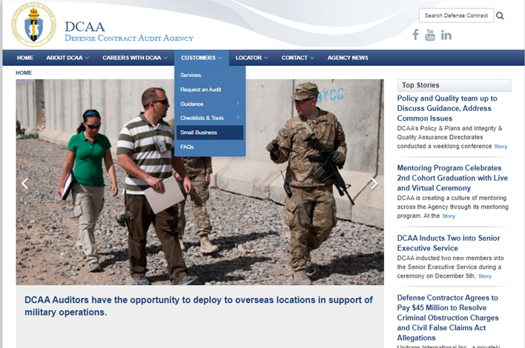

Slide 16
Notes:
Screenshot of www.dcaa.mil – the “Help for Small Business” link.
Point out:
Contact info for DCAA Help for Small Business Contractors
Small Business Seminar Slides

Slide 17
Contact Information
Email: Joseph.Greger@dcaa.mil
Phone: (571) 448-3478

Slide 18
Questions/Comments

