Slide 1

Nutrition and fitness
How they work together
Amy Carroll © 2011

Slide 2
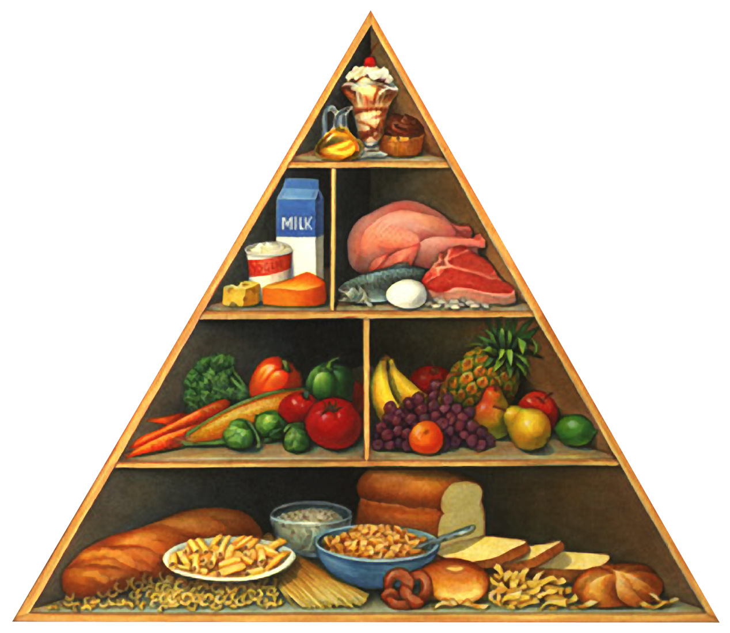
What is a nutrient?
A SUBSTANCE OBTAINED FROM FOOD AND USED IN THE BODY TO PROMOTE:
•GROWTH
•MAINTENANCE
•AND/ OR REPAIR
SIX CLASSES OF NUTRIENTS:
•CARBOHYDRATE
•PROTEIN
•FAT
•WATER
•VITAMINS
•MINERALS

Slide 3

MACRONUTRIENTS AND MICRONUTRIENTS
MACRONUTRIENTS
•CARBOHYDRATE, FAT, AND PROTEIN ALL PROVIDE ENERGY THAT THE BODY CAN USE
MICRONUTRIENTS
•VITAMINS AND MINERALS ARE CONSIDERED MICRONUTRIENTS
•”MICRO” DOES NOT MEAN UNIMPORTANT (WE JUST NEED THEM IN MUCH SMALLER AMOUNTS.)
VITAMINS AND MINERALS HELP US TURN THE CARBS INTO ENERGY (CATALYSTS)

Slide 4
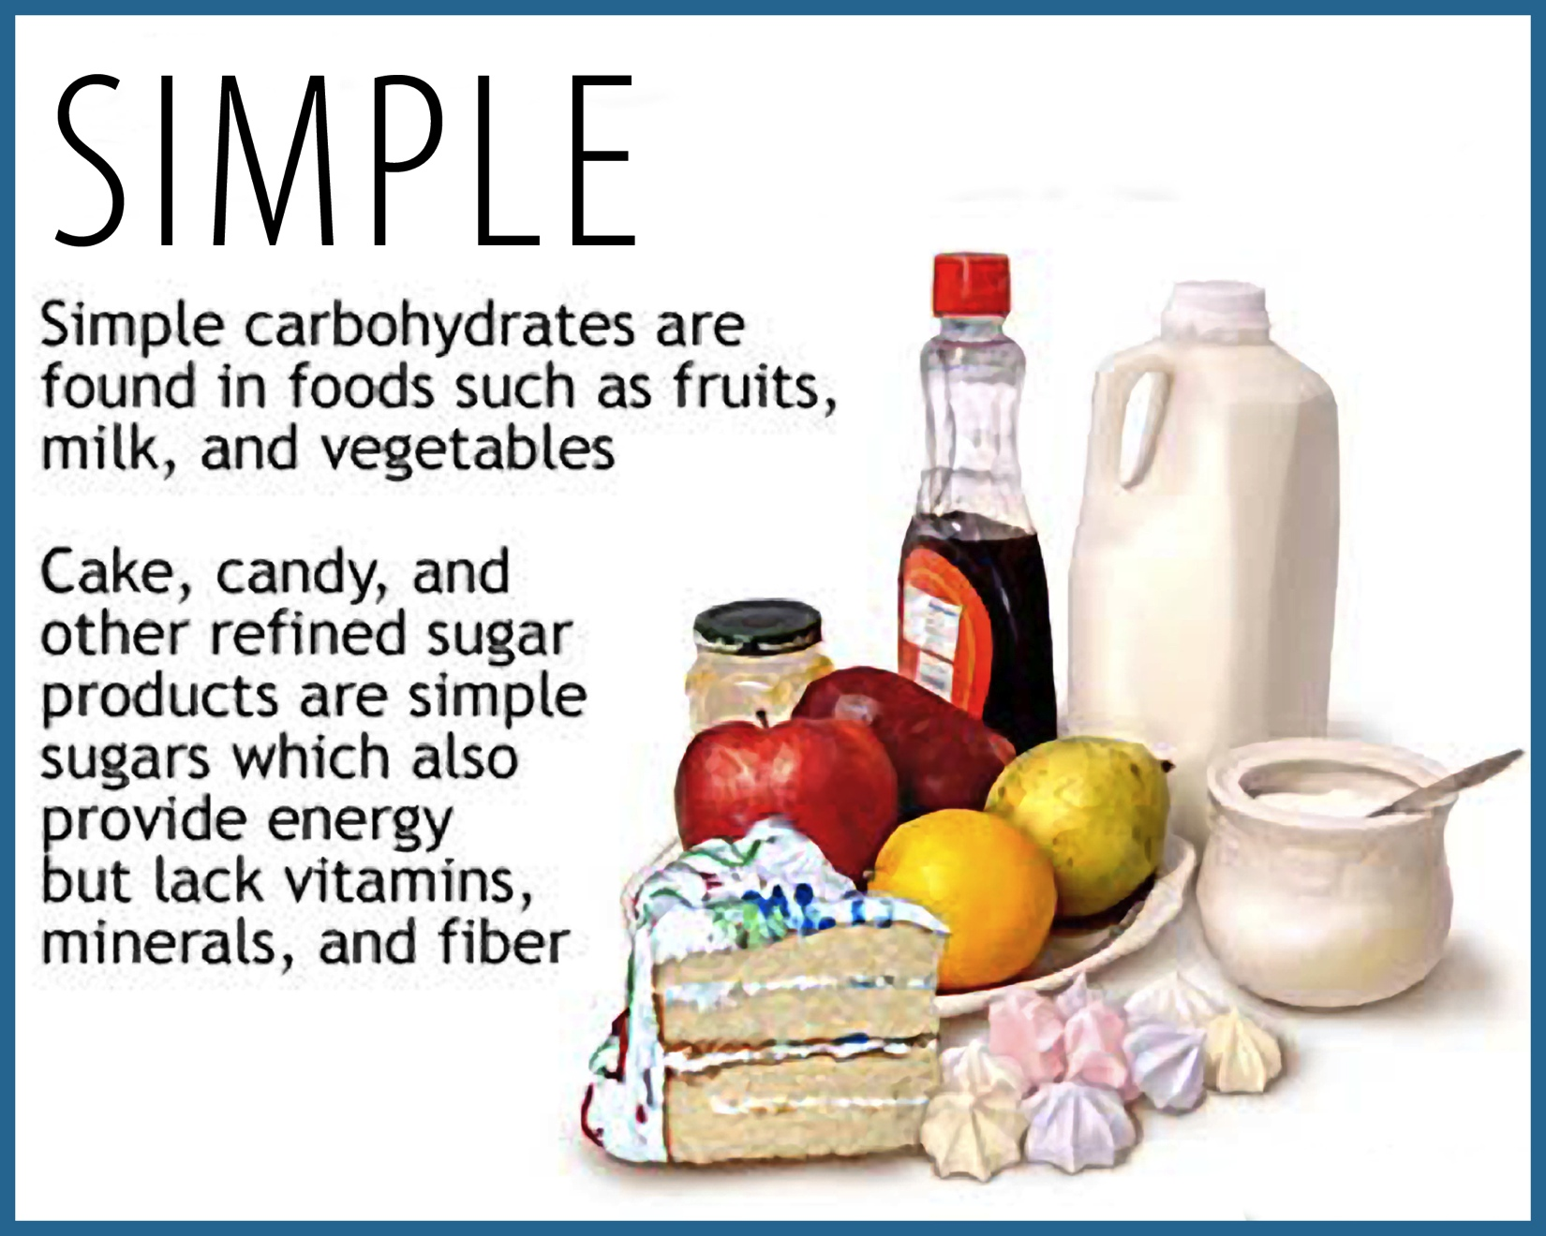
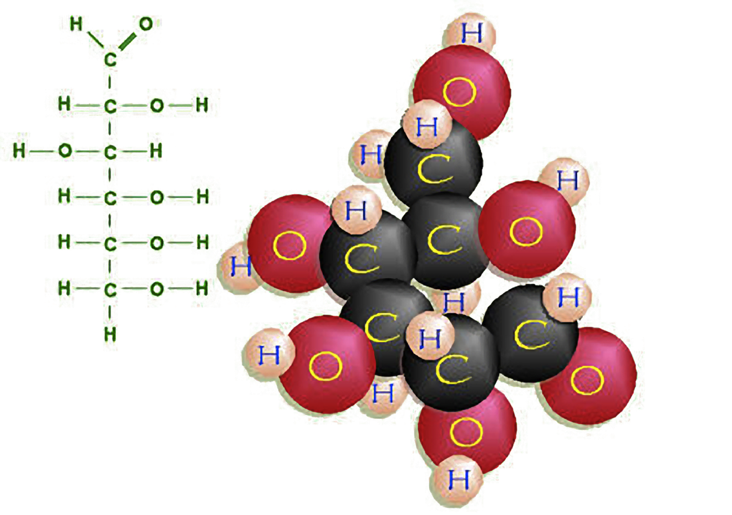
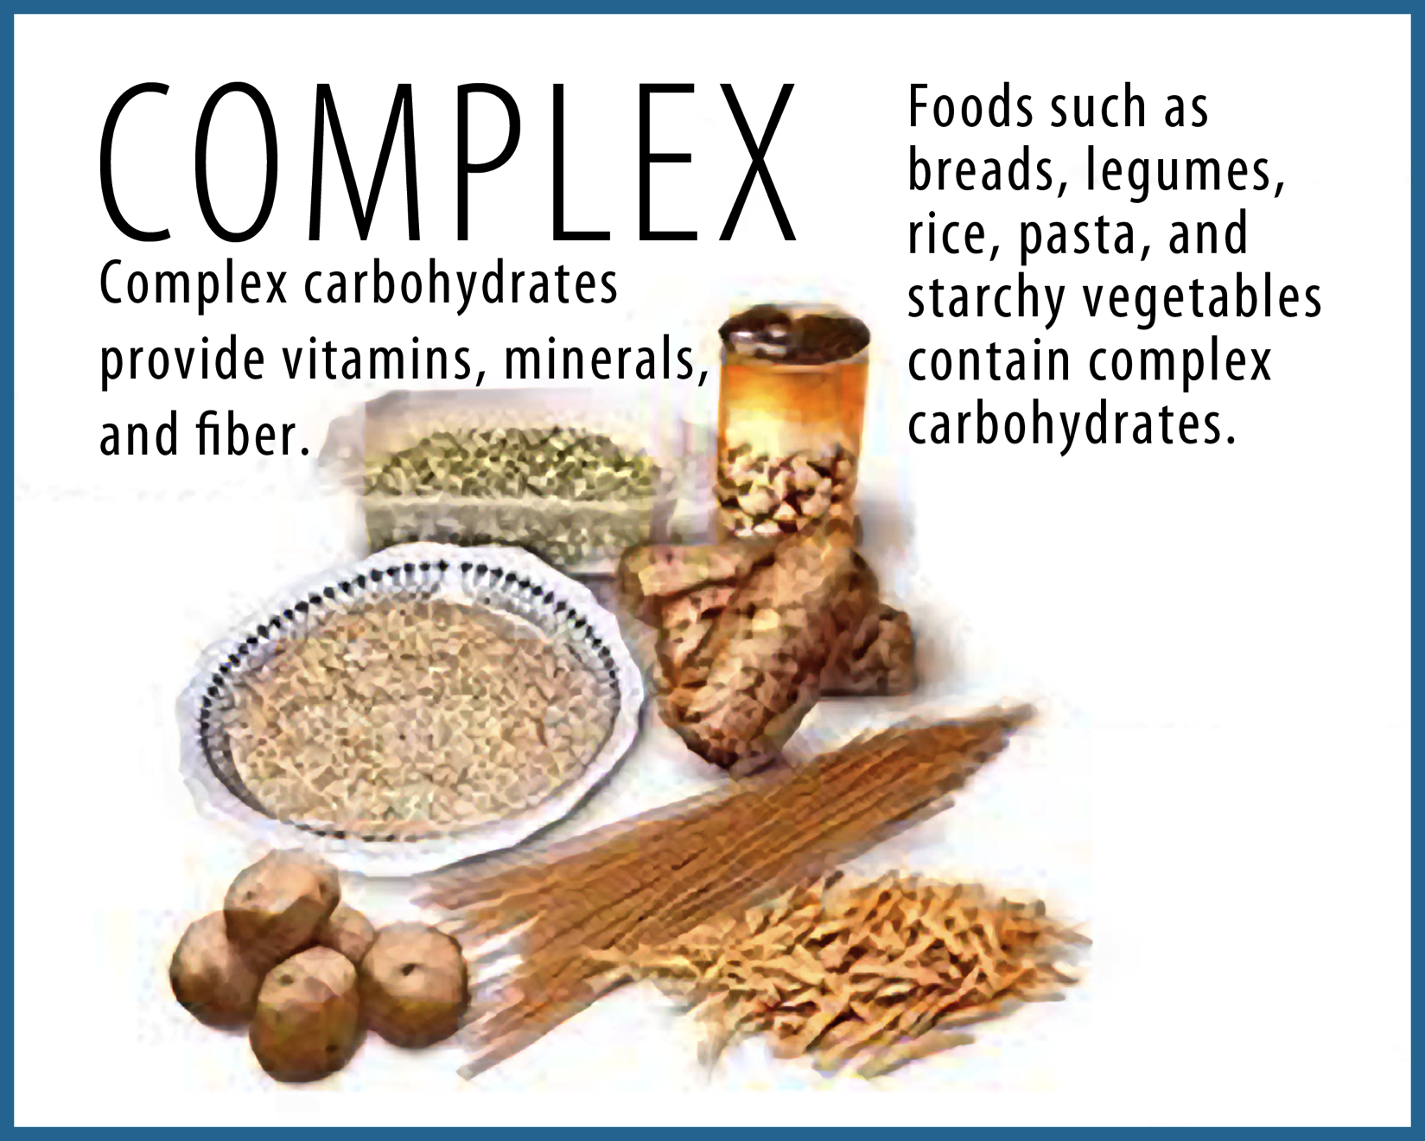
TYPES OF CARBOHYDRATES
ROLE IN THE BODY
•IMMEDIATE SOURCE OF BODY FUEL
SIMPLE
•SUGARS
•FRUCTOSE: (FRUIT SUGARS) LACTOSE:
(MILK SUGARS)
(SUFFIX “OSE” MEANS SUGAR)
COMPLEX
•STARCHES
•PASTA, BREADS, GRAINS, ETC.
Notes:
Glucose molecule shown.

Slide 5
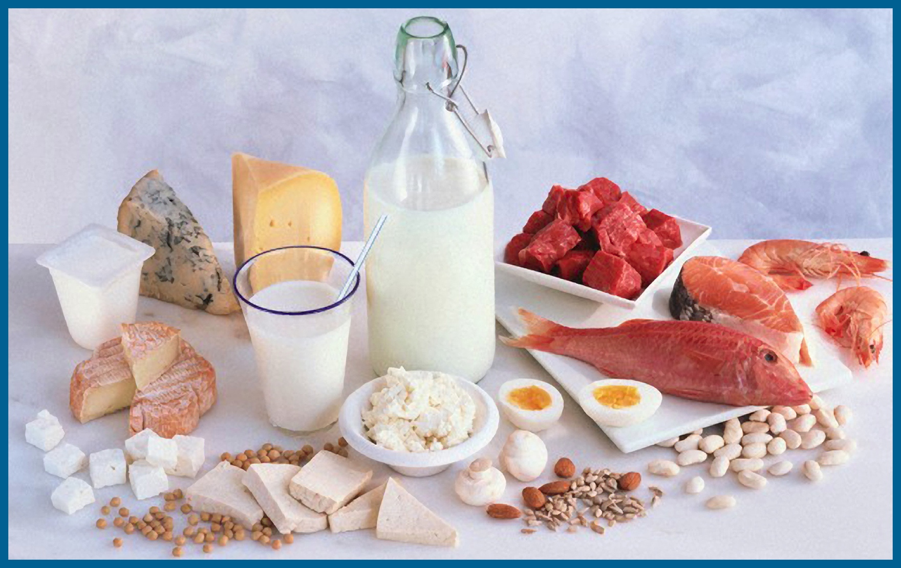
PROTEIN
ROLE IN THE BODY
•GROWTH AND REPAIR OF TISSUES
•ANTIBODIES AND IMMUNITY AGAINST BACTERIA, VIRUSES, AND OTHER FOREIGN ORGANISMS
•ENZYMES TO HELP BREAK DOWN AND BUILD SUBSTANCES
•HORMONES
•FLUID BALANCE
•PH BALANCE
•BLOOD CLOTTING
Notes:
Mention Blood clotting benefits of protein.

Slide 6
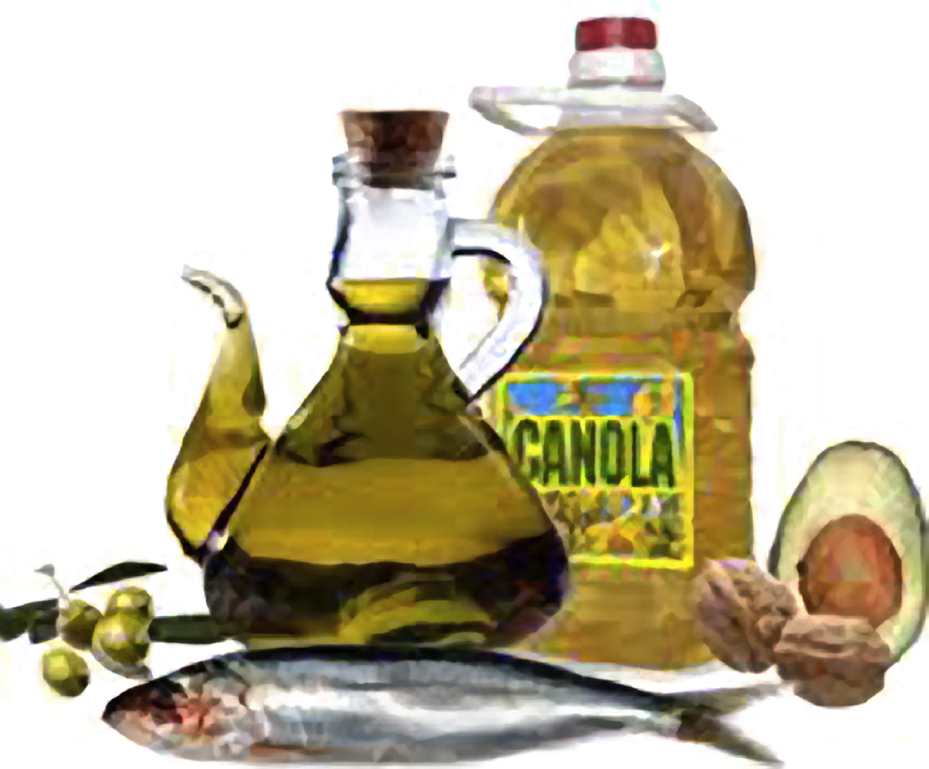
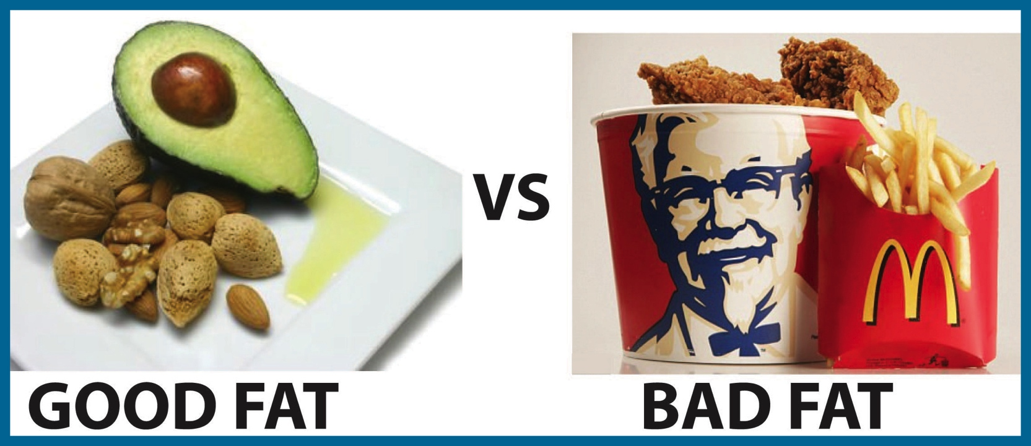
FATS
ROLE IN THE BODY
•PLENTIFUL ENERGY SOURCE
•PROTECTION AND INSULATION
TYPES OF FATS:
UNSATURATED (PLANT BASED)
• THE GOOD FATS ARE LIQUID AT ROOM TEMPERATURE
• FATS THAT COME FROM FISH, FLAX, AND OTHER NUTS AND SEEDS (OMEGA 3’s)
SATURATED (ANIMAL BASED)
(EXCEPT FOR PALM AND COCONUT OILS)
•THE BAD FATS ARE SOLID AT ROOM TEMPERATURE
Notes:
Protection and insulation is especially important with hemophilia.

Slide 7

WATER
ROLE IN THE BODY
•CARRIES WASTE PRODUCTS FROM THE BODY
•LUBRICATES JOINTS
•PROTECTS ORGANS LIKE HEART, LUNGS, INTESTINES, AND EYES
•PROVIDES STRUCTURE AND FORM TO THE BODY
•ABSORBS HEAT
•AVERAGE SUGGESTED WATER INTAKE
IS 2.5 LITRES
(OR ½ YOUR BODY WEIGHT IN OUNCES)

Slide 8
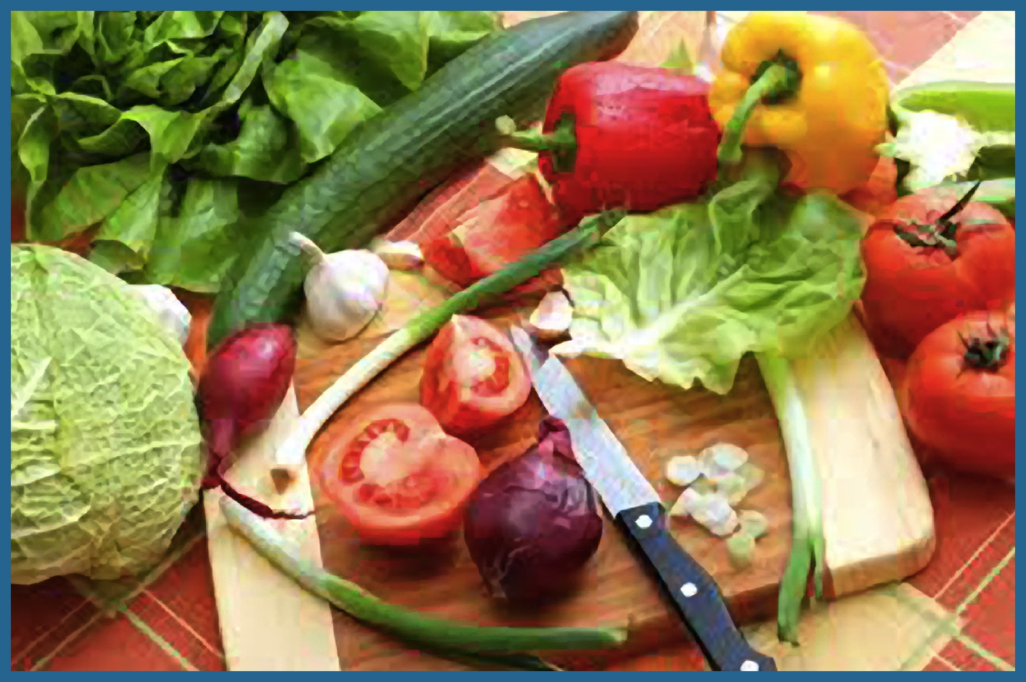
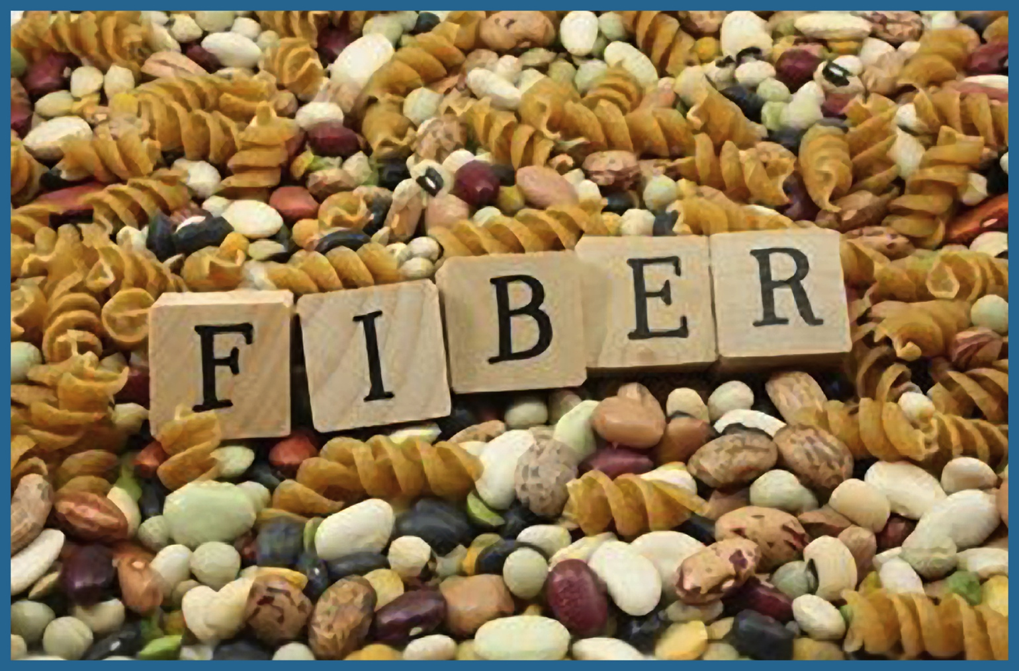
FIBER
UNDIGESTIBLE FOODS
•SOLUBLE FIBER: ACTS LIKE A SPONGE SOAKING UP DISEASE CAUSING FATS IN THE BLOOD AND TAKES THEM OUT OF THE BODY.
•INSOLUBLE FIBER: ACTS LIKE A BROOM BY ADDING BULK TO THE STOOL AND INCREASING TRANSIT TIME
FIBER SUGGESTIONS
•READY TO EAT CEREALS: 3 GRAMS OF FIBER PER SERVING
•WHOLE FRUITS AND VEGETABLES: DRIED FRUITS (ESPECIALLY FIGS)
•ADD TO MEAT DISHES: BEANS, PEAS, BRAN OR OATMEAL
•ALSO ADD TO YOGURT, OR COTTAGE CHEESE THINGS LIKE NUTS OR SEEDS, FRUIT, WHOLE GRAIN OR BRAN CEREALS.
•USE WHOLE WHEAT OR GRAIN INSTEAD OF WHITE FLOUR
•THE LESS PROCESSED, THE BETTER!
•LOOK FOR WHOLE FOODS

Slide 9
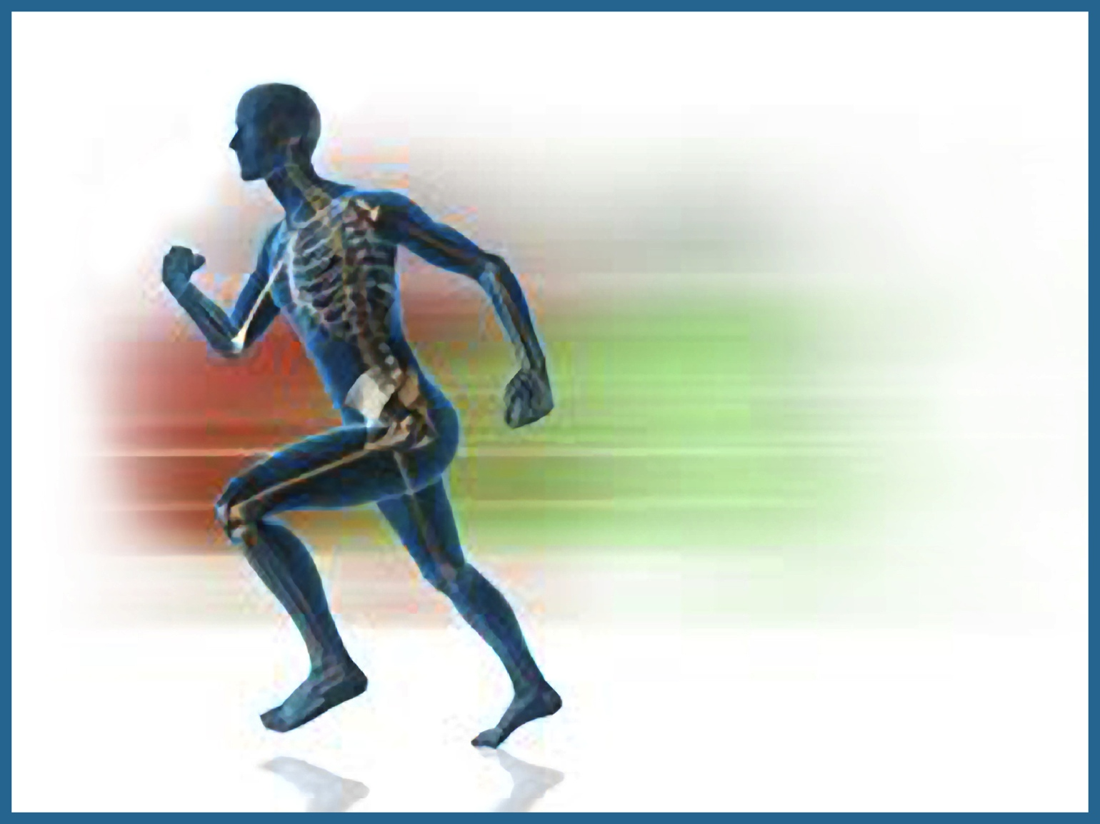
FITNESS
•THE CONDITION OF BEING PHYSICALLY FIT AND HEALTHY
•THE QUALITY OF BEING SUITABLE TO FULFILL A PARTICULAR ROLE OR TASK
•MORE THAN FEELING JUST OK OR GOOD
•FEELING LIKE A CHILD WITH AMAZING ENERGY, BOUNCE, AND STRENGTH

Slide 10
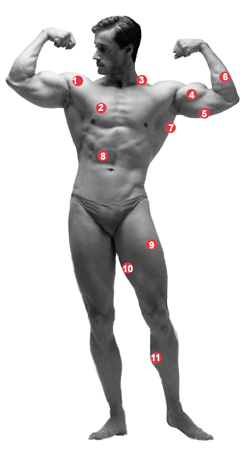
MUSCLES
1. SHOULDER
2. CHEST
3. TRAPEZIUS
4. BICEPS
5. TRICEPS
6. FOREARM
7. BACK
8. ABDOMINALS
9. QUADRACEPS
HAMSTRING
CALVES
Normal exercise and workout range is to exercise 3 sets of at least 10 reps, with three different exercises for each major muscle group.
Notes:
Normal exercise and workout range is to exercise 3 sets of at least 10 reps, with three different exercises for each major muscle group.

Slide 11
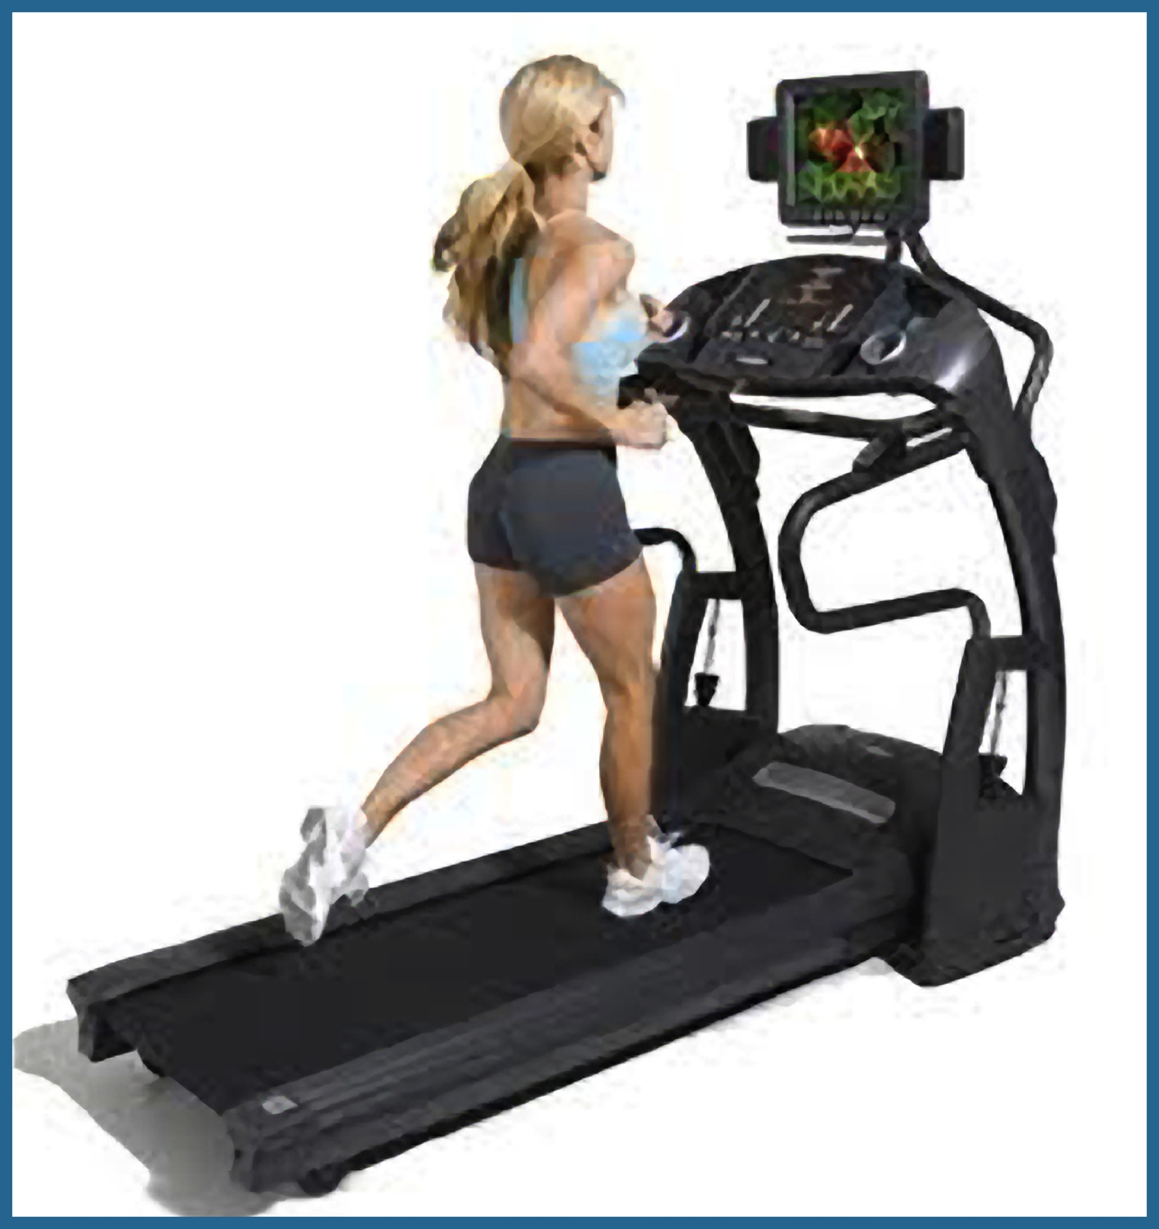
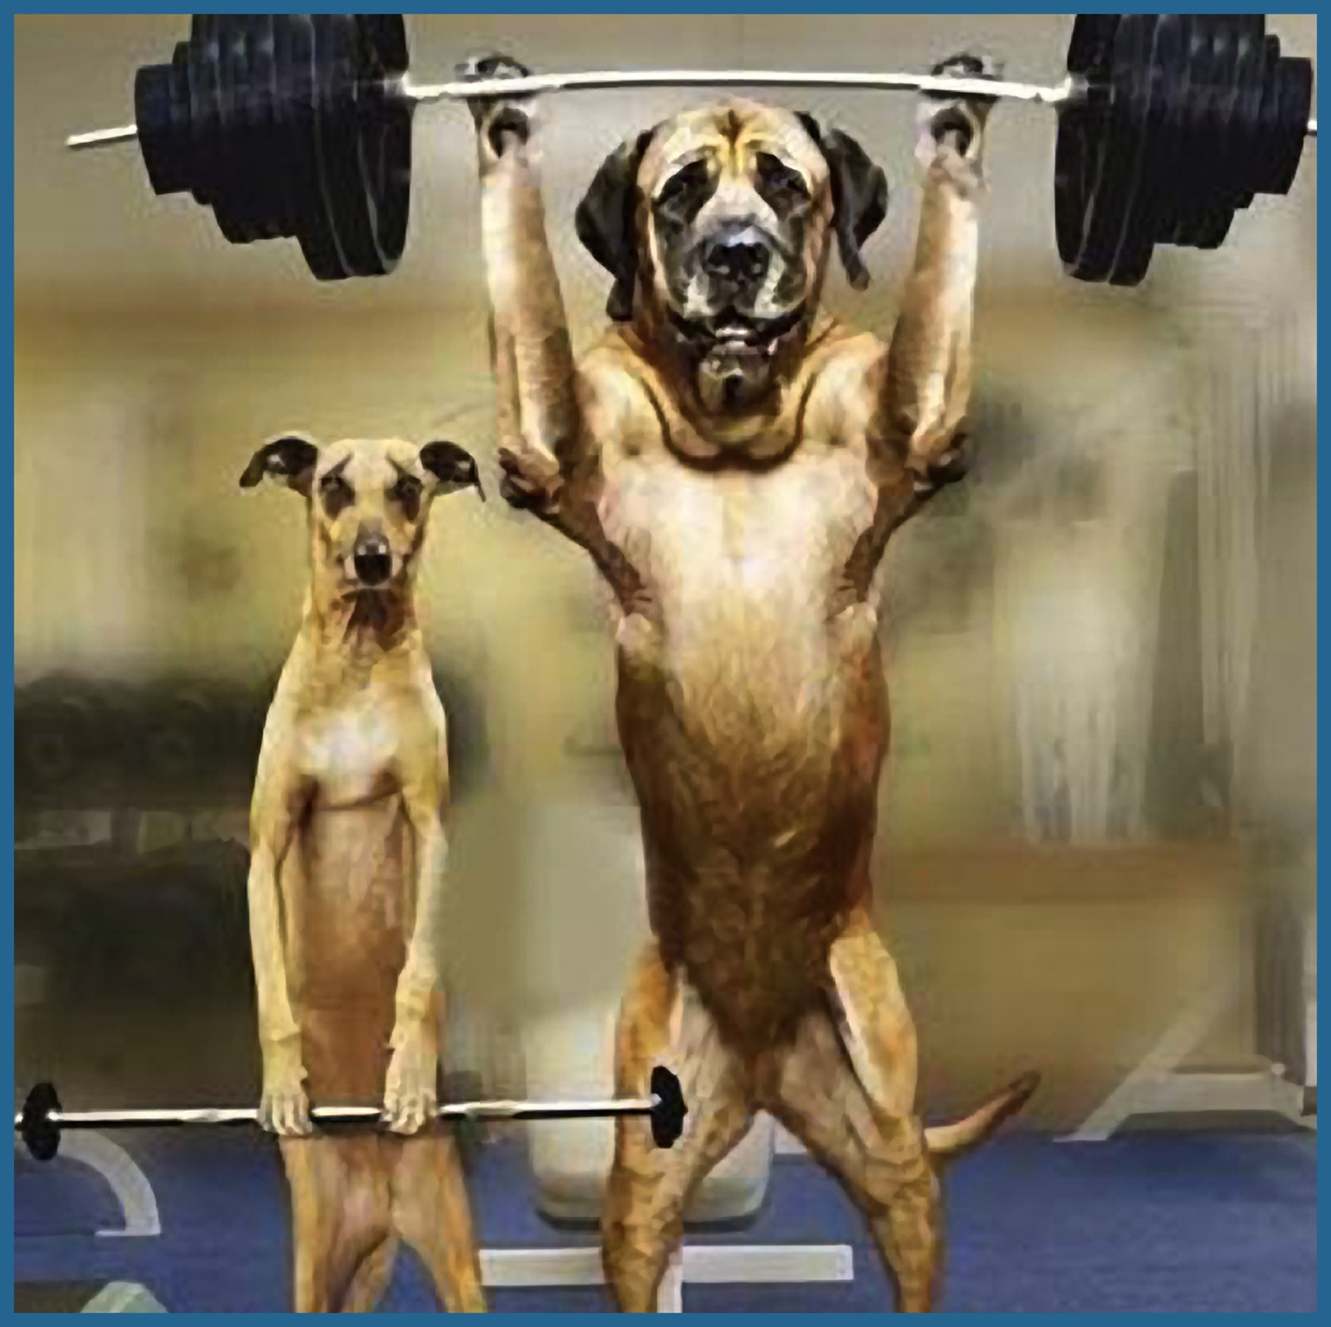

Keys to a strong body
•CARDIO TRAINING: (TREADMILL, RUNNING, STAIRSTEPS, BICYCLING, SWIMMING, ETC.)
•STRENGTH TRAINING: (WITH WEIGHTS OR RESISTSANCE BANDS, PILATES)
•FLEXIBILITY TRAINING: (YOGA)
20 MIN. 20 MIN. 20 MIN.

Slide 12
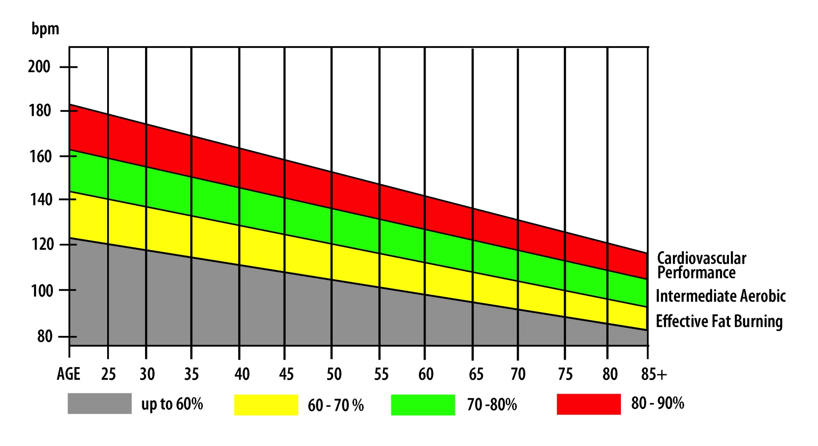
HEART RATE CHART
Notes:
Colors are levels of exertion.

Slide 13

The Bottom line:
Either you are ready for the challenges of life or you will be haunted by the “what ifs”, “if onlys”, and “I should’ves” that accompany the failure.
DISCIPLINE YOUR BODY AND BRING IT UNDER
SUBJECTION TO YOUR MIND
•VISION
•PREPARATION
•DILIGENCE
•KNOWLEDGE
•ENDURANCE

Slide 14

Sunflower health food store
http://www.mysunflowerhealth.com

Slide 15
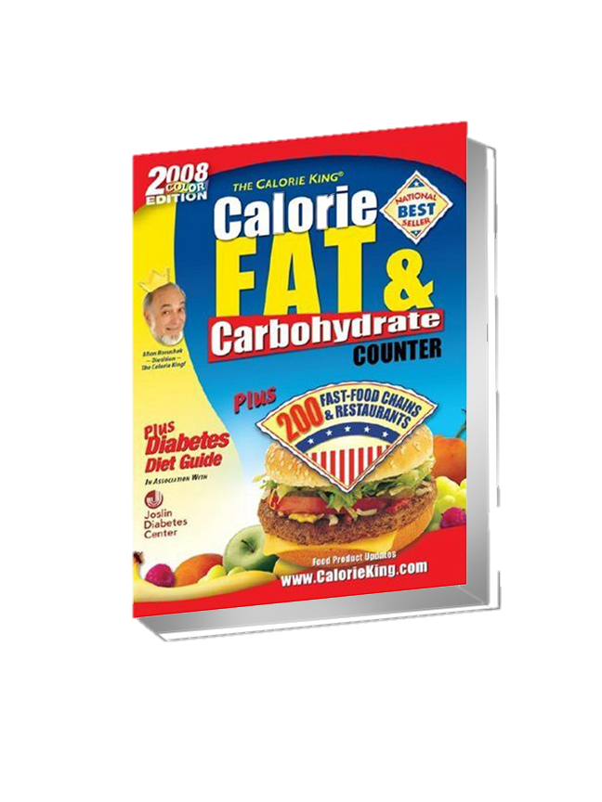


Reference books recommened
• Calorie King / Calorie, Fat, & Carbohydrate Counter by Allan Borushek
• The Yeast Connection by William C. Crook
• Fat Fighting Foods by Consumer Guide editors

