Slide 1
Nominations & Elections
MVBOA Executive Board and Commissioner Elections

Slide 2
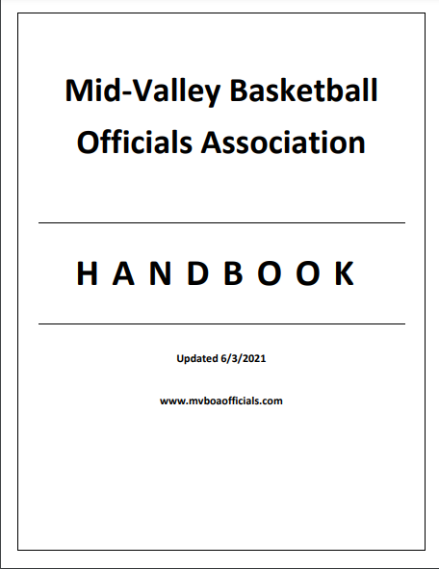
MVBOA Handbook
mvboaofficials.com
Includes:
  Current Executive Board
  Meeting Schedule & Attendance Policy
  Constitution
  Standard Operating Procedures
    Independent Contractor Agreement
    Commissioner’s Contract
    Additional Information

Slide 3
Current mvboa executive board
OFFICE | TERM | ELECT | OFFICER | TERM EXPIRES
President | 1 Year | N/A | Bill Draper | 2020-21
President-Elect | 1 Year | Every Year | Dave Albanese | 2020-21
Secretary | 2 Years | Odd Years | Nina Pruett | 2020-21
Trainer | 2 Years | Odd Years | Michael Rascon | 2020-21
Treasurer | 2 Years | Even Years | Carl Chambers Dwayne Johnson | 2021-22
Member-At-Large | 2 years | Even Years | Quincy Johnson | 2021-22
Parliamentarian | 2 Years | Even Years | Gibby Reynolds | 2021-22
Commissioner | 3 Years | 3rd Year | Dave Brooks | 2020-21

Slide 4
President & president-elect
The PRESIDENT presides over all meetings, represents the association, and leads the membership
The PRESIDENT serves a one-year term after serving one year as the PRESIDENT-ELECT
The PRESIDENT-ELECT fulfils the PRESIDENT’s role in their absence
The PRESIDENT-ELECT is elected to serve a one-year term then automatically assumes the office of PRESIDENT for their second year
A new PRESIDENT-ELECT is elected every year

Slide 5
secretary
The SECRETARY keeps attendance, records meeting minutes, and maintains association records and correspondence
The SECRETARY is elected for a two-year term in odd years

Slide 6
trainer
The TRAINER coordinates and provides the membership with rule changes and is responsible for training officials
The TRAINER is elected for a two-year term in odd years

Slide 7
commissioner
The COMMISSIONER is the MVBOA / OSAA / School liaison and is a non-voting member of the Executive Board
The COMMISSIONER is responsible for assignments and fee distributions
The COMMISSIONER is elected for a three-year term and cannot hold another MVBOA office
The COMMISSIONER is an independent contractor and enters a contract with the MVBOA and is renumerated for their services

Slide 8
2021-22 Elections Schedule
6/6/2021
  Nominations are held during the second to last scheduled regular meeting
6/13/2021
  Elections are held during the last scheduled regular meeting
6/30/2021
  Terms end for officers expiring in 2020-21 (extended from March 31)
7/1/2021
  Terms for new officers begin
3/31/2022
  Terms end for officers expiring in 2021-22

Slide 9
eligibility
All Executive Board officers serve 2-year terms (Commissioner is 3 years)
There are no term limits
Members cannot hold more than one office at a time
Only members that are currently in good standing and have been in good standing for at least the past two years are eligible to be nominated to an elected office
Anyone, member or non-member, can be nominated as COMMISSIONER

Slide 10
nominations
Nominations will come from the floor, no second is required
Members may nominate themselves
Nominations may only come from present members in attendance
Nominees do not have to be present to be nominated
Members cannot be nominated for more than one office
Nominees must accept their nomination and may accept by proxy
Nomination order: PRESIDENT-ELECT, SECRETARY, TRAINER, then COMMISSIONER

Slide 11
elections
Elections will take place at the next meeting (electronically)
Before elections, nominees will have an opportunity to address the membership
Only present members (in-person or virtually) in good standing may vote in elections
Officers shall be determined by a simple majority (plurality) vote of present eligible voters
All votes shall be weighted equally, and each vote shall count as one single vote
If there is a tie, the office will be determined by a run-off between the tied nominees

Slide 12
Questions before nominations
“When the going gets tough, the tough take a coffee break.” -Confucius

Slide 13
NOMINATIONS
Nominees
Dante Lewis
Rylan Owen
Michael Schwartz
PRESIDENT-ELECT

Slide 14
NOMINATIONS
Nominees
Nina Pruett
SECRETARY

Slide 15
NOMINATIONS
Nominees
Raynel Whitney
TRAINER

Slide 16
NOMINATIONS
Nominees
Dave Brooks
Marcus Eng
COMMISSIONER

