Slide 1




BROTHERS OF INFLUENCE 202-2022 Officer

Slide 2


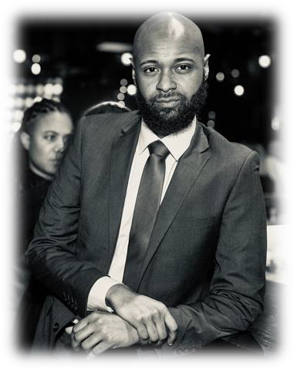
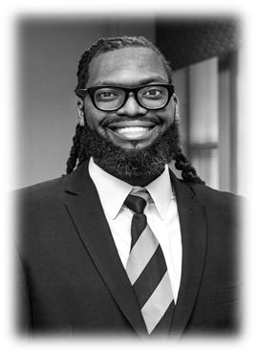
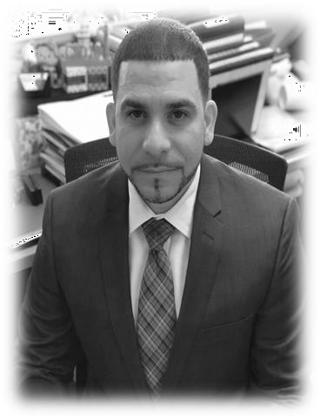
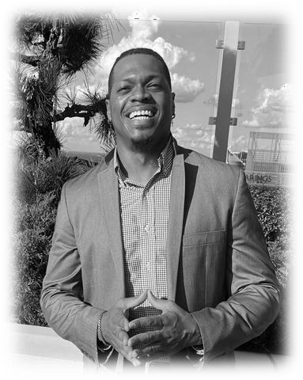
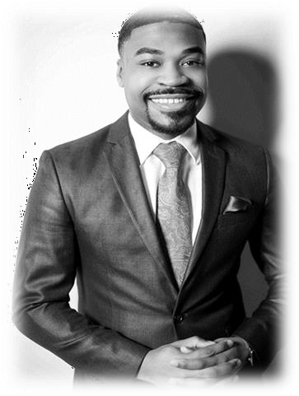
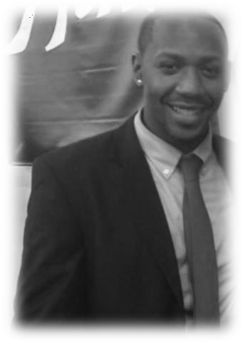
Malik Vaugh-Burnett, Chairman of the Board
Dr. MarTeze D. Hammonds, Vice Chairman of the Board
Rafeal T. Alvarez, Director of Finance
Seph McWhite III, Director of Social Programming
Karl Thomas, Director of Communications
Craig Feggins, Board Secretary

Slide 3
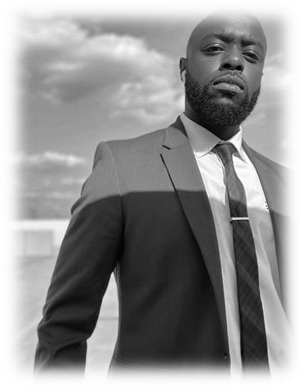
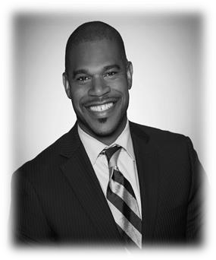
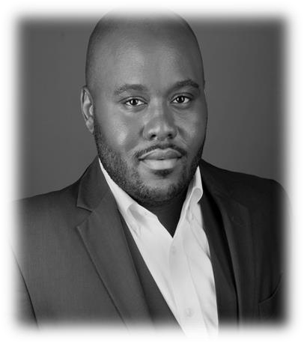
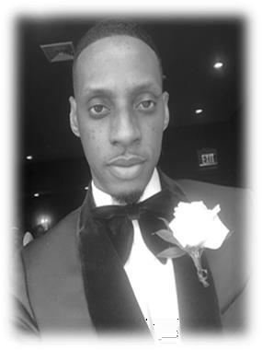
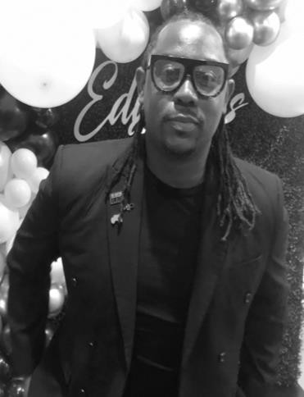
Travis Evans, National President
Kalon Goins, National Vice President
Jaylen Rice, National Social Secretary
Ronald Supoint, National Secretary
Chaseson Allen, National Treasurer

