Slide 1
A STUDY IN APPROPRIATE ACTION
JOHN CONNALLY, JIM HOSTY, RUTH PAINE & LHO

Slide 2
Oswald Was An Aviation Electronics Operator
His stepfather worked in research with Texas Electric
Oswald was 7-9 years old during this formative period
His stepfather was the formative father figure in LHO’s life
LHO threatened to provide espionage information
No proof that LHO actually provided espionage information
The military was not concerned re espionage information
The military was concerned about renouncing citizenship

Slide 4
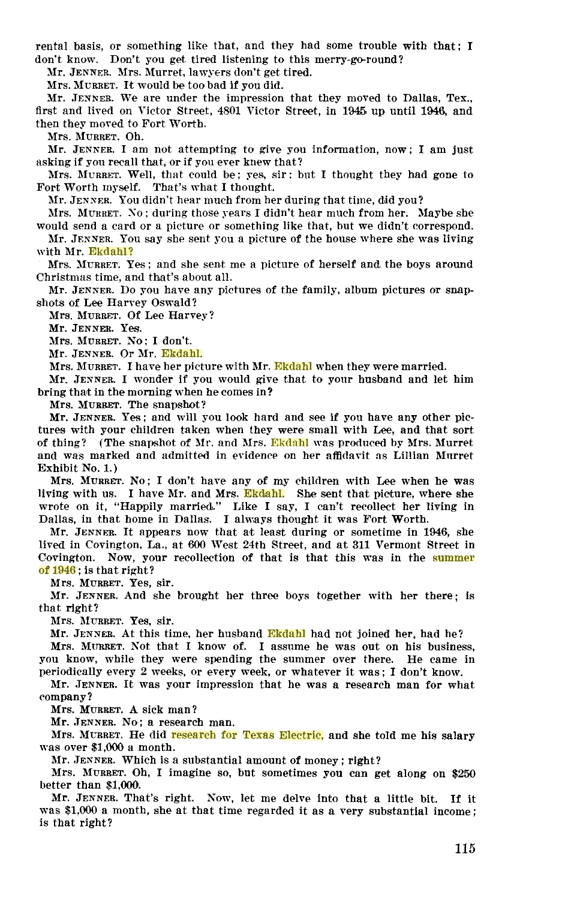

Slide 5
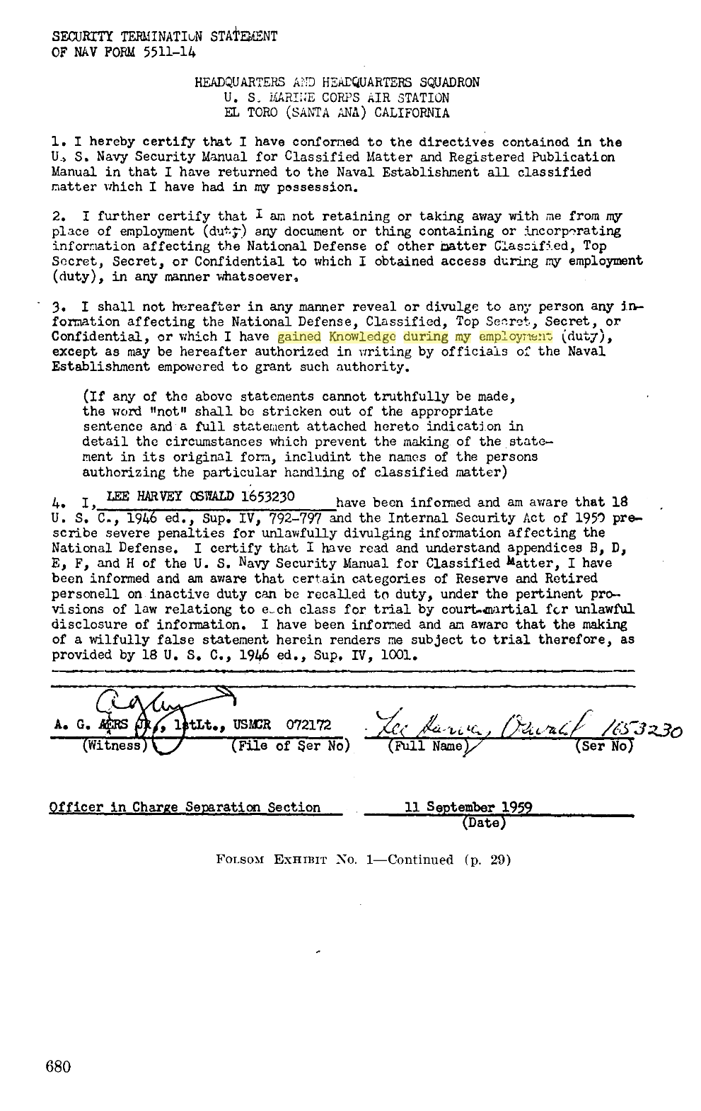

Slide 6
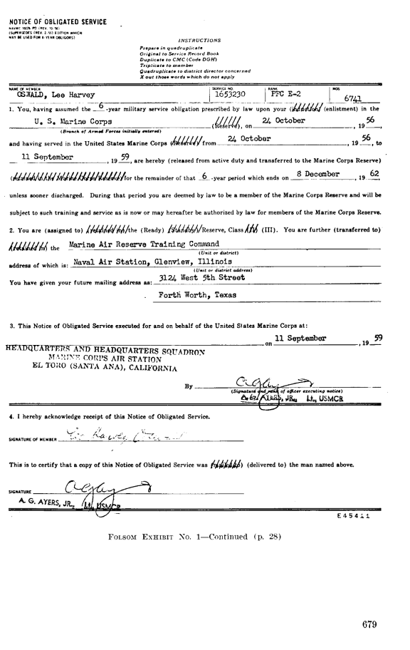

Slide 8
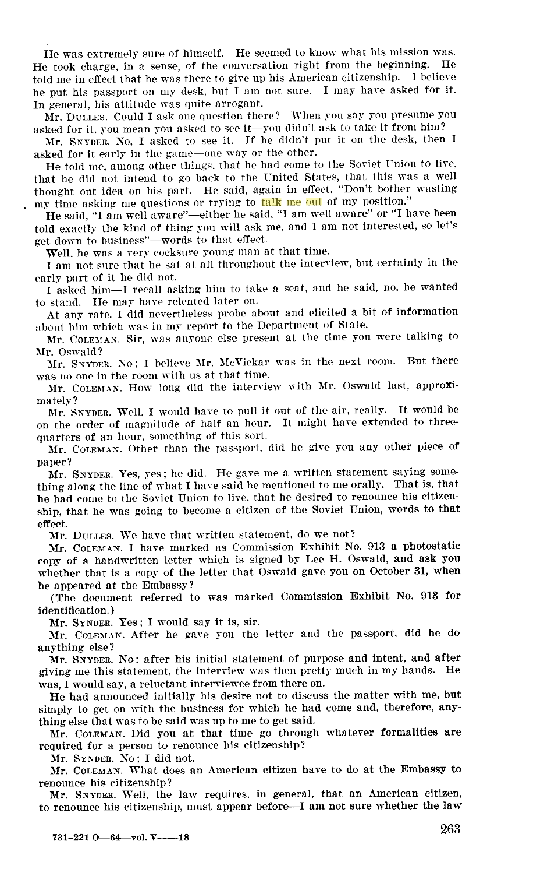

Slide 9
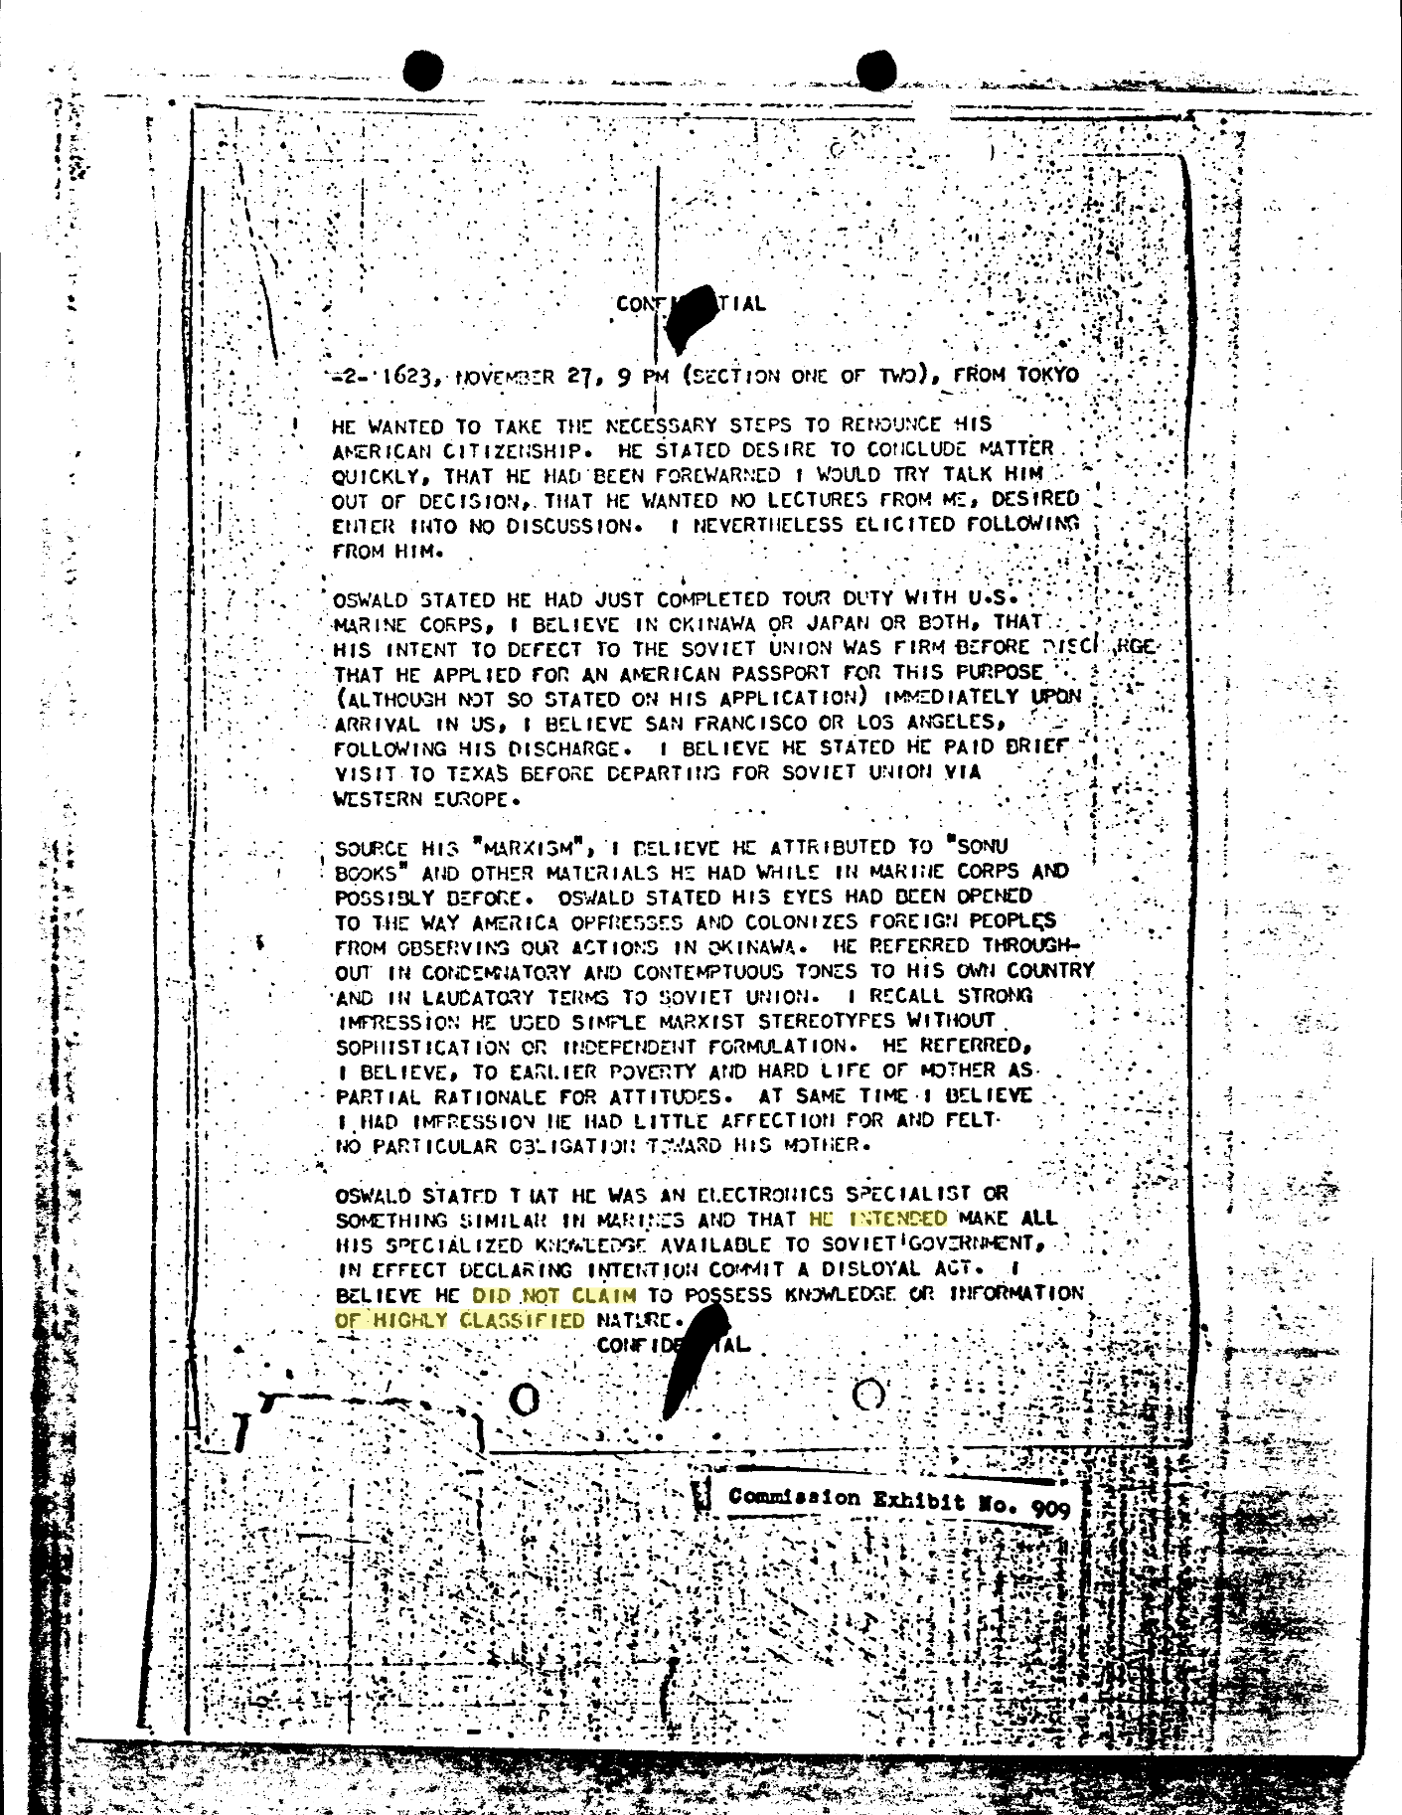

Slide 10
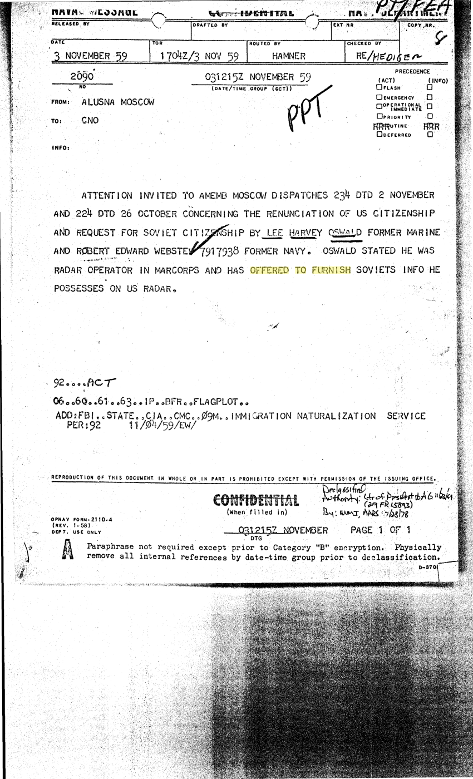

Slide 11
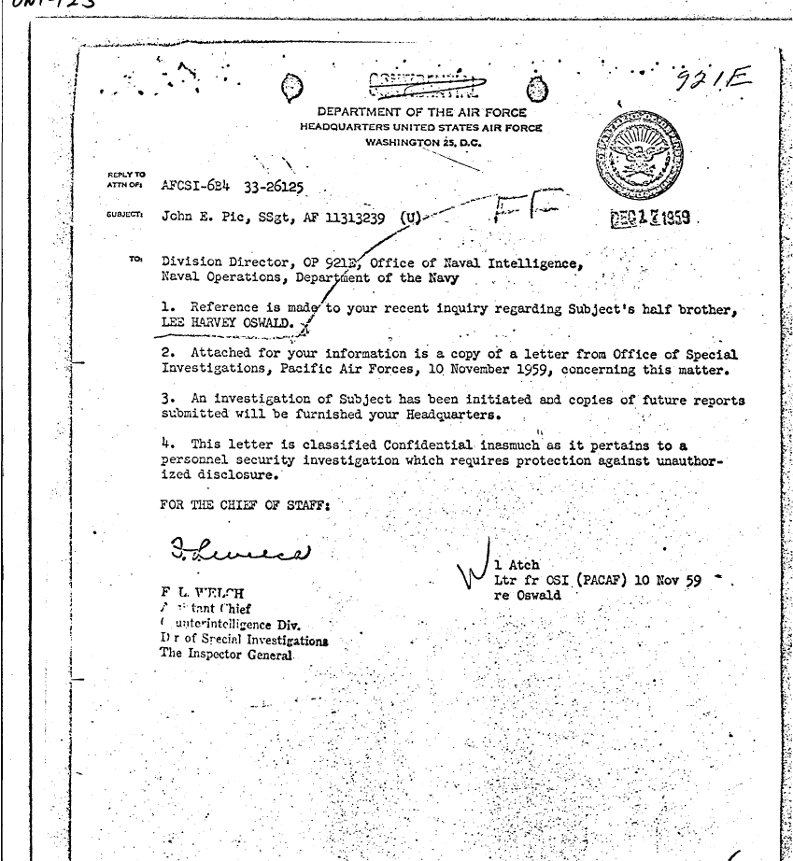

Slide 12
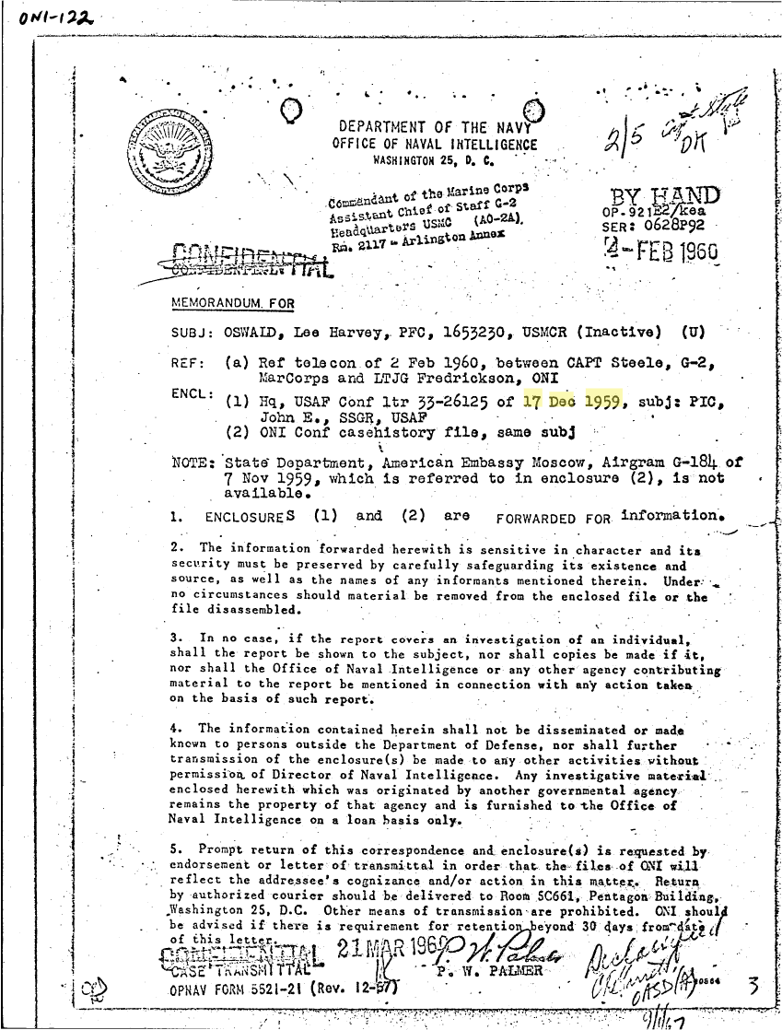

Slide 13
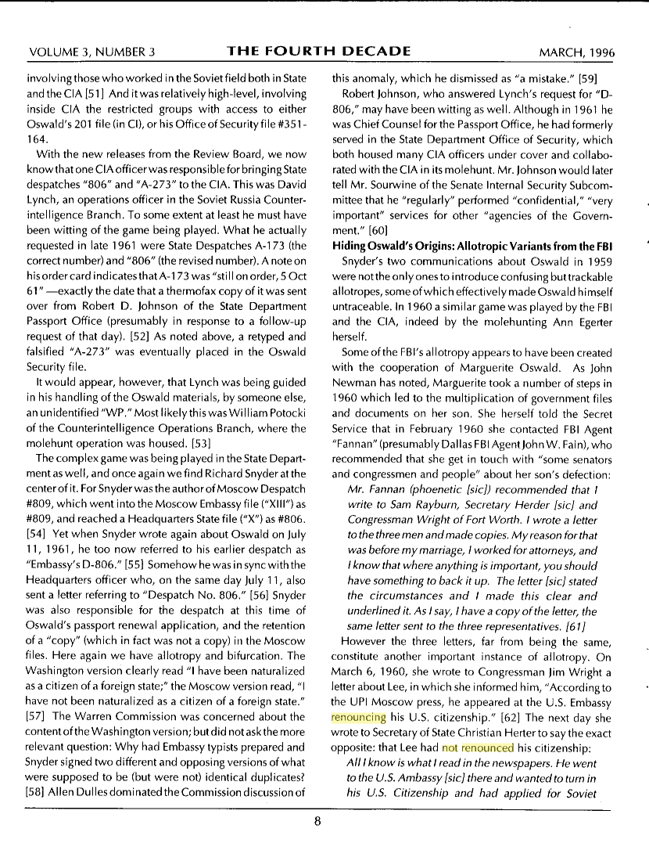

Slide 14
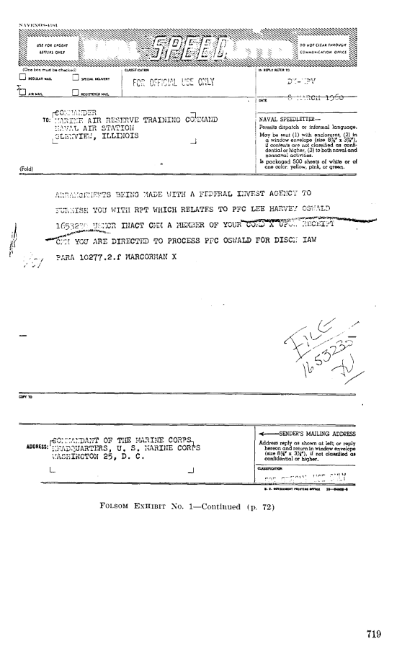

Slide 15
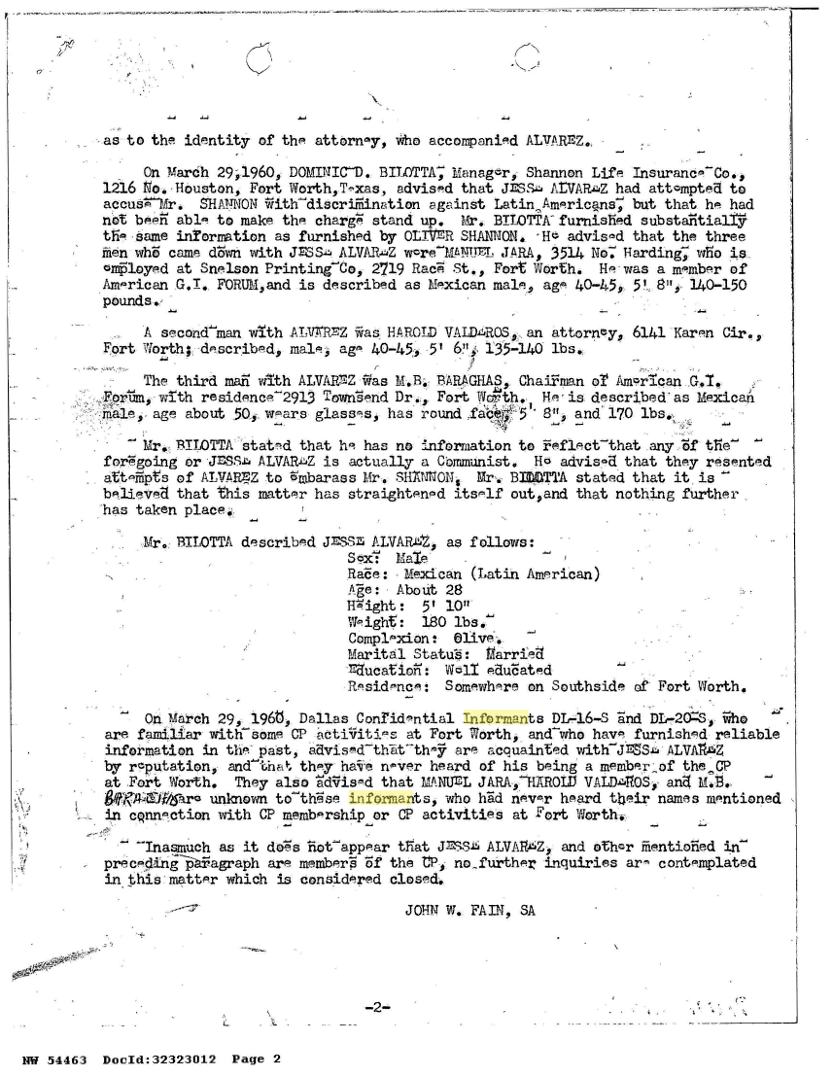

Slide 16
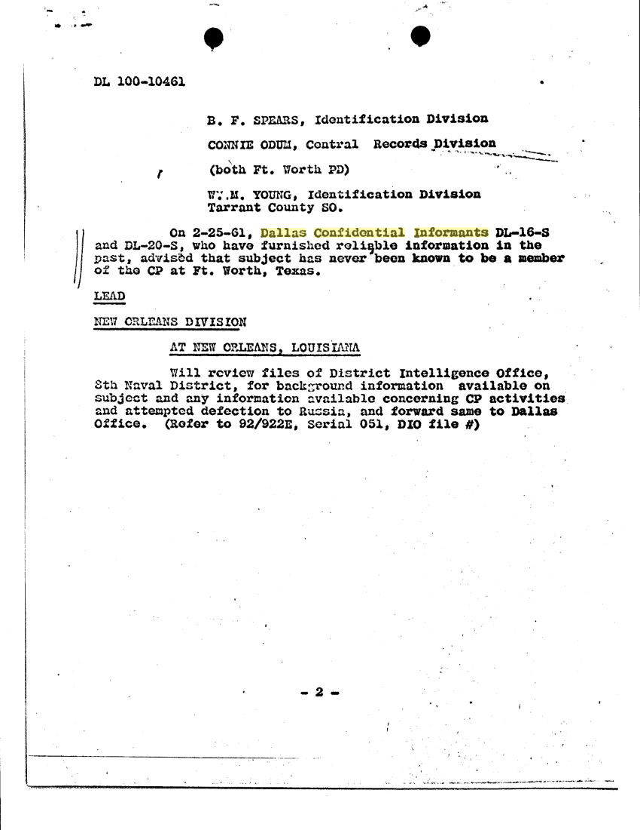

Slide 17
Marguerite Oswald addresses – 59/61
3616 Harley – Real address – Oct 59
(In news - Never used in correspondence)
3613 Harley – Fake address – Apr 60
(Used by Marines on letter - #1)
3613 Hurley – Fake address – Apr/Jun 60
(Used by Marines on envelope - #1, #2)
1410 Hurley - Mail drop – Mar 60-?
(Used by Marines on green card - #2)
1612 Hurley - Real address – Late 60-61

Slide 18
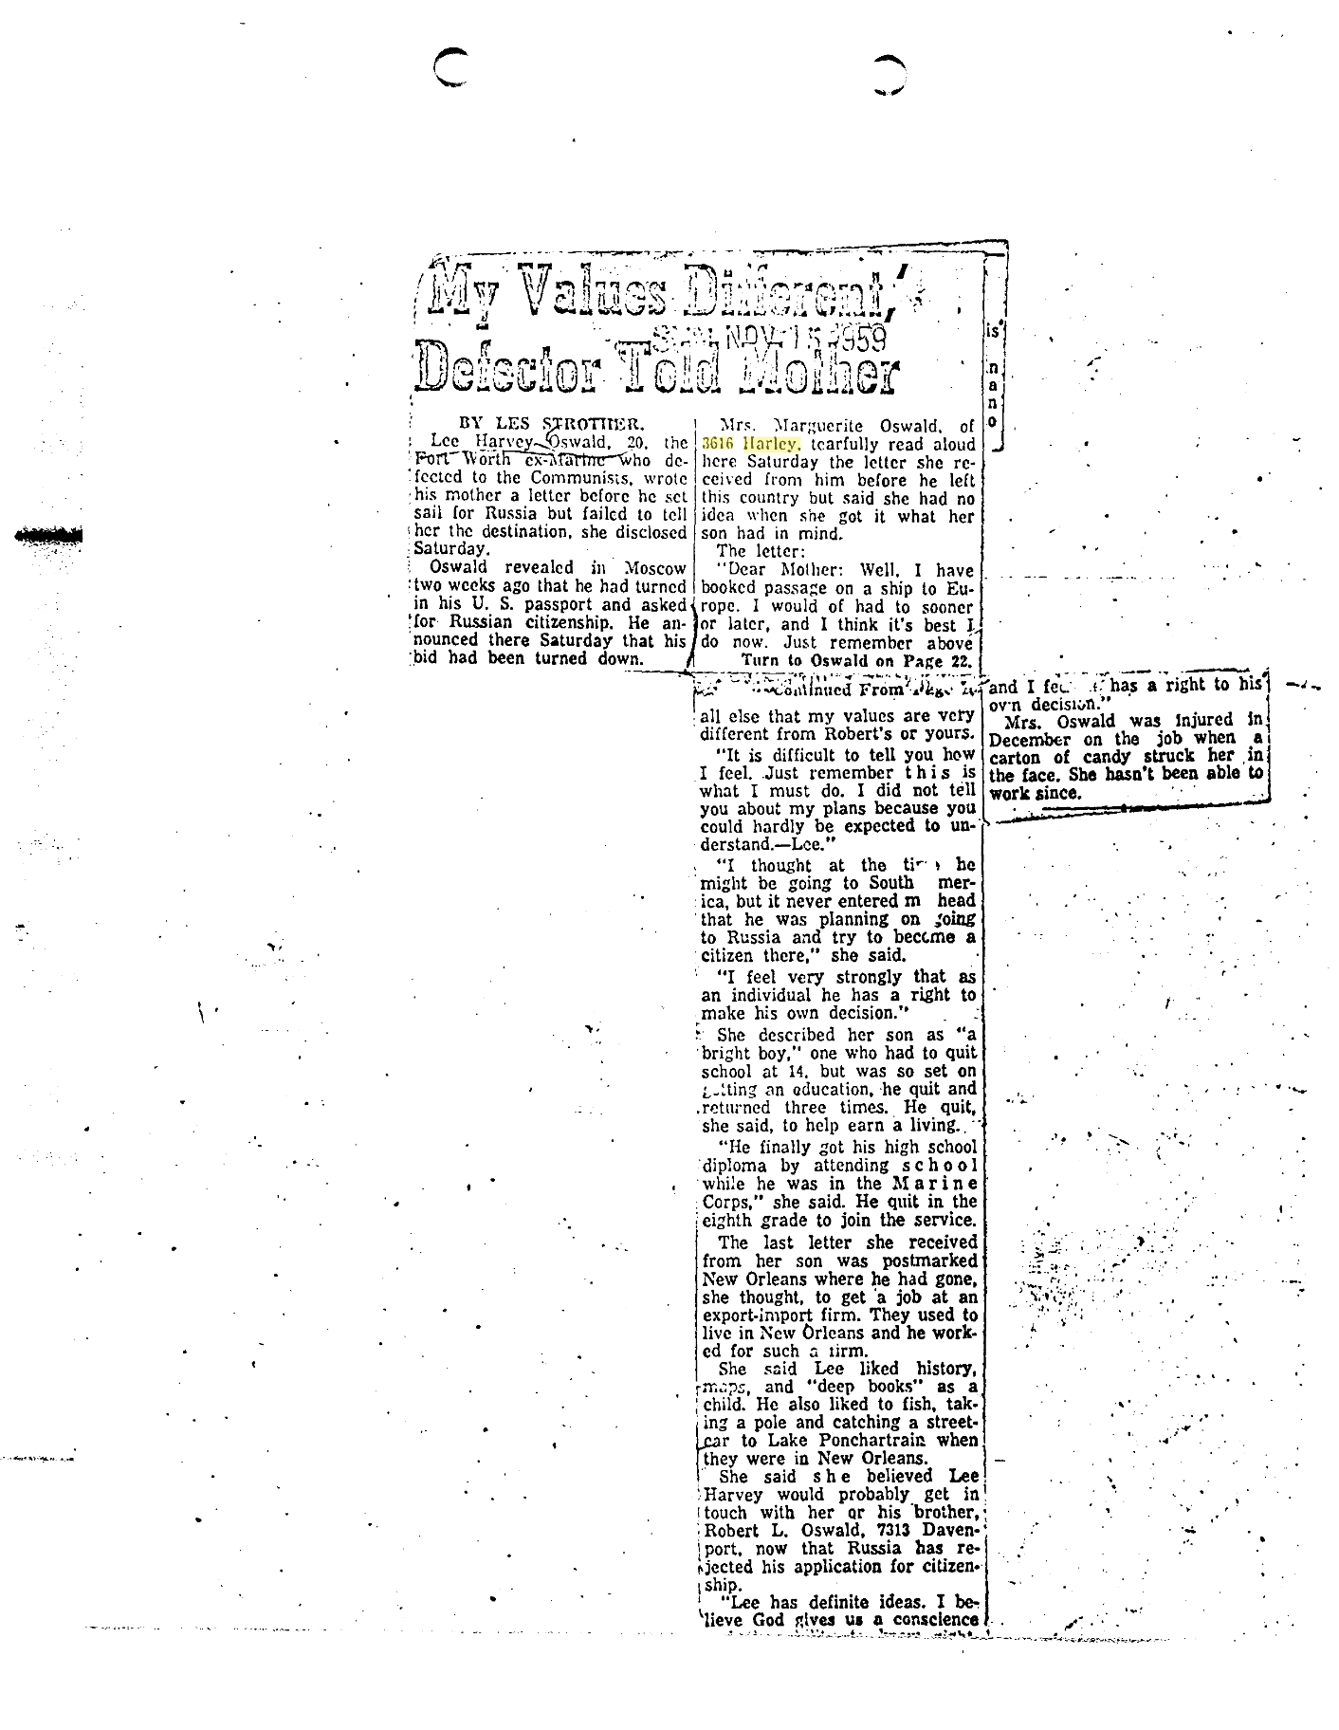

Slide 20
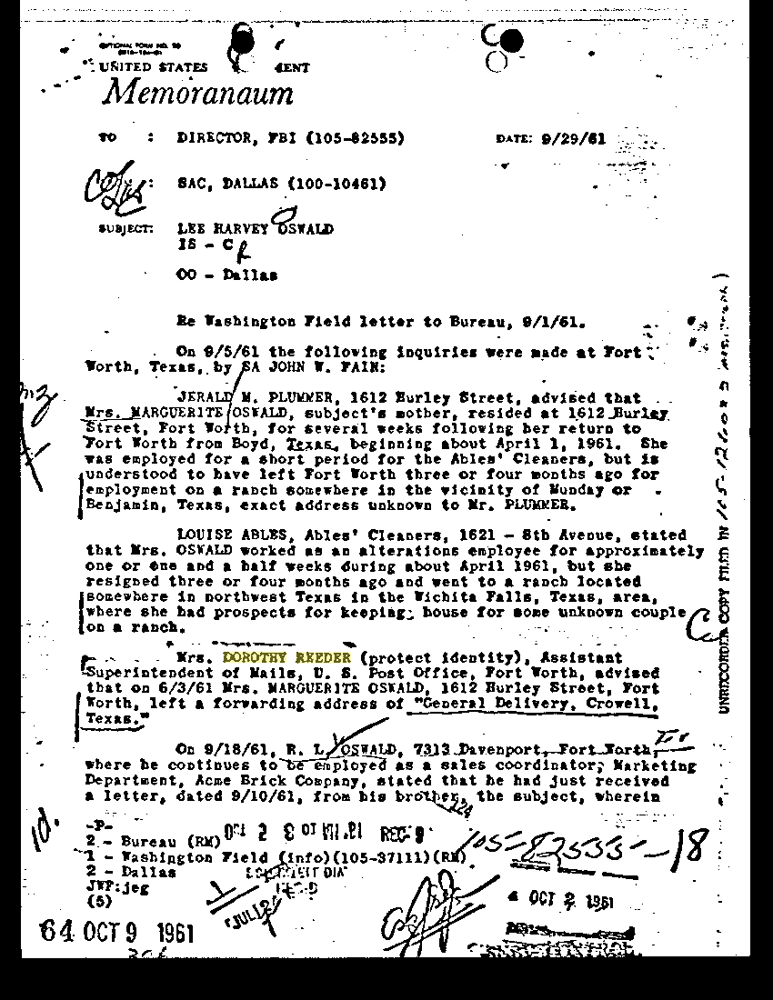

Slide 21
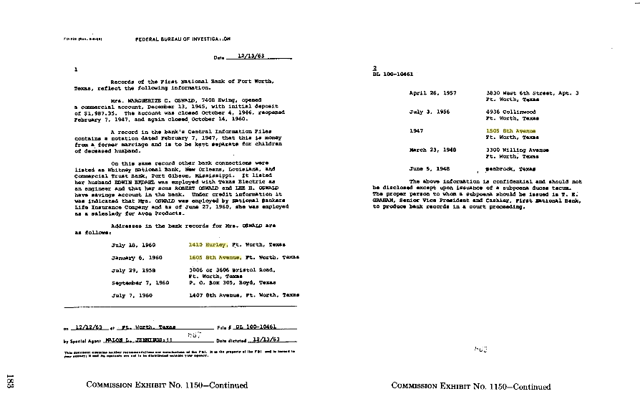

Slide 22
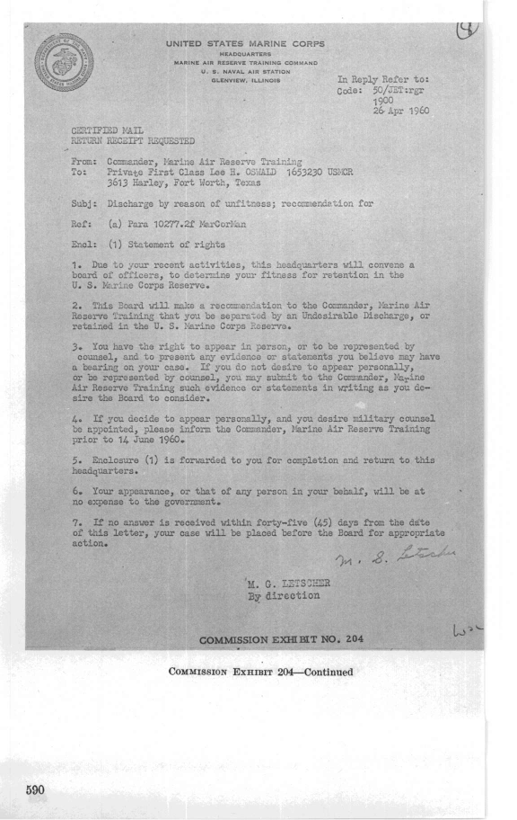

Slide 23
APRIL-AUGUST 1960 – Oswald had his discharge downgraded – no due process – loss of veterans’ benefits
JANUARY 1962 – Oswald appealed to Secretary of the Navy John Connally - he took “Appropriate Action”
JULY 1963 – Final appeal to Secretary of the Navy Fred Korth – no sign Korth saw any of these appeals
SEPT 1963 - Oswald turned to John Connally – referred to Selective Service

Slide 25
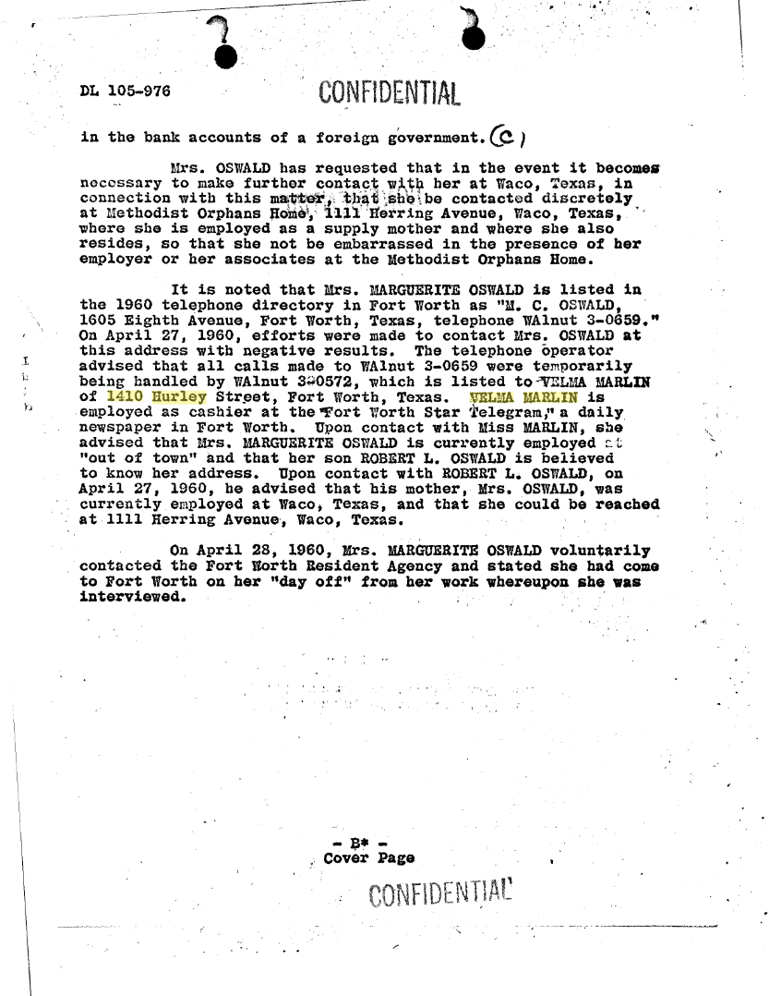

Slide 26
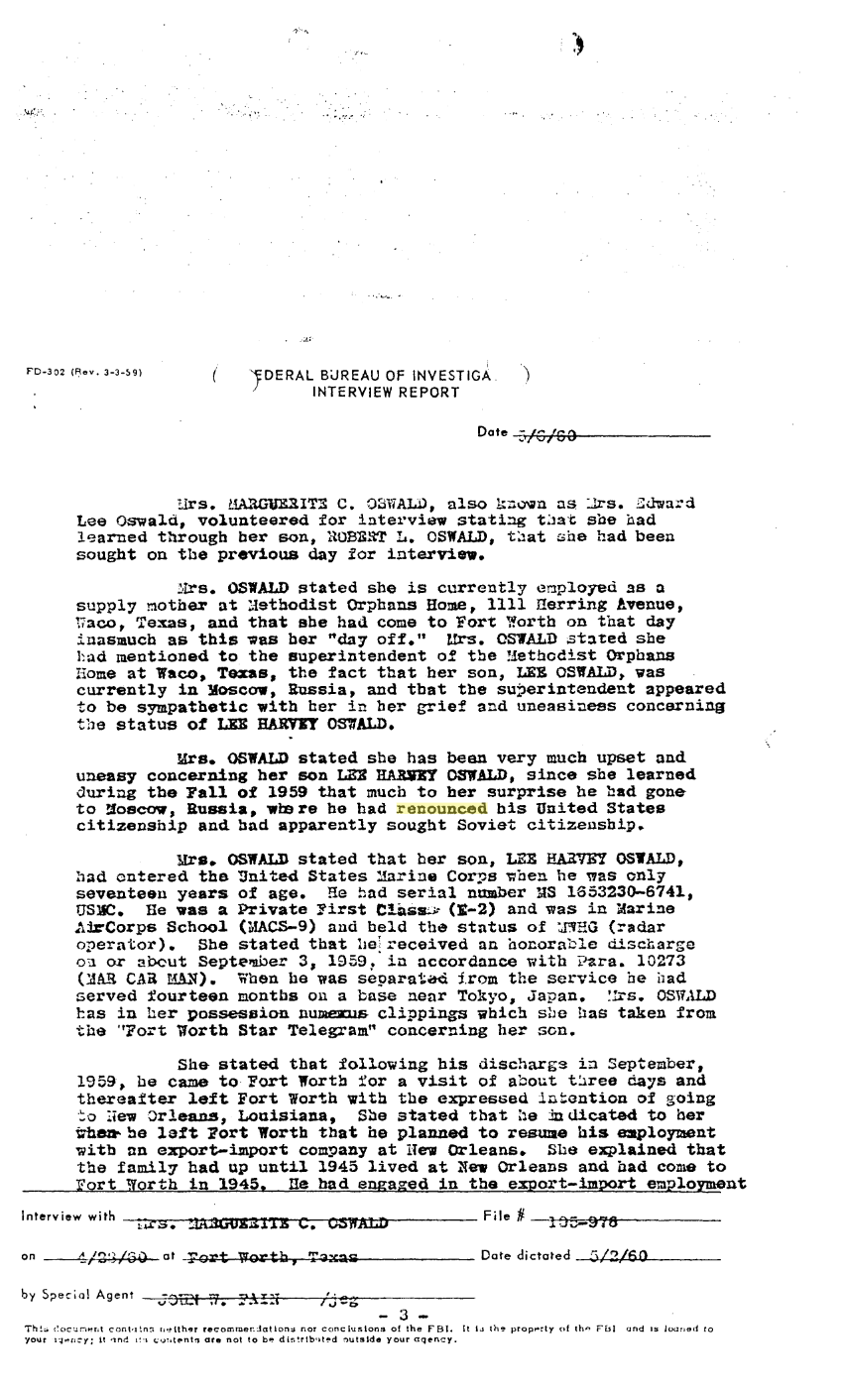

Slide 27
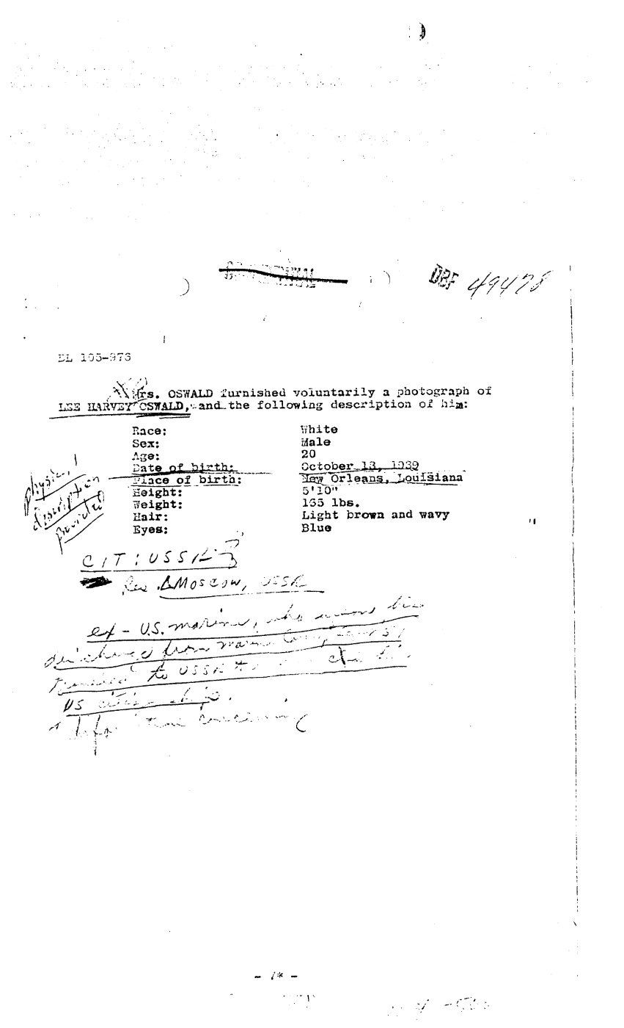

Slide 28
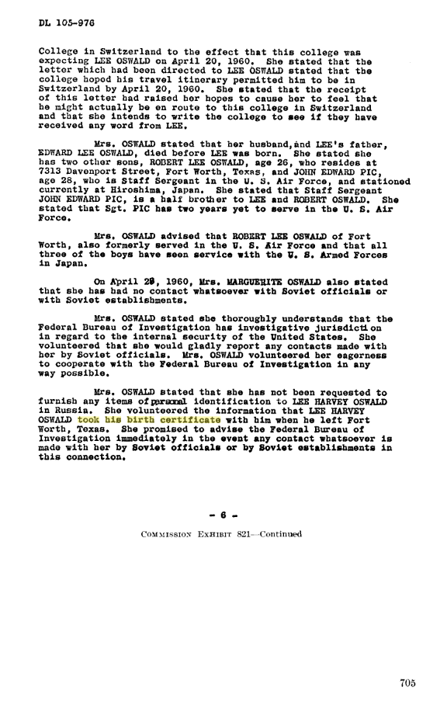

Slide 29
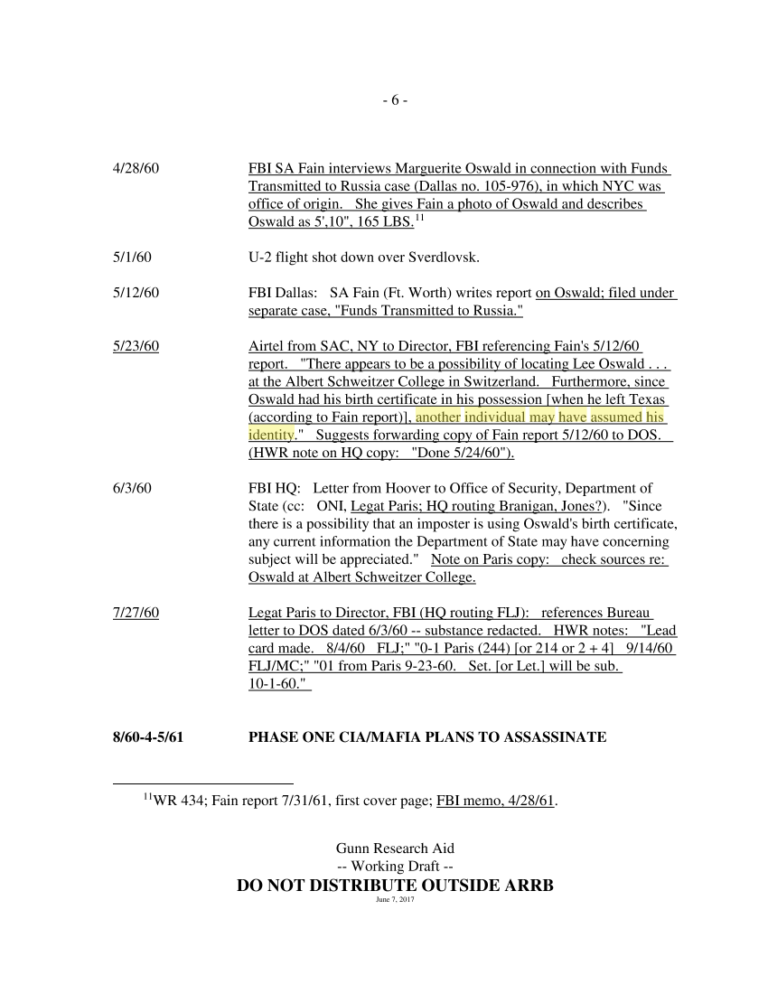

Slide 30
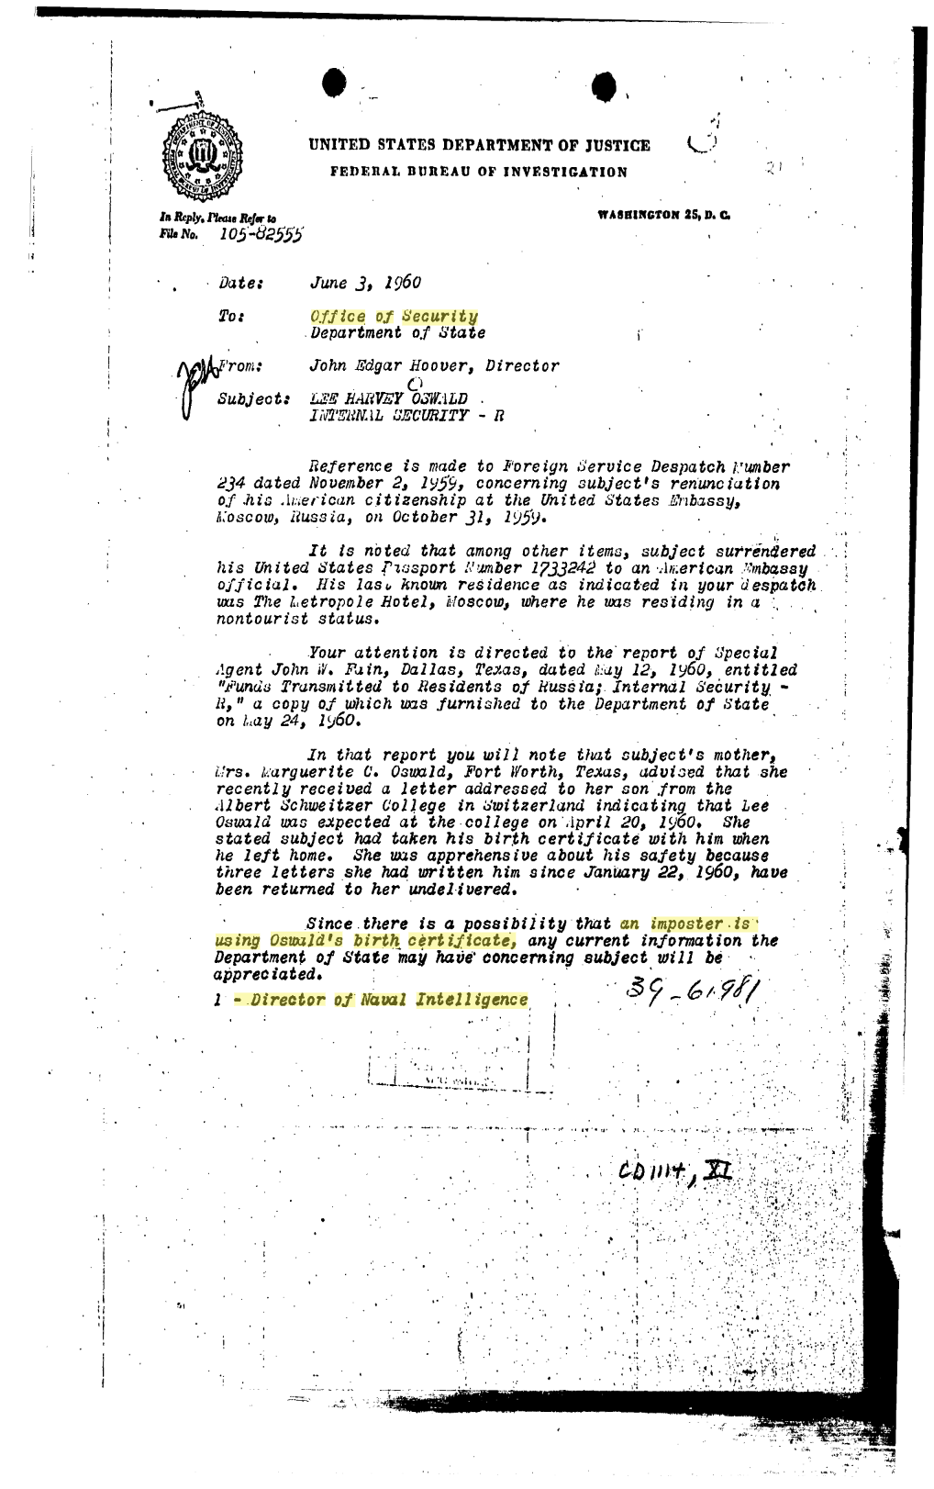

Slide 31
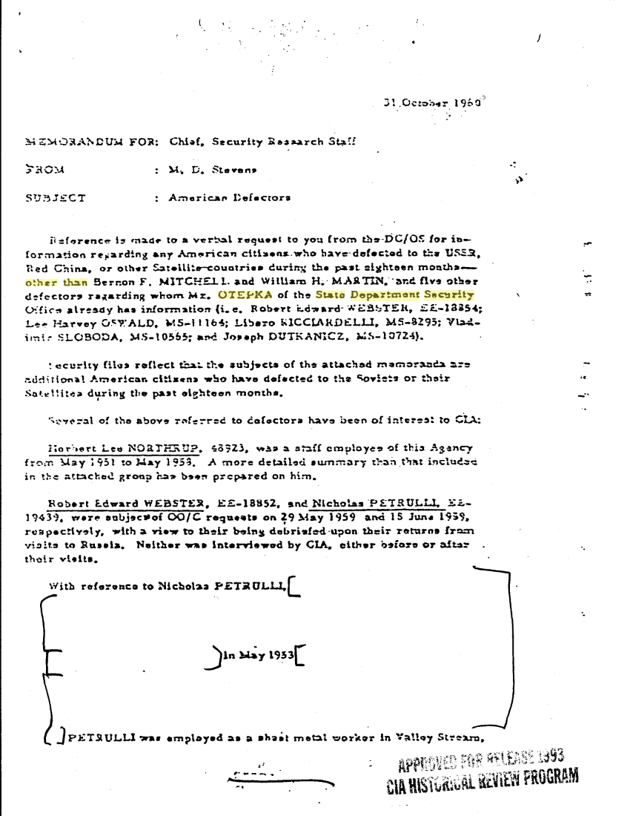

Slide 32
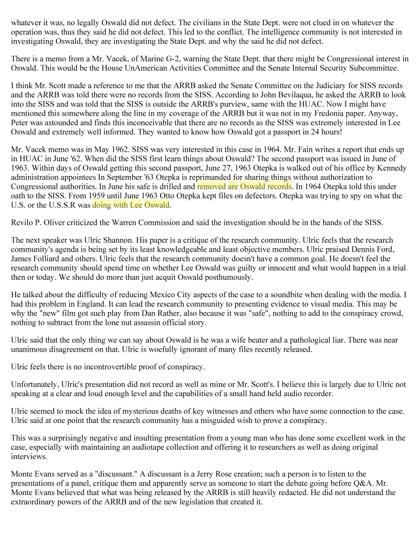

Slide 33
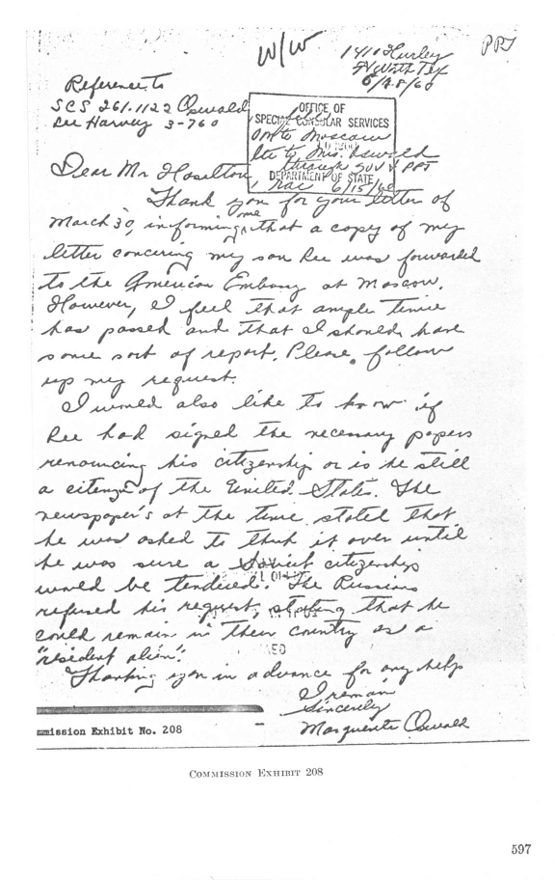

Slide 35
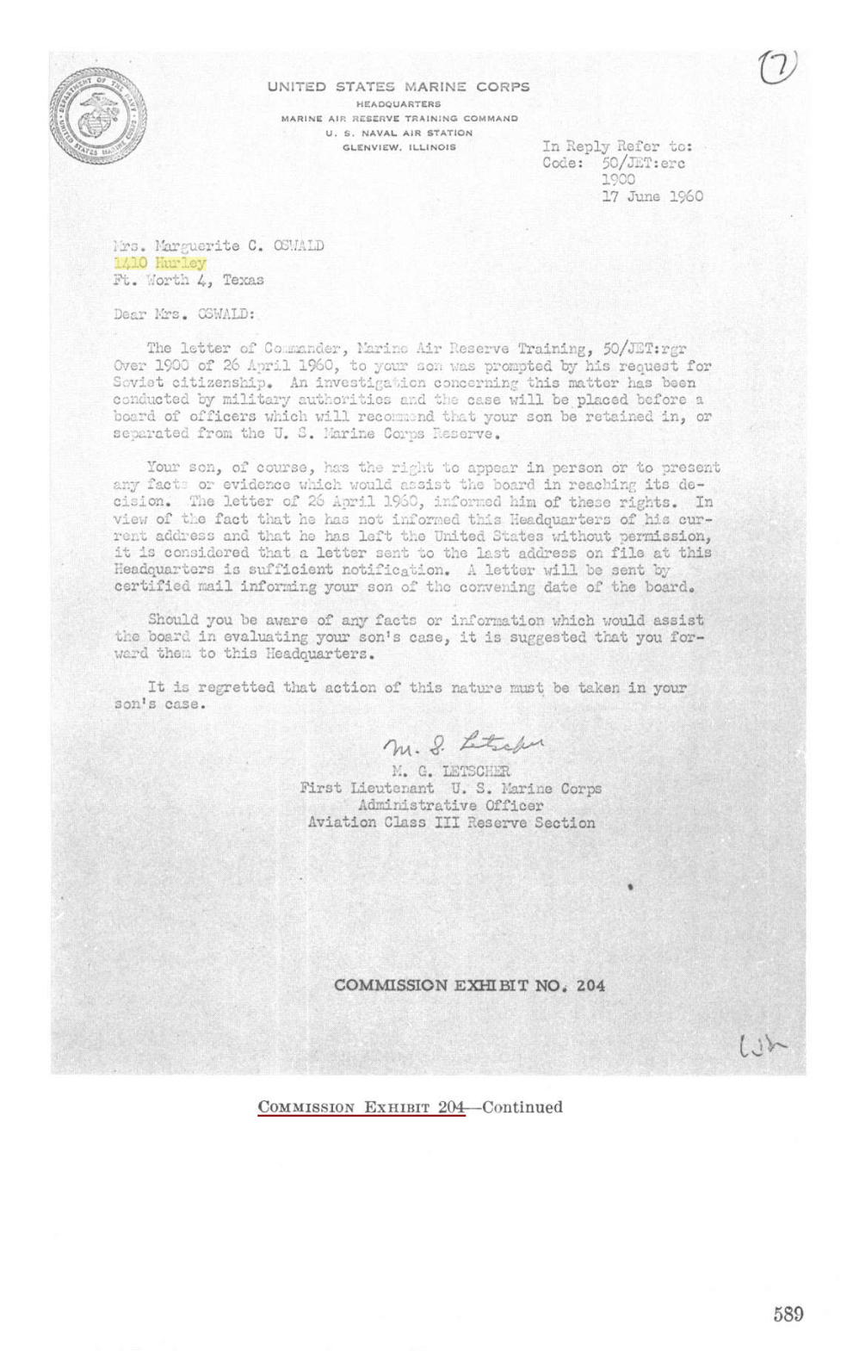

Slide 36
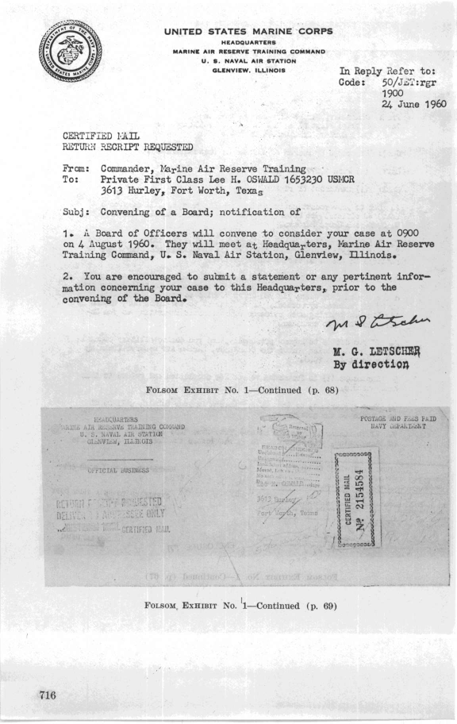

Slide 37
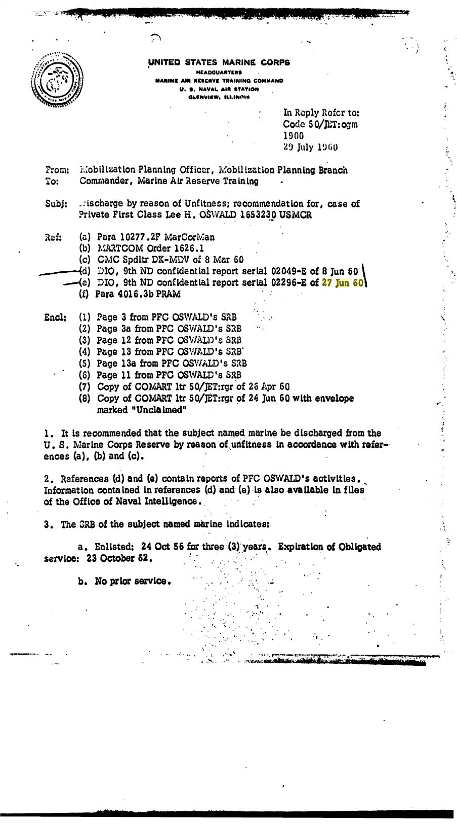

Slide 38
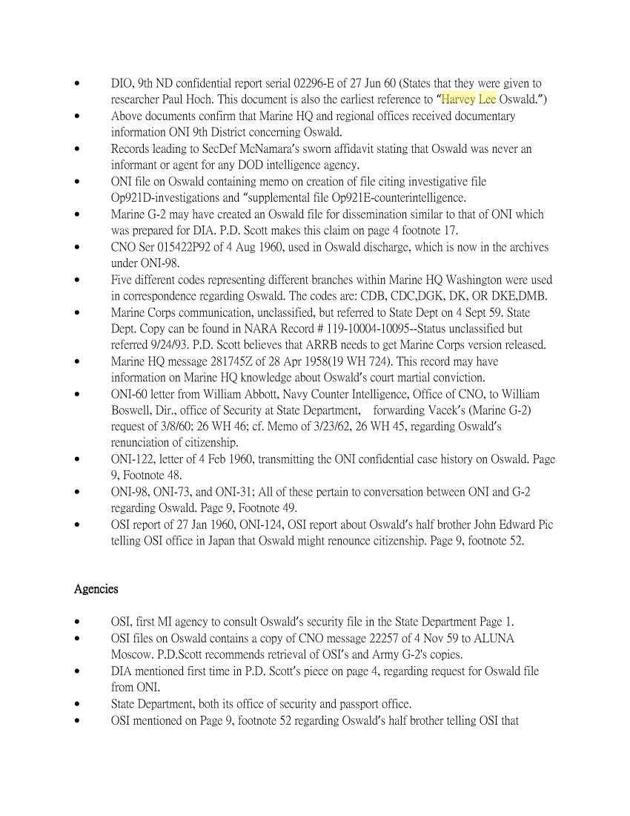

Slide 40
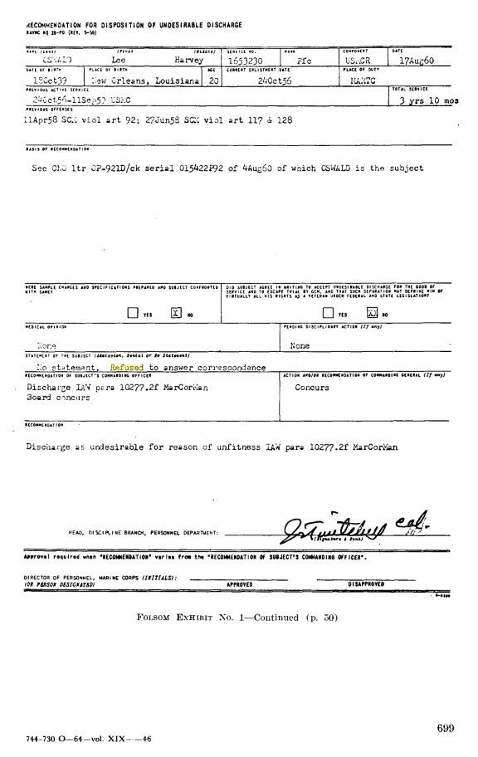

Slide 41
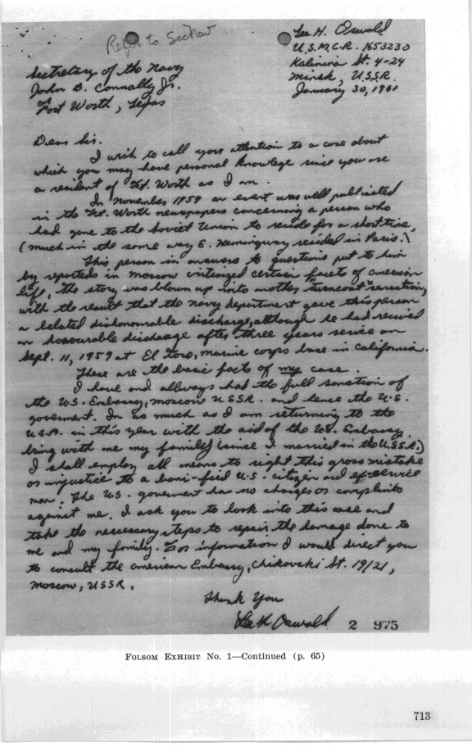

Slide 42
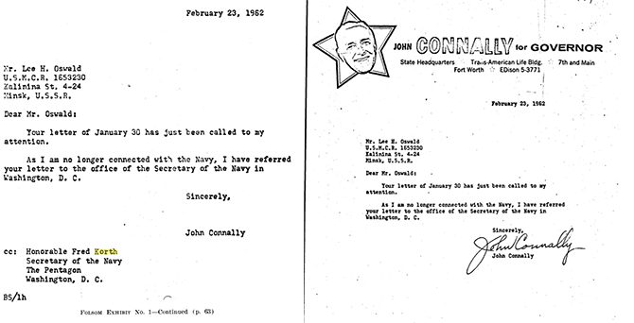

Slide 43
In Oswald's case, my conclusions were that his complaint had no legal basis, his request was without merit, and that Connally should not involve himself in any way. I recommended that he refer the letter to the commandant of the Marine Corps for "appropriate action."
This phrase meant, in clear officialese, that the secretary was washing his hands of the case. The commandant could do with it as he wished. No one could doubt that the result would be. It was a kiss-off.

Slide 44
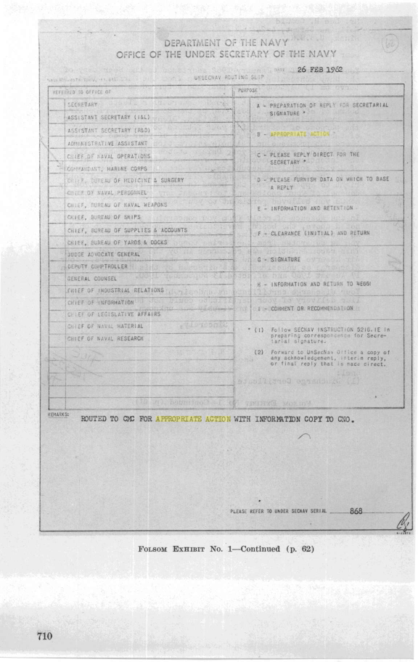

Slide 45
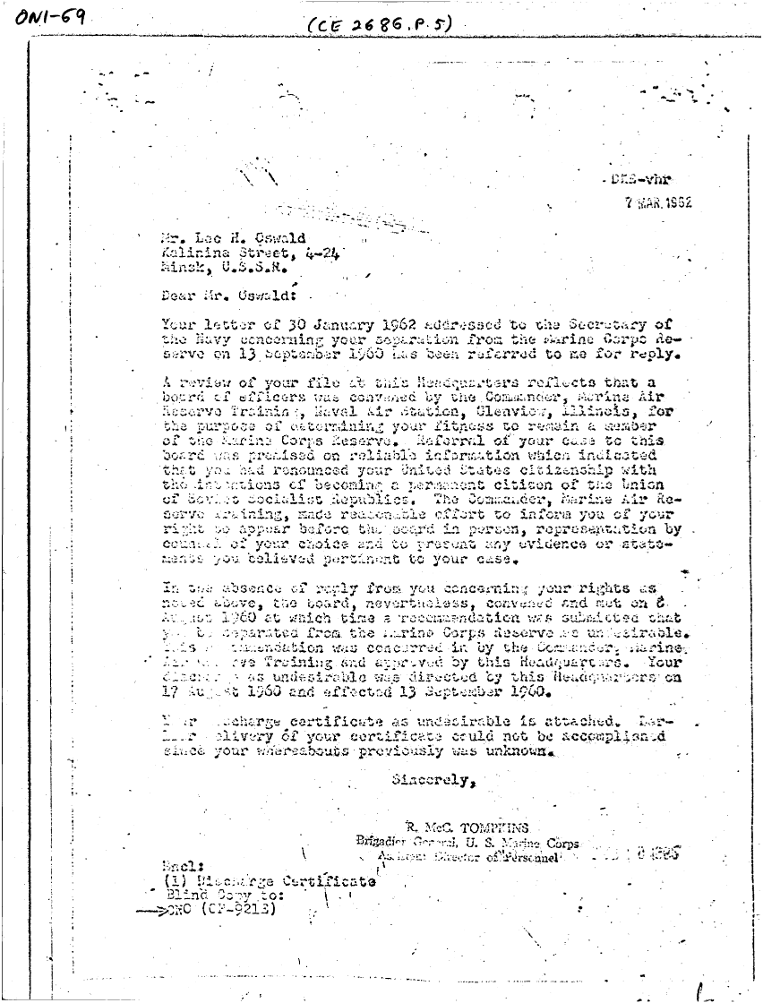

Slide 46
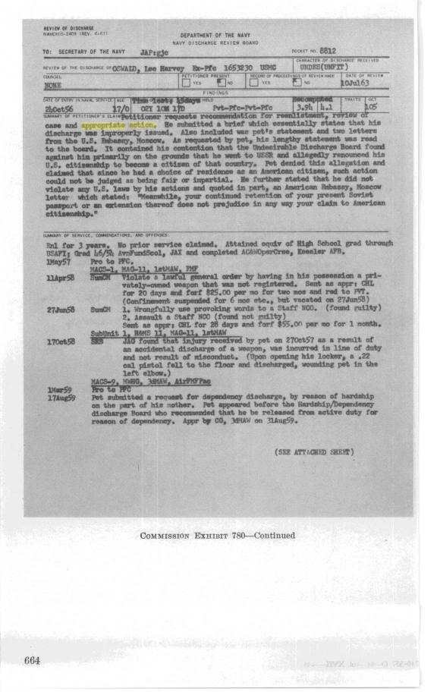

Slide 47
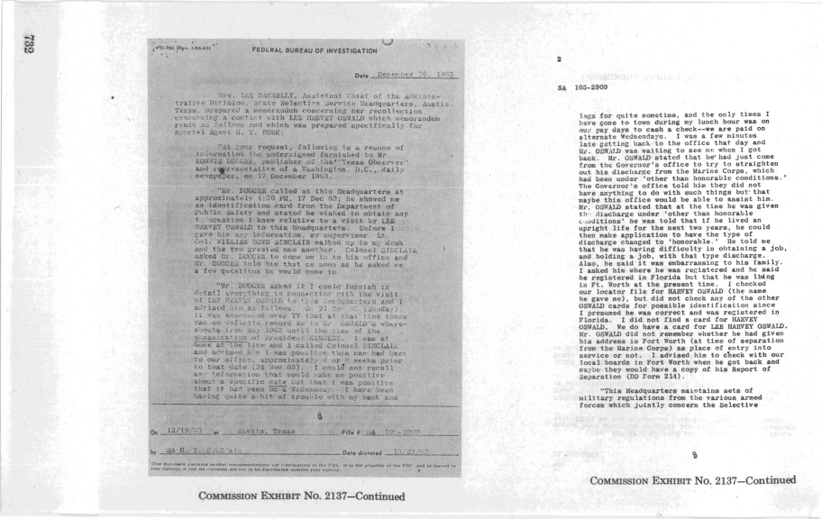

Slide 48
11/10/63 - Ruth saw “under the fold” of the letter
“The FBI is Not Now Interested in My Activities”
11/15/63 – FBI secretary saw “unsealed” letter
“I will blow up the FBI and the Dallas Police Dept”
11/15/63 - Jim Hosty saw the letter
“I will take appropriate action.”
11/15/63 - Jim Hosty’s supervisor saw the letter
“Some kind of threat was made.”
Marguerite & Ruth wanted to talk to the FBI – was it about Espionage?

Slide 49
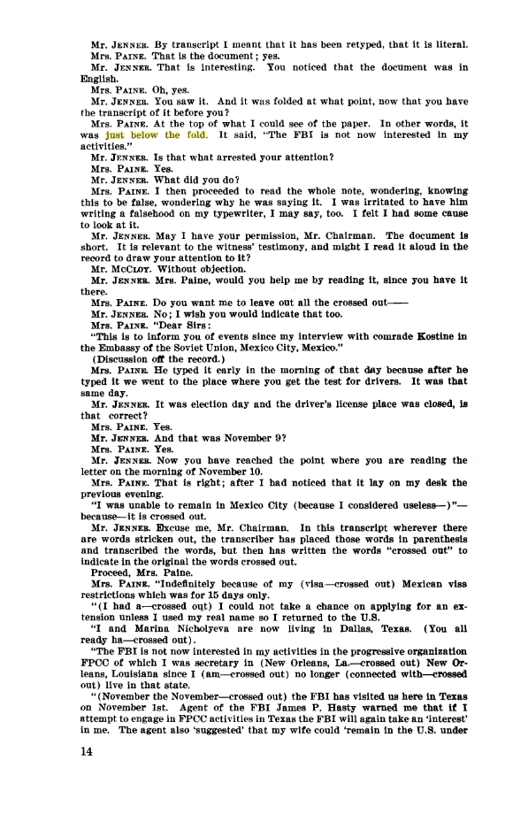

Slide 50
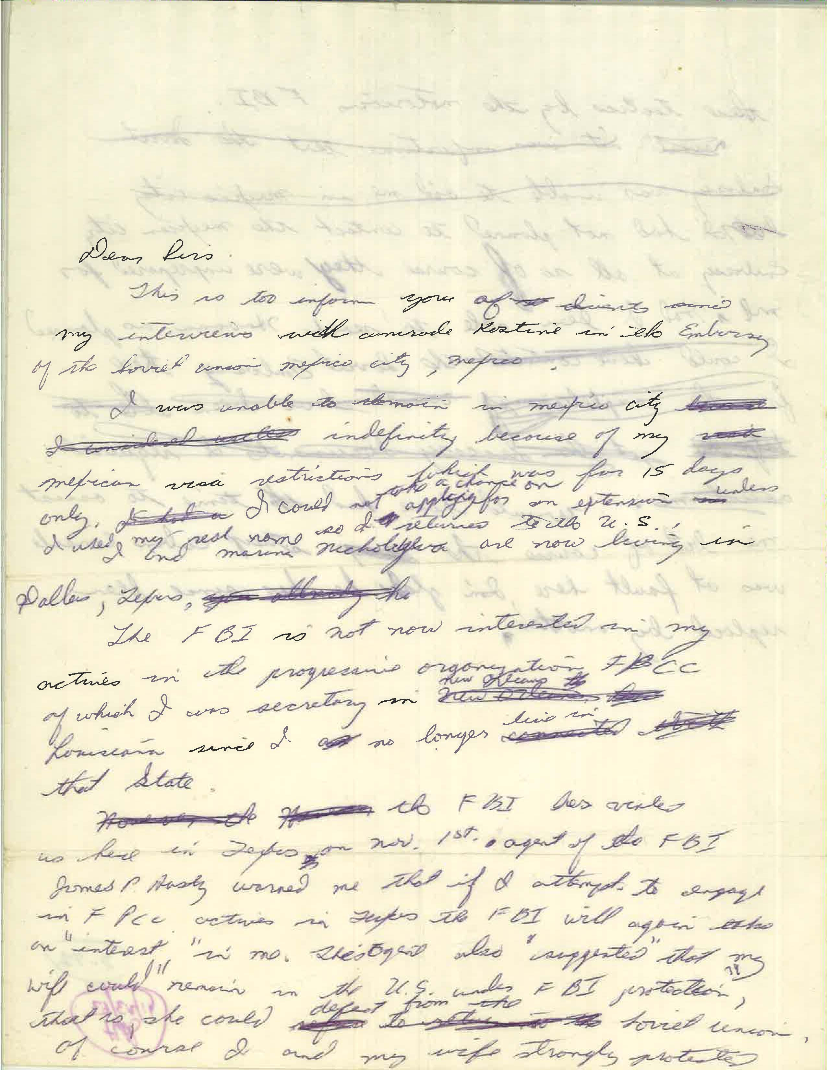

Slide 51
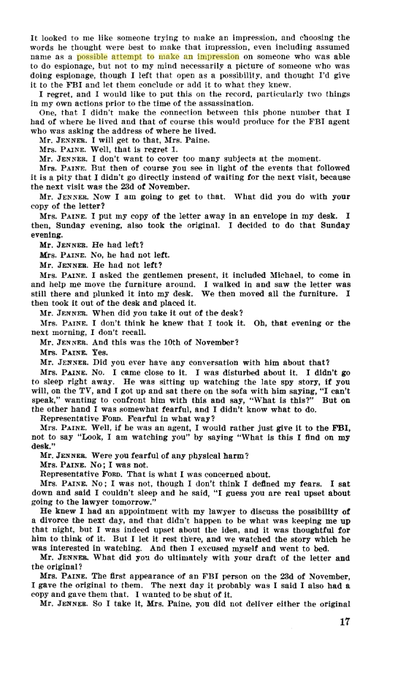

Slide 52
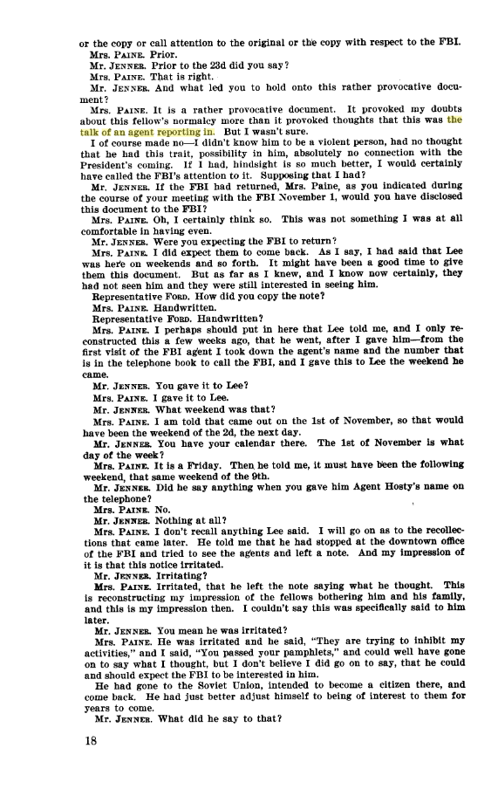

Slide 53
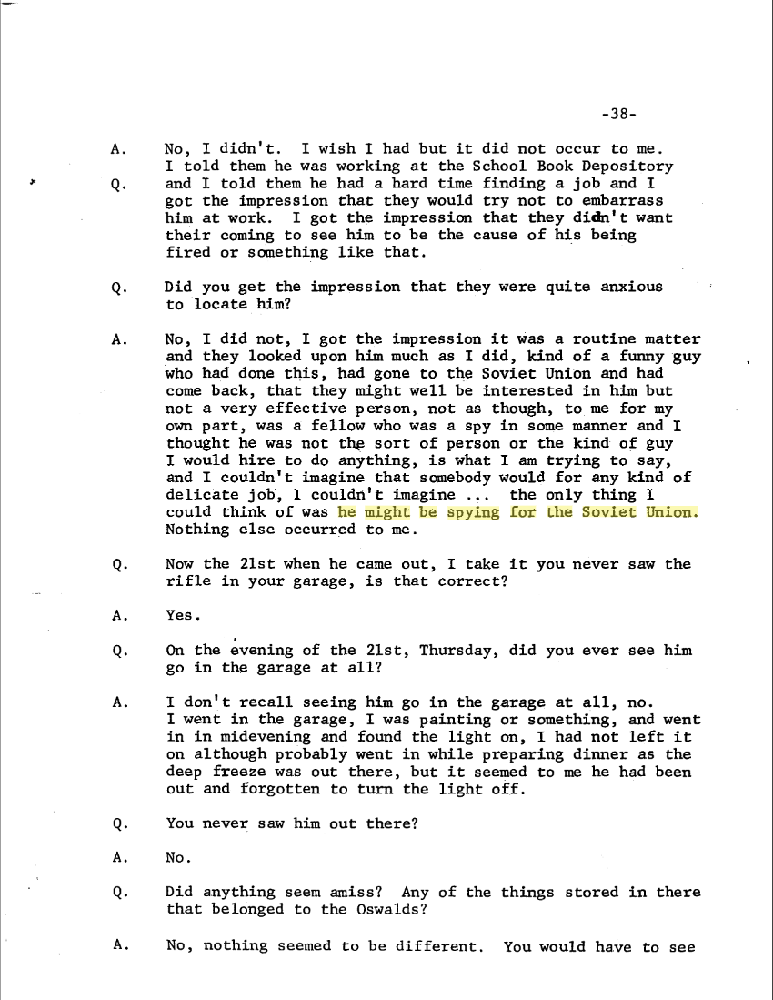

Slide 54
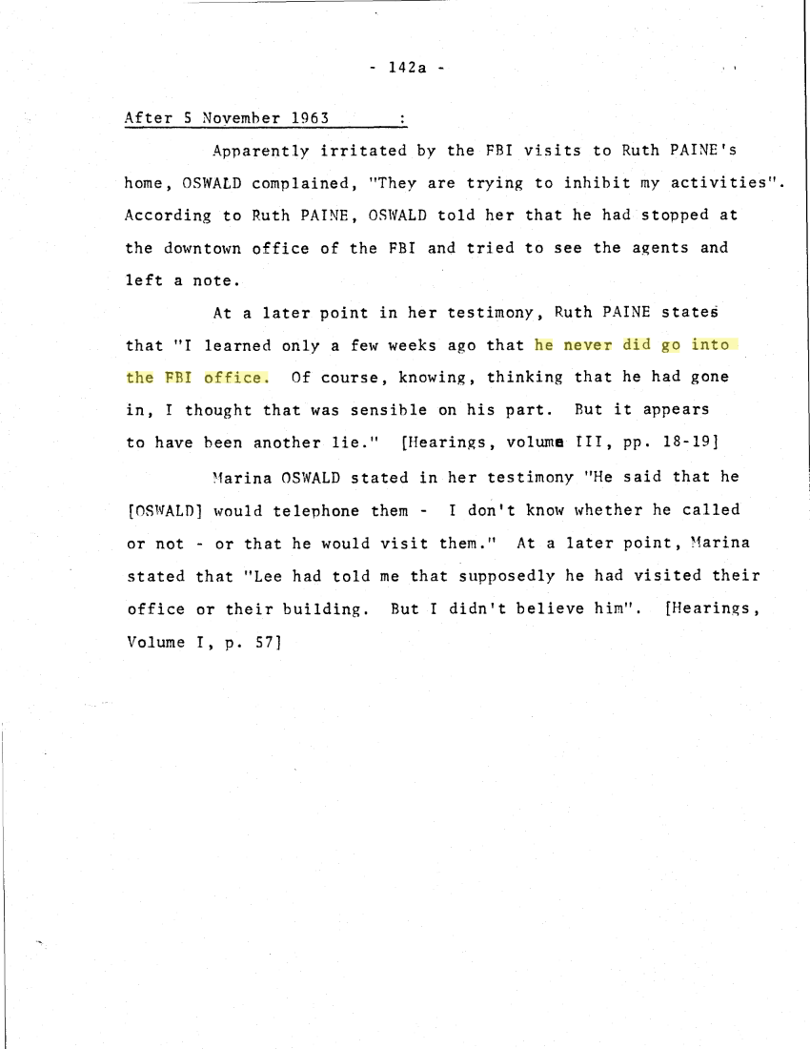

Slide 55
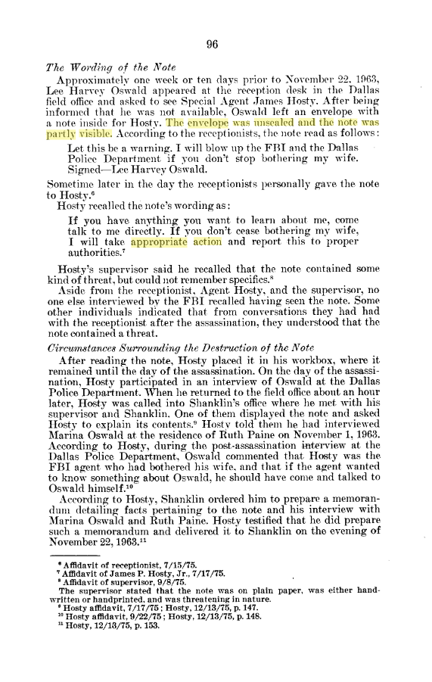

Slide 56
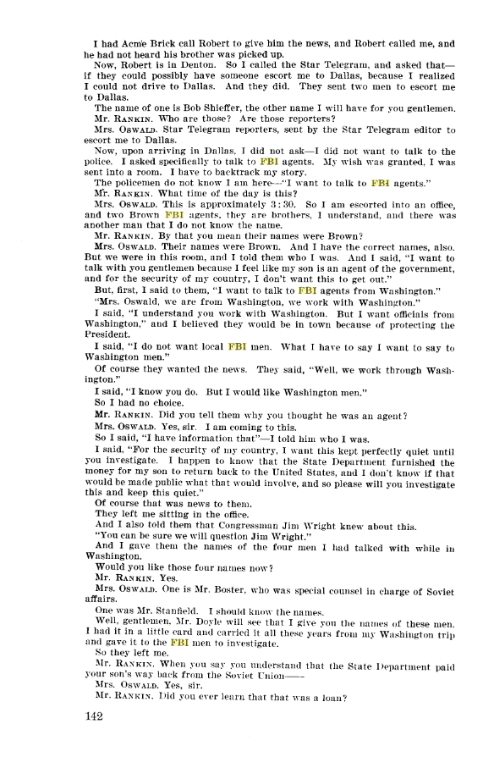

Slide 57
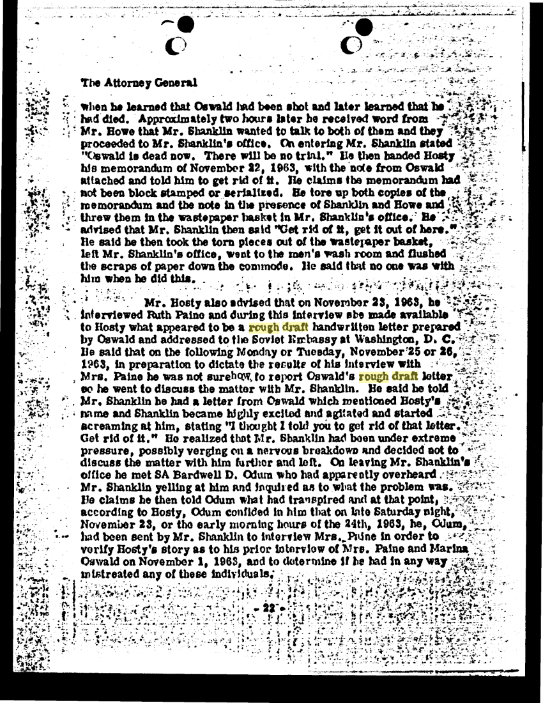

Slide 58
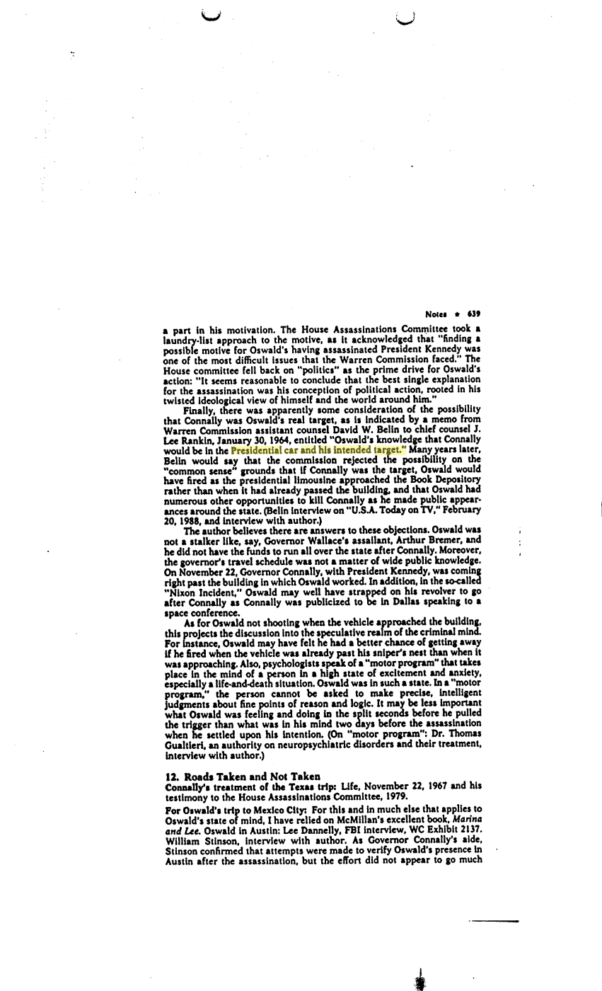

Slide 59
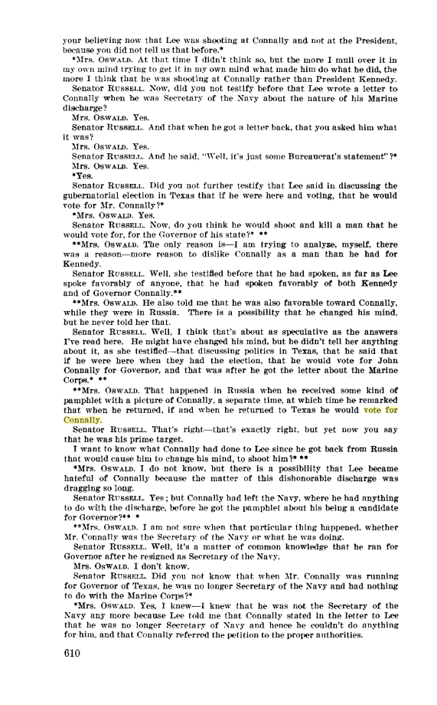

Slide 60
Did he think Lee Harvey Oswald fired the gun that killed Kennedy?
"Absolutely not," Connally said. "I do not, for one second, believe the conclusions of the Warren Commission." So why not speak out? "Because I love this country and we needed closure at the time. I will never speak out publicly about what I believe."

