Slide 1
A Counter-Narrative to the Warren Report:
Westbrook, the Wallets, and the Exoneration of Oswald

Slide 2
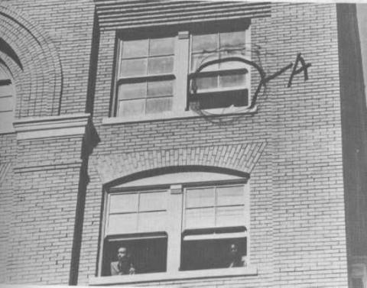

Slide 3
A 5 FOOT 10/165 SUSPECT, WITH 30-30 OR WINCHESTER
12:44 pm – unidentified citizen offers 5/10, 165 description
No description of clothing, generally most important
Only visible from the waist - no way to tell his height!
5 foot 10, 165 description in CIA/FBI file records since 1960
No comment re similarity of report with CIA/FBI file records.
FBI: No leads on who provided 5 foot 10, 165 description
The person who provided this lead was not Howard Brennan
"Carrying 30-30, or some kind of Winchester rifle“
1:07 pm, Shanklin tells Hoover JFK shot with a Winchester

Slide 4
WESTBROOK, THE WALLET, & THE HIDELL ID
After description called in, Tippit's partner Murray Jackson calls him into Oak Cliff
Tippit makes a number of frantic stops in next 20 minutes
Tippit's father says Tippit was looking for Oswald
Two witnesses saw Oswald at theater before Tippit killed
Unidentified man tells Jerry Hill 5 foot 10, 160-170 pounds, wearing jacket
Unidentified man at Tippit crime scene gives wallet to officer Kenneth Croy
No one sees the wallet on the ground - we only see it in Westbrook's hands

Slide 5
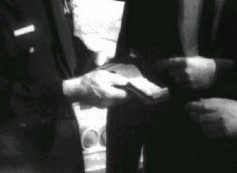
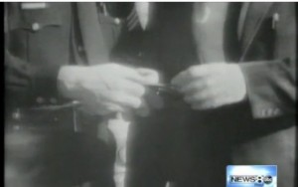
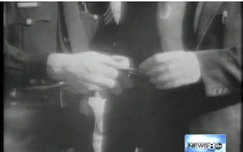

Slide 6
BACKGROUND ON PINKY WESTBROOK
Westbrook was ranking officer at Tippit crime scene and Texas Theatre
His junior Jerry Hill was at sixth floor, Tippit crime scene and Texas Theatre
Westbrook did not wear a uniform - had no crime investigation experience
Westbrook was captain of personnel, had access to everyone's files
Westbrook conducted all background investigations of applicants
May have been CIA-affiliated - he was the "Ann Egerter of the Dallas police"

Slide 7
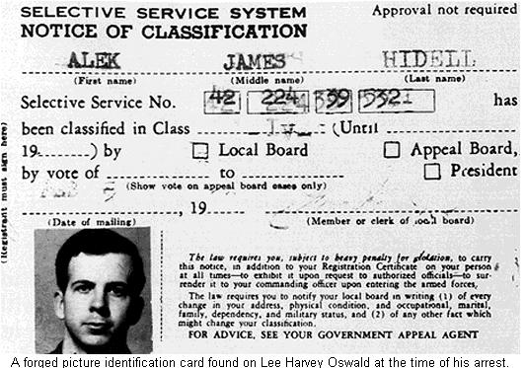

Slide 8
WESTBROOK AT THE TIPPIT CRIME SCENE AND THE THEATER
Video of Westbrook holding the wallet at Tippit crime scene
Westbrook asks Barrett if he's heard of Oswald, and then asks about Hidell
The Hidell alias is the first-day evidence that linked Oswald to the rifle and the pistol
Westbrook and Barrett go to theater, and enter together
They are directed towards Oswald by Johnny Brewer
After Oswald is apprehended, Westbrook orders a list of patrons - which disappears!
Oswald admits the ID belongs to him, but nothing more

Slide 9
BENTLEY/WALLET/HIDELL ID
Nothing on Hidell ID in DPD reports
Bentley sprained ankle in the theater
Bentley saw Hidell ID in police car
Zero about Hidell ID on police tape
1st Report: 112th MIG, 3:15 pm
Hoover: Get full info on this card

Slide 10
HIDELL ID LINKS RIFLE AND PISTOL
11/23 AM: FBI discovered “Hidell” had mail-ordered the Carcano rifle/later, the pistol as well
Rifle and pistol had been delivered to Oswald’s post office box address back in March.
Inspector Harry Holmes admitted anyone could pick up the rifle or pistol without showing ID
11/23 PM: The DA then announced the discovery of the Hidell card
That week: The Hidell/Oswald card was published in the weekly magazines

Slide 11
The Tippit Crime Scene Wallet and Oswald's Arrest Wallet
It looks like there were two wallets, made by same manufacturer
The crime scene wallet is similar to Oswald's arrest wallet at Archives
Circular snaps, metal strips, and a zipper over main compartment
One appears to have square corners and a metal band running from edge to edge.
The other has rounded corners and a metal band that does not run from edge to edge.

Slide 12
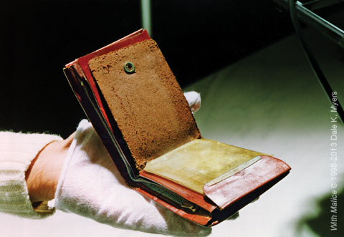

Slide 13
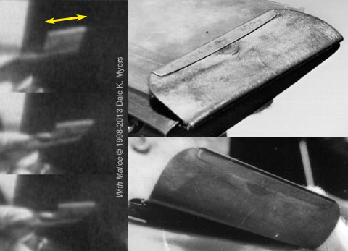

Slide 14
On Oswald’s pistol and the rifle
"I can assure you, no one sniffed the pistol in Oswald's possession"
Such a test would have proven the pistol wasn't fired
Similarly, no one sniffed the rifle
According to FBI's Frazier, barrel of rifle was also corroded with rust
Appears it hadn't been recently fired

Slide 15
The hulls in the pistol
Several cartridge hulls found at Tippit crime scene
Leavelle admitted hulls never marked on the scene by Dallas officer Poe.
Poe has admitted memory problems, now refuses to talk about it.
The HSCA relied solely on hulls to make its case that Oswald shot Tippit
Failure to mark the hulls nullify that homicide case against Oswald.

Slide 16
TWO HULLS AND ONE LIVE ROUND
Four shots would indicate more than one shooter.
The ideal was a one shooter case, focusing on the shooter in custody.
How to show that three shots emanated from the sixth floor window?
The evidence photos do not show "three cartridge cases" on the sixth floor –
They show two hulls and one live round.
The Dallas police inventory lists “two spent 6.5 hulls” and “one live round”.
The FBI report of the photographing of this evidence states the same
This FBI report was unreleased until many months after the Warren Report.

Slide 17
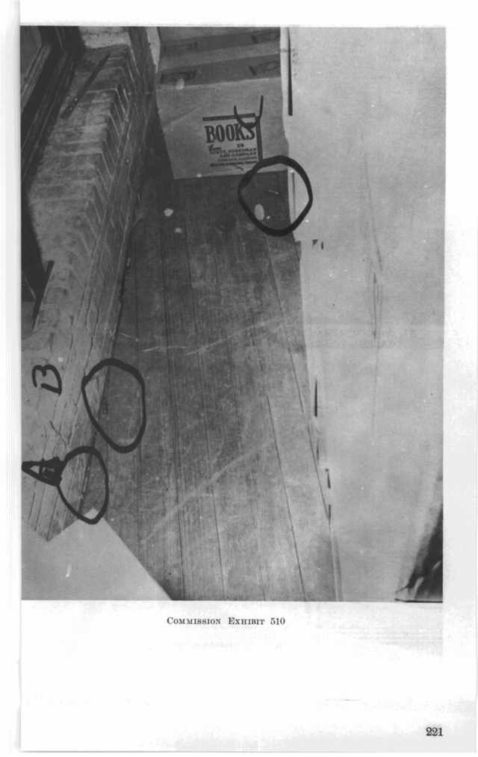

Slide 18
Hedging their bets at the sixth floor
Was official story going to be “two shots” or “three shots”?
Leave room for the story to change if needed.
Homicide chief Will Fritz said he kept one of the hulls
Needed it for comparison checks to determine where bullets obtained
Live round found at the scene was the best way to conduct a comparison.
Audacious to list these photos as “three cartridge cases” and “three shells”

Slide 19
The pointed “single bullet” became round
The “single bullet” was found on stretcher by Darrell Tomlinson
Tomlinson gave it to personnel officer O. P. Wright
Secret Service Richard Johansen was given custody of single bullet. His initials not on it, in violation of regulations
Johansen turned custody over to Chief James Rowley - Rowley's initials not on it!
None of the four men recognized the round, 6.5 mm bullet, known as CE 399
Wright, who knew ammo, said it was pointed, looked like a 30-30

Slide 20
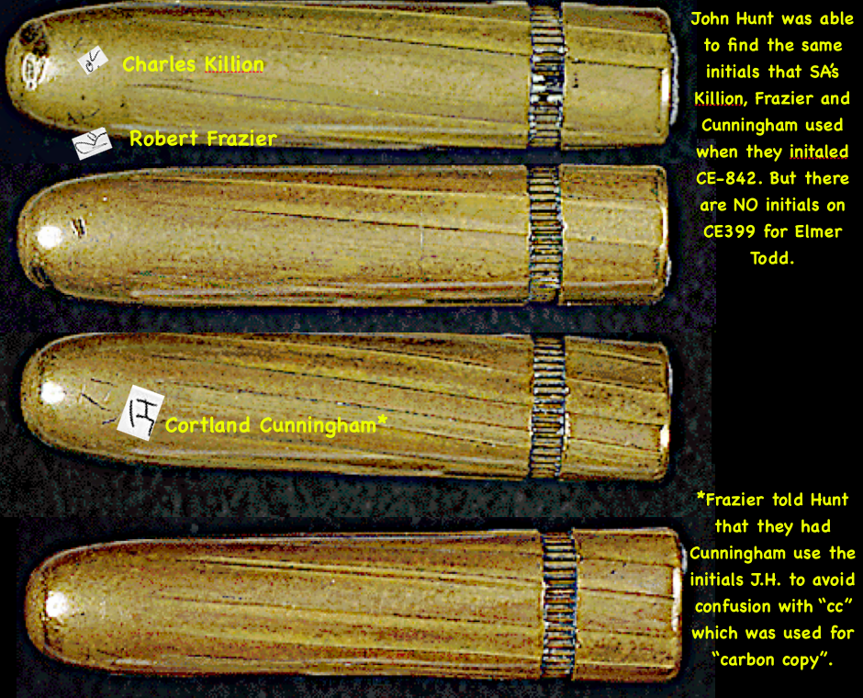

Slide 21
What happened to the chain of custody?
Chief Rowley passed it to FBI agent Elmer Todd, who insists he initialed it before lab delivery
His initials are not on it either - only the initials of three men at lab
The original pointed 30-30 bullet was replaced with what we see today
Effort to align evidence with report of a "30-30 or some kind of Winchester"?
A report surfaced in 1967 saying Wright and Tomlinson recognized bullet
In 2002, author Bard Odum was interviewed - he denied writing the report!

Slide 22
Firearms, wallet, and ID evidence: Untrustworthy
The 5'10"/165 description was in intelligence files/A 30-30/Winchester meant a pointed bullet
A pointed bullet was reported/bullet in evidence is round - with no initials
A wallet was left at the Tippit crime scene - and covered up - similar to the arrest wallet
The Hidell/Oswald card linked Oswald to the Carcano rifle and the pistol
No one ever admitted to sniffing the rifle or the pistol – first thing you would do
No chain of custody for hulls from the pistol/two hulls – not three – found on sixth floor
Westbrook and Bentley should be treated as suspects

