Slide 1
Millennials, Innovation & Technology
With Dr. Catherine Sy Luib
FPACC Vice President of Digital Technology

Slide 2
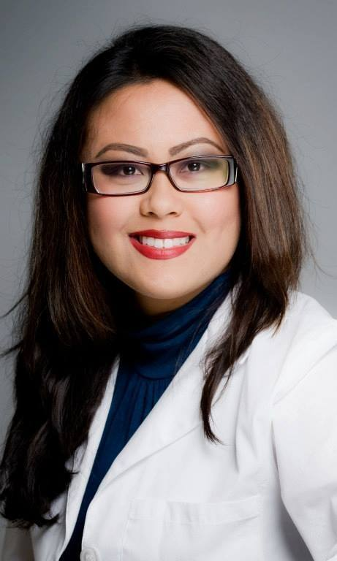

“Millennials, Innovation & Technology”
Workshop Moderator
Luib Health Center
Dr. Catherine Sy Luib
D.C., L.Ac., M.A.O.M., B.Sc. (Kin), CCH, CNLP
Author | Speaker | Philanthropist

Slide 3
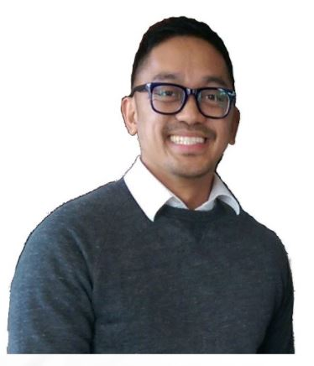

“Millennials, Innovation & Technology”
Workshop Panel Speaker
Young Business United
Ryyn Schumacher
MBA

Slide 4
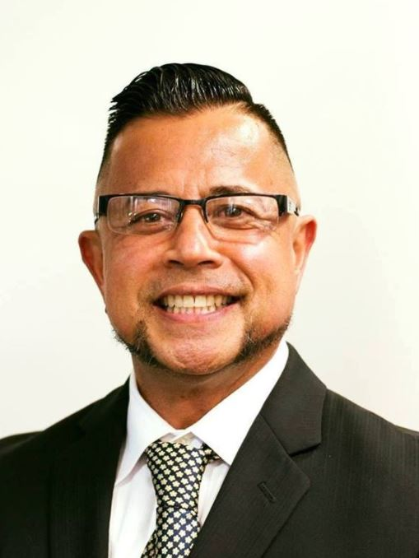

“Millennials, Innovation & Technology”
Workshop Panel Speaker
The Kaizen Group
William Peetoom
RCFE
Digital Marketing Strategist | Home Healthcare Champion | Connector

Slide 5
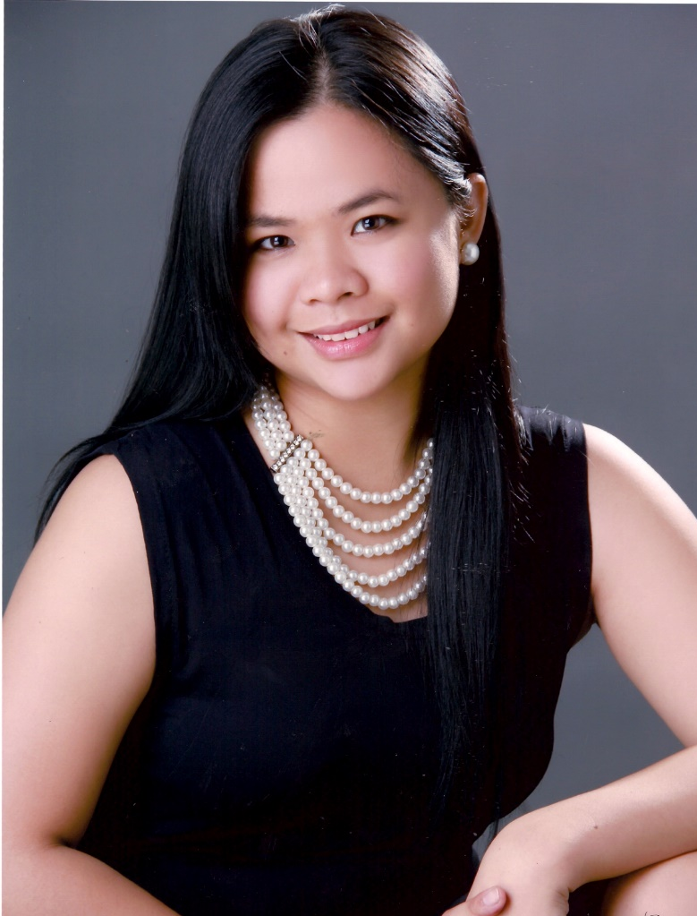



“Millennials, Innovation & Technology”
Workshop Panel Speaker
Ishka Villacisneros-Tusjakova
Internet Visionary | Entrepreneur | Mom

Slide 6
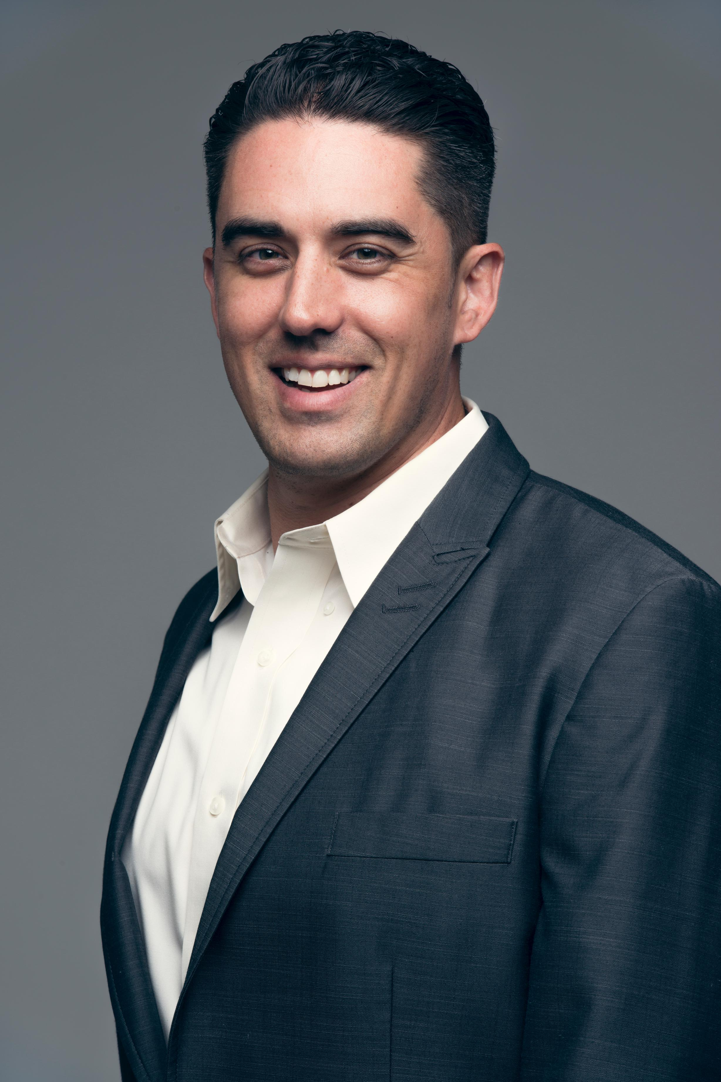




“Millennials, Innovation & Technology”
Workshop Panel Speaker
Innovative Urban Solutions
Ryan D. Winkle

Slide 7
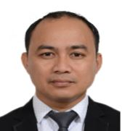

“Millennials, Innovation & Technology”
Workshop Panel Speaker
Sweet Heaven Enterprise
Kelvin Parreño
Founder | President | Competitive Entrepreneur

Slide 8
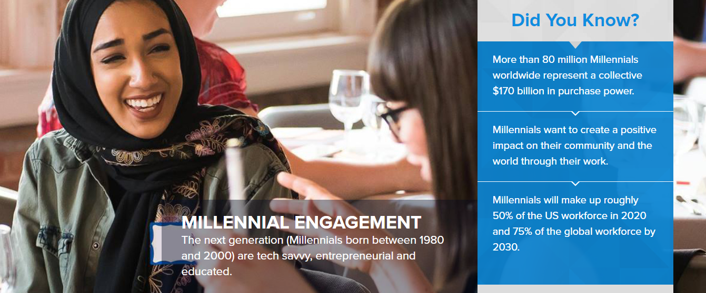

Slide 9
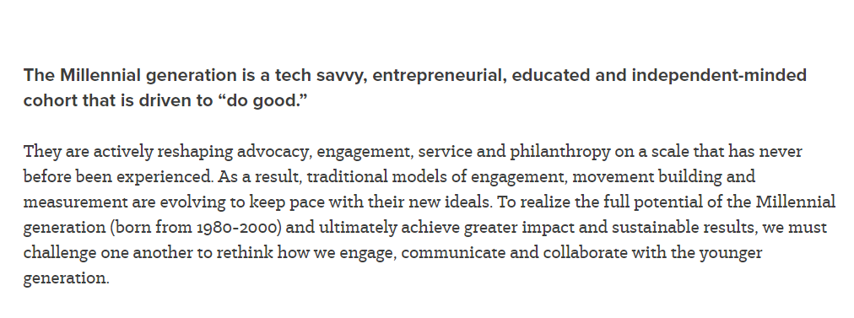

Slide 10
What are millennials seeking when buying & doing business?

Slide 11
What are effective technologies, apps, platforms, softwares to market/communicate business to millennials?

Slide 12
What are some tips for small business owners/entrepreneurs in forming strategic business partnerships with this demographic?

Slide 13

Q & A

Slide 14
Ryyn Schumacher
MBA
Young Business United
www.ybuhub.com
747-477-5022
Sign Up on our landing page for upcoming promotions

Slide 15

William Peetoom
RCFE
The Kaizen Group
www.thekaizengroup.us
858-333-6893
Sign Up on our landing page for upcoming promotions

Slide 16
Ishka Villacisneros-Tusjakova
Internet Visionary | Entrepreneur | Mom
Ishkaster Media
  (626) 808-4778 ext 101 | www.ishkaster.com
Californila
  (626) 272-9404 | www.californila.com
Pinoy Town Hall
  (855) PINOYTH | www.pinoytownhall.com
Enter ISHKAV in any of our websites' coupon box and get a FREE Consultation or a Special Discount!

Slide 17
Ryan Winkle
Innovative Urban Solutions
Ryan.d.winkle@gmail.com
Ryanwinkle.com
6027416465

Slide 18
Kelvin Parreño
Sweet Heaven Enterprises
Sweetheaven_enterprise@yahoo.com
www.Facebook.com/KYensSukaNatural
+63 933-501-1532
Contact me for Sales of Organic Coconut Sugar, Syrup, Cyder, Amino Sauce and Customized Coconut Products

Slide 19

Dr. Catherine Sy Luib
D.C., L.Ac., M.A.O.M., B.Sc. (Kin), CCH, CNLP
Luib Health Center
DrCat@LuibHealthCenter.com
www.LuibhealthCenter.com
Follow us on Facebook & Instagram
760-683-8738
Special Offer
FREE PDF RECIPES for Brain & Body Performance Enhancement
FREE CONSULTATION for Brain & Body Performance Enhancement

