Slide 1


Procurement/Consolidation: THE CHALLENGE OF INCLUSIVENESS
Koronadal, South Cotabato
November 14, 2016
Rene T. Pamintuan

Slide 2

Consolidator
An Individual/Company that sees and feels the market, creates value added product innovation, logistics arrangement benefiting and connecting the Market, and allows efficient Procurement and Supply arrangements to Manufacturing and Consumers.

Slide 3

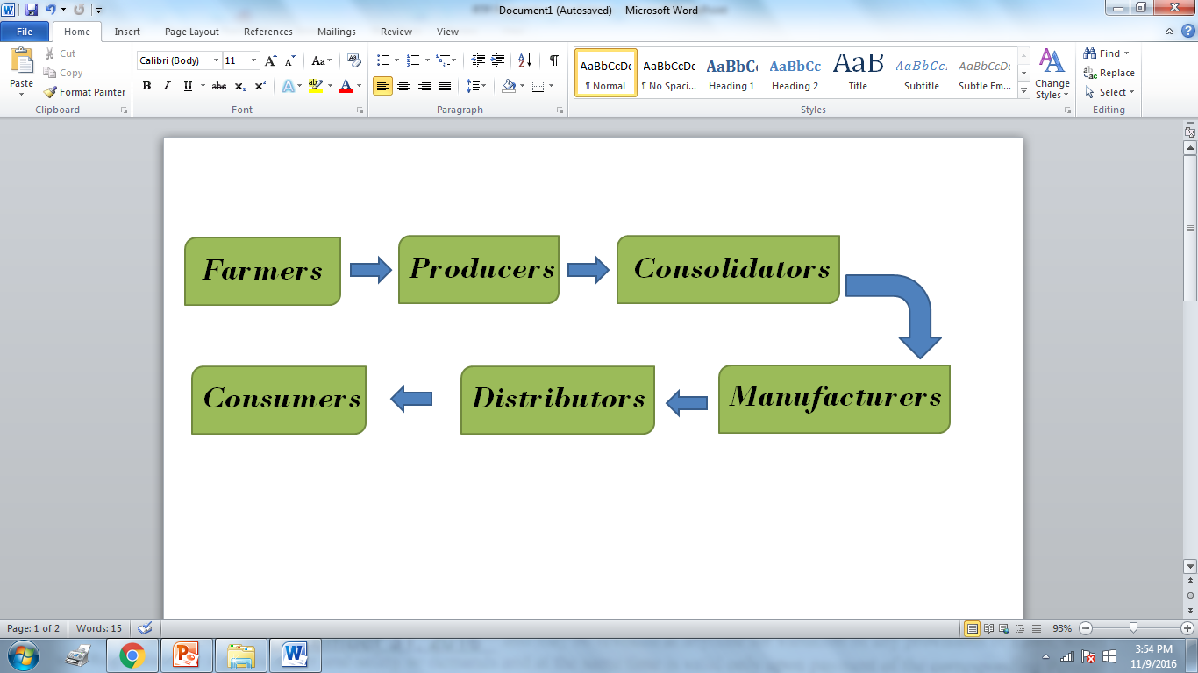
Present Marketing System

Slide 4

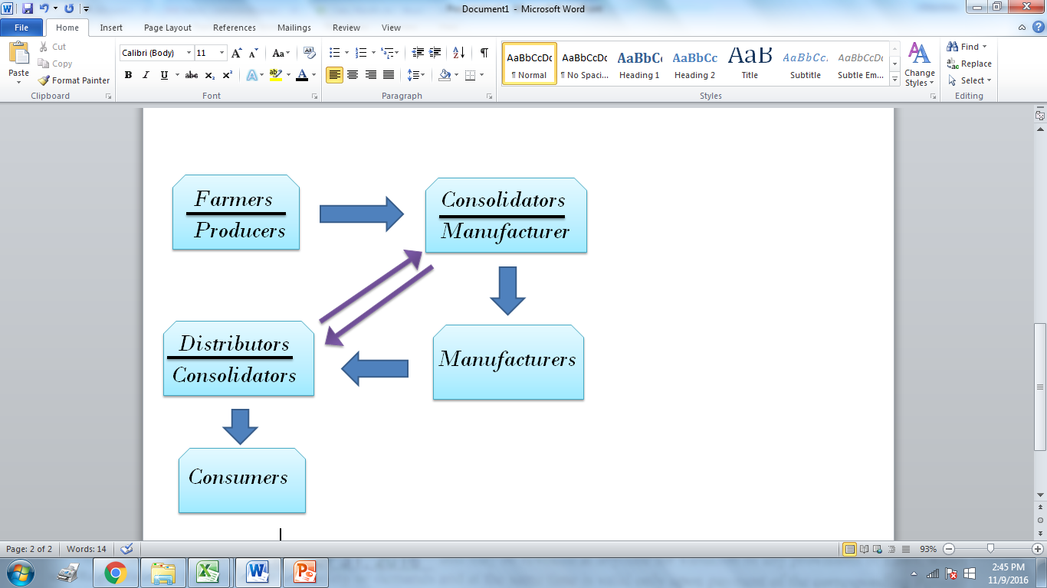
Proposed Arrangement

Slide 5
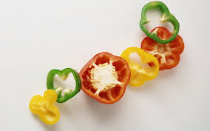
Usual/Institutional Farmer`s Problems
Perishability / Storage
Lack of Technology
Packaging Capability
Logistics Shortcomings
Need for Quick Cash
Lack actual access to markets
Capital/Financial loses

Slide 6

Production System
Value Added
Inclusiveness

Slide 7

Farmers must become VALUE ADDERS
Storage/Production/ Simple Manufacturing should be at FARMER`S LEVEL
Consolidator and Farmers should be helping each other.
  Storage
  Marketing and sales
  Sharing of Value-added/profits

Slide 8

Market Development
    Producers/Farmers
    at value added set up.
    Buyers ( Local, Metro Manila, Cebu and Foreign).
    Logistics arrangements, including storage facility value added factory at farmers level, trucking and freight.
    Capital and Financing.

Slide 9


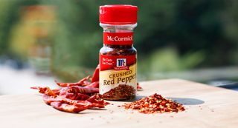
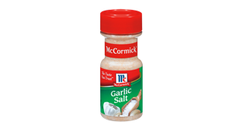
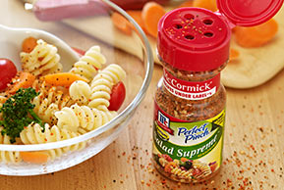
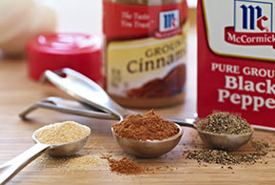
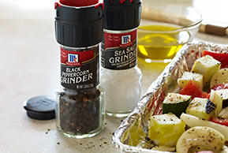
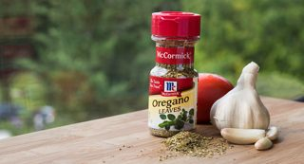

Slide 10
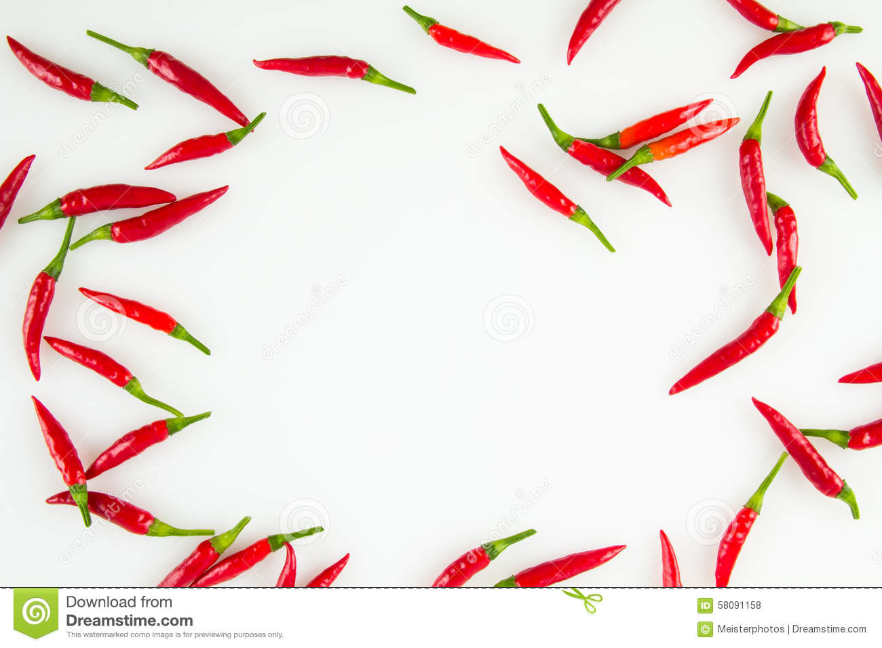
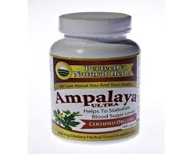
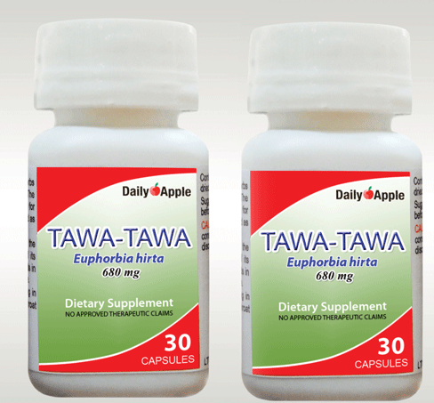
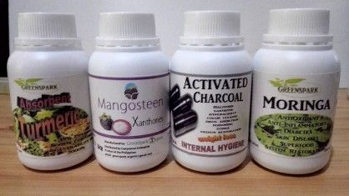
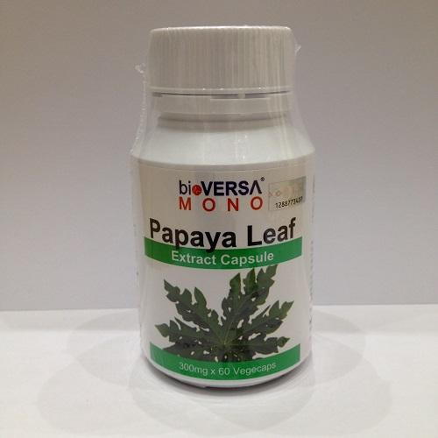


Slide 11
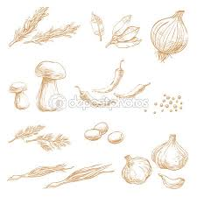
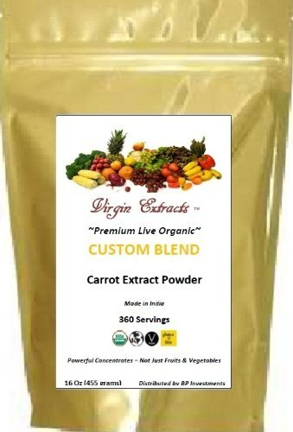

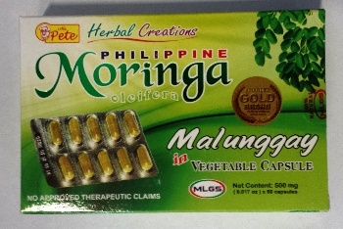


Slide 12
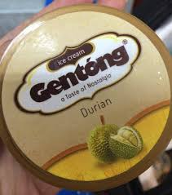

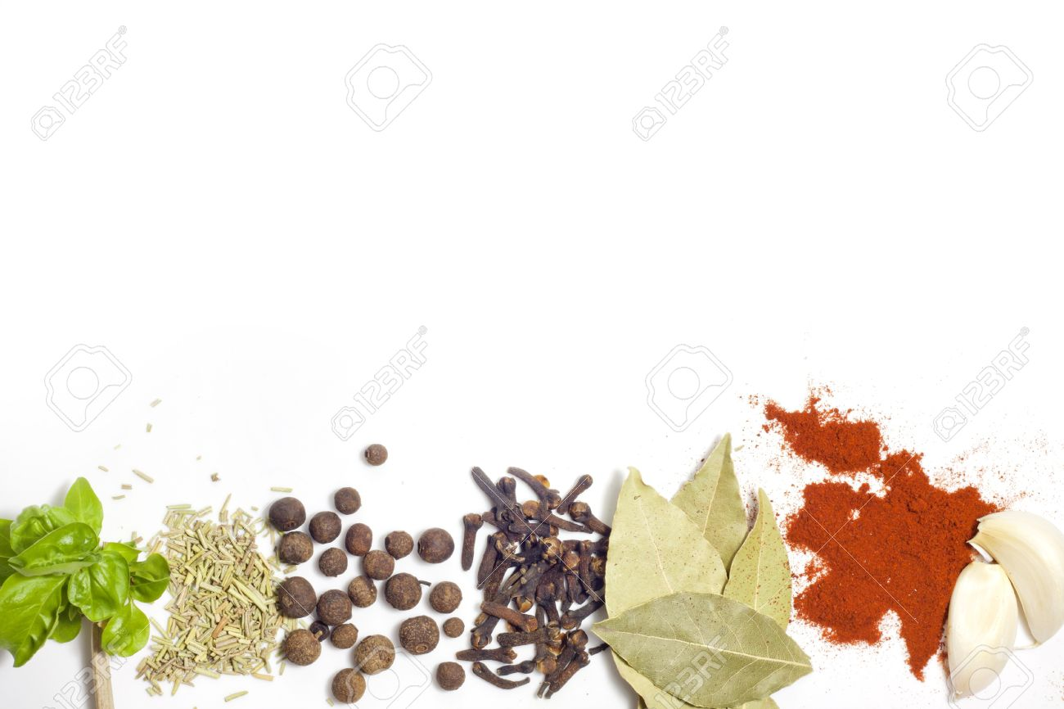

Slide 13
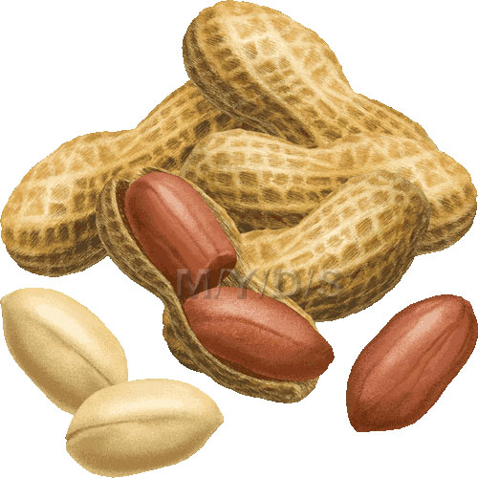
Small Family Farm Factory
Small family farm amidst fellow small farm holdings.
  Produce little volumes of goods.
  Usually seasonal harvest
  No real sustaining markets
  Small Financial capabilities
  High unemployment rates

Slide 14
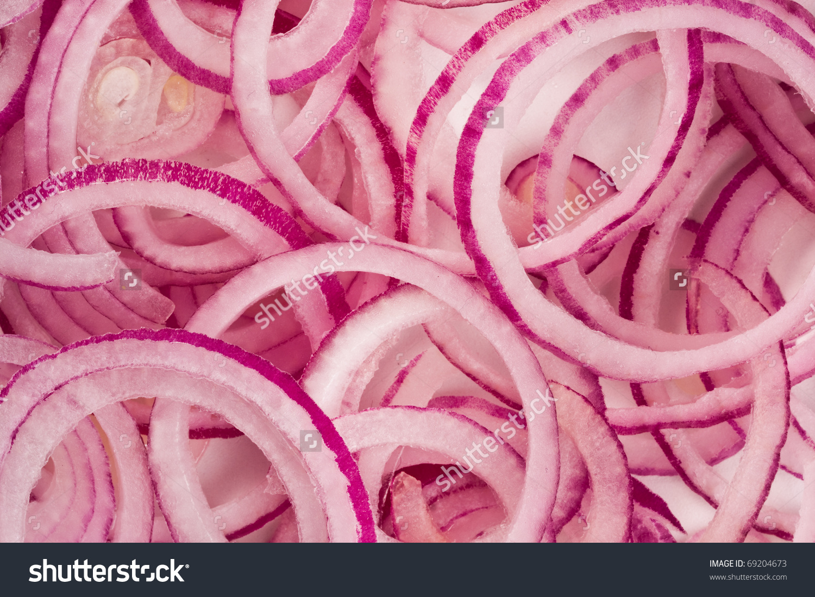
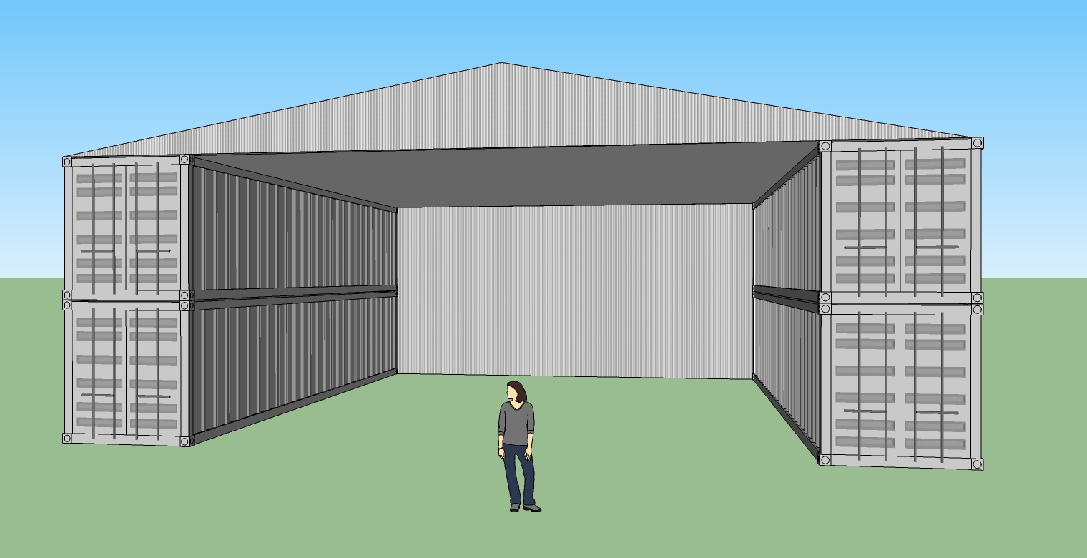

Slide 15

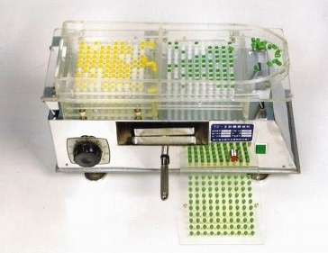
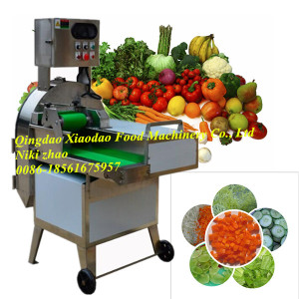
Capsuling Filling Machine
Slicer Cutting Machine

Slide 16
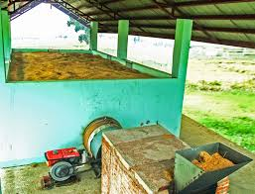
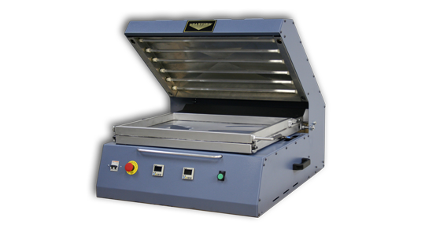
Mechanical Dryer Machine
Packaging Machine

Slide 17

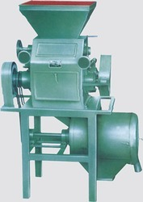
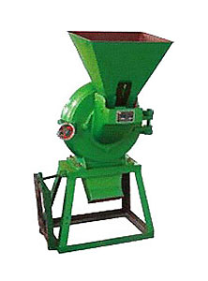
Grain Grinder Machine

Slide 18
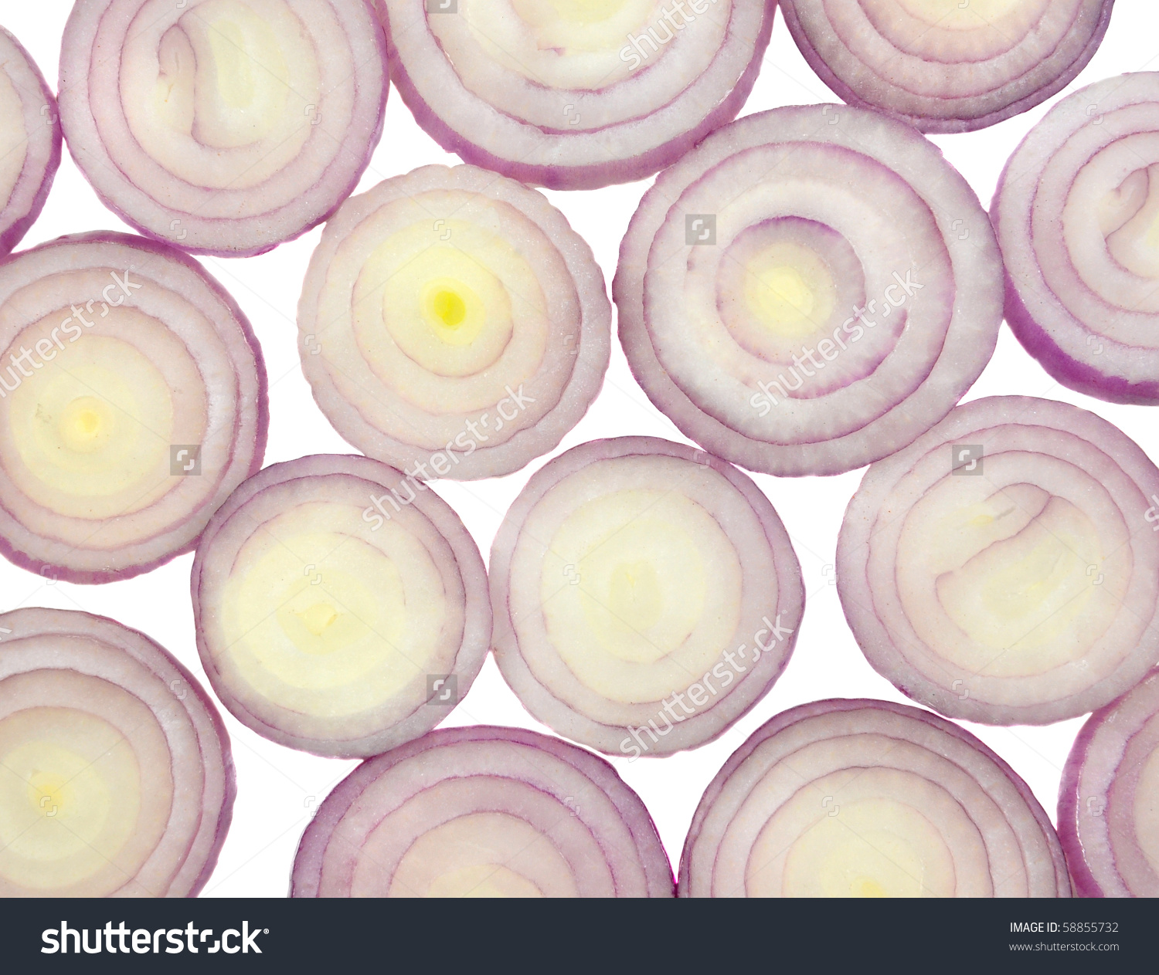
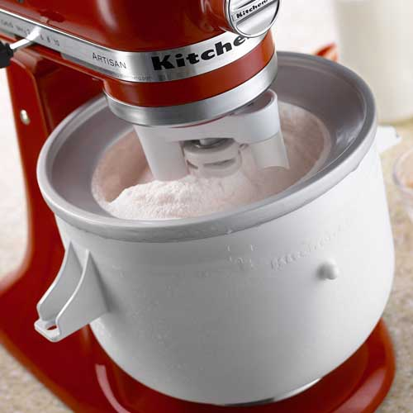
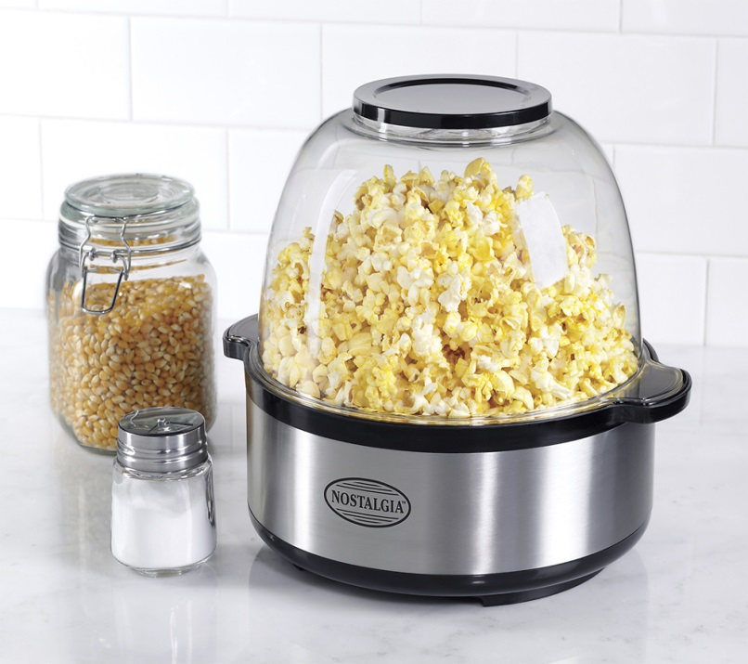
Small Ice Cream Maker
Pop Corn Maker

Slide 19
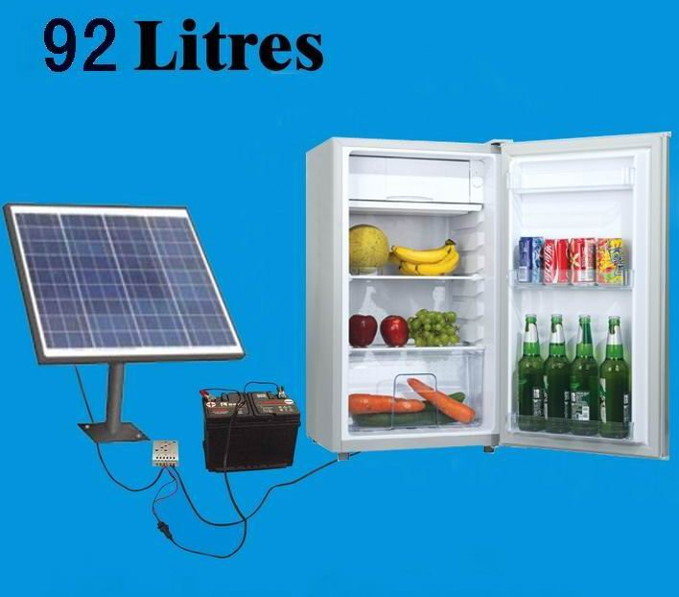
Solar Refrigerator

Slide 20



Farm Office Needs

Slide 21
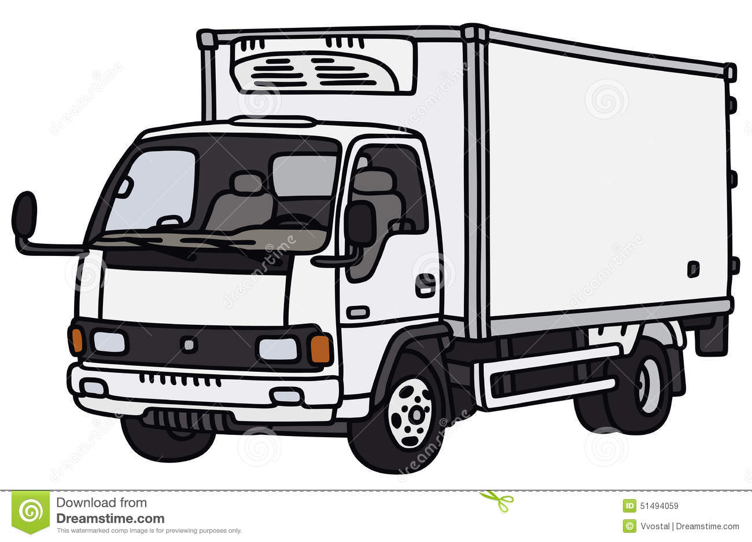
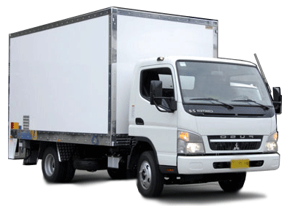
Trucks

Slide 22

Arrange for Following :
  Containers (van) as storage, factory, office, kitchen, processing area.
  Mechanical or solar dryers, grinders, packaging capabilities, re-packing, labelling, cutting sorting etc.
  Family members and community neighborhoods as laborers.

Slide 23

Things to Buy/Sell
Fruits and Vegetables:
    Ginger
    Carrots
    Peanuts
    Pineapple
    Mango
    Papaya
    Chili
    Bell Pepper
    Onions white
    Garlic
    Turmeric

Slide 24
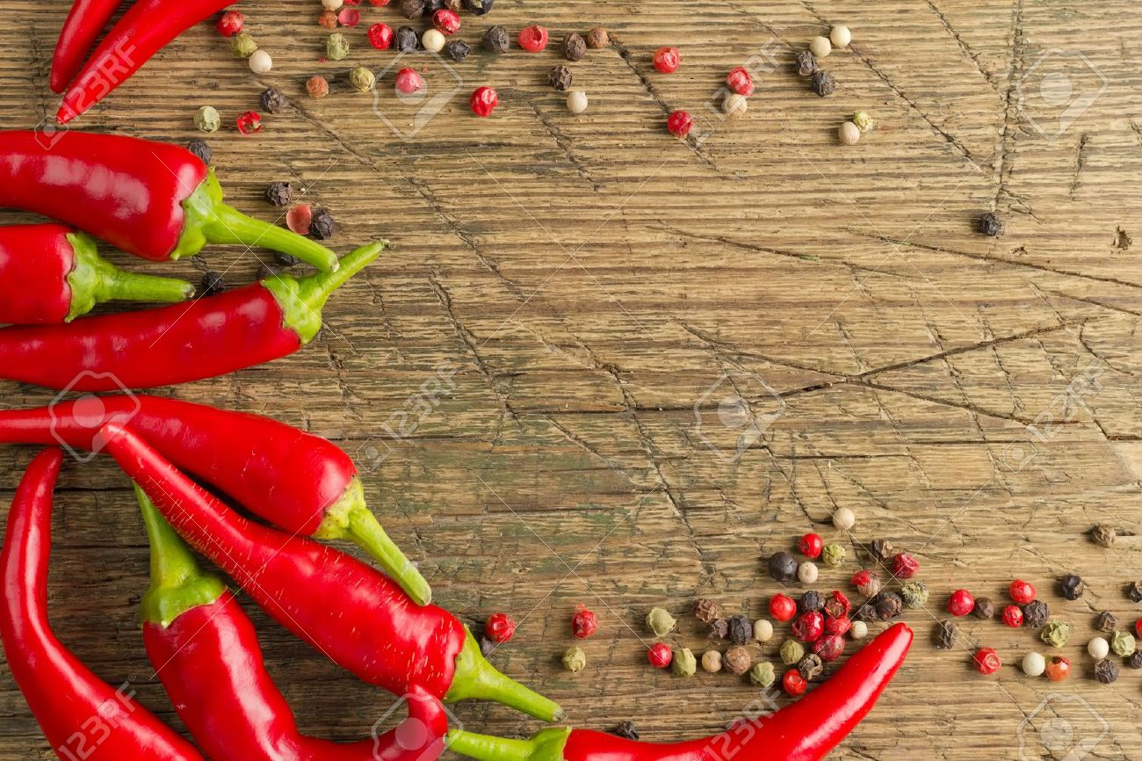
THANK YOU!

