Slide 1


Consolidation L gistics
by Rene T. Pamintuan
September 1, 2016
Tagbilaran, Bohol

Slide 2
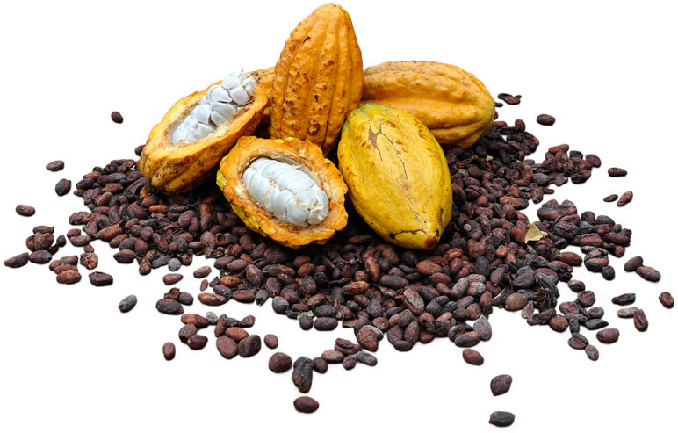
Logistics
is generally the detailed organization and implementation of a complex operation. In a general business sense, logistics is the management of the flow of things between the point of origin and the point of consumption in order to meet requirements of customers or corporations.

Slide 3

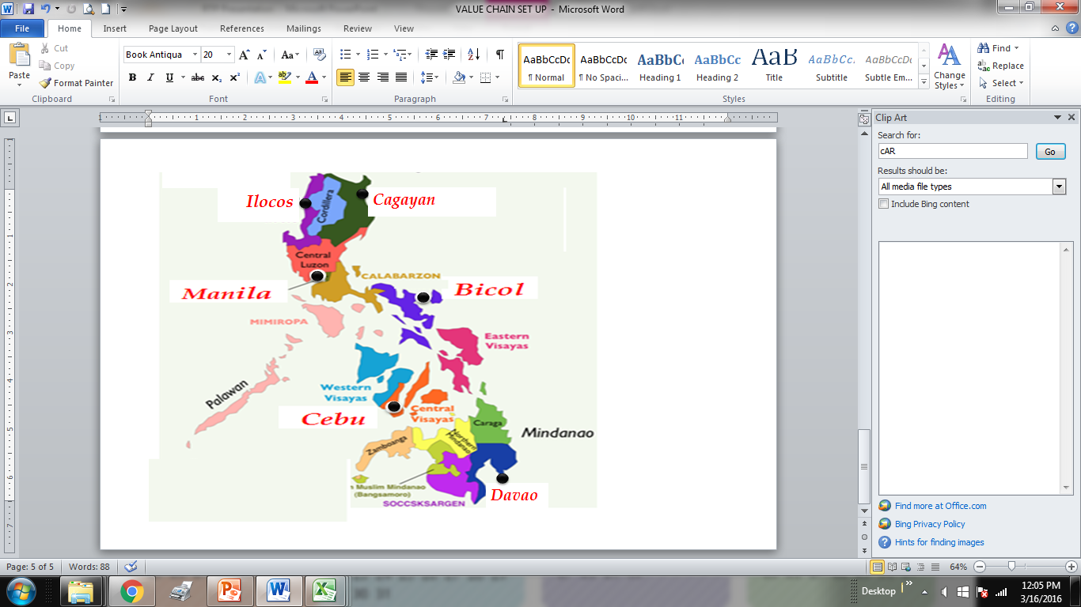
CONSOLIDATION & POOL DISTRIBUTION
CONSOLIDATION
We gather individual shipments from shippers throughout our operating territory and inventory and consolidate at our regional hubs. We then build detailed consolidated loads in to your receiving locations

Slide 4
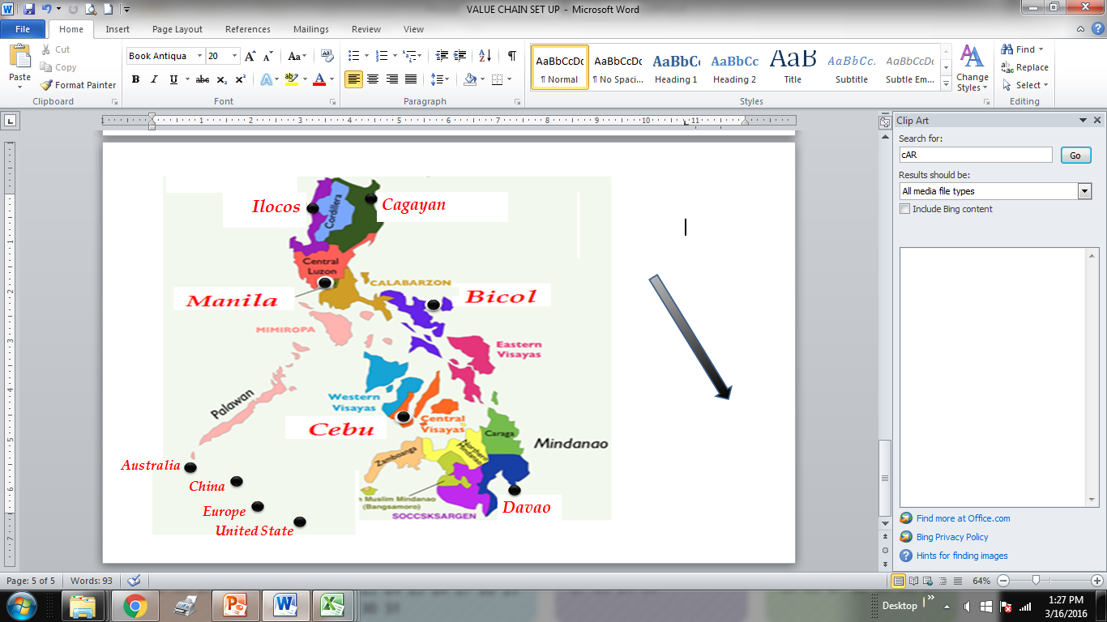
POOL DISTRIBUTION
Is the distribution of orders to numerous destination points within a particular geographic region.
Cebu
United States

Slide 5
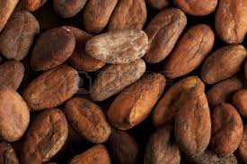

Realities of Philippine Logistics

Slide 6

7,500 Island
Domestic Ports
LUZON
*Manila
*Subic
*Batangas
VISAYAS
*Cebu
Iloilo
Bacolod
Dumaguete
MINDANAO
Zamboanga
*General Santos
*Davao
*Cagayan De Oro
Butuan
* International Ports

Slide 7
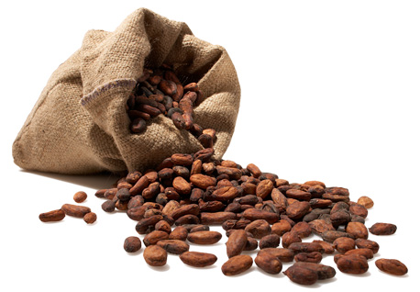
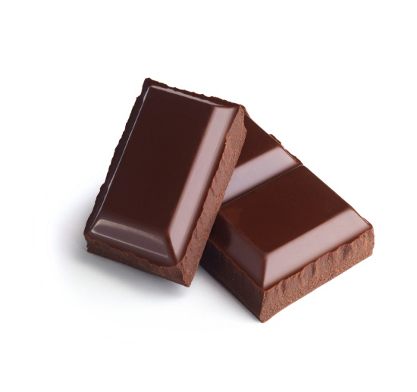
Consolidation Needs
Trades will opt for consolidation from all Bicol region for filling of trucks.
> Legaspi Bicol
> Quezon Province
      > Batangas
      > Cavite
        > Laguna
        TO: MANILA PORTS
2. Manila - Cebu ( Containerized )

Slide 8
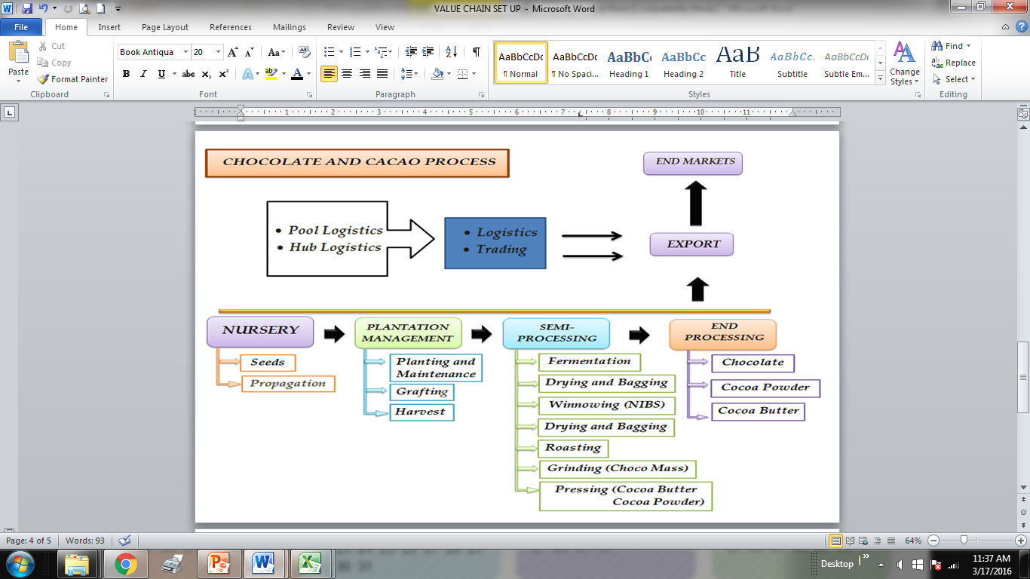

Slide 9
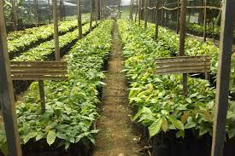

Slide 10
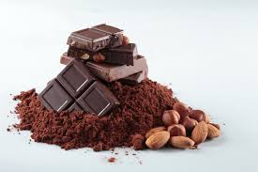
STAGES OF GROWTH
1. PLANTING AND EXPANSION OF FARMS
( 1 million trees / Year )
2.FERMENTATION AND ROASTING CAPABILITIES EXPANSION
3. TRADING
Export
Manufacturing
Domestic Retailing
Coffee Shops
Chocolate Making
Grocery
Bakeshops

Slide 11
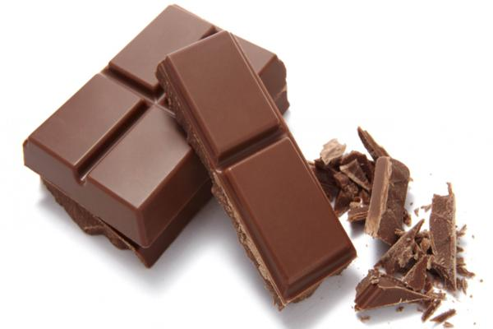
REALITIES AND CHALLENGES
1. A MILLION NEW PLANTING YEARLY
- Will produce progressively rising volumes of cacao beans.
A. Fermentation and Roasting Centers
- Having centralized Fermentation roasting centers is needed for quality, standards and logistics cost.
- Need capital investments for more Fermentation and roasting centers.
- Storage facilities will be needed
- Logistic set ups needed.

Slide 12
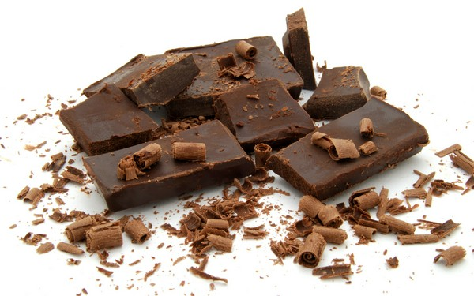
B. Chocolate Market Development
A. Foreign Buyers (Penang?)
- will need logistics consolidation possibly at Manila, Legaspi, Cebu, Davao, Gensan and Cagayan De Oro.
B. Development of local Markets
- Coffee/chocolates shops?
- Manufacturers/ Retail chocolates with brands?
- Brand Consciousness
- Factories, large and small for commercial and backyard generations.
- Franchise stores and Operations
- Massive consumer education on chocolate and cacao

Slide 13
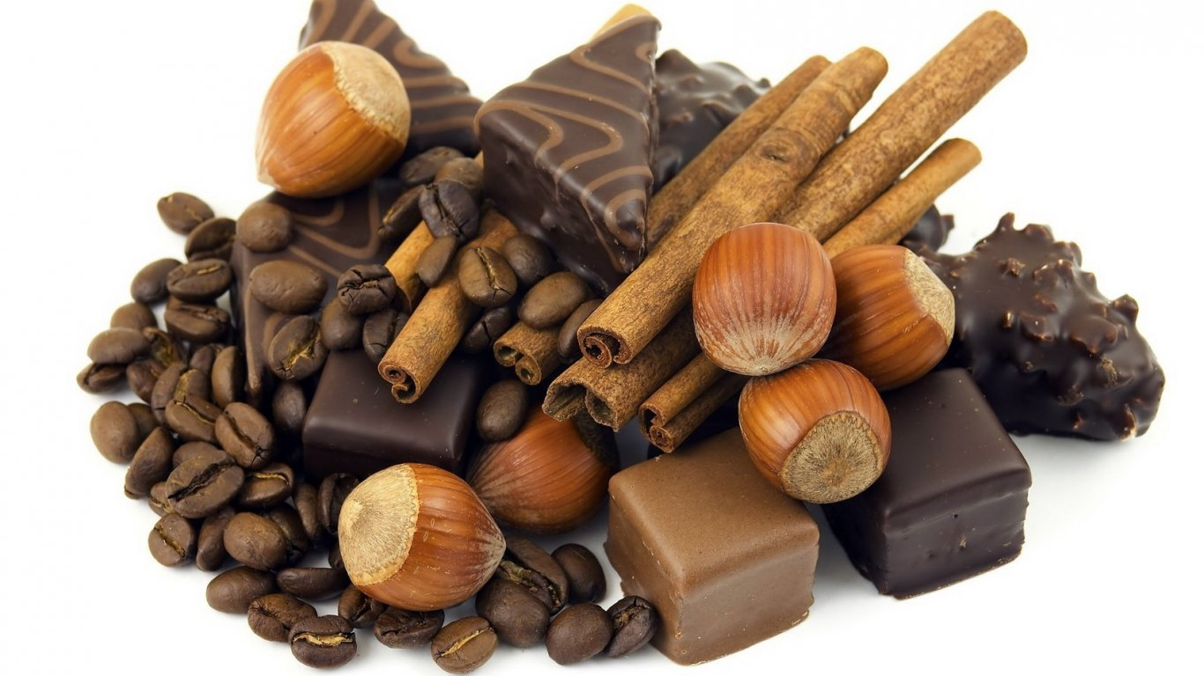
C. Consolidating Local Demand
- Pricing should not be dependent and controlled by external markets.
- Sustain the demand for local beans and avoid Market and Supply disruptions.
- Creating and sustaining a PHILIPPINE chocolate industry.

Slide 14
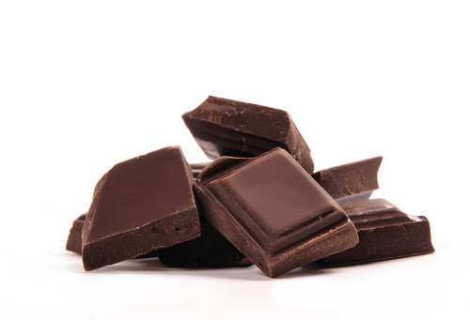
2. PRICE MOVEMENTS
- External Forces
- Internal / Domestic Forces
a. Planting
b. Consumption
c. Consumer Education
d. Optimizing Logistics and warehousing/storage systems cost.
e. Progressive Growth of Farm and Harvest
- Leads to glut in Market
- Leads to Price Downwards
- Loses to Farmers
- Loses to the whole industry

Slide 15
3. PHILIPPINE CACAO / CHOCOLATE INDUSTRY
  A. Planting and Farm Maintenance
  B. Development of market within
-Massive consumer education
-Logistics Preparations
-Retail and warehouse markets
-Centralized practices and Improvements
-Packaging, Processing and Franchising.

Slide 16
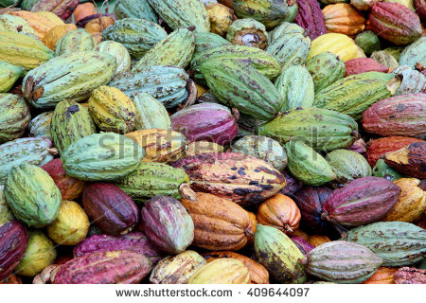
Cacao Nursery

Slide 17
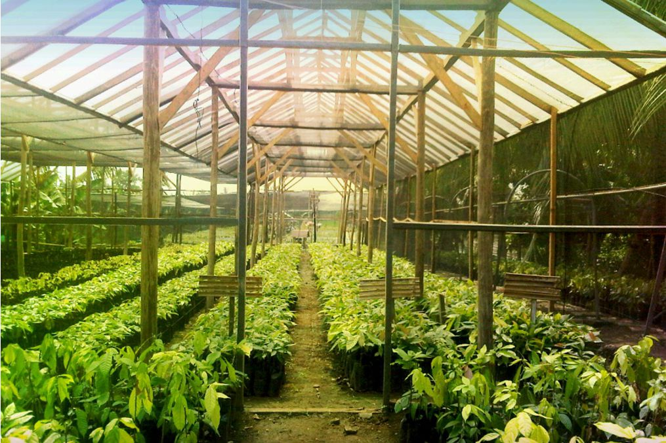

Slide 18
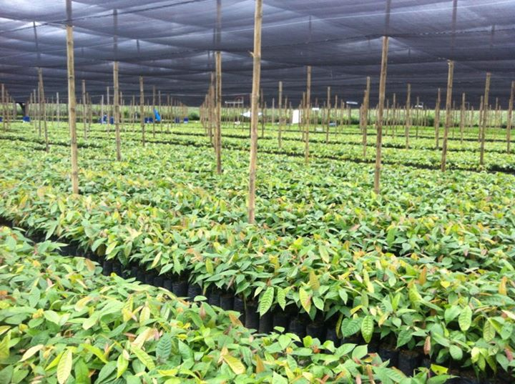

Slide 19
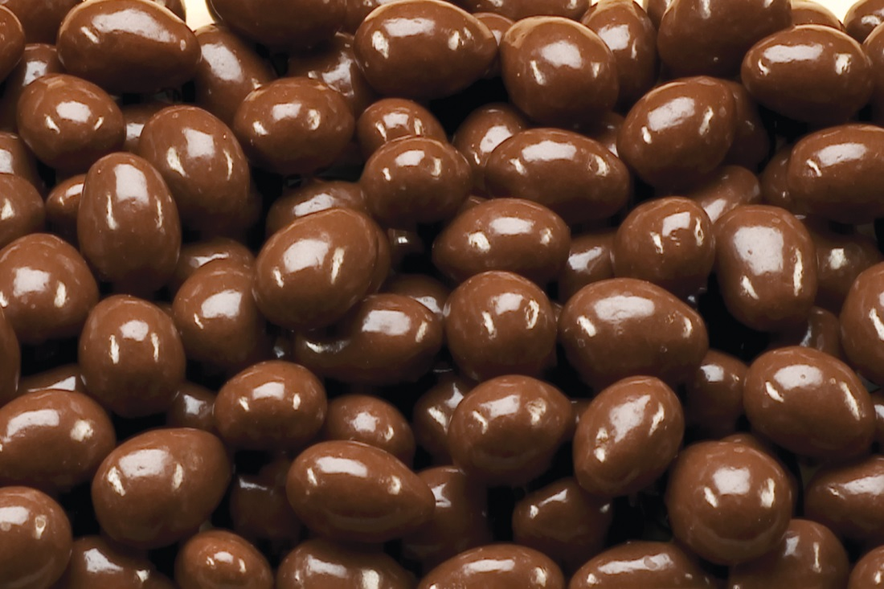
Thank You!

