Slide 1
Collaboration for Change
Taking CONTROL of the Cacao and the Environment
Honorary Amb. Yolanda Ortega Stern, CA, USA
President – One Word Institute
Plantacion de Sikwate Cacao Producers Association, Inc.
Philippine Cacao Summit and Exposition 2016
May 27-29, 2016 SM Seaside, Cebu

Slide 2
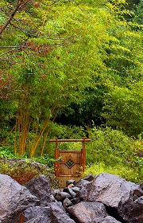
GOALS
Plant Trees
Plant Organic for Branding
Plant for 60% Shade
Plant multi-strata: agro-farm
Consolidate, Collaborate, Federate
Join ICCO
Plant for a Carbon Neutral Country
Create WEALTH for Farmers

Slide 3
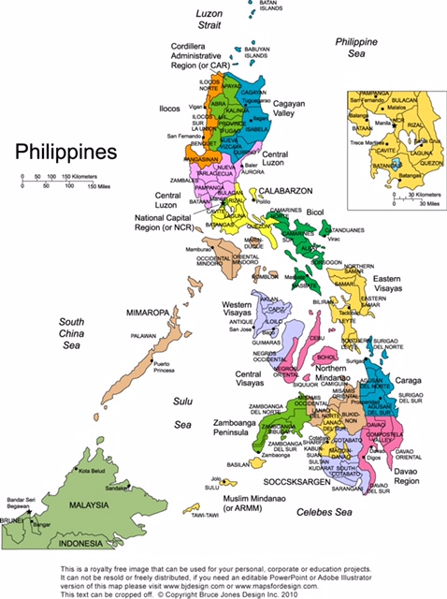
MOTHERLAND
POPULATION: 102,250,103
70% Rural
57 yrs - Average Age of Farmer
$ 50.00 Aver. Income/Mo

Slide 4
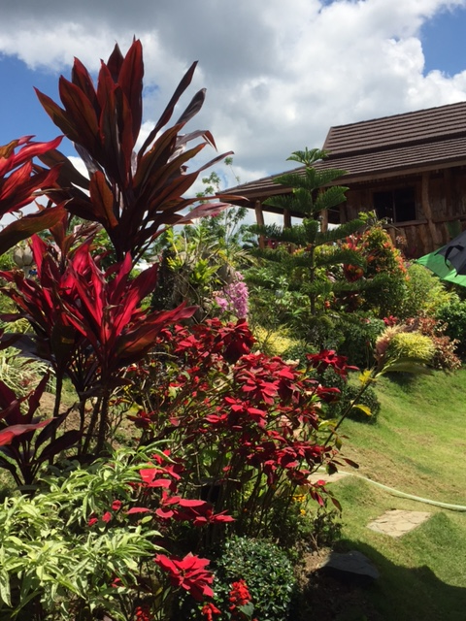
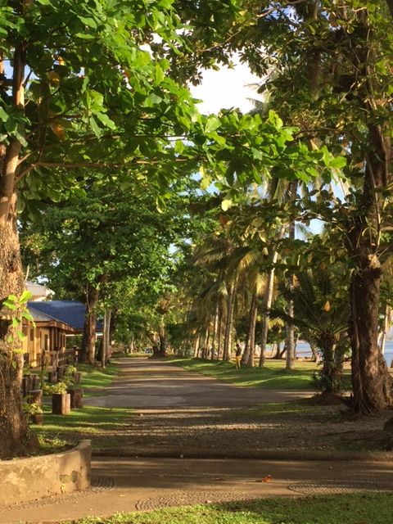
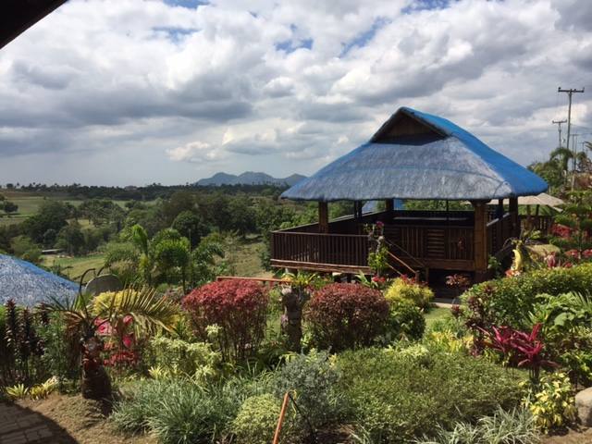
FLORA
and
FAUNA
and
RURAL LIVING

Slide 5
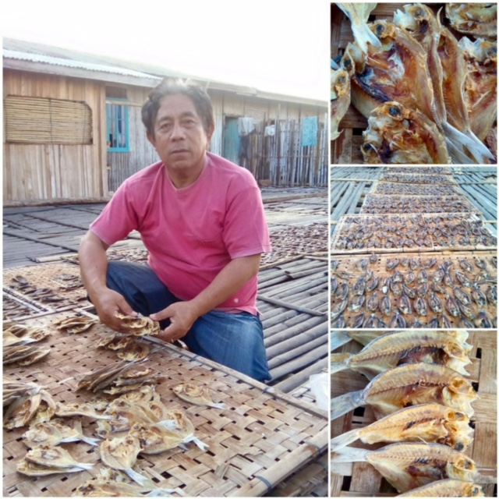
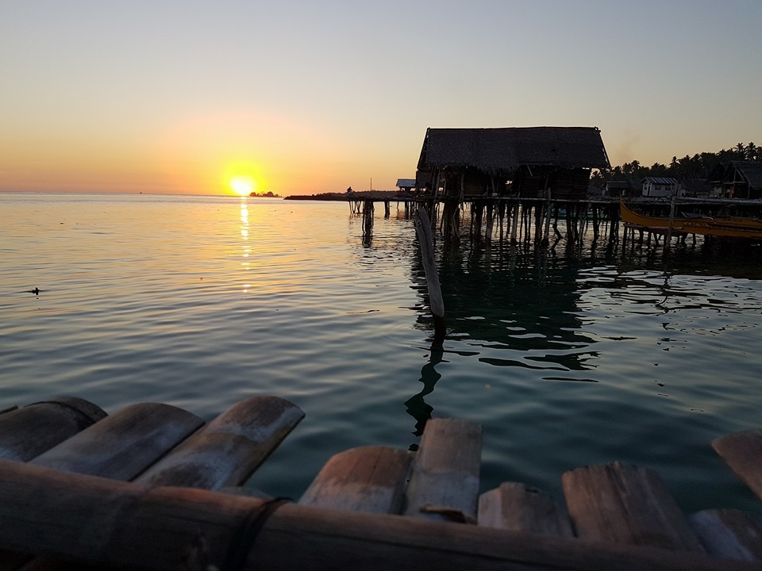
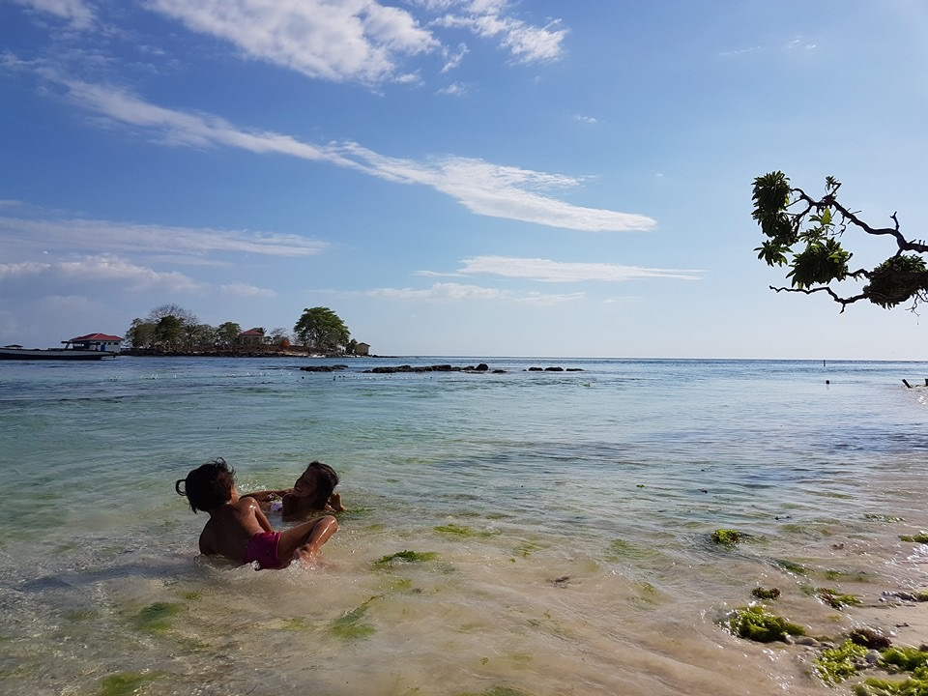
ISLAND LIVING

Slide 6
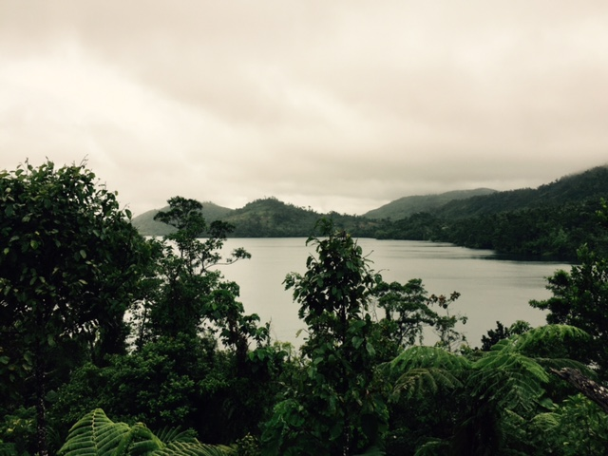
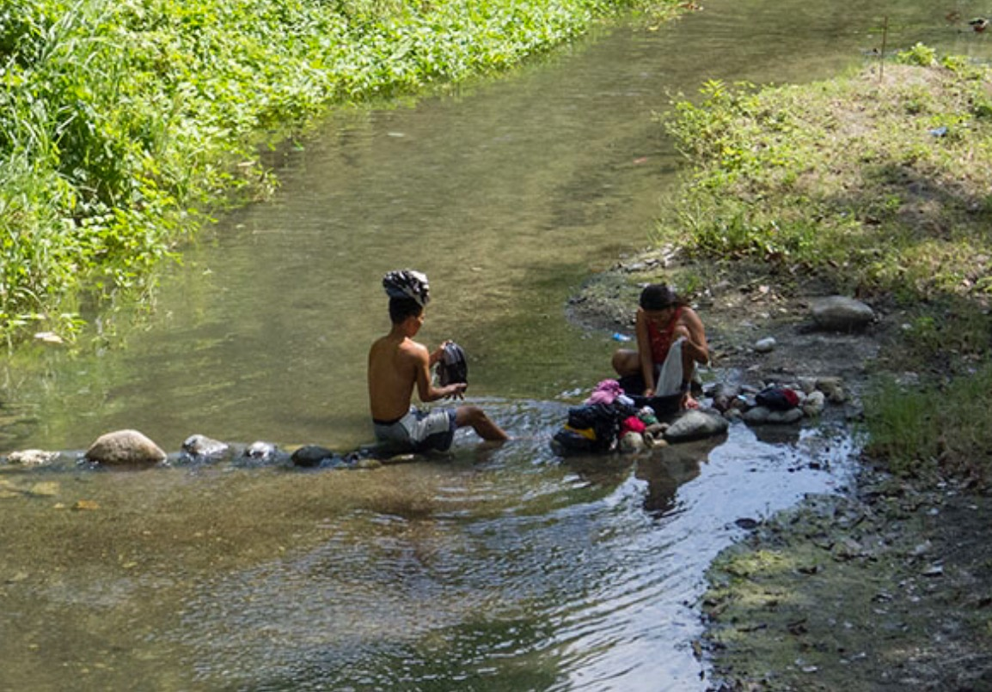
Mountain Living

Slide 7
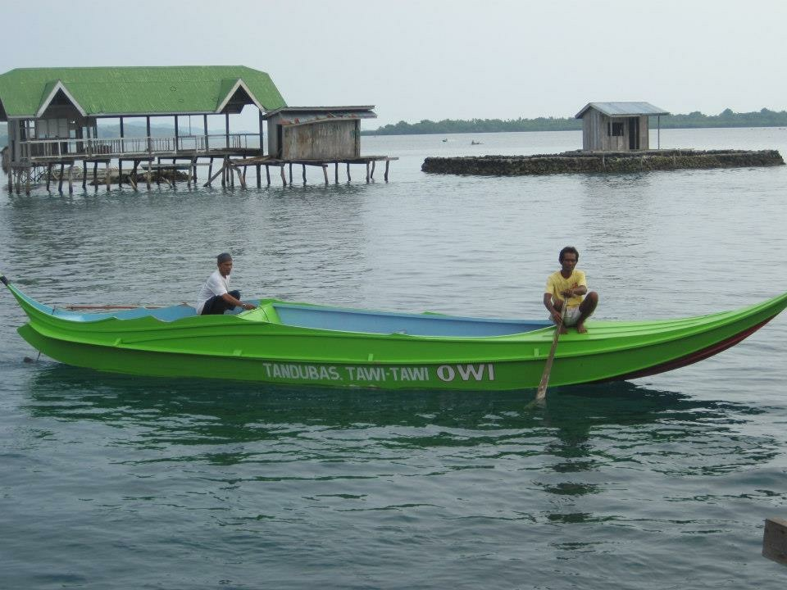
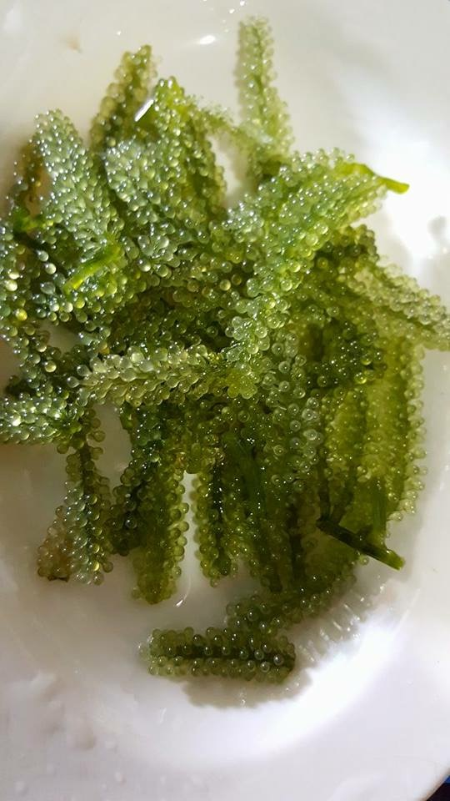
WATER
LIVING

Slide 8
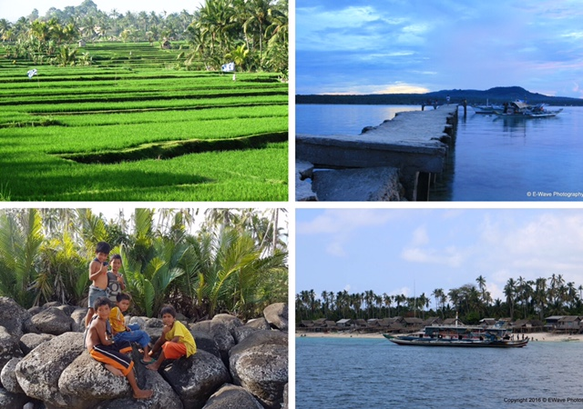
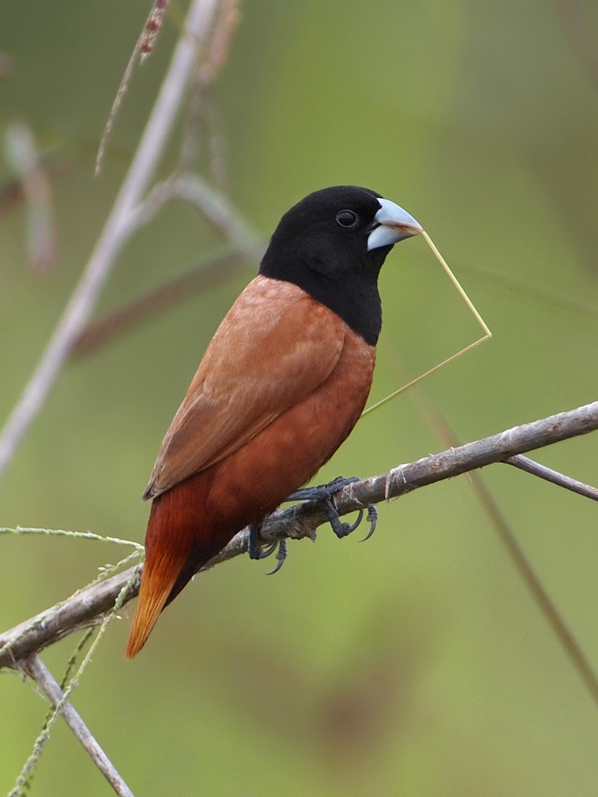
PRECIOUS
MEMORIES

Slide 9
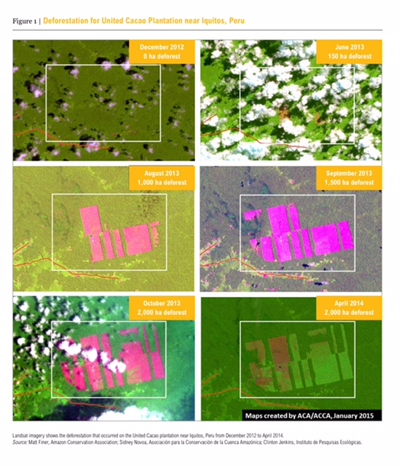
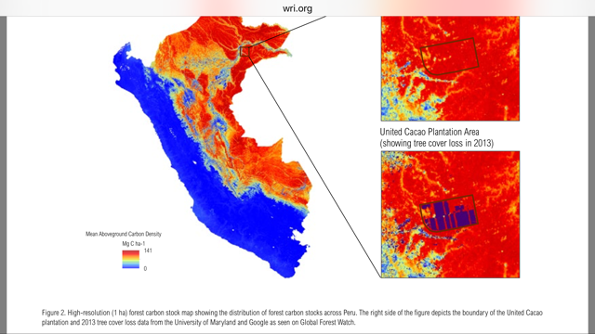
Peru- Deforestation for Cacao

Slide 10
LAND USE CHANGE DISTRIBUTION IMPACTS ACROSS ENTIRE PLANTATIONS and PLAYS A ROLE IN THE CARBON CYCLE, FOR GOOD OR FOR BETTER.
HAZARDOUS CHEMICAL ABSORPTON and RUNOFFS IMPACTS THE AQUAFIR AND THE PEOPLE.

Slide 13
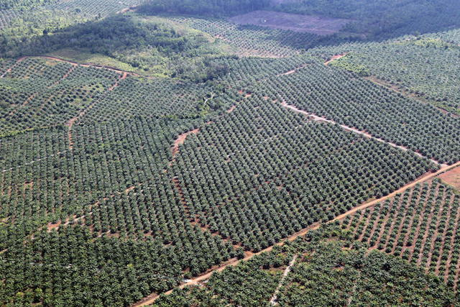
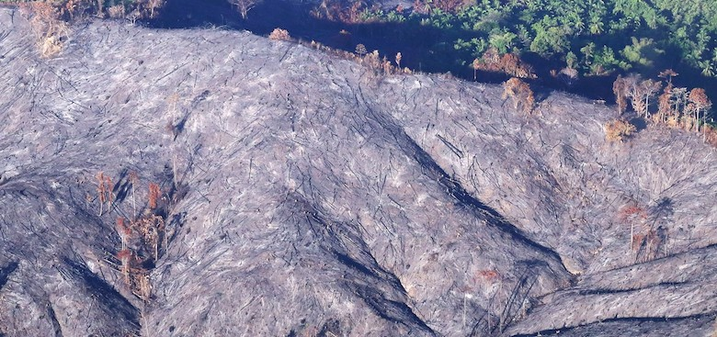
PALAWAN Palm Oil
Plantation

Slide 14
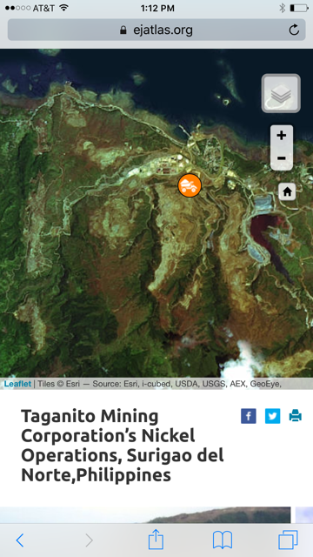
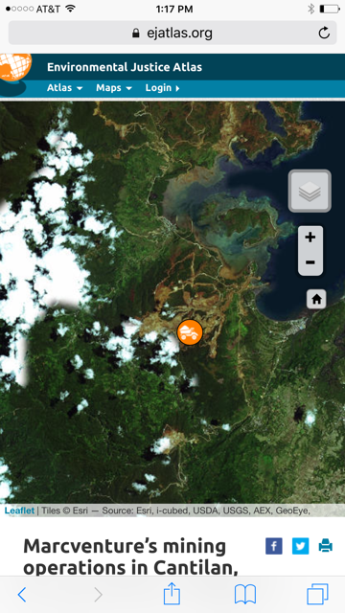

Slide 15
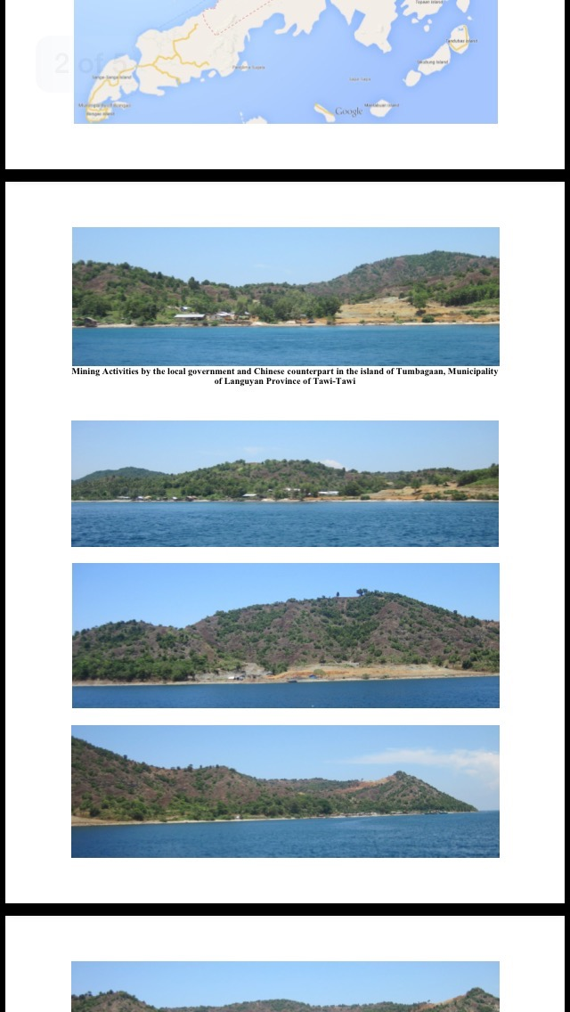
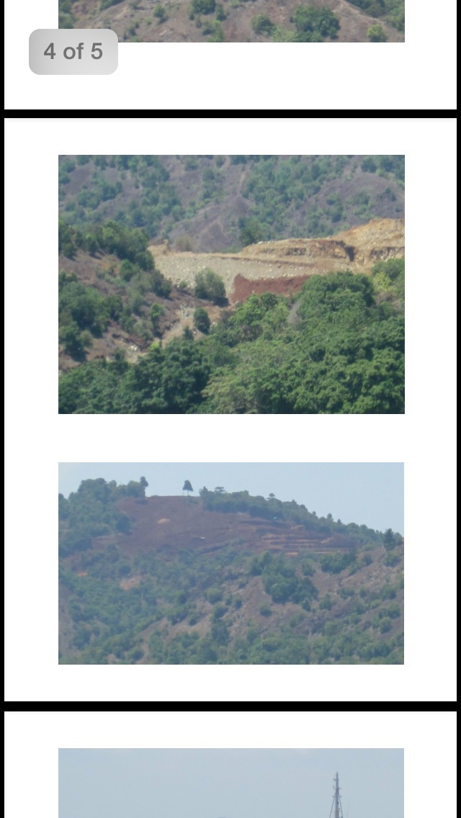
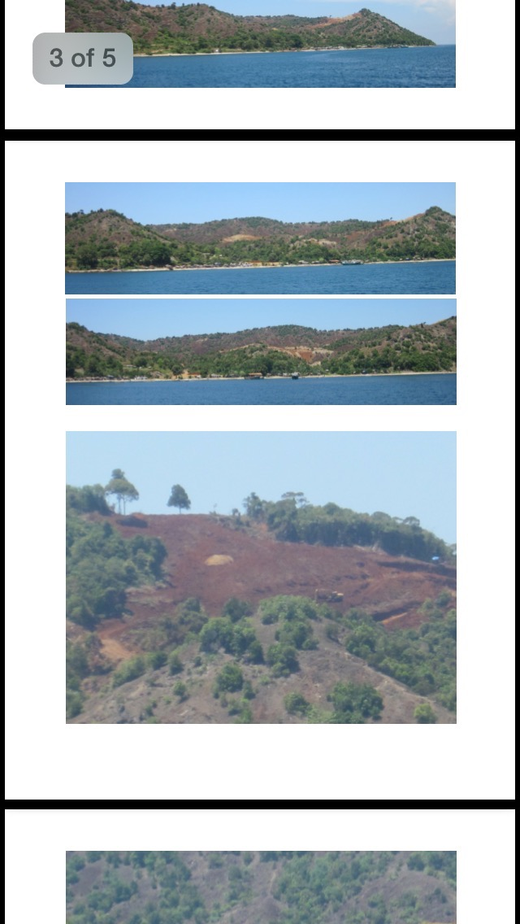
Languyan, TawiTawi
Nickel Mine

Slide 16
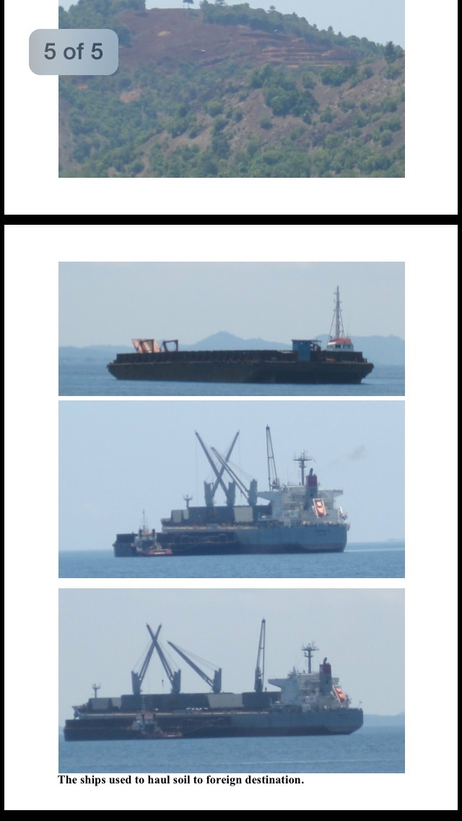
Ore bound for external destinations are completely lost to
the Philippines.

Slide 17
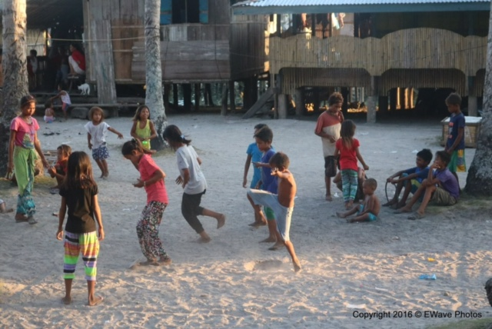
REMEDIATION
RESTORATION
HEALTHIER ENVIRONMENT

Slide 18
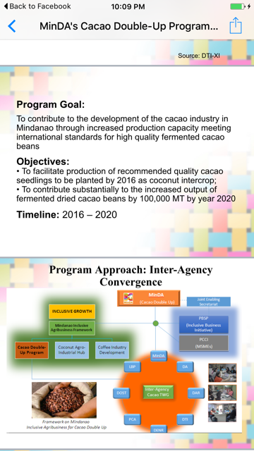
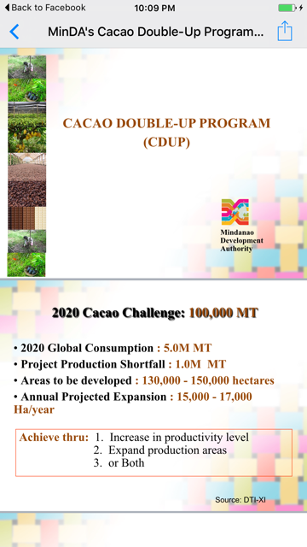

Slide 19
REGION 8
40,000 Planting materials by VSU to Javier,Leyte
30,000 Grafted by VSU-OXFAM to 500 Balangiga,
Giporlos, Hernani, Salcedo, Guian E. Samar
12,000 grafted bought by Pakisama(NGO) Hernani E. Samar
25-30,000 Dr. G. Gerona Grp. Sogod So. Leyte, Kenner assisted
2,000 VSU to Jaro, Leyte (DOST)
30,000 DA Region (info Boy Dayap)
6,000 San Francisco S. Leyte (info MAO)
1,000 planted by Mr. Abuyabor (Mahaplag)
1,000 planted by Atty Malaya (Imelda, Baybay City, Leyte)
1,000 LGU, Basey, W. Samar
12,000 Maasin (info Kennemer Cacao Doc)
Source: Dr. Jose Bacusmo - VSU

Slide 20
REGION 8 – ADDITIONAL
Mahaplag, Leyte
Maasin, So. Leyte assisted by Kennemer
5 Nurseries in E. Samar: Balangiga, Giporlos, Hernani, Guian currently propagating cacao. Each has 10,000 planting materials available at this time.
1 Provate Nursery in Ormoc – Pura Farm Nursery
NGOs to incude PLAN, World Vision, CRS also distriuted to Yolanda affected areas.
TOTAL REGION XIII = 979, 650 cacao plants distributed.
479,650 to PCA Region
500,000 KEDP Coconut Cacao Enterprise
Source: Dr. Jose Bacusmo - VSU

Slide 21
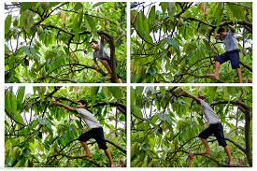
PER HECTARE
500-600 cacao plants if
under coconuts
1,111 monocropped

Slide 22
WORLD PRODUCTION FORECAST 2015-2016
1.607 – 1.494 Million Tonnes (2% decrease)
2020 Philippine Cacao Industry Challenge
100,000 MT
30,000 – 150,000 @ 330 trees/hectare
Provide shortfall of 10% or produce 2% of global output.

Slide 23
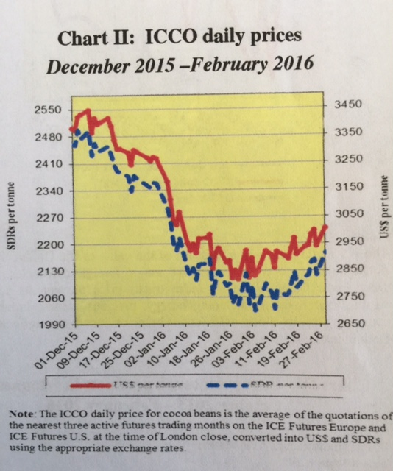
February 2016 –
First Week
$2,916 per tonne

Slide 24
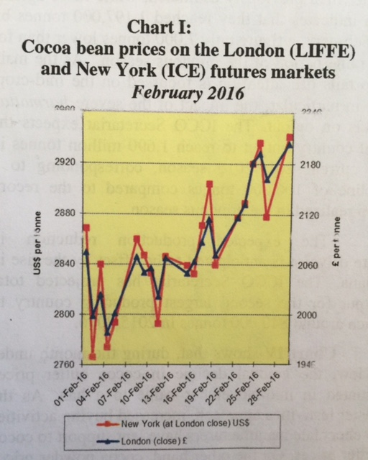
February 2016
Third week
-3,006 per tonne

Slide 25
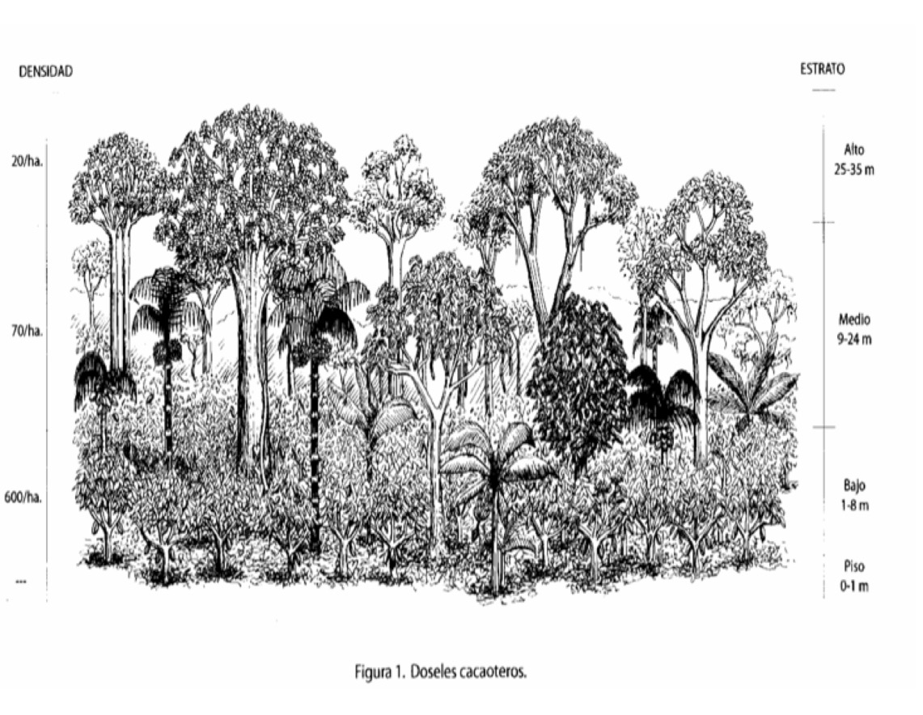
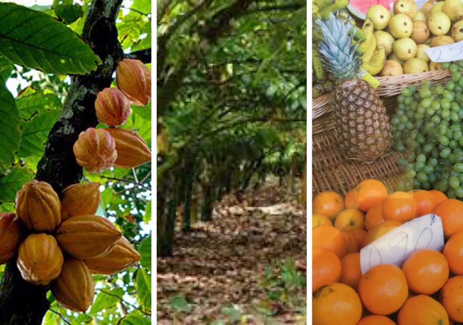
PROTECT, DEFEND, NURTURE

Slide 26
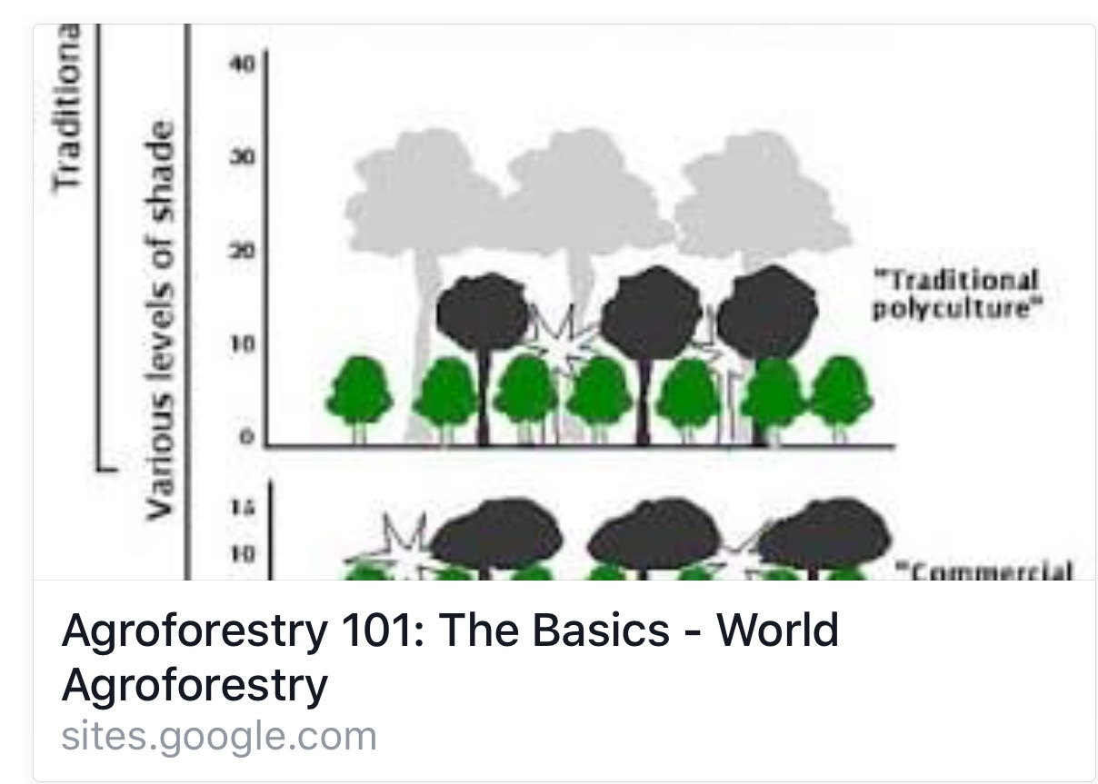

Slide 27
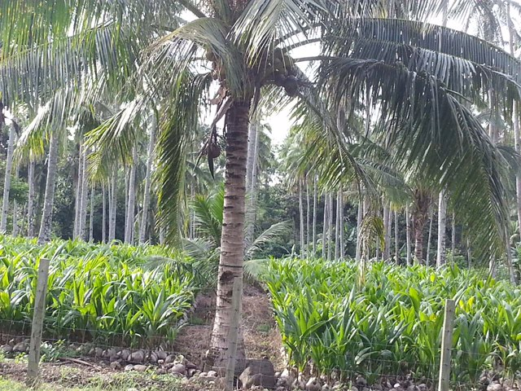
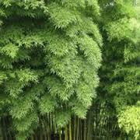
SHADE

Slide 28
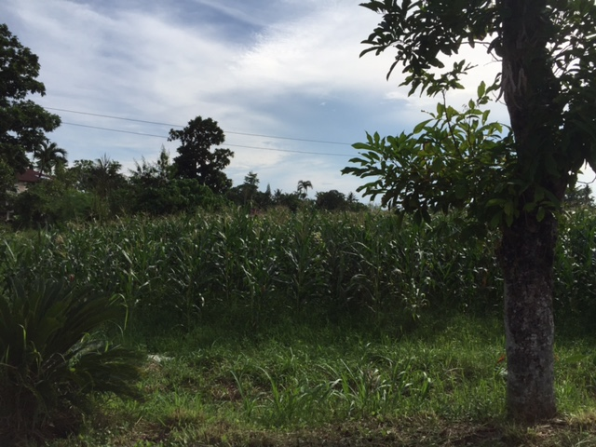
BORDERS

Slide 29
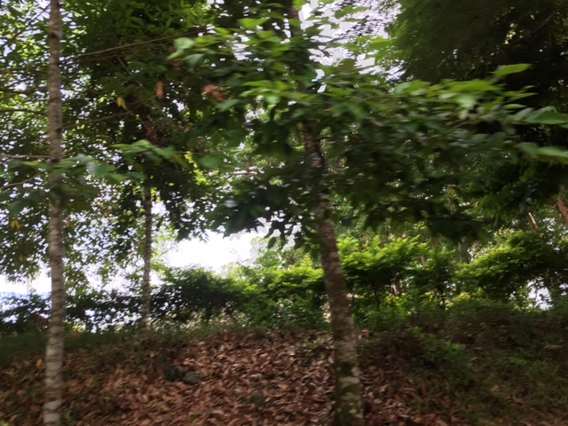
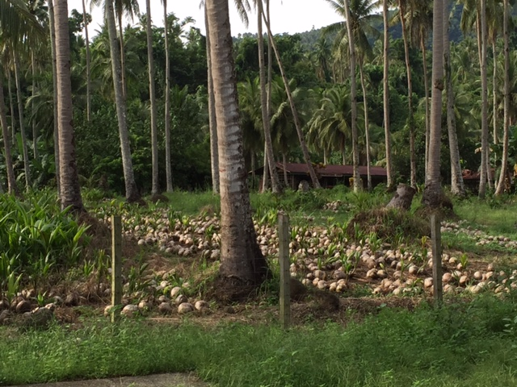
NUTRITION

Slide 30
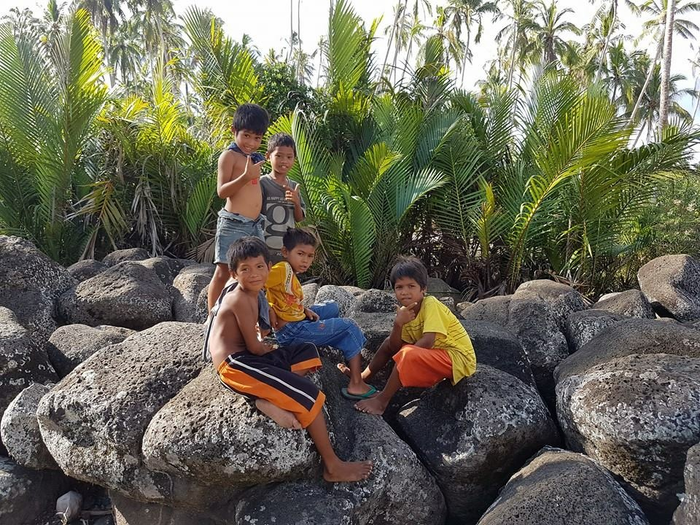
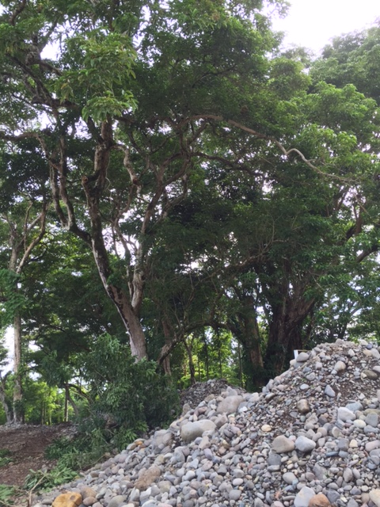
HEALTHY
ENVIRONMENT

Slide 31
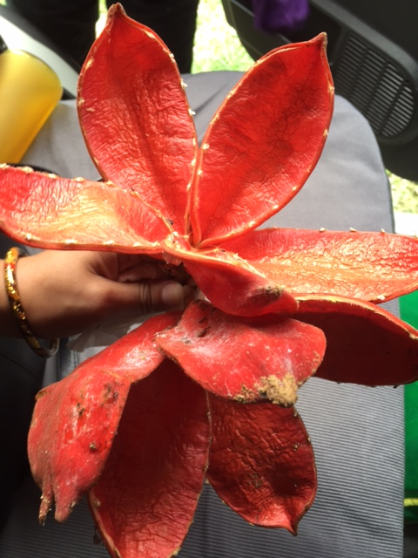
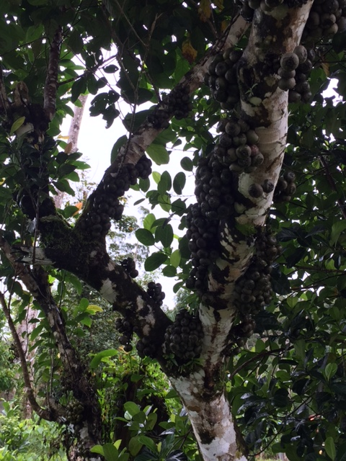
CARBON NEUTRAL Philippines

Slide 32
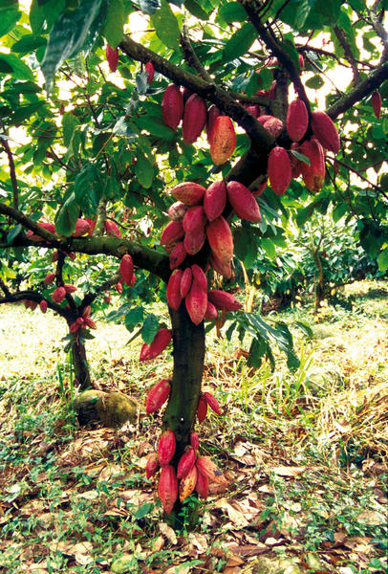
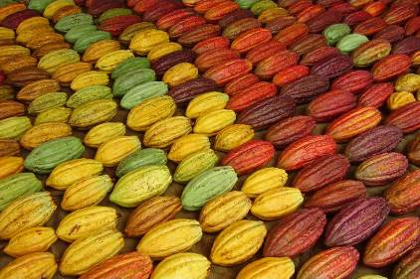
CERTIFIED ORGANIC

Slide 33
CHILEAN MODEL – Market Production Orientation
Farmers: “Domestic”, “Transition”, “Export”
CONSOLIDATE Growing; Logistics; Payment
SUPPLY: Copper; Ore; Fruits and Nuts; Fish; Woodpulp; Wood; Beverages; Inorganic Chemicals; Meat; Gems, precious metals
Total Exports: $ 52.5 Billion Pop: 17.6 M

Slide 34
“EXPORT FARMER”
More educated
Uses all the modern tools such as computers, smart phones, texts, email, internet search engines
Understands modern accounting systems
Knows how to expand networks
Takes advantage of information

Slide 35
Farmers Cacao
Local Processors
Market
PLANT FOR MARKET STRATEGY ->
DEVELOP INFRASTRUCTURE
$$$ BANK

Slide 36
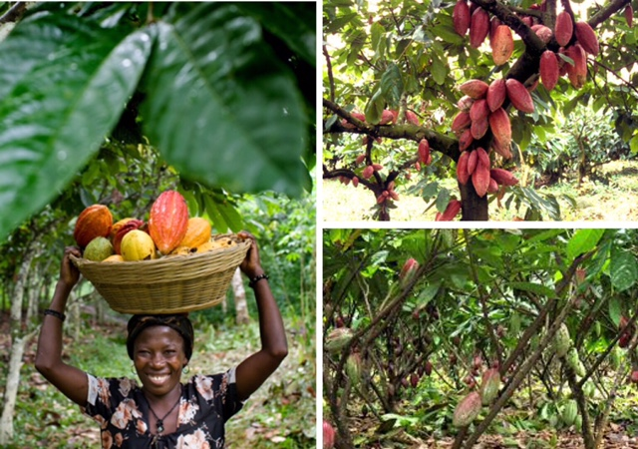
GOALS
Plant Trees
Plant Organic for Branding
Plant for 60% Shade
Plant multistrata – agrofarm
Consolidate, Collaborate, Federate
Join ICCO
Plant for Carbon Credits
Create WEALTH for Farmers

Slide 37
THANK YOU!
www.theoneworldinstitute.org

