Slide 1
Senator WSS 8.0kg with STEAM replaces
Senator WXS 8.0kg

Slide 2
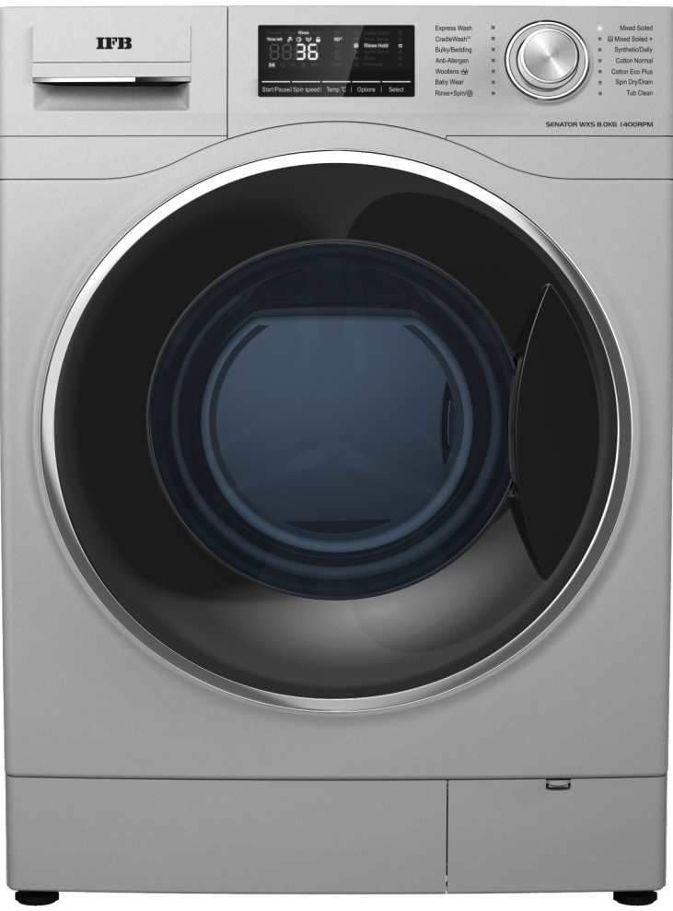
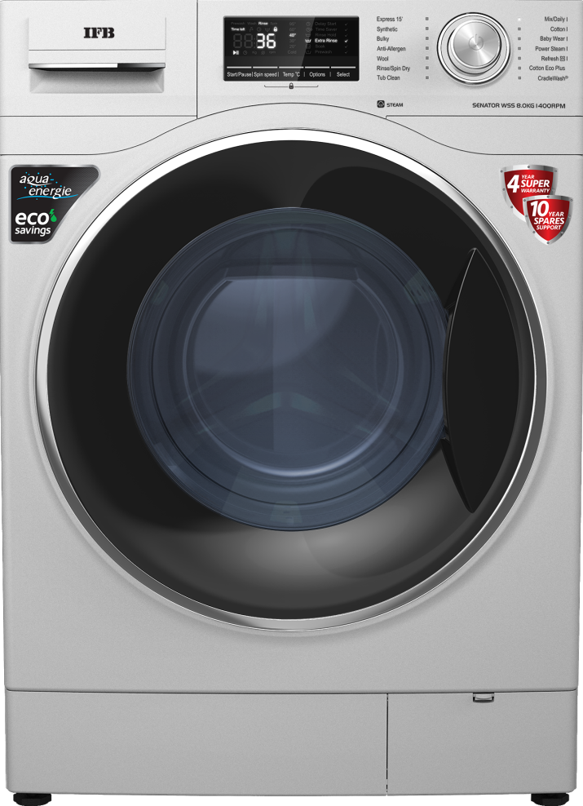
Aesthetics
Replaced with
SENATOR WXS 8.0kg
1400 RPM
SENATOR WSS 8.0kg
1400 RPM
MRP: Rs 40,990
MRP: Rs 41,990
5th Sep'20
2

Slide 3
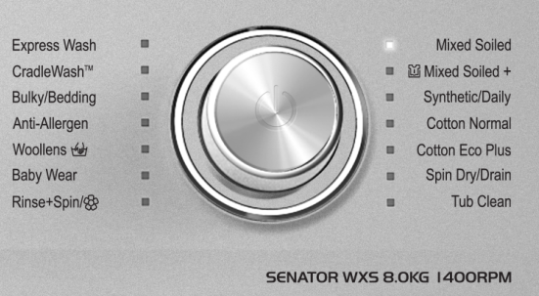
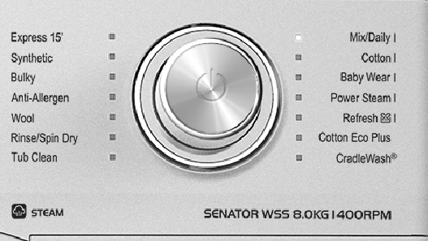
Aesthetics
SENATOR WXS 8.0kg
1400 RPM
Replaced with
SENATOR WSS 8.0kg
1400 RPM
Wash program with Steam
has suffix ‘I’
5th Sep'20
3

Slide 4
Specs ...
Replaced with
SENATOR WXS 8.0kg
1400 RPM
SENATOR WSS 8.0kg
1400 RPM
Body – Silver
Front – 2 pc [metal + plastic]
Door – Black with Chrome [double tone]
Door Outer Dia – 515 mm
Motor drive – DC Control
Display – White colour LED 7 segment
Program selector – Multi positions Smart Encoder
Program knob – Chrome Illuminated
Switch type – Touch
Buttons qty - 5
Body – Silver
Front – 2 pc [metal + plastic]
Door – Black with Chrome [double tone]
Door Outer Dia – 515 mm
Motor drive – DC Control
Display – White colour LED 7 segment
Program selector – Multi position Smart Encoder
Program knob – Chrome Illuminated
Switch type – Touch
Buttons qty - 5
5th Sep'20
4

Slide 5
Features related..
Specs ...
Replaced with
SENATOR WXS 8.0kg
1400 RPM
SENATOR WSS 8.0kg
1400 RPM
Aqua Energie
4D Wash
Protective Rat mesh
Express Wash
Cradle Wash^{R}
Crescent Moon Drum
No of Wash Programs – 14
Unbalance correction
High / Low Voltage control
Foam Detection
Auto Restart
Self Diagnosis
WxDxH – 598 x 606 x 875mm
Aqua Energie
4D Wash
Protective Rat mesh
Express Wash
Cradle Wash^{R}
Crescent Moon Drum
No of Wash Programs – 14
5 programs are with STEAM
Unbalance correction
High / Low Voltage control
Foam Detection
Auto Restart
Self Diagnosis
WxDxH – 598 x 606 x 875mm
5th Sep'20
5

