Slide 1
Case of the Month
November 2023
Col (Dr) P Sengupta
Prof and HOD
Dept of Pathology
Command Hospital (EC)
Kolkata 700027

Slide 2
65 years old male
Past history of Tuberculosis under treatment
Presented with weight loss of 10kgs in 6 months
Pedal edema
Passing frothy urine

Slide 3
On Examination
Thin Built
BP 110/70 mm Hg
Pulse 70 beats per minute
Hepatomegaly noted

Slide 4
Lab Investigations
Hb 8Gm/dL
TLC, DLC Within Normal Limits
ESR 100 mm fall/1st hour, Westergreen
Urea 18mg/dL
Creat 0.9 mg/dL
24 Hr Urinary Protein 8 Grams
Serum electrophoresis : No M spike noted.
Renal Biopsy done

Slide 5
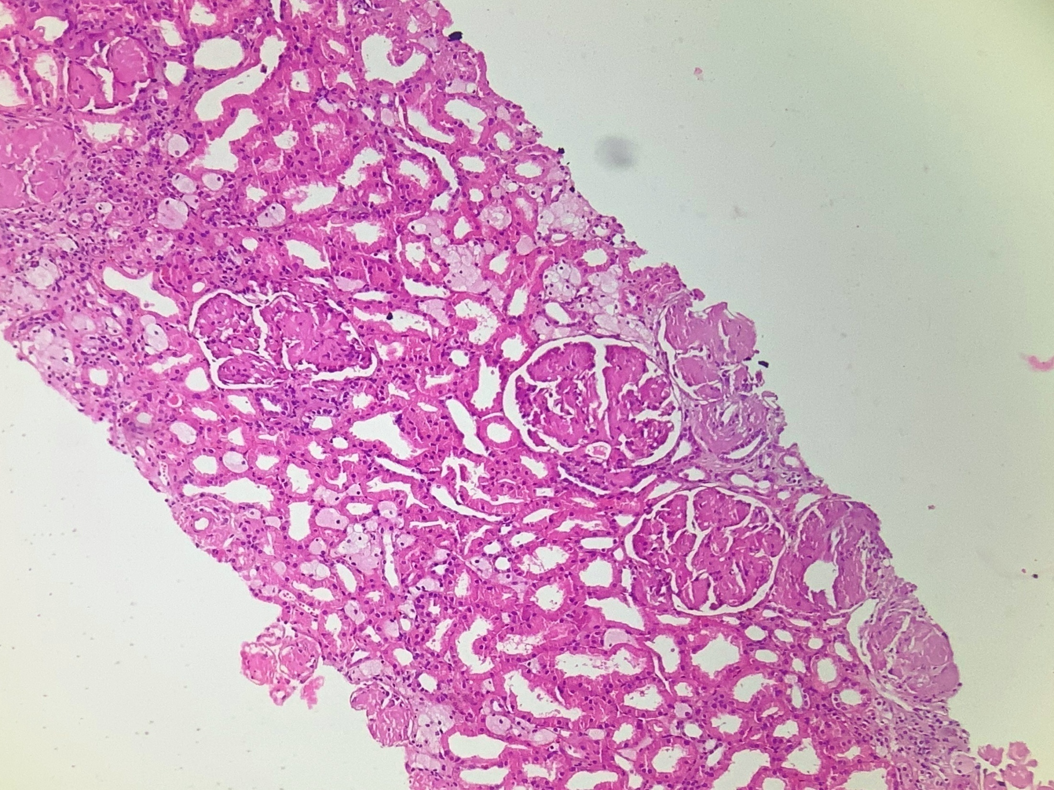

Slide 6
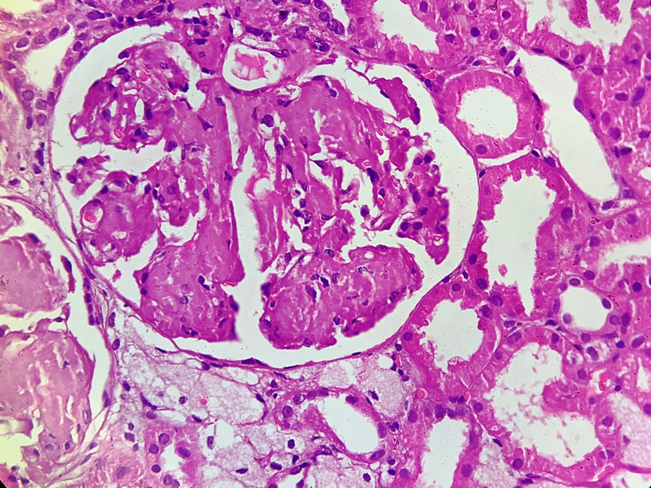

Slide 7
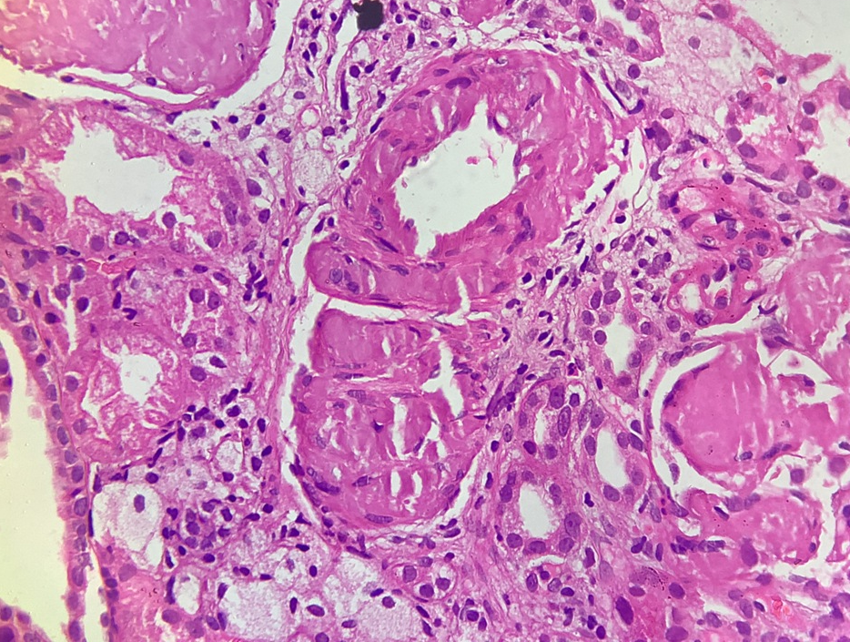

Slide 8
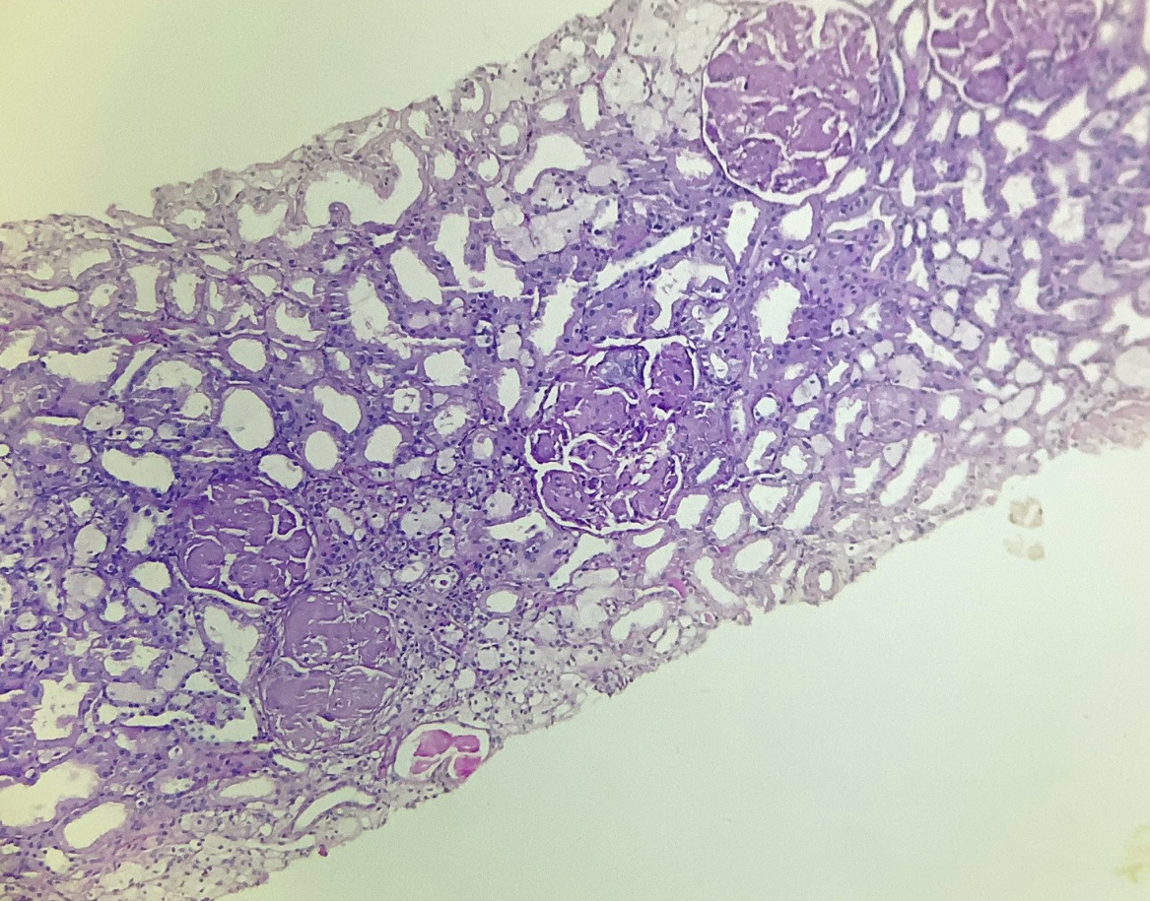
PAS Stain

Slide 9
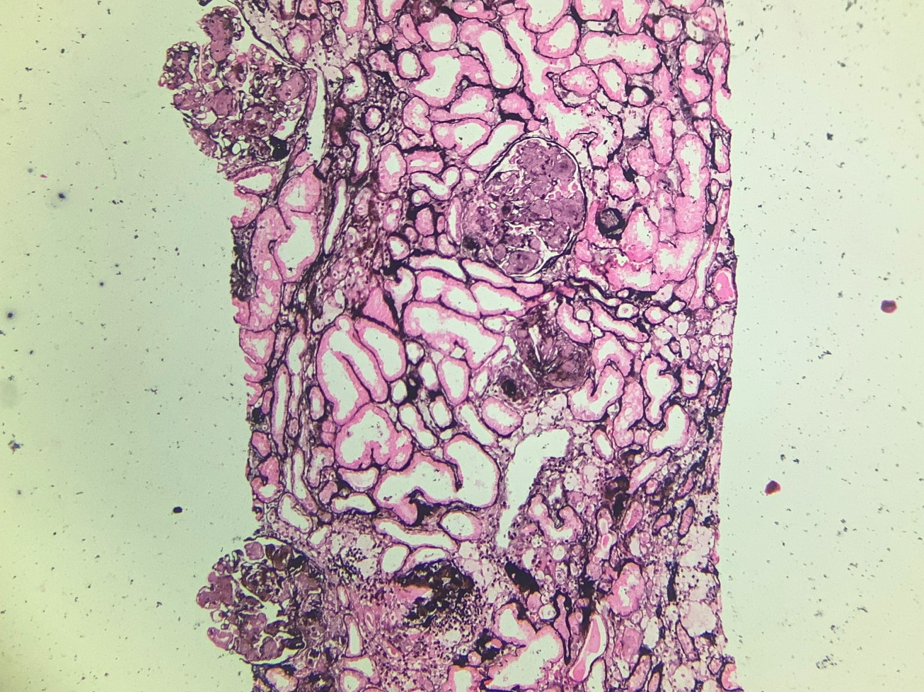
PASM Stain

Slide 10
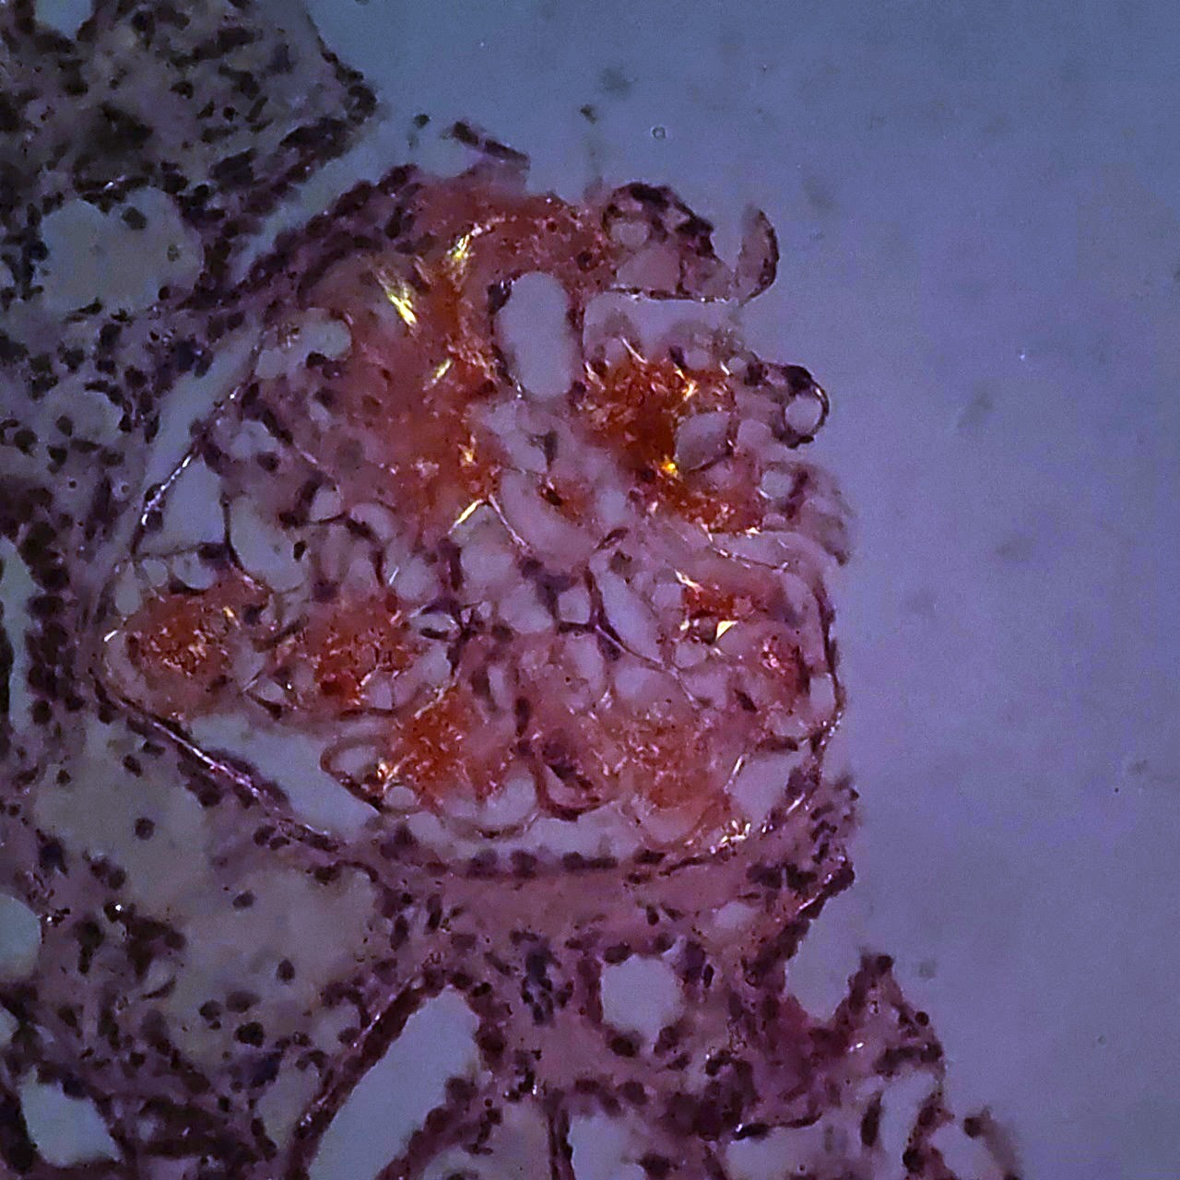
Congo Red stain under polarised light

Slide 11
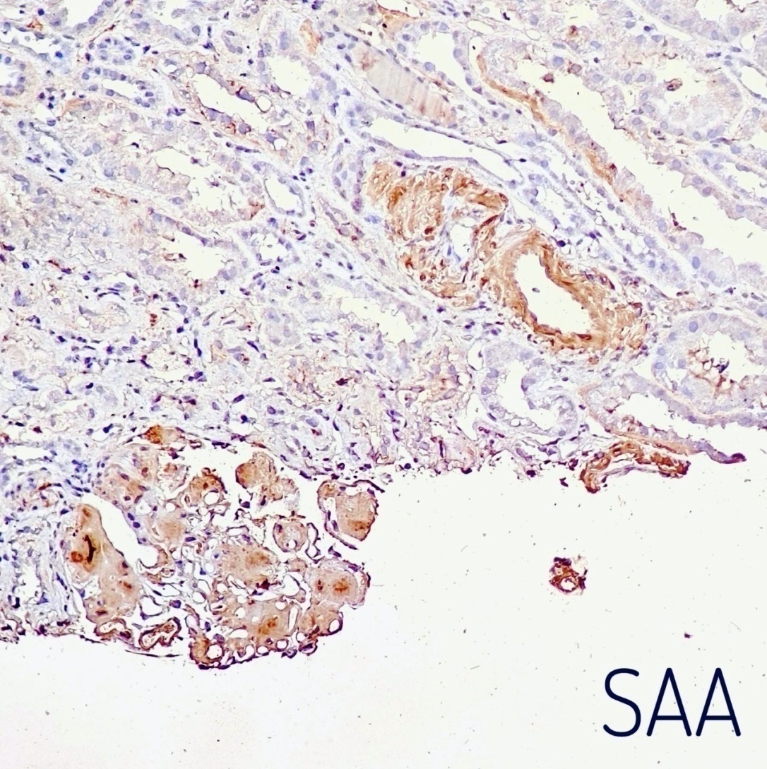
IHC for SAA

Slide 12
What is your Diagnosis?
What additional IHCs may be done?
What findings do you expect on electron microscopy?

