Slide 1
ISRTP
Case of the Month-May,23
30 years male presented with Rapidly progressive renal failure
Contributor: Dr Manoj Jain

Slide 2
33 year old male
C/O
Headache - 3 days ; Blurring of vision - 2 days
Evaluated and detected to have BP of 212/160 mmHg
Fundus examination - multiple haemorrhages and grade IV HTR
ECG - changes s/o LVH with strain pattern
O/E:
CNS- Lateral rectus palsy on Lt side
Rest - WNL
O/I
Hb- 9.6 gm/dl, TLC- 11.2 x1000/ul, Platelets – 72 x1000/ul.
PBS 4-5% schistocytes, Reticulocytes -3.33 %
S. Creat - 6.2 mg%
LDH - 1426 mg%, C3 - 101.0 mg/dl, C4 - 26.6 mg/dl,
Anti-GBM <3.0 u/L , Anti MPO <3.0 u/L , Anti PR3 <3.0 u/L
Urine Examination
Albumin 2+, WBCs 8-10m /HPF , RBCs >100/HPF
USG: Bilateral normal sized kidneys
Syndromic diagnosis: Rapidly progressive renal failure
Kidney Biopsy performed

Slide 3
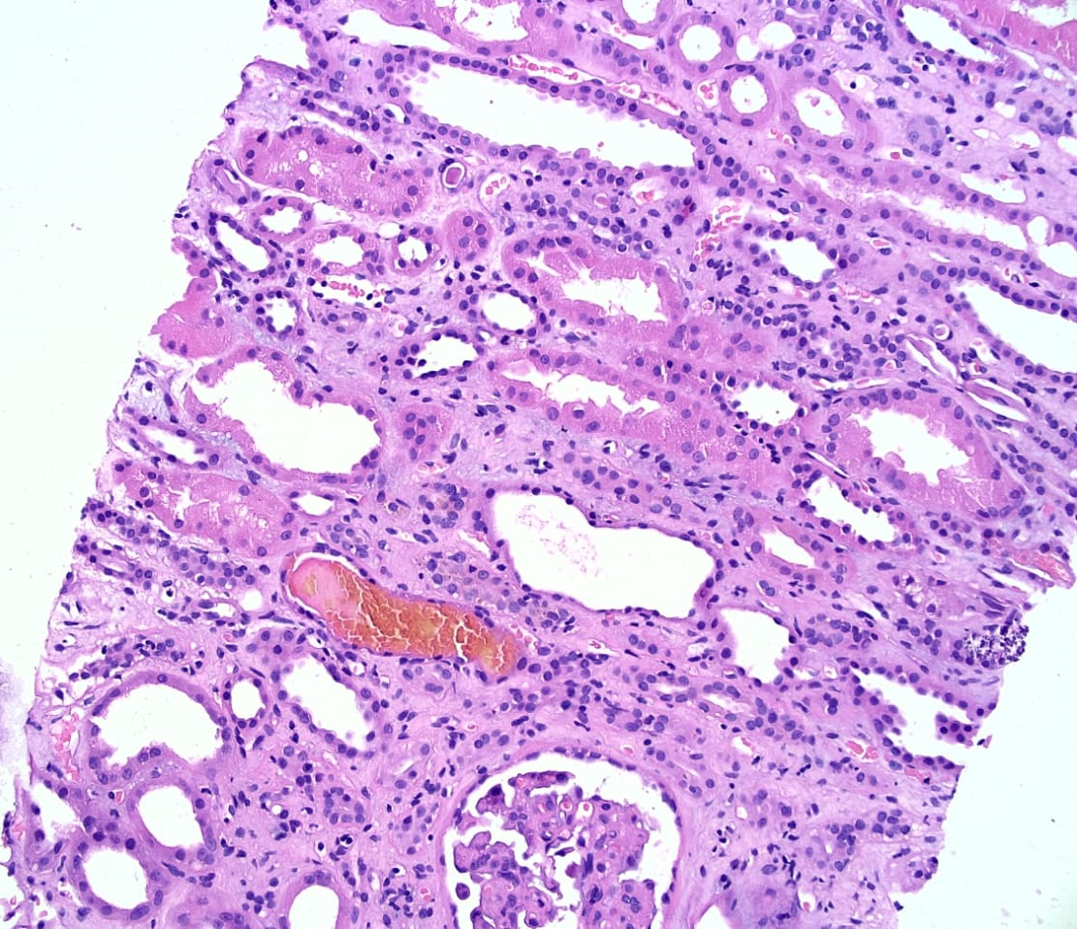

Slide 4
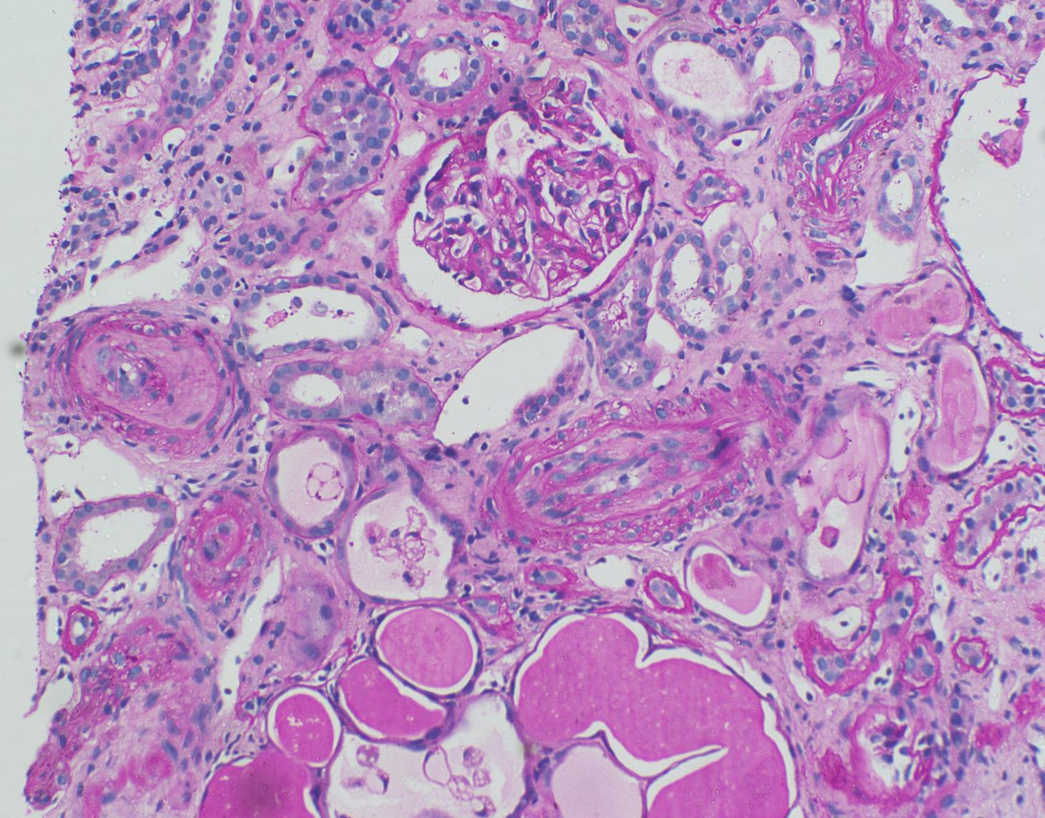

Slide 5
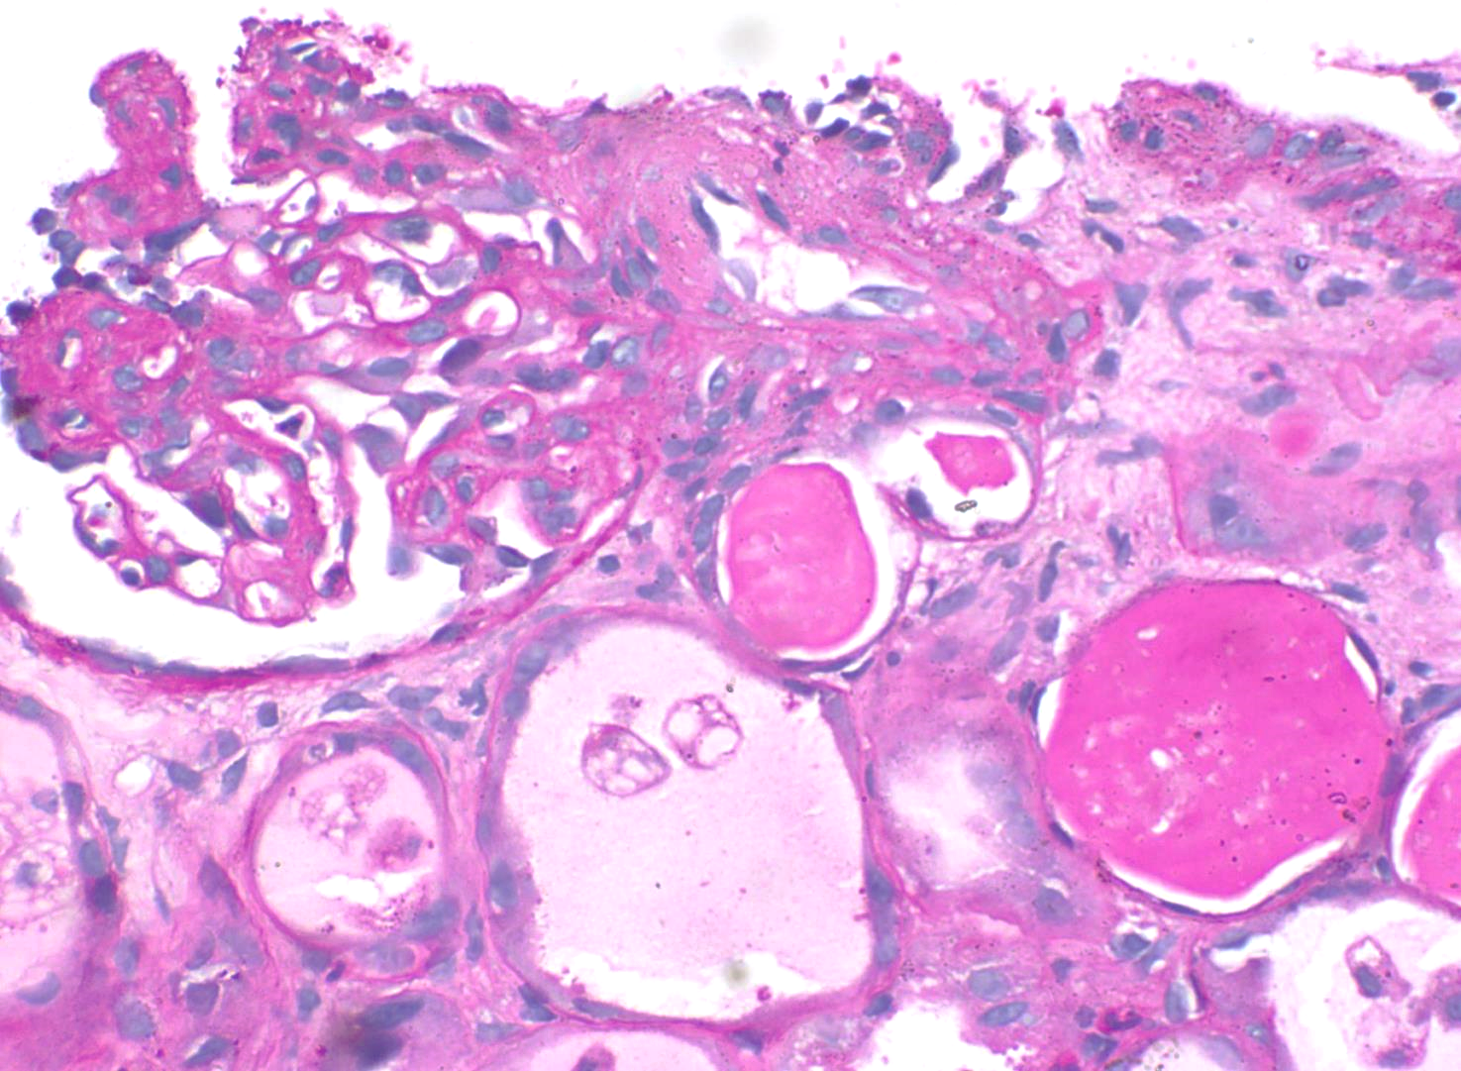

Slide 6
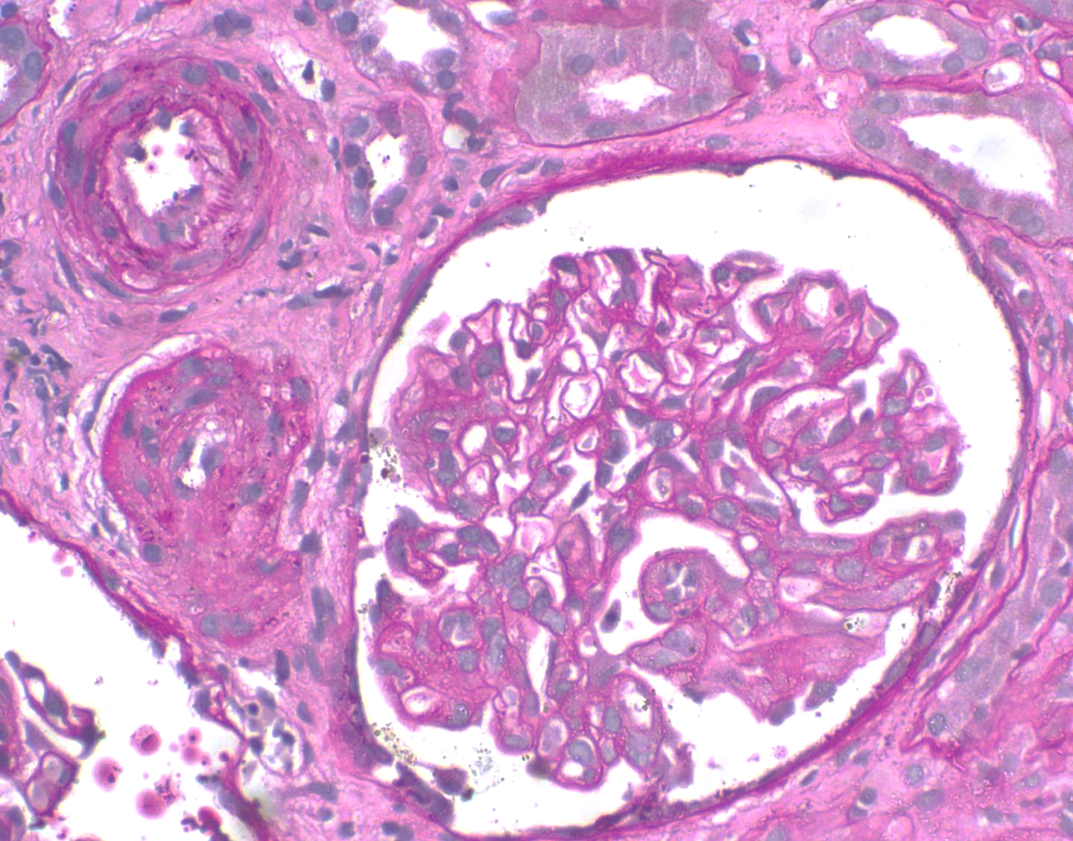

Slide 7
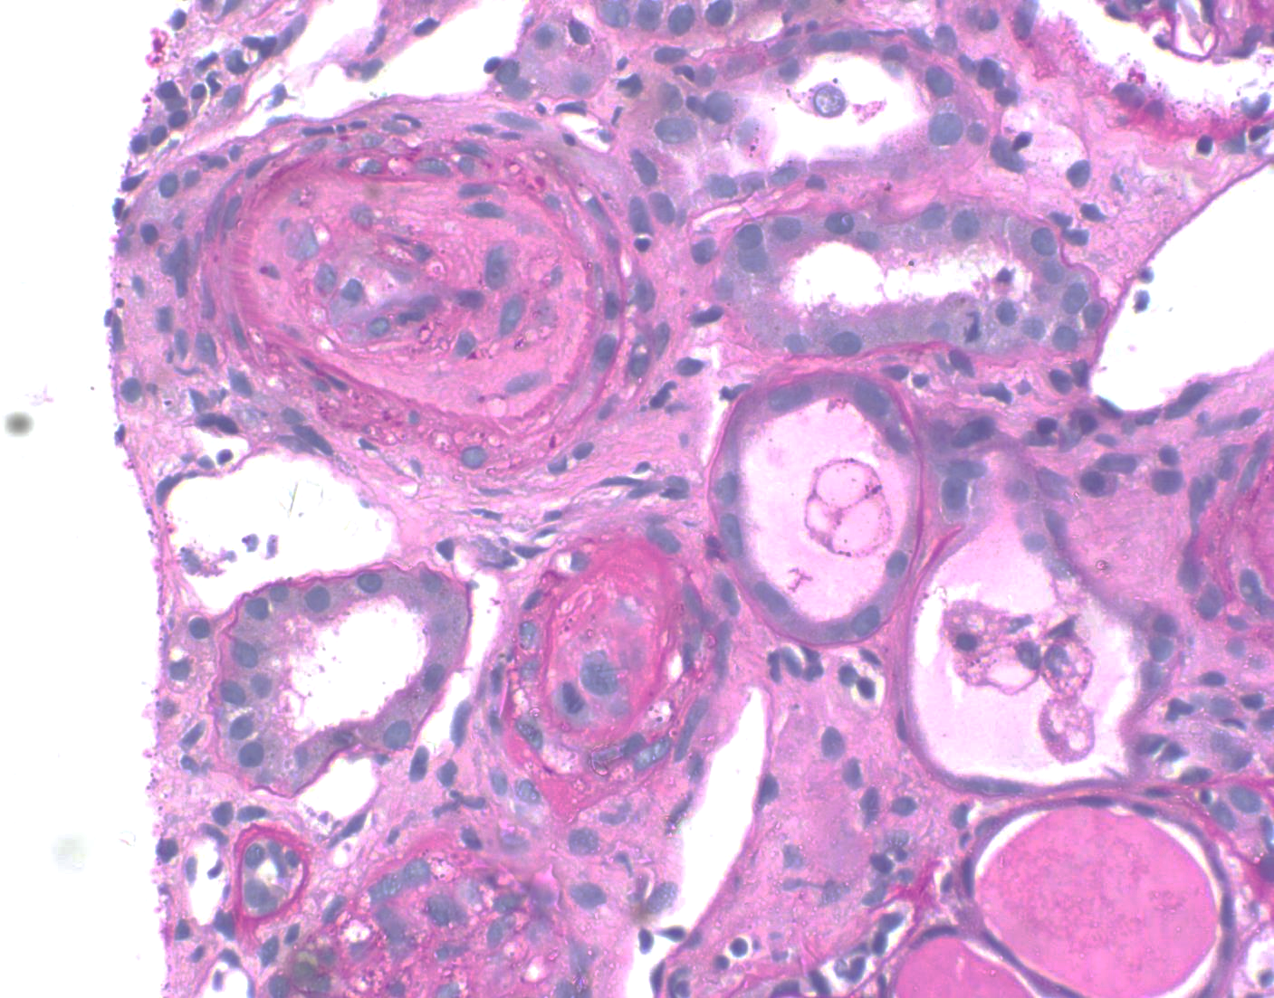

Slide 8
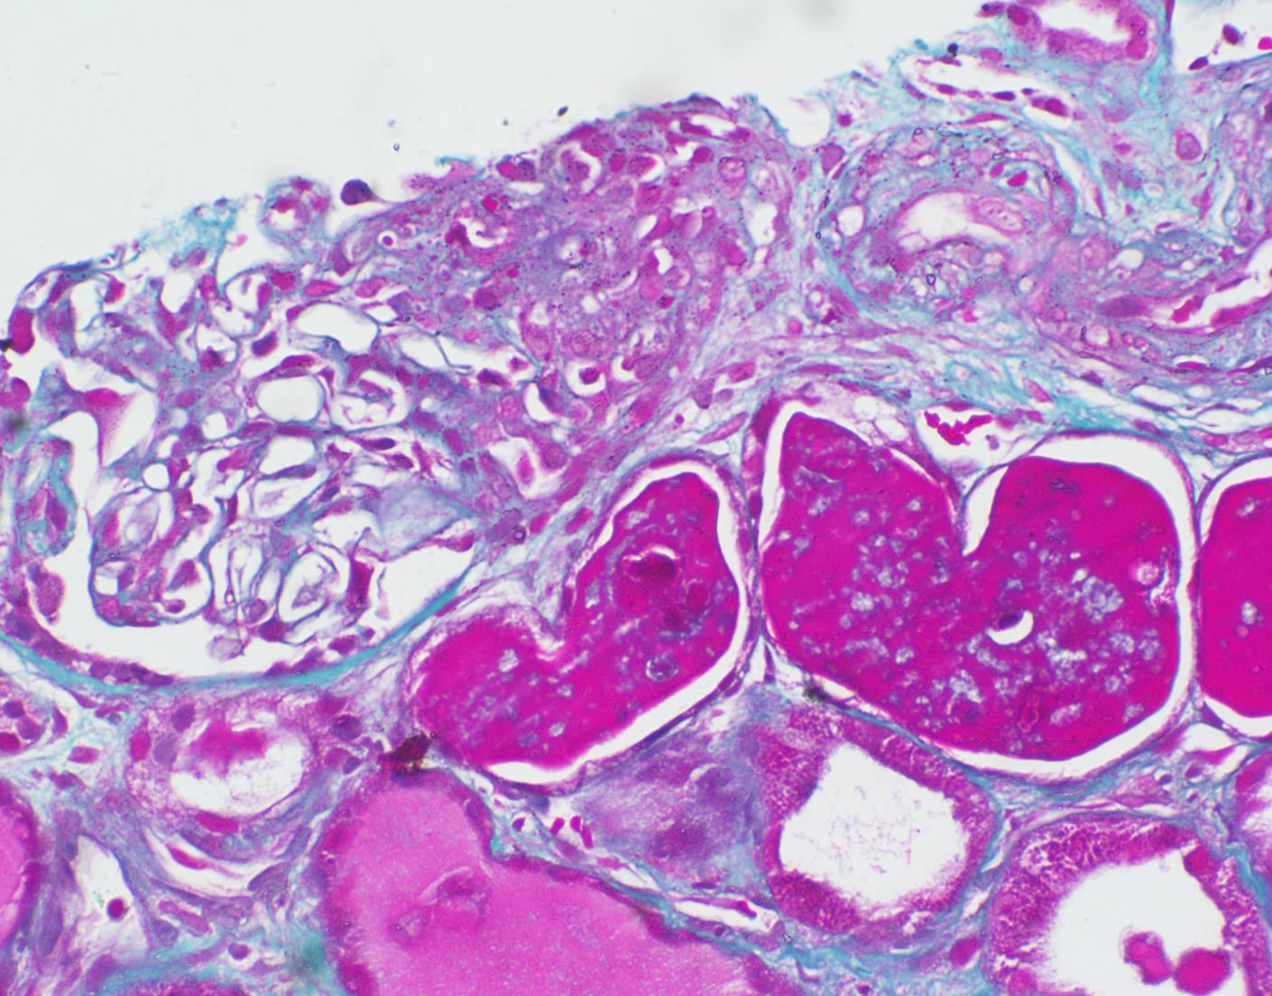

Slide 9
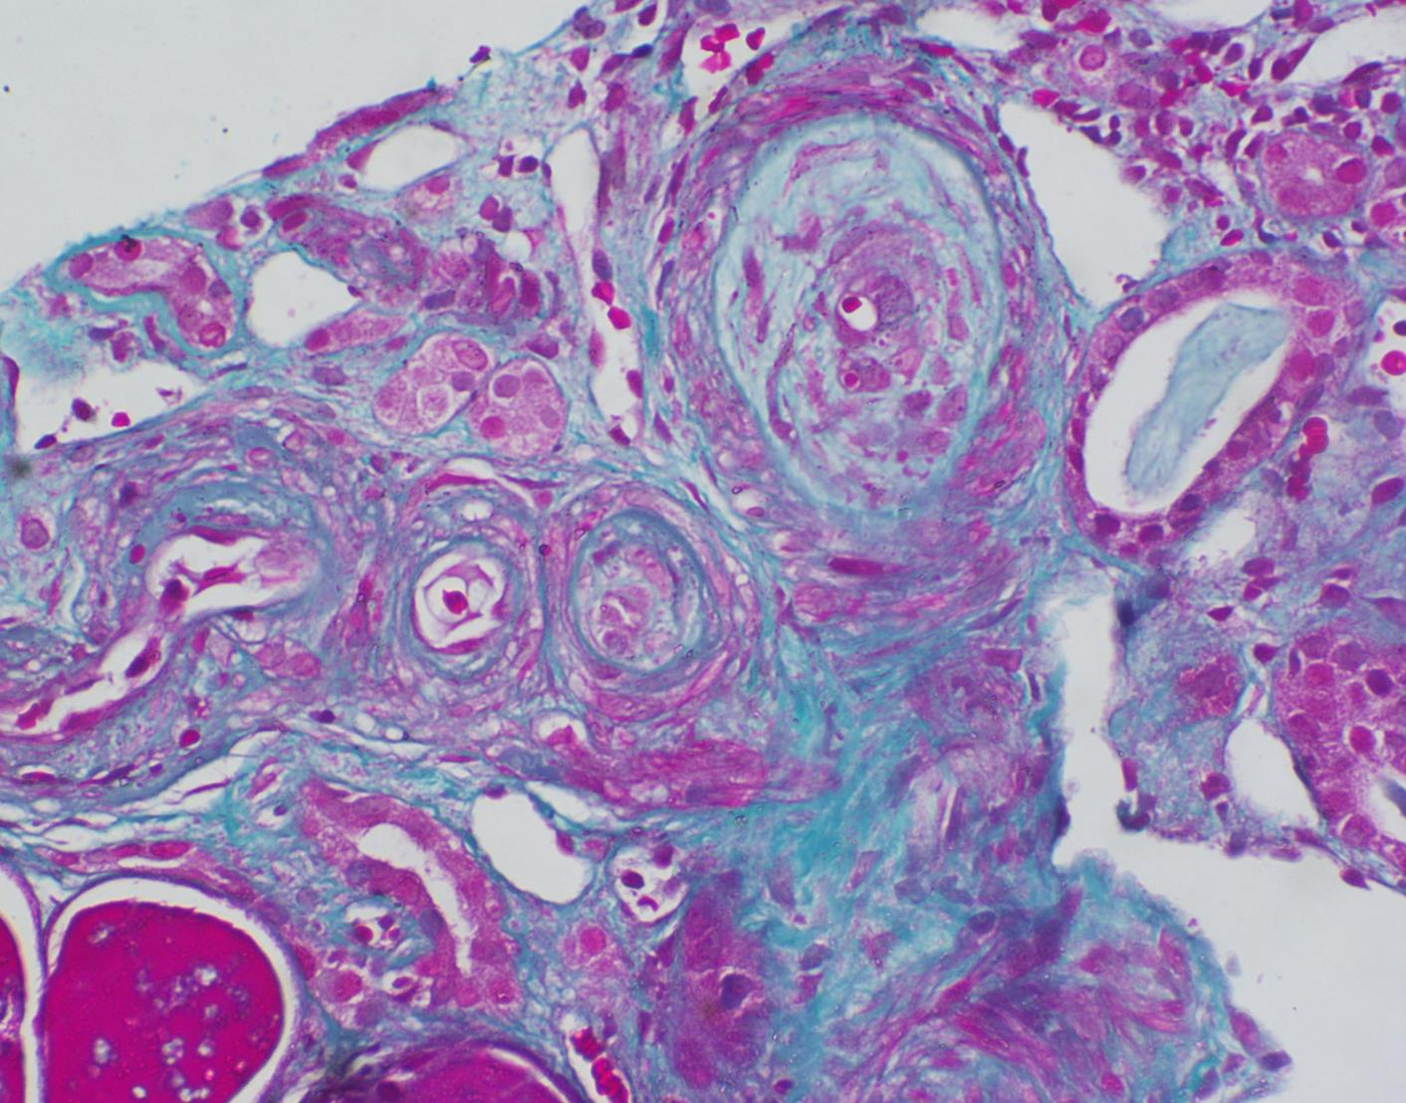

Slide 10
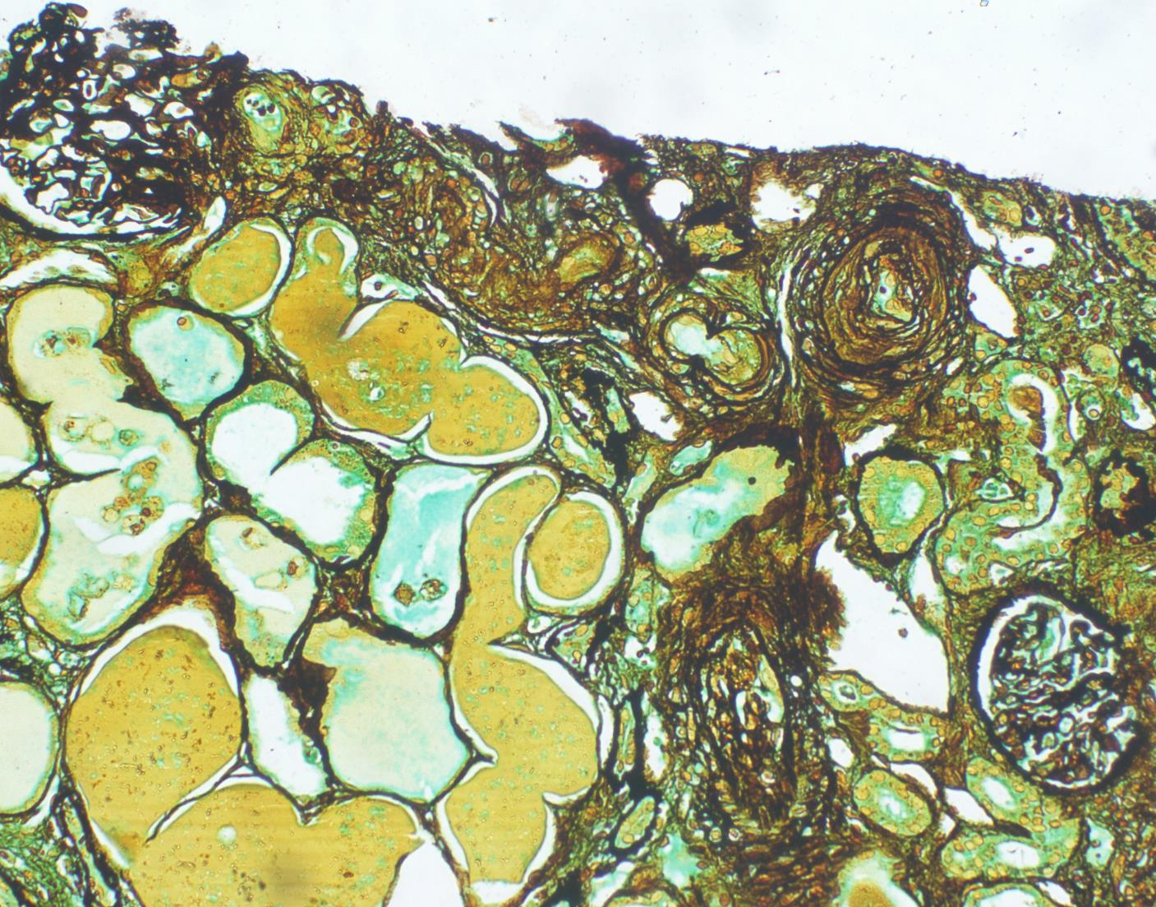

Slide 11
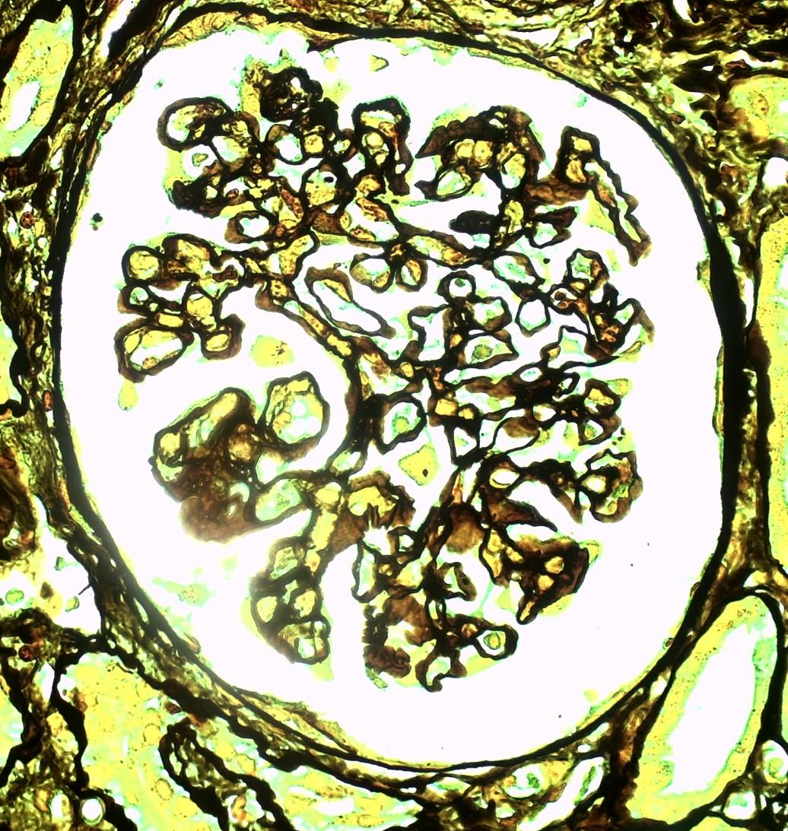

Slide 12
Direct Immunofluorescence
Negative for IgG, IgM, IgA, C3 & C1q

Slide 13
Diagnosis?
Probable aetiology ?
Further diagnostic workup?
Management ?

