Slide 1
Case history
42 yr male nondiabetic, hypertensive presented with progressive raise in serum creatinine.
USG shows bulky left kidney, with presence of hypoechoeic lesion. Right kidney shows small hypoechoeic lesions.
Previously in June '09- He had bilateral suppurative pneumonia with empyema; treated with ATT in outside hospital for 6 months.
Later in Aug 2010, CT showed bilateral lung opacities along with paraaortic lymph node enlargement, hepatomegaly. Spleen is spared.
Wedge Biopsy – Liver (Aug 2010)
Biopsy – LEFT kidney (Oct 2010)

Slide 2
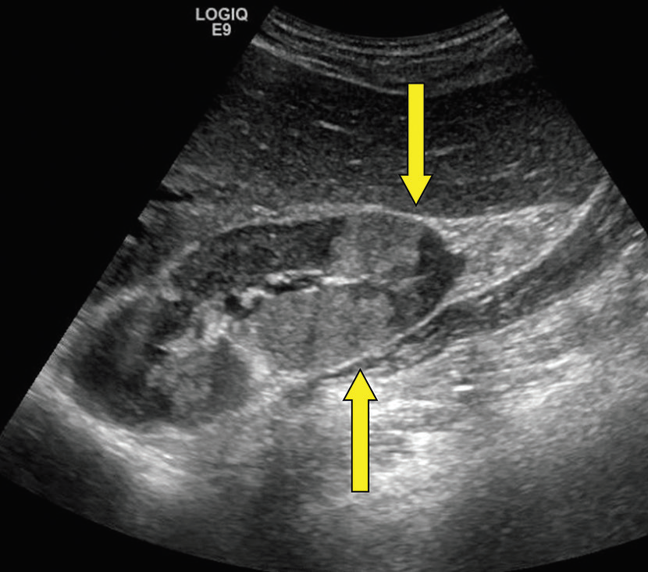

Slide 3
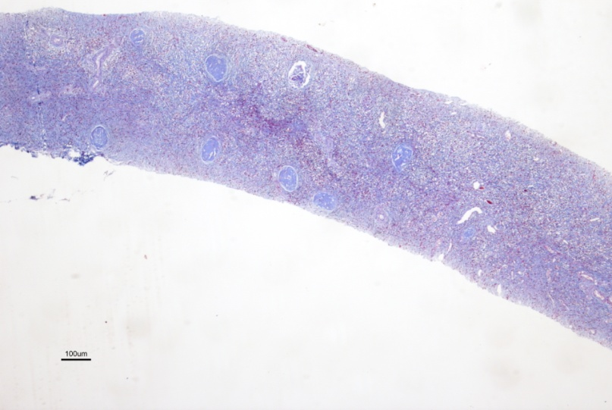
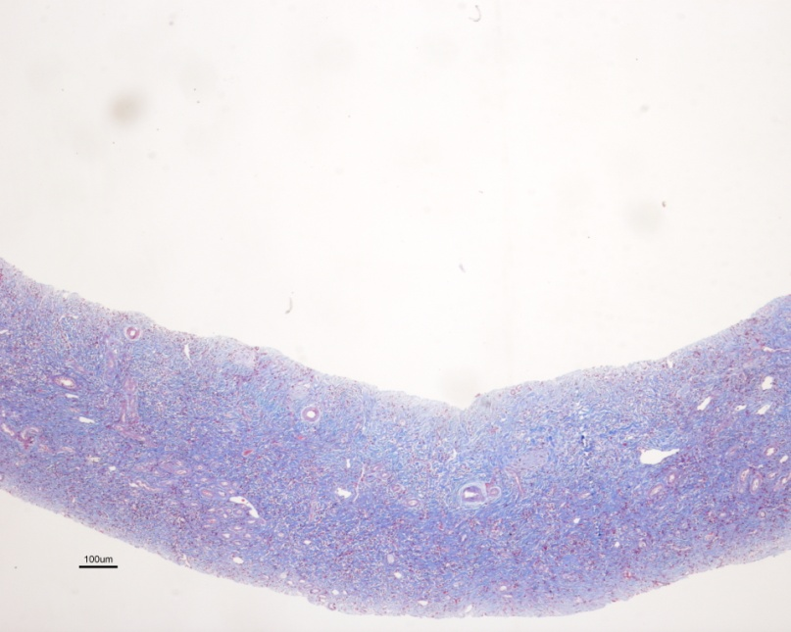
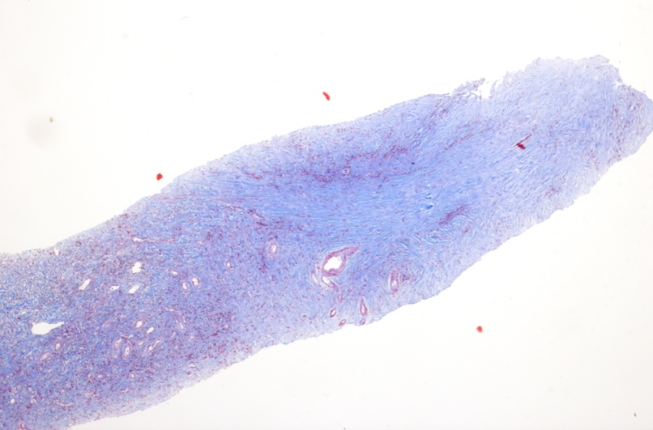
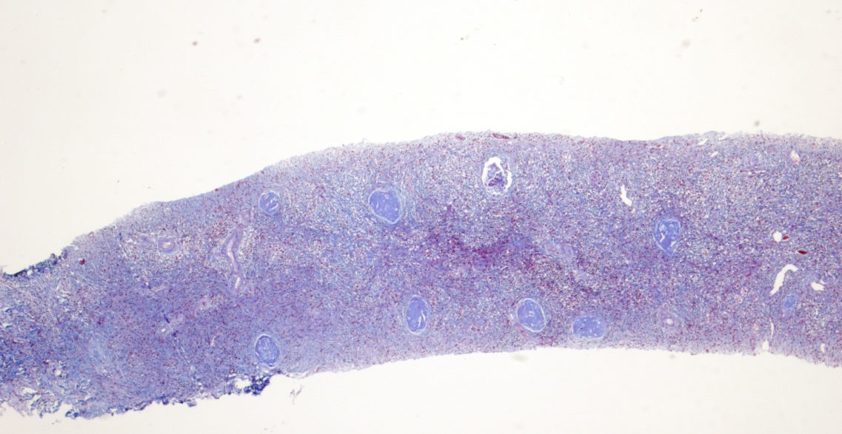
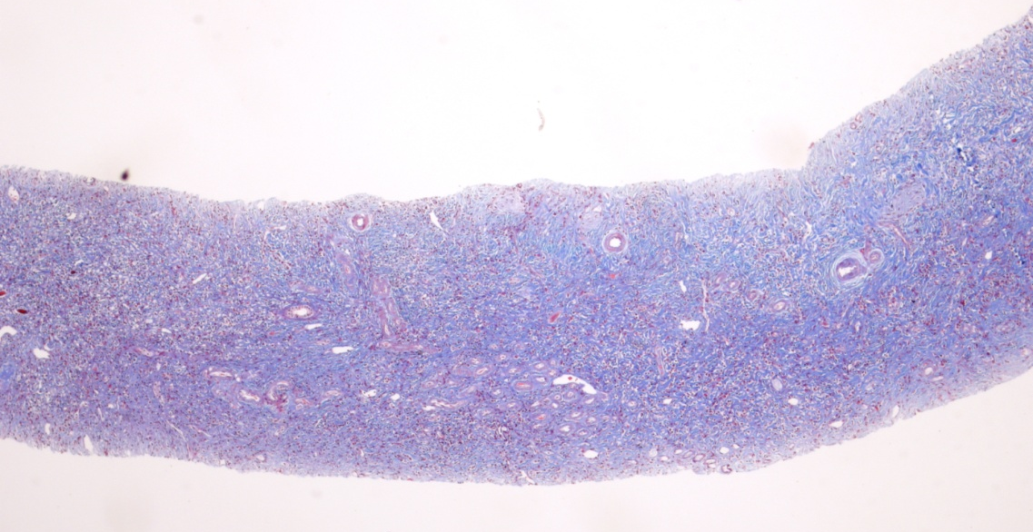

Slide 4
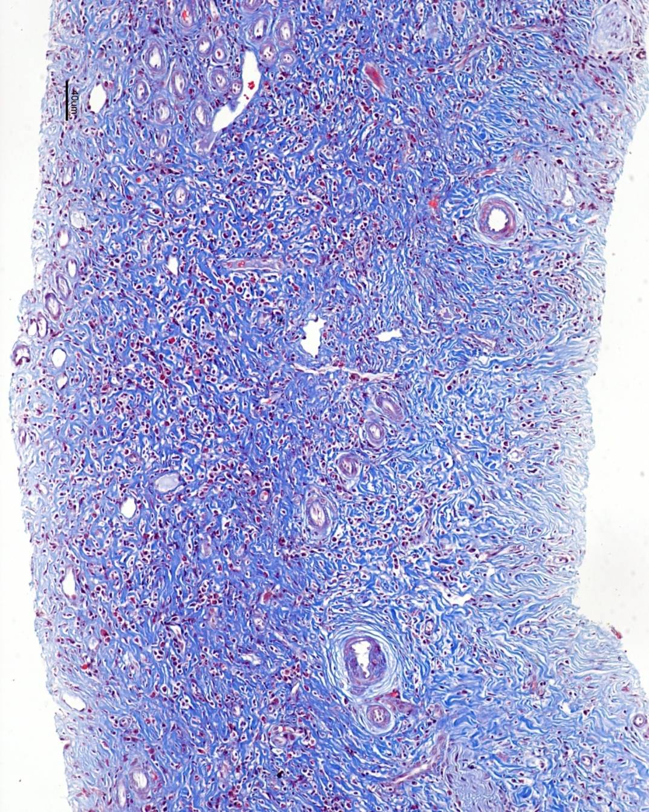
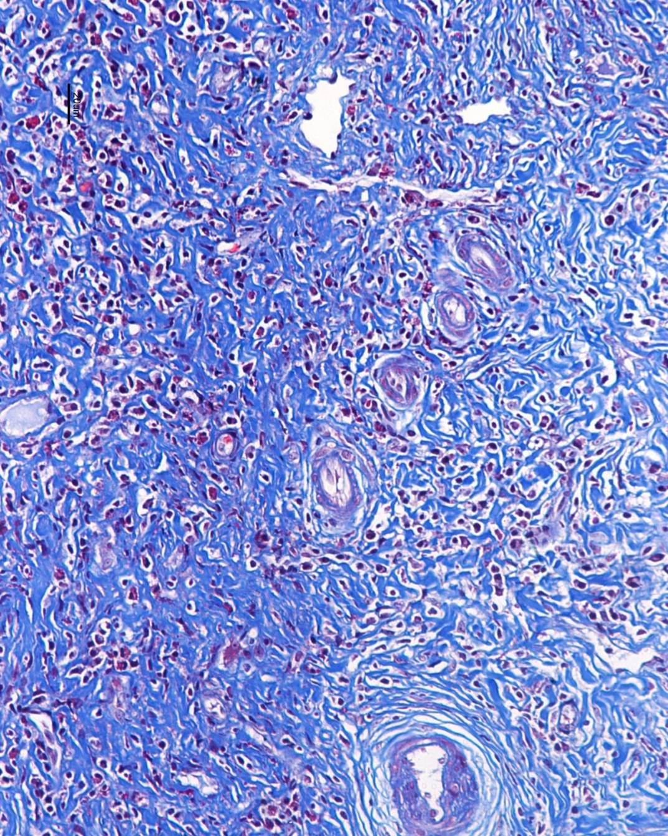

Slide 5
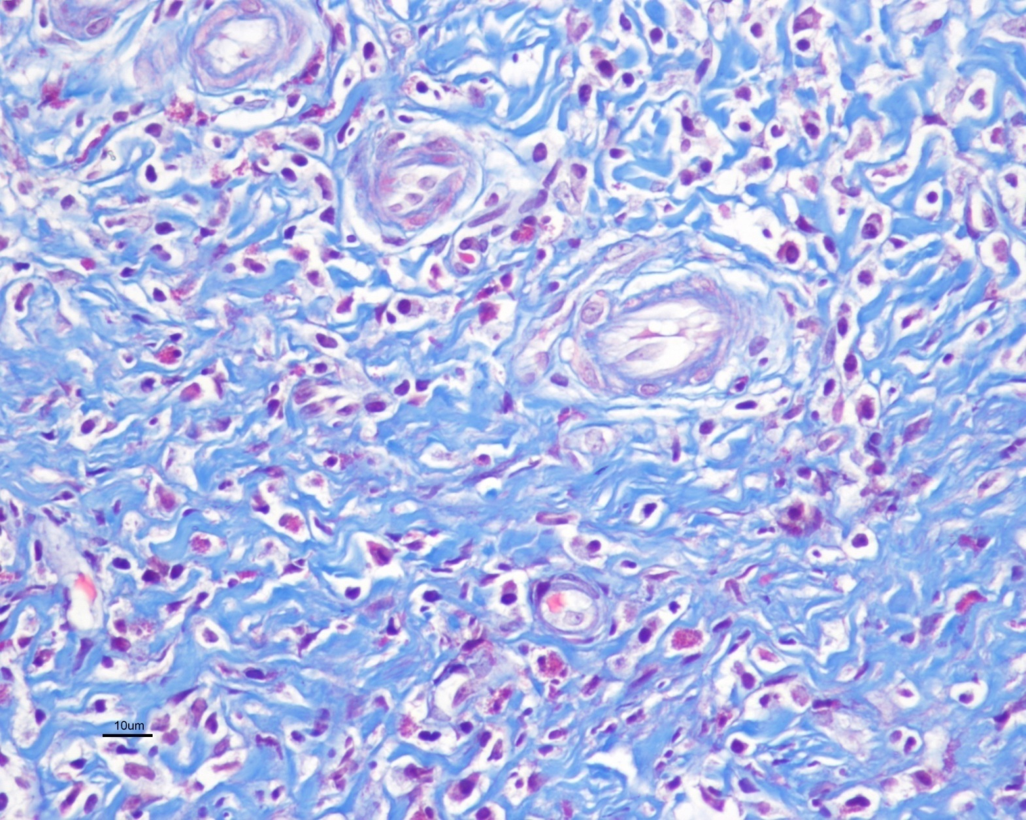

Slide 6
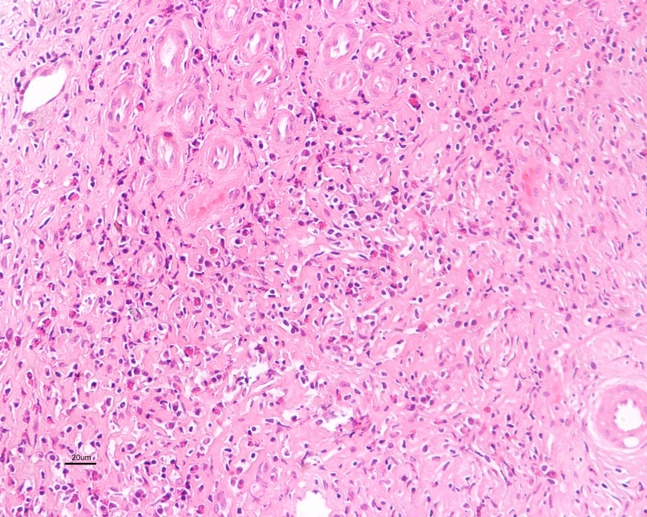

Slide 7
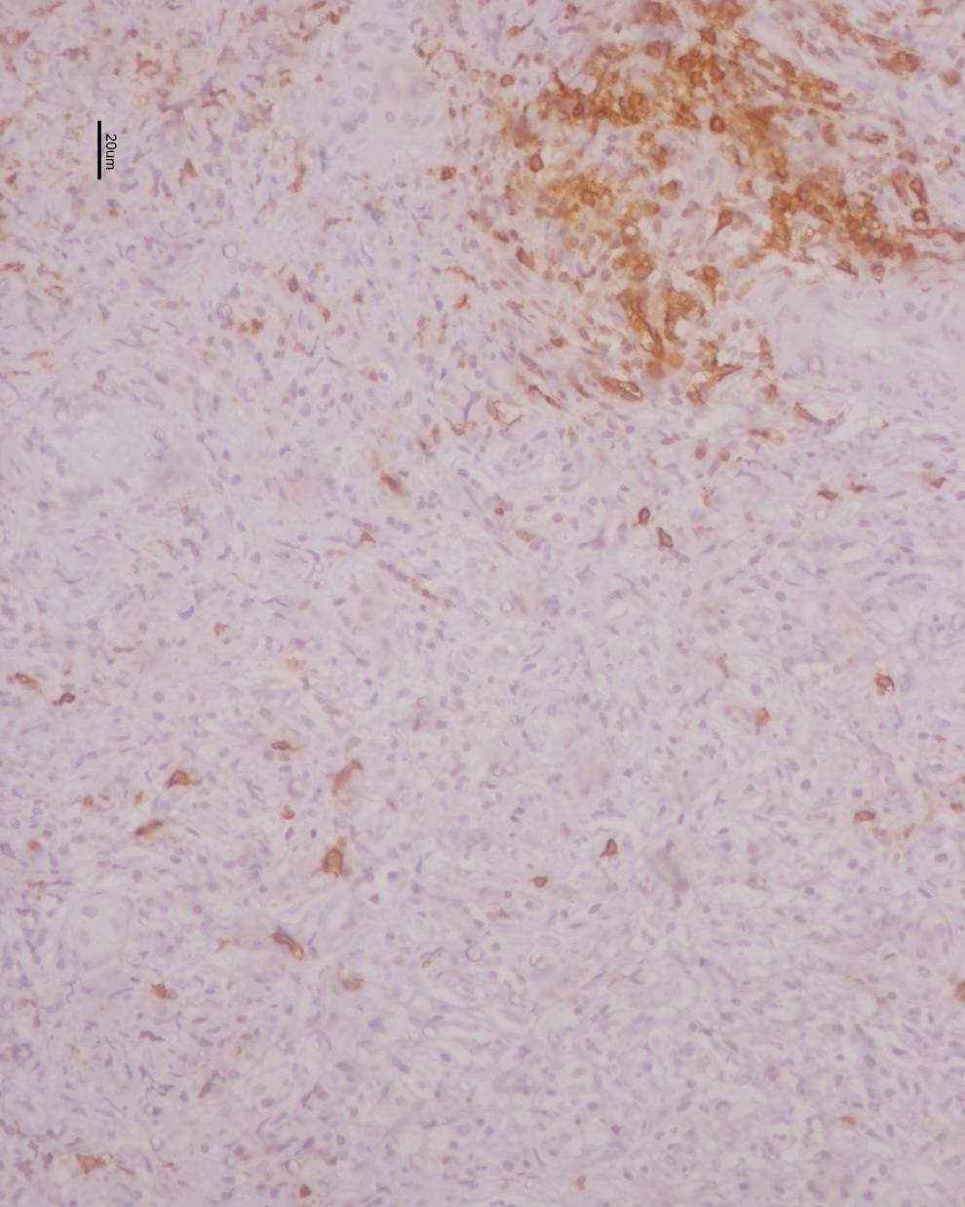
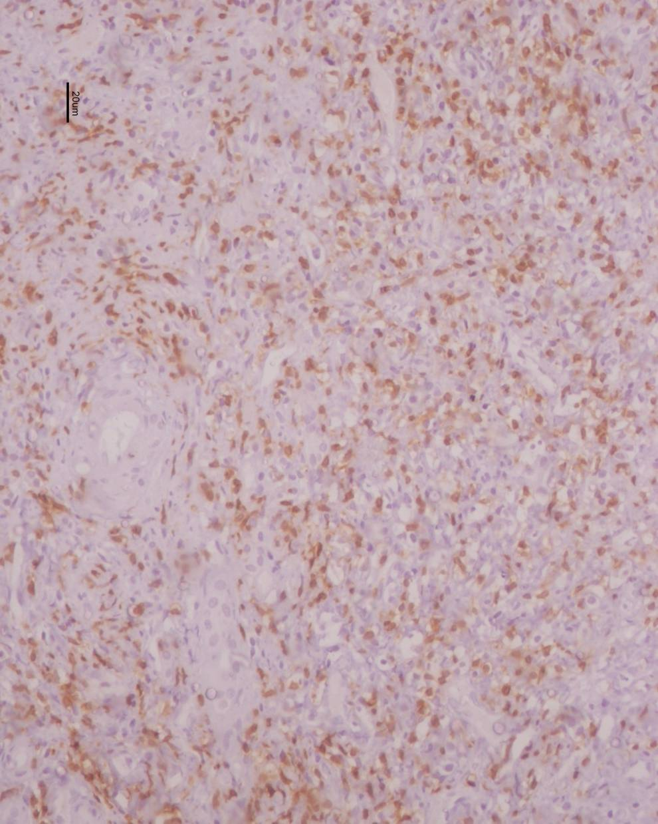
CD 20
CD 3

Slide 8
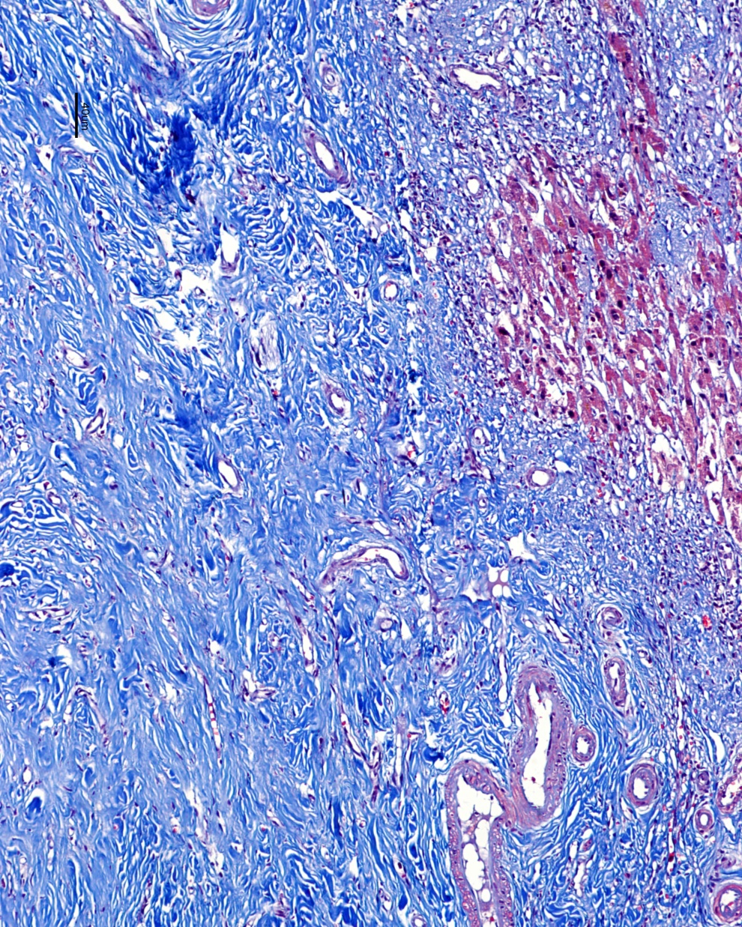
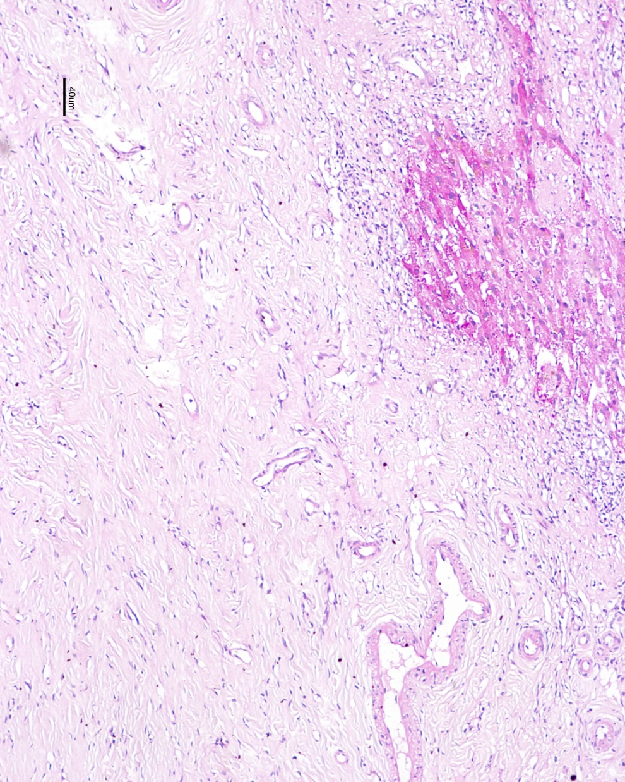
Liver, wedge biopsy

Slide 9
IMPRESSION
Inflammatory Pseudotumor / Pseudolymphoma

Slide 10
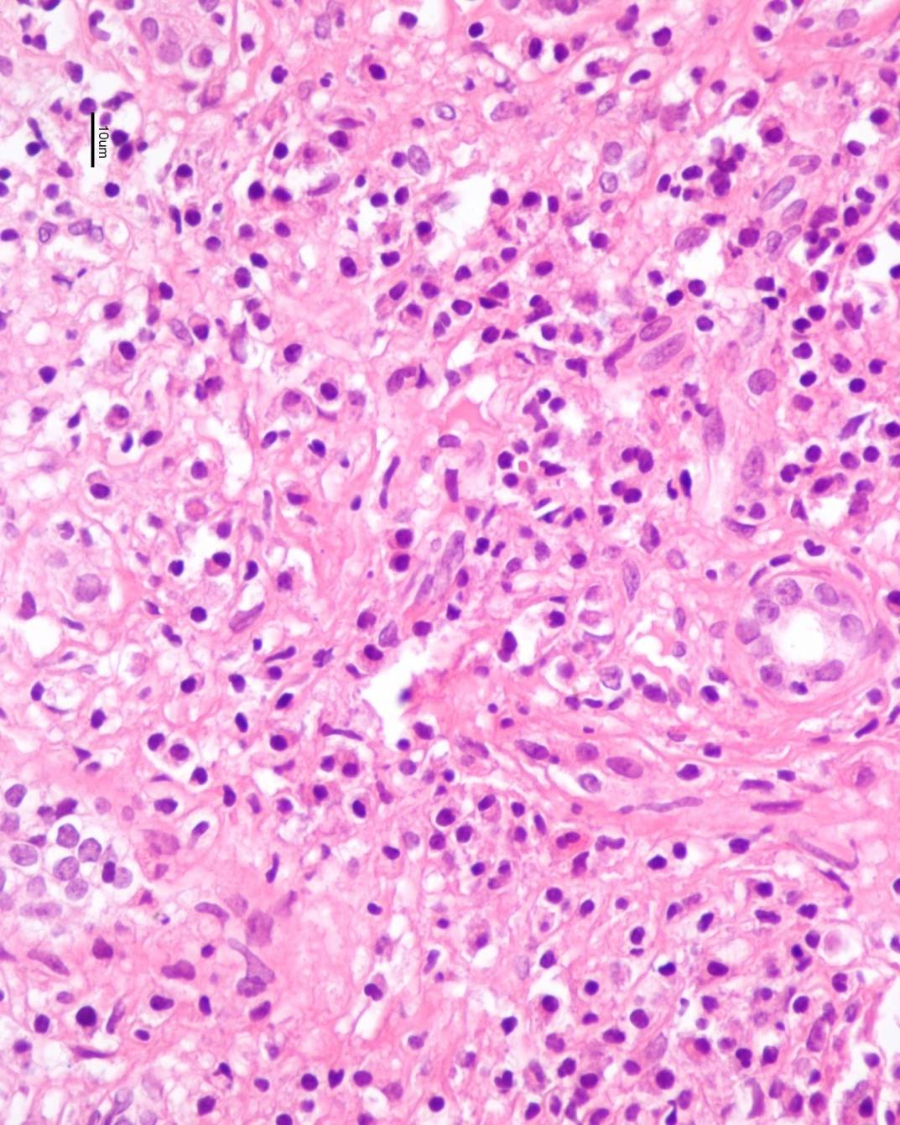
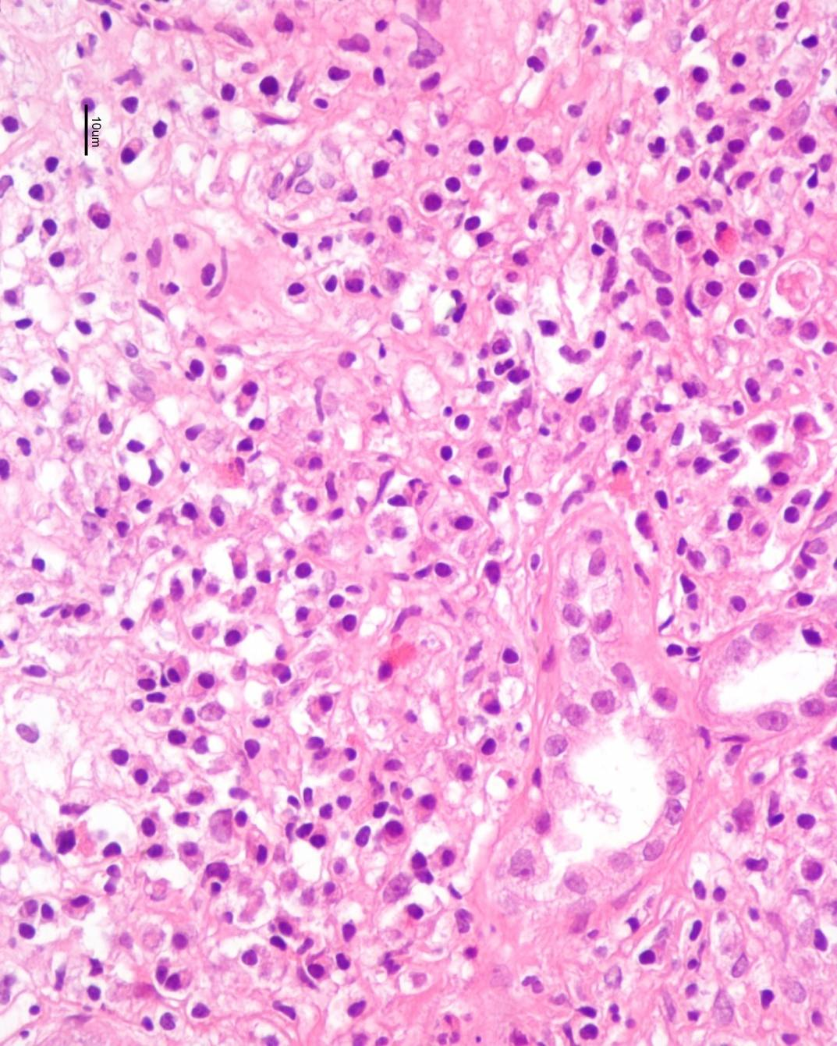

Slide 11
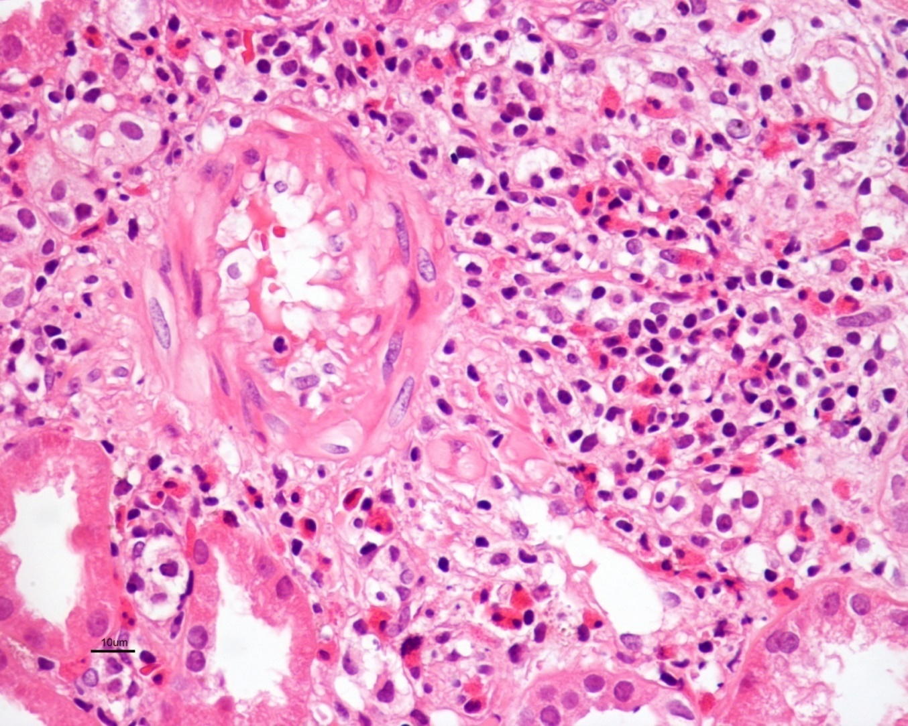
3

Slide 12
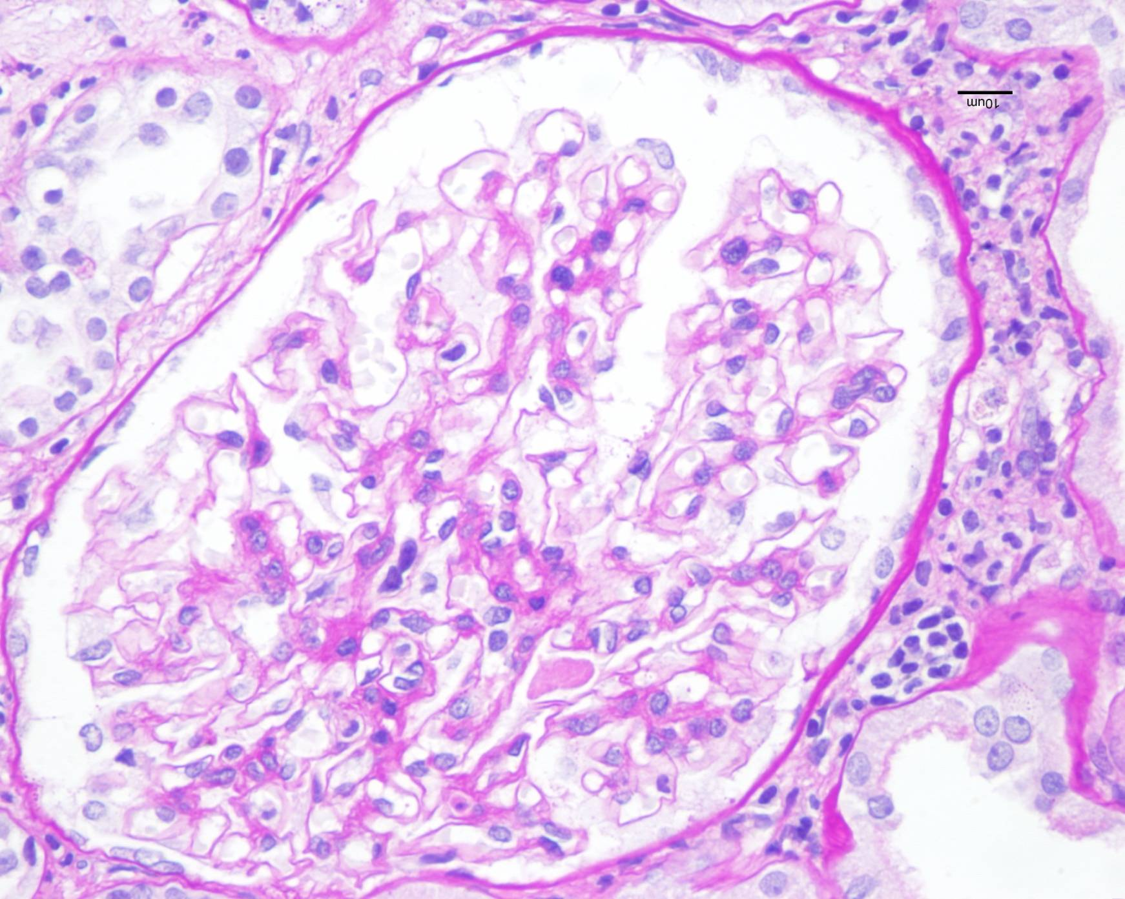

Slide 13
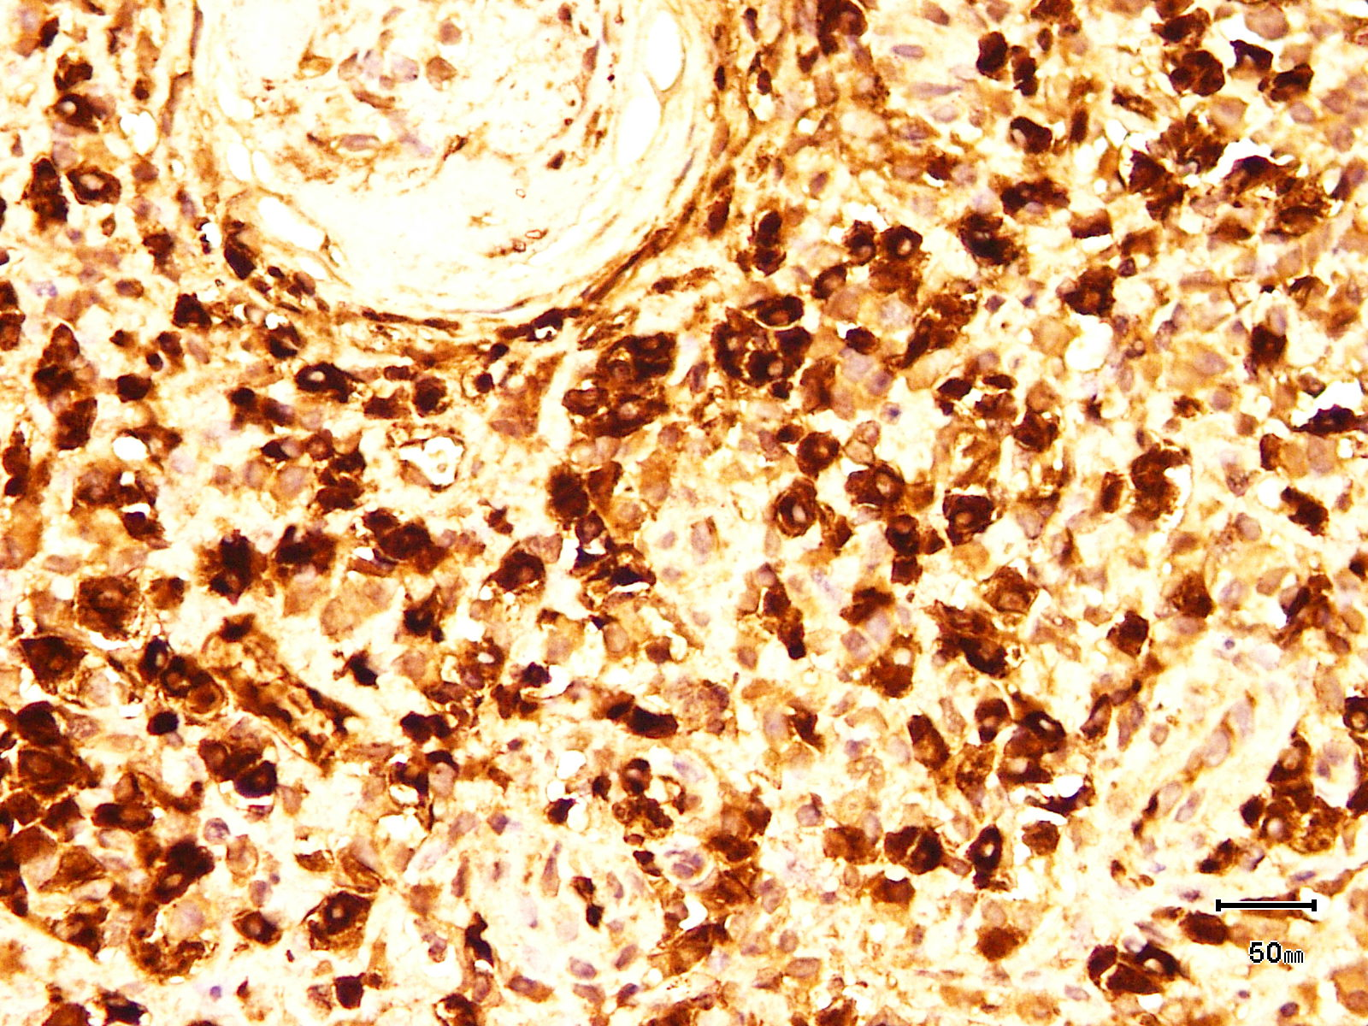
IHC- IgG4

Slide 14
Serum IgG4 - 26.9 g/l (normal <135 mg/dl) and
Serum IgG4/IgG ratio 68% (normal <5%).

Slide 15
N Engl J Med 2012; 366:539-551

Slide 16
IgG4 RELATED DISEASES Organ distribution
Pancreas: prototype disease
Extrapancreatic involvement
prior
concomitantly
following pancreatic disease
Other organ involvement 83%
May occur independently in the absence of pancreatitis
Renal TID 17%

Slide 17
Criteria for diagnosis of IgG4-TIN

Slide 18
J Am Soc Nephrol 22: 1343–1352, 2011

Slide 19
Histological features of IgG4-related and non-IgG4-related TIN
Lesion | IgG4 | Non-IgG4
Inflammation extending into renal capsule | ●
>10/HPF IgG4-positive plasma cells | ●
“Storiform” fibrosis | ●
Granulomatous lesions |  | ●
Lymphoid follicles |  | ●
Severe tubulitis |  | ●
Neutrophils |  | ●
Eosinophils | ● | ●
Medullary involvement | ● | ●
Nephrol Dial Transplant. 2012 Jul;27(7):2755-61

Slide 20
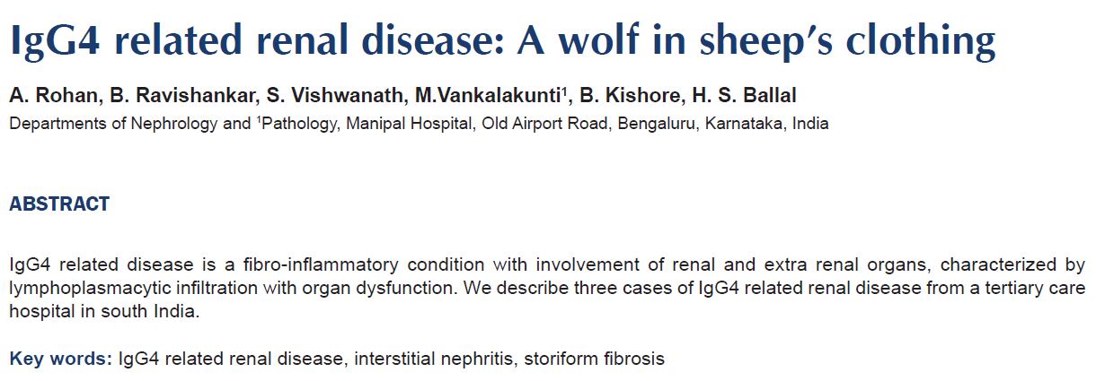
Case 1
Oral prednisolone - dialysis independent.
Tapering doses – improved pulmonary symptoms & resolved mediastinal nodes on X-ray
Case 2
Oral prednisolone & subsequently MMF - Complete remission
Case 3
Lost to follow-up
Indian J Nephrol 2014;24:382-6

Slide 21
All but one patient (90.9%) received ISP therapy.
Complete remission – Four (36.3%)
ESKD – Three (27.2%)
Death – Two, due to infections while on steroid Rx.
One patient with a mass had end stage renal disease for 12 months and did not improve with steroid therapy, &
One had progressive chronic kidney disease on follow-up.
April 2011 - July 2013
11 patients/3929 (0.28%)
Age range, 21=71 yrs
M:F = 8:3
Mean Sr Creat, 5.1 mg%
Follow-up, 1 year

