Slide 1
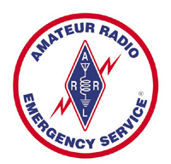
Foster City Amateur Radio Emergency Service® (ARES®)
Very Brief Emergency Power
March 9th, 2026

Slide 2
Agenda
Definitions
How much do I need?
Sources of power
Bringing it together
Safety
Q&A

Slide 3
How much do I need?
Typical discussions involve Current (Amperes), Voltage (Volts), Power (Watts, Watt-hours) and sometimes other terms.
For today, we will make a few assumptions and simplify things:
  DC voltage needed by most modern devices is 13.8 Volts DC.
  RF power (i.e. 50 watt VHF mobile at high power) is not the same as electrical power.
  Rule of thumb -> Electrical power is 2-4x the RF power when transmitting.
  Watts are instantaneous power
  Watt-hours are how much is stored or consumed
    50 watts for 2 hours is 100 watt-hours
    More realistic – 50 watts for 2 hours, 25% TX, 10 watts standby/listen
    (50 watts * 25% + 10 watts * 75% ) * 2 hours → 40 watt-hours

Slide 4
Definitions
Power
  Power (P) is the rate at which electrical energy is used
  Power is measured in watts (W)
Power is related to Voltage and Current
  P = E * I or E = P / I or I = P / E

Slide 5

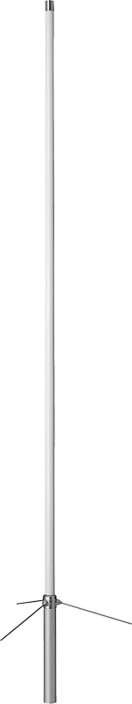
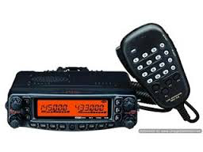
Electrical Power vs. RF Power
Radios convert electrical power from a battery or a power supply to modulated radio frequency (RF) power that radiates out into space (plus some heat)
Electrical Power (in)
Heat
RF Power (out)
  Electrical Power (in) = RF Power (out) + Heat (out)
  Electrical Power (in) > RF Power (out)

Slide 6

Definitions
Energy
  The ability of a system to do work
  A property of objects which can be transferred to other objects or converted to different forms, but cannot be created or destroyed -> conservation of energy
  Types of energy
    Kinetic
    Potential
    Chemical
    Elastic
    Radiant
    Thermal
    …

Slide 7
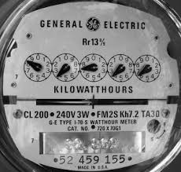
Energy
Remember - Power is the rate at which electrical energy is being used (energy / second) so…
  Energy is Power multiplied by time
Measured in several ways, most useful for us would be Watt-hours (Wh)
BUT since we are almost always working with constant voltages we sometimes will leave voltage out and look at:
  Amp-Hours (Ah)
  Milliamp-hours (mAh)
more on that later...

Slide 8
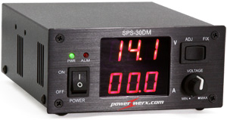
An Example
But first we need a power supply
Voltage (volts)
13.8
00.0
Current (amps)

Slide 9
An Example
System set up, radio turned off
13.8
00.0

Slide 10
An Example
Radio turned on, not receiving, not transmitting
Heat
13.8
00.5

Slide 11
An Example
Radio turned on, receiving, not transmitting
Heat
13.8
00.5

Slide 12
An Example
Radio turned on, transmitting on low power (5W in this example)
Heat
13.8
02.7

Slide 13
An Example
Radio turned on, transmitting on medium power (20W in this example)
Heat
13.8
04.8

Slide 14
An Example
Radio turned on, transmitting on high power (50W in this example)
Heat
13.8
07.6

Slide 15
An example
Lets look at the data from our little experiment
RF Power Setting | Current Drawn | Electrical Power (@13.8V)
0W | 0.5A | 6.9W
5W | 2.7A | 37.3W
20W | 4.8A | 66.2W
50W | 7.6A | 104.9W

Slide 16
What did we learn?
For this radio
  Just listening consumes power
  Transmitting on the lowest power setting takes 5 times the power of just listening
  Efficiency (RF power/Electrical power) improves as you increase RF power

Slide 17
An interesting question
If I were using this radio as a net control operator for a busy net, how much power do I use on average?
Assumptions:
  50% of the time there is no activity (0.5A)
  25% of time we are listening (0.5A)
  25% of the time we are transmitting on low power (2.7A)

Slide 18
A little math
Weighted average current
= (50% * 0.5A) + (25% * 0.5A) + (25% * 2.7A)
= 1.05A
P = E * I = 13.8V * 1.05A = 14.5W

Slide 19
Another question
So how much energy will I need in two hours of operation?
Recall:
  Energy = Power * Time
Energy = 14.5W * 2 hours = 29.0 Wh (watt-hours)

Slide 20
Radio Power Needs
Most mobile radios will need a nominal voltage of 13.8V DC and are designed to operate off conventional automotive 12V DC power systems
HTs usually run off of batteries specific to the radio and have their own specific operating voltages.
Large fixed base stations will generally run off of household AC (110V AC in the US)

Slide 21
Power Sources
All power sources convert some form of supplied or stored energy into the form you need for your radio. We will be discussing:
  AC to DC Power Supplies
  Batteries
  Solar Power
  Generators

Slide 22
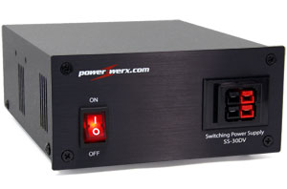
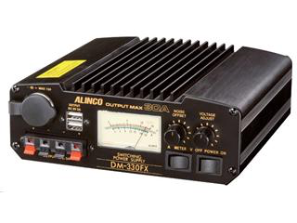
AC/DC Power Supplies
Take household power (110V AC) and convert it to DC.
Useful Features
  Control of voltage/current
  Meters for voltage/current
  Powerpole connectors
  USB ports
Power supplies have a maximum current rating. Use a power supply that is big enough for everything that it needs to power (radio(s), TNC, etc.

Slide 23
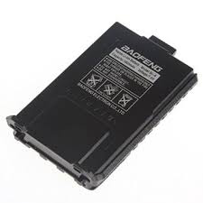
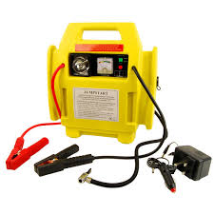
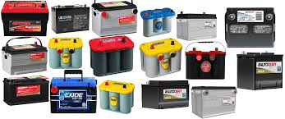
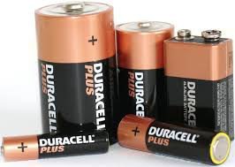
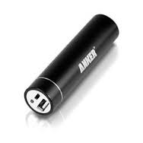
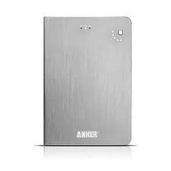
Batteries
Devices that uses chemical reactions to create electrical potential and supply current or the reverse to store energy
Many different battery “chemistries”
Different voltages, capacities, sizes, packaging, handling characteristics

Slide 24
Battery Chemistries
Different chemical reactions have different characteristic electrical potentials (voltages)
  Lead-Acid, Nickel Cadmium (NiCd), Lithium Ion (Li-ion, Nickel-Metal Hydride (NiMH), Lithium Iron Phosphate (LiFePO₄)
Because the battery chemistries differ, when charging batteries you must use a charger compatible with that particular battery type/chemistry

Slide 25
Lead-Acid Battery Types
Most common 12V battery type
Construction
  Wet – liquid electrolyte, needs periodic maintenance
  Gel – gel electrolyte, no maintenance required, spill resistant
  AGM – absorbed glass mat, spill proof, no maintenance (best for portable use)
Types
  Starting – Provide a very large amount of current for a short period of time (for starting a car)
  Deep-cycle – Provides a steady amount of current over a long period of time. (use these)

Slide 26
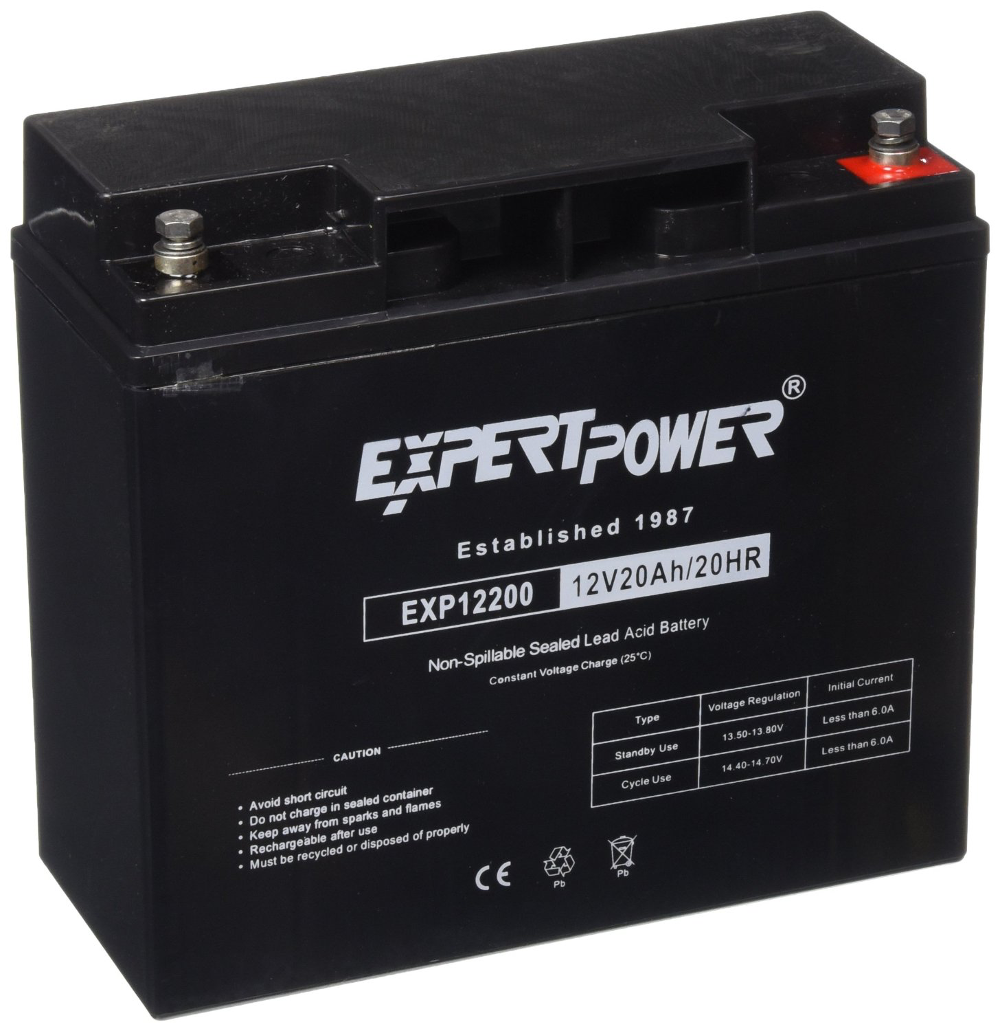
Battery Capacity
Battery capacity is measured in Ampere-hours or Watt-hours (Ah * V = Wh)
For example, a 20Ah, 12V battery can sustain:
  1 A current for 20 hours
  2 A current for 10 hours*
  5 A current for 4 hours*
Tradeoffs
  Lead-acid $40, 12.3 lbs., 138 inches³
  LiFePO4 $204, 5.8 lbs., 154 inches³
*Not exactly…

Slide 27
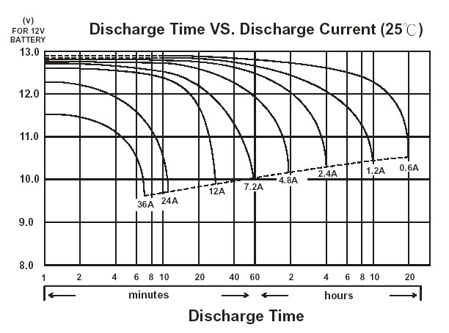
Battery Capacity
It turns out that how long a battery “lasts” depends on how much current we draw from it.

Slide 28

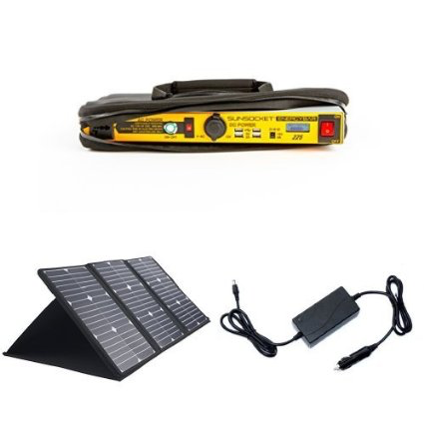
Solar
Many different and improving options exist
Systems may include panels and a battery
Can extend operating time, but is it enough?
  60 watt panels, 7 hours full sunlight to charge a 250 Wh battery pack (note loss)
  14.5W average radio usage x 24 hours = 348Wh < (250Wh battery charge + 250 Wh charge from sunlight)
  But if we assume that you only get 7 hours of full sunlight, that is 17 hours of “dark” during which you are using 247Wh…
  ...too close for comfort, no margin here

Slide 29
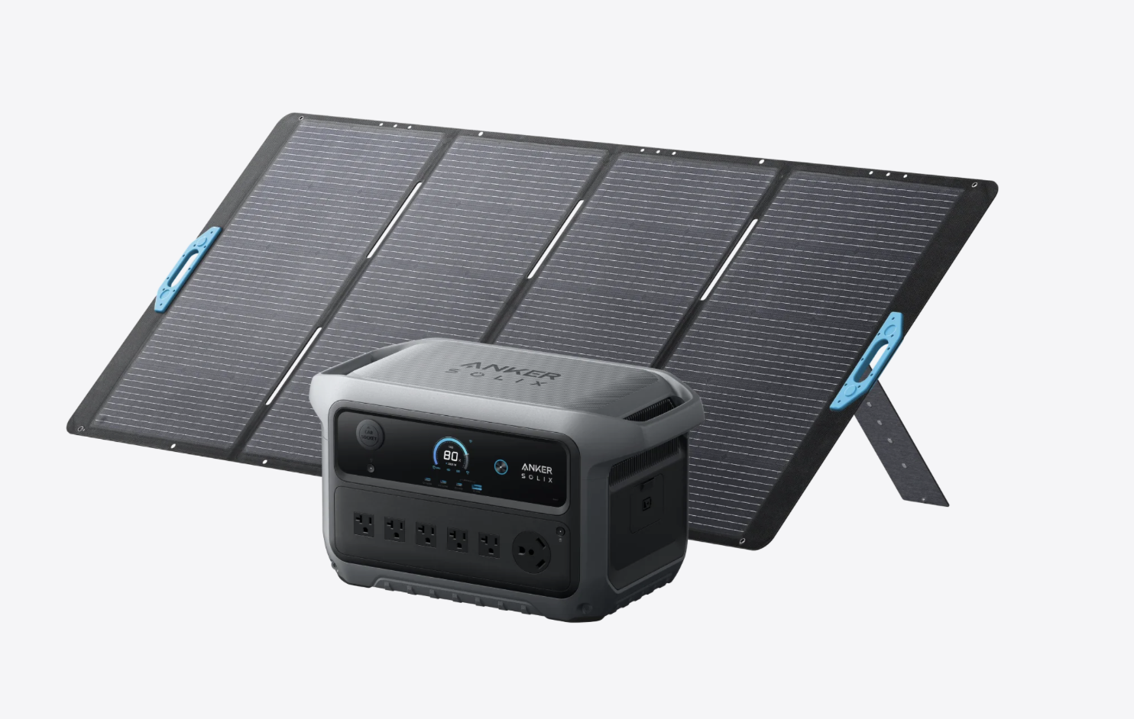
Solar
  400 watt panel, 2048 Wh battery pack
  ~8 hours to charge
  14.5W average radio usage → can run for ~3.5 days without recharging
  Heavy (43lbs) and not cheap ($1200 on sale)
  Big enough for dual use – camping, refrigerator/freezer backup

Slide 30
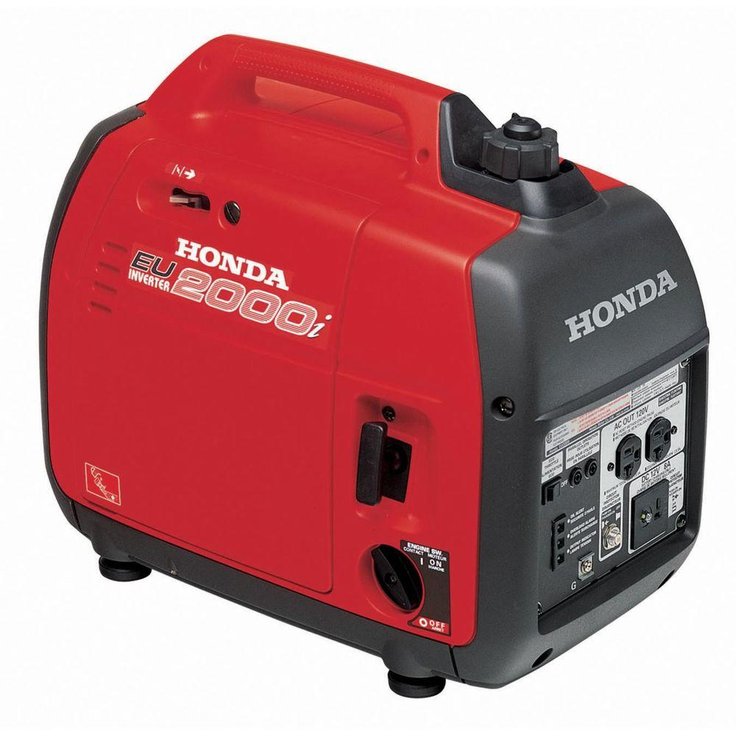
Generators
Burn fossil fuels to generate electricity
  Gas, Diesel, Kerosene, LPG, NG
Available in different sizes 1000W and up
Trade-offs between efficiency, maximum power, noise, weight
Honda eu2000i a favorite (eu2200i)
  Gasoline (conversions available)
  $1000
  8 hours on 1 gallon at 25% load
  Rated load 13.3A
  46 lbs
  Quiet

Slide 31
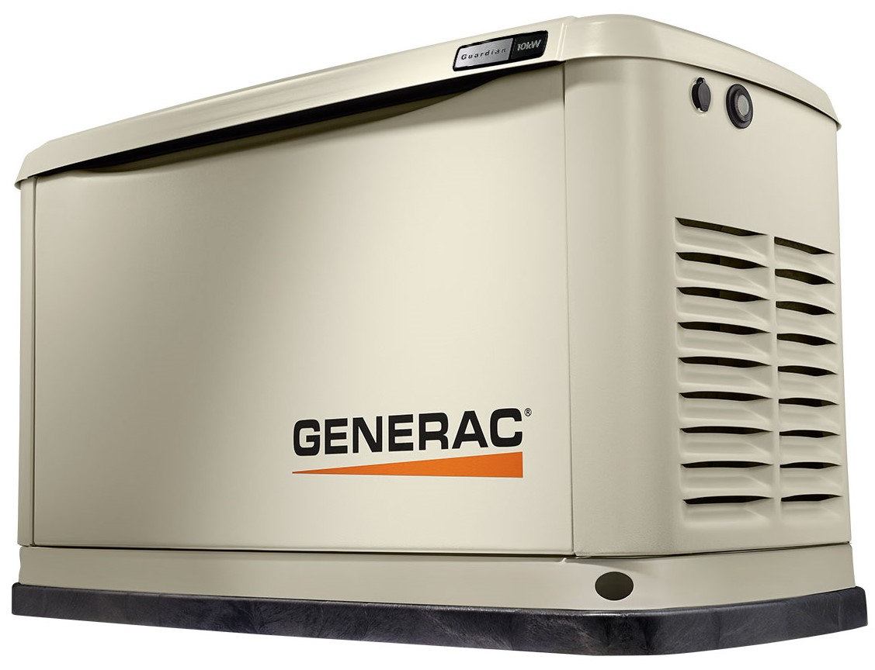
Whole House Solutions
Whole-house Generators
  Run on Natural Gas or Propane
  Can be noisy
  Can produce power in all weather/seasons
  13kWh @ 50% use
  1.5 gallons/hour LPG,
  $3.50/gallon

Slide 32
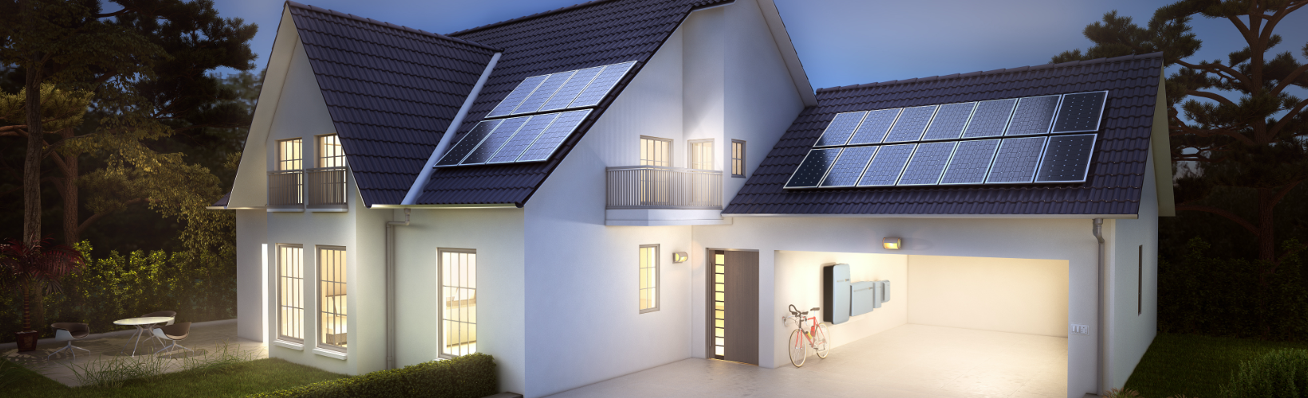
Whole House Solutions
Solar/Battery Hybrid Systems
  Complex but getting simpler
  Fairly Expensive 10.5KWh system ~$10-15K (excl Solar)
  Silent
  Battery capacity is limiting factor

Slide 33
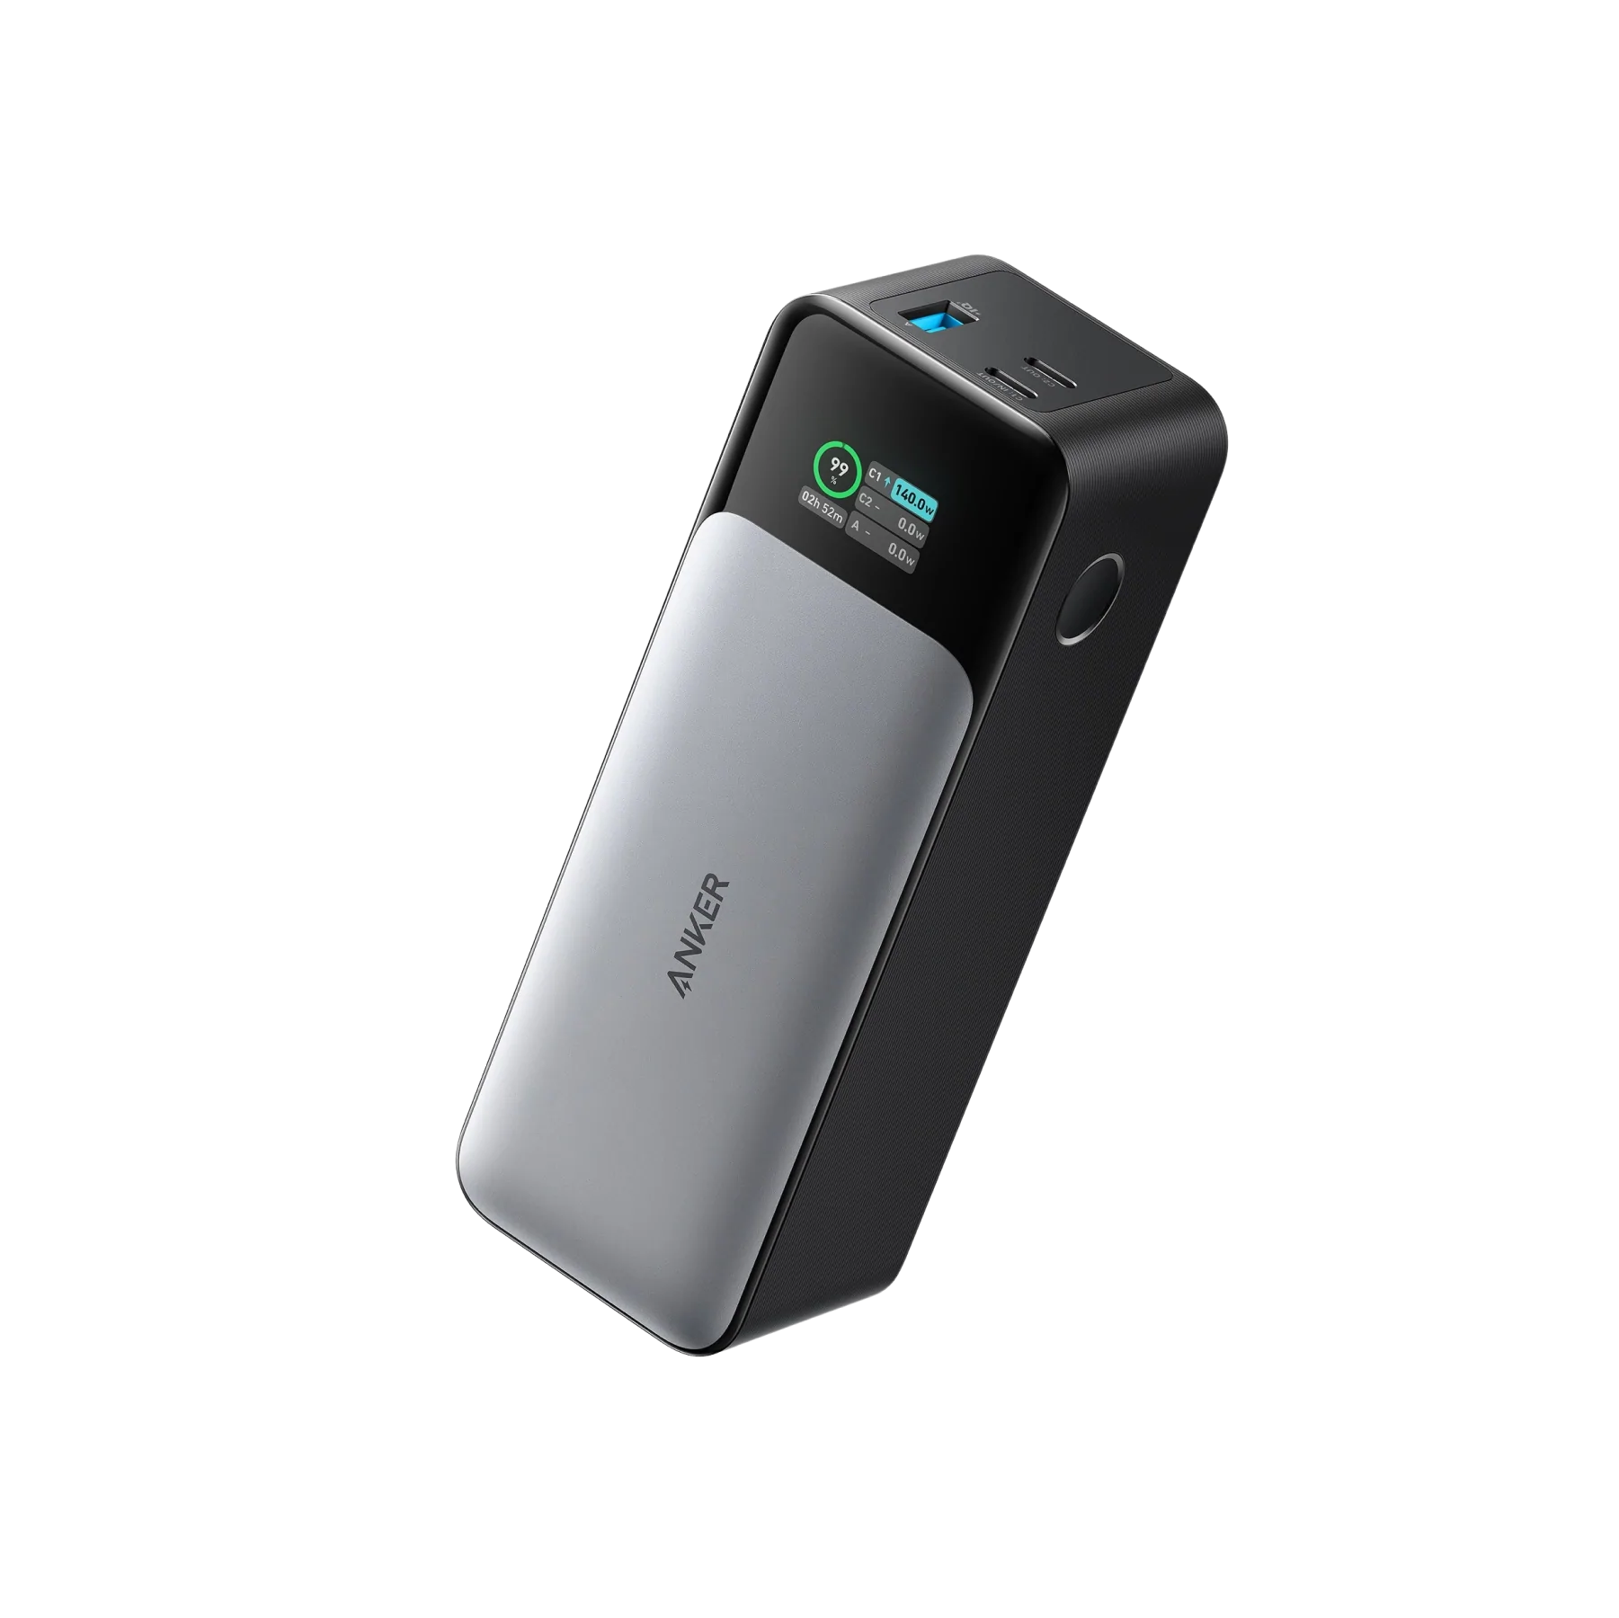
Other Alternatives
Jumpstart Portable Battery Packs
  Originally for automotive use
  Dual purpose

Slide 34
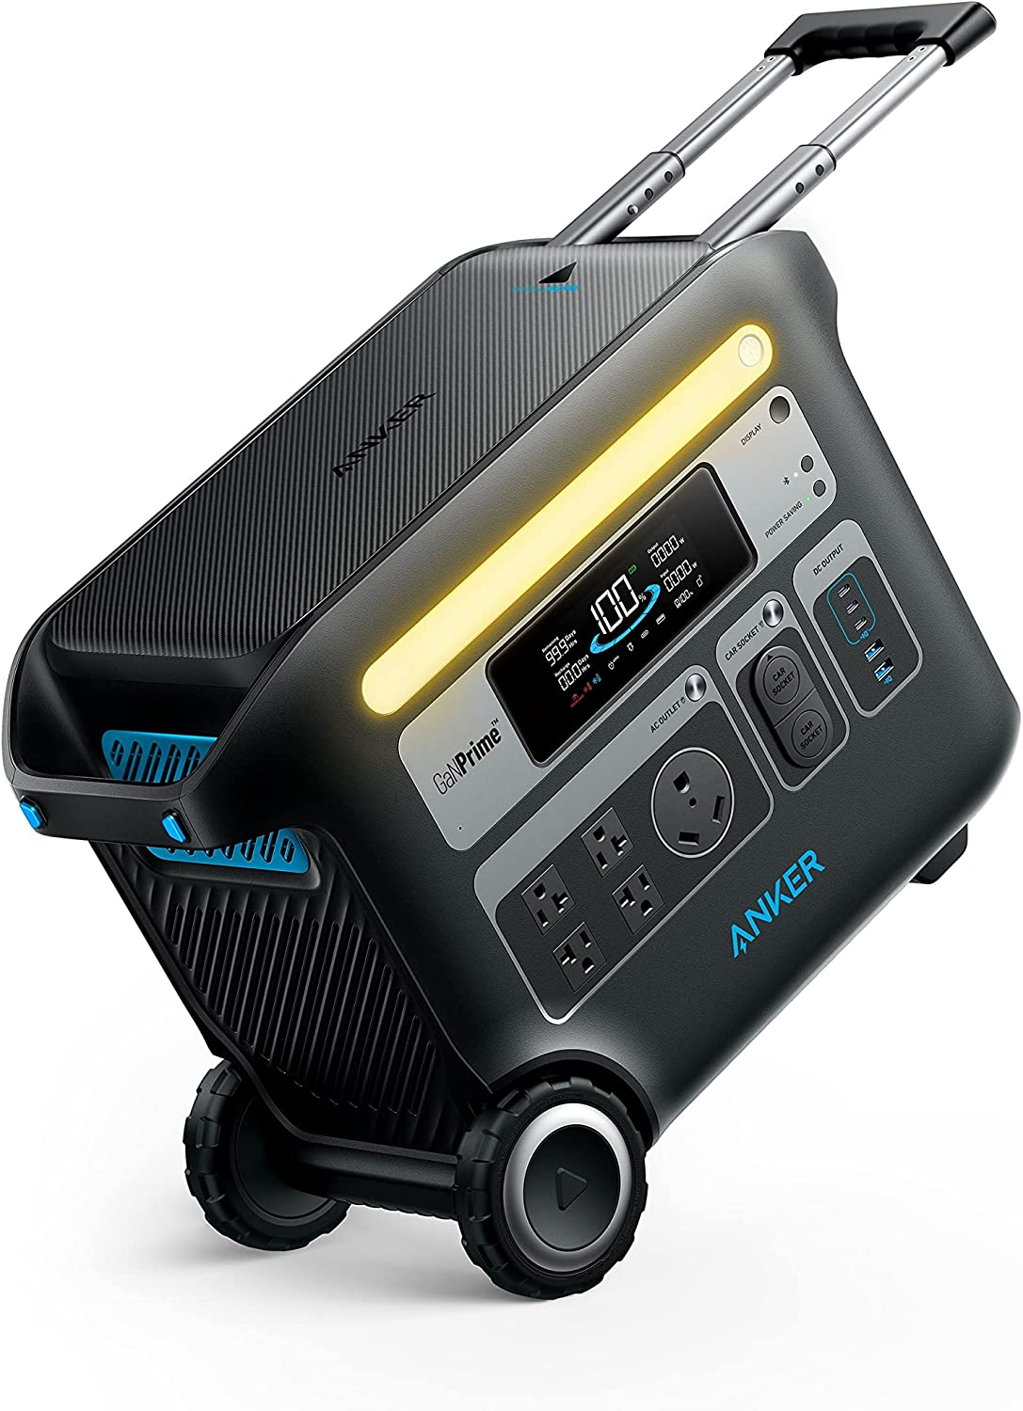
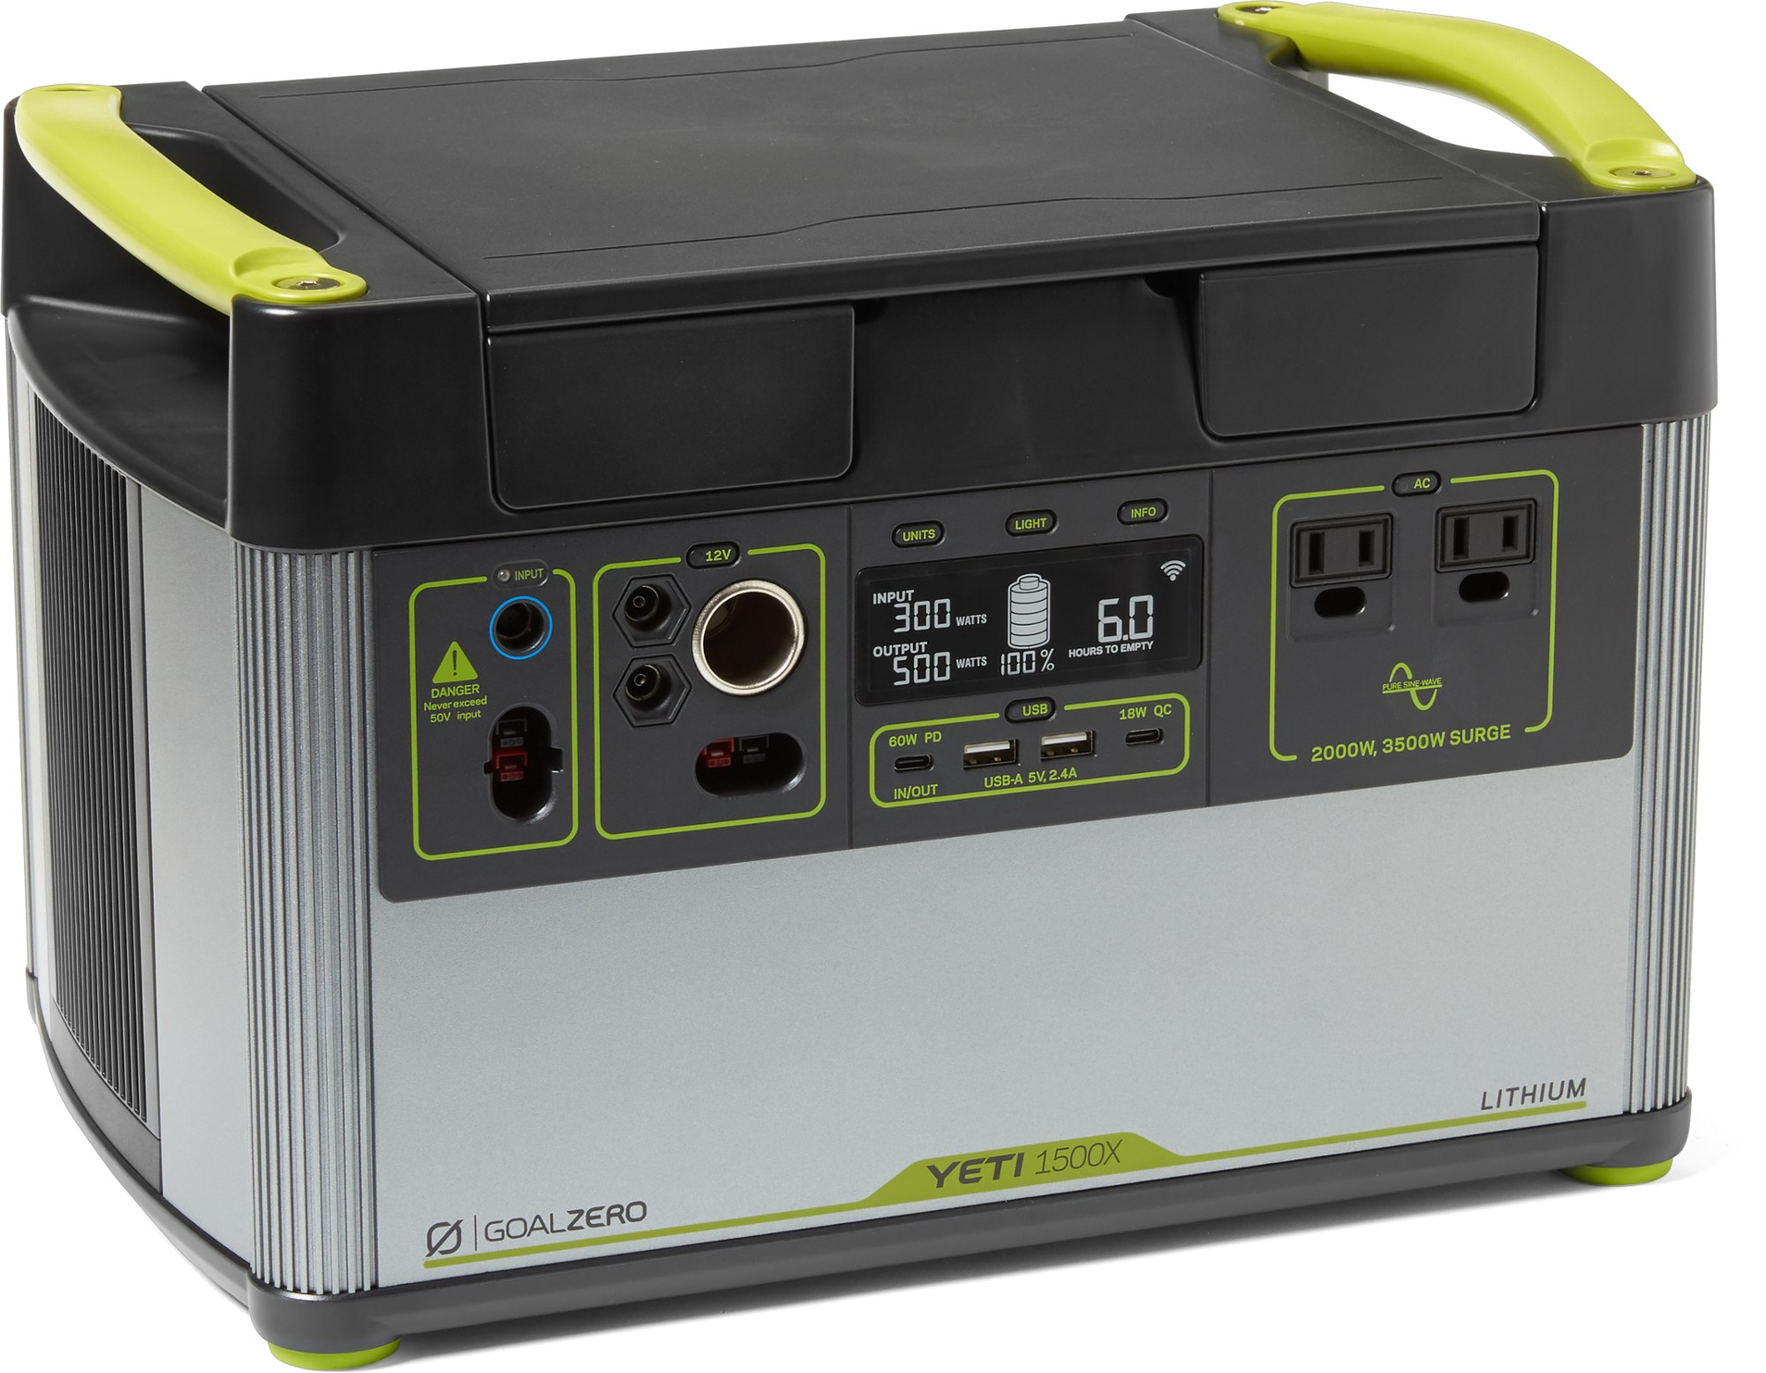
Other Alternatives
Portable Battery Packs
  Originally for automotive use
  Variety and applications grew rapidly with advances in electronics and battery tech

Slide 35
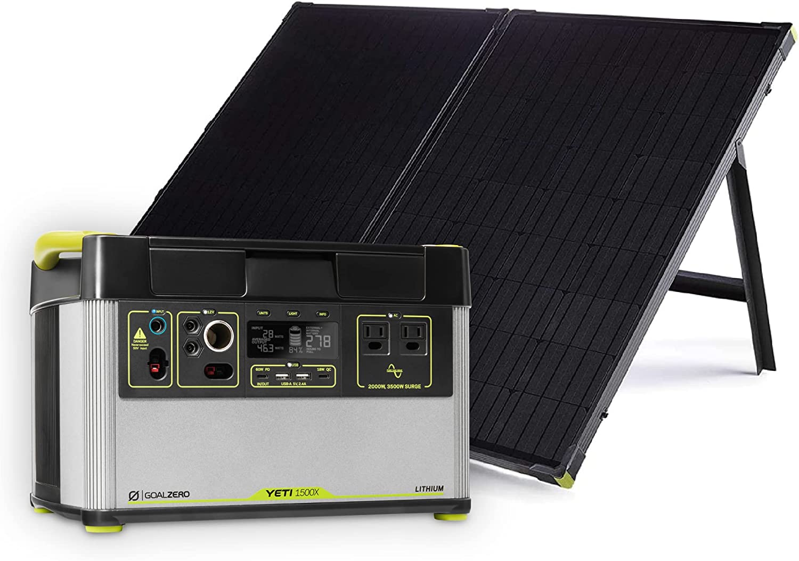
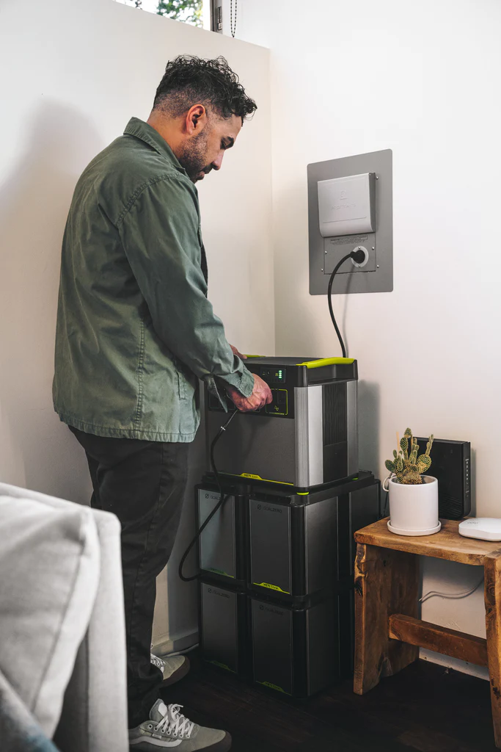
Other Alternatives
Some solutions are very flexible and can cover a lot of needs with one system

Slide 36
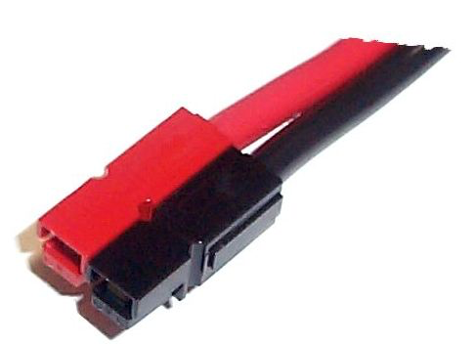
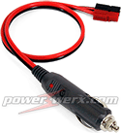
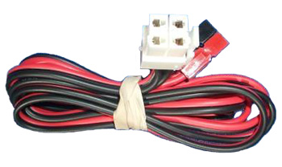
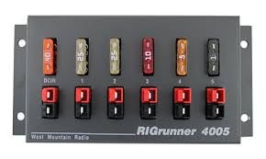
Plugging it all together
Emcomm standard for connecting DC components uses Anderson Powerpoles
A large assortment of adapters is commercially available or you can make your own.

Slide 37

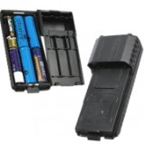
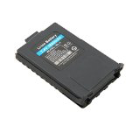
What about HTs?
Typically run on less than 12VDC
Battery capacity measured in milli ampere hours (mAh), typically ~1700 mAh for many HTs
Charging:
  AC chargers (if you have AC)
  12V adapters (if you have a 12V source)
  Newer models use USB-C
Field use:
  Must have extra battery packs (normal or extended), and/or AA or AAA battery cases and batteries

Slide 38
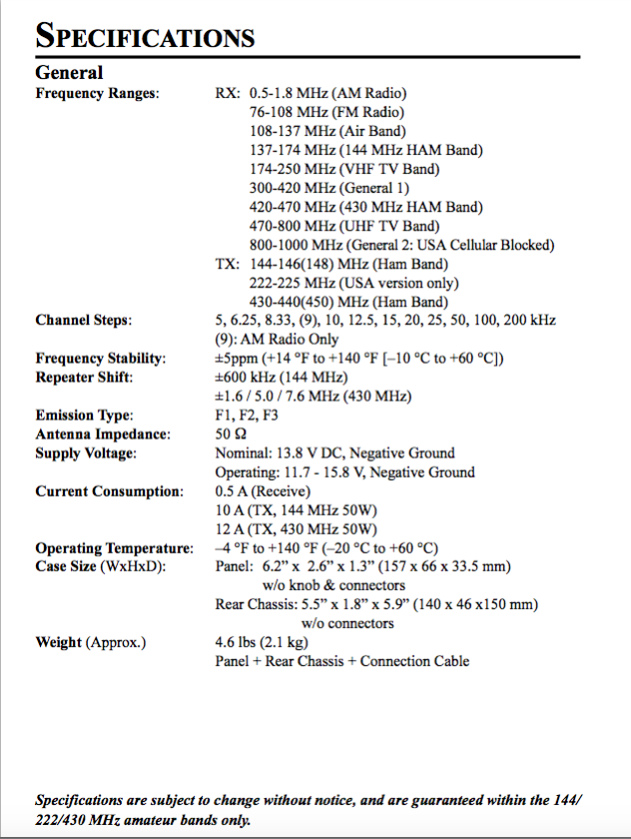
Evaluating your own needs
RT#M – Reading the specifications (usually in the back of the manual) will give information about power needs
Placards on the radio chassis or battery are helpful
These will mostly be maximums and limits

Slide 39

Evaluating your own needs
It is best to measure if you can
Use a power supply with meters or an inline meter (buy, borrow…)
  Configure your system as you would in the field
  Operate and observe
  Take notes
  Exercises are great for simulating the real thing

Slide 40
Remember the Example
Radio turned on, transmitting on low power (5W in this example)
Heat
13.8
02.7
50% quiet + 25% receive + 25% transmit = 1.05A average; 14.5W @13.8V

Slide 41
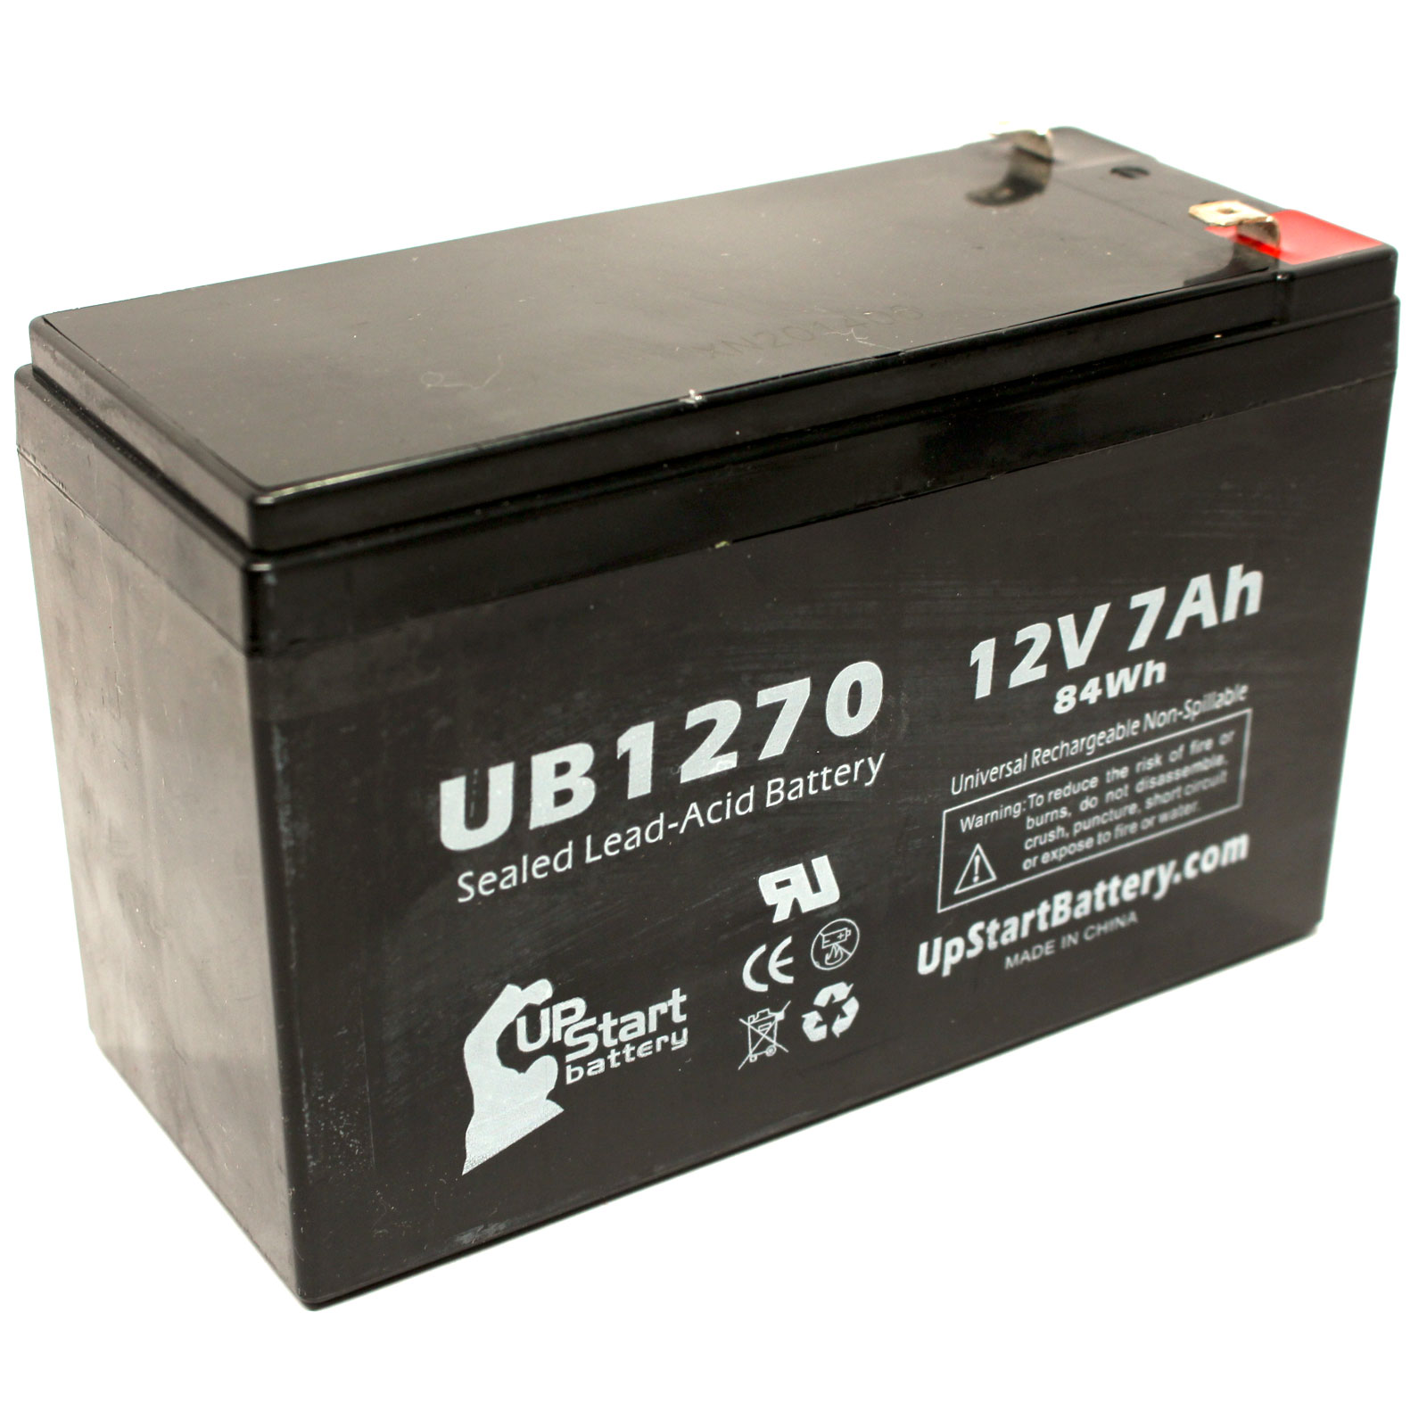
Evaluating your needs
If you have a fully charged 7Ah battery, how long can you operate?
7Ah / 1.05A = 6.7 h
Well, sort of…
  Is it really 50%/25%/25%?
  Temperature
  Battery age/cycles
  Voltage regulation
Maybe 80% rule is good here → 5.4 h

Slide 42
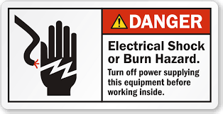
Safety
Electricity can cause shocks, burns, and fires that can kill you
Batteries can catch fire and explode if not handled/recharged properly, and kill you
Generators produce carbon monoxide, a colorless, odorless gas that can kill you
Notes:
8 people died in recent storms because of fumes from their emergency generators

Slide 43
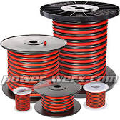

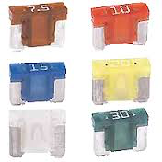
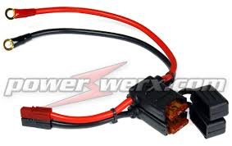
Safety
Just like your house wiring, your ham setup needs protection → fuses.
Use the correct size for the current you need to handle
  Fuses
  Wire
  Components
Wire Size (AWG) | NEC Max Current (Amperes)
8 | 40
10 | 30
12 | 20
14 | 15

Slide 44
Q & A

