Slide 1

Economic Insights
Enduring Pandemic Response Impacts
Association of Government Accountants
May 24, 2022

Slide 2

Kem C. Gardner Policy Institute
Our Vision: Be Utah’s preeminent public policy institute and a vital gathering place for policy leadership and thoughtful discourse that helps our community prosper.
Our Mission: Develop and share economic, demographic, and public policy research that sheds light and helps people make INFORMED DECISIONS™.

Slide 3
Setting the Stage: Five Observations
Economic disruptions continue to constrain goods supply
Massive fiscal and monetary policy responses continue to support strong demand
Accelerating inflation spurring interest rate increases
With wages below equilibrium, labor shortages continue (and will continue until wages increase)
Utah’s underlying economic fundamentals remain quite strong, despite some challenges

Slide 4
Recurring Takeaways
Be Prepared for Economic Re-sorting, Including Scarcity
Care for People, Including Those Left Behind
Kem C. Gardner Policy Institute
DAVID ECCLES SCHOOL OF BUSINESS UNIVERSITY OF UTAH

Slide 5
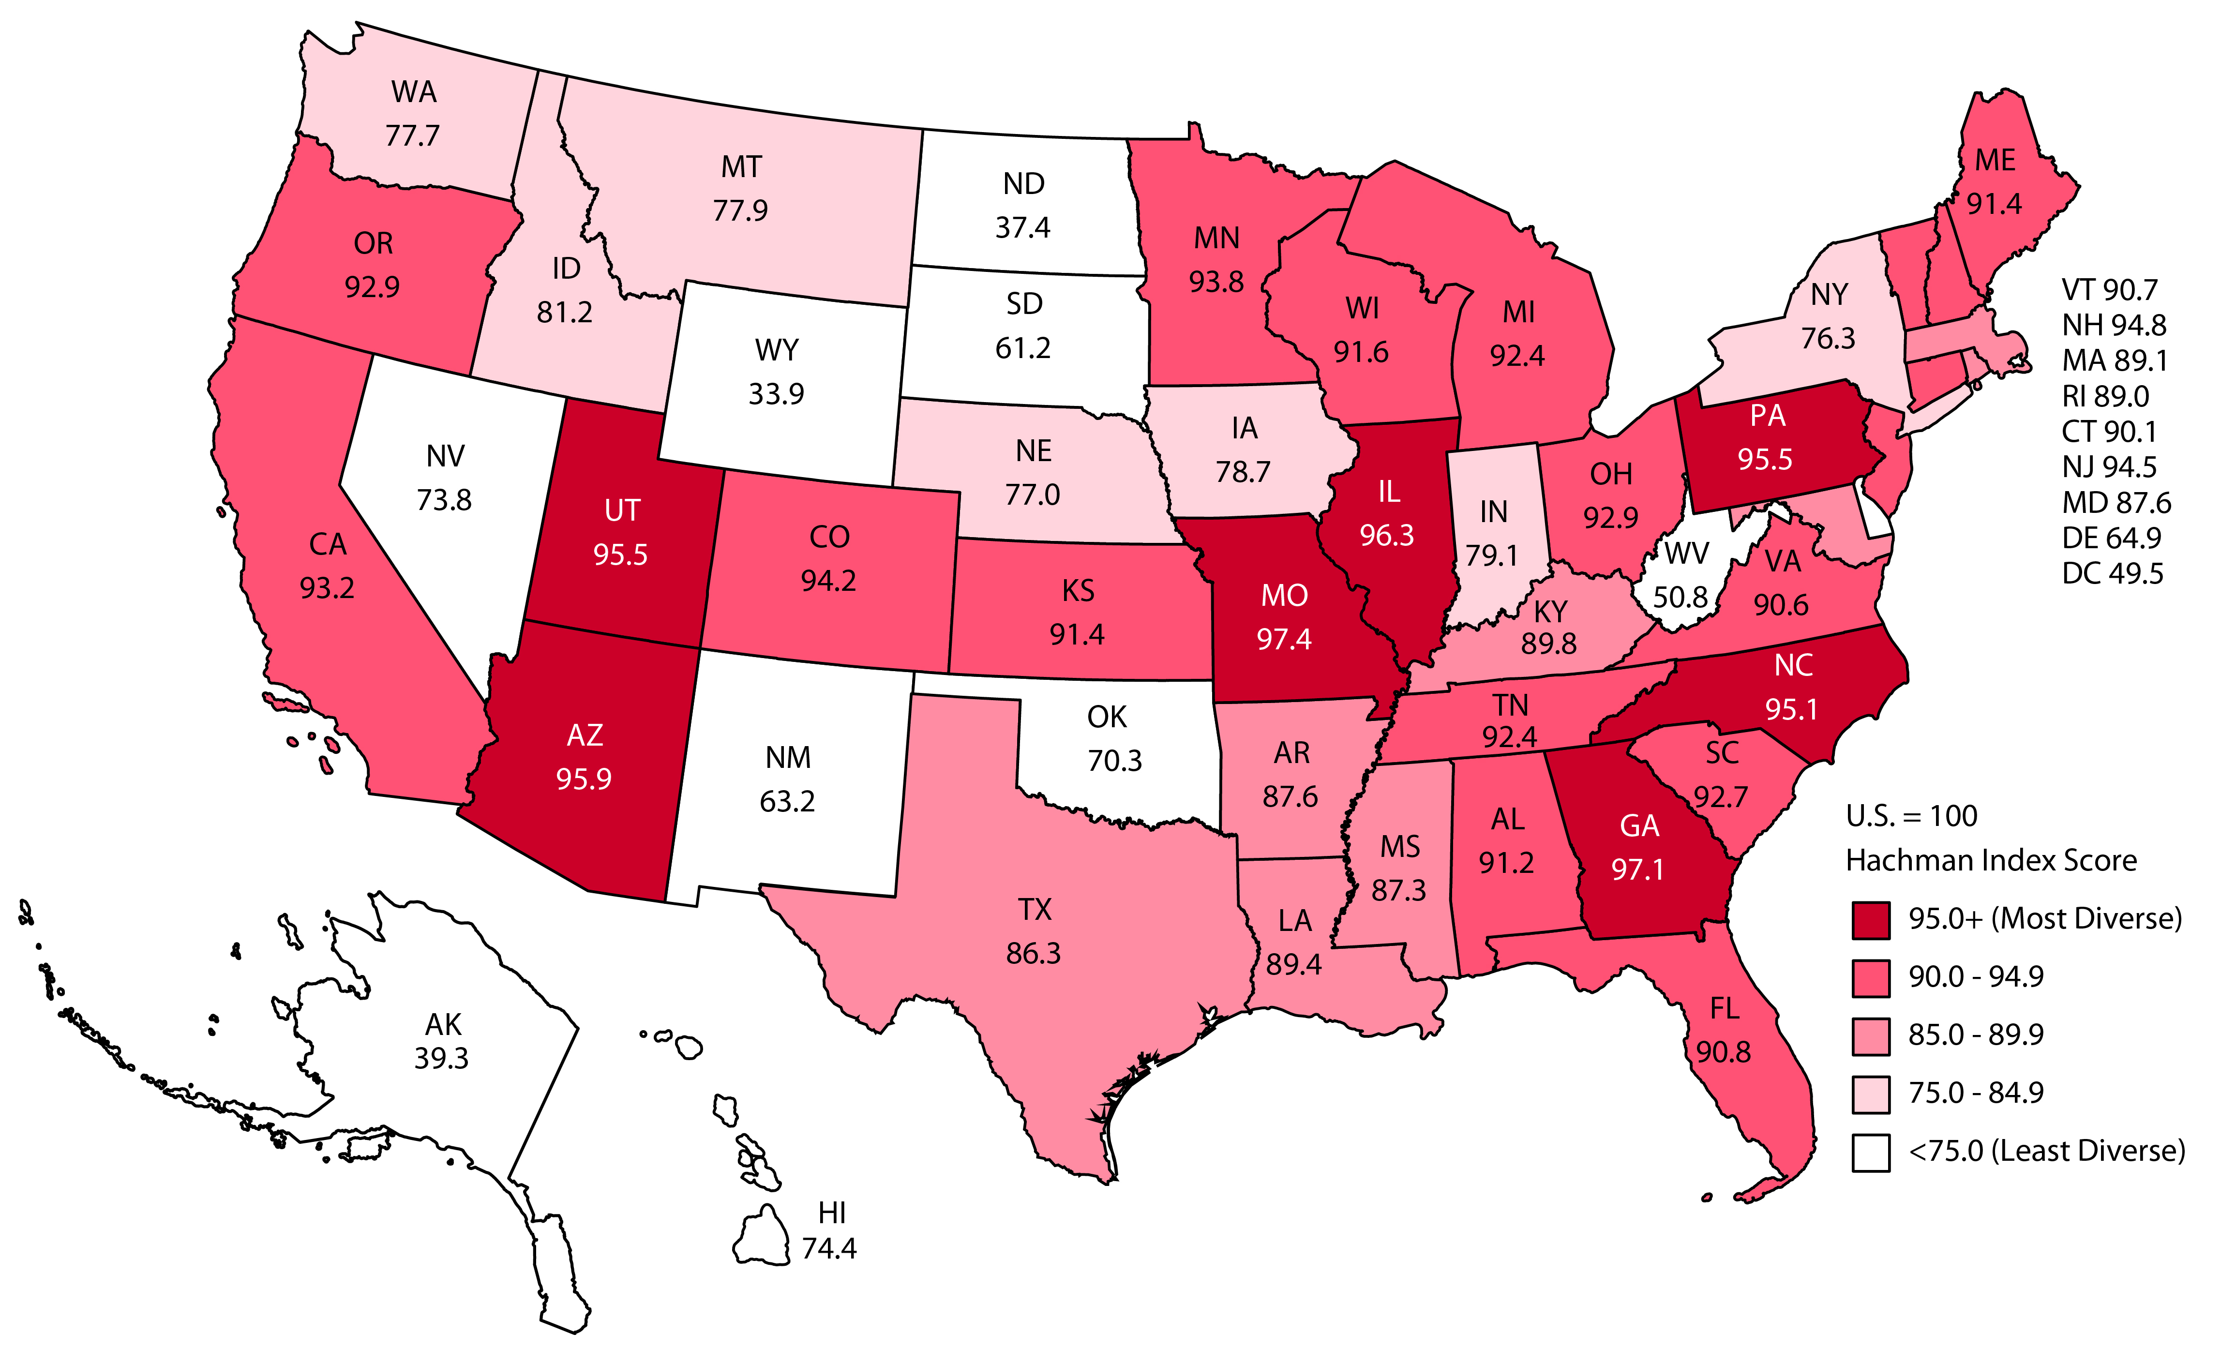
Utah’s Diverse Economy
Hachman Index 2020, 100=Most Diverse
Source: Kem C. Gardner Policy Institute
Kem C. Gardner Policy Institute
DAVID ECCLES SCHOOL OF BUSINESS UNIVERSITY OF UTAH

Slide 6
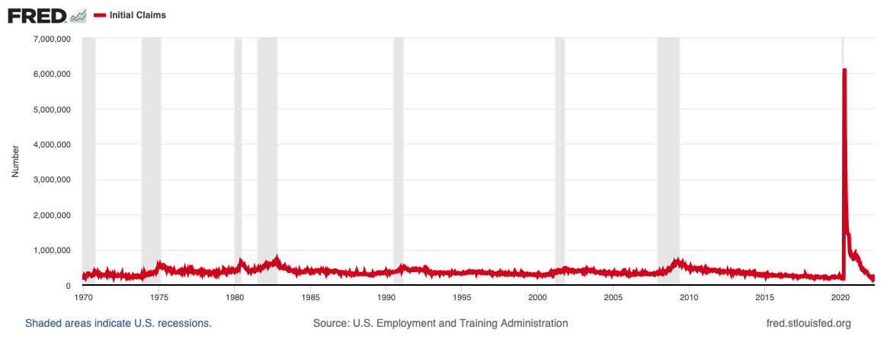
Pandemic - Unemployment Insurance Claims

Slide 7
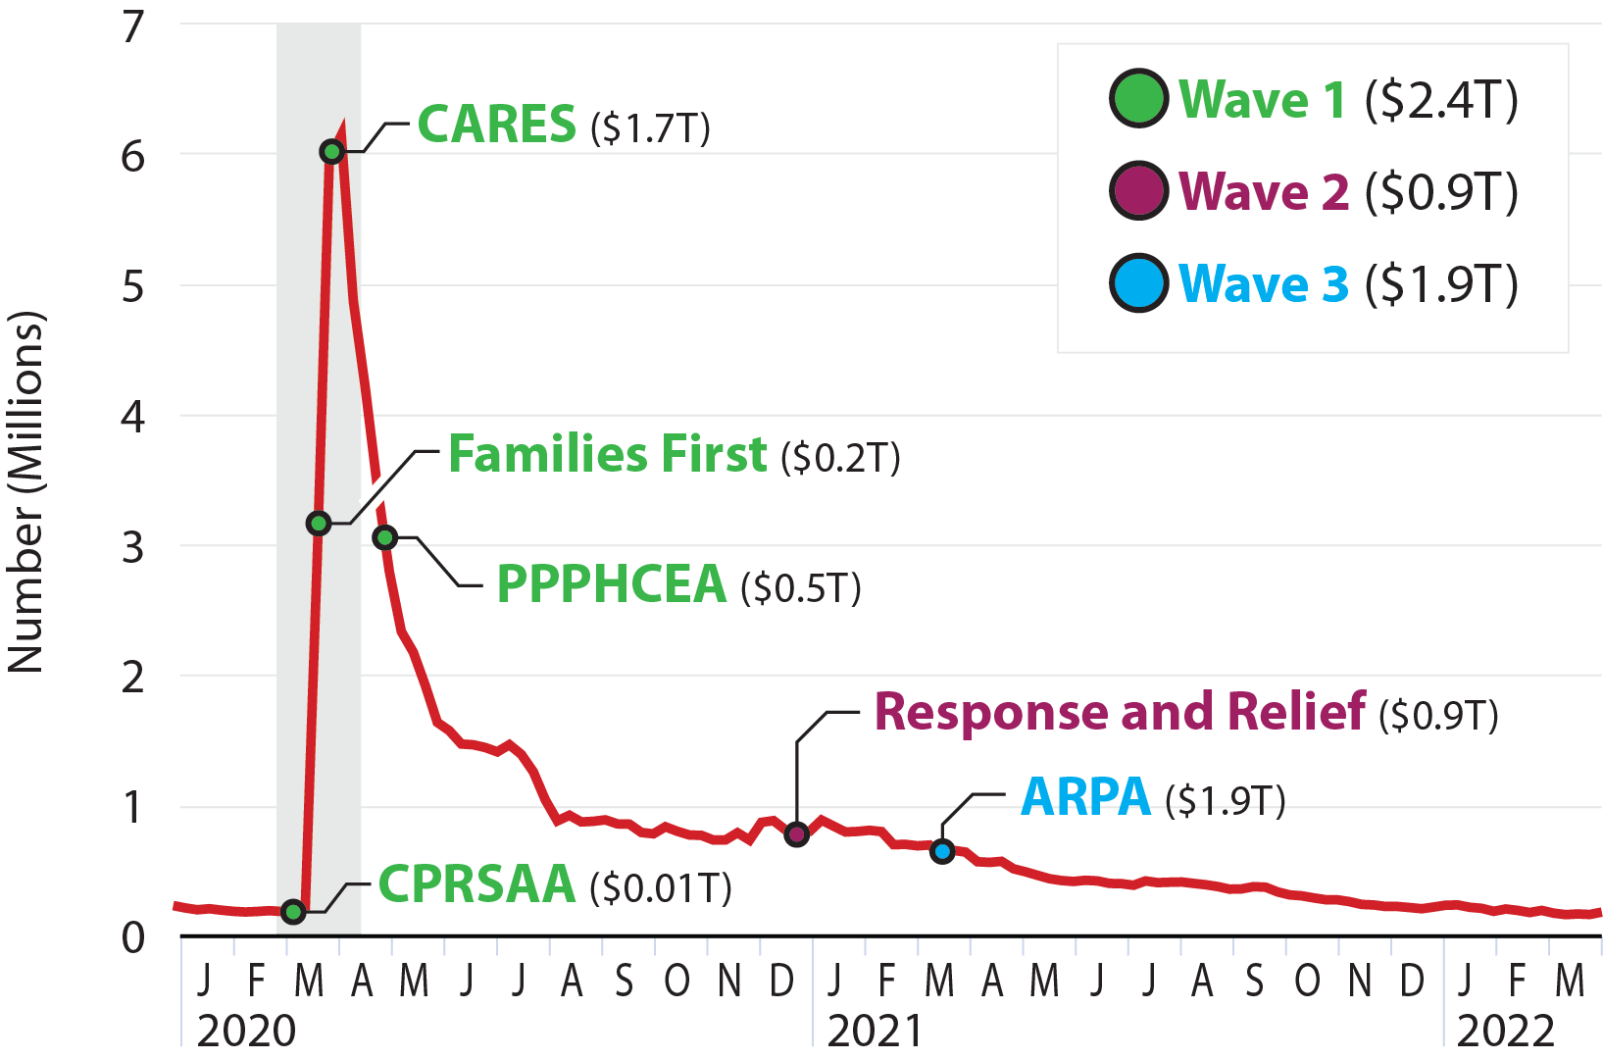
“Unprecedented” Federal Fiscal Support
Massive Fiscal Stimulus Within Year of Pandemic Beginning
Source: Congressional Budget Office

Slide 8
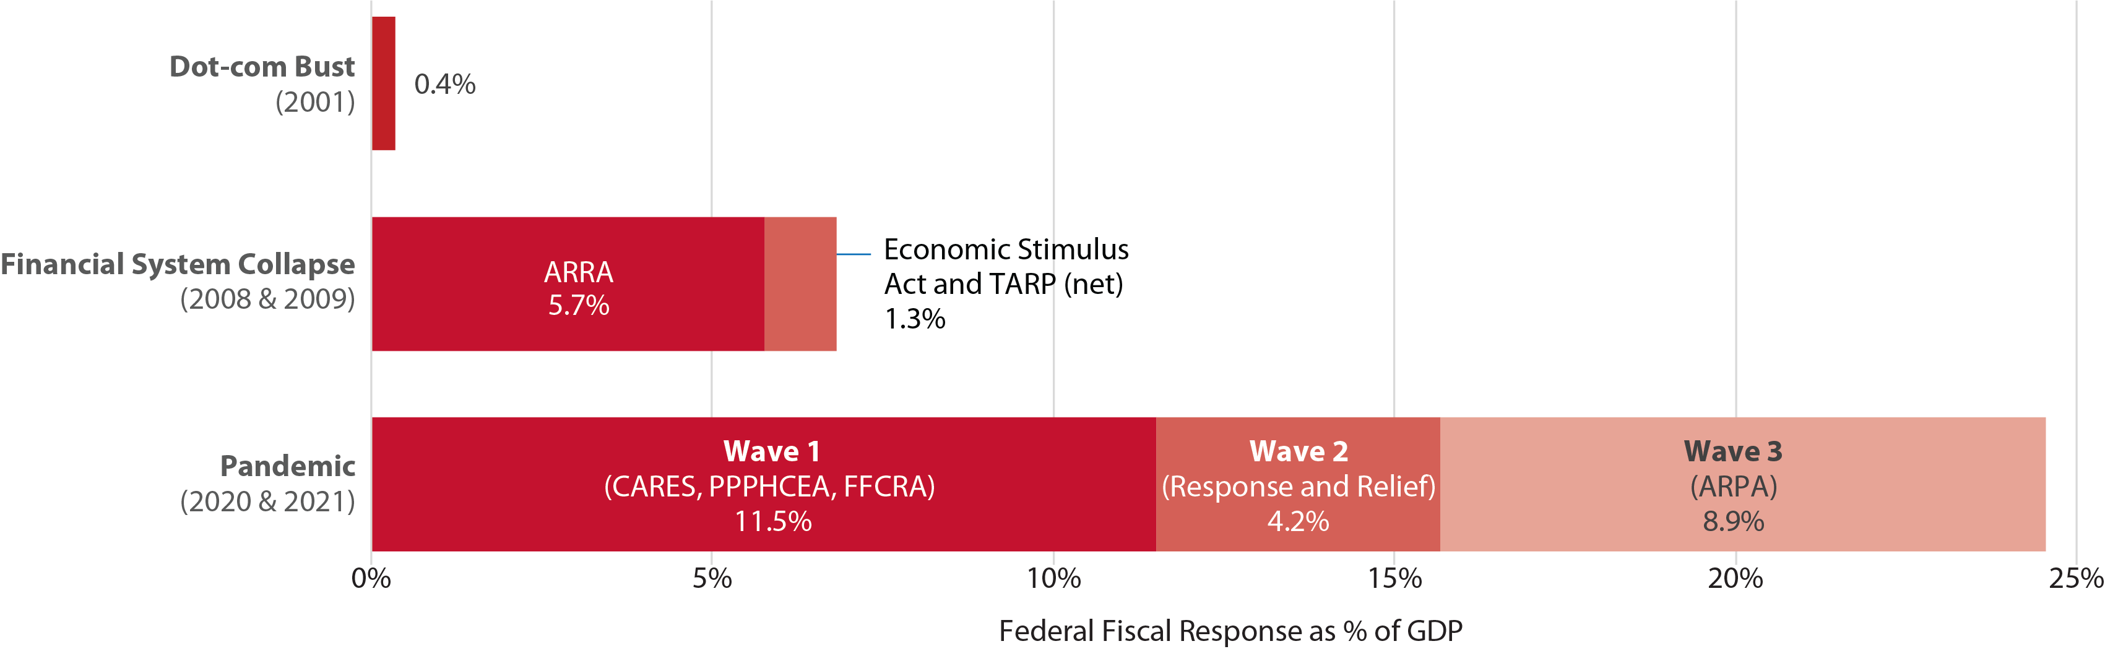
“Unprecedented” Federal Fiscal Support
Source: Congressional Budget Office and National Bureau of Economic Research

Slide 9
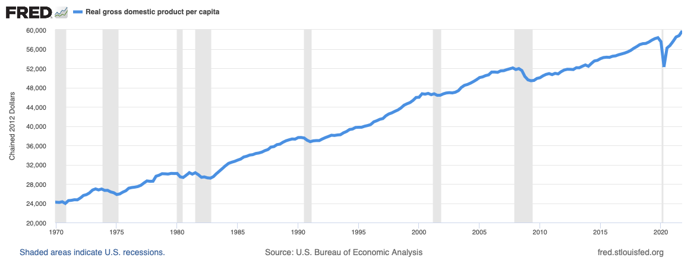
Recovery – U.S. Real GDP Per Capita

Slide 10
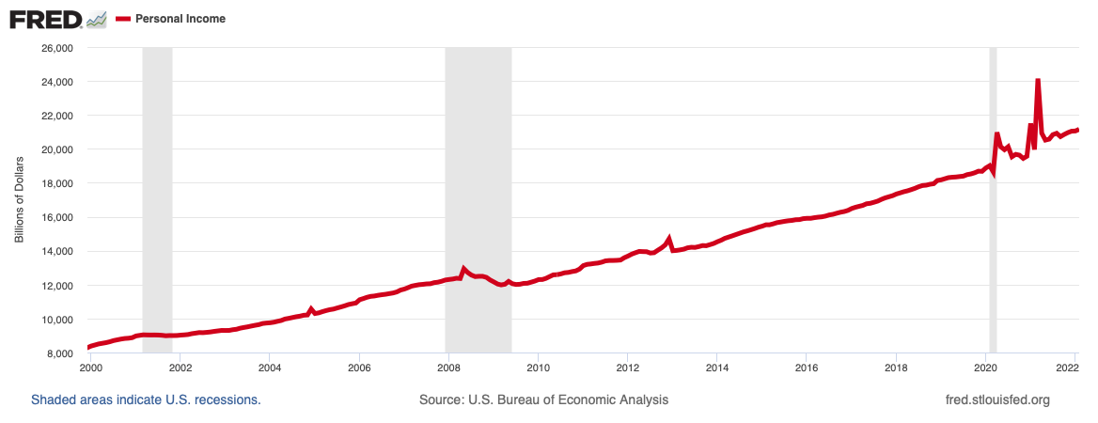
Recovery – Transfer Payments
Spiked U.S. Personal Income

Slide 11
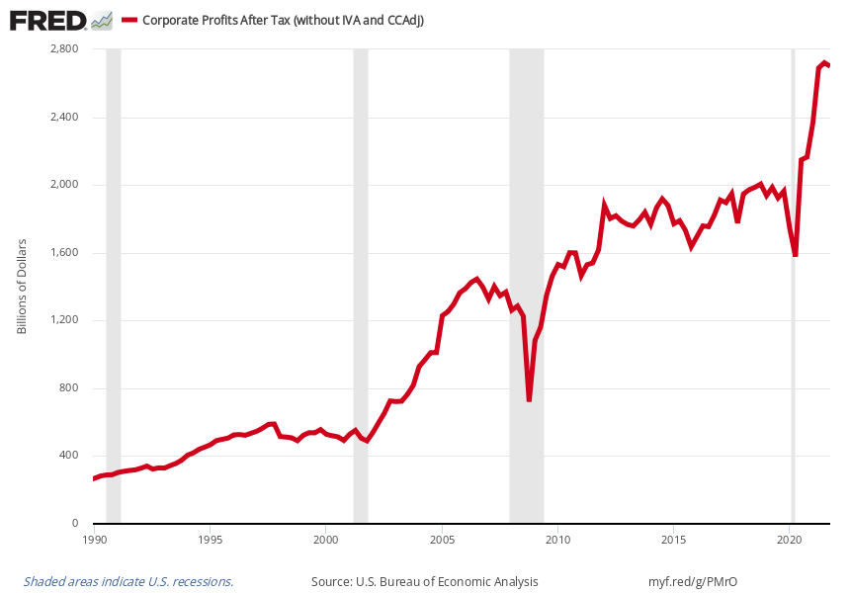
Very Strong U.S. Corporate Profits

Slide 12
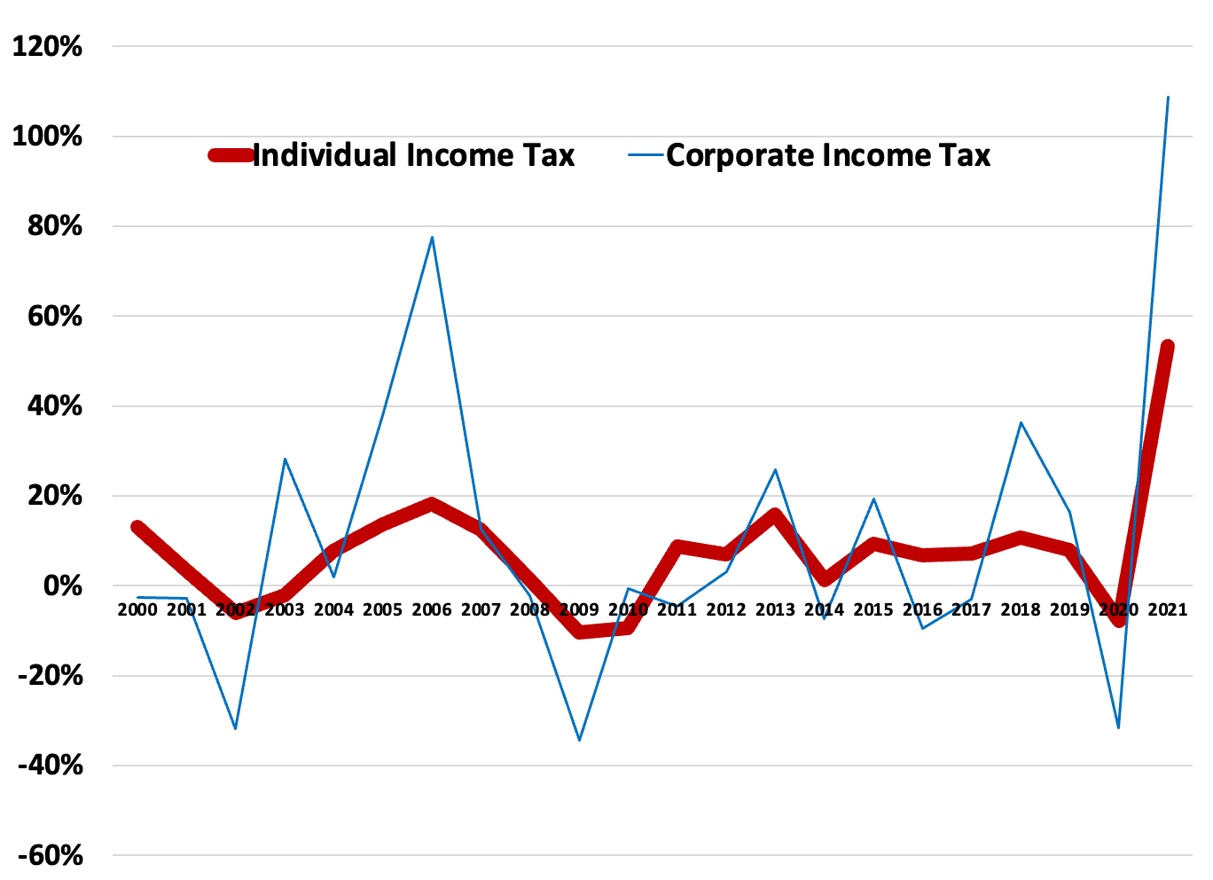
Strong, but Volatile, Utah Income Taxes
A portion of strong 2021 growth is pandemic due date timing shift from April 15 to July 15, which shifted revenues from FY 2020 into FY 2021
Through April 2022, income tax withholding up 14.7%

Slide 13
Takeaways
Monthly tax collections not only a state budget indicator, but a real-time economic indicator
State of Utah income taxes remain strong (both individual and corporate)
State still has revenue imbalance with constitutional restriction of income taxes for education, children, and those with disabilities

Slide 14
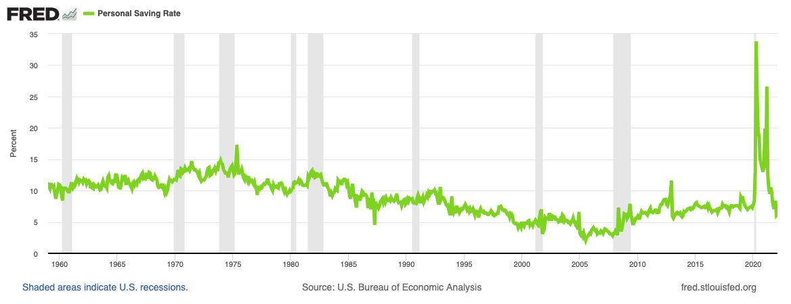
Stimulus Impacts – Personal Saving Spiked

Slide 15
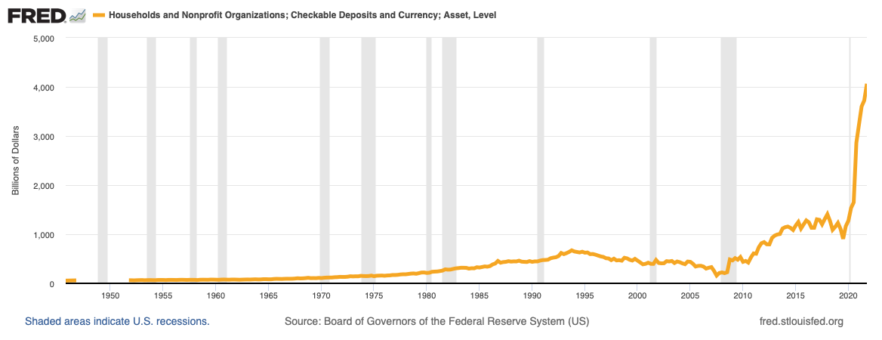
Stimulus Impacts – Checkable Deposits Spiked

Slide 16
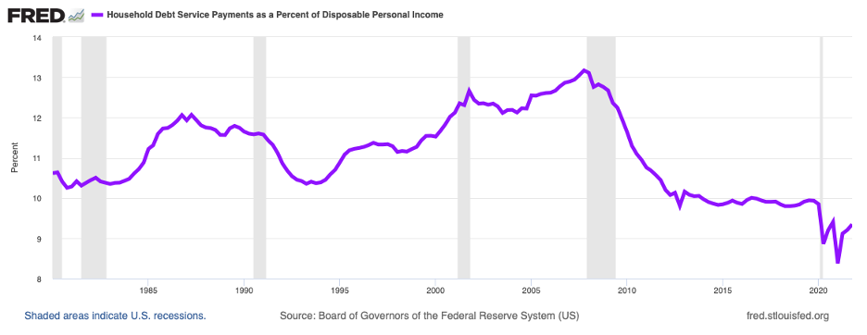
Stimulus Impacts – Debt Service Payments Dropped

Slide 17
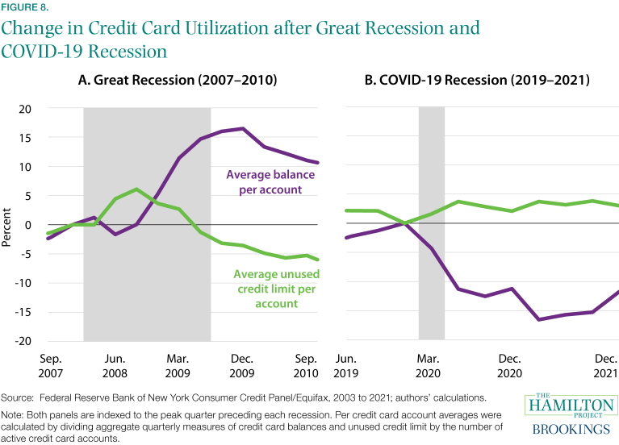
Stimulus Impacts – Strong Household Balance Sheets

Slide 18
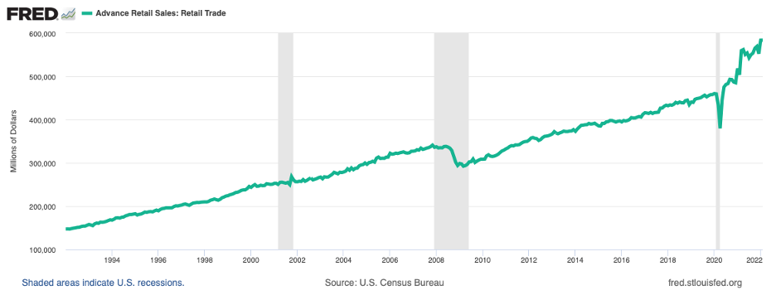
Stimulus Impacts – Retail Therapy
U.S. Retail Sales Grew Rapidly
Kem C. Gardner Policy Institute
DAVID ECCLES SCHOOL OF BUSINESS UNIVERSITY OF UTAH

Slide 19
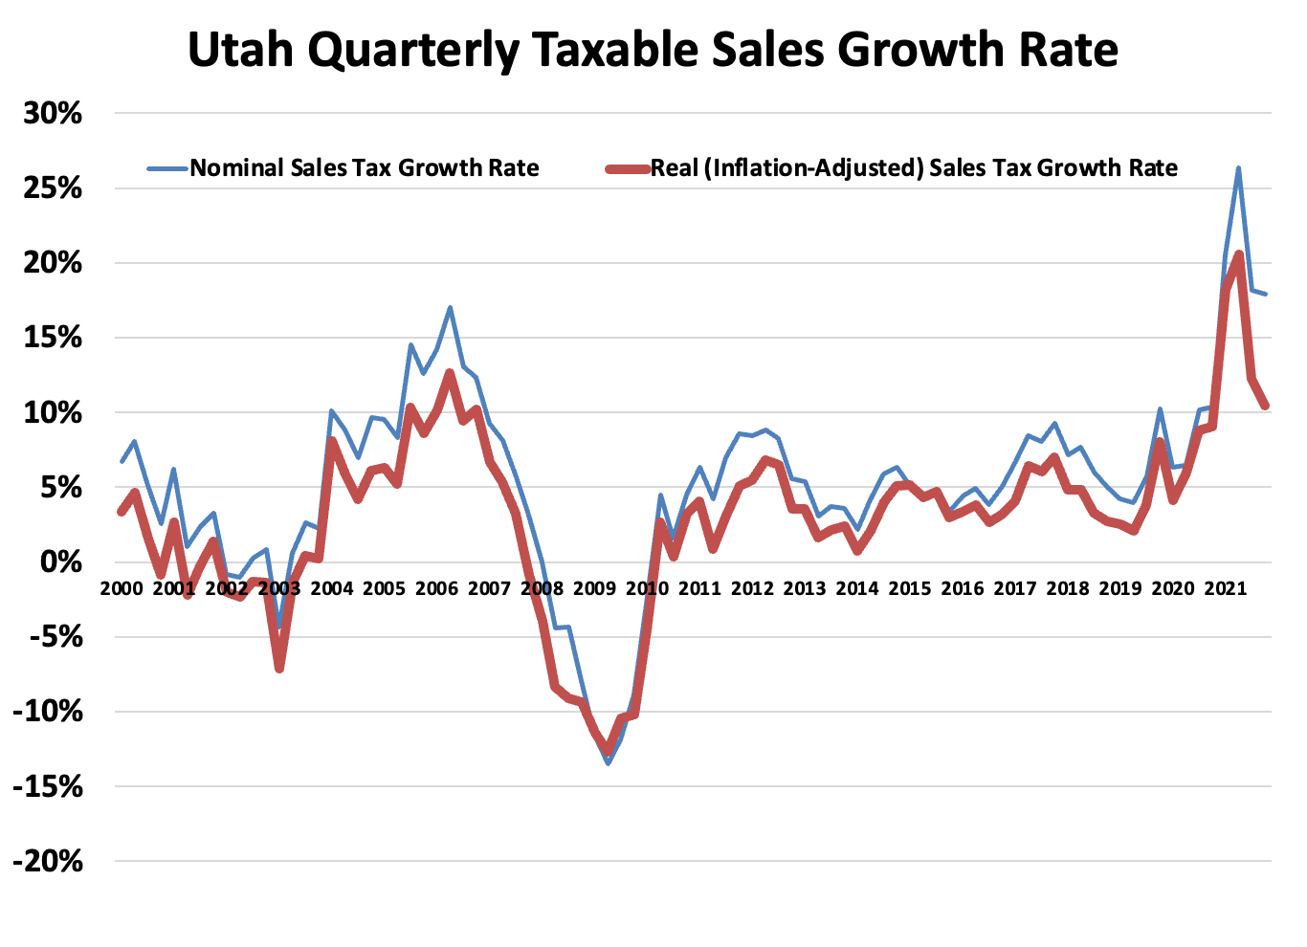
Stimulus Impacts – Utah Taxable Sales Grew Rapidly
Through April 2022, sales tax up 18.1%
Source: Utah State Tax Commission
Kem C. Gardner Policy Institute
DAVID ECCLES SCHOOL OF BUSINESS UNIVERSITY OF UTAH

Slide 20
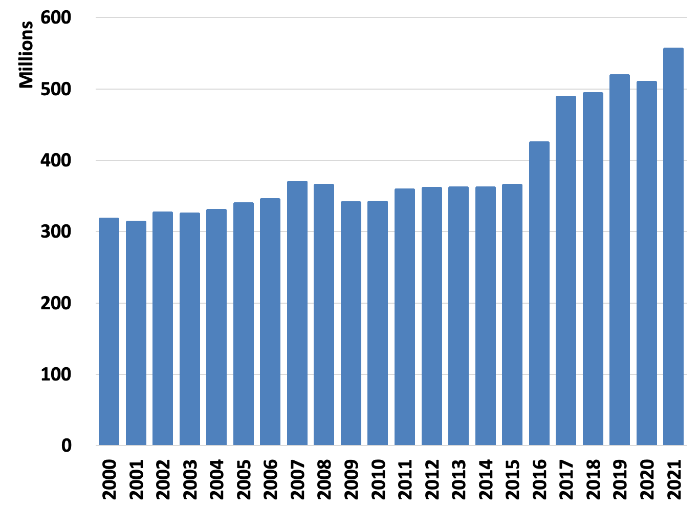
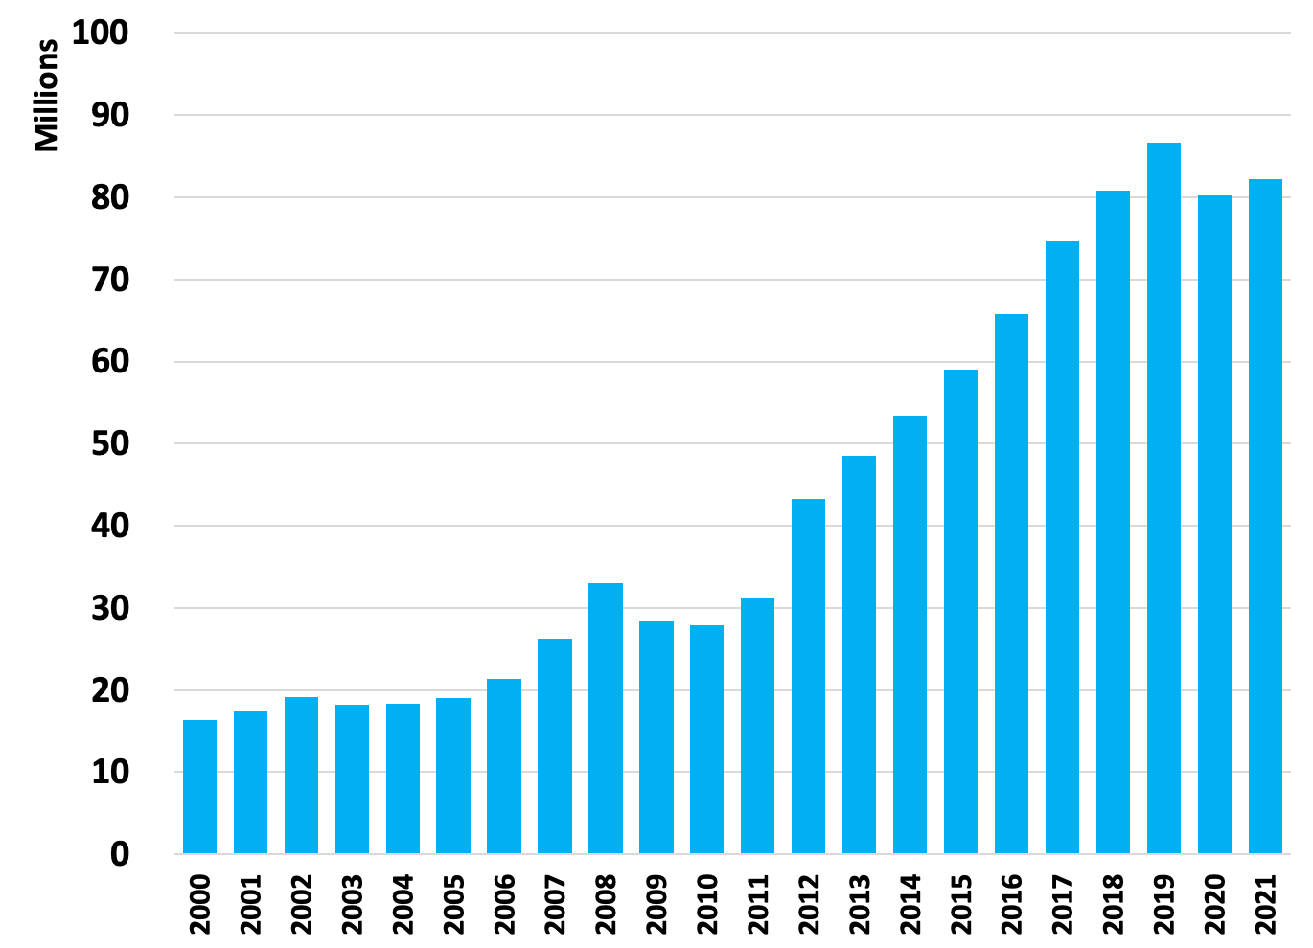
Travel Recovery
Motor and Special Fuel Taxes
Transient Room Taxes
Source: Utah State Tax Commission
Kem C. Gardner Policy Institute
DAVID ECCLES SCHOOL OF BUSINESS UNIVERSITY OF UTAH

Slide 21
Takeaways
Probably unwise to plan on growth rates like that experienced in the past few years
Dramatic increases are partially illusory (just represent overall price inflation) and need to be allocated to increased costs, like labor
Household balance sheets very strong overall - lower debt, higher savings
But not all have benefited, some are being left behind
Uncertainty about when households unleash accumulated savings on economy

Slide 22
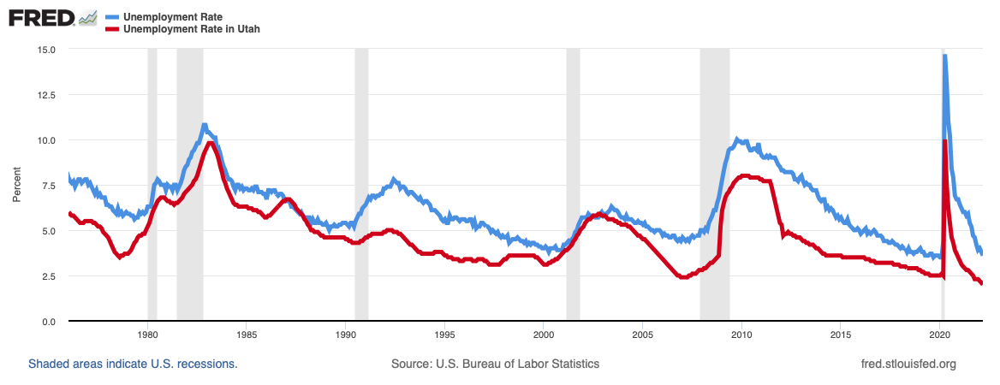
Record Low Unemployment
Source: U.S. Bureau of Labor Statistics
Kem C. Gardner Policy Institute
DAVID ECCLES SCHOOL OF BUSINESS UNIVERSITY OF UTAH

Slide 23

Jobs, Jobs, Jobs in Utah
& “The Great Resignation”
April 2022 year-over job growth 62,000 (3.9%)
April 2022 unemployment rate 1.9% - RECORD LOW
33,300 unemployed Utahns
Nearly 86,000 Utah jobs available
Source: Utah Department of Workforce Services and Indeed.com
Kem C. Gardner Policy Institute
DAVID ECCLES SCHOOL OF BUSINESS UNIVERSITY OF UTAH

Slide 24
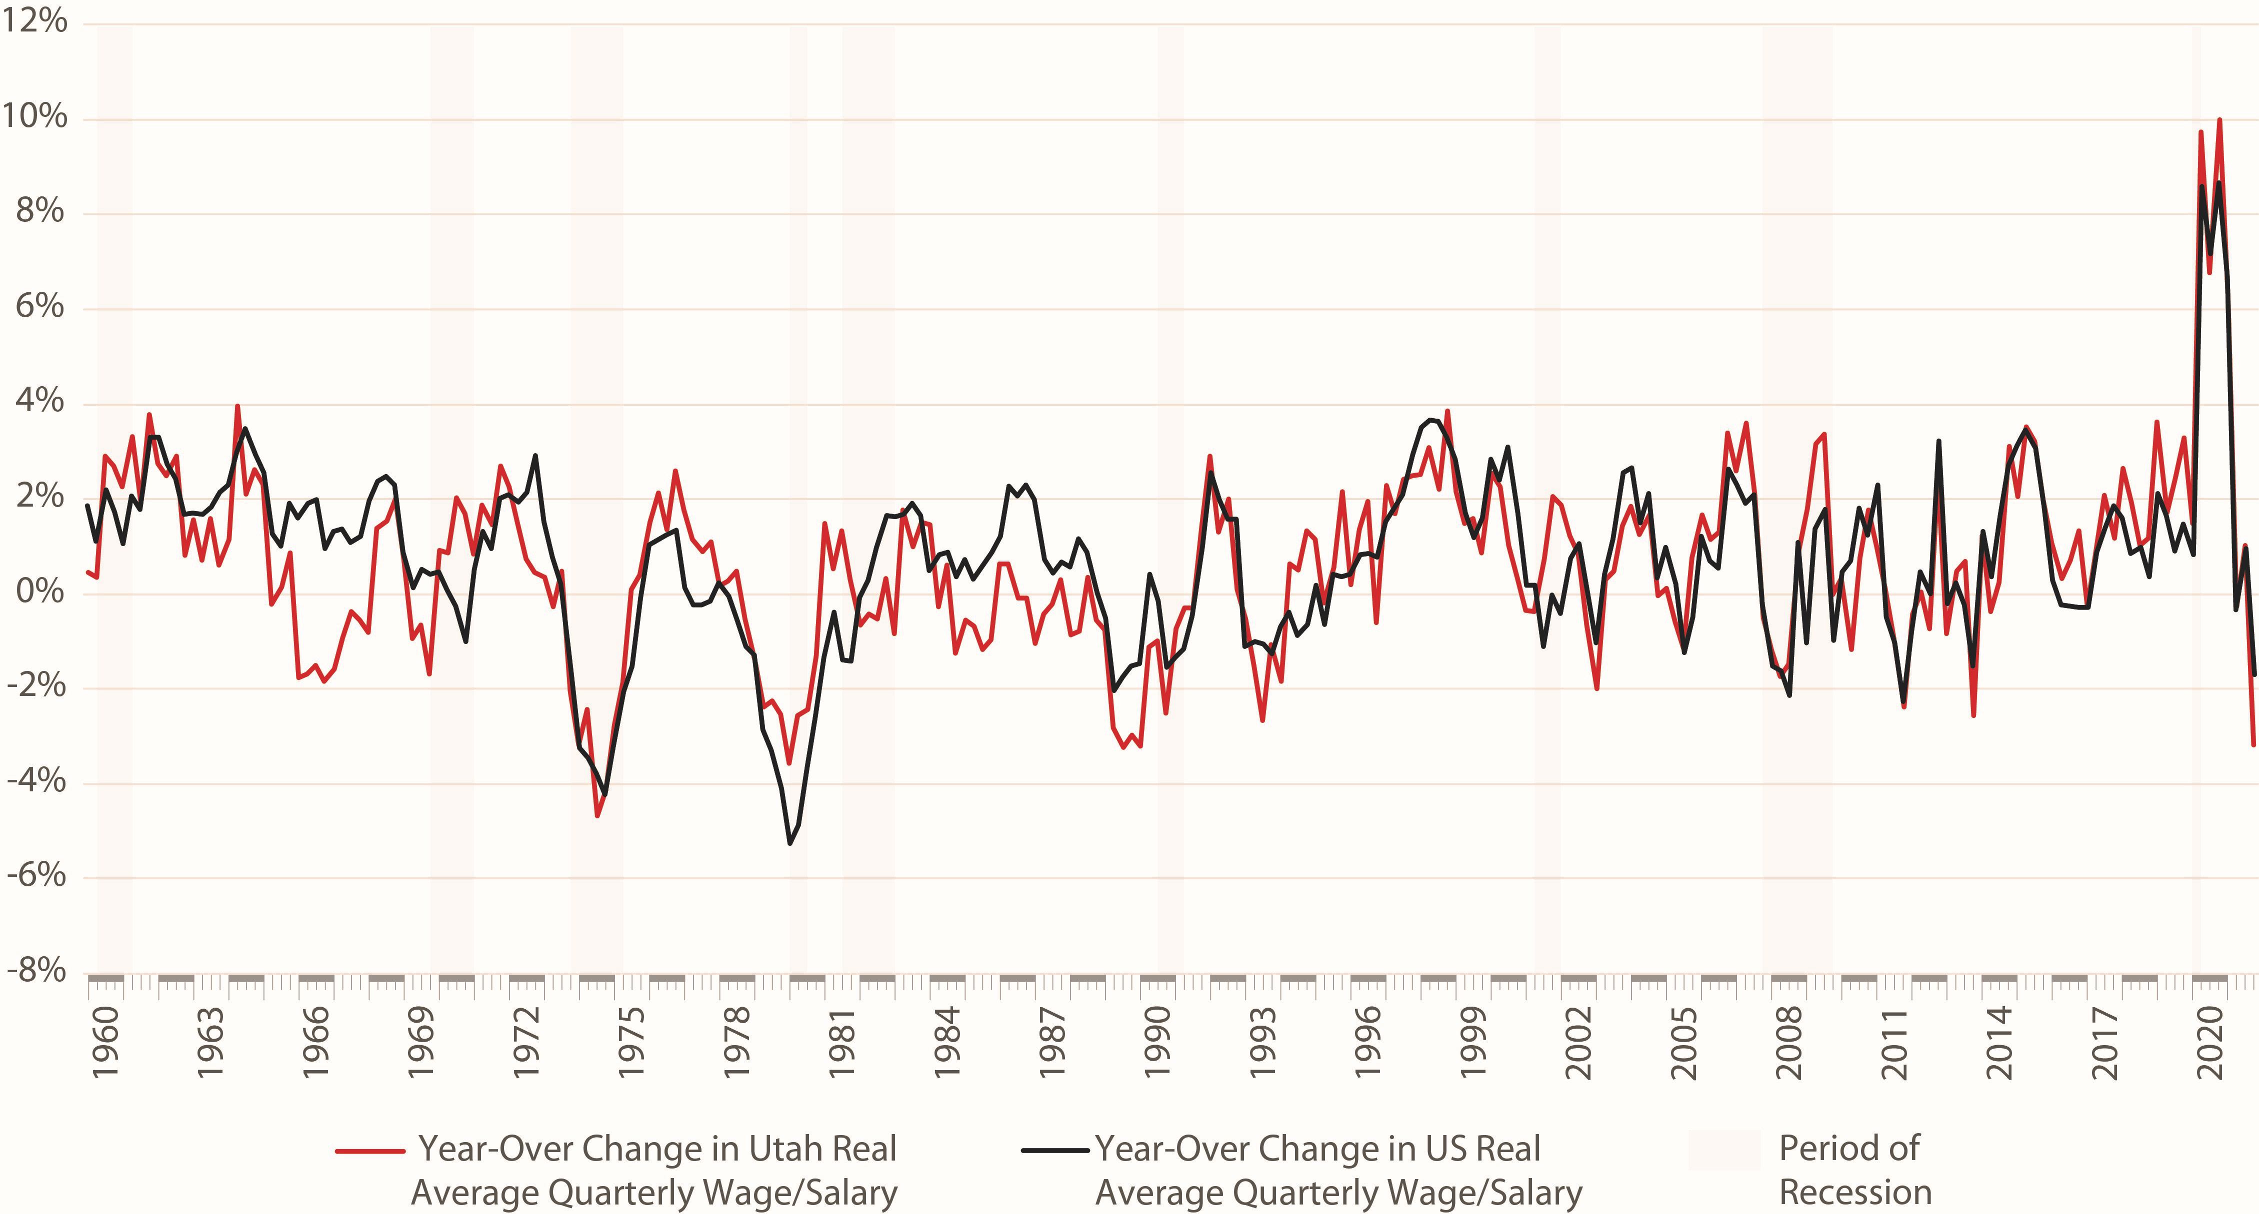
Declining Real Wages
One of Largest Real Wage Drops in Recent History
Source: U.S. Bureau of Labor Statistics
Kem C. Gardner Policy Institute
DAVID ECCLES SCHOOL OF BUSINESS UNIVERSITY OF UTAH

Slide 25
Labor Shortages – Econ 101
Supply
Prices below the market equilibrium result in shortages
Equilibrium
Demand

Slide 26
Takeaways
Scarce labor is the new normal (influenced by permanent demographic changes)
The days of cheap labor are over
With scarce labor - focus on keeping your productive employees (it’s probably much cheaper and easier than finding new ones)
Become a better employer (better wages, benefits, working conditions)

Slide 27
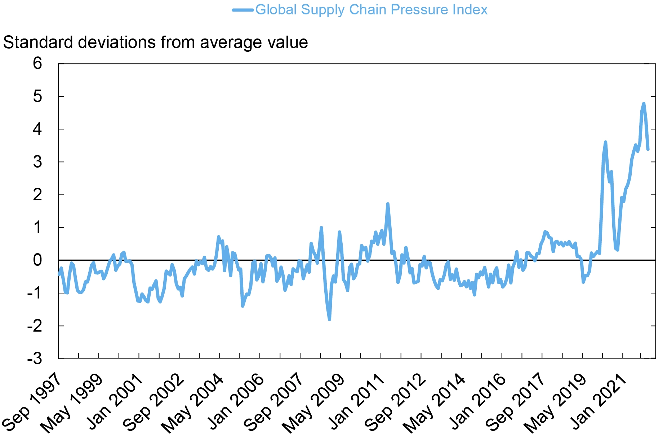
Global Supply Chain Disruptions Persist
Source: Federal Reserve Bank of New York

Slide 28
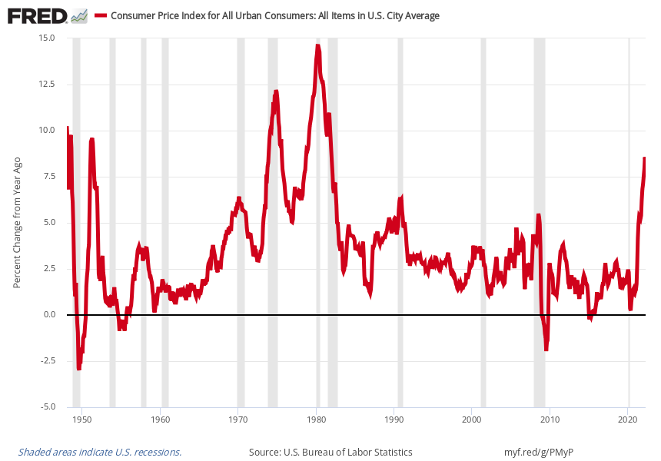
The Sting of Accelerating Inflation
Year-Over Change in Consumer Price Index
As of April 2022:
Mountain – 9.8%
U.S. – 8.3%

Slide 29
Takeaways
Few have had to meaningfully manage high inflation (it’s been 40 years)
Your dramatic revenue increases are partially illusory and a sizable portion of revenues need to be reserved for increased costs, like labor
Consumers are grumpy about high inflation, as it erodes their purchasing power (particularly those at the lowest end of economic spectrum)

Slide 30
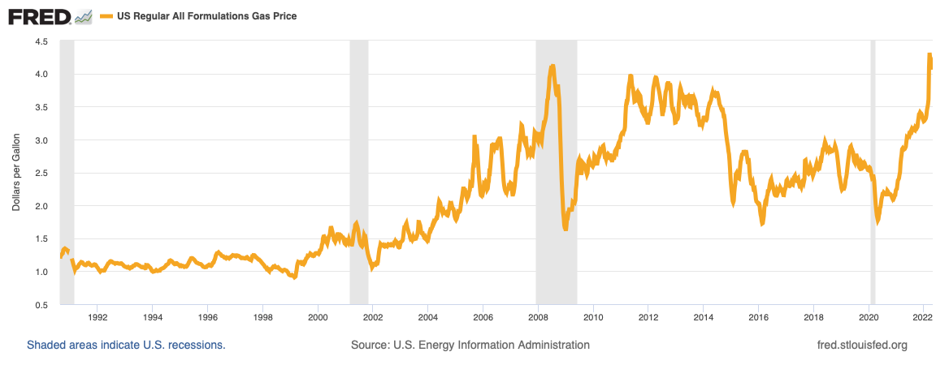
Increasing Gas Prices –
Accelerating with Ukraine Situation

Slide 31
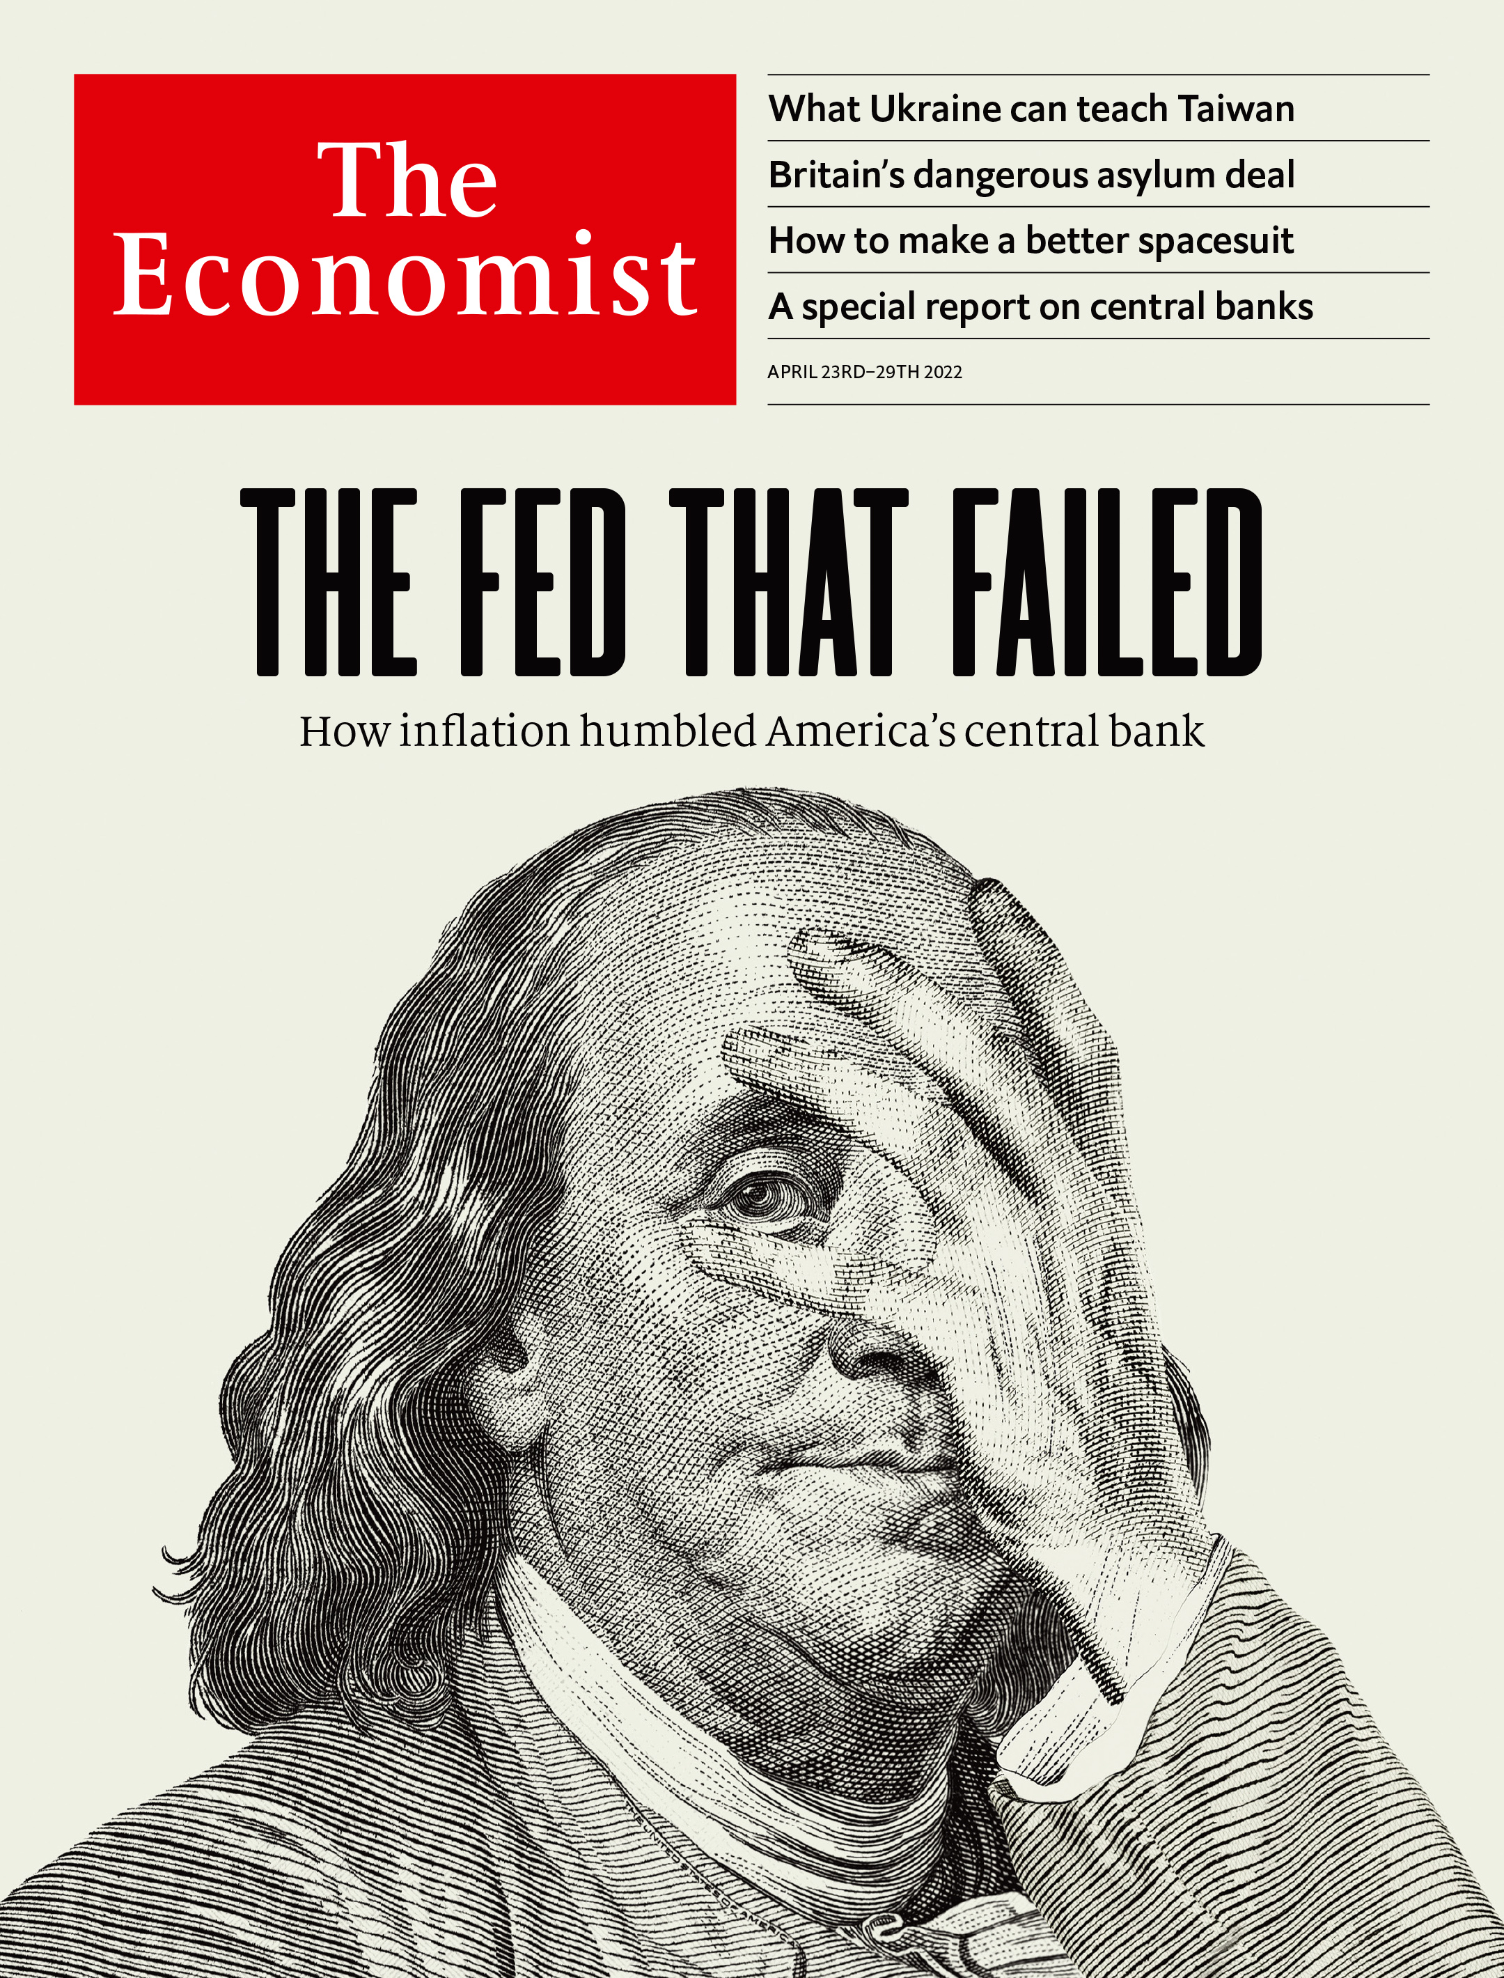
Monetary Policy Behind the Curve

Slide 32
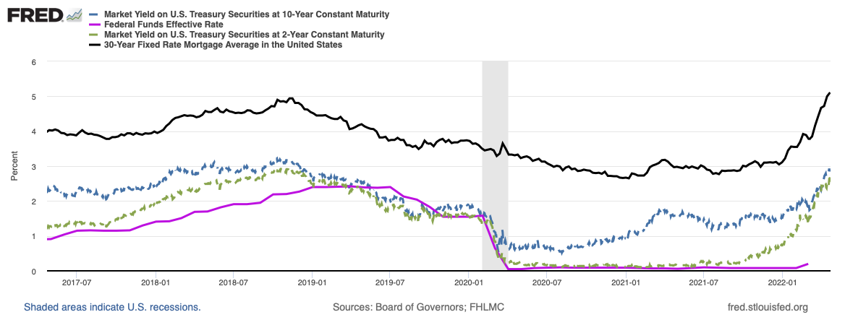
Interest Rates Have Increased….

Slide 33
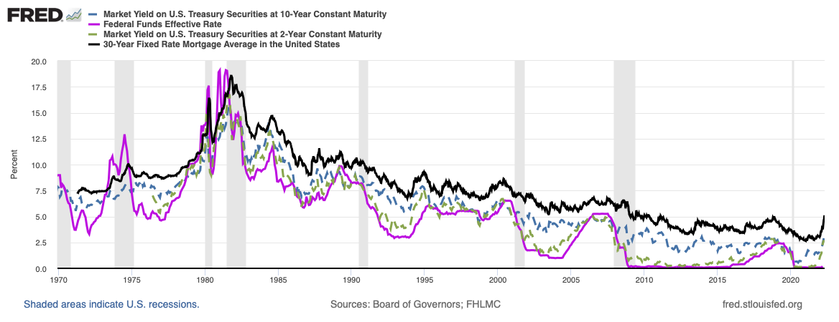
….But Still Expansionary…

Slide 34
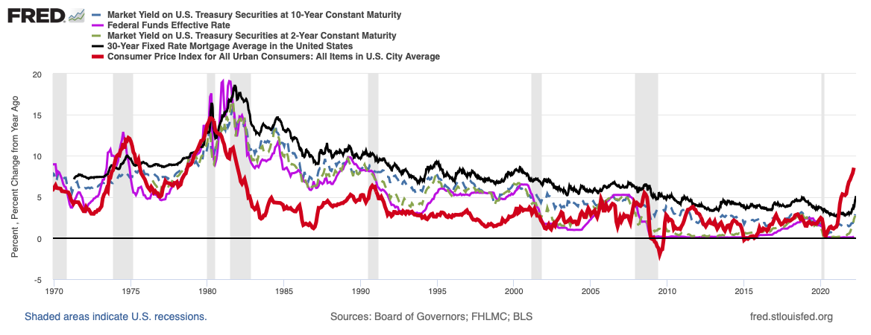
…and Lagging Far Behind Inflation

Slide 35
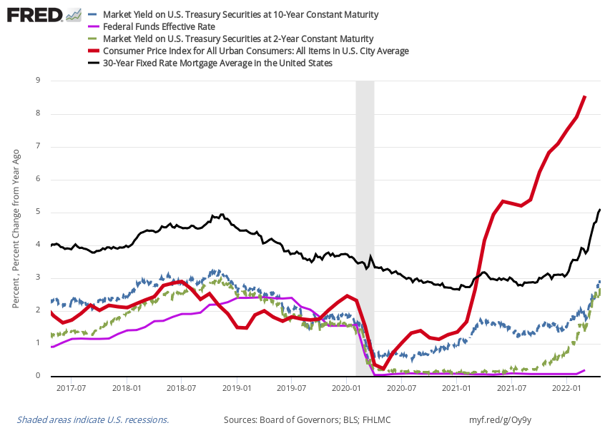
Negative Real Interest Rates for Past Year

Slide 36
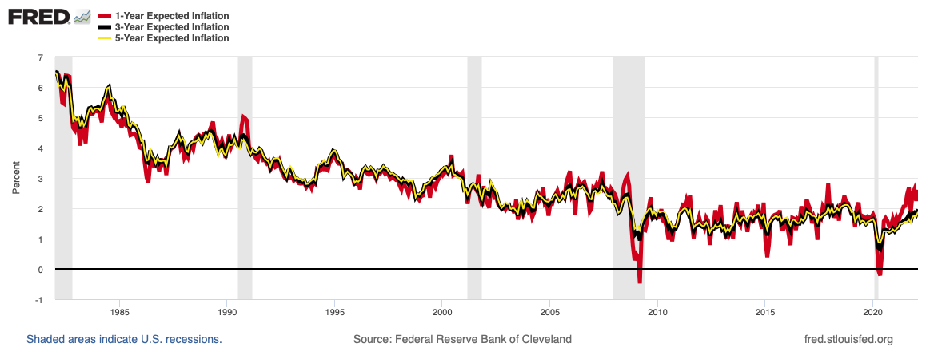
Warning Signal:
Sustained Increases in Some Inflation Expectations

Slide 37
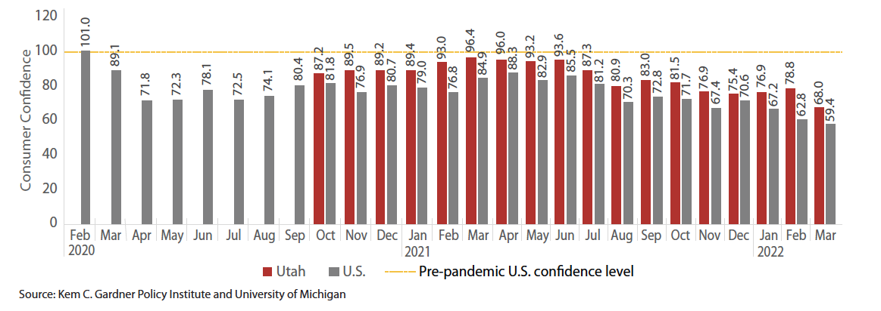
Warning Signal:
Consumer Sentiment

Slide 38
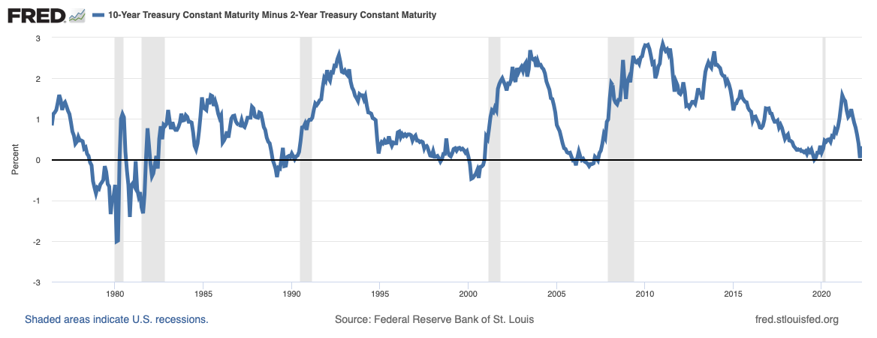
Warning Signal:
Inverted Yield Curve

Slide 39
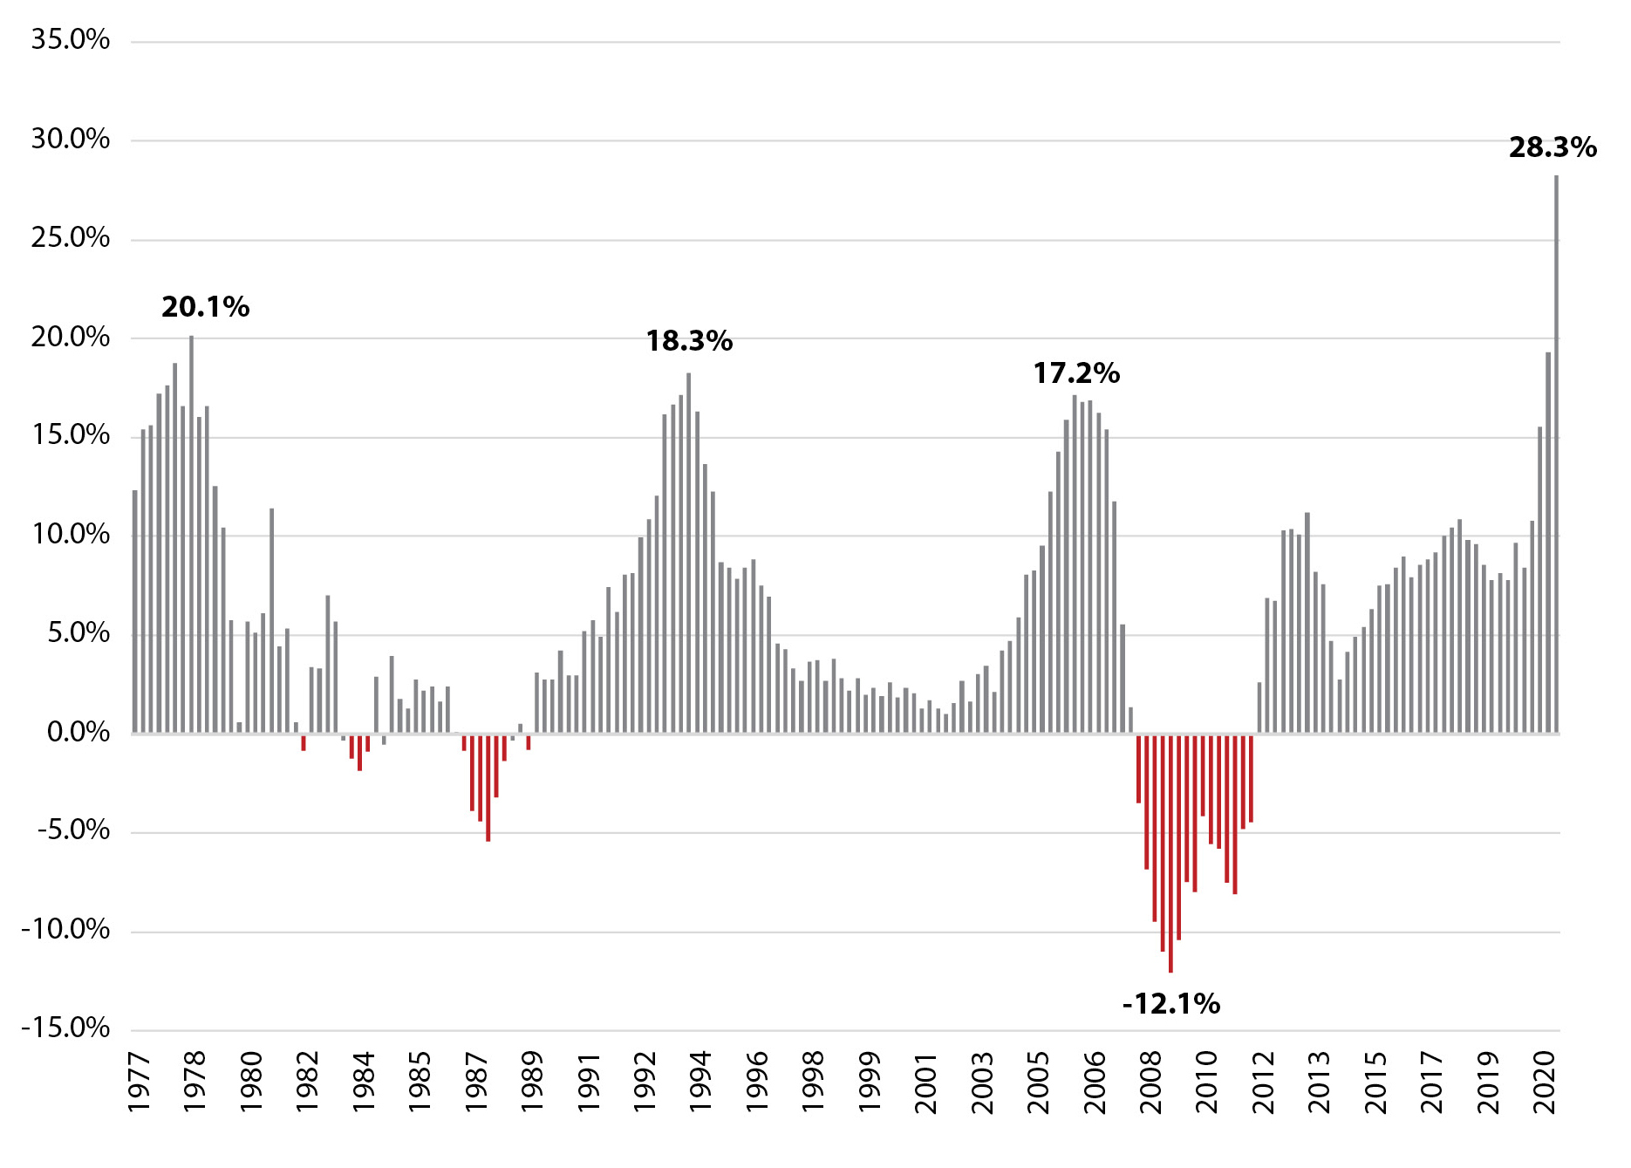
Skyrocketing Utah Home Prices
Source: Federal Housing Finance Agency Housing Price Index

Slide 40
Not From Loose Lending

Slide 41
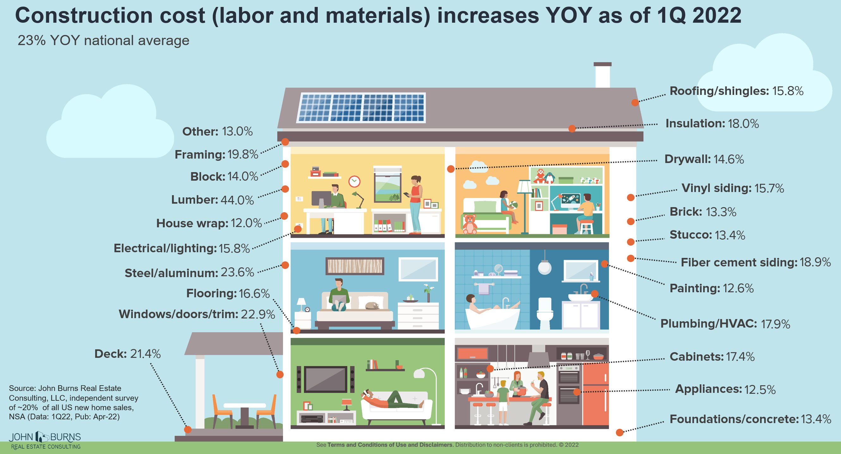
Increasing Housing Construction Costs

Slide 42
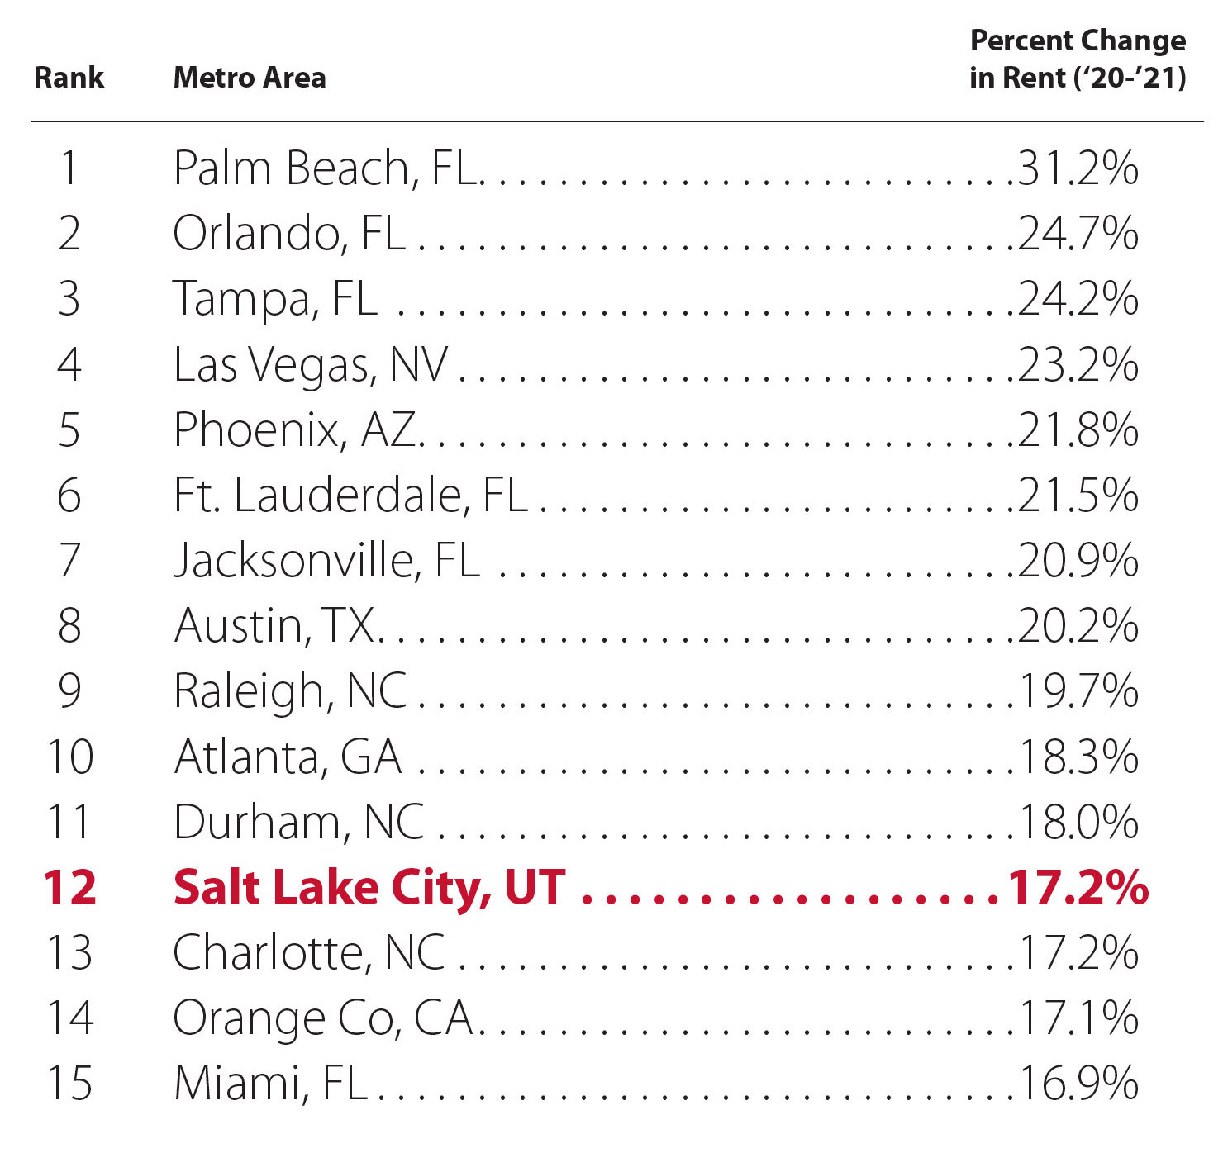
Increasing Rents
Source: CoStar

Slide 43
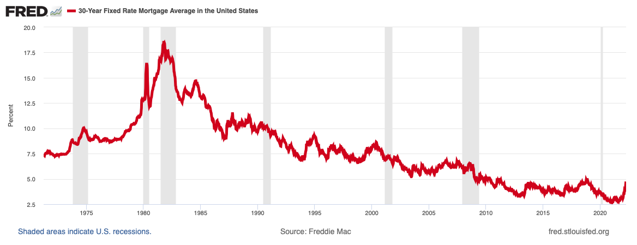
Increases from Historic Low Mortgage Rates
30-year Fixed Mortgage Interest Rates

Slide 44
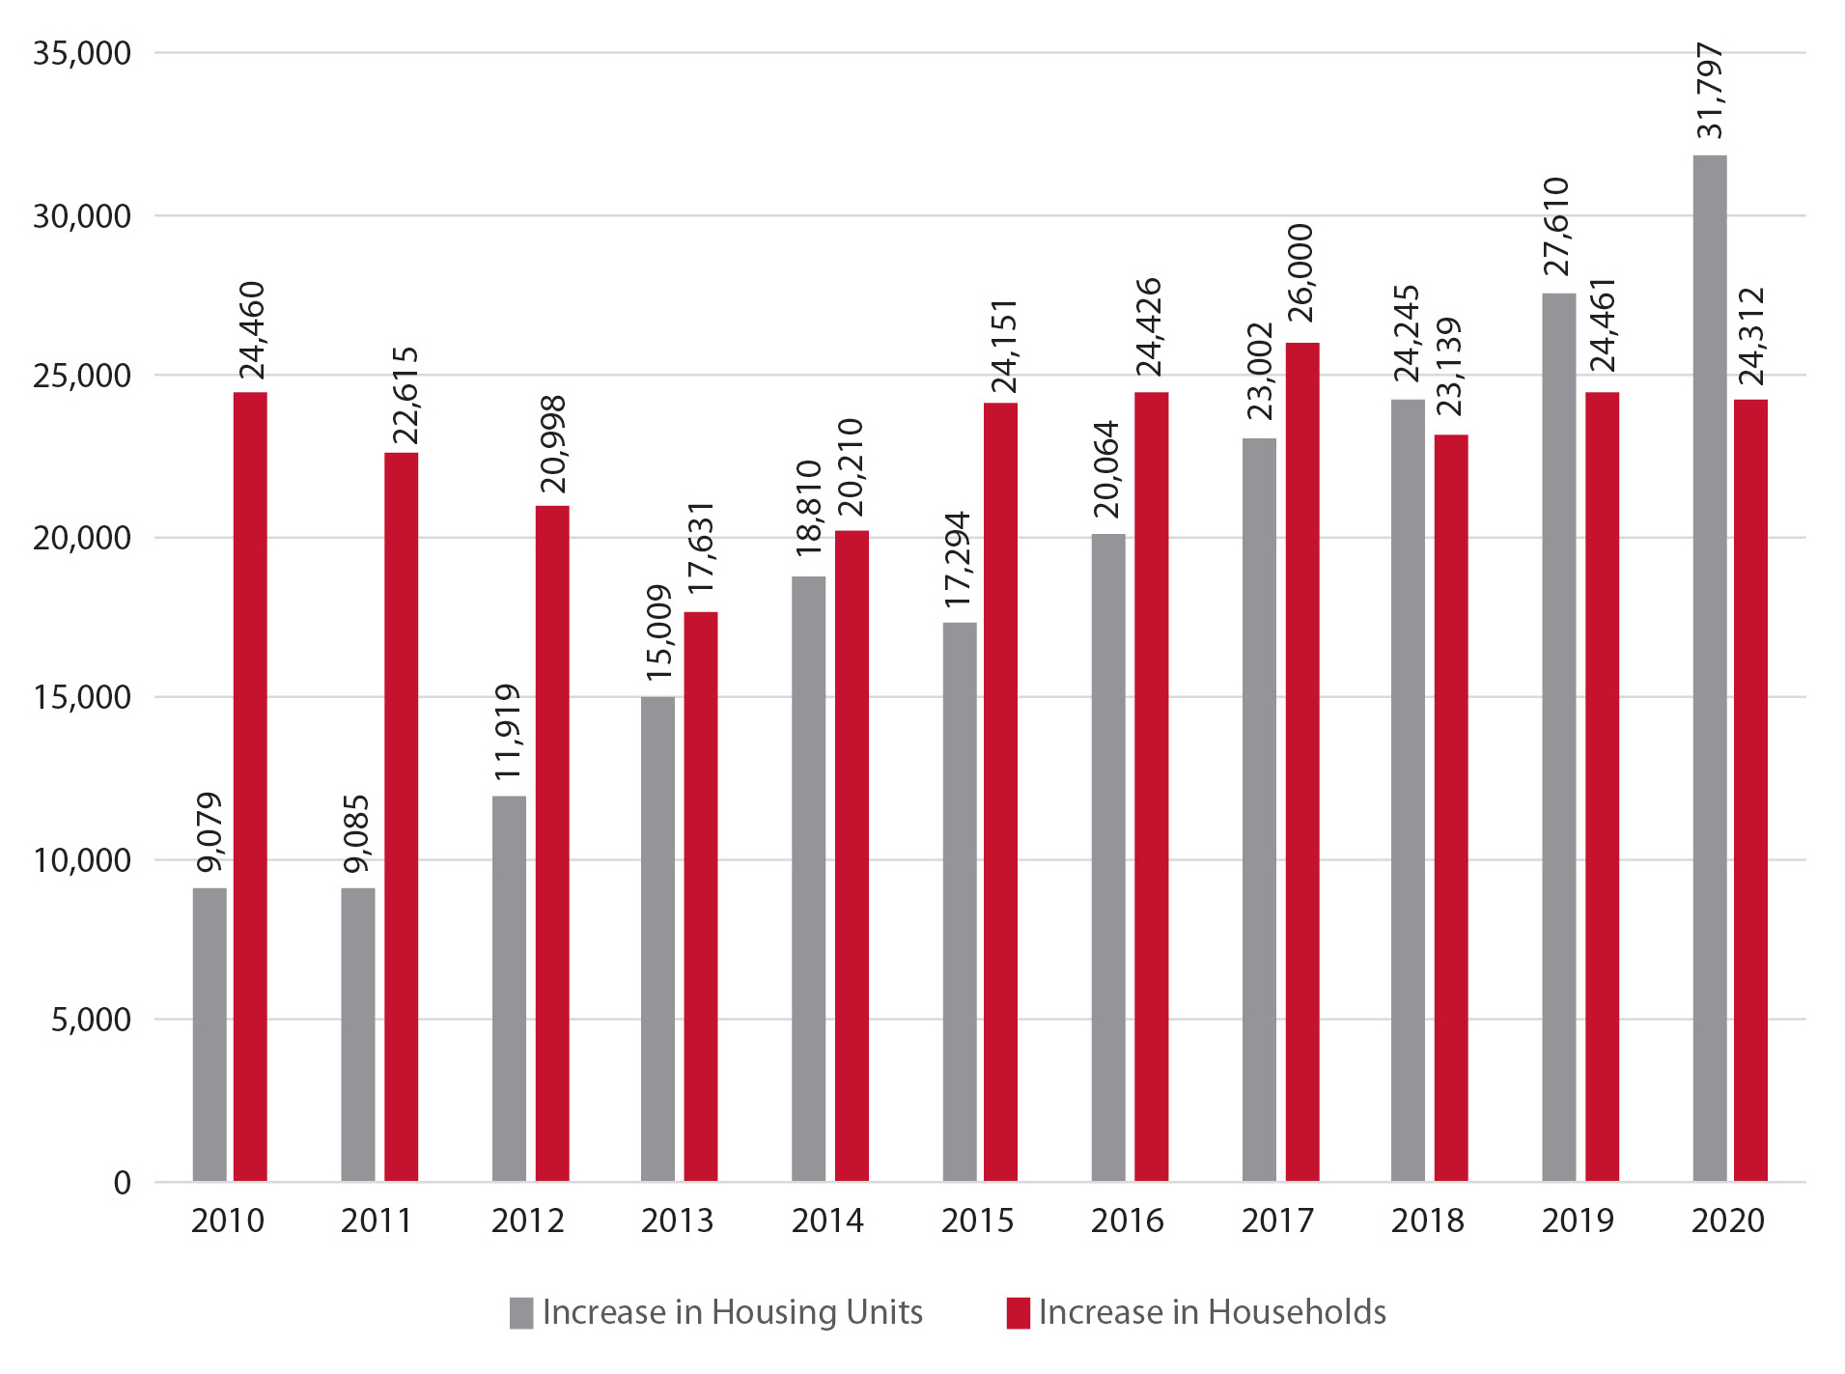
Housing Demand and Supply
Mismatch Since 2010
Source: Kem C. Gardner Policy Institute

Slide 45
More Households to be Priced Out
% of Households Priced Out of the 2021 Q4 Median-Priced Home Based on Interest Rates
Note: Assumes 30% debt-to-income, PMI, annual property tax, and 30-yr rate.
Source: Calculations based on U.S. Census Bureau 2019 1-year ACS Survey Income Data (adjusted to 2020), NAR 2021 Q4 Median Sales Price data.

Slide 46
Future Housing Demand
(Utah Needs Additional ~250K Units by 2030)
Source: Kem C Gardner Policy Institute

Slide 47
Takeaway
Housing markets are massively undersupplied
High housing costs are single greatest risk to Utah’s economy long-term

Slide 48
Economic Uncertainty Reigns Supreme
Utah Tailwinds
  Early and strong pandemic recovery
  Accumulated savings
  Diverse economy
  Young, growing, educated population
  Quality of life, including outdoor recreation
  Responsive and responsible government
  Infrastructure investments
  Social capital
Utah Headwinds
  Housing availability and affordability
  Accelerating inflation
  The Great Resignation
  Supply chain disruptions
  Increasing interest rates
  Geopolitical risks
  Unbalanced economic impacts leaving some behind

Slide 49
Looking to Utah’s Strong Future
At the end of the day, we will be measured by our humanity, who we cared for and who we brought in, and not those we left behind.
President Taylor Randall

