Slide 1



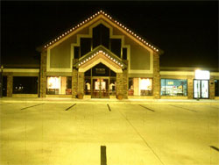
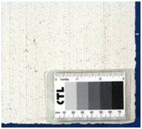
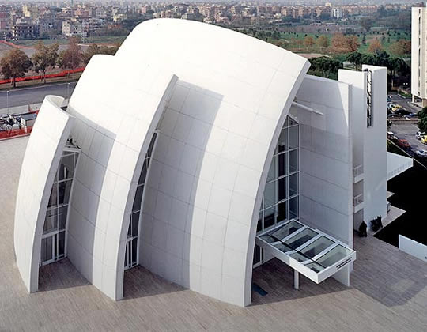
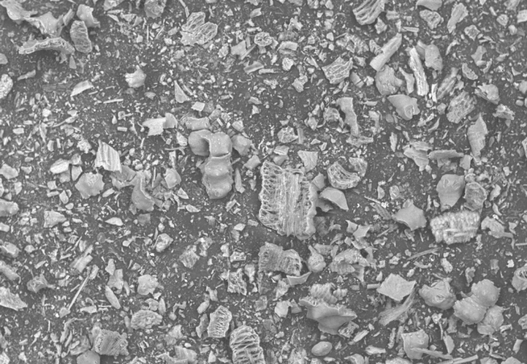
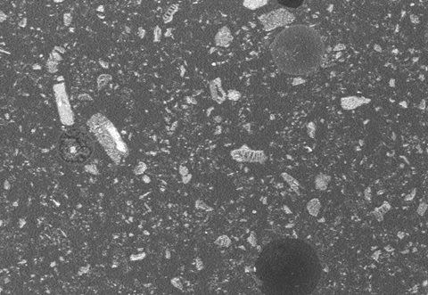
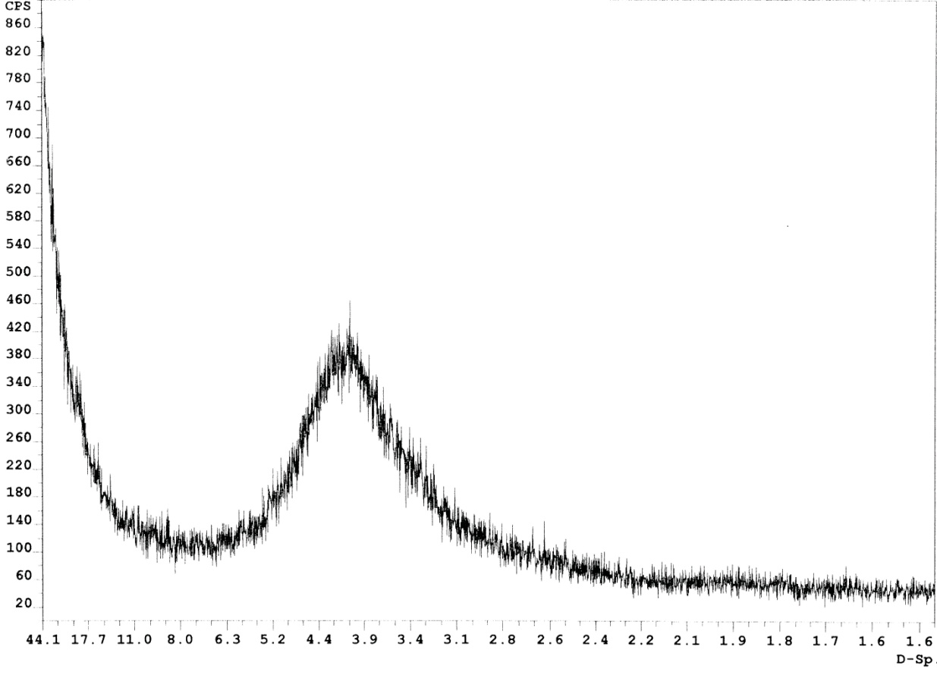
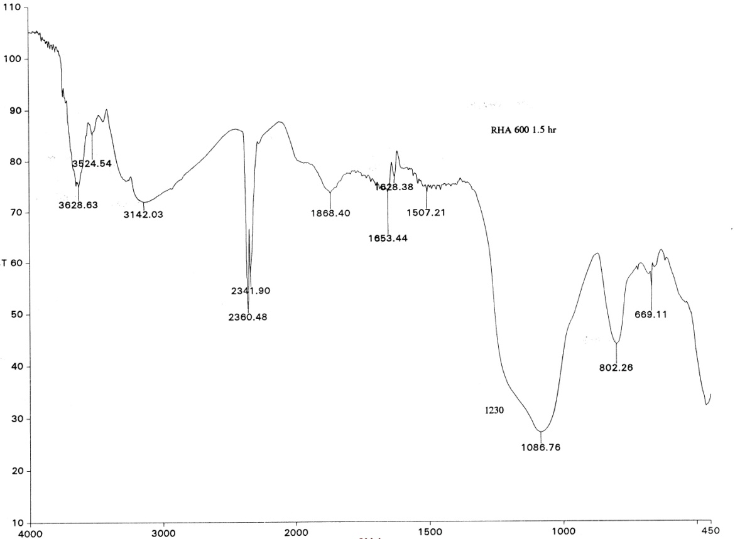
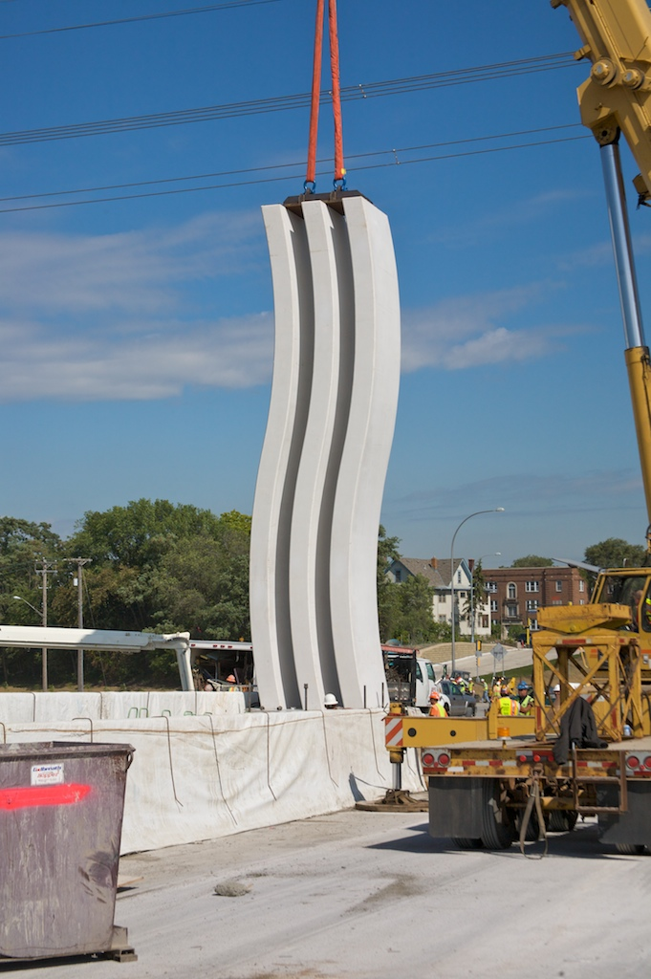
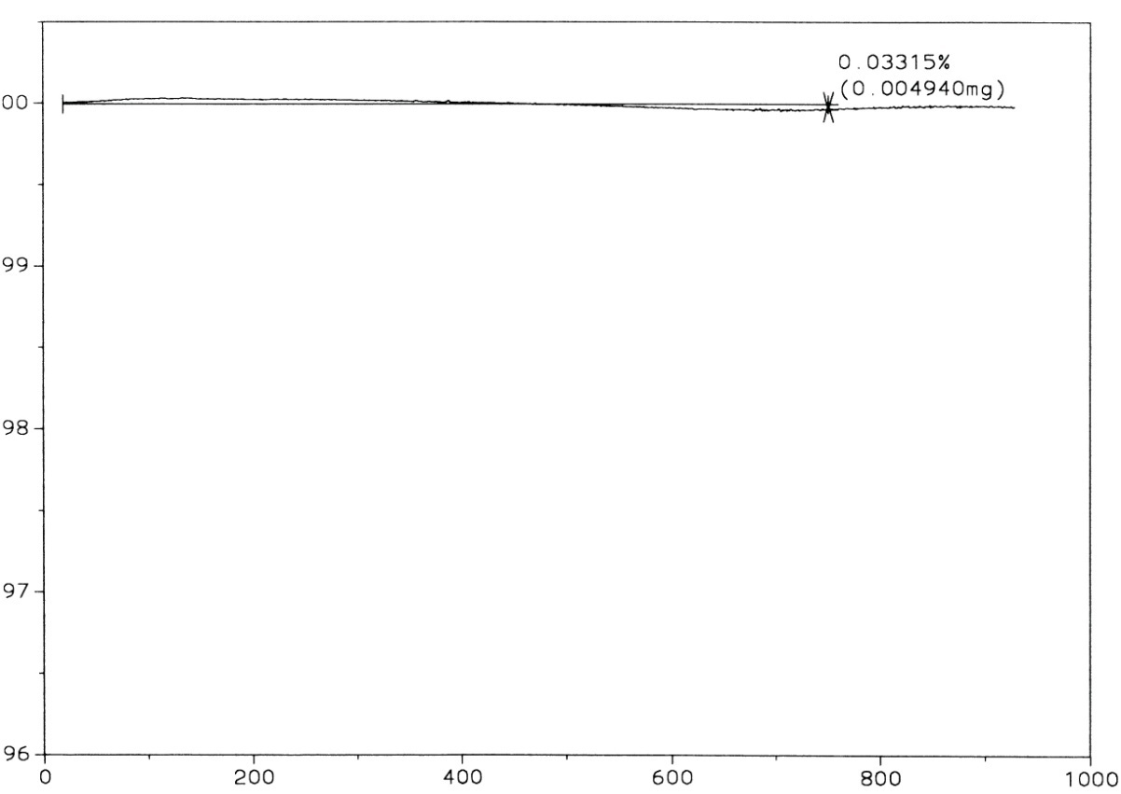
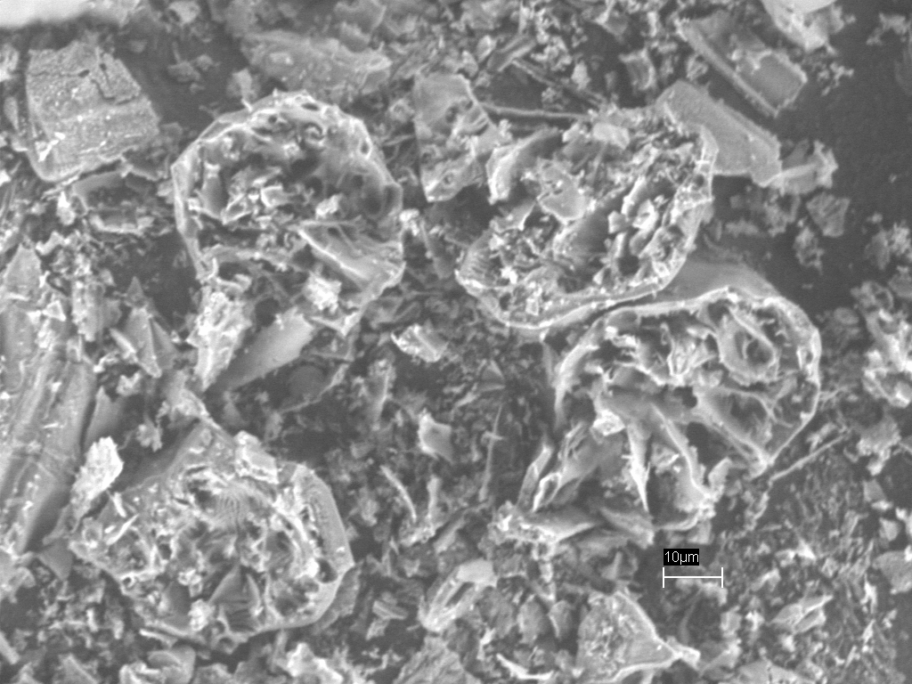
Build green with off-white!
Cementitious materials for sustainable construction
R.M. Ferraro, F. Matta, A. Nanni
University of Miami
White Concrete
Off-White Rice Hull Ash
Introduction:
Not too long ago, when architects and engineers mentioned concrete, ordinary people rarely got excited: concrete meant a dull, grey, visually unappealing appearance. Today, thanks to new technological advances, concrete can be cast in a variety of finishes and colors, offering architects and the construction industry a material that is both eminently practical and aesthetically pleasing. But color is not only about aesthetics, it can also offer important practical benefits in terms of safety (i.e., reflection in the dark) and environmental impact.
Based on the U.S. Green Building Council certification practice, the LEED Green Building Rating System for New Construction and Major Renovation (LEED-NC) considers that the reflective quality of white surfaces may help to improve lighting efficiency and reduce temperature fluctuations, resulting in lower heating and cooling with a reduction of related energy costs.
Introduction:
Rice hull, as an agricultural residue, constitutes the largest (about the 20%) and most useless by-product of the rice milling industry. Rice hull ash (RHA) also contains about 90% silica by mass. A well-burnt and well-ground RHA, with most of it silica in an amorphous form and with N₂-specific surface varying between 40 and 60 m²/g, is very active and can considerably improve the strength and durability of concrete.
The ChkGroup demonstrated the manufacturing of off-white rice hull ash (OWRHA). The possibility to have natural by-product, with no graphitic carbon in it, generated the idea to combine this green material with white cement to make an off-white eco-friendly concrete.
Figure 1.: Parking lots of Portland cement concrete are better lit with the same amount of lighting, making the property safer and more inviting.
Goals:
Characterization of the off-white rice hull ash;
Characterization of the white concrete mixed with OWRHA
Color analysis of the white concrete with OWRHA
(a)
(b)
(a)
(b)
500 microns
500 microns
Figure 2.: (a) Color reference chart is a subjective tool to evaluate the color; (b) Hunter Lab color scale gives a numerical evaluation of the color.
Figure 4.: Scanning Electron Microscope(SEM) image of (a) OWRHA (no C-Graphite) and (b) Ground Rice Husk Ash (with C-Graphite)
Methods:
White Portland cement was used in this investigation. A ground rice-hull ash with an average particle size of 5 micron was used. Standard graded Ottawa sand was used in preparation of all the mortar samples.
The microstructure of the off-white rice hull ash were evaluated by means of:
X-Ray diffraction (XRD)
Scanning electron microscopy (SEM)
Fourier Transform Infrared Spectroscopy (FTIR)
Thermogravimetric analysis.
The following properties of the mortar were evaluated:
Strength Activity Index (ASTM C 311)
Alkali Silica Reaction (ASTM C 1567)
Conclusions and future work:
The broad X-ray diffraction pattern of OWRHA confirmed the absence of any ordered crystalline structure;
The FTIR spectrum of OWRHA showed the presence of two main functional groups, Si-O-Si and Si-OH;
The thermogravimetric analysis confirms the absence of carbon in OWRHA;
OWRHA was found to improve the properties of cement mortar significantly.
The next step of this research project will be to evaluate the whiteness and the reflectivity of the white concrete with and without OWRHA, and evaluate the potentiality of this as a material for sustainable construction.
Figure 3.: Jubilee Church in Rome
Substitute cement in
new structure
Sustainability
Use eco-friendly building materials
Figure 5.: Project goals representation
Reduce the urban heat island effect with liter color building materials
(a)
(b)
References:
E.P. Mora , 2007. Life cycle, sustainability and the transcendent quality of building materials. Building and Environment; 42, p. 1329–1334.
W.W.J. Chan, C.M.L. Wu, 2000. Durability of concrete with high cement replacement. Cement and Concrete Research; 30, p.865-879.
R. Jauberthie, F. Rendell, S. Tamba, I. Cisse, 2000. Origin of the pozzolanic effect of rice husk. Construction and Building Materials; 14, p.419-423.
Intensity (CPS)
Transmittance
D-Sp
Frequency cm-1
(c)
(d)
Weight (%)
Acknowledgement:
The authors gratefully acknowledge the National Science Foundation for financially supporting the project. The authors also would like to thank Artistic Stones INC. for assistance and collaboration.
Temperature (ºC)
Rossella Mafalda Ferraro
Figure 6.: (a) X-ray diffraction pattern of OWRHA; (b) FTIR spectra of OWRHA; (c) Thermogravimetric analysis of OWRHA; (d) Scanning electron micrographs of OWRHA.
Figure 7.: White concrete sculpture that marks the Mississippi river gateway
Contact information: R.M. Ferraro, PhD Candidate, Department of Civil Architectural and Environmental Engineering, University of Miami, – Email: r.ferraro@miami.edu; Web: http://www.rb2c.miami.edu/NSF Grant # 0724463 “Grant Title: High Performance Cement Additive from An Agricultural Byproduct,” Program: “SBIR/STTR Program, Industrial Innovation and Partnerships, National Science Foundation,” PI name: Rajan K. Vempati.

