Slide 1
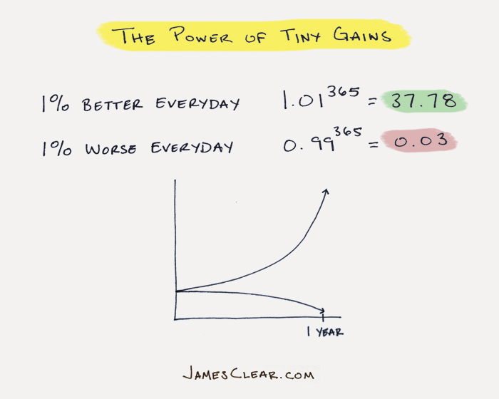
Make yourself the best version of you
1% better each day
That’s 365% better in a year

Slide 2
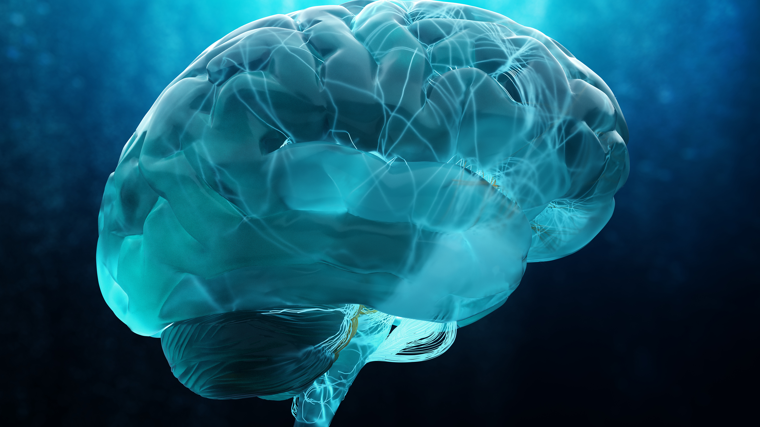
The Science
What Are the 4 Laws of Atomic Habits?
The 4 laws of atomic habits are derived from the four stages of habit formation. These stages are the cue, the craving, the response, and the reward. Every habit you have is linked to these four stages.
The cue is the element that triggers the brain to notice an opportunity for a reward, or pleasure. A cue can be a smell, a sound, an event, an interaction, or anything else that triggers a desire. This desire is known as the craving.
The craving is the emotional relevance attached to a certain cue. When you notice the cue, the brain anticipates an opportunity for a change in your physical or emotional state. You crave the satisfaction that change will elicit, and this craving is what prompts you to act.
The response is the actual behavior, or habit, performed to elicit the change you desire. Your brain prompts you to take a certain action it believes will create the feeling of satisfaction you want.
The reward is the satisfaction gained from the action taken. You have successfully satisfied your craving and changed your physical or emotional state. The brain builds a pathway from the cue to this state of pleasure. Every time you experience the same cue, the brain will be triggered to desire that pleasure again. You will be prompted to perform the same action, thereby creating a habit.

Slide 3
What is a Habit
Determine what is a habit
Shift your mind into what you want to improve
Notes:
Ask: What is a habit? Give some examples. Drinking water, breathing, meditating, exercising,

Slide 4
Laws of Habit Formation
Make it Obvious
01
Make it Attractive
02
Make it Easy – one push up
03
Make it Satisfying
04

Slide 5
Make it Obvious – link to existing habits
Habit Stacking
Make a list with +, -, =
After current habit, do a new one
As soon as I walk into the office, I’ll check and sort my emails for 15 minutes.
As soon as I eat my breakfast, I’ll meditate for 10 minutes

Slide 6
Make It Attractive – new habits
Personal | Professional
While I am watching TV, I will workout. | While I go get coffee, I will call my carer back.
While I listen to music, I will clean the bathroom. | While I listen to music, I will finish my case review.
Personal | Professional
Once I read 10 pages, I’ll go on TikTok for 5 mins | If you do a case note, get a lolly.
If you clean the bathroom, you get out of cooking dinner | When you finish a case review discussion, go for a walk for 15 mins and listen to some music

Slide 7
Make it Easy
2 minute rule
Table of very easy, easy, moderate, hard, very hard
Set your environment – put your workout clothes where they need to be the night before.
Clean your desk so everything is where you need it, and you minimise distractions
Very Easy | Easy | Moderate | Hard | Very Hard
Save the case review document | Fill out the front page | Hold the meeting | Complete the discussion | Complete the actions

Slide 8
Make it Satisfying
Use an app
Use a checklist
Tell a friend of your achievements
Notice – get that dopaminergic fix
Never miss twice – get back on track, but forgive yourself.

Slide 9
Be a BOSS
Create many positive feedback loops
Stop negative feedback loops asap!!!

Slide 10
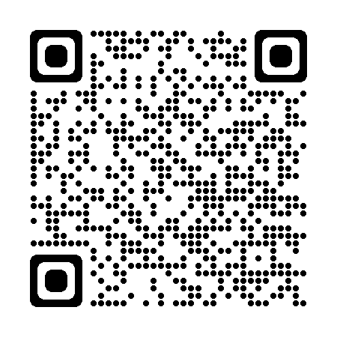
Habit Tracking
Apple
Android

