Slide 1
Positive Behaviour Support Strategies
Developed March 2022 by Thomas Cobden

Slide 2
What is it?
Strength based
Grounded in positive reinforcement
Extrinsic rewards for intrinsic effect
Hard to do when emotions are heightened
Affected heavily be personality attribute if negative emotionality, specifically sub category of volatility.
Not thought to be a ‘normal’ human reaction, taking practice and learning.
May be improved by strong reciprocal attachment (Circle of Security)

Slide 3
Video

Slide 4
The role of empathy
Helps increase effectiveness
Helps strategies be tailored towards mutual positivity
One way to do this is by Generating “I” statements. This involves adopting the perspective of the client, their family or carers and service providers to provide different causal explanations for the presenting issues. For example, individuals may be asked “If the client was here, how might they explain the presenting issues?” – Support & Intervention of Client Behaviour Guidelines, 2017

Slide 5
examples
* provide positive praise when the behaviour is appropriate
* provide positive focus on strengths and achievements
* identify and build on the person’s strengths and their abilities
* incorporate emotional literacy into everyday life: identifying, labelling and supporting emotions
* redirection
* giving explanations
* encouragement
* giving help
* collaborating to solve problems
* helping to understand the consequences and impact of their behaviour
* model appropriate behaviours
* be understanding and supportive – acknowledge person’s emotions
* provide acceptable alternatives
* using a reward system, which incorporates a highly desired item; the person will be more motivated to learn the new skill and use it when necessary.
* stop, look and listen for triggers to changes in behaviours to know when to put in place distraction activities
* identify familiar tasks to keep both mentally and physically active
* organise with relatives and/or friends planned visiting times and coordinate regular outings if possible
* review timing of meals/snacks and other activities like showering
* identify and minimise confusing sensory environments/loud or disliked music
* avoid sensory overload
* use signs with pictures around the house to minimise confusion and ensure adequate lighting
* plan a possible arts and crafts activity program
* plan a regular physical activity program
* identify at least one safe wandering area around the house which has easy access
* discuss the need for respite and additional support

Slide 6
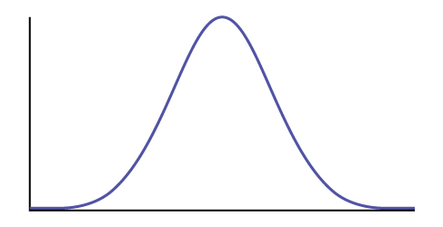
Intersectionism
TCI
123 magic: pick the right consequence (response cost) and make it clear early on in the escalation.
Bringing up great kids: The message of behaviours - Why do my kids do what they do? Are they just trying to push my buttons?
Behaviour (y) vs time (x)

