Slide 1
Communicating with purpose
Things to consider

Slide 2
The goal
Creating your communication goal before you begin, will help you to get what you need.
Notes:
Being able to come back to the goal after an hour of challenging conversation, or multiple back-and-forth emails, is incredibly tricky, but incredibly rewarding when done well.

Slide 3
Vectors of change
Vectors | Challenge | Approach
Intellectual | Understanding Context Awareness | Discussion Teaching Reference
Emotional | Attitude Judgement Hopes/Fears | Personal Listening Normalising
Motivational | Intent Investment Ownership | Encouragement Inclusion Value
Vector: “Having direction as well as magnitude” (Oxford)
Notes:
Everyday communication encompasses all of this, however the recipient infers certain details which they elicit from making assumptions which have been reinforced over time with consistency in a relationship.

Slide 4
Use deductionism
Deductionism will help you to keep communication specific to the issue, maintain curiosity, and not generalise your progressive thoughts.
Inductionism may lead to formulating incorrect judgments based only on what YOU observe. This is known as observation bias, and here’s a fun video.

Slide 5
When to use different things
SMS
Emojis
Email
Chat messages (Teams)
Threaded discussion (Teams)
Letters
Affidavits
Case Review documents

Slide 6
SMS
A traditional text message is 160 characters. This is exactly how much content you can fit within that limit:
The quick brown fox jumped over the lazy dog. The quick brown fox jumped over the lazy dog. The quick brown fox jumped over the lazy dog. The quick brown fox ju
When to Send a Professional Text Message?
It’s not a lot of space, but the best professional messages are clear, concise, and action-oriented. Let’s look at a few situations where a text can be a great tool.
You might want to send a text message if…
You want to send time-sensitive information
You want to send staff updates
You want to confirm or change the details of a meeting/appointment
You have questions or you’re looking to collect opinions
You want to send encouraging messages or kudos
You want to send an introduction text
You need to set appointment reminders
The only times a text message may not be appropriate are moments when an in-person conversation is necessary or you need to communicate private information such as medical or legal records (although there are special rules for these types of texts too)

Slide 7
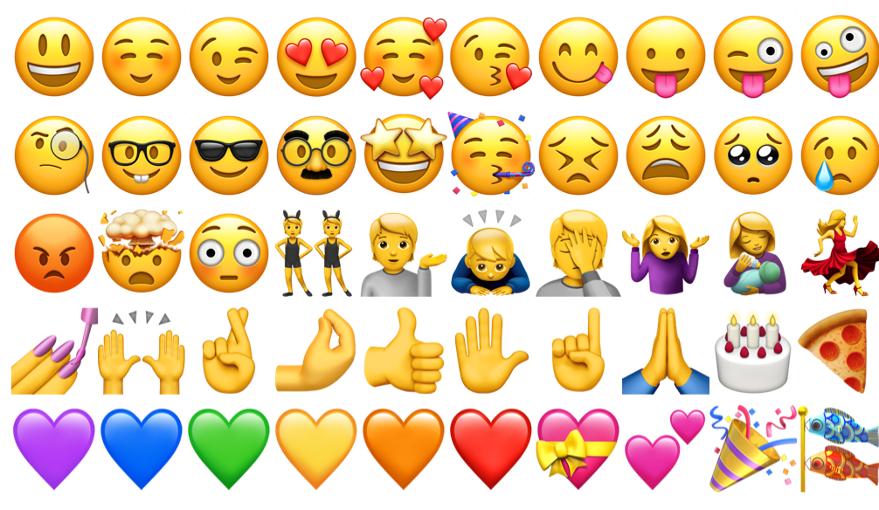
Emojis
Context is important
Whether you should use emojis at work depends on context. If your workplace is informal, emojis are likely more acceptable, particularly if your co-workers use them frequently.
"Mirroring is a proven strategy for in-person communication, and I believe the same is true online," said PR manager Hillary Hafke. "Emojis are appropriate for some business emails in the same way that jokes are OK in some job interviews. You simply need to know your audience."

Slide 8
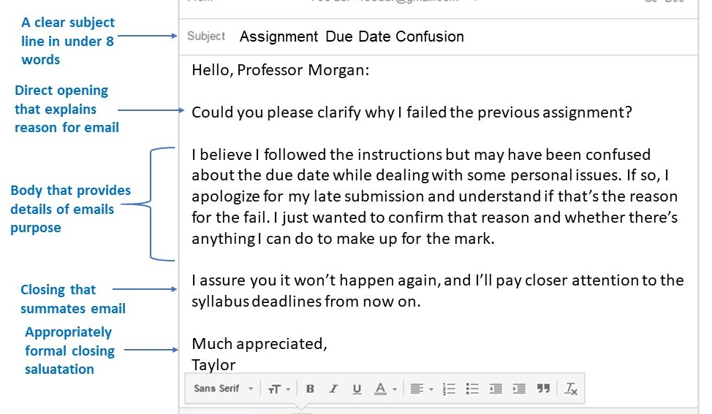
emails
What’s To?
What’s a CC?
What’s a BCC?
What’s a @Mention?
Emails aren’t as formal right? So, I can skip the vectors?
NO, a well formulated email will get results!
The person who needs to do something
The people who need to know, but take no action
The people who need to know, but the attention of the recipient on this would likely cause problems
A modern way to reference and call to attention
If there’s back and forth over approving a document, remember to always keep forwarding so attachments remain for every email, to assist the readers.
Don’t break chains, or omit emails within a chain unless absolutely necessary.

Slide 9
affidavits
“The primary reason to write an affidavit is so that the writer can formulate and organize an informed, coherent and sophisticated set of ideas about something important.”
-Dr. Jordan Peterson
Great checklist
When presenting information directly to parties at Court is the best way to avoid perceived bias and uphold evidentiary strength.
Affidavits are used in ​Court as evidence. In some cases, if you make an affidavit, you may not need to give evidence in person. In other cases, you may still have to go to Court to answer questions about the information in your affidavit.
Affidavits must be deductive in their layout (think a good essay or research). They also need to be clear and concise (intellectual). Perceiving the emotional vector for the courts parties will help you anticipate and respond to parties’ concerns. Tailoring to motivation will help the other parties take action.
Legal requirements: LINK

Slide 10
Case Review Documents
Meaningful participation is the key to the success of our children.
“Children have the right to freely express their views on all matters and decisions that affect them, and to have those views taken into account at all levels of society. It is the right of every child, without exception.”
-United Nations
A placement review is an opportunity to assess whether:
• the goals and objectives outlined in the child or young person’s case plan have been met
• the goals and objectives are still relevant and appropriate
• there is an ongoing need for the child or young person to receive wraparound services
• additional wraparound services are required. Instability and uncertainty are a common reality for children and young people in out-of-home care.
Regular placement reviews will:
• promote stability of the placement by identifying and addressing possible problems, and
• remove uncertainty for the child or young person by inviting their involvement in the review process and communicating decisions.
- OCG http://www.ocg.nsw.gov.au/ArticleDocuments/452/Guidelines_Review_of_Placementsv3.0_180611.pdf.aspx?Embed=Y
Ask yourself – Would the child care about this? How can I use vectors to increase the chance of success for them?

Slide 11
Letters
Consider using them to create evidence.
What you can summarise effectively in a letter will reduce the need for other notation, as it will be the primary source of evidence as long as;
it’s dated
It invites return engagement in a flexible manner
It motivates the reader to do something
It engages with their emotion
It clearly indicates facts in a manner that has the possibility of being well perceived by the reader
https://www.publicworld.org/files/writing_effective_letters.pdf
Notes:
Consider talking about:
Cultural aspects

Slide 12
Teams - chat
Reduce email clutter
Move noisy replies and acknowledgments out of email threads and into quick chats where they belong. Easily share pictures and documents with a specific person or your entire team with the Microsoft Teams instant messenger program.
Instant message one-to-one or with a group, hop on a video call, or share your screen for fast-paced decision making. Customise your messages with rich text editing, tag people to call their attention, and use your favourite apps in chats.
Keep your team focused
Organise your conversations, files, and apps in one place to keep your team in sync whether they are inside or outside your organisation. Right-size collaboration by limiting which team members can see instant message conversations and content around a particular topic.
Take conversations anywhere
Stay connected and collaborate with others wherever you are. Record voice messages while on the go, reply to specific chats from your mobile device, and customise notifications to help you be present during personal time.

Slide 13
Teams - threads
For key information we may want to refer back to later. Anyone can create a post which then tracks replies.
This is helpful for slightly more important questions. Maybe a question about a process or practice idea.

Slide 14
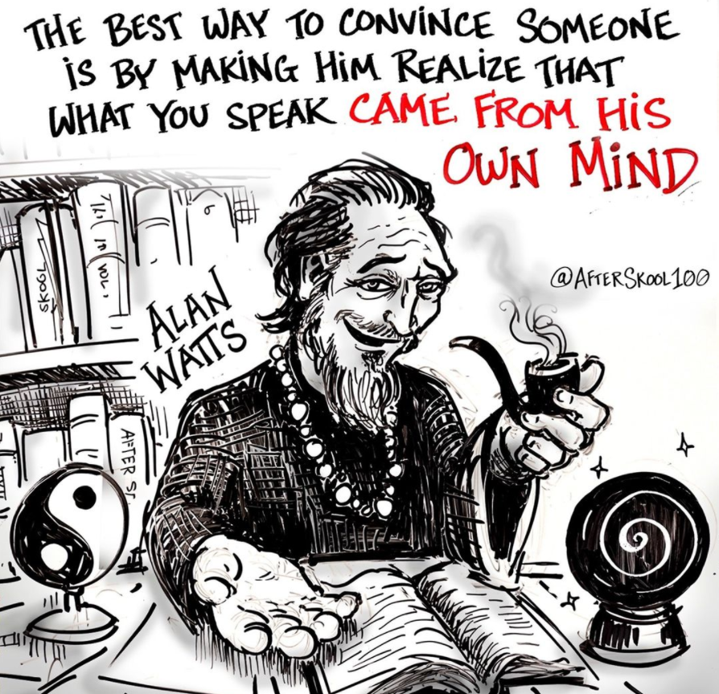
The end

