Slide 1

How to Add the Mountain Shadows Website to a mobile phone
Instructions are for iphone, Android installation would be similar.

Slide 2
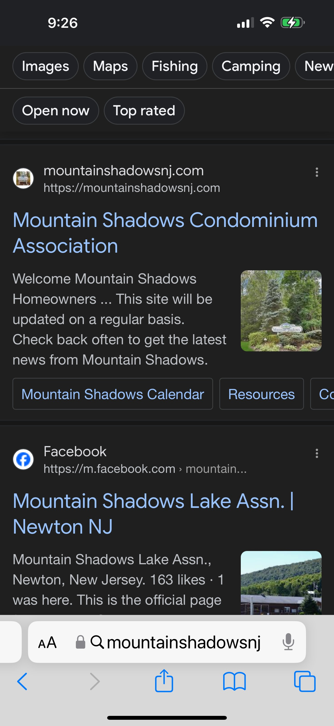
Search for the Mountain Shadows
website and click on the link to
open the site.
www.mountainshadowsnj.com

Slide 3
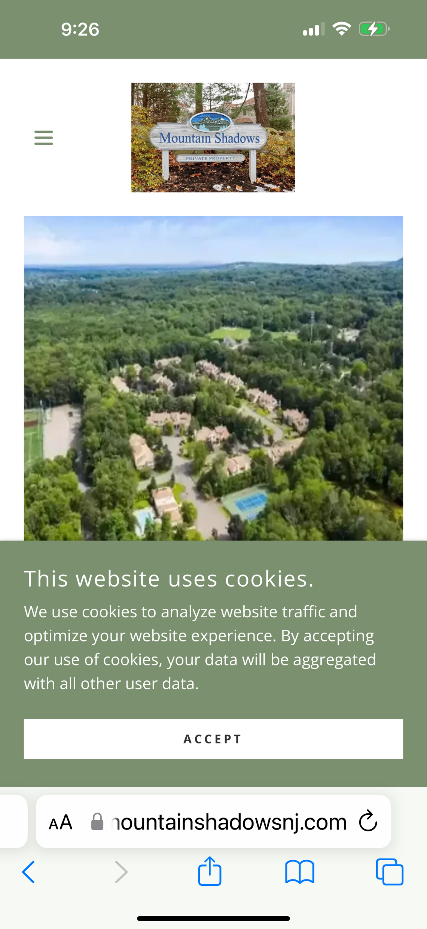
1. Accept cookies before
entering the site.
2. Click on square with arrow
on the bottom of your screen

Slide 4
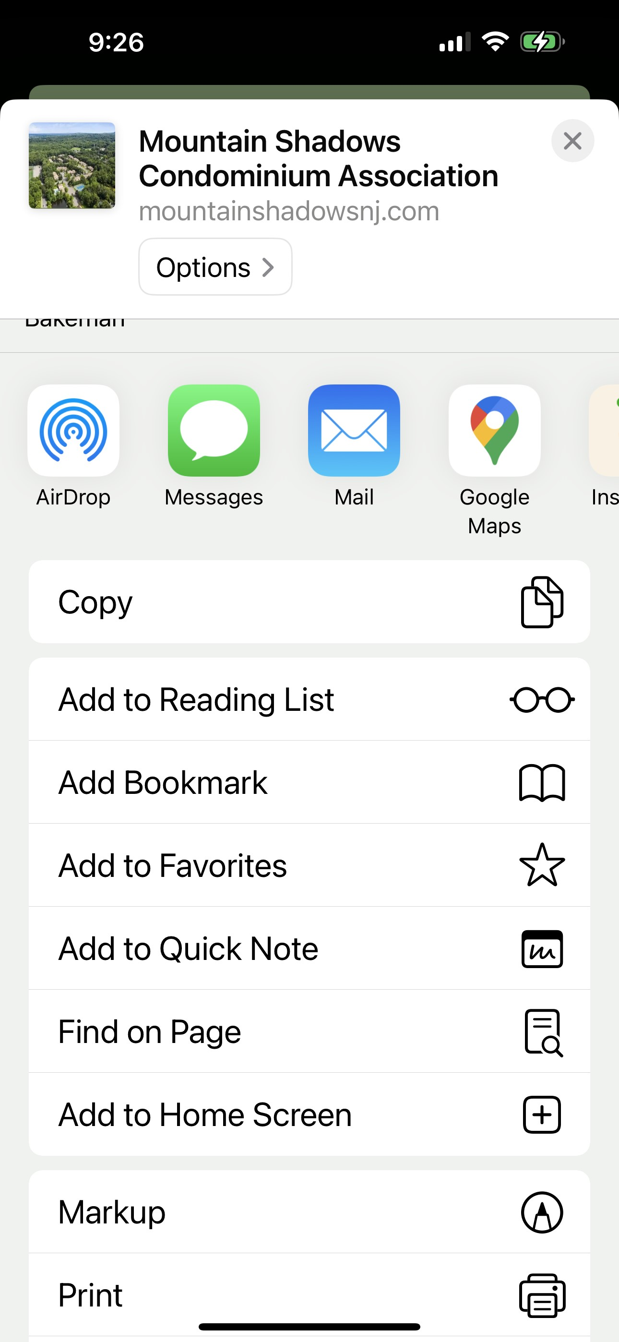
Choose “Add to Home
Screen”

Slide 5
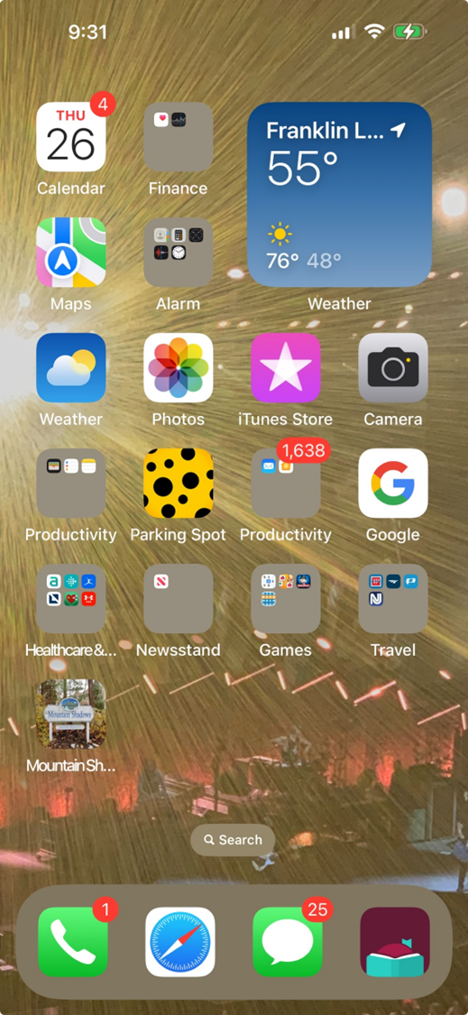
The Mountain Shadows icon can now be found
on the home page of your mobile phone.

Slide 6
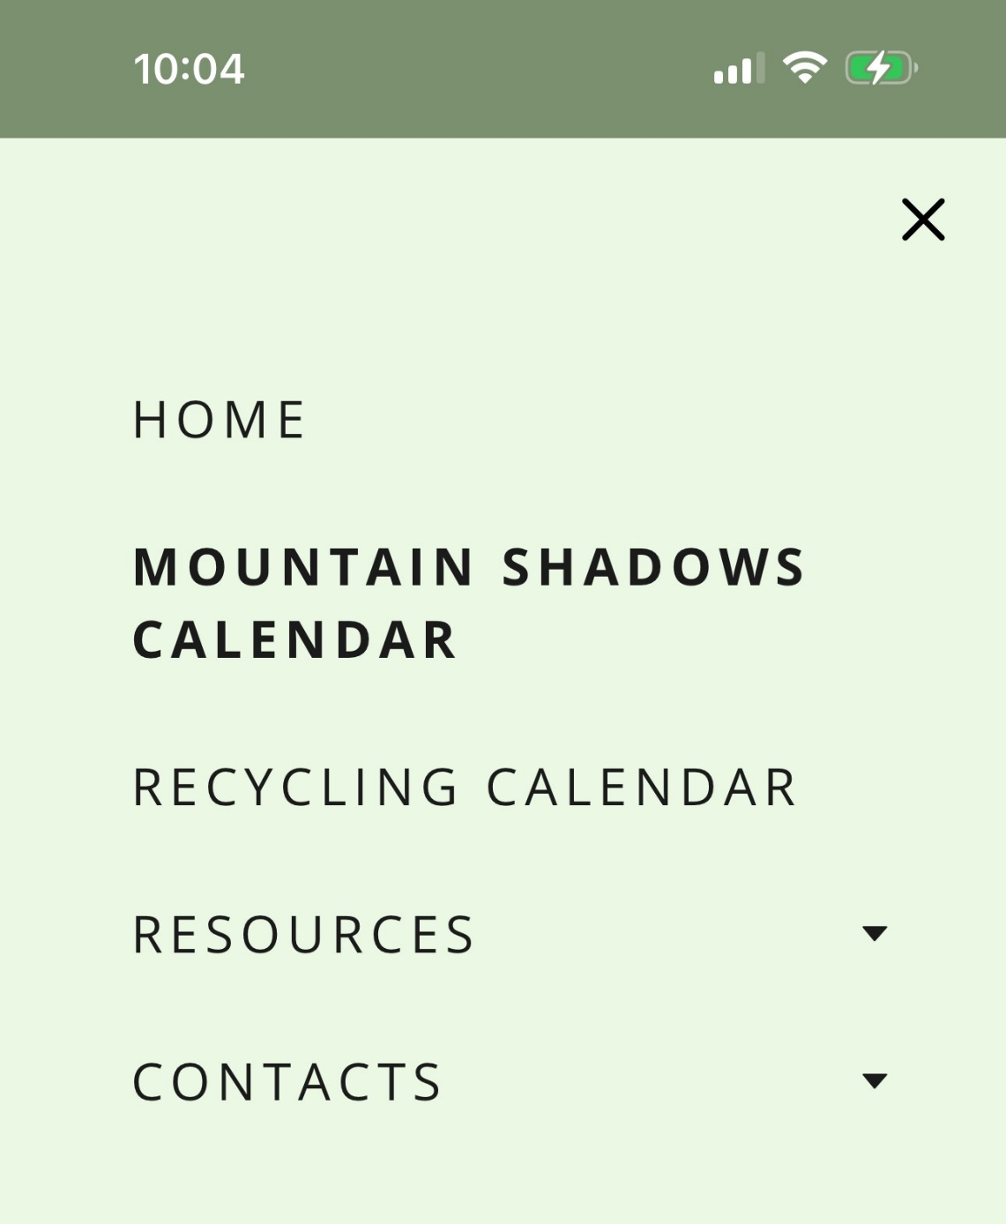
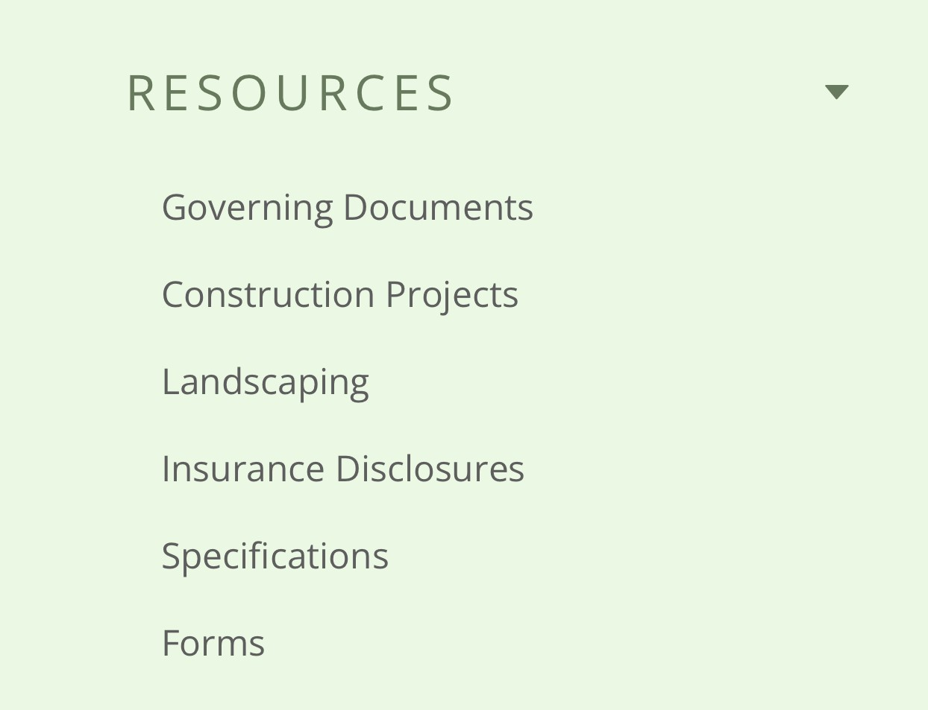
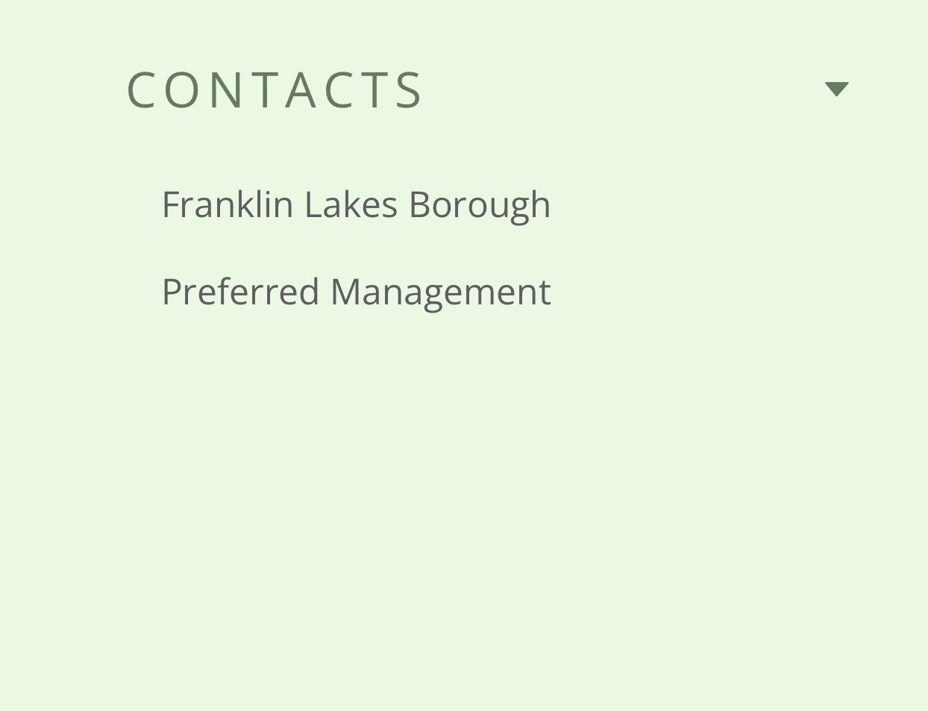
Users can access the following information on the Mountain Shadows
website:

Slide 7
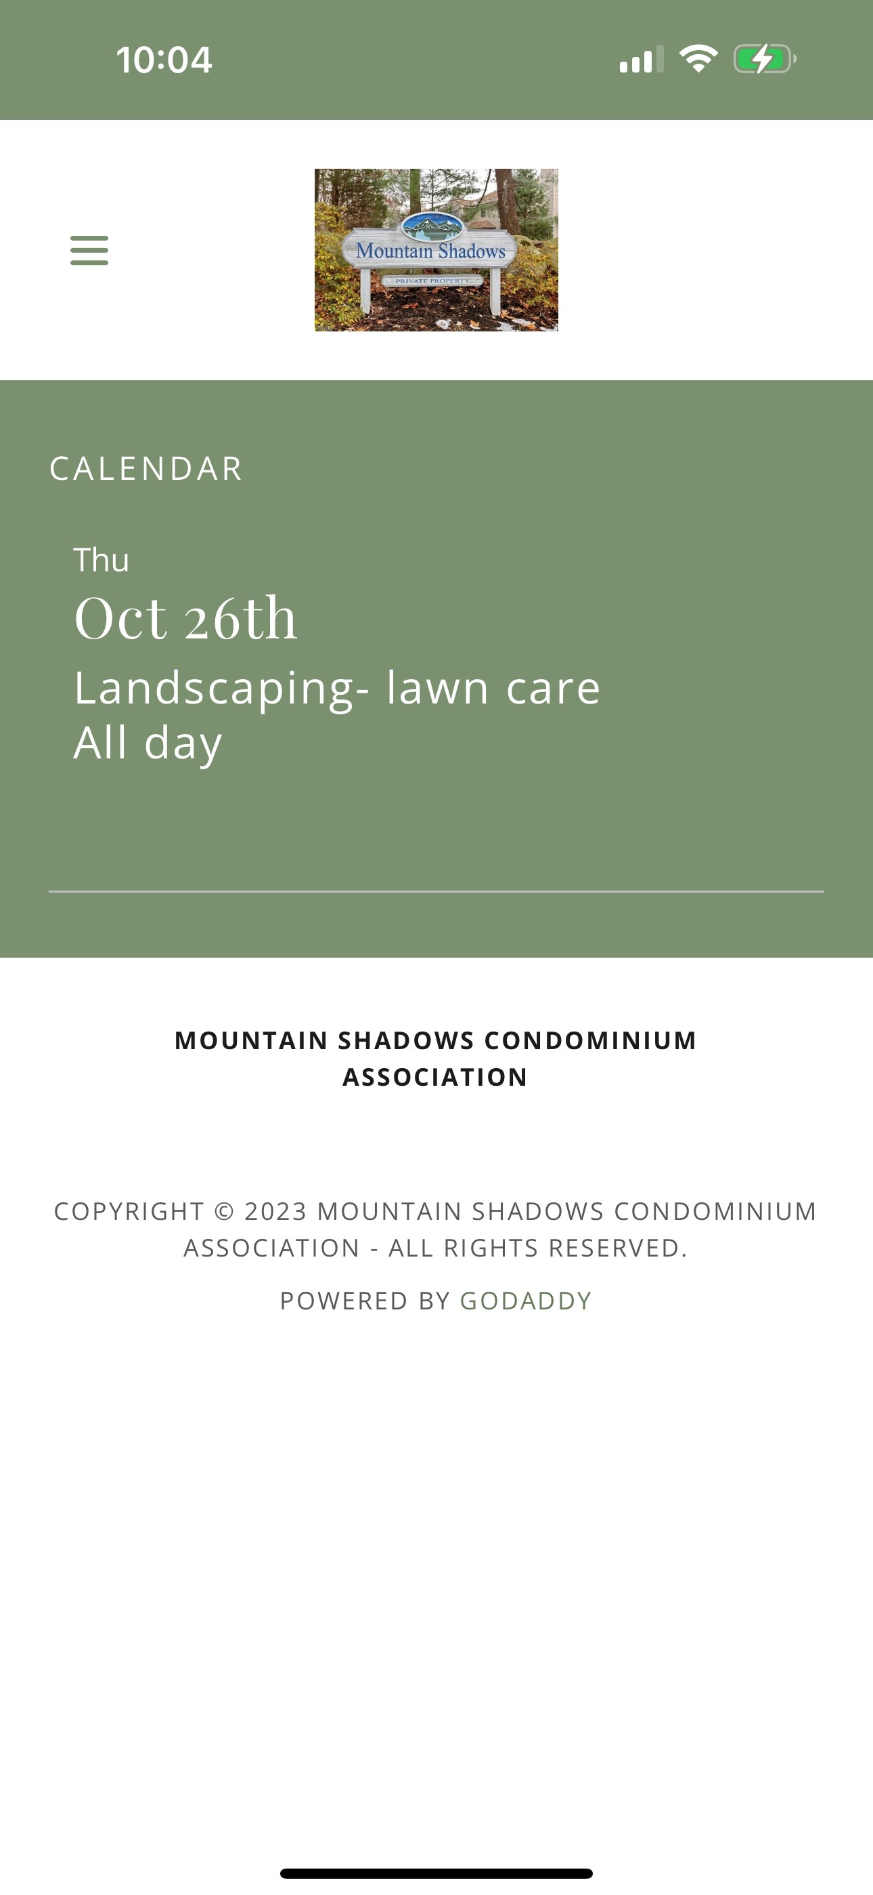
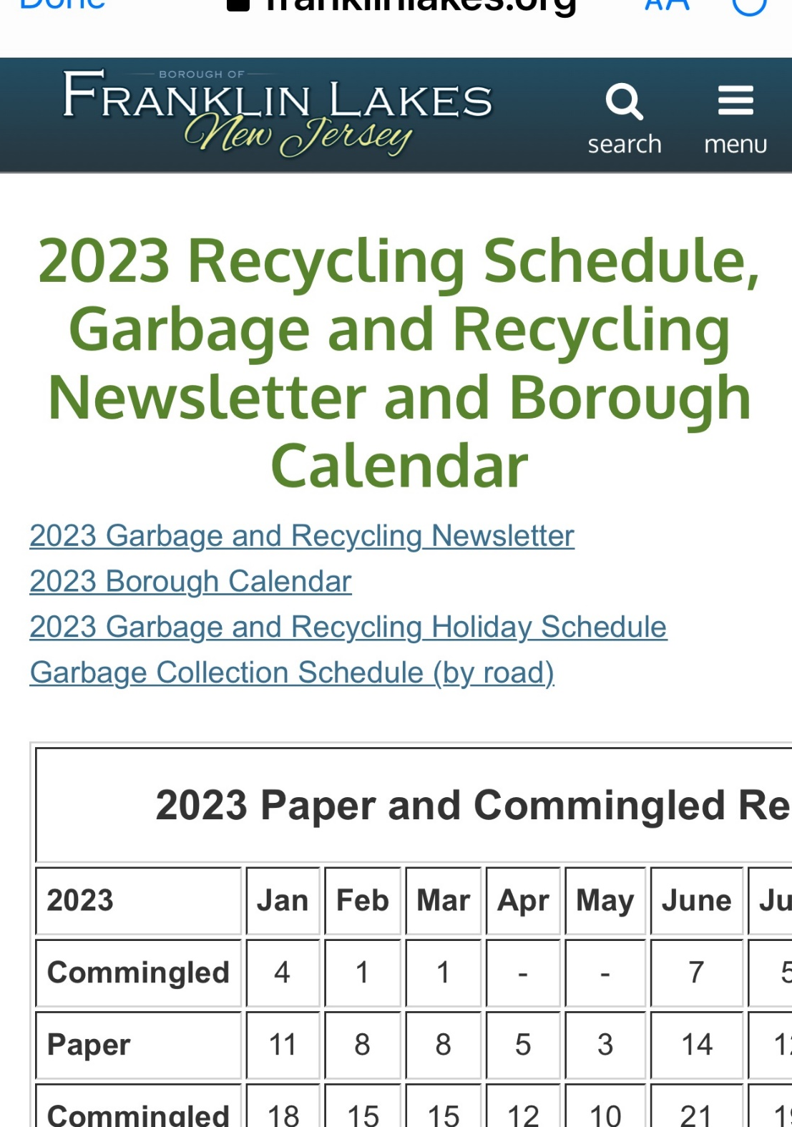
Franklin Lakes Garbage and
Recycling Calendar
Mountain Shadows Calendar

