Slide 1
Aspiring Children LLC
Project 1 – Basic Tool Exploration (2 Hours)

Slide 2
Project Goals Overview
(Skill 1) Multimeter – learn meter settings and practice test with real world items.
(Skill 2) Wire Cutters – understanding how to safely operate and properly use tool.
(Skill 3) Wire Stripping – how to properly strip cables for engineering projects.
(Skill 4) Helping Hands Tool - understanding how to safely operate and proper use of tool.
(Skill 5) Solder Iron - understanding how to safely operate and properly use tool.
(Skill 6) Using Solder – understand the use of solder and at the end of class will successfully bridge two wires together.

Slide 3
Skill 1 - Multimeter
This skill will show you a new tool. This tool is called a multimeter. A multimeter is used for testing electrical projects. We will show you the basic testing that the meter can do to assist you in anything electrical that you wish to do.

Slide 4
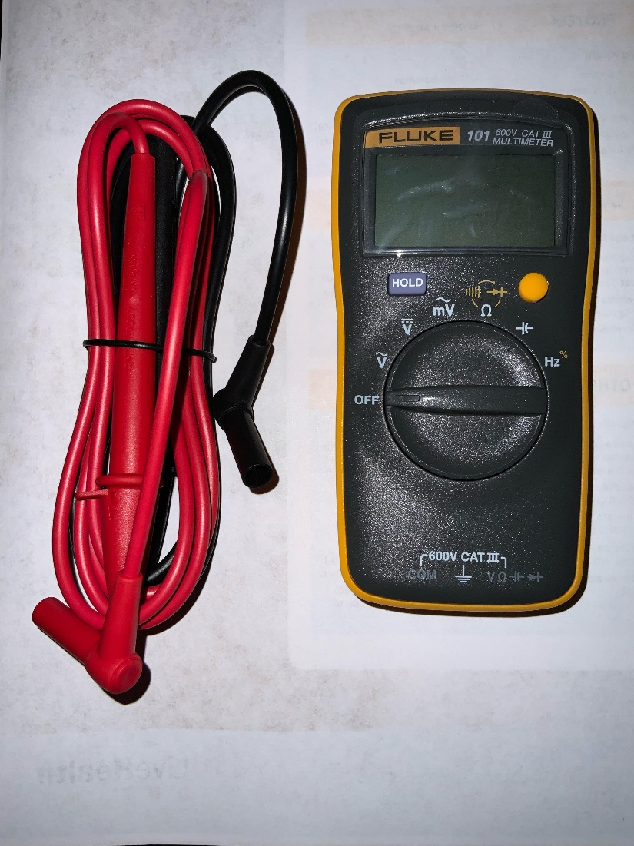
What is a multimeter?
A multimeter is a measuring instrument that can measure multiple electrical properties. We will learn to measure the following:
Voltage (DC and AC)
Resistance
Current
Continuity
This meter can also do diode tests, capacitance, and frequency measurements. These are advanced tests that we can explore in future classes.

Slide 5
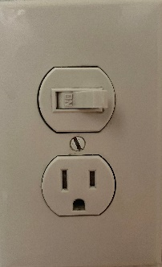
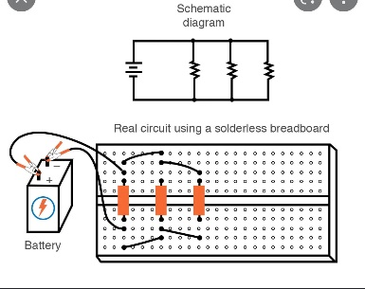
Why use a multimeter?
Safety – when working on an electric project it is important to know what electricity is present that can harm you:
For example, when working on an outlet you don’t want to take apart the front and touch dangerous wires. We will show you how to test the outlet to make sure that the electricity is off before taking it apart to work on it.
Testing values – when working on a project you will want to know what amount of electricity yo9u have in your project.
When testing your circuit the meter will tell you your voltage values, resistance values, and see if your circuit has continuity. We will go over these tests as a helpful learning skill.

Slide 6
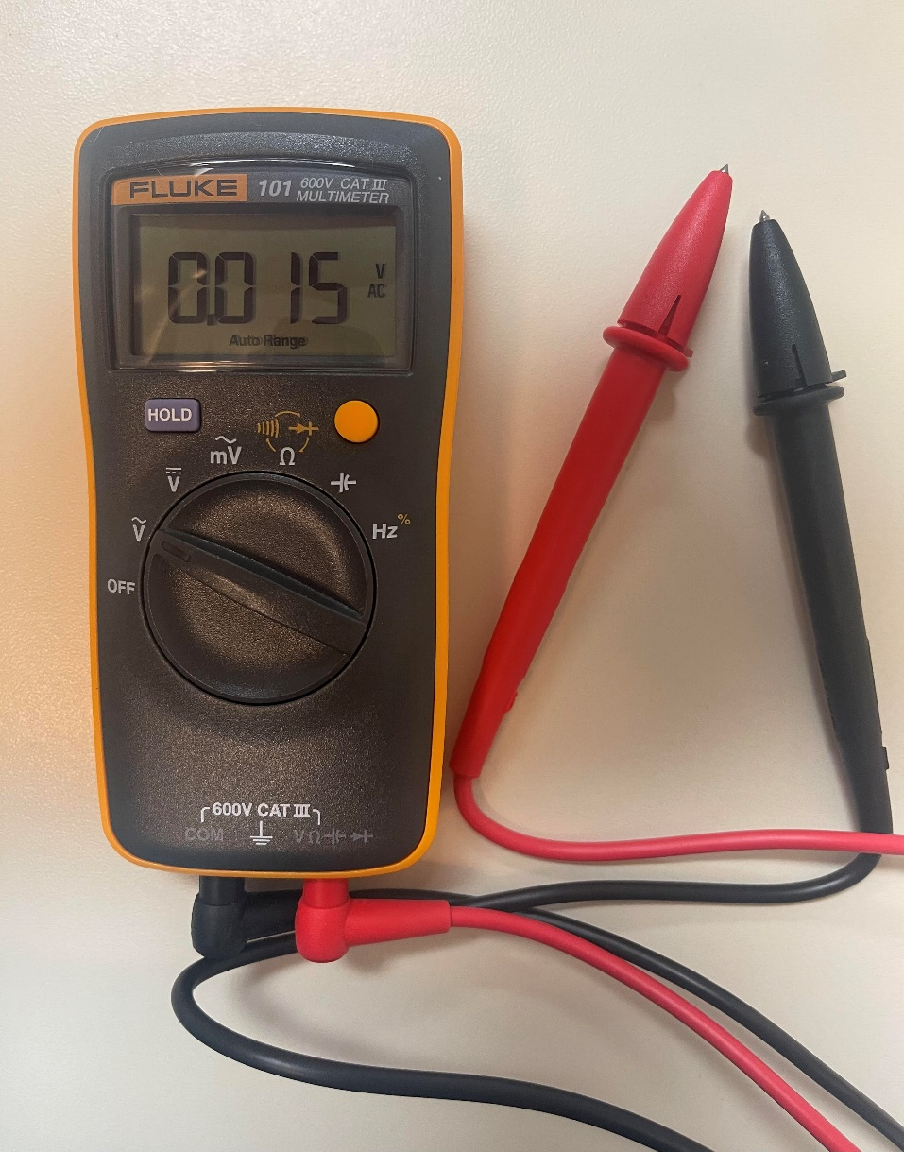
Important Parts of the multimeter
Positive test lead
Negative test lead
Resistance test setting/Continuity
Capacitance test setting
Frequency test
AC millivolt test setting
DC Test setting
AC Test setting

Slide 7
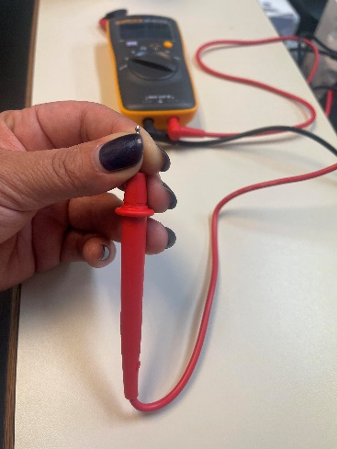
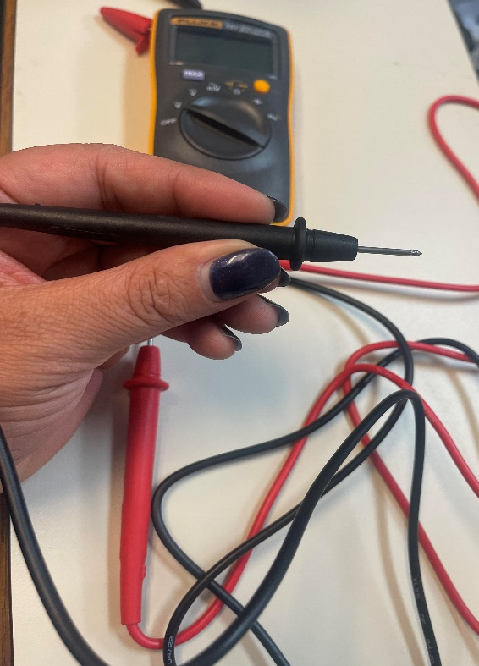
Skill 1: Multimeter testing voltage (AC)
Safety Always First – when using the leads DO NOT touch the metal tips with your fingers
Electricity is in the metal and will shock you if you touch it when testing. Only touch the plastic.

Slide 8
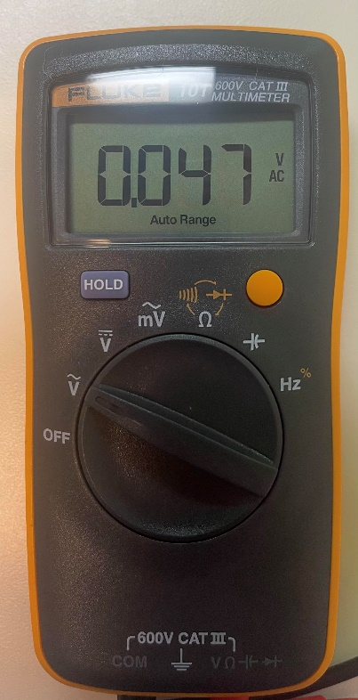
Skill 1: Multimeter testing voltage (AC)
Set the selection switch on the AC setting:
AC setting is the V with the ~ above it. The curvy line is the symbol for AC power. AC power is the type that is in your outlets on your wall. We will use this setting to test the power in the wall.
Note: AC stands for ‘Alternating Current’. This is the electricity in your home that is often called 110 Volts but measures at 120 Volts. (It also can be 240 Volts for ovens and washer machines.)

Slide 9
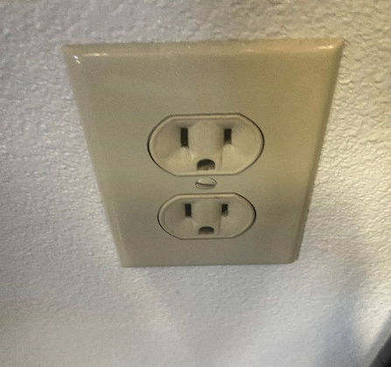
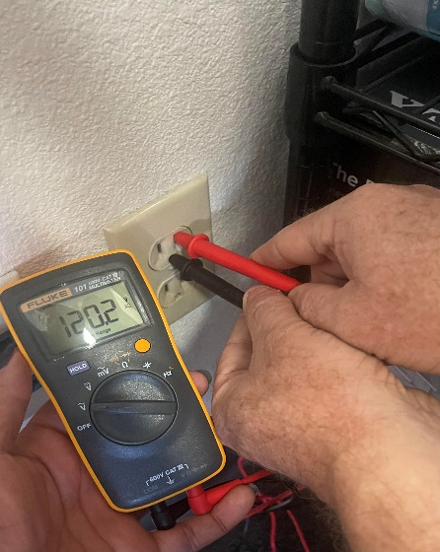
Skill 1: Multimeter testing voltage (AC)
Where to test in the AC outlet? One lead needs to go to ground and the other to the positive where the electricity is. NEVER put anything in the holes except the metal leads.
Usually, the positive lead goes on the right side, but it is best to check both sides.
This hole is where the ground wire is.
See that the meter shows 120.2 AC volts. That shows that there is AC voltage in the outlet. Notice the black (ground) lead is in the ground hole, and the red (positive) lead is in the top right hole. I also tested the left side, and it did not show voltage – but that is ok. Only one of them will have ac voltage.

Slide 10
Congratulations You mastered Skill 1!

Slide 11
Skill 2: Multimeter testing voltage (DC)
Testing for DC voltage is the next setting on the multimeter. The DC stands for ‘direct current’. We can set our meter to the DC setting and use a nine-volt (9V) battery to test. Batteries are typically DC voltage.

Slide 12
Add a Slide Title - 5

