Slide 1


Member Dashboard
Demo| 11.02.2020
CUNA Mutual Group is the marketing name for CUNA Mutual Holding Company, a mutual insurance holding company, its subsidiaries and affiliates.
CUNA Mutual Group Proprietary and Confidential | Further Reproduction, Adaptation or Distribution Prohibited
© CUNA Mutual Group, 2018 All Rights Reserved

Slide 2
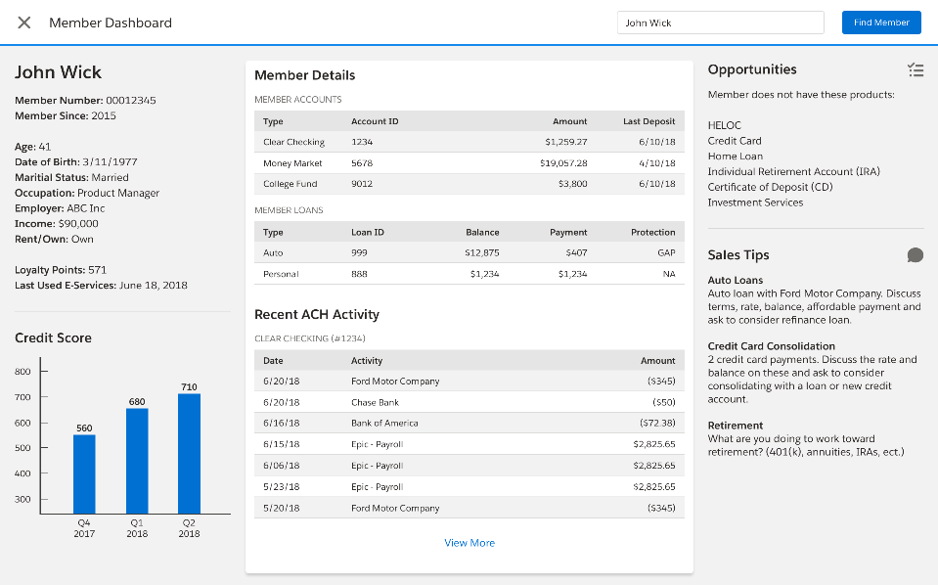
Member Dashboard
DEMO

Slide 3
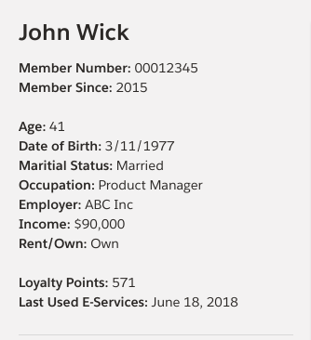
Member Demographics

Slide 4
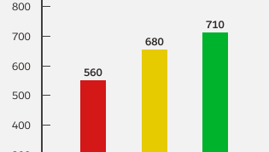
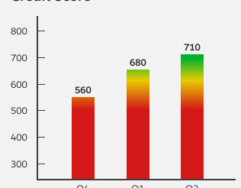
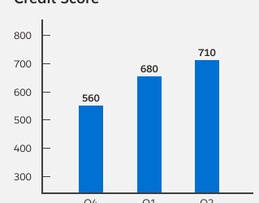
Credit Score

Slide 5
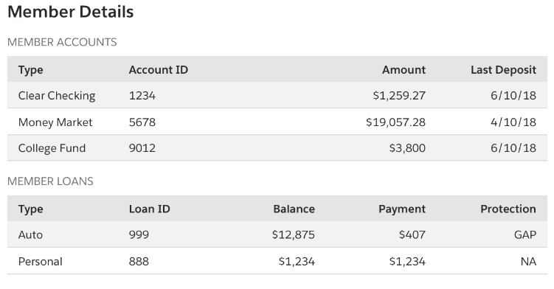
Account Overview

Slide 6

Opportunities & Sales Tips
New Account Opportunities
Algorithms Tied to Member Profile

Slide 7
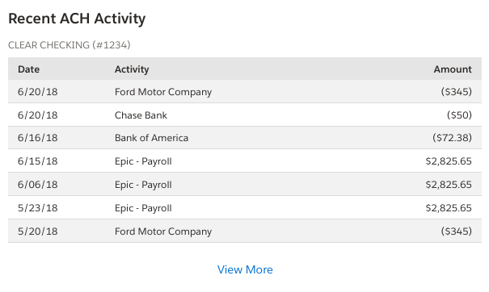
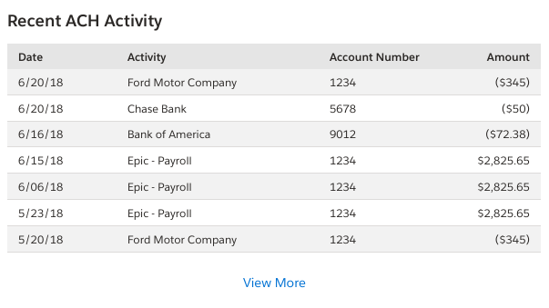
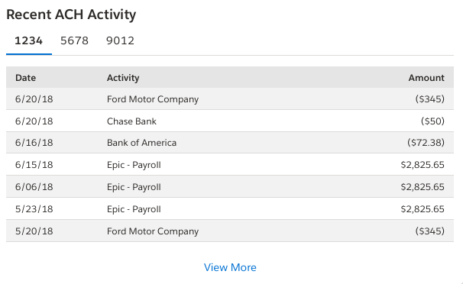
Primary Checking
Aggregate
Account Tabs

Slide 8
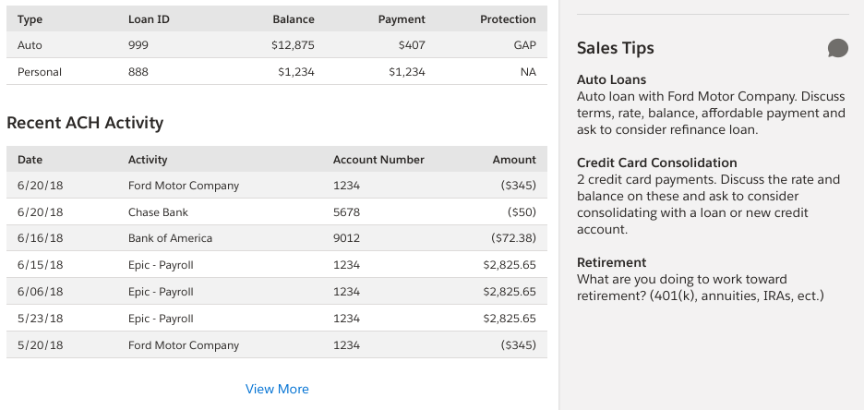
Sales Tips & ACH Activity

Slide 10

Core Partner Integration - Status
SymConnect
CMG has text Sym Connection
Finivation transformers completed to integrate with Concert
E2E Testing not complete
Finivation transformers completed to integrate with Concert
E2E Testing not complete
SymXchange

Slide 11
Verified Data Elements
Demographics
LAST_NAME
FIRST_NAME
ADDRESS
CITY
STATE
ZIP_CODE
MEMBER_NUMBER
DOB
MARITAL_STATUS
OCCUPATION
EMPLOYER
INCOME
RENT_OWN
MEMBER_START_DATE
MOTHERS_MAIDEN_NAME
SECURITY_PHRASE
ESERVICES_LAST_LOGON
Account Overview
ACCOUNT_TYPE
ACCOUNT_NUMBER
ACCOUNT_OWNERSHIP
ACCOUNT_BALANCE
ACCOUNT_LAST_DEPOSIT
ACCOUNT_PAYMENT
ACCOUNT_PROTECTION_PRODUCT
Credit Score
CREDIT_SCORE_1
CREDIT_SCORE_1_DATE
CREDIT_SCORE_2
CREDIT_SCORE_2_DATE
CREDIT_SCORE_3
CREDIT_SCORE_3_DATE
ACH Activity
ACCOUNT_TXN_ACTIVITY_DATE
ACCOUNT_TXN_DESCRIPTION
ACCOUNT_NUMBER
ACCOUNT_TXN_AMOUNT

Slide 12

QUESTIONS
Notes:
Tools: Member’s Financial Health-check / Prescription

Slide 13
CUNA Mutual Group Proprietary
Reproduction, Adaptation or Distribution Prohibited
© 2018 CUNA Mutual Group, All Rights Reserved

