Slide 1

GREATER LOVE CHURCH OF RALEIGH

Slide 2


International Ministry Partners in Christ
Greater Love Church of Raleigh

Slide 3
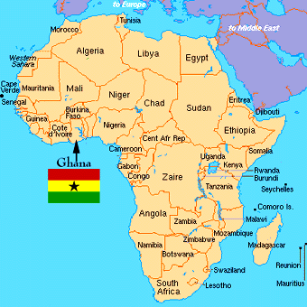
Ghana, West Africa
Notes:
Over 100 tribes in Ghana.
Church serves - Fante, Ga, Ewe People

Slide 4
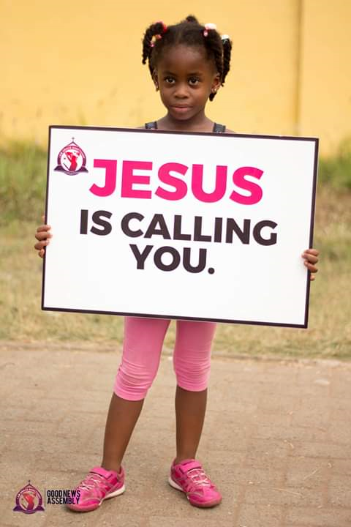
Ghana, West Africa
International Outreach
December 2020
Mamprobi, Accra Central
Kofi Kwei, Accra Village
Notes:
Pic taken during street evangelism with the kids

Slide 5

I Am Vision Praise
Pastor Osbert Longdon
Notes:
I Am Vision Praise is an Apostolic ministry inaugurated in March of 2019. Presently they operate two branches, one in Mamprobi Accra and Kofi Kwei (a village in Accra).
The Vision is to raise men and women who are ready to preach Jesus at any opportune time.
Mission is to lead people into a growing relationship with Jesus.
Pastor Osbert’s passion is village evangelism and community outreach.
The church is legally registered at the registral office in Ghana.

Slide 6
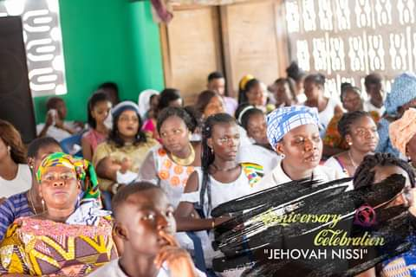
Mamprobi, Greater Accra
Church Service
Outreach & Evangelism
Baptism
Notes:
Church Service in Accra – pre COVID
Total members in city – 60-90 members with a goal of 100+

Slide 7
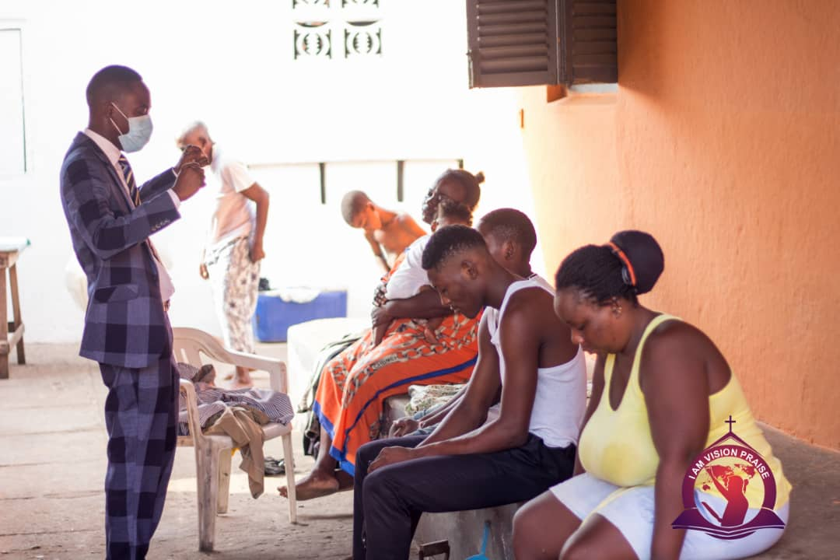
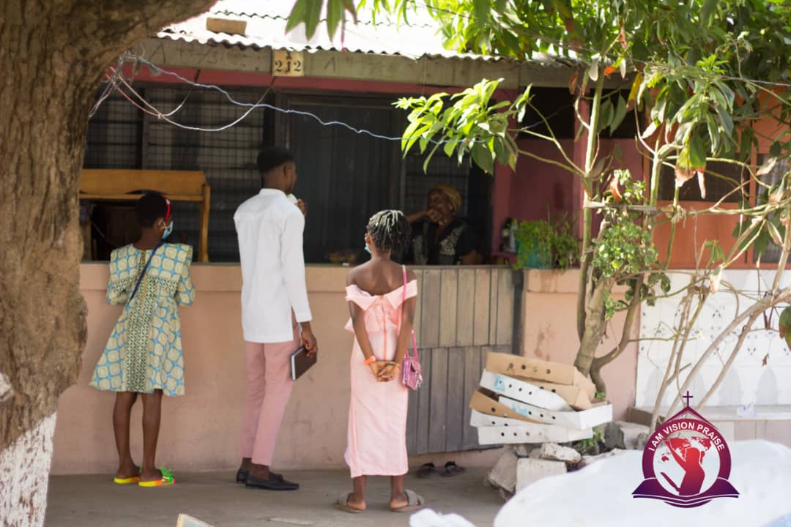
Evangelism

Slide 8
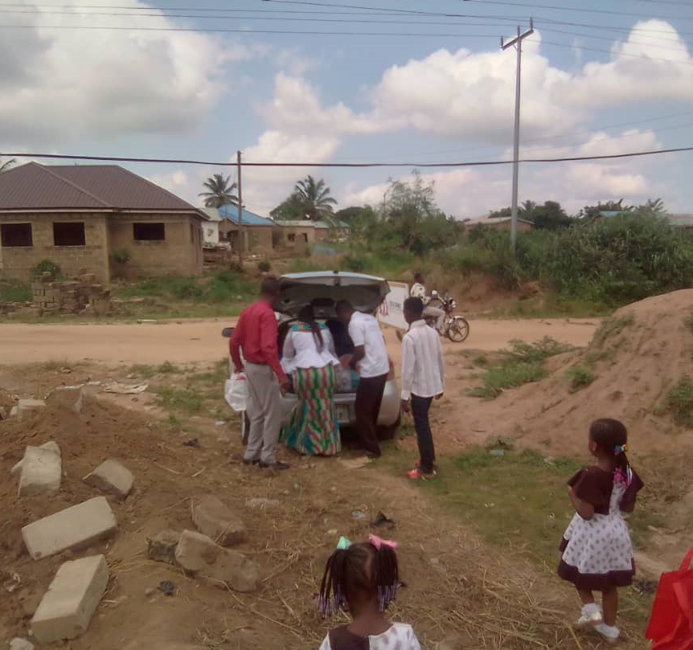
Outreach
Notes:
Serving meals and dropping of donations.

Slide 9
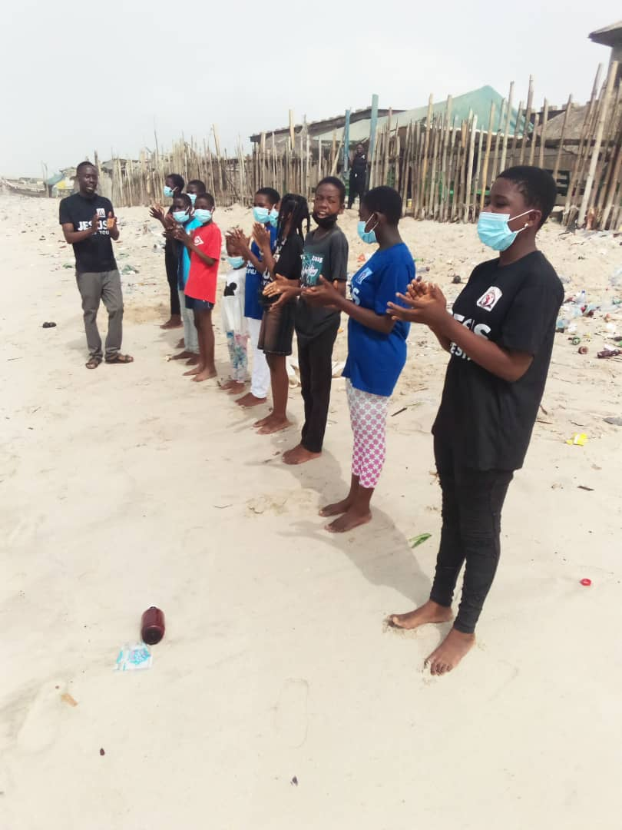
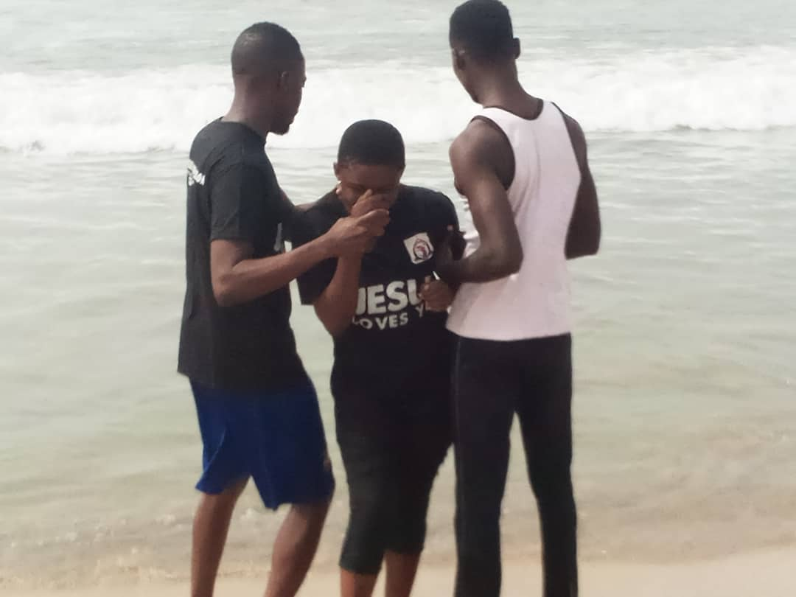
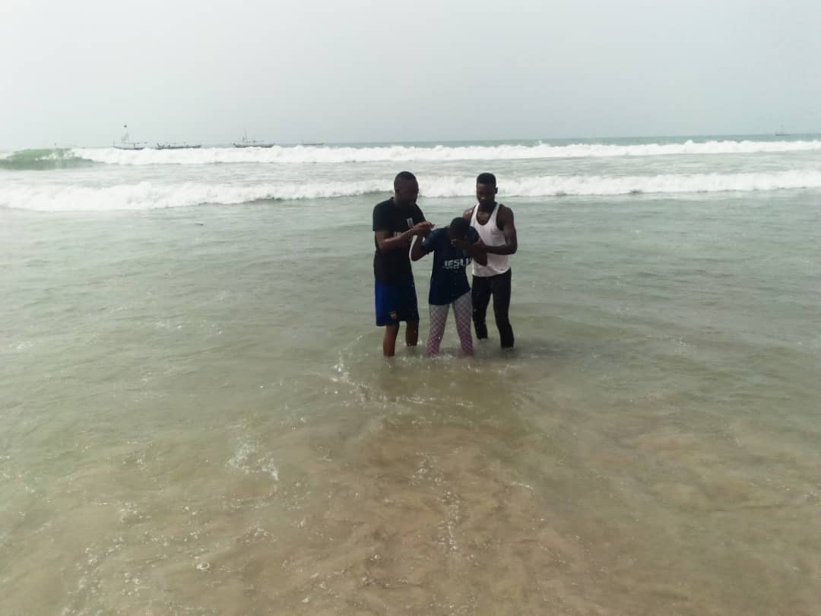
Baptism
Notes:
Baptism

Slide 10
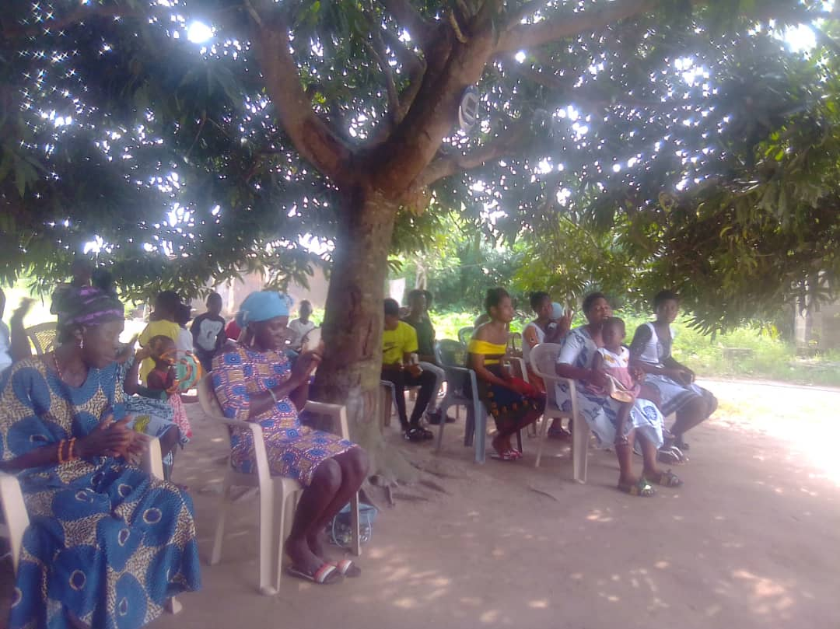
Kofi Kwei Village Ministry
- Church Service
- Baptism
- Outreach
- Project: Shelter
Notes:
Village Members – 30 – 40 w/ a target membership of 100

Slide 11
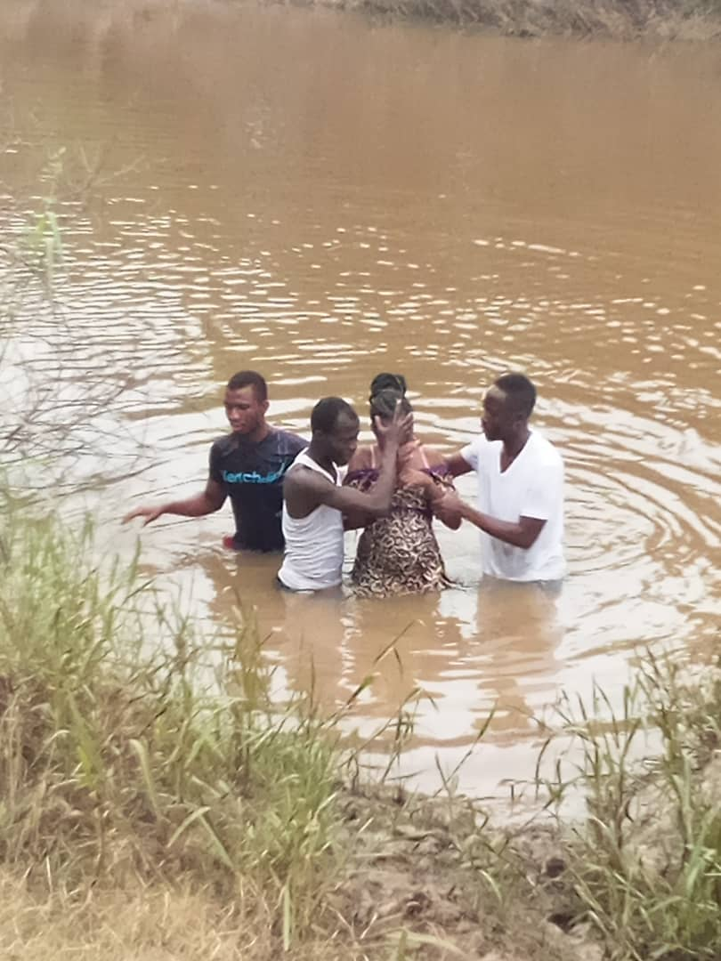
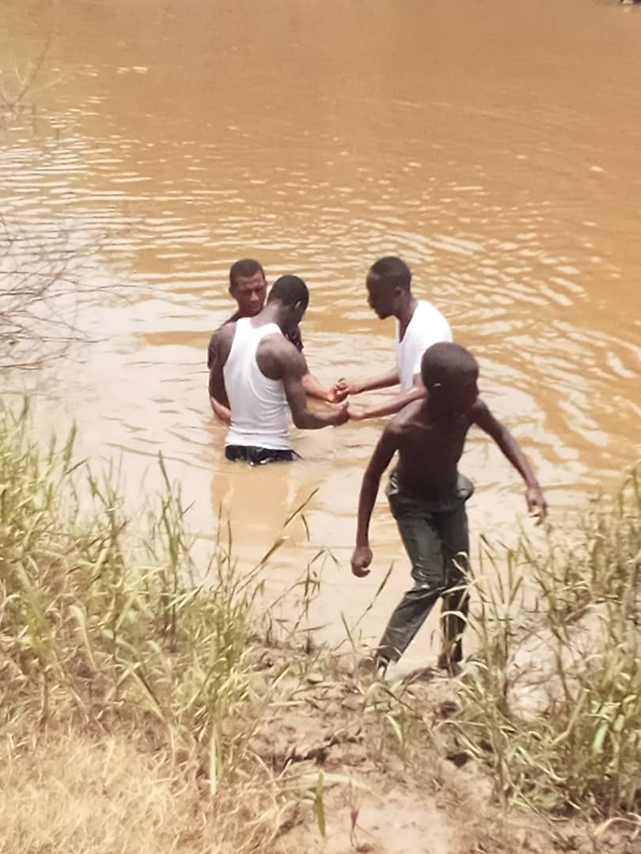
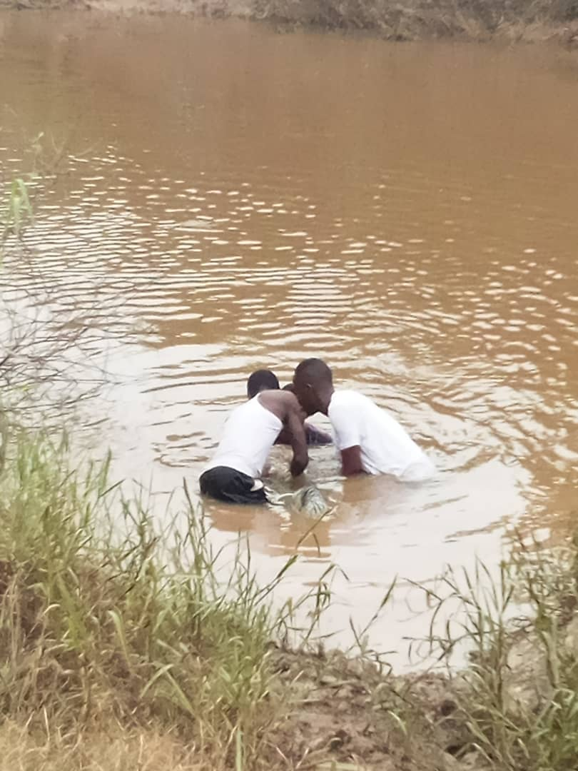
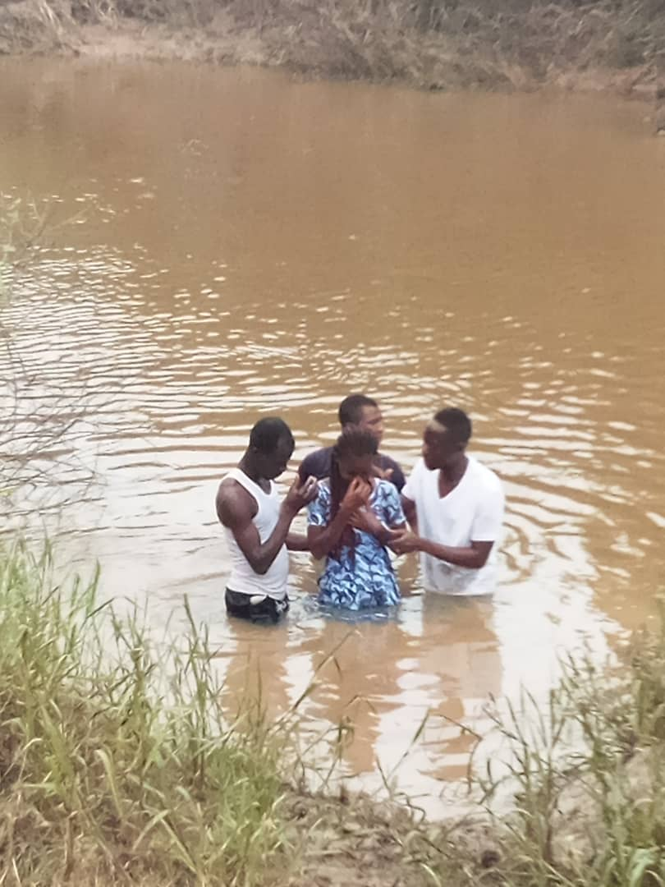
Baptism

Slide 12
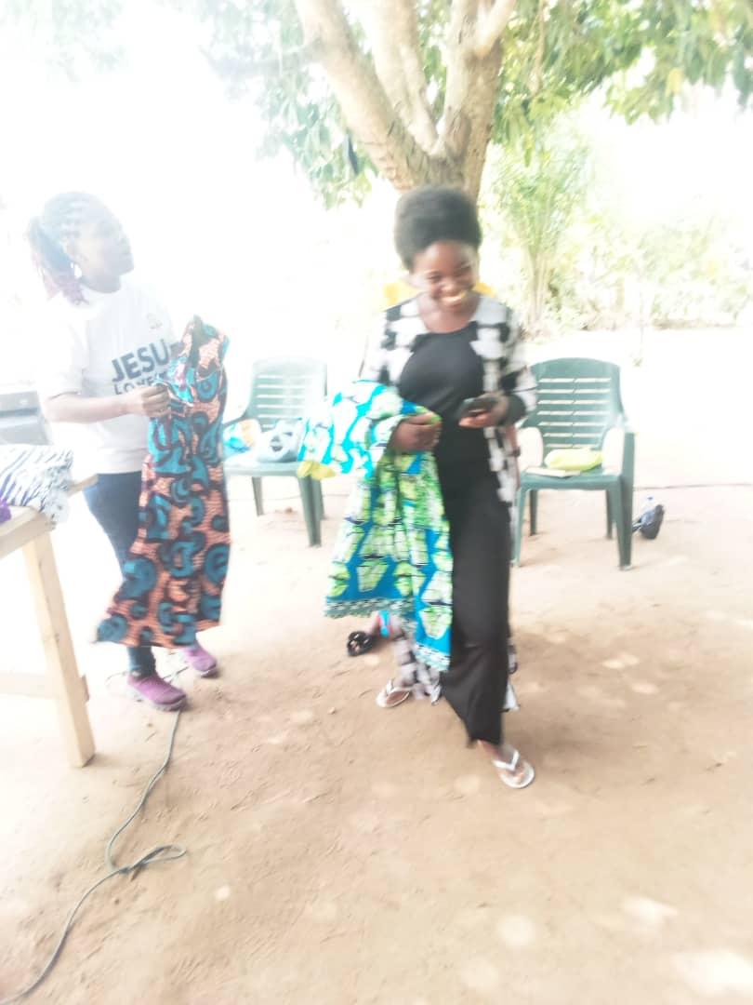
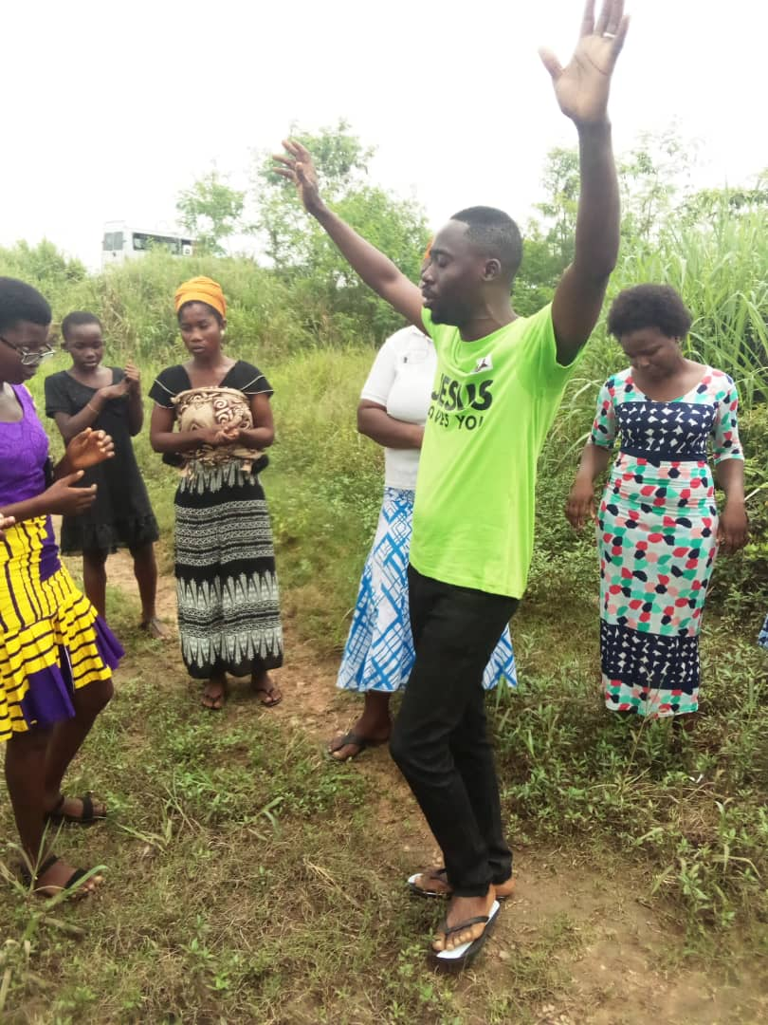
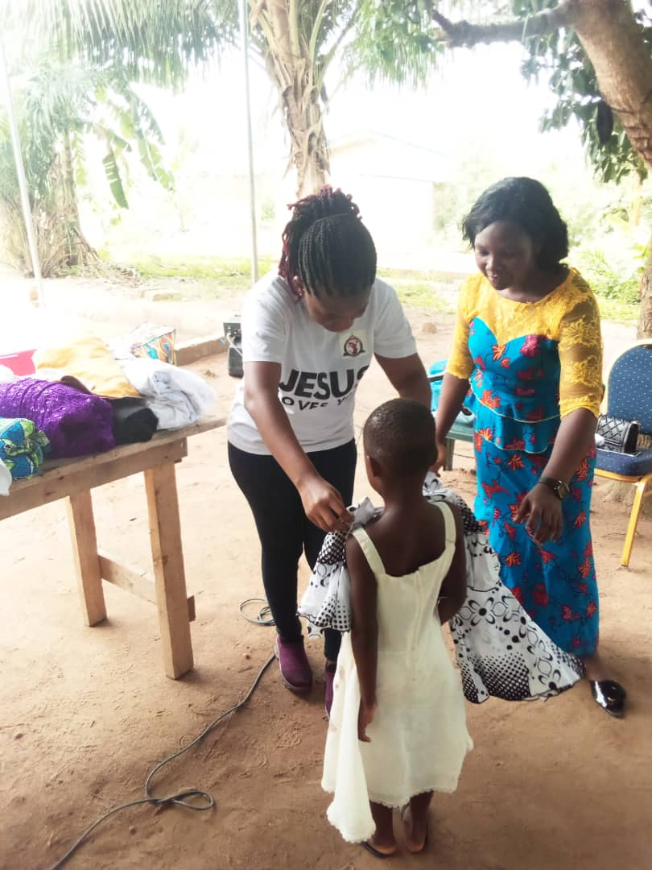
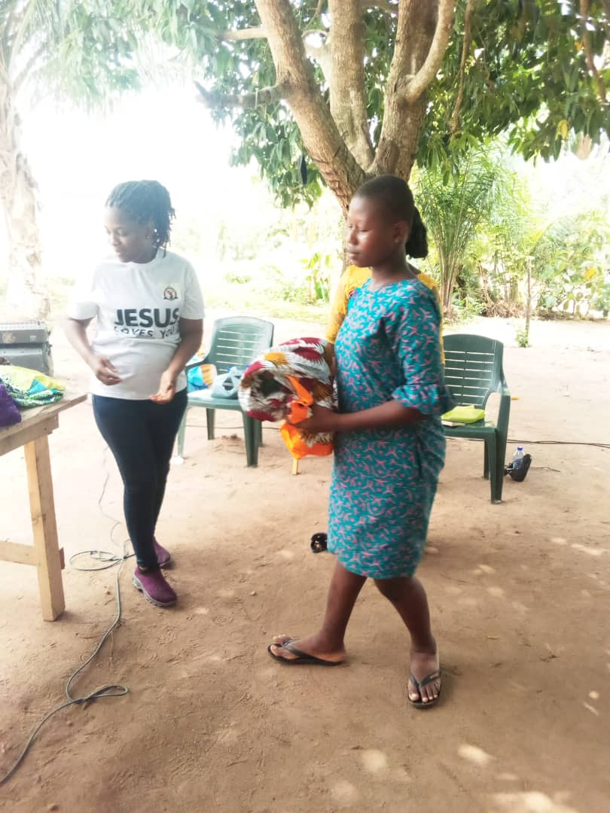
Outreach
Prayer & Clothing Donations

Slide 13
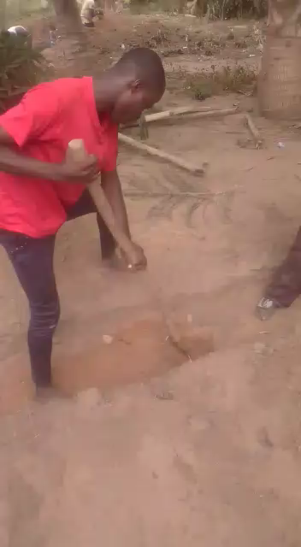
Project: Shelter

Slide 14
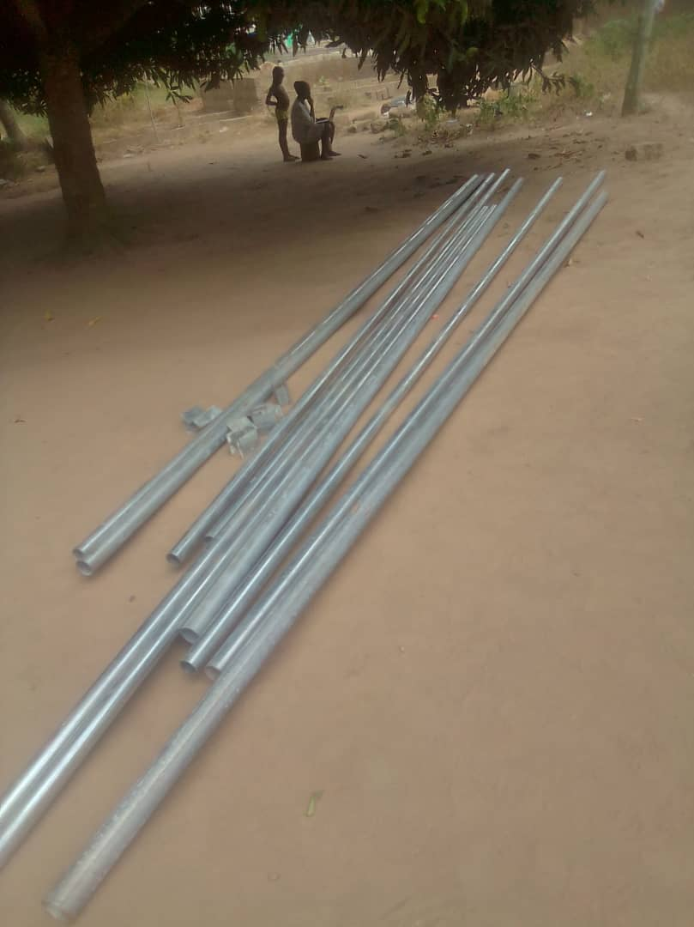
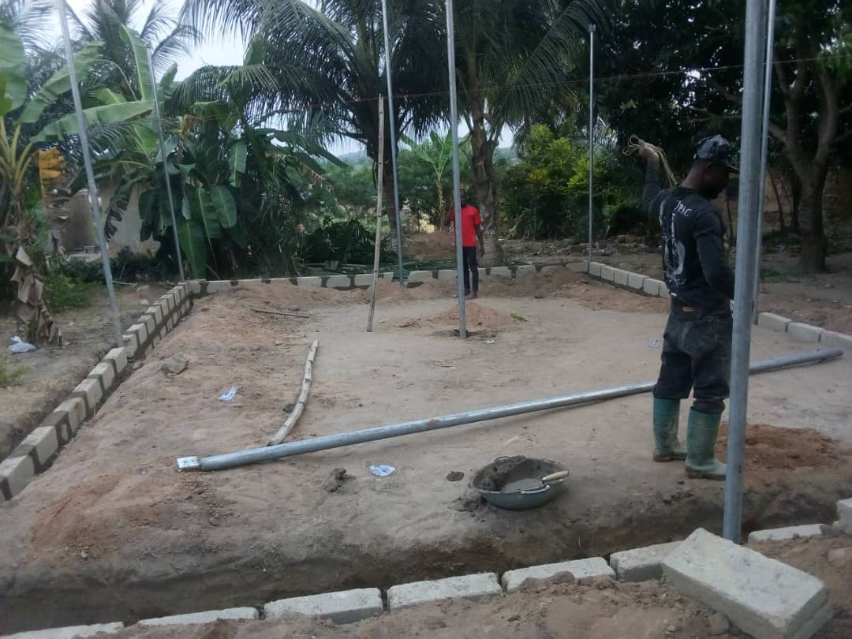
Project: Shelter

Slide 15
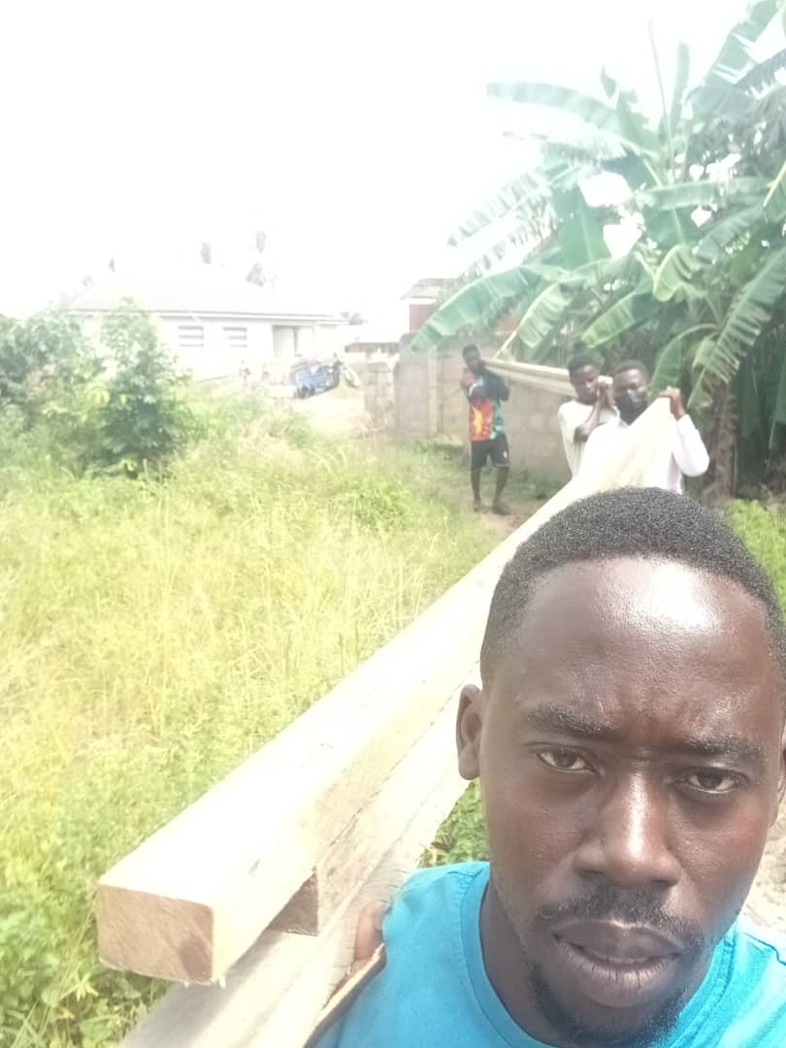
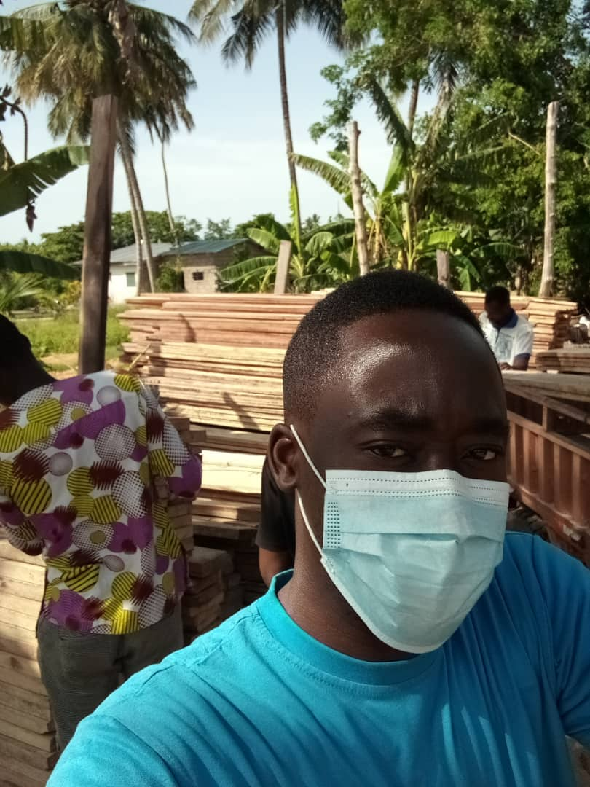
Project: Shelter

Slide 16
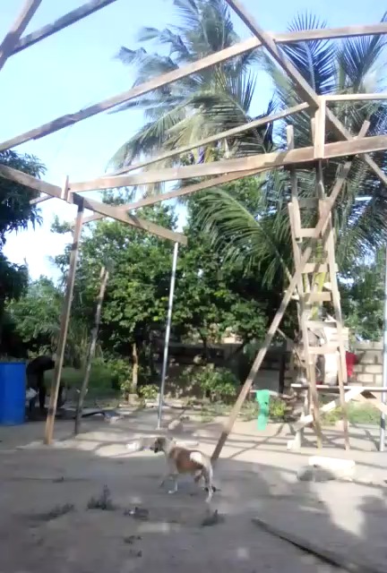
Project: Shelter

Slide 17
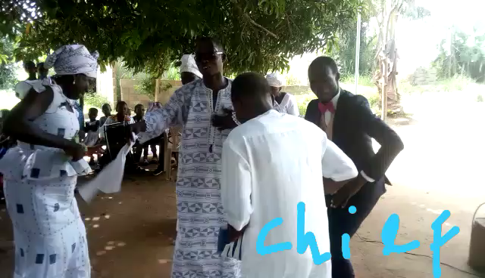
“I will sing!
I will sing!
I will sing of your greatness!”
~Borborbor Dance with Ewe Chief ~

Slide 18
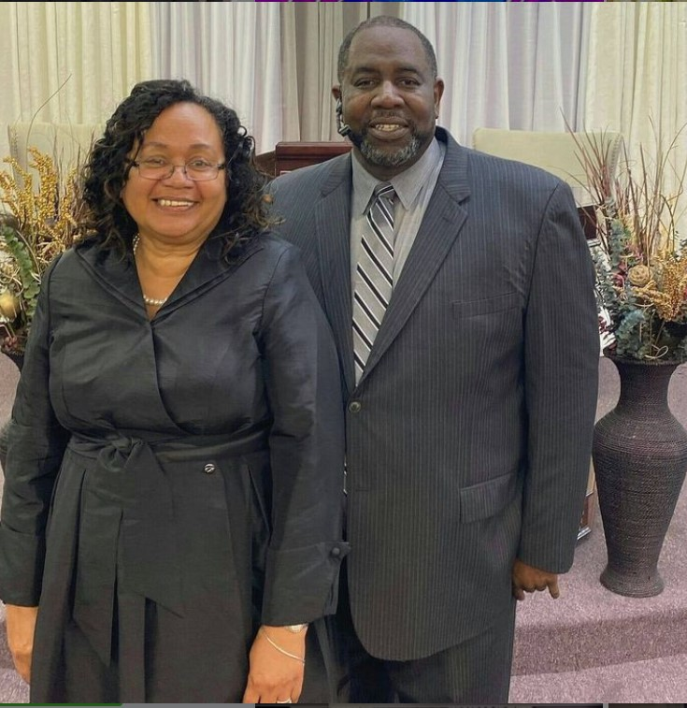
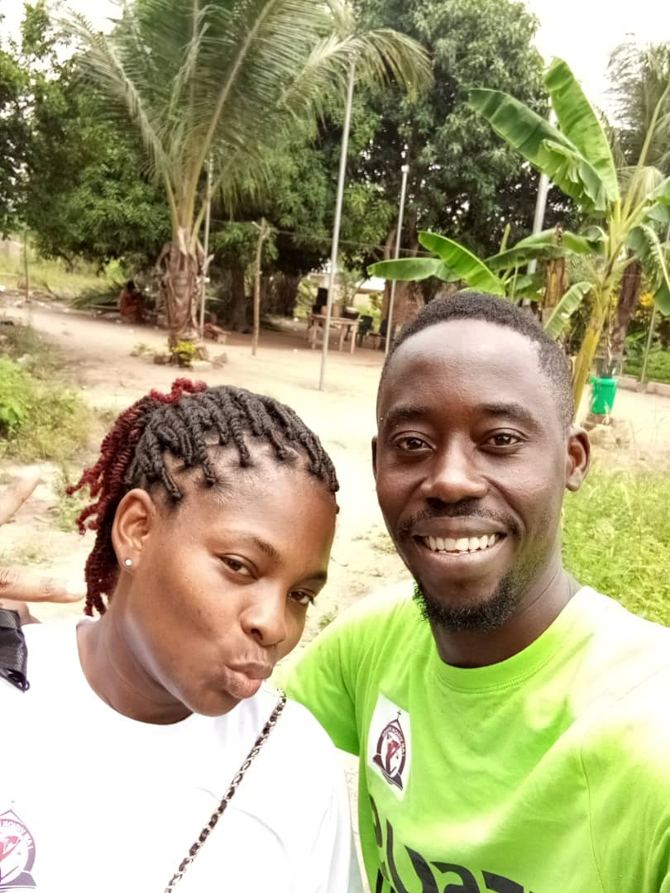
“Go ye therefore, and teach all nations, baptizing them in the name of the Father, of the Son, and of the Holy Ghost.” Matthew 28:19
Thank you!

Slide 19

Visit us on the web at www.glcraleigh.org
Partner with us by donating a love offering at $glcraleigh via CashApp

Slide 20
GREATER LOVE CHURCH OF RALEIGH

