Slide 1
ALF Therapy
Why compromise when ALF Therapy can optimize?

Slide 2
ALF: Origins
The Advanced Light Force (ALF) dental appliance was created over 35 years ago by Dr. Darick Nordstrom with the goal of finding a better solution to the challenges that he found with traditional orthodontic techniques

Slide 3
Through observation came innovation
As he created and refined his vision for ALF Therapy, he collaborated with healthcare providers from other professions to explore the options and designs that would complement the function of the body .
Several orthodontic techniques and appliance designs seemed to compliment the natural motions of the body while others impaired them.
ALF Therapy was created through decades of interdisciplinary collaboration, careful observation and continual refinement to become the simple yet sophisticated family of appliances that are currently utilized by ALF Therapy providers from all over the world

Slide 4
The Foundation of ALF Therapy is built on the principles of nature
The creation of familiar sensations and gentle, repetitive and rhythmic forces create harmony between light forces and human physiology.
Dental expansion and neurologic benefits are the result of working with Mother Nature at our side

Slide 5
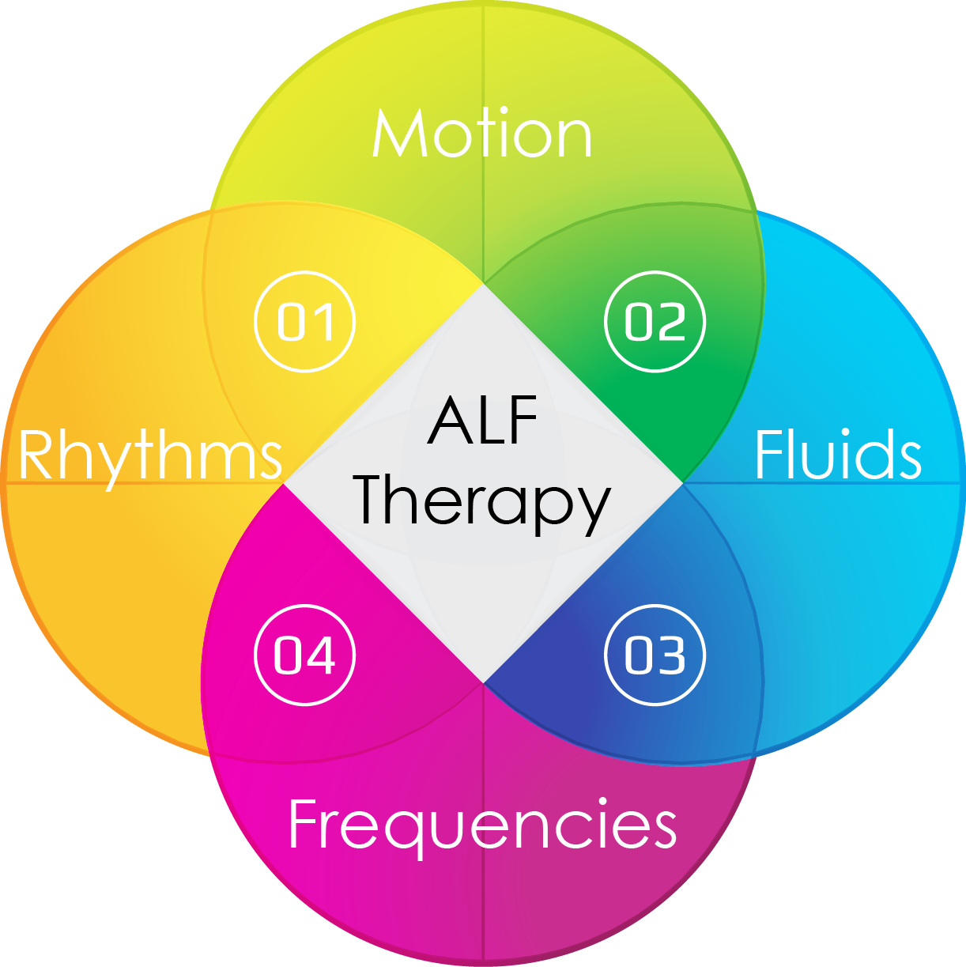
The Concepts of function and physiology are intimately interconnected
ALF Therapy supports the:
Inherent motion of cranial function
Fluid flow throughout the head and neck
Amplification of the delta wavelength frequency created by the natural, soothing motion of the swallow
Rhythmic nature of the swallow as a creator of tooth movement and facial growth

Slide 6
The goals of ALF Therapy are not limited to orthodontic tooth movement
Many people have attempted to compare ALF Therapy to orthodontic treatment.
The truth lies in the differences between the goals of therapy
The goals of ALF therapy are to enhance more than just the appearance of the oral environment.
Even though ALF appliances can be used strictly as an orthodontic appliance, that was never the intention behind its creation.

Slide 7
ALF orthodontics Compared to ALF Therapy
Goals of orthodontics
https://www.nhs.uk/conditions/orthodontics/
Goals of Therapy
https://www.merriam-webster.com/dictionary/therapy
Orthodontic treatment (usually with braces) is most often used to improve the appearance and alignment of crooked, protruding or crowded teeth, and to correct problems with the bite of the teeth
therapeutic medical treatment of impairment, injury, disease, or disorder

Slide 8
Goals of ALF therapy include:
Natural gentle , rhythmic forces stimulating orthodontic tooth movement
Familiar sensations supporting improved neurological function
Consistent support for cranial growth and tongue function

Slide 9
Results of ALF Therapy include
Beautiful smiles
Improved tongue and neurologic function
Balanced faces

Slide 10
How does ALF Therapy achieve these goals?
Through the gentle, rhythmic forces of the tongue, the appliance acts as a gentle, consistent and rhythmic force that the body recognizes as natural
As a result, the body responds with movement of teeth and growth of bone that supports a broader smile and more room for the tongue to function as it should
By supporting both the teeth and the bones that surround the teeth, the interconnected bones of the head and neck can receive the momentum to support growth that may not have existed as a result of less than ideal tongue function

Slide 11
Mother Nature knows best
By mimicking and enhancing the signals received from the function of the swallow, the body is able to not only receive structural growth signaling, but also grow as the patient is able to accept the growth
The gift of a gradual growth process in a natural environment allows for the brain and body to integrate and function as a unit
This gradual and supportive growth process is commonly associated with reports from patient that reflect improvements in overall health and function

Slide 12
The secret behind the miracles associated with ALF Therapy
The secret is that there is no secret at all
ALF Therapy simply supports the natural forces and sensations that the body was missing, recognizes them as familiar and welcomes back as a gift of improved function
The carefully designed and infinitely customized dental appliances offer the gentle reminder of what the tongue is designed to do to improve facial growth and neurological function

Slide 13
Life is dynamic and non-linear Our therapies should reflect the nature of human function
Many orthodontic techniques define the goals of their treatment by linear measurements and computer-generated models to predict tooth movement based on man-made statistics
ALF Therapy uses linear measurements as a guide and computer-generated reports as tools but primarily rely on the needs and individual responses of the patient to guide their therapies in an interdisciplinary healthcare model

Slide 14
The human body is complex. therapies to support health should offer solutions for the complexities
Even though ALF Therapy can be performed to treat simple tooth alignment, it can also be utilized to treat highly complex patient needs
The skills needed to perform complex patient care are help by those providers who seek the advanced training required to address those complexities
The training required to identify the complex patient and support their needs are instructed by those who offer more than a simplified approach to ALF education

Slide 15
Reason. Season. Lifetime.
Tooth movement
Functional craniofacial growth appliance
Tool to improve neurologic signaling and resilience

Slide 16
ALF Therapy can create better beginnings

Slide 17
ALF Therapy supports the growth of beautiful healthy faces for the actively growing child ages 6-12

Slide 18
…or Guide a patient back to health if they have had trauma and/or unfavorable growth

Slide 19
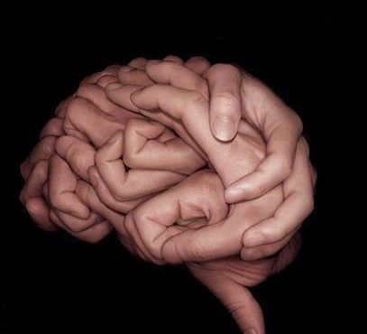
ALF Therapy providers think “outside of the box” while understanding what is in it
If “the box” is the cranium, the function of the neurologic tissue within are directly and indirectly affected by the forces placed on the head by the soft and hard tissues of the mouth

Slide 20
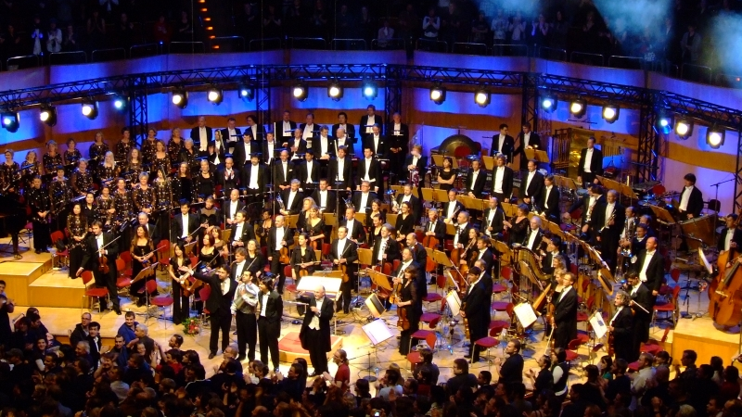
By Working in concert with the rhythms of the body, ALF Therapy enhances the vibratory, rhythmic vibrations that create:
Support for the rhythm generating centers of the brain that influence sleep and ability to self-soothe
Support for ideal tongue function
Support for both the structure and reflexive function of the airway
Mobility and growth of the craniofacial complex
Neurologic feedback
This Photo by Unknown Author is licensed under CC BY-SA

Slide 21
A constant reminder and centering force
Even ancient societies were aware that the tongue should be at rest with the tip of the tongue on the roof of the mouth
Modern research is now supporting that finding through studies on body posture and neurologic function
ALF Therapy appliances act as “north star” to remind the patient of their proper tongue position while encouraging simultaneous and balanced signals from the tongue to multiple cranial nerves while mobilizing the cerebral spinal fluid and glial cells by encouraging a proper swallow

Slide 22
Other dental appliances do the opposite
They prevent the tongue from functioning normally
They impede the benefits of a proper swallow which in return impairs the flow of cerebral spinal fluid and the glial cells that remove the toxins and proteins and can damage the brain
They create speech and feeding impediments that make the patient self conscious and insecure
They are often visible, create speech and swallow impediments and are difficult to keep clean

Slide 23
The many benefits of ALF Therapy
Almost invisible to the observer
Easy to maintain and clean
Infinitely customized for the needs of the individual patient
Easy to wear and not intrusive on everyday life

Slide 24
Why compromise when you can optimize?
Form
Ease of wear
Function

Slide 25
Complimentary therapies to enhance the results of treatment
Oral Myofunctional Therapy
Bodywork
SmileLase and BabyLase

Slide 26
Who can benefit from ALF Therapy?
ALF Therapy offers options for patients from newborn to the elderly
Treatment for crooked, crowded teeth
Dentofacial orthopedics to address small or misaligned jaws
Those who can benefit from a gentle reminder of proper tongue position to enhance airway and neurological function

Slide 27
Who provides ALF Therapy?
Primarily dentists and orthodontists who seek an opportunity to offer their patients an alternative to traditional orthodontics
Secondarily by the interdisciplinary treatment teams that support the patient as they grow and evolve through the course of therapy

Slide 28
ALF Therapy providers are passionate about understanding the needs of their patients
They are trained to:
Never introduce a simple solution to a complex patient
Diagnose and assess in a wholistic model of healthcare while treating within their scope or practice
Perform dynamic, functional assessments to compliment their dental therapies
Recognize the value of linear measurements but not be limited to them as goals of treatment

Slide 29
ALF Therapy is provided by dentists and orthodontists that are seeking a deeper, more meaningful truth
They have either experienced or witnessed the effects of more traditional techniques
They embrace a more natural and physiologic approach to rhythmic signaling ang gradual, consistent growth
ALF Therapy providers are drawn to working with other healthcare providers to optimize the results of therapy for their patients
They are willing to sacrifice the comfort of conformity to embrace the possibility of a better option

Slide 30
Addressing the conflicts and confusion
ALF Therapy is both associated with miracles and disappointments
Just as any other form of teaching a technique, practicing a faith or using a tool, the clarity of the message can be distorted over time and lack of full understanding.
Just as in the “telephone game” the message received by the dental provider can be different than message originally sent by the creator of the ALF.

Slide 31
Professional skepticism: and potential explanations
Potential explanations
Adjustments made to create expansion as the sole goal of treatment
Criticisms
Overexpansion
Underexpansion
Tipping of teeth
Overpromised and underdelivered results
Treatment that takes too long or is unable to be finished
Underinformed/ unqualified ALF instructors
Providers using the appliance inappropriately
Lack of patient compliance
Complex treatment objectives

Slide 32
Concerning ALF Education
There is a great deal of confusion regarding ALF Therapy as a result of several dentists and orthodontists who have limited training yet teach courses to providers
ALF providers not trained by Dr. Nordstrom may have a limited understanding of the benefits and complexities of ALF Therapy. Therefore, they may have limitations to the success of their therapies

Slide 33
Creating Clarity
The goal of the ALF InterFACE Academy is to create clarity where there is confusion and support ALF Therapy providers
Our mission is to honor the principals of nature and the authenticity of ALF Therapy

Slide 34
The ALF InterFACE Academy believes in complete transparency
We believe that providers deserve to know where their instructors have received training
We believe that a patient deserves to know where their providers have received their training
We support a provider listing for the ALF Therapy providers that have received training from Dr. Nordstrom, the ALF InterFACE Academy and Synergy Academy
We do not advocate for any provider over another and leave it to the educated patient to make their decision based on the training and experience of their provider

Slide 35
Introducing the AIA Faculty
Dr. Darick Nordstrom
Dr. Angie Tenholder

Slide 36
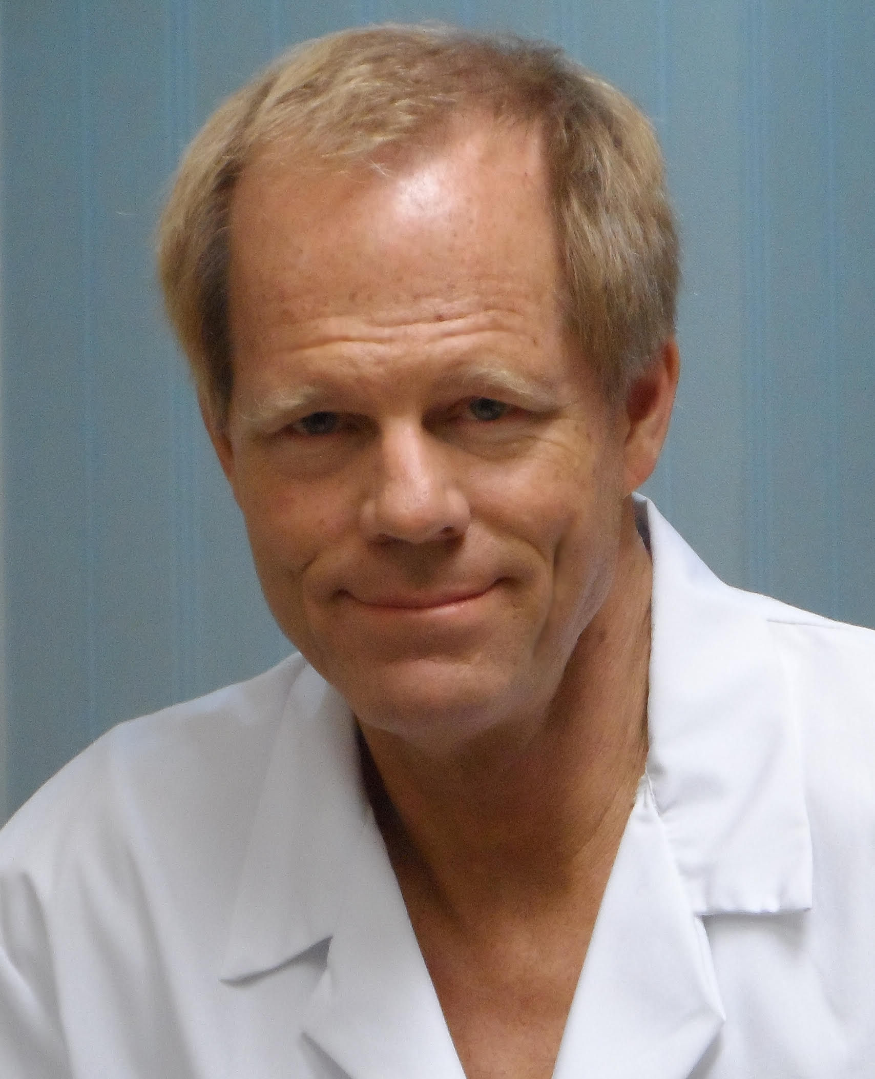
Darick Nordstrom DDS
Creator of:
ALF Therapy
The family of the ALF family of appliances
The OraLase Technique

Slide 37
Angie Tenholder DMD, FAACP, DABCDSM, FAGD
Fellowship status in the Academy of Craniofacial Pain and Academy of General Dentistry , Diplomate status in the Academy of Craniofacial Dental Sleep Medicine
Certified Team Dentist – Academy of Sports Dentistry
Platinum provider – Academy of Facial Esthetics
Developer of the BabyLase technique
Featured in multiple podcasts, presentation and publications

Slide 38
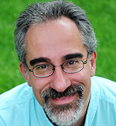
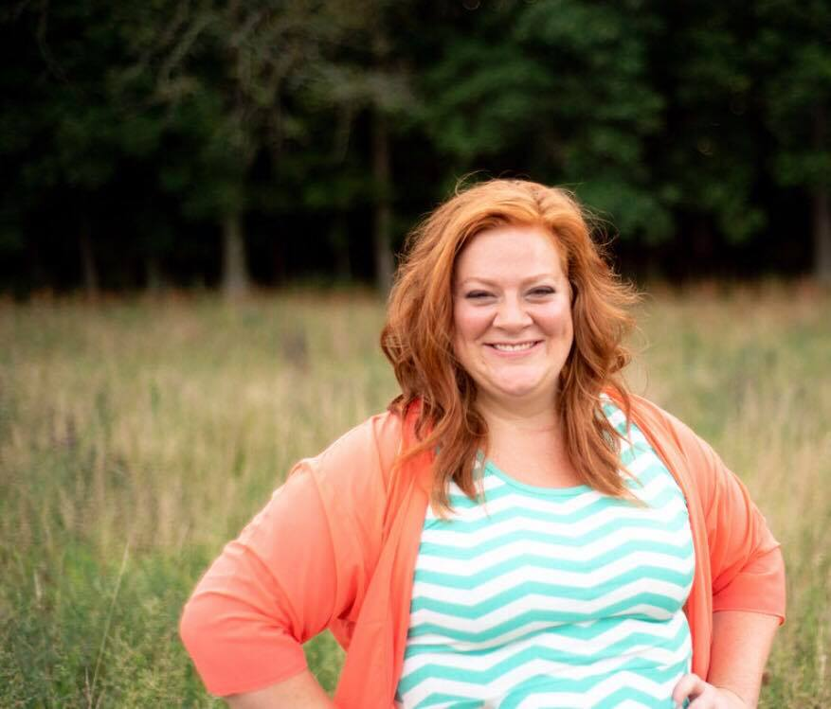
Supportive faculty
Dianah Davidson, RDH, COM
Charlie Beck DO, FAAIO
Nicole Edwin MS-CLC

Slide 39
The ALF InterFACE Academy provides ongoing educational opportunities to support to their members
Online educational platform
Hands on courses instructed in a clinical setting
Annual interdisciplinary conference to encourage TEAM treatment and collaboration

Slide 40
Offering a Multifaceted approach to authentic ALF Therapy Education
Introduction to concepts and multiple appliance designs
Age appropriate diagnostic tools and therapeutic interventions to support the needs of the providers and their patients
Instruction on assessment tools and technologies
Tips on clinical implementation
Education on sleep biometrics and functional assessments

Slide 41
Our goal is to dig deeper as providers so that our providers can help their patients to smile bigger, breathe easier, sleep restfully and live better lives through the benefits of ALF Therapy

Slide 42
We want to welcome our fellow providers to join with us in embracing the complexities, exploring the possibilities and addressing the challenges of modern life and facial development.

Slide 43
ALF Therapy is rooted in neurology and function
It embraces the role of:
Tongue function
Cranial motion
Airway reflexive function
Retained primitive reflexes
Neuroendocrine influences
Metabolic challenges

Slide 44
ALF Therapy promotes health
Dental expansion creates oral and airway volume
Cranial and tongue support creates flow of cerebral spinal fluid and removal of toxins of the brain through enhanced rhythmic motion of the cranium
As a result of improving the structural environment of the pituitary gland, many patients report improvement of symptoms associated with the hypothalamic pituitary adrenal axis.

Slide 45
ALF Therapy Grows beautiful faces
Gentle, rhythmic signaling of the swallow enhances growth that the patient’s body not only creates but embraces
Growth is guided as a reflection of the individual needs of the patient instead of the demands of the provider
The balanced forces of the tongue allow for symmetric and physiological expansion of the teeth and bones of the face and head creating beautiful natural smiles

Slide 46
The simple sophistication of ALF Therapy is often misunderstood
Life is complicated.
As a society, we are getting sicker. We have more challenges with tongue ties, crowed teeth, impaired sleep, improper breathing and crooked faces
ALF Therapy reflects the complexities of life and the simplicity of nature
When we can understand the root cause of the dysfunction, we can address the optimal solution for the patient

Slide 47
Why compromise?
Other techniques simply focus on:
Tooth alignment
Structural airway volume
Rigid appliances that impair tongue function
Unsightly, bulky appliances and difficulties with patient compliance

Slide 48
When ALF Therapy can optimize.

Slide 49
Miracles are everywhere. Be one.
ALF InterFACE Academy, Inc
www.alfresources.com

