Slide 1







Starting and Sustaining Your Own Business
Presented By
Best-Selling Author, Dr. Dorian R. Williams, Sr.
www.StrategyBrother.com 210.838.9910

Slide 2

Overview
Why Us? Why You?
Conducting a Market Analysis
Profit Margin Fundamentals
Determining Your Capacity
Product Lines And Services
Hands of the Law!

Slide 3





Why Are We Doing This Session?
We care—equity matters (free due to the pandemic)
The data does not favor us:
  20% of small businesses fail in their first year
  30% in their second year
  50% by their fifth
  70% beyond their tenth
  That’s us—so why are you starting your business?
  Why did you start your business? It matters!
Notes:
I talk to small-business owners every day, and while they all come from different industries and places, it is passion, freedom and impact that have been the main drivers determining their success or failure, progress or regression.
Let’s take a closer look:
Clate Mask
GUEST WRITER
Co-founder and CEO, Infusionsoft
“Every company, organization or group with the ability to inspire starts with a person or small group of people who were inspired to do something bigger than themselves." - Simon Sinek

Slide 4


Impact Others
Work for Yourself
Legacy (Family Business)
Control Work Hours
Why you do something is more important than what you do, and when you do it.
Just To Do It
You Are a Natural
Impact Others!
Passion For It!
Profit or Financial Gain
Notes:
I talk to small-business owners every day, and while they all come from different industries and places, it is passion, freedom and impact that have been the main drivers determining their success or failure, progress or regression.
Let’s take a closer look:
Clate Mask
GUEST WRITER
Co-founder and CEO, Infusionsoft
“Every company, organization or group with the ability to inspire starts with a person or small group of people who were inspired to do something bigger than themselves." - Simon Sinek

Slide 5
Pa$$ion
Impact
Passion is your drive, ambition and the love of what you do and who you serve.
It provides you with a very special view of the world that others often don’t see.
Steve Jobs had the passion for a phone with one button on the front.
Jeff Bezos of Amazon had a passion for a store that sold everything.
Passion Test: Is your passion contagious? Do others become excited when you share your passion?
Impact should be at the core of your business.
Don’t wait! Start from the beginning.
What’s your vision for your company’s impact on the world or your local community?
Your customers have a conscience!
They will support a cause over a product
Impact Test: If your company fails—what will be the impact?
Notes:
These are well-known examples of entrepreneurs who had a unique view of the world that others didn’t see at the time. Every successful small-business owner and entrepreneur must have a passion that drives them forward -- a core belief that keeps them pressing on, even though others don’t necessarily have the same vision.
My strongest passion is serving entrepreneurs and small-business owners. In the beginning, many people thought I was crazy for believing that a thriving company -- just focused on small-business success -- could last. Today, Infusionsoft serves more than 25,000 small businesses.
Stop and ask yourself: What is your true passion? What makes you excited about what you are doing? The difference between those who push through difficult times and those who do not is passion.
Very early in our business we made giving and helping others a key part of our purpose. If having an impact is a key part of your business from day one, you will make an impact on someone’s life every day.

Slide 6
CONDUCTING A MARKET ANALYSIS
Part of your Business Plan—a market analysis is the process of gathering information about a market within an industry.
Your analysis studies the dynamics of a market and what makes potential customers tick.
Notes:
A market analysis may seem complex, but it’s necessary.
Your market analysis can make or break your startup.
Helps you reduce risks because you better understand your customers and market conditions.
Your analysis helps you clarify what makes you different from the competition.
Whether you’re starting a venture, introducing a new product, or growing your small business, market research can help take you to the next level.

Slide 7


Key Questions = Key Answers
Who are my potential customers?
What are my customers’ shopping and buying habits?
How large is my target market?
How much are potential customers willing to pay?
Who is my competition?
What are my competitors’ strengths and weaknesses?
Secret Weapon is a Competitive Analysis
Notes:
arket research blends consumer behavior and economic trends to confirm and improve your business idea.
It’s crucial to understand your consumer base from the outset. Market research lets you reduce risks even while your business is still just a gleam in your eye.
Gather demographic information to better understand opportunities and limitations for gaining customers. This could include population data on age, wealth, family, interests, or anything else that’s relevant for your business.
Then answer these questions to get a good sense of your market.
Demand: Is there a desire for your product or service?
Market size: How many people would be interested in your offering?
Economic indicators: What is the income range and employment rate?
Location: Where do your customers live and where can your business reach?
Market saturation: How many similar options are already available to consumers?
Pricing: What do potential customers pay for these alternatives?
You’ll also want to keep up with the latest small business trends. It’s important to gain a sense of the specific market share that will impact your profits.
You can do market research using existing sources, or you can do the research yourself and go direct to consumers.
Existing sources can save you a lot of time and energy, but the information might not be as specific to your audience as you’d like. Use it to answer questions that are both general and quantifiable, like industry trends, demographics, and household incomes. Check online or start with our list of market research resources.

Slide 8

Use competitive analysis to find advantages
Competitive analysis helps you learn from businesses competing for your potential customers.
This is key to defining a competitive edge that creates sustainable revenue (Sales).
Your competitive analysis should identify your competition by product line or service and market segment.
Assess the following:
  Market share
  Strengths and weaknesses
  Your window of opportunity to enter the market
  Importance of your target market to your competitors
  Barriers that may hinder you as you enter the market
  Indirect/secondary competitors who may impact you

Slide 9
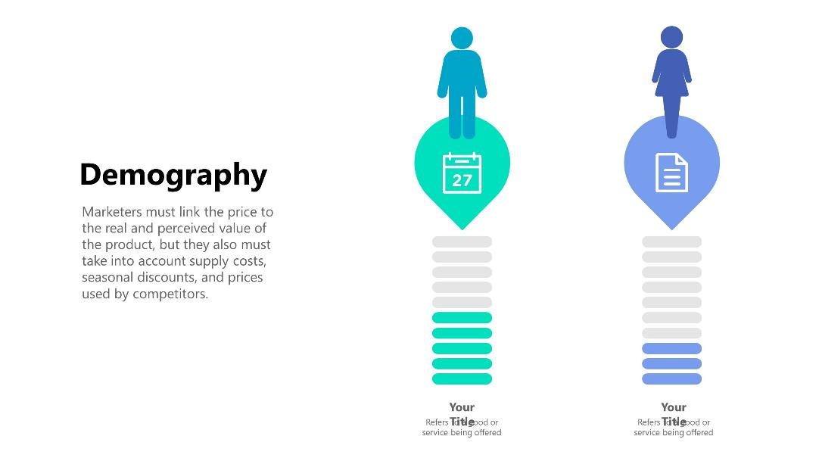
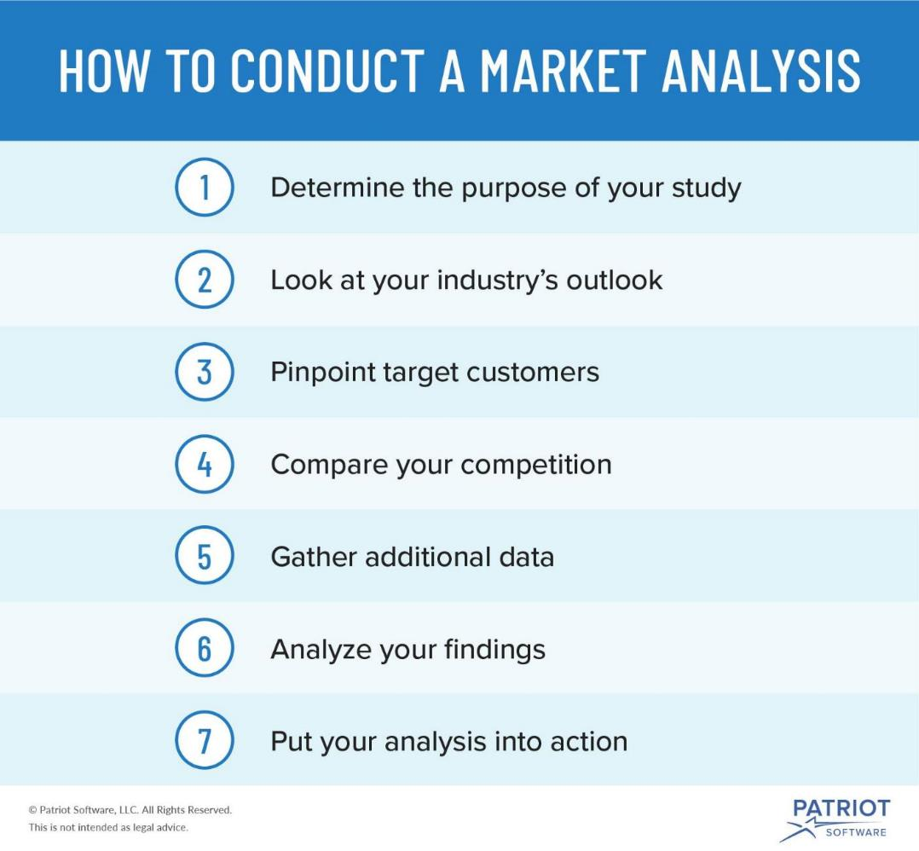
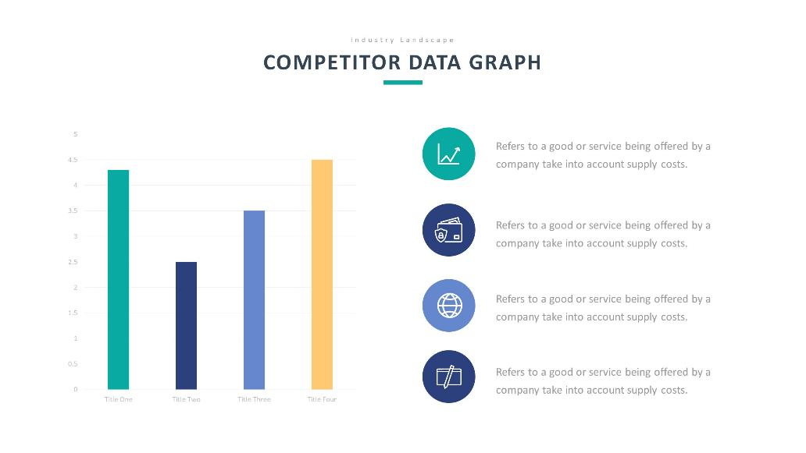
Notes:
1. Determine the purpose of your study
There are many reasons why businesses might conduct market research. You may use them to assess business risks (e.g., threats), reduce issues, or create opportunities.
You can look at past problems to decrease future risks. And, analyze past successes to see what you need to continue to do in the future.
Before starting any market research, determine whether the analysis is for internal or external purposes. Internal purposes include things like improving cash flow or business operations. External purposes include trying convince lenders to give you a business loan.
2. Look at your industry’s outlook
In your analysis, outline the current state of your industry. Include where the industry is heading using metrics such as size, trends, and projected growth. Be sure to have relevant data to back up your claims.
This section will let investors or lenders see that you’ve done your homework on your business’s industry. And, it will show them whether or not your industry is worth their time and money.
3. Pinpoint target customers
The truth is, not every person will be your customer. But that’s OK! When you analyze the market, you must determine who your potential customers are. This part of the process is called a target market analysis.

Slide 10
PROFIT MARGIN
Profit margin is the measure of a company’s earnings (or profits) relative to its revenue.
The profit margin ratio compares profit to sales and tells you how well the company is handling its finances overall. It's always expressed as a percentage.
Notes:
Profit margin is the measure of your profitability.
It is important to measure your margin of profit to ensure that your business is making enough revenue to invest back into your business.
Companies who build on revenue rather profit are experiencing false growth and are incurring debt.
Profit should be used to grow your business through marketing, advertising, additional resources, etc.
Profit margin is an indicator of:
The profitability and stability of a business
Company’s ability to manage expenses
Company’s pricing strategy
Company’s performance vs. competition
Company’s investment potential

Slide 11
Key Terms and Concepts?
Cost - The absolute cost to produce or source a product. This includes the cost of labor, materials, and variable costs.
Margin - When pricing a product the margin cost is the percentage increase you apply to the cost in order to make a profit from a sale.
Revenue - Profit added to the cost of the product equates to the revenue figure, which is the total amount received for a product by a customer.
Profit - Your revenue minus costs. In order to benchmark success on a regular basis profit must be known. Profit should increase consistently to ensure growth in a business.
Notes:
Low profit margins could suggest a wide array of issues, from inability to efficiently manage expenses and overheads, to inadequate pricing strategy. It’s crucial for businesses to monitor their profit margin closely, as it’s a great tool to identify areas ripe for improvement and optimize their earnings.
Interestingly enough, higher revenue doesn’t always translate into higher profit margin. If expenses associated with higher sales have increased faster than the revenue, the company can actually end up making less money. That’s why keeping the costs low, effectively managing the inventory and optimizing the pricing strategy for maximum profit is as much a determining factor for healthier profit margin as increased sales.
Essentially, there are only two ways for companies to achieve better profit margin:
Generate more revenue while keeping the costs low
Lower the costs while generating the same amount of revenue
Since generating additional revenues is often more difficult, businesses typically experiment with revenue optimization strategies and tend to look for opportunities to cut down on costs and fine-tune their pricing strategy to improve their profit ratio.
Although profit margin can be useful for comparing companies with one another, the comparisons should only be drawn between companies within the same industry and ideally, with similar business models. Seasonality and cyclical sales trends should also be taken into consideration when comparing profit margin over a specific time period.

Slide 12






HOW IS PROFIT MARGIN CALCULATED?
+
Profit margin can be calculated using a simple formula:
  Profit Margin = (Total Sales – Total Expenses) / Total Sales
Example:
  Your company made $500k in sales (revenue) last year.
  After all of your costs and expenses (overhead), such as rent, salaries, cost of goods, etc., you’re left with net profits of $100k. Note: Count what you should make…..
  Now divide net profits by total sales.
    $100k / $500k = 0.2, or 2%, as profit margin is typically expressed in percentages.
What was your profit margin for the last quarter?
  20% margin is considered high (or “good”)
  10% net profit margin is considered average
  5% margin is low

Slide 13

WHAT IS A GOOD PROFIT MARGIN?
Investors compare the operating profit margin of a company with the operating profit margin of industry competitors or a benchmark index such as the Standard & Poor's 500 index.
Operating profit margin is one of the key profitability ratios that investors and analysts use when evaluating a company.
  Operating margin is considered a good indicator of how efficiently a company manages expenses because it reveals the amount of revenue returned to a company once it has covered virtually all of its fixed and variable costs except for taxes and interest.
Product should meet a certain consumer demand, or it should be so compelling that consumers believe they need it.

Slide 14
PROFIT MARGIN SOLUTIONSS
+
Keep costs low and effectively managing the inventory (inventory loss #1 culprit)
Optimize your pricing strategy
  Revenue optimization (Google Shopping, Yahoo Shopping, Bizrate, camelcamelcamel, NexTag, etc.)
Essentially, there are only two ways to achieve better profit margin:
  Generate more revenue while keeping the costs low
  Lower the costs while generating the same amount of revenue
Don't be seduced into thinking that that which does not make a profit is without value.
Arthur Miller

Slide 15
DETERMINING YOUR CAPACITY
Capacity = Maximum output you can produce with the available resources in a given period.
Production capacity can be calculated based on a single type of product or a mix of products. (Intangible vs. Tangible)
  How long does it take you to produce a product? How much time is left?
  How long does it take you to sale a product? How much time is left?
  What does it cost to make or distribute? Budget remaining?
  How long does it take to distribute the item?
  Intangibles: Capital, talent/skill, network, brand awareness, credibility (expert), proven wins, etc.
Capacity building secret weapon: Minimize an over-reliance on outside experts as sources of knowledge, resources, and solutions.
Notes:
Low profit margins could suggest a wide array of issues, from inability to efficiently manage expenses and overheads, to inadequate pricing strategy. It’s crucial for businesses to monitor their profit margin closely, as it’s a great tool to identify areas ripe for improvement and optimize their earnings.
Interestingly enough, higher revenue doesn’t always translate into higher profit margin. If expenses associated with higher sales have increased faster than the revenue, the company can actually end up making less money. That’s why keeping the costs low, effectively managing the inventory and optimizing the pricing strategy for maximum profit is as much a determining factor for healthier profit margin as increased sales.
Essentially, there are only two ways for companies to achieve better profit margin:
Generate more revenue while keeping the costs low
Lower the costs while generating the same amount of revenue
Since generating additional revenues is often more difficult, businesses typically experiment with revenue optimization strategies and tend to look for opportunities to cut down on costs and fine-tune their pricing strategy to improve their profit ratio.
Although profit margin can be useful for comparing companies with one another, the comparisons should only be drawn between companies within the same industry and ideally, with similar business models. Seasonality and cyclical sales trends should also be taken into consideration when comparing profit margin over a specific time period.

Slide 16
PRODUCT LINES/SERVICE DEFINED
Products
Products are tangible and discernible items that the organization produces
Something you make for someone
Services
A service is the production of an essentially intangible benefit,
Something you do for someone
Products and services should meet a certain consumer demand, or it should be so compelling that consumers believe they need it.

Slide 17
PRODUCT LINES/SERVICE DECISIONS
Key Decisions
Individual Product
Product Line
Product Mix
Product Mix
  Product mix width
    Number of different product lines
  Product mix depth
    Number of versions of each product
  Product mix length
    Total number of products within a company’s product lines.
      Example = 10 product lines and each line has 3 product variations then product mix length is (10×3) = 30
Products and services should meet a certain consumer demand, or it should be so compelling that consumers believe they need it.

Slide 18


LEGAL CONSIDERATIONS FOR STARTING AND SUSTAINING A BUSINESS
Dr. Reginal D. Harris Attorney

Slide 19

BUSINESS START-UP TOOL KIT
Business Start-up Checklist
Types of Business Entities
Legal Formation Requirements
Employer Identification Number (SS-4)
County Clerk’s Office & Resources
Small Business & Entrepreneurship Services
Local & State Business Certifications & Benefits
Veterans Entrepreneur Program Support & Services
Business Startup & Counseling Support Organizations

Slide 20


