Slide 3
Student 1
PTSD
Spoke in a whisper
We played with tongue twisters until she found a giggle inside her that just had to come out
She was able to use her voice again

Slide 4
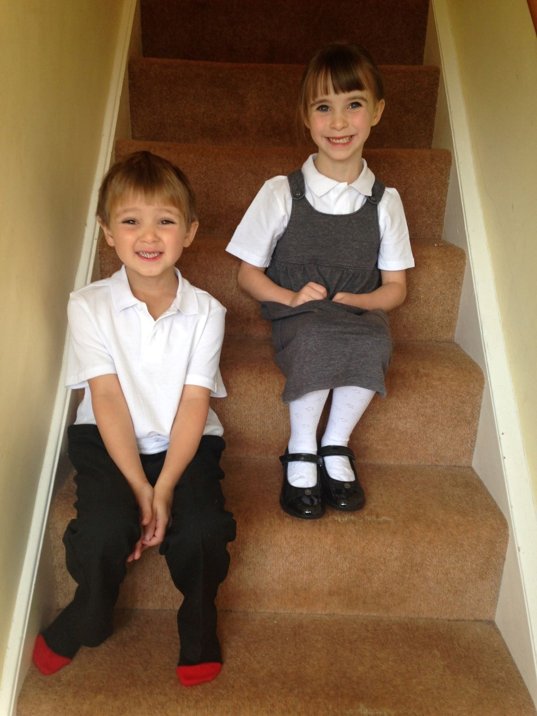
Let’s start at the beginning…
Mirroring
Children / adults / peers
Student 2 – child who struggled with TH sounds

Slide 5
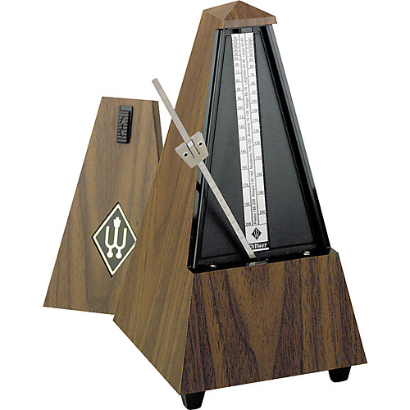
Student 3
Eastern Europe, strong accent
Lawyer
Spoke too fast
In court she was frequently misunderstood

Slide 6
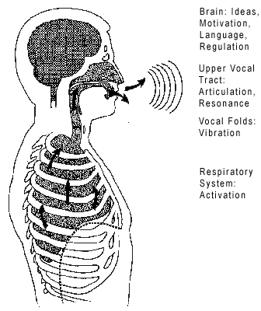

Slide 7
Voice work makes use of the whole body from head to toe. The way you stand, the angle of your head, the drop of your shoulders, the position of your spine and pelvis all contribute to the production of a strong voice. Speaking (and singing) is really the end result of a whole series of reflexive physical actions and body placement which you simply must become aware of in order to gain mastery and control over your vocal instrument.
(Patsy Rodenburg, The Actor Speaks)

Slide 8
Breathing Exercises
Relax your stomach to allow it to inflate when breathing.
Sit up straight.
Breathe in slowly through your nose and out slowly through your mouth.
On the exhale count aloud slowly.
Now try and count higher.
Breathe in for a count of five, hold for a count of five, and then breathe out for a count of five.
Now try ten... Increase this number - eleven, twelve, thirteen and so on.

Slide 10
Resonance
Breathe through some vowel sounds
Try this:
/o/ as in hot
/ah/ as in park
/u/ as in hut
/er/ as in curl
/e/ as in set
/ay/ as in make
/i/ as in it
/ah/ as in park
/ee/ as in sea
/oo/ as in cool
/oh/ as in snow
/aw/ as in Paul
Yawn / sigh
Drop tongue – ‘hah’
Keep relaxed “Eve ate apples all afternoon’
…contrast with tension in all areas of voice.

Slide 11
Warm Up – Free Gift!
Hum
Hum / ahhhh
Flutters
Where is your spoon?
Try this with the spoon in:
B, C, D, F, G, H, J, K, L, M, N, P, Q, R, S, T, V, W, X, Y, Z

Slide 13
Vowels – created in the spaces!
Oo | Aw/Or | Ah/Ar | I | Ay | Ee
Let’s watch each other’s mouths for observation…..

Slide 14
Minimal pairs - /e/ and /ʌ/
bet | but | hemp | hump
net | nut | leg | lug
hem | hum | Ben | bun
said | sud | dead | dud
sex | sucks | send | sunned
better | butter | bed | bud
wren | run | Fen | fun
Ben | bun | rest | rust
trek | truck | ten | ton
Steph | stuff | pedal | puddle

Slide 16
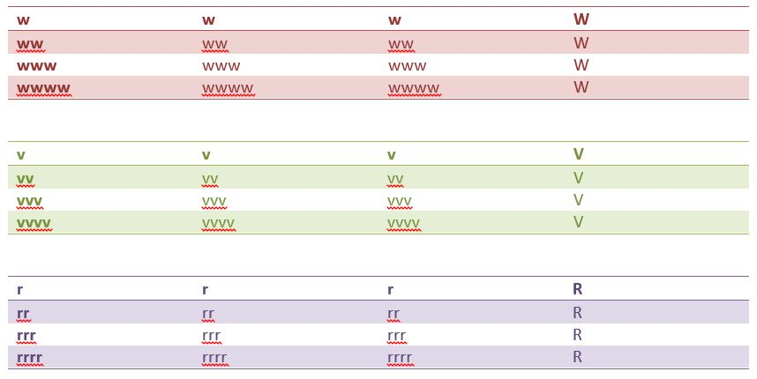

Slide 17
TH – one of the most common sounds I have to work on – voiceless fricative
Thank | Tank | death | debt
Thread | Tread | Thought | Taught
Both | Boat | Thin | Tin
Through | True | Thigh | Tie
Three | Tree | Theme | Team
Faith | Fate | Path | part
Maths | Mats | Fourth | fort

Slide 18
What are YOUR target sounds?
Make a note now of the sounds you’d like to work on…..

Slide 19
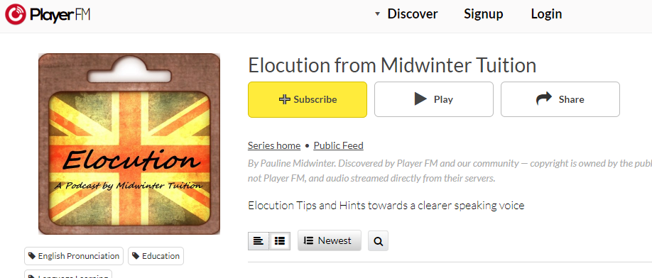
How can I work on them, alone? Links on my website www.midwintertuition.co.uk
Take an online course – mine is on Udemy
https://www.udemy.com/elocution/learn/v4/overview
Use free resources like YouTube
Podcasts
And podcasts…

Slide 21
Tongue Twisters – firstly /s/ and /sh/

Slide 22
/f/ and /s/

Slide 23
/d/ and /t/
Oh what to-do, to die today, at a minute or two 'til two,
A thing distinctly hard to say, yet harder still to do,
For they'll beat a tattoo, at twenty to two,
With a rattatta tattatta tattatta too,
And the dragon will come when he hears the drum ,
At a minute or two 'til two today
At a minute or two 'til two.

Slide 24
/d/ and /dzh/

Slide 25
/w/ and /th/

Slide 26
English is a tricky language…
Buffet | Ballet
Brochure | Gear
Castle | Fasten
Champagne | Comb
Bomb | Plumber
Cruel | Fuel
Debt | Issues
Often | Wednesday

Slide 27
Storytelling…

Slide 28
Disfluencies….

Slide 29
www.midwintertuition.co.uk
01502 471701
07851920306

