Slide 2
Sales and Strategy Name: Gail Bozeman Region: Midwest Area: South Chicago & NW Indiana

Slide 3
Sales Review Gail Bozeman
Q1 Goal Alignment
Securing “Proper” new accounts:
Reducing DSD:
Turning over some accounts to AM Distribution, Adjust assortment in several stores
to allow them to order directly from their distributor
Topic / Results | January | February | March
Average Calls Per Working Day | 16 | 17 | 17
DSD Cans Sold | 1405 | 1595 | 2081
New Accounts Gained | 9 | 9 | 0
Consumer Engagements | 0 | 7 | 0
TTL New Accounts | Tobacco Retailers | Gas Stations | C-Stores | Vape Shops | Smoke Shops
18 | 22% | 22% | 28% | 17% | 11%

Slide 4
Sales Review Gail Bozeman
Number of Accounts, by Type | Type Description
75 | CS Convenience Store/Gas
1 | VAPE Vape Stores
1 | WM Wholesale Distributor
8 | TS Tobacco Shop
N/A | NS Newsstand/Bodega/Deli
1 | LS Liquor Store
N/A | GS Grocery Store
N/A | DT Drive Through
N/A | BA Bar/Other
1 | CD Cigarette Deep Discount
87 | TOTAL ALL ACTIVE ACCOUNTS IN SA UNIVERSE

Slide 5
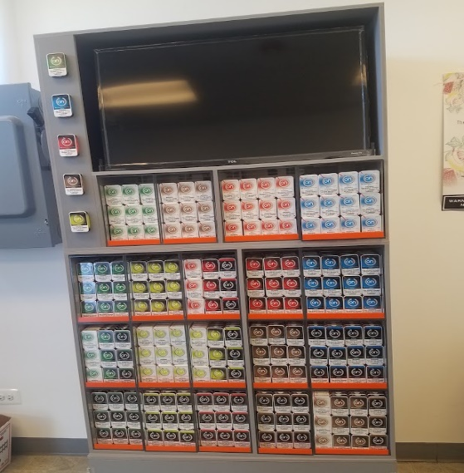
Accomplishments Gail Bozeman
AM Distributor- Alsip, IL
New wholesaler – currently carrying 5 flavors/all strengths
Merchandised Cash and Carry custom display
AM Distributor agreed to provide their customer list
Part of strategy to reduce DSD to focus more on sales

Slide 6
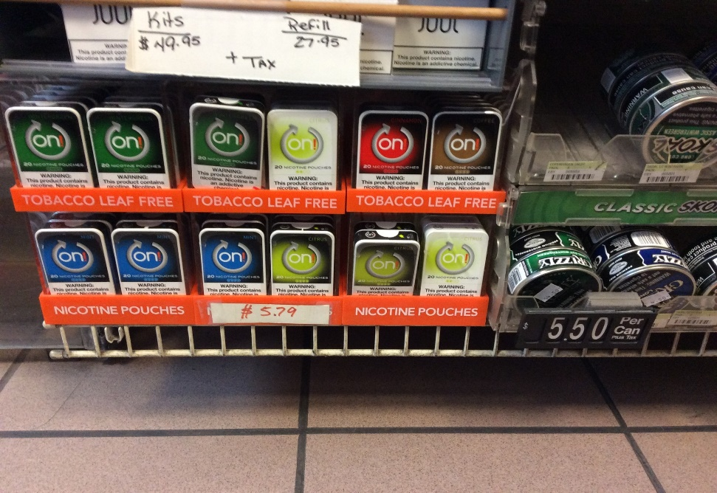
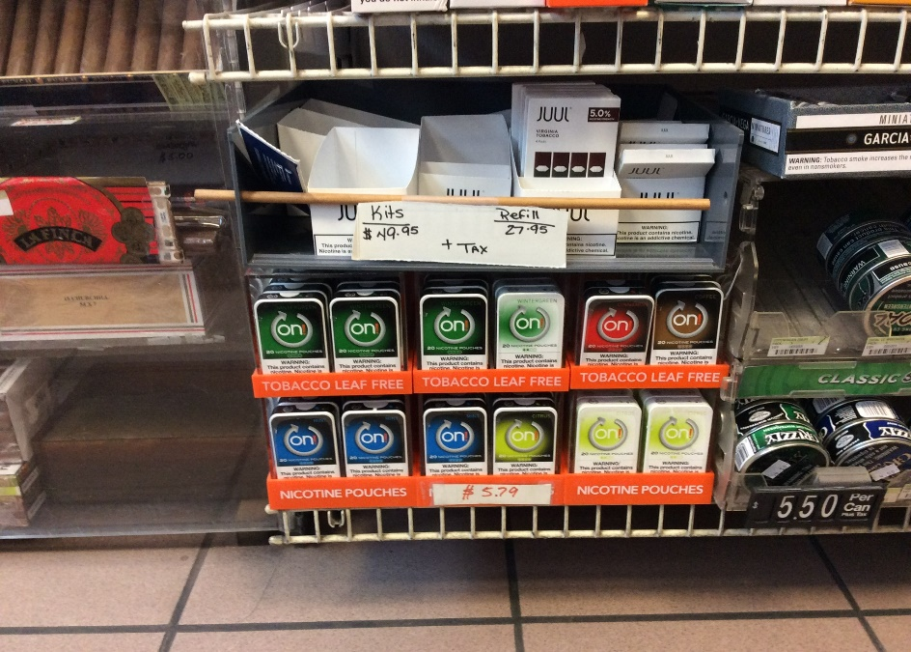
Accomplishments Gail Bozeman
Gas Express Citgo- Chicago, IL
Saw an opportunity to add an additional SKU to drive sales
Modified display to accommodate the 7th SKU
Before adding SKU
After adding SKU

Slide 7
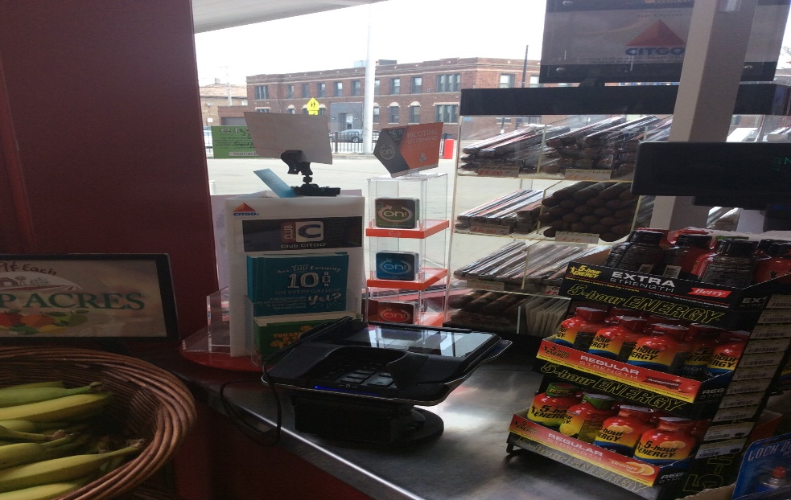
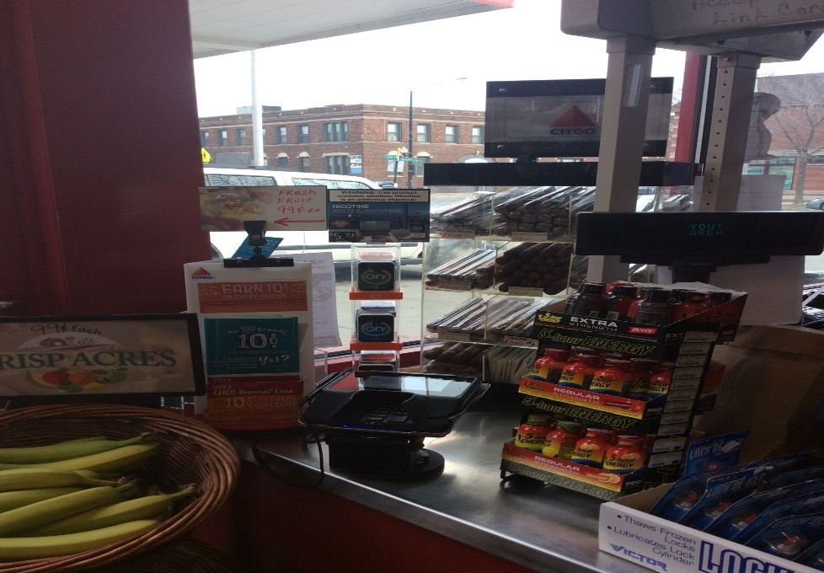
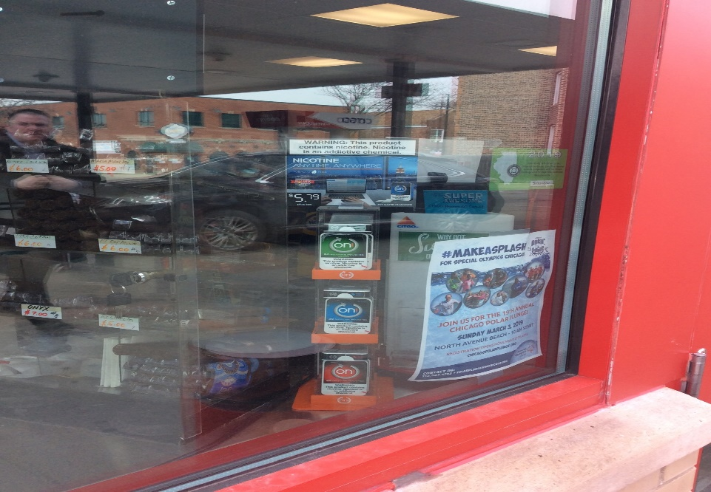
Accomplishments Gail Bozeman
Gas Express Citgo- Chicago, IL
Relocated and modified secondary display so customers can see product from all directions (whether inside or out)
Facing customers inside store
After changes inside store view
After changes outside store view

Slide 8
Q2 Opportunities Gail Bozeman
Possible regional chains in area to secure
Luke Oil- Hobart, IN (27 stores)
Good to Go Oil – Winamac, IN (16 stores)
Possible Wholesalers in area to secure
Expo Wholesale Inc.
Continually looking for Wholesalers in territory
Plan to reduce DSD
Working with Wholesalers/Distributors and retail partners
Plan to secure “Proper” new accounts
Spend more time researching the account vs the shot gun approach
Develop and follow store call process
Plan to increase Consumer Engagements
Coordinate with retailers for best possible times to engage customers
Work with marketing to create ‘demo like’ experience while performing consumer engagements

Slide 9
SWOT ANALYSIS Gail Bozeman
S
W
Strong entry into market from Al Capone
Product is in some of the top 10 US convenience store distributors
Convenience store news listed On as one of their best New Products for 2018
I am new to the category and outlet, but learning very quickly
Distributors not carrying all SKU’s
Competitor has better eye- catching display
O
T
Need sales data by quarter and period for more fact-based selling
Focus more on selling to small/medium retailers
Continue to build business relationships to drive sales
Marketing and advertising needs to be more visible
Zyn potential rollout at Corp 7-Eleven
JUUL, while not in our category continues growing with Millennials and Gen Xers for both genders
Dryft and others tighten category space
Recreational Marijuana

Slide 10
Comments Gail Bozeman
Working Well
Company
Personal
DSD / Distributor Sales
Developed markets
Developing long-term business relationships
Scheduling delivery/sales calls
Educating retailers to ‘text’ or ‘call’ me with their orders
Needs Improvement
Company
Personal
Distributors need to carry all SKU’s
Provide more detailed sales data
Provide better work/life balance creating more focused sales managers
Transition from DSD to more focus on sales (more clients = more sales)
More effective Pre-call planning
Increase client service focus
Provide more profitable revenue to the organization

Slide 11
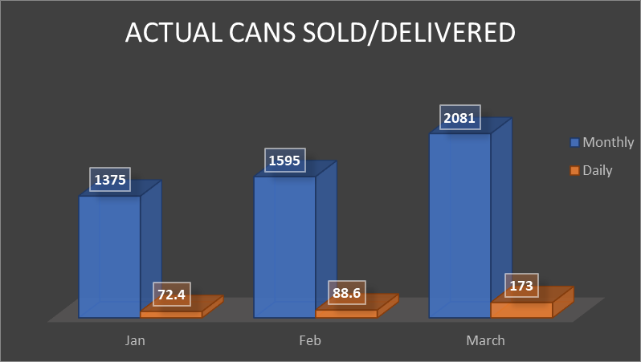
Positive Trends, But Are We Missing Opportunities? Gail Bozeman
Current Trends:
Avg 17 Calls/day
Avg 9 hrs. / day
Primarily deliverable calls
What if :
We reduced calls from 17 to 14
My Can sales trend would continue
Laser-focus on sales to new retail partners .
Generates more profitable revenue faster:

Slide 12
Need Help Gail Bozeman
 | Weekly Sales Data for 7-Eleven, 6350 West 135th. Street
 | Flavor / Strength | 20-Dec | 27-Dec | 3-Jan | 10-Jan | 17-Jan |  | 24-Jan | 31-Jan |  | 7-Feb | 14-Feb | 21-Feb | Totals units sold
 | Citrus | 7 | 11 | 8 | 8 | 8 |  | 11 | 7 |  | 6 | 6 | 7 | 79
 | Wintergreen | 0 | 0 | 2 | 0 | 0 |  | 1 | 2 |  | 0 | 0 | 1 | 6
 | Cinnamon | 0 | 0 | 0 | 1 | 0 |  | 1 | 1 |  | 0 | 1 | 0 | 4
 | Mint | 1 | 0 | 0 | 0 | 0 |  | 0 | 0 |  | 0 | 0 | 0 | 1
Citrus is selling well, however we need ideas to drive sales from other flavors/strengths
If other SKU’s don’t sell, they will be delisted and/or they will expire
Good News – Moved from DSD to McLain
Thoughts and ideas?

