Slide 1
Homecoming 2023: Wild, Wild West
Dress Code Guidelines

Slide 2
Dress Code – Formal Attire
For girls, dresses and attire that reflect modesty are required. Each year, the most difficult task for administrators is the determination of modesty for girls. Traditional interpretations are often at odds with fashion and cultural trends.
Following the guidelines put into place can prevent from making one feel uncomfortable because they have been asked to modify their attire.

Slide 3
Dress Code – Formal Attire
Homecoming attire should reflect more of a formal family occasion rather than a night on the town or a at club.
For boys, dress slacks, collared button-down shirts, and ties or bowties are expected.
For girls, dresses are expected. Dresses that are strapless, too revealing, skin-tight or form-fitting, expose midriffs or cleavage, or are too short in length are not appropriate.
Themed items such as cowboy boots and hats, bolo ties (boys), denim jackets and vests are permitted at the Homecoming Dinner and Reception.

Slide 4
Dress Code – Formal Attire
Modesty is admittedly a subjective interpretation, but one which we have the duty to uphold. Girls should therefore err on the side of modesty and formality. These guidelines should be referred to before choosing a dress for Homecoming. We expect nothing less than full cooperation from students and parents on this issue.

Slide 5
Specifics for Dresses
All dresses must have straps. No strapless dresses are permitted.
Dresses must not be low-cut in the front. Be careful with scoop and sweetheart necklines!
NO plunging necklines or visible cleavage is permitted.
Dress backs may not be lower than the armpit.
Dresses with more open backs may be worn if covered by a shawl, shrug, vest, jacket, etc. that must remain in place throughout the entire evening.
The length of the dress must fall to the top of the knee while standing and while sitting. If a dress has a slit, it may rise no higher than the top of the knee (not above the knee) when standing AND when seated.
Dresses must fit but not be skin tight or too form fitting.
Appropriate undergarments should be worn based on the style of the dress. Foundation garments must not be visible while wearing the dress.
No bare or sheer midriffs or cutouts are permitted.
Two piece dresses must overlap, even when the arms are raised.
Nude colored inserts give the illusion of skin showing where it should not be and are not permitted.

Slide 6
All dresses must have straps. No strapless dresses are permitted.
If your dress does not have a spot for your arm to pass through, it is considered strapless.
Halter-style dresses, spaghetti straps, off-the-shoulder are acceptable.

Slide 7
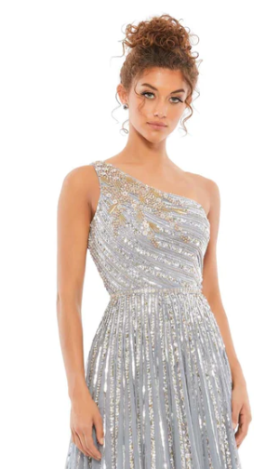
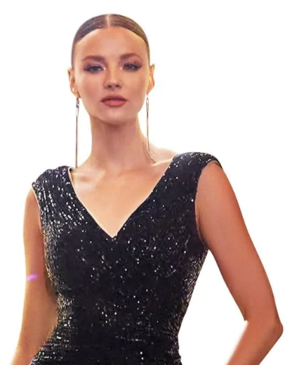
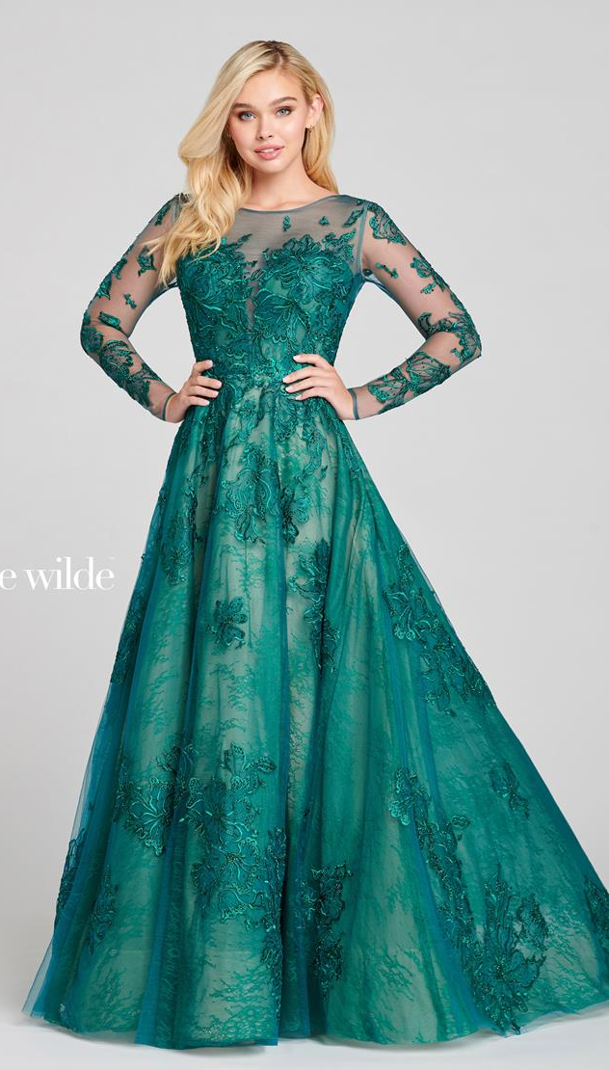
Appropriate Dresses
Straps and/or sleeves = YES!

Slide 8
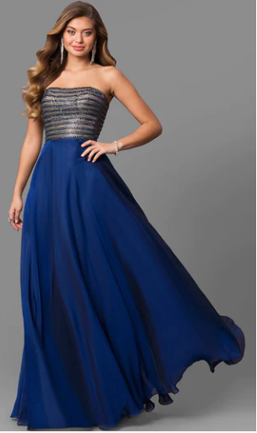
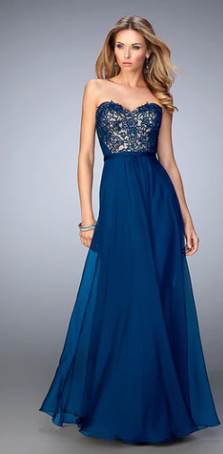
Inappropriate Dresses
No Straps
=
Not Permitted!

Slide 9
Dresses must not be lowcut in the front.
No plunging necklines.
No cleavage.
No nude insets that give the appearance there is skin showing that should not be.
Be careful of scoop neck and sweetheart necklines!

Slide 10
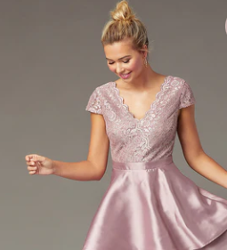
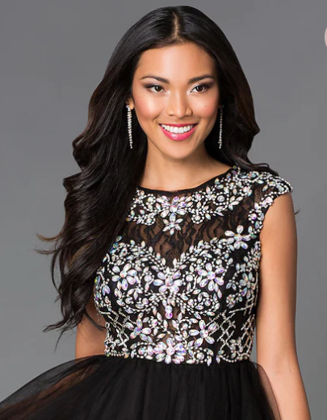
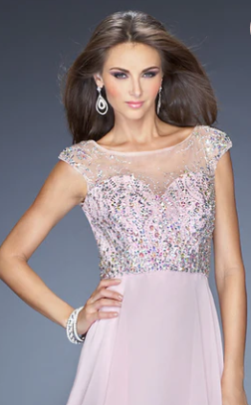
Appropriate Dresses
Modest Necklines = YES!

Slide 11
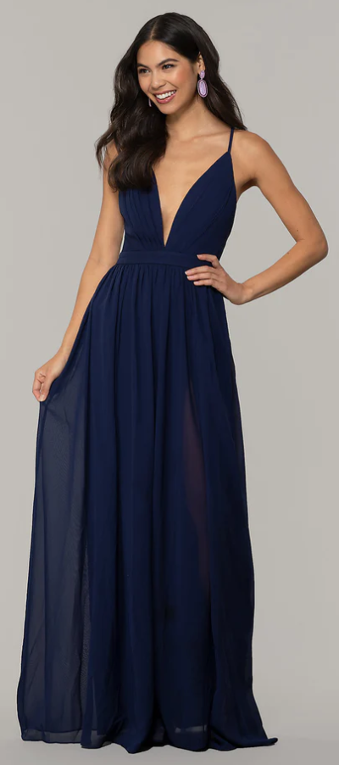
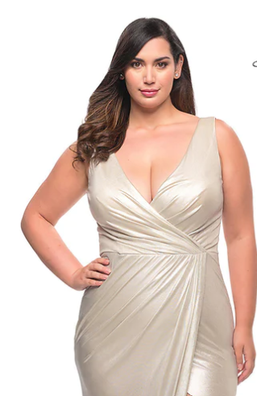
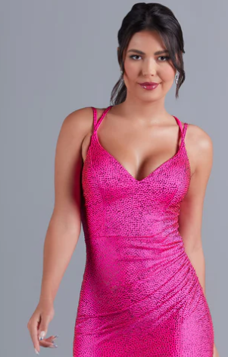
Inappropriate Dresses
Immodest necklines = No!
Cleavage showing!
Plunging necklines!
Nude mesh fabric still gives an immodest look = NO!

Slide 12
Dresses must not be low cut in the back.
Backs of dresses may be cut no lower than armpit height.
Dresses that are cut lower than armpit height must be covered with a wrap, or covered with a jacket, or covered with a garment worn under the dress. The covering must remain in place the entire evening.

Slide 13
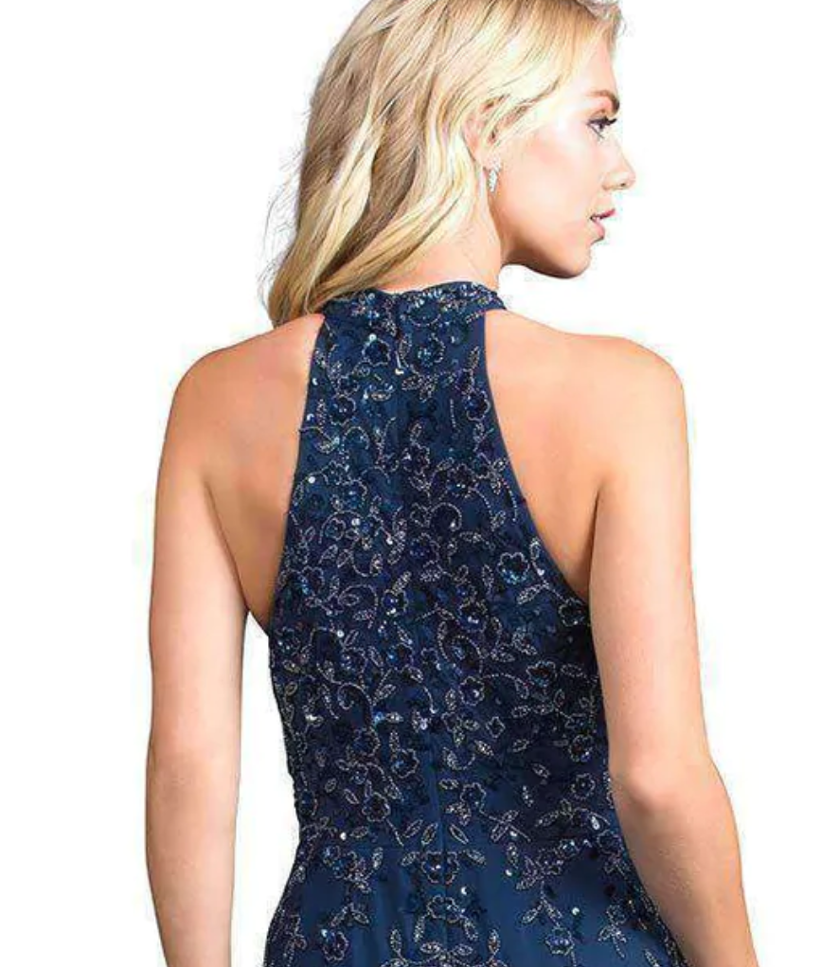
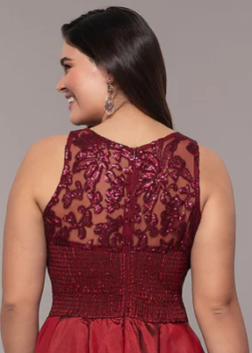
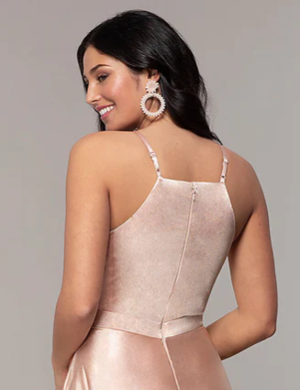
Appropriate Dresses
High Backs = YES!
Appropriate Coverings = YES!

Slide 14
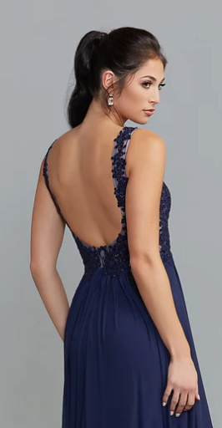
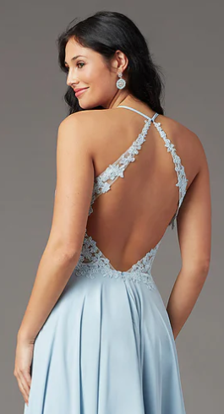
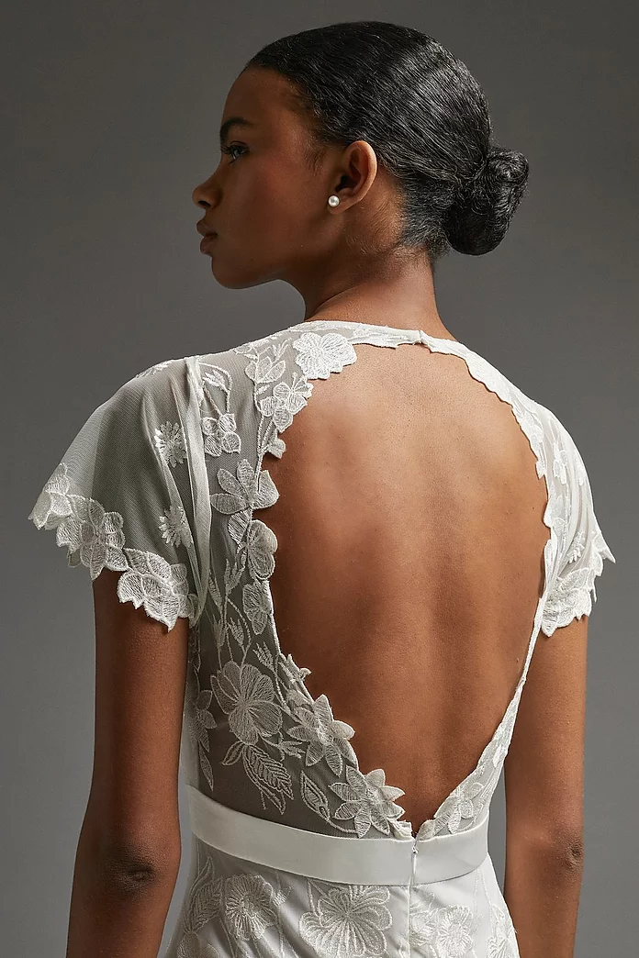
Inappropriate Dresses
Plunging Backs, Bare Backs = No!
Cover-up Needed!

Slide 15
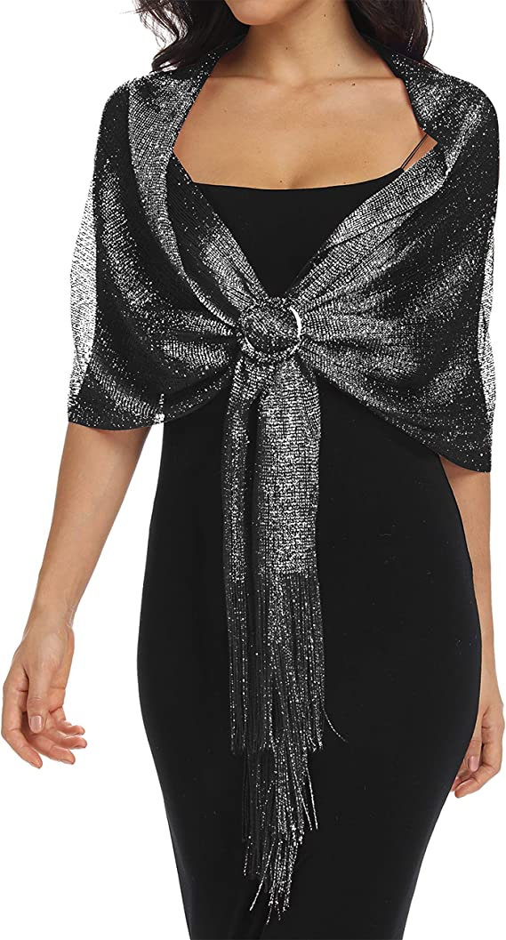
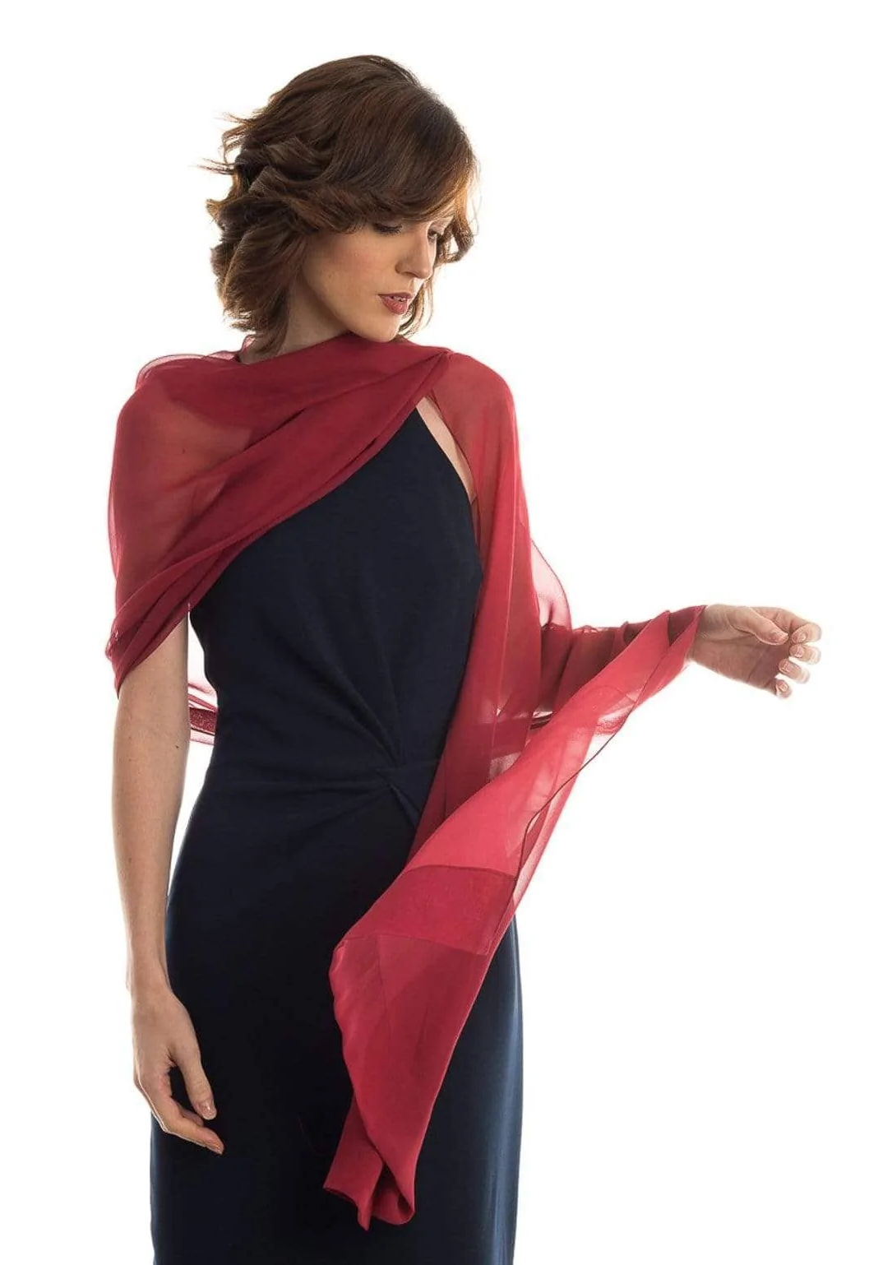
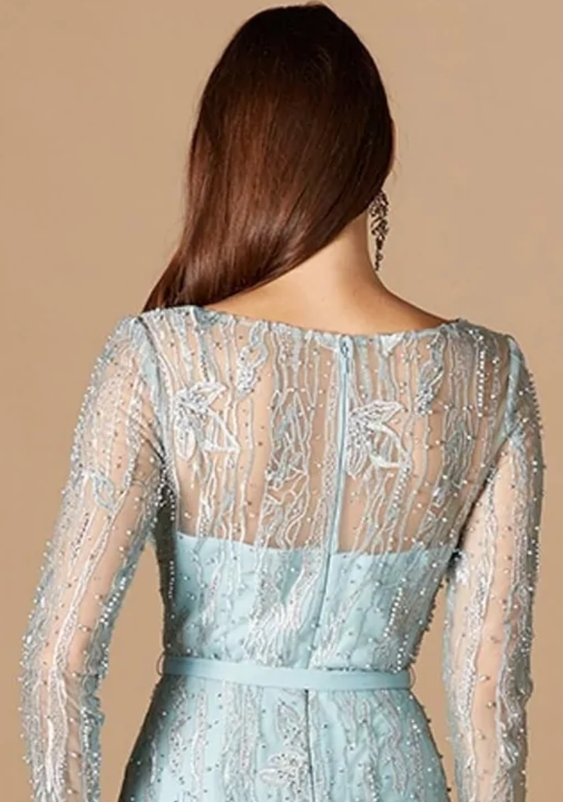
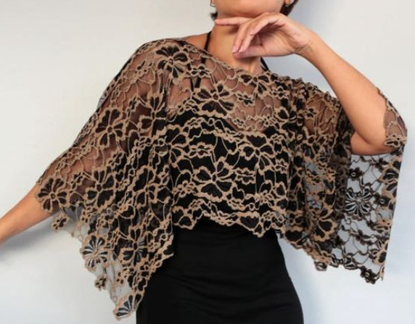
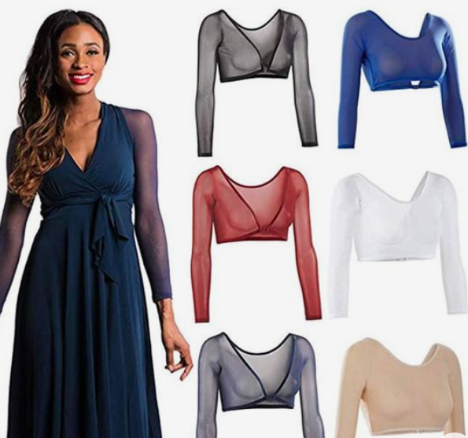
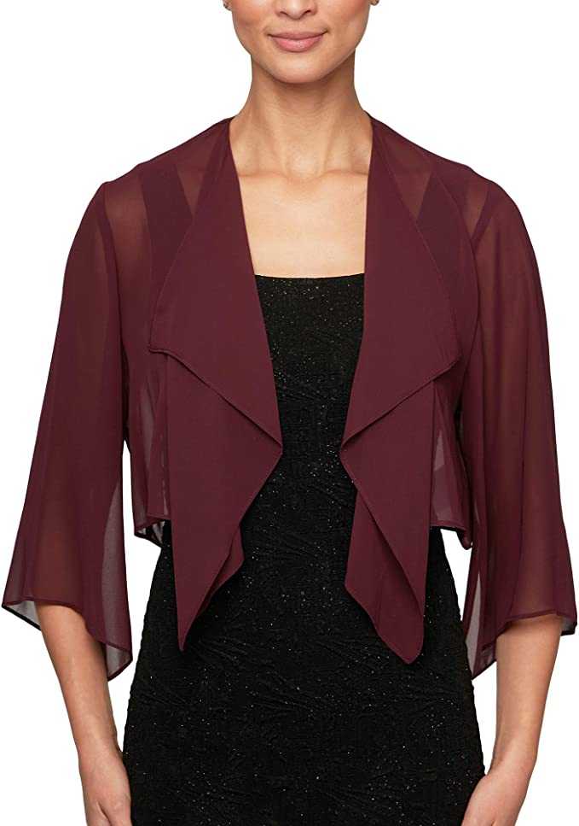
Appropriate Dresses
Appropriate Coverings For A Too Open Back = YES!

Slide 16
The length of the dress must fall to the top of the knee when standing AND when seated. If a dress has a slit, it may rise no higher than the top of the knee when standing AND when seated.
Try the dress on and look in a mirror when standing straight up as well as when sitting in a chair!

Slide 17
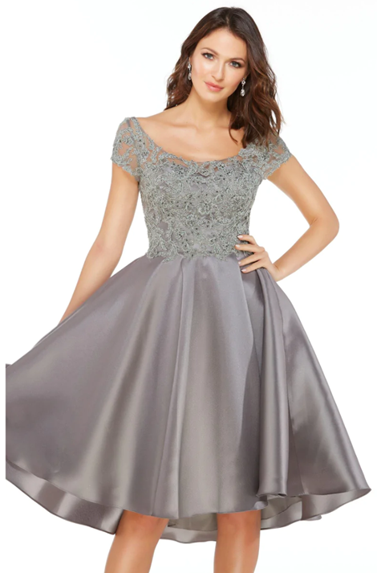
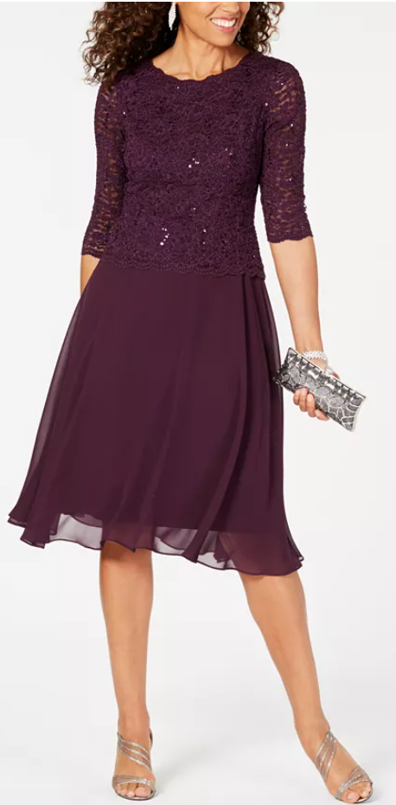
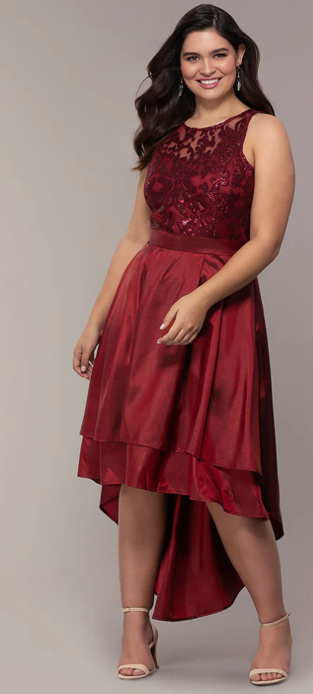
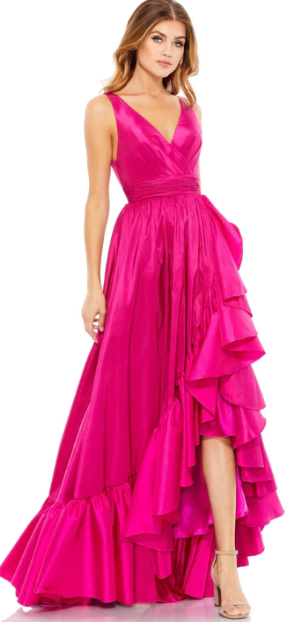
Appropriate Dresses
Knee length or longer = YES!

Slide 18
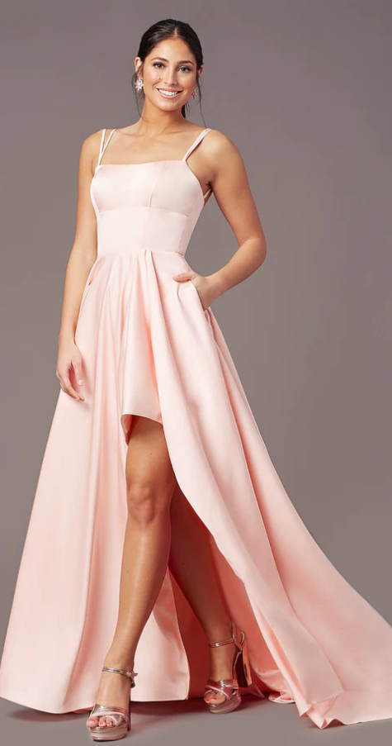
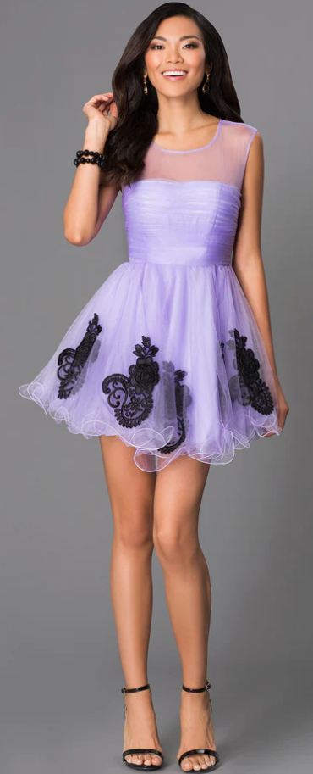
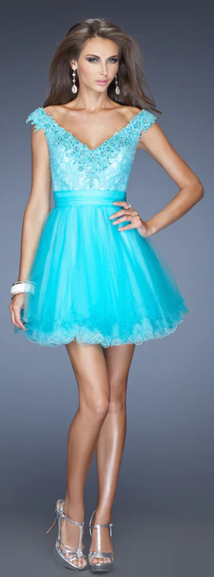
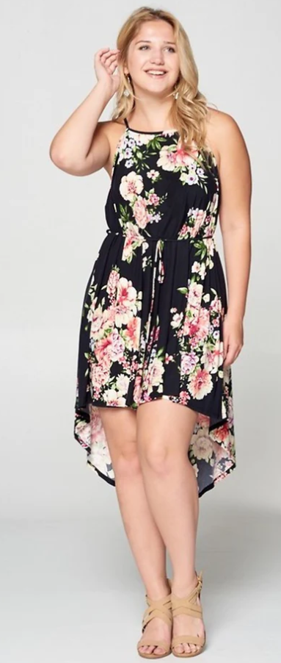
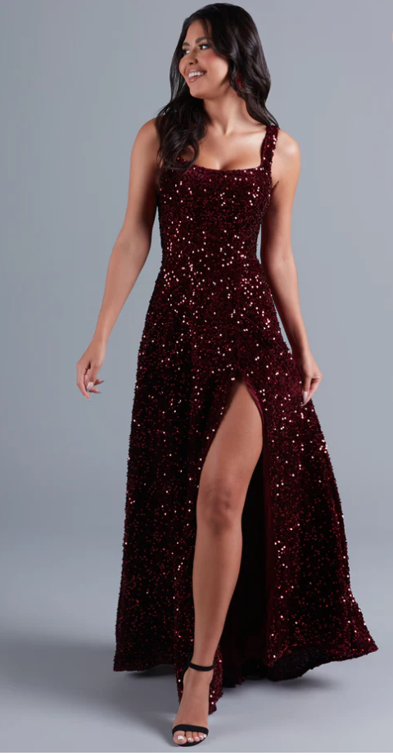
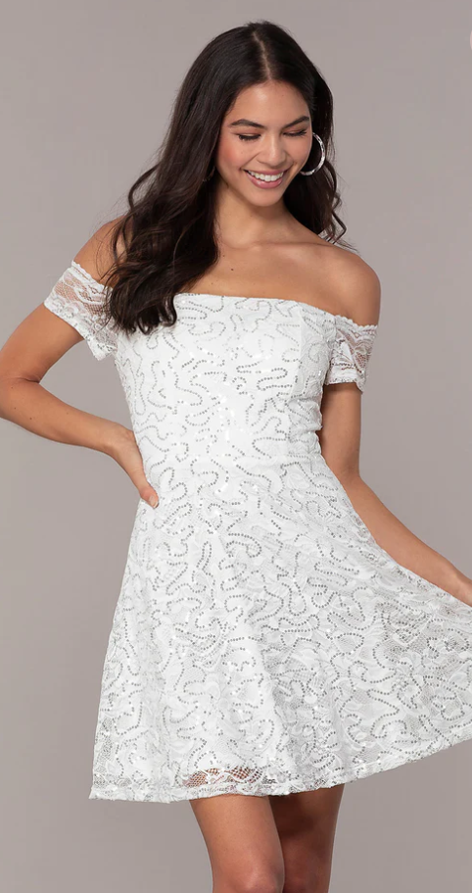
Inappropriate Dresses
Higher than knee length = NO!
High-low is too high in front!
Too short!!
Slit is too high!

Slide 19
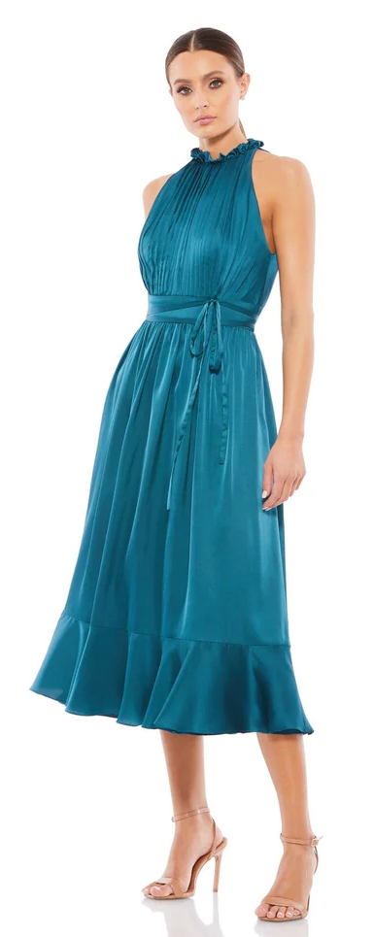
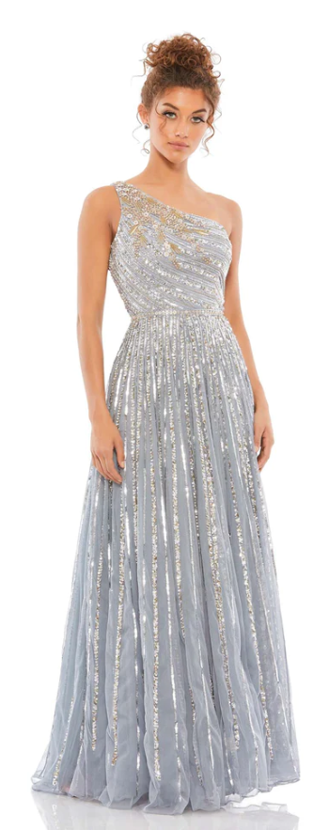
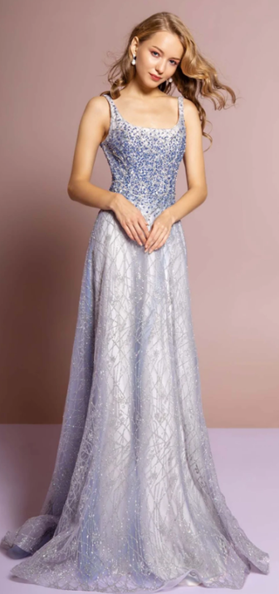
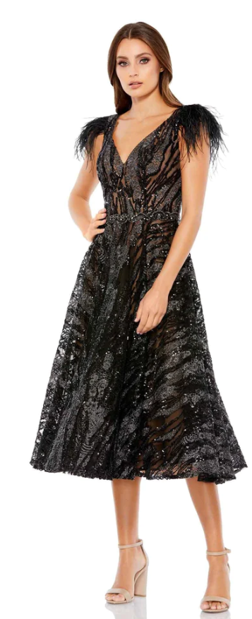
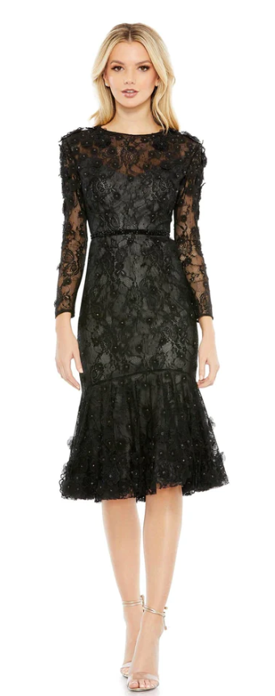
Dresses must fit but not be skin tight or too form fitting.
Appropriate Dresses

Slide 20
Inappropriate Dresses
Too tight = NO!

Slide 21
No bare or sheer midriffs or cutouts.
Two-piece dresses must overlap, even when arms are raised.
No cutouts are permitted.
No nude colored inserts, which give the illusion of skin showing where it should not be.

Slide 22
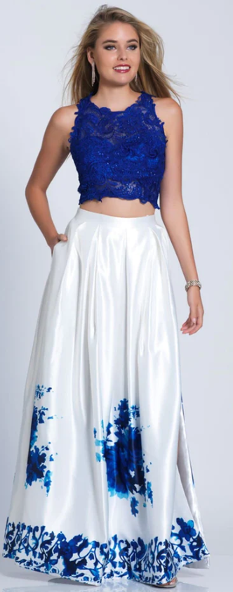
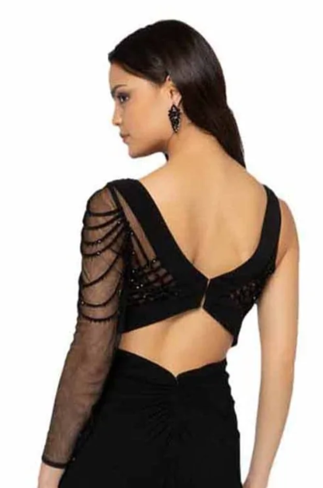
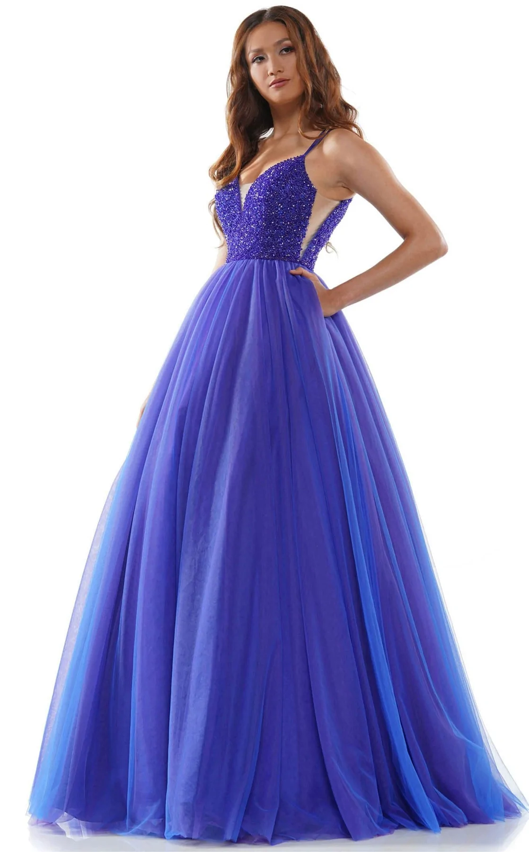
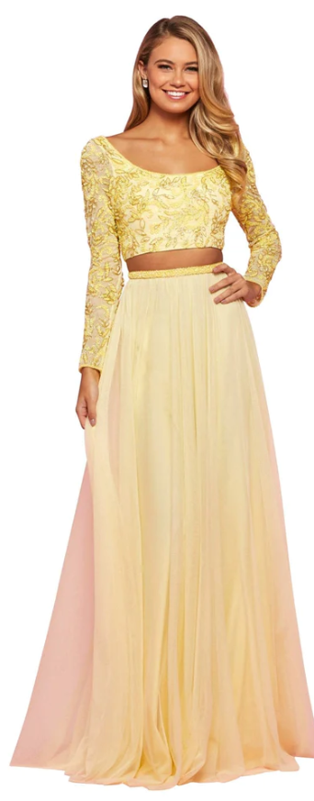
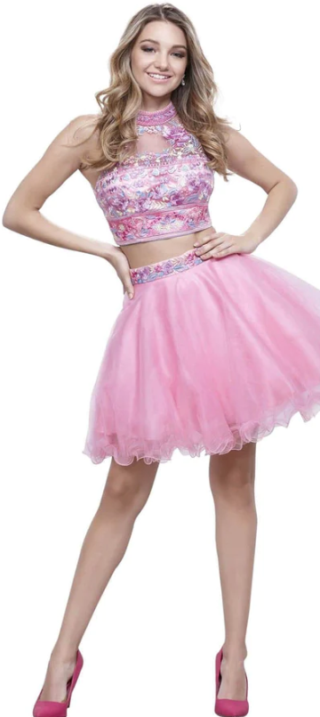
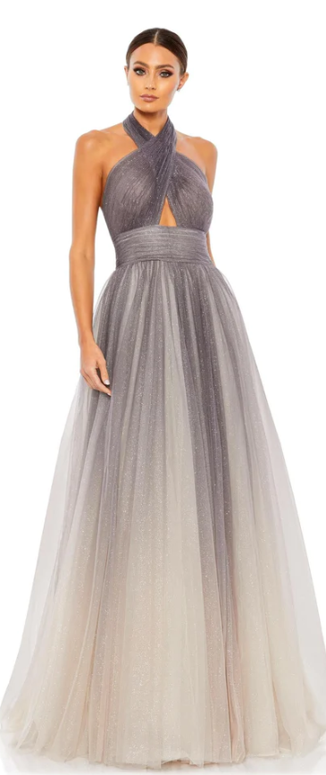
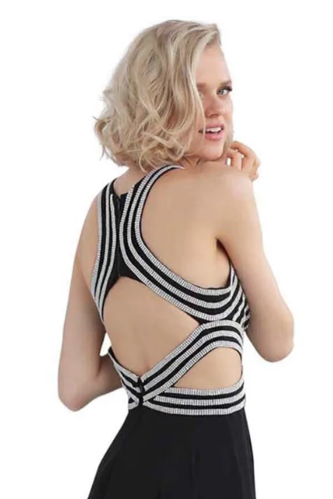
Nude insets = NO!
Bare Midriff = NO!
Cut-outs = NO!

Slide 23
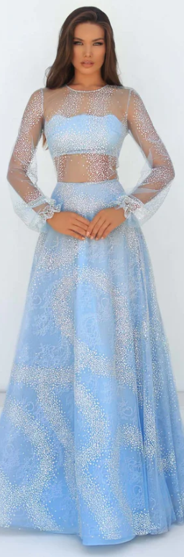
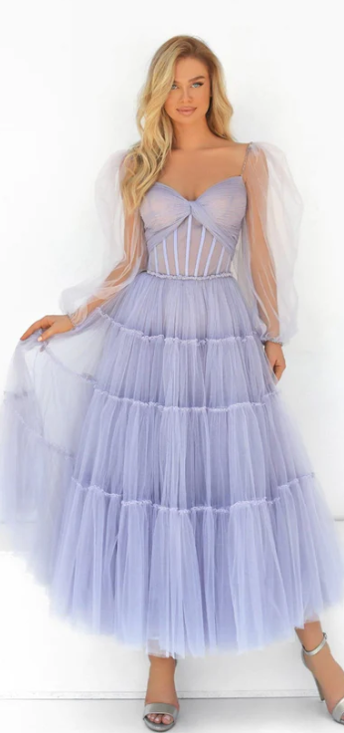
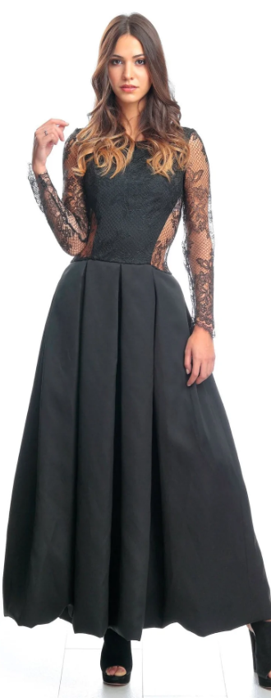
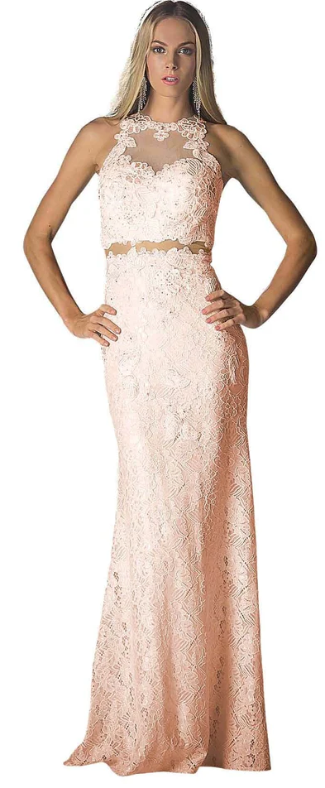
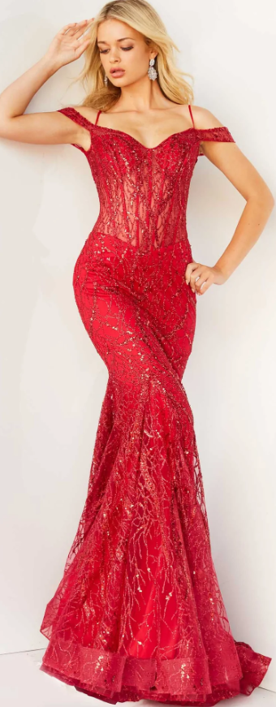
Sheer Midriff or Sheer Cutouts = NO!

Slide 24
Have Fun!
Show Your Personal Style
Make Good Choices!

