Slide 1
Warm Up: Answer in your notebook. Write in complete sentences. Don’t forget your topic sentence!
What would it take to make your world perfect?
What would you be willing to give up to have your world perfect?
Novels & study questions will be given out while you complete the warm up. I will record the number on your book. You must return this book at the end of the unit or pay $ 7.

Slide 2
Anticipation Guide for The Giver by Lois Lowry
Students will stand up by their desks if they agree with each statement. Think carefully.
An ideal community would not have any hunger or starvation.
An ideal community would not have any jealousy or competition.
An ideal community would not have any unemployment.
All children should have equal possessions and privileges at a certain age, regardless of the status of their families.
Families are much closer when they share their feelings.
con’t next slide

Slide 3
Con’t Anticipation GUide
6. Life would be better and easier if we did not carry bad memories in our heads.
7. Overpopulation is such a problem that families should not be allowed to have more than two children.
There is no real need to learn about world history.
There is no real need to learn about one’s own family history.
One’s job or occupation in life should be a careful match to one’s interests, talents, and skills.

Slide 4

Study the book cover Note: Do not answer if you have already read the book.
What do you think the title, The Giver, means?
Look at the picture on the front cover:
Describe the man.
What does the expression on his face indicate?
What do you think the torn photo means?

Slide 5
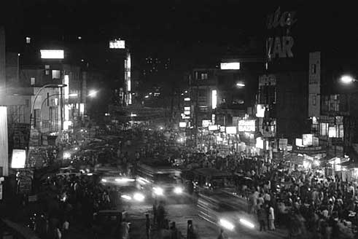
The Giver
L o i s L o w r y
Biography
About Her Writing
Book Reviews

Slide 6
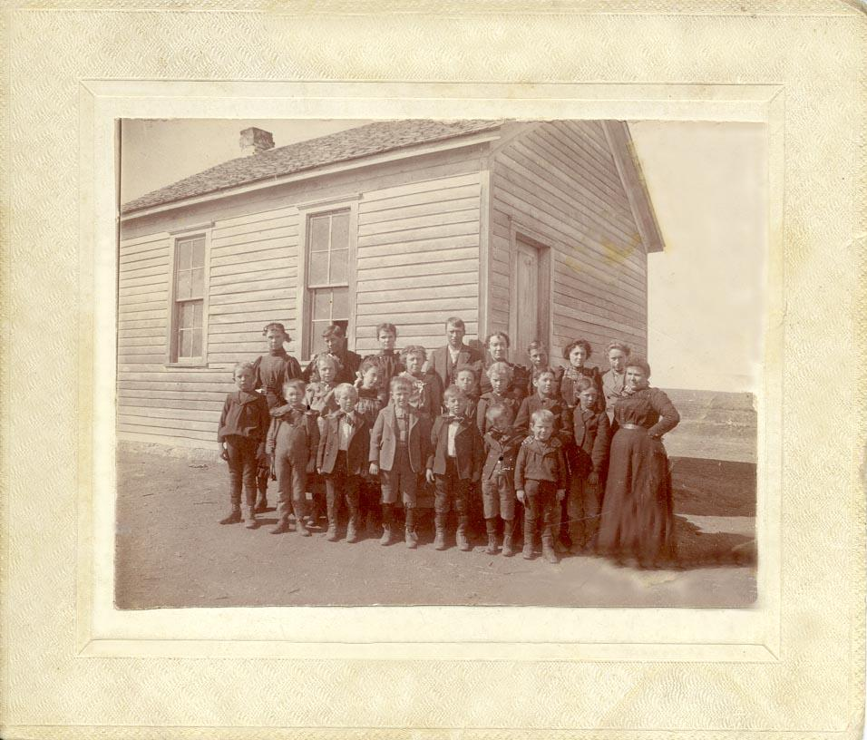
Biography Lois Lowry
Birthplace: Hawaii
Birth Date: March 20, 1937
Parents: Robert & Katherine Hammersburg
Education: Brown University,
University of Southern Maine
*
Her father was in the Army so her family moved around a lot. Lois has lived all around the world.

Slide 7

Biography
L o i s L o w r y
She married after her sophomore year at Brown and had four children. They settled in Maine where she finished her degree at USM. She is currently divorced living in West Cambridge with her dog, Bandit.

Slide 8

About Her Writing
L o i s L o w r y
“She fulfilled a childhood dream when she began writing in the mid-1970’s”
She’s an author of over 20 books for young adults including those in the popular Anastasia Krupnik series.
Twice the winner of the Newbery Medal

Slide 9

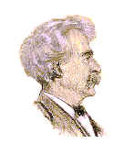
About Her Writing
L o i s L o w r y
“She fulfilled a childhood dream when she began writing in the mid-1970’s”
Winner of the Dorothy Canfield Fisher Award.
Winner of the Boston Globe – Horn Book Award.
Winner of the California Young Reader’s Medal.
Winner of the Mark Twain Award.
Over 5 million copies of The Giver sold
The Giver has been translated into 29 languages.

Slide 10
L o i s L o w r y
About Her Writing
“
She has tackled a number of topics in her literature including adoption, mental illness, cancer, the Holocaust and futuristic societies. Whatever the theme, Lowry portrays realistic life experiences to her audience.

Slide 11
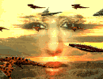
L o i s L o w r y
About Her Writing
“She fulfilled a childhood dream when she began writing in the mid-1970’s”
In her books, Lois Lowry throws her characters and readers into many thought-provoking situations.

Slide 12

Book Reviews
L o i s L o w r y
“Lowry is once again in top form – raising many questions while answering few, and unwinding a tale fit for the most adventurous readers.”
Publishers Weekly
February 15, 1993

Slide 13
L o i s L o w r y
Book Reviews
“…The Giver, a powerful and provocative novel, is sure to keep older children reading and thinking!”
Karen Ray of the
New York Times
October 26, 1993

Slide 14


Bonus Question?
What was
Lois Lowry’s
Dog’s name?

Slide 15

Bonus Answer!
Bandit!

Slide 16

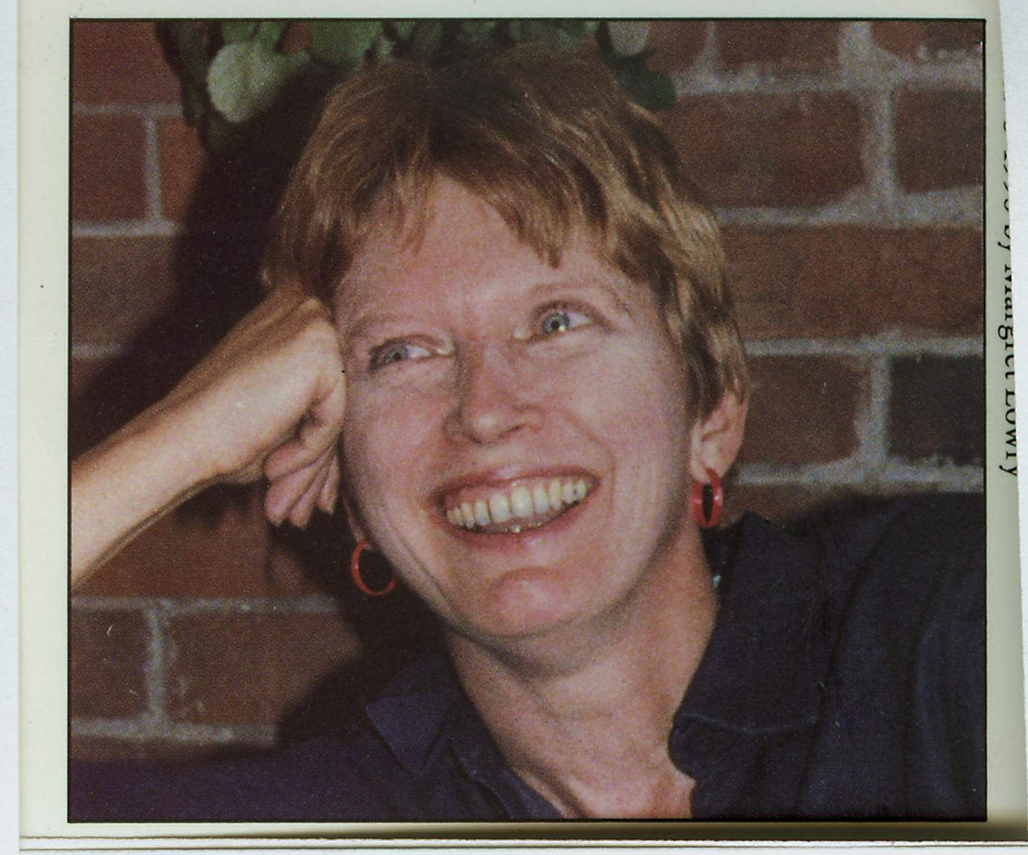
L o i s L o w r y
Once readers make contact with Lowry’s treasure, they may never see things exactly quite the same.

Slide 17
What is a utopia?
Utopia is a perfect place where people can lead perfect lives. The Giver takes place in such an ideal community.

Slide 18
Here are other utopias that people have described or written about through the ages.
The Golden Age
The Garden of Eden
Atlantis

Slide 19
Utopia is A Greek Term
The word utopia was derived from the Greek ou topos, which means “no place.”
Some synonyms for utopia are paradise, arcadia, and Zion.

Slide 20


Slide 21
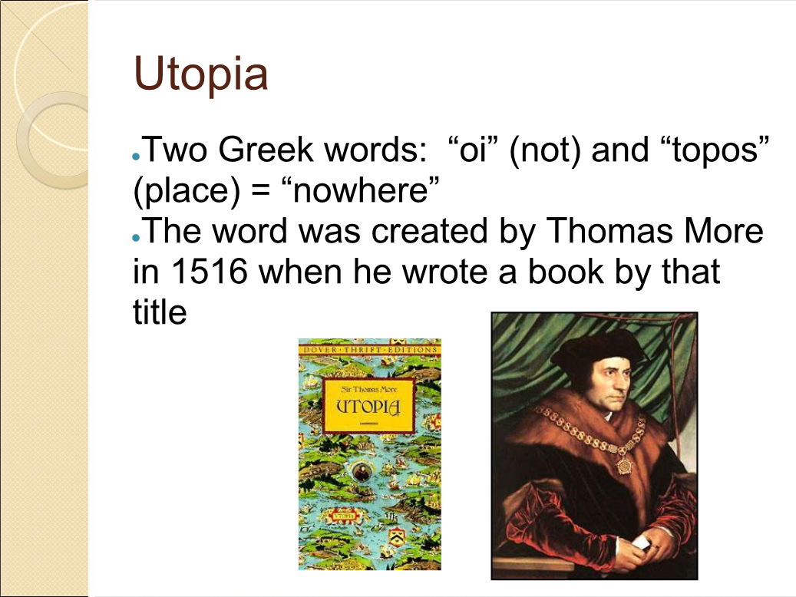

Slide 22
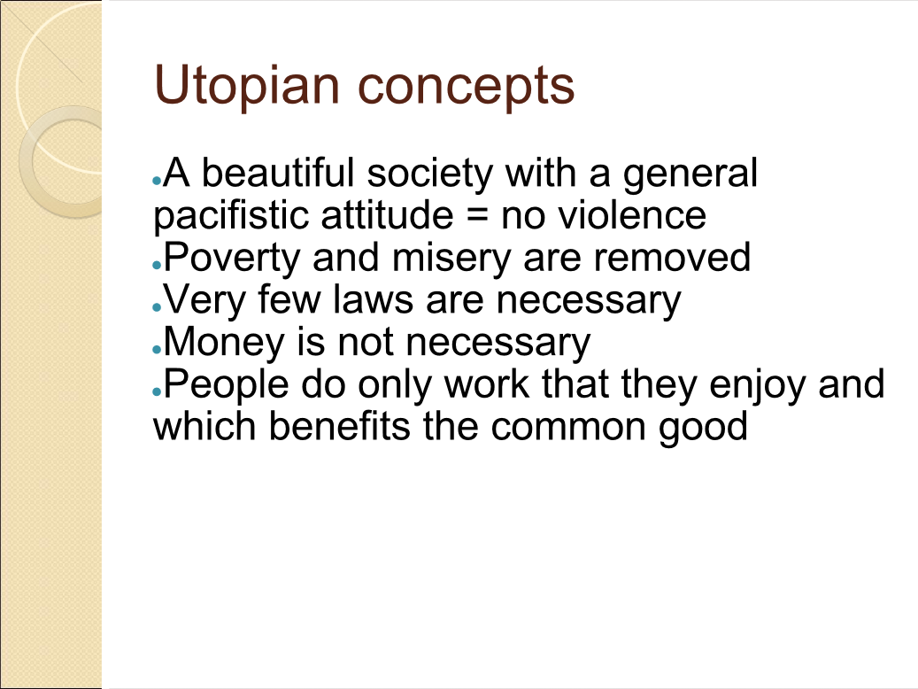

Slide 23
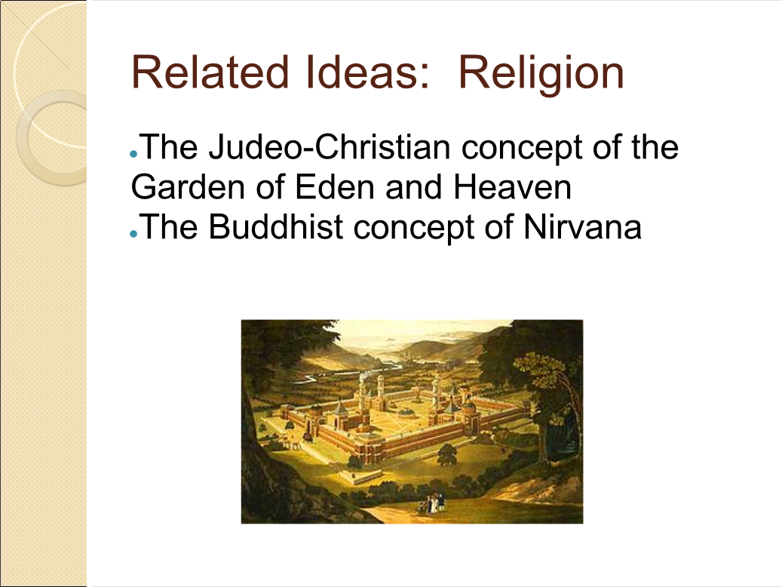

Slide 24
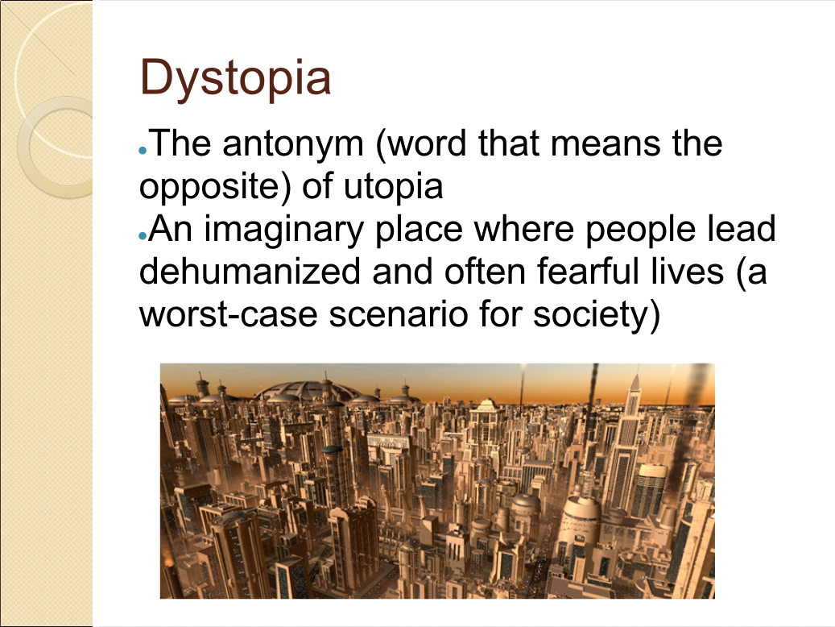

Slide 25
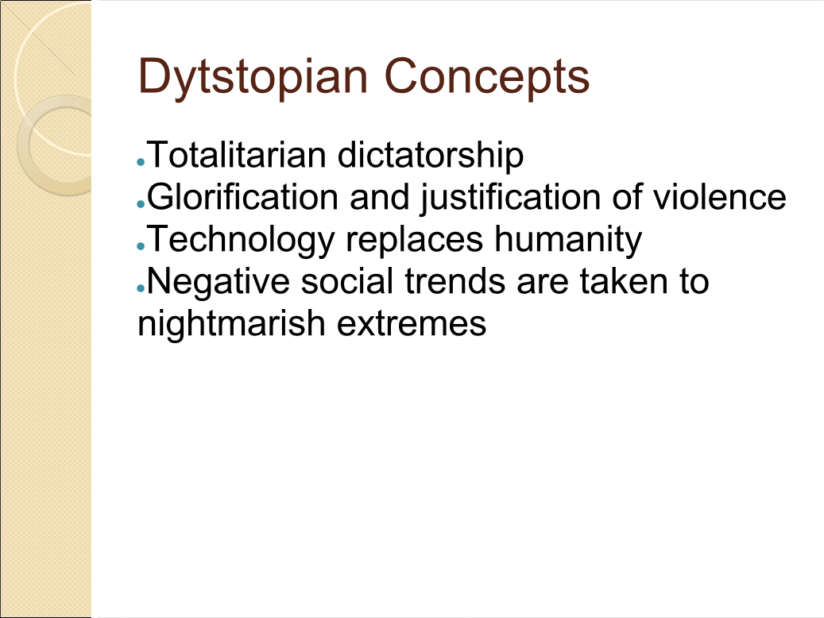

Slide 26
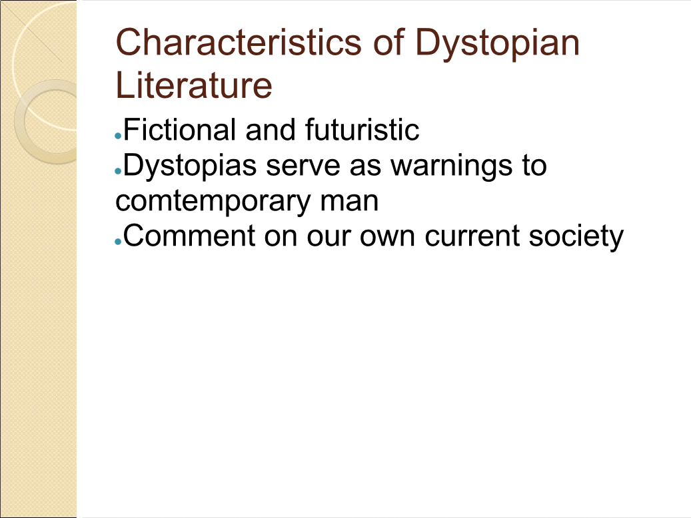

Slide 27
Think while you read.
Is the society in The Giver a utopia or a dystopia?

Slide 28
Watch out tone & Mood are similar.
Tone is the author’s attitude toward the writing (his characters, the situation) and the readers. A work of writing can have more than one tone. An example of tone could be both serious and humorous. Tone is set by the setting, choice of vocabulary and other details.
Mood is the general atmosphere created by the author’s words. It is the feeling the reader gets from reading those words. It may be the same, or it may change from situation to situation.

Slide 29
Words that describe Mood
Fanciful Sentimental
Melancholy Happy
Frightening Sorrowful
Mysterious Joyful
Frustrating Suspenseful
Romantic Gloomy

Slide 30
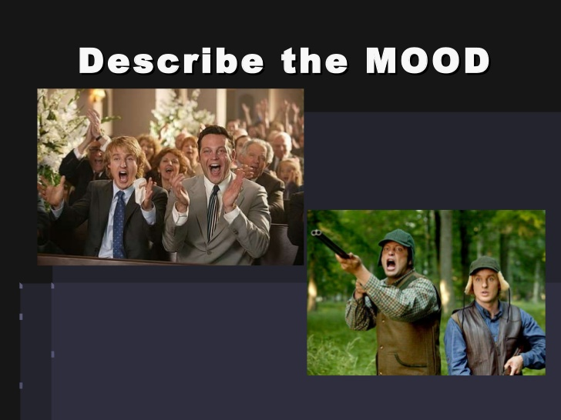

Slide 31


Slide 32
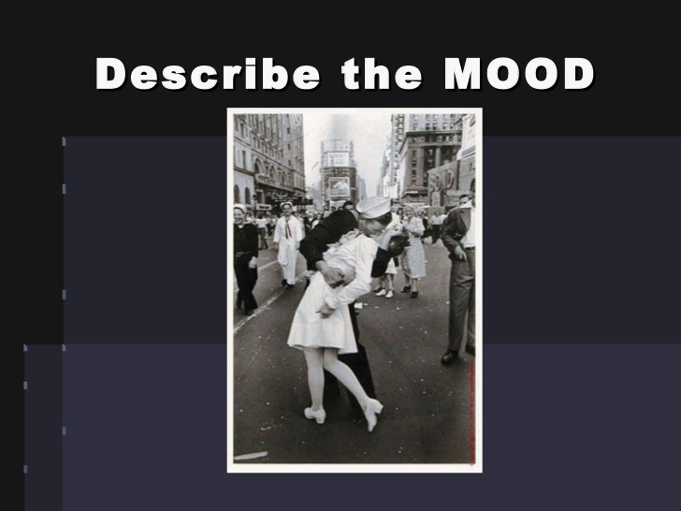

Slide 33
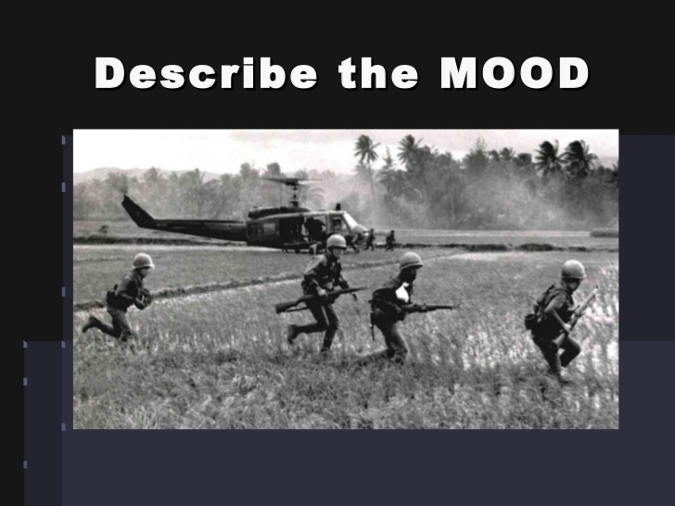

Slide 34
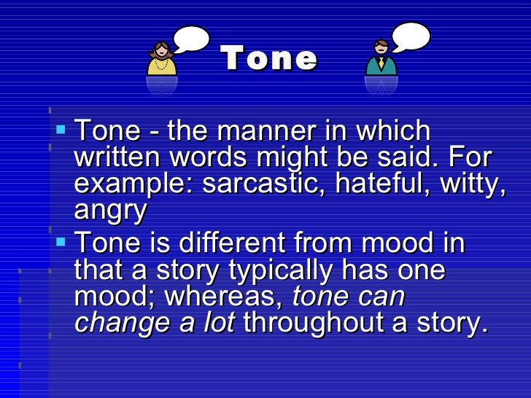

Slide 35
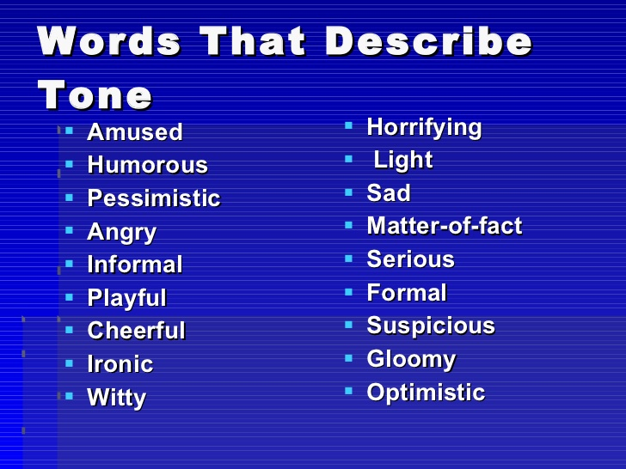

Slide 36
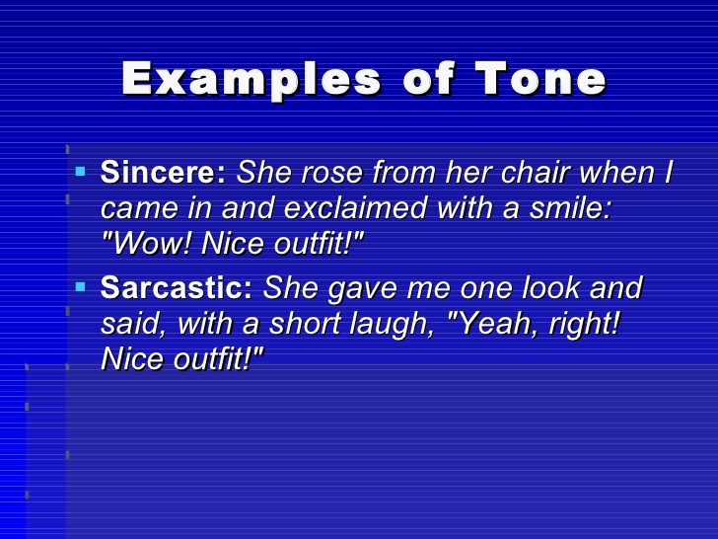
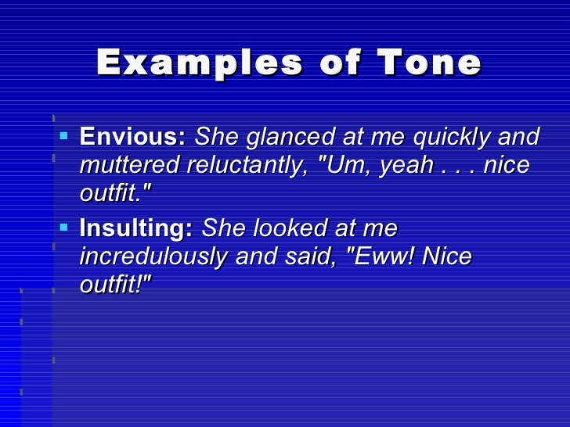

Slide 38
Let’s read the first nine paragraphs of chapter one of The Giver. Pay attention to the author’s tone and the mood of the writing.
After reading:
What is the hook the author uses to get your interest?
What is the author’s tone?
How does the story make you feel? (mood)
Homework: Read chapters 1 & 2. Answer study questions for these chapters in your notebook.

