Slide 1
The Boy in the Striped Pajamas
By: John Boyne

Slide 2
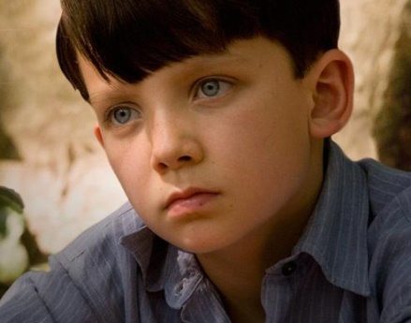
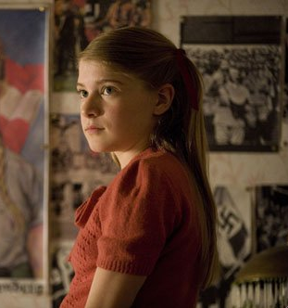
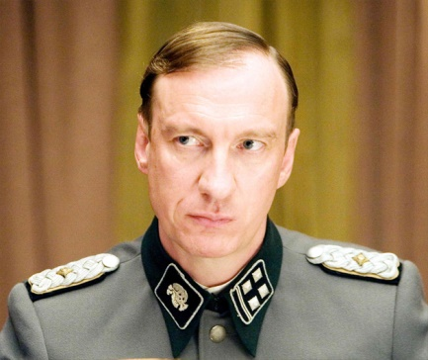
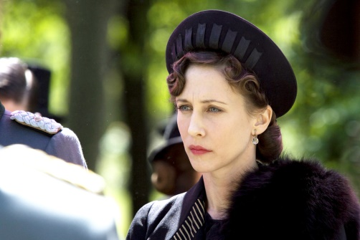
The Characters
Bruno- 9 year old boy from Berlin
Gretel- Bruno’s 12 year old sister
Father- Bruno and Gretel’s dad who is a commandant in the military (he’s the boss)
Mother- Bruno and Gretel’s mother

Slide 3
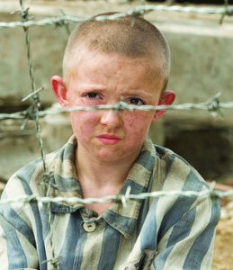
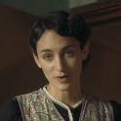
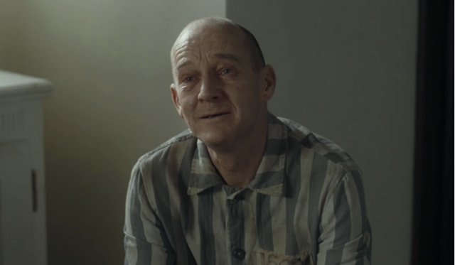
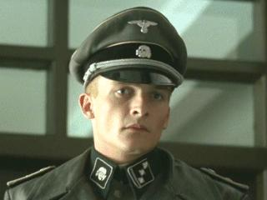
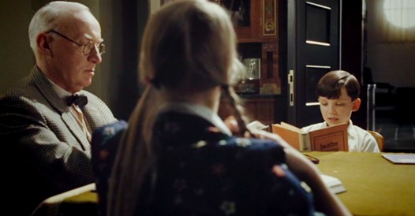
Shmuel- A Jewish boy who lives in the camp and Bruno becomes friends with
Maria- the family’s maid
Pavel- A man from the camps who waits on the family during dinner
Lieutenant Kotler- A mean soldier who Bruno does not like and Gretel has a crush on
Herr Liszt- The family teacher for Bruno and Gretel

Slide 4
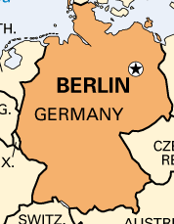
Chapter 1: Bruno Makes a Discovery
Bruno came home from school to find Maria packing up everything in his room. He asks Mother what is going on and she tells him they all must leave his house in Berlin and move to another one far away.

Slide 5
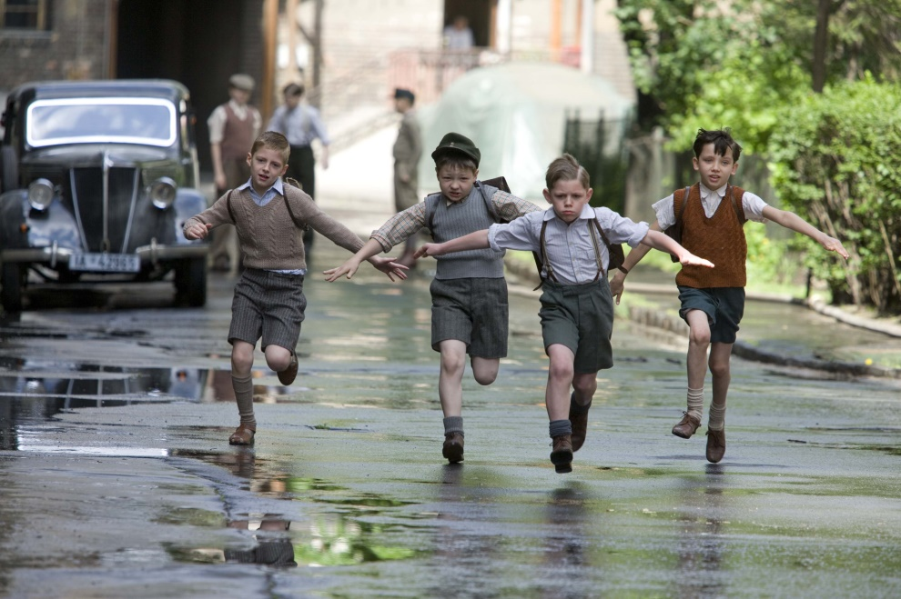
Father needs to move for his job and they all must go with him so he is not lonely. Maria will go with them too. Bruno will have to go to a new school and he has to say goodbye to his friends, and this makes him sad.

Slide 6

Chapter 2: The New House
They arrive at the new house and Bruno does not like it. The house is small and there is no one for him to play with. He asks Mother if they can go back to the other home but she says that is not allowed. Bruno is mad Father’s job took away the big house and his friends.

Slide 7

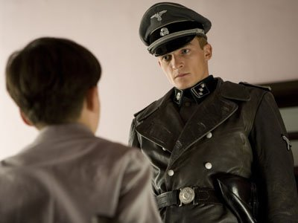
Bruno goes upstairs to help Maria unpack, and a young blonde soldier walks through his room. After, Bruno finds a window in the corner of his room and he looks out. He cannot believe what he sees.

Slide 8
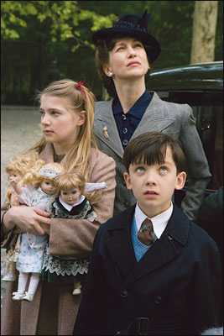

Chapter 3: The Hopeless Case
Bruno talks about how Gretel is sometimes mean to him because she is older, and he is short for his age. When he goes into her room, she says she does not like the new place either. She tells Bruno the new place is called Out-With.

Slide 9
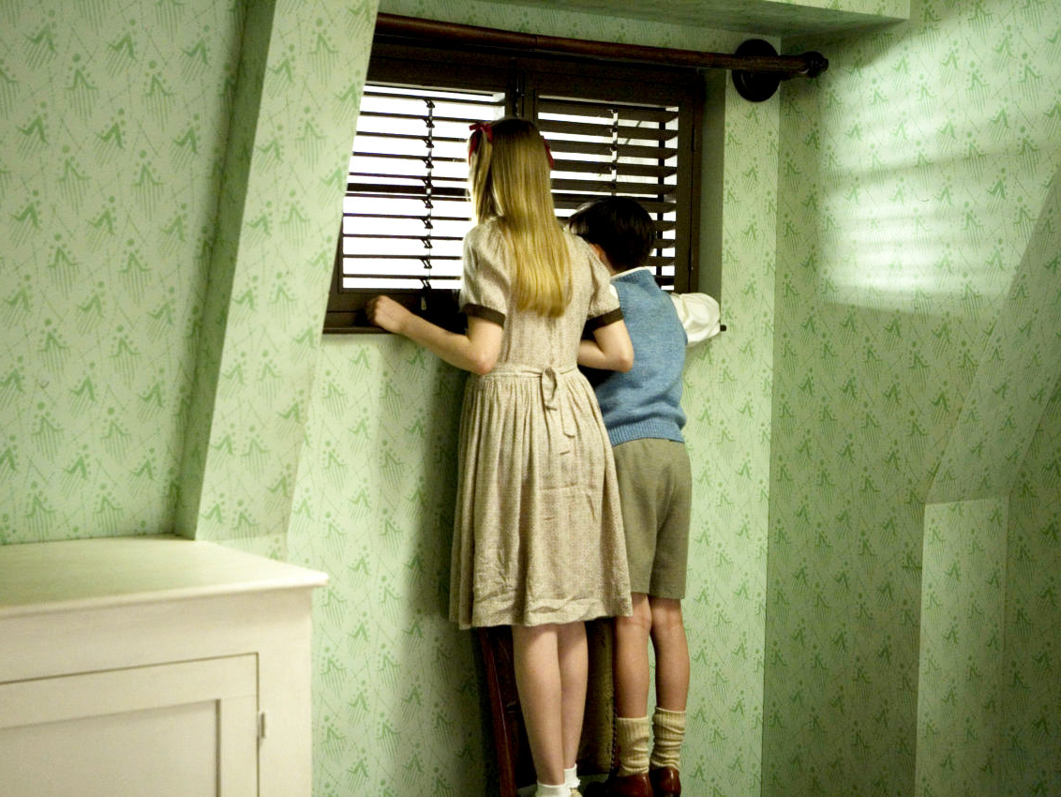
Then, Bruno shares with Gretel how he saw children when he looked out the window in his room. They walk back to his room so he can show her. They look out his window together. When she looks out she sees what her brother was talking about.

Slide 10

Chapter 4: What They Saw Through the Window
When Bruno and Gretel look out the window, it is not just children they see, but big boys, fathers, and grandfathers too. They are all stuck behind a huge wire fence that is so long you could not see where it ended with your eyes.

Slide 11
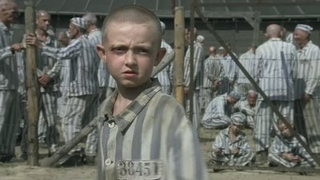
Behind the fence are square buildings, smoke stacks, and sandy fields. Bruno notices all the people are getting yelled at by soldiers that are just like Father. All the people have on grey striped pajamas.

Slide 12
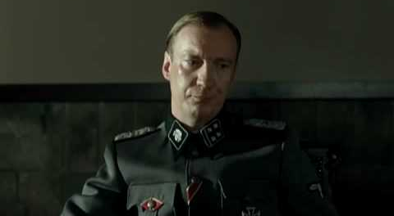
Chapter 5: Out Of Bounds At All Times And No Exceptions
After they are settled in the new house, Bruno tries to talk to his Father. He has not seen Father since they moved. He goes to his office and knocks on the door because he is not allowed in. Father lets him inside and asks Bruno if he likes it here. Bruno says no.

Slide 13
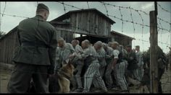
Father tells Bruno he needs to do what is best for everyone and be happy at Out-With. Then, Bruno asks Father about the people on the other side on the fence. Father says not to worry about them, they do not matter.

Slide 14
Chapter 6: The Overpaid Maid
After complaining to Father, Bruno goes to Maria about how much he does not like Out-With and calls Father stupid. Maria tells Bruno he should never call Father that because he is a good man and he gave her a job, a home, and food.

Slide 15
Maria explains to Bruno how when her mother died, Father took care of her. It makes Bruno realize she has a life and feelings of her own. Bruno then tells Maria how he had thought of running away. She tells him that it is not a good idea and he should stay.

Slide 16
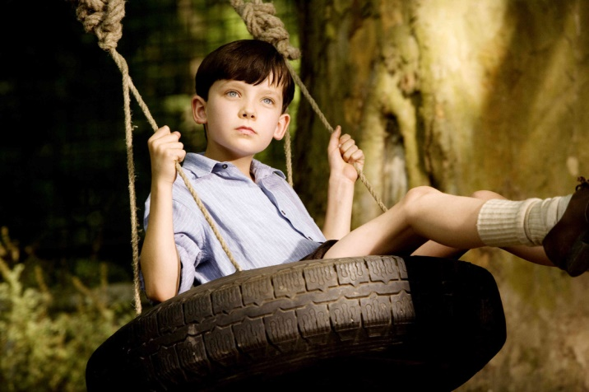
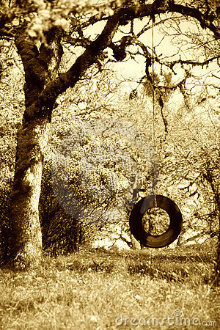
Chapter 7: How Mother Took Credit For Something That She Hadn't Done
Bruno is very bored one day so he decides to build a tire swing. Pavel helps him find a tire and Bruno puts it together himself. He swings too high though and falls off and hurts himself. Pavel sees this happen and brings Bruno inside to clean him up.

Slide 17
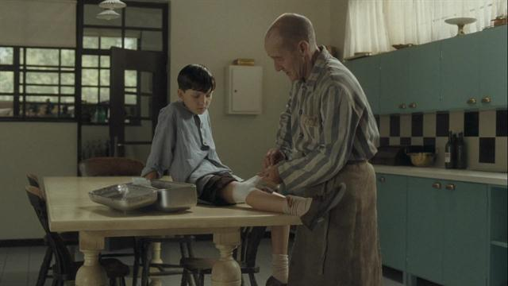
Pavel cleans up the wound and Bruno asks him how he knows he will be okay. Pavel tells him he was a doctor before he came here. Then, Mother came home and Bruno told her what happened. She says if Father asks they must say Bruno cleaned up the wound, not Pavel.

Slide 18

Chapter 8: Why Grandmother Stormed Out
Bruno talks about how he misses his grandparents a lot because they did not come to Out-With. Grandmother was mad at Father for joining the Nazi Party, so Bruno has not seen her. He did not get to say bye to her before they came here.

Slide 19
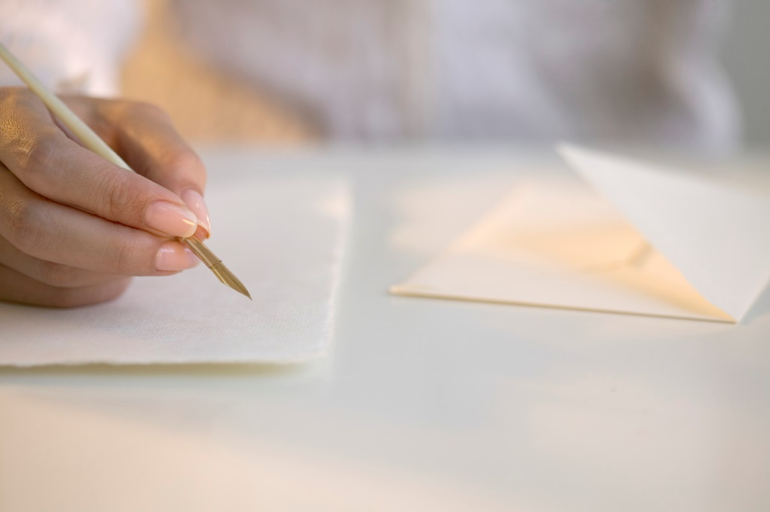
Since he did not get the chance to say bye, he writes his grandparents a letter. Bruno tells them how much he misses them and all about how much he does not like his new home. He also tells them everything he sees when he looks out his window.

Slide 20
Chapter 9: Bruno Remembers That He Used to Enjoy Exploration
After a few weeks, Father decides that Bruno and Gretel should have a tutor so they can continue studying. The tutor, Herr Liszt, tells Bruno geography and history are more important than his favorite subjects of reading and art. This makes Bruno a little upset.

Slide 21
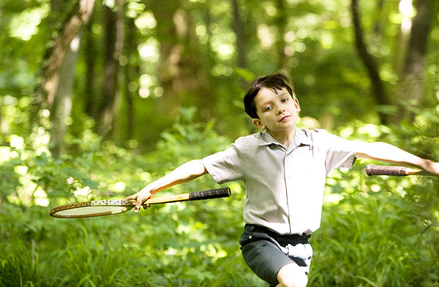
After classes were over, Bruno decides to explore what was near the other side of the fence. He knew Mother and Father would not want him over there, but he missed exploring. Bruno wanted to go on an adventure.

Slide 22
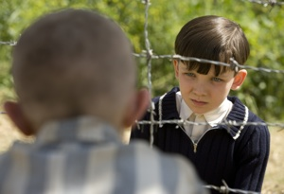
Chapter 10: The Dot That Became A Speck That Became A Blob That Became A Figure That Became A Boy
Bruno walks along the fence and realizes he cannot get in anywhere. He was going to go back home until he meets a boy his age name Shmuel. He is very skinny and has a grey face. They sit down and talk and Bruno is happy he made a new friend.

Slide 23
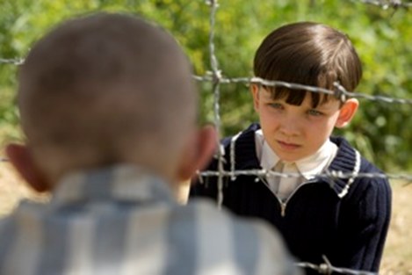
They ask each other a lot of questions and they realize they have the same birthday. Bruno wishes he could come inside the fence so they could play. Shmuel says he would not want to. Bruno asks him why there are so many people on his side and what they are doing there.

Slide 24
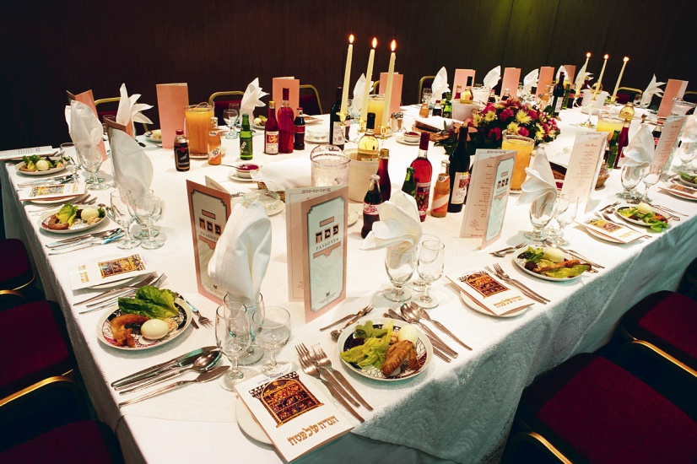
Chapter 11: The Fury
Bruno talks about The Fury (head of country) coming for dinner a few months before coming to Out-With. He says how him and Gretel had to get dressed up and there was no playing in the house. They had to greet The Fury when he arrived, but he was rude.

Slide 25
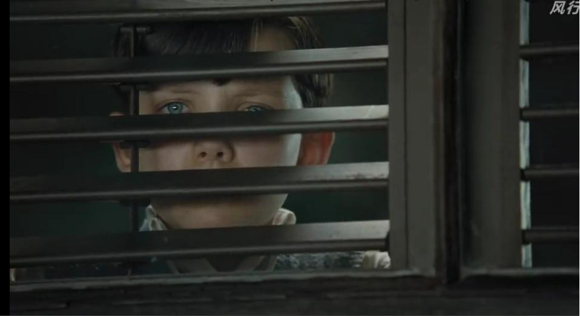
After The Fury had dinner to talk with Father about his job, he left. Bruno could hear conversations between his parents about them leaving Berlin. A few days later he came home to find Maria packing up his clothes.

Slide 26
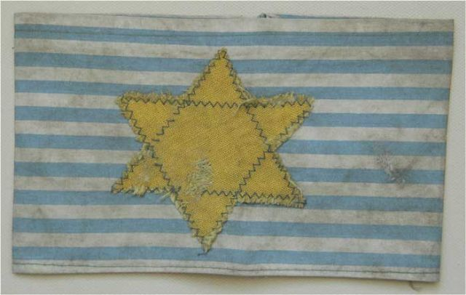
Chapter 12: Shmuel Thinks Of An Answer To Bruno's Question
Shmuel shows Bruno the armband he has to wear. He tells him how soldiers came and got his family and put them on trains. It was horrible because there was so many people on one train that he could not breath and it smelt bad.

Slide 27
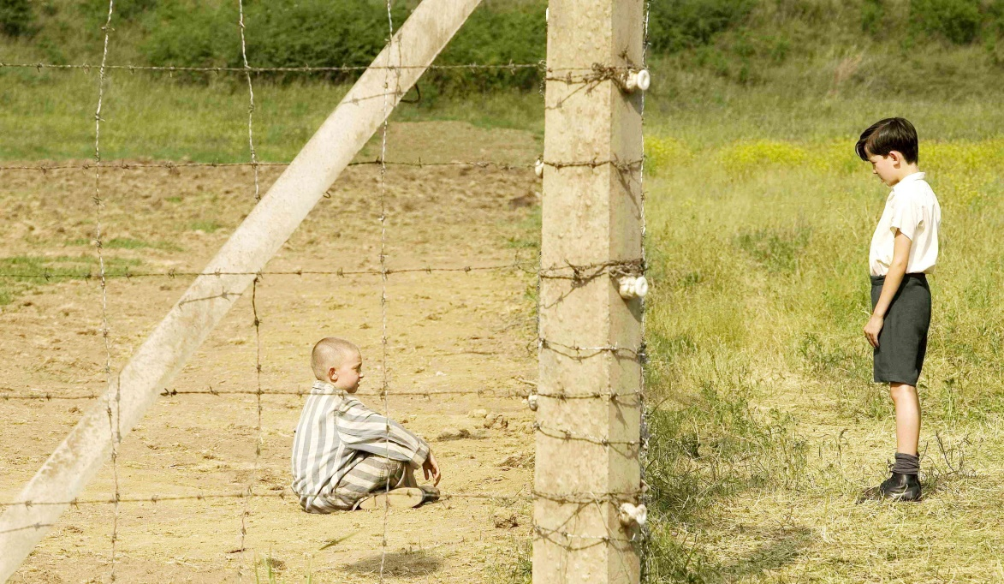
When the trains stopped they had to walk to the camps. Shmuel never saw his mother again. He then asks Bruno for some food. Bruno did not have any, but he says Shmuel should come eat dinner at his house some time. Shmuel says he must go and ran off.

Slide 28
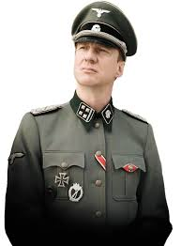
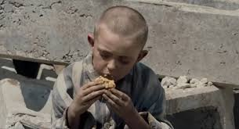
Chapter 13: The Bottle Of Wine
After some time, Bruno starts to like living at Out-With and visits Shmuel every day after class. He brings him food and they talk about the camp and the soldiers. Shmuel says there are no good soldiers. Bruno says Father is a good soldier though.

Slide 29
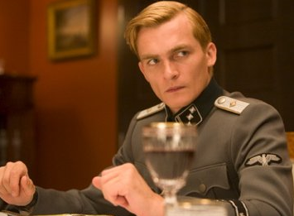
When Bruno gets home, Lieutenant Kotler joins them for dinner. Bruno notices how weak Pavel is getting. When serving wine to the Lieutenant, Pavel’s hand slips and gets wine all over the Lieutenant. He gets very angry and screams at Pavel. This is very scary for Bruno to see.

Slide 30
Chapter 14: Bruno Tells A Perfectly Reasonable Lie
For the next few days, Bruno goes to see Shmuel like usual. On a very rainy day, he could not go out in the field so he went to Gretel’s room. He accidentally tells her he missed seeing Shmuel and Gretel wonders who Shmuel is.

Slide 31
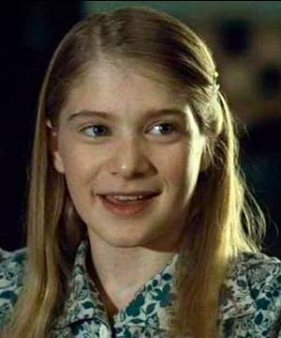
To keep his friend a secret, Bruno lies and tells Gretel Shmuel is an imaginary friend. This makes Gretel laugh, but Bruno tells her about all of their talks. He missed going to see Shmuel that day.

Slide 32
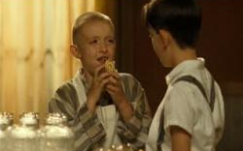
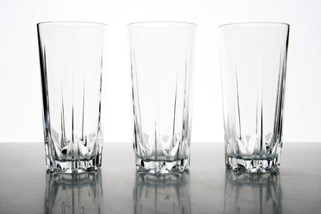
Chapter 15: Something He Shouldn't Have Done
One day when Bruno walks into the kitchen, he found Shmuel in there polishing the glasses for Father’s birthday! He gives Shmuel food and he eats it very quick because Shmuel is afraid he would get in trouble.

Slide 33
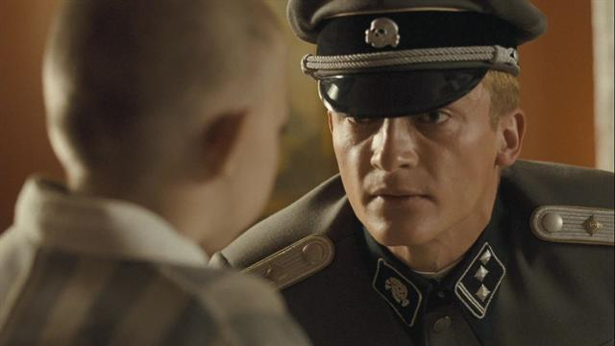
Lieutenant Kotler comes in and sees the boys talking. He notices Shmuel has eaten. Shmuel says he got it from his friend and points to Bruno. Bruno says that he did not give the food to him because he was too scared to get in trouble himself.

Slide 34
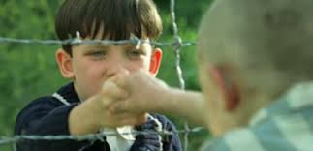
Bruno feels terrible for what he did. Next time he saw Shmuel at the fence, he tells him he is sorry for being a bad friend. Shmuel holds out his hand so he can hold Bruno’s and they shake hands. Bruno knows Shmuel has forgiven him.

Slide 35
Chapter 16: The Haircut
The family gets news that grandmother has died, so they go back to Berlin for the funeral. Lieutenant Kotler has been moved to another camp and Gretel is upset because she liked spending time with him.

Slide 36
Bruno decides to go to Gretel’s room to talk to her. He asks her about the fence again. She tells him those people are Jews and that they do not like them. While they are talking she finds an egg in her hair. Gretel and Bruno find out they have lice. So, Bruno has to get his head shaved.

Slide 37
Chapter 17: Mother Gets Her Own Way
One day, Bruno overhears his parents talking about going back home. Then, Father has him and Gretel come into his office so they can talk about it. He asks them if they were happy at Out-With or if they want to go back home.

Slide 38
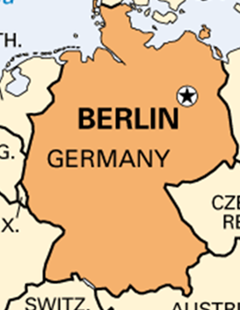
Father does not see Out-With as a place for children anymore. Bruno says there are so many on the other side of the fence though. Father sees that he has been here for too long. Bruno is starting to see things he should not. Father makes the decision for them to go home to Berlin with Mother.

Slide 39
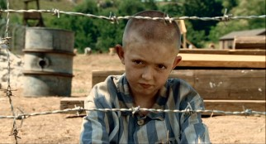
Chapter 18: Thinking Up The Final Adventure
The next day Bruno goes to see Shmuel. He is upset because he cannot find his Papa. Then, Bruno tells him he is leaving and this makes him more sad. Shmuel will not have anyone to talk to anymore.

Slide 40

Bruno says he would still like to climb under the fence to explore. The boys think of a plan where Shmuel will get Bruno a pair of striped pajamas to wear. This way, Bruno will look just like Shmuel. Then they can go exploring together one last time to look for Papa.

Slide 41
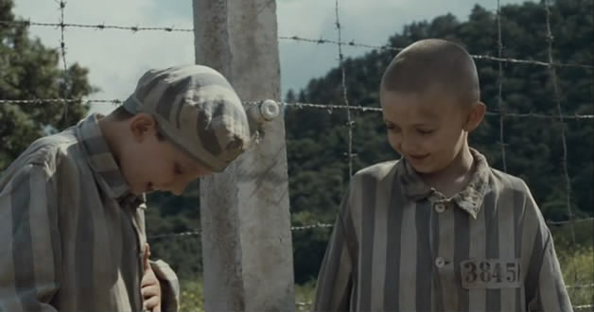
Chapter 19: What Happened The Next Day
The next day Shmuel is waiting at the fence with the striped pajamas. When Bruno gets inside the camp, everyone is sad and getting yelled at by the soldiers. He wants to go home because he thought it would be nicer. He promised Shmuel he would help him find his Papa though, so he stays.

Slide 42
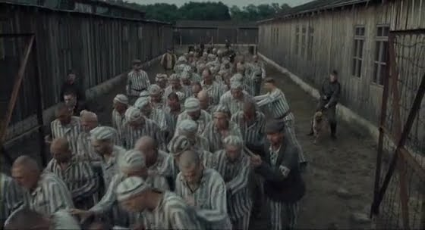
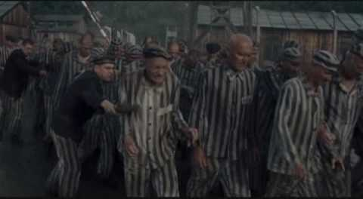
Just as Bruno asks to walk home, the soldiers blow the whistles and it starts to rain very hard. All of the people around are ordered to march into a room. Bruno tells Shmuel he is sorry for not being able to find his Papa.

Slide 43
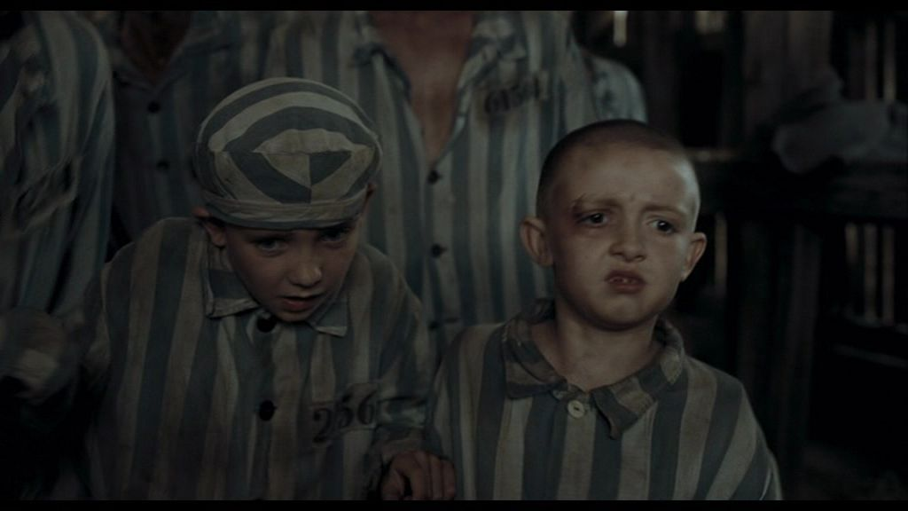
Bruno takes Shmuel’s hand and tells him that he is his best friend. Right after, the door to the room closes and all of the other marchers gasp. The room goes dark and Bruno and Shmuel hold each other close.

Slide 44
Chapter 20: The Last Chapter
After that day, no one could find Bruno anywhere. His family was so sad, they cried every day. The soldiers went out to look everywhere for him. His clothes were found by the fence where he left them. Father realized Bruno snuck under the fence and was killed in the camp.

Slide 45
Themes
Friendship
Bruno and Shmuel wanted a friendship even though they lived in completely different worlds. They kept it a secret so no one would find out. They cared for each other. It shows how important it is to have friendship during childhood.

Slide 46
2. Innocence of Childhood
Bruno was too young to understand what was really going on in the camps. Shmuel was too young to realize how terrible he was being treated. Children should not be taken advantage of and lied to just because they are younger.

Slide 47
3. Inequality
The characters were all not treated the same or fairly. Some were lied to, like Bruno. Some were physically hurt, like Shmuel and the others in the camp. It sent the reader the message that you should treat others the way you want to be treated.

Slide 48
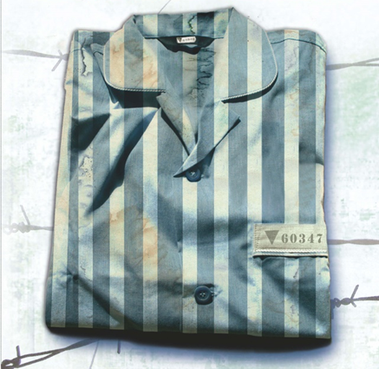
Tactile Objects
(These are objects or items that can be given to the student while they are reading or after they are done.)
Striped Pajamas
The teacher can find a pair of pajamas that are similar to these so the student can visually see what Shmuel was wearing.

Slide 49
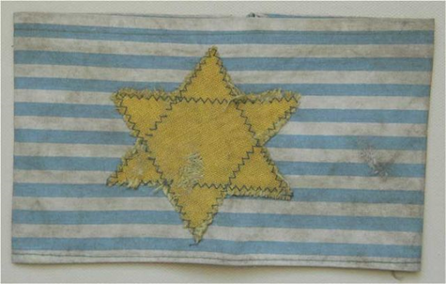


Armband
Teacher can either try to find an armband, which may be difficult, or recreate a simple one out of fabric.
Jewish Star and Nazi Symbol
Have printouts of these labeled for the student to have in front of them while reading so they do not get confused between the two.

Slide 50
Resources for Pictures
www.lavenderfieldsonline.com
http://yourcinematicsurvivalkit.wordpress.com/2010/02/16/the-boy-in-the-striped-pajamas/
http://www.glogster.com/benjam1n/the-boy-in-the-striped-pajamas/g-6l1u04hisof7rluu3ikr9a0
http://theboyinthestripedpajamas.wikia.com/wiki/File:Bruno%27s_Father.jpg
http://jyothsnay.wordpress.com/2009/03/27/the-boy-in-the-striped-pajamas/
http://www.aceshowbiz.com/still/00003224/tbitsp08.html
http://boyinthestripedpajamas.weebly.com/maria.html
http://boyinthestripedpajamas.wikia.com/wiki/Lieutenant_Kotler
http://boyinthestripedpajamas.wikia.com/wiki/File:Pabel.png
http://www.amazon.com/Striped-Pajamas-Young-Readers-Choice/dp/0385751532
http://kids.britannica.com/elementary/art-170143
http://www.law.uwa.edu.au/research/ccr/seniors-downsizing-on-their-own-terms-research-project
http://forum.xcitefun.net/the-boy-in-the-striped-pyjamas-t36938.html
http://www.clipartlord.com/free-window-clip-art-3/
http://www.telegraph.co.uk/culture/film/3559459/Vera-Farmiga-rare-breed.html
http://www.aceshowbiz.com/still/00003224/tbitsp31.html
http://www.glogster.com/hhliu/haihao-the-boy-in-the-striped-pajamas-book-review/g-6nsj0v3qe3basdcueqcsc9k
http://www.glogster.com/vinvin18/poster-glog-by-vinvin18-the-boy-in-the-striped-pajamas/g-6lb8tphb7gsq93hh7j3ila0
http://therollingpicture.blogspot.com/2012/05/film-review-boy-in-striped-pyjamas.html
http://www.pinterest.com/LauranneWuyts/the-boy-with-the-striped-pyjamas/
http://ianstripedpajamas.weebly.com/brunos-explorations.html
http://www.miramax.com/watch?v=V5eHBrYTp8tfX4C2bdbOlGTYgdFkFKEq
http://www.meh.ro/tag/nazi/page/6/
http://www.rottentomatoes.com/celebrity/asa-butterfield/pictures/14076376/
http://www.damaris.org/film-and-bible-blog/724
http://simwanqingel4221.wordpress.com/2012/09/26/settings-the-boy-in-the-striped-pyjamas/
http://www.epier.com/product.asp?1994354
http://tiffanimaria.wordpress.com/2014/03/31/movie-review-the-boy-in-the-striped-pajamas/
http://www.glogster.com/07dmumaw/the-boy-in-the-striped-pajamas/g-6ku3pdd5kkce9l34mlu4ua0
http://heavenlyrupertfriend.proboards.com/thread/18/rupert-kotler-boy-striped-pyjamas
http://aminaalhalawani98.wordpress.com/2012/06/24/the-boy-in-the-striped-pyjamas/
http://www.ehow.com/how_7157124_remove-cloudiness-drinking-glasses.html
http://www.miramax.com/watch?v=9yMnBrYTqbK6rBar1Q1vYpNw3uEYpb2f
http://theboyinthestripedpajamasproject.weebly.com/friendship.html
http://stemansi.blogspot.com/2013/06/the-boy-in-striped-pyjamas-differences.html
http://www.dvdizzy.com/boyinthestripedpajamas.html
http://galleryhip.com/bruno-from-the-boy-in-the-striped-pajamas-black-and-white.html
https://sites.google.com/site/misskristenshea/climax
http://www.glogster.com/epicsquirrels/the-boy-in-the-striped-pajamas-shmuel/g-6n3bpc2bljcg5v2jdjs8da0
http://anngeneral.wordpress.com/2013/08/02/book-review-the-boy-in-the-striped-pyjamas/
http://www.youthworker.com/youth-ministry-resources-ideas/youth-ministry/11600861/
http://www.gokyuzudergisi.com/boy-striped-pyjamas-cizgili-pijamali-cocuk/

Slide 51

This Adapted Literature resource is available through
The Center for Sensory and Complex Disabilities (CSCD).
The text and graphics are adapted from the original source. These resources are provided for teachers to help students with severe disabilities participate in the general curriculum. Please limit the use and distribution of these materials accordingly.
The College of New Jersey
School of Education Room 102
PO Box 7718
Ewing, NJ 08628-0718
Phone: 609-771-3083 Fax: 609-637-5144
https://njcscd.tcnj.edu

