Slide 1
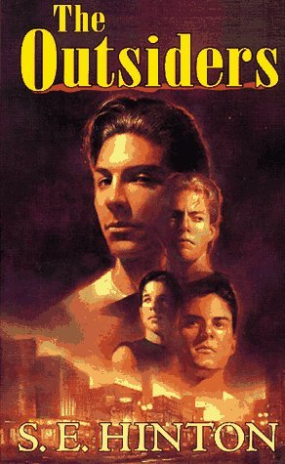
The Outsiders by S.E. Hinton https://www.youtube.com/watch?v=wJnfleLeOZg

Slide 2
Day 1

Slide 3
21: Outsider
(10 lines in 7 minutes)
What does it mean to be an “outsider”? When do you feel like one? Always? In certain situations or groups? Describe your outsider experience.
http://www.youtube.com/watch?v=jYa1eI1hpDE

Slide 4
Round Robin Pre-Reading Reflection Questions
Have you ever felt stereotyped? Do you find yourself stereotyping others?
Is it easier to be a follower or a leader? Explain and give examples.
If one of your friends got him/herself into serious trouble, what would you do to help him/her? Give examples.
Do you believe we have different groups here at school? Do you feel that these groups get along? Explain.

Slide 5
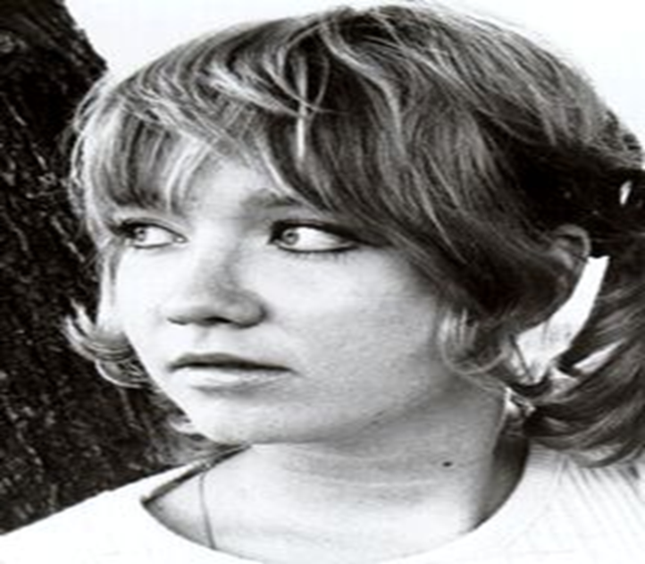
ELA: Summarize the bio, thinking about how life influences art.
Born in Tulsa, Oklahoma in the 1950s
Inspired by class divisions at her high school
Used initials only to cloak her gender
She began writing the book at 15
Published in 1967—this is the book’s 50th anniversary!

Slide 6
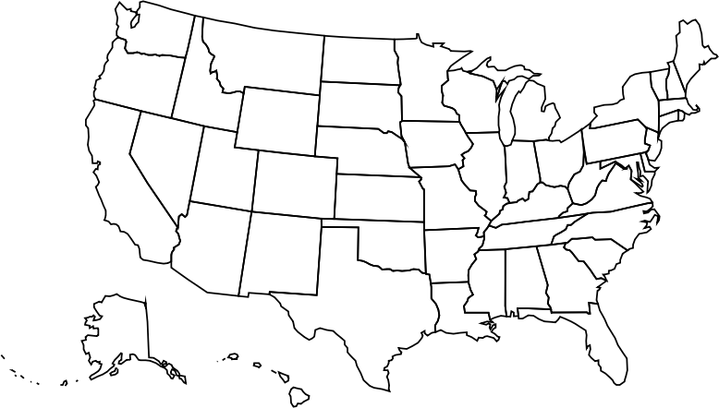
S.E. HINTON
Hinton was born in Tulsa, Oklahoma in 1948.
As a young child, she was an avid reader and would spend her time writing her own stories.
She wanted to
create stories
about the truth
of teenagers (no
sugar coating).
© Presto Plans

Slide 7

S.E. HINTON
At the age of 15, Hinton began writing, inspired by class divisions at her high school, The Outsiders. During her high school graduation ceremony, she was offered a publication contract for the novel. She published the novel under the name S.E. Hinton (instead of Susan Eloise)
because the publishers didn’t
think boys would want to read
a ‘tough’ novel by a female. It
was published in 1967.
© Presto Plans

Slide 8

S.E. HINTON
After the success of The Outsiders, she attended
the University Of Tulsa where she earned a
Bachelor of Science in Education.
In college, she met David Inhofe (her future husband). He was a major influence in her writing her second novel, That Was Then, This Is Now.
© Presto Plans

Slide 9

S.E. HINTON
Susan married David and they had one son who they named Nicholas David.
She wrote a few more books (Tex, Rumble
Fish, Taming The
Star Runner). In
the 1990’s, she focused mainly on children’s picture books.
© Presto Plans

Slide 10
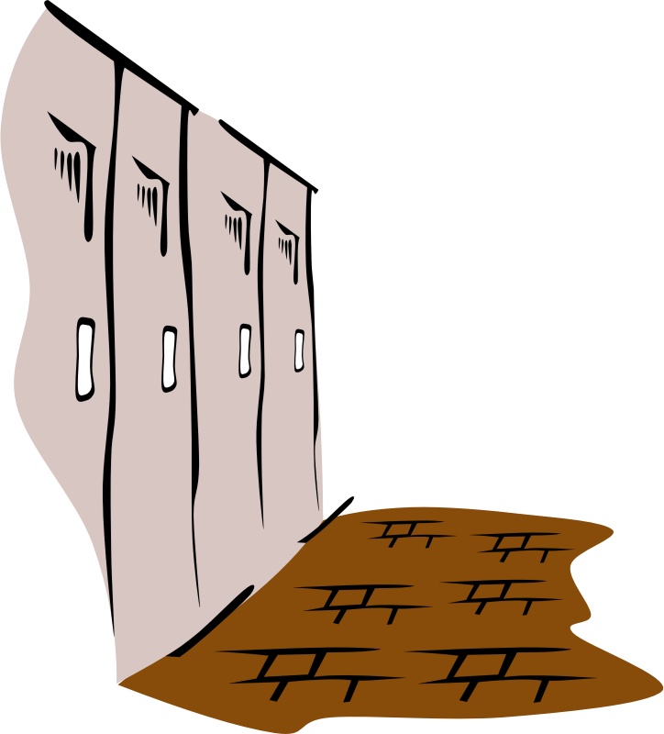
THE OUTSIDERS
The Outsiders was inspired by real-life events at Hinton’s high school in Tulsa, Oklahoma.
This novel is widely
considered the first realistic young-adult novel.
© Presto Plans

Slide 11

THE OUTSIDERS
Many of Hinton’s novels were so successful, they were turned into films
The Outsiders (1983)
That Was Then, This is Now (1985)
Tex (1982)
Rumble Fish (1983).
© Presto Plans

Slide 12

HISTORICAL CONTEXT
The book reflects the social division Americans experienced during the 1960s. Young people were attempting to find their voices and express their political opinions. Race relations were changing dramatically as the Civil Rights Movement drew attention to discrimination against African Americans. Though Hinton does not refer directly to
any historical or political events in her
work, the novel seeks to elevate public
awareness of marginalized groups and to
validate the voices and experiences of
young people.
© Presto Plans

Slide 13


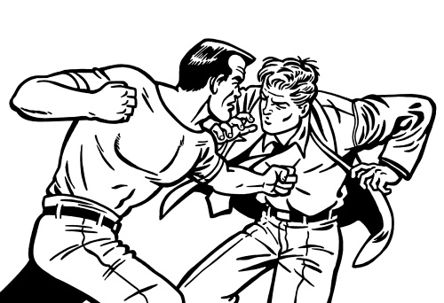

1960s TERMINOLOGY
Below are some words you may encounter in the novel The Outsiders that were popular in the 1960’s
JD = Juvenile Delinquent
The Cooler = Jail
Rumble = Fight
Pickled = Drunk
© Presto Plans

Slide 14


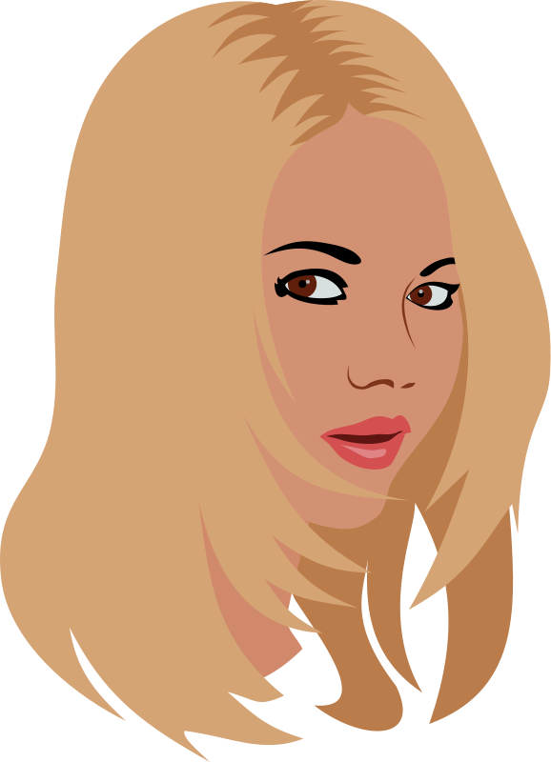

1960s TERMINOLOGY
Below are some words you may encounter in the novel The Outsiders that were popular in the 1960’s
Fuzz = Police
Heater = Gun
Broad = Woman
Hacked Off = Angry
© Presto Plans

Slide 15
Literary Elements: Overview
Genre: realistic fiction
Setting: mid-1960s; Tusla, Oklahoma
POV: first person
Themes:
Class conflict: rich v poor
Social divisions or cliques
Appearance v reality
Honor and loyalty
Isolation and belonging
Loss of innocence
Violence begets violence

Slide 16
Academic Words to Know
Point of view
Tone
Diction
Formal/informal
Voice
Characterization
Character traits
Dynamic
Static
Foil
Flashback
Allusion
Reading Section: label 1 page ACADEMIC VOCABULARY
Internal conflict
External conflict
Plot elements
Exposition
Rising Action
Climax
Falling Action
Resolution
Theme
Symbolism
Imagery
Hyperbole
Metaphor/simile
Personification

Slide 17
Chapter Vocabulary
Chapter 1:
bawl (8)
quivering (8)
unfathomable (10)
rarities (11)
savvy (17)
Chapter 2:
Roguishly (22)
Incredulous (24)
Nonchalantly (25)
Defensively (26)
Chapter 3:
Gallantly (37)
Aloofness (38)
Ornery (39)
Elite (41)
Dumbfounded (42)
Cunning (43)
Chapter 4:
Apprehensive (59)
Defiance (59)
Contemptuously (59)
Ruefully (60)
Premonition (67)
Chapter 5:
Reluctantly (71)
Imploringly (72)
Quavering (74)
Eluded (78)
Indignant (80)
Wistfully (82)
Chapter 6:
Surveyed (86)
Bewilderment (88)
Conviction (89)
Hysterics (96)

Slide 18
Chapter Vocabulary
Chapter 7:
Aghast (112)
Exploits (113)
Manslaughter (108)
Chapter 8:
Numbly (119): to act without feeling
Faltered (121): waver or hesitate
Resemblance (123): likeness
Divert (125): redirect
Doggedly (127): decisively
Chapter 9:
Mortal (134): fatal, leads to death
Grimacing (134): scowl
Conformity (137): obedience to group norms
Leery (139): cautious
Chapter 10:
Stupor (150)
Delirious (150)
Chapters 11 and 12
You pick several words to learn

Slide 19
Chapter Vocabulary: set up 3 pages with this heading
WORD | DEFINITION | OTHER FORMS | SYNONYM/ANTONYM
Set up 3 pages for voc

Slide 20
WORD | DEFINITION
Bawl (8) | I looked away hurriedly, because, if you want to know the truth, I was starting to bawl.
Quivering (8) | I drew a quivering breath and quit crying.
Unfathomable (10) | He liked fights, blondes and for some unfathomable reason, school.
Rarity (11) | In New York, Dally blew off steam in gang fights, but here, organized gangs are rarities. (11)
Savvy (17) | “It’s because you’re the baby- I mean,he loves you a lot. Savvy?”

Slide 21
WORD | DEFINITION | OTHER FORMS | SYNONYM/ANTONYM
Bawl (8) | Cry, weep (v) | Bawling (adj) | S=Howl, Sob A=Whisper, Giggle
Quivering (8) | Trembling (adj) | Quiver (v), quiver (n) | S=Shaky, Weak A=Steady, Composed
Unfathomable (10) | impossible to understand (adj) | Unfathomably (adv), fathom (v) | S=Immeasurable, Profound A=Straightforward, Upfront
Rarity (11) | Something unusual (n) | Rare (adj), rarely (adv) | S= oddity A=regularity
Savvy (17) | Understand (v) | Savvy (noun) | S=know-how, knowledge A=ignorance, unawareness

Slide 22
VOICE : SHORT RESPONSE Remember - tone, point of view, and diction create a voice.
Voice: tone, point of view, and diction (word choice).
Read paragraphs 1-2. The 3 adjectives below describe Ponyboy’s voice. Find 1 piece of evidence to support each of these adjectives. A piece of evidence may be just a few words.
Youthful
Colloquial (informal, casual, conversational)
Perceptive (observant, notices things that others don’t)

Slide 23
WHEN I STEPPED OUT into the bright sunlight from the darkness of the movie house, I had only two things on my mind: Paul Newman and a ride home. I was wishing I looked like Paul Newman--- he looks tough and I don't--- but I guess my own looks aren't so bad. I have light-brown, almost-red hair and greenish-gray eyes. I wish they were more gray, because I hate most guys that have green eyes, but I have to be content with what I have. My hair is longer than a lot of boys wear theirs, squared off in back and long at the front and sides, but I am a greaser and most of my neighborhood rarely bothers to get a haircut. Besides, I look better with long hair.
I had a long walk home and no company, but I usually lone it anyway, for no reason except that I like to watch movies undisturbed so I can get into them and live them with the actors. When I see a movie with someone it's kind of uncomfortable, like having someone read your book over your shoulder. I'm different that way. I mean, my second oldest brother, Soda, who is sixteen-going-on-seventeen, never cracks a book at all, and my oldest brother, Darrel, who we call Darry, works too long and hard to be interested in a story or drawing a picture, so I'm not like them. And nobody in our gang digs movies and books the way I do. For a while there, I thought I was the only person in the world that did. So I loned it.

Slide 24
“The Outsiders” Chapter 1
We do:
Character chart
Vocabulary and reinforcement
Theme discussion
Note cards with a partner
You do:
Read pages 1-18
Comprehension questions
Chapter summary
Notebook entries

Slide 25
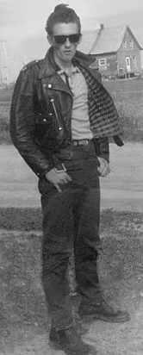
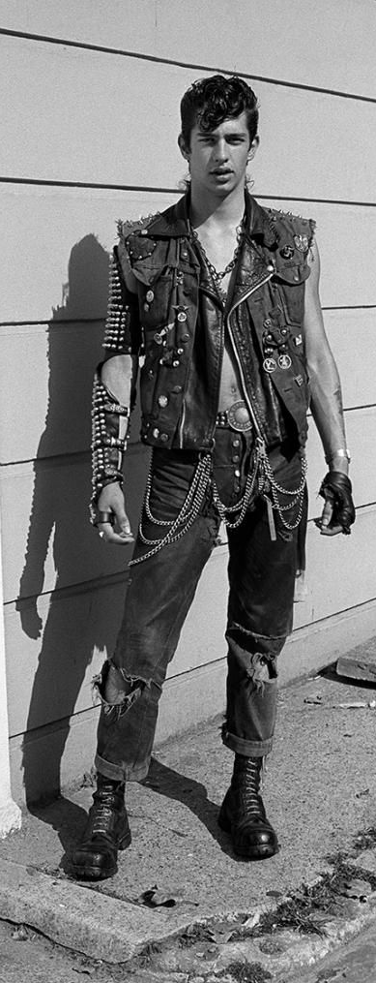
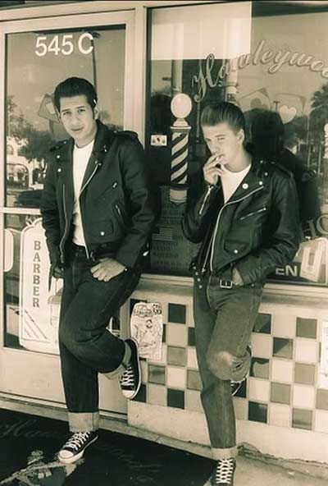
Greasers are a youth subculture that was popularized in the late 1940s and 1950s to 1960s by predominantly working class and lower class teenagers and young adults in the United States. Hair styles were rebelliously long and modelled after rock n roll stars like Elvis Presley.

Slide 26
Character Chart:
Character Name | Group | Background | Traits | Evidence

Slide 27
Character Chart:
Character Name | Group | Background | Traits | Evidence
Ponyboy Curtiss | Greaser | Parents died in car accident and lives with two brothers now as long as they behave | A thinker who is good at school but lacks common sense Doesn’t like the way greasers are seen Doesn’t like the unfairness or inequity of life | -Digs movies and books 2 -”Don’t use my head” 4 Doesn’t like being called a “hood” 15 “Darry doesn’t deserve to work like an old man…” 16

Slide 28
Character Chart:
Character Name | Group | Background | Traits | Evidence
Darry Curtis | Greaser | Parents died in car accident and lives with two brothers now as long as they behave. Responsible for holding family together. Had to give up athletic scholarship to work | Hardworking Strong Cold; tough on others and himself Responsible | -works constantly and can’t relax with others Broad, muscular 6 -Ice eyes 6 -Hard on Ponyboy after he is jumped (“you don’t ever think…) 13 “had to grow up quick” 6

Slide 29
Character Chart:
Character Name | Group | Background | Traits | Evidence
Sodapop Curtis | Greaser | Parents died in car accident and lives with two brothers now as long as they behave. | Light-hearted handsome Not book smart Caring Adventurous | -”happy-go-lucky -”movie-star” 7 Dropped out of school Dabs Ponyboy’s wound 7 “Reckless and thoughtful at the same time”

Slide 30
Character Chart:
Character Name | Group | Background | Traits | Evidence
Steve Randall | Greaser |  | Arrogant | “Cocky” “Smart” 9
Two-bit Matthews | Greaser |  | Oldest and still in school Funny/Disrespectful | “Life was one big joke” 10 “smarting off to the cops” 10

Slide 31
Character Chart:
Character Name | Group | Background | Traits | Evidence
Dallas Winston | Greaser | Spent 3 years in NYC and arrested at 10 | Tough, cold, mean, More of a hood than a greaser | “wild as the boys in the downtown outfits…” 11
Johnny Cade | Greaser | Socs jumped him. Abusive father/negligent mother | Nervous Suspicious Traumatized | “little dark puppy that has been kicked too many times…”11

Slide 32
Character Chart:
Character Name | Group | Background | Traits | Evidence
 | Greaser | Tend to come from poor and broken homes | -rebellious in looks -lower class -acts like family- -Misunderstood; seen as hoods or criminals | Wear hair long and dress in jeans/t-shirts poor…wild…steal things…fight 3 “tight-knit” 3 Only “love and affection” Johnny has “You are a hood.” “Marked lousy” 15

Slide 33
Comprehension Question
Why does Ponyboy like to go to the movies alone?
On pages 5, 7, and 17, the phrase “Need a haircut, greaser.” is repeated. Why do you think the Socs focused on Ponyboy’s hair during the fight? Why do you think the phrase bothered Ponyboy?
Describe Pony, Soda, and Darry’s relationship?

Slide 34
Comprehension Question
He likes to watch movies undisturbed so he can get into them and live them with the actors. He feels it‘s like having someone read over your shoulder when someone goes with you to the movies. Besides no one in his crowd likes books and movies the way he does.
Ponyboy’s long hair is part of his identity. As a Greaser, hair is how he expresses himself since he has poor. When assaulting Ponyboy, the Socs focus on his long hair, a superficial part of greaser identity. Instead of seeing him as an individual, they see him only as a member of a rival group.
Ponyboy loves Soda more than anyone in the world—idolizes him; Pony isn‘t really close to Darry, but looks up to him and respects him, somewhat out of fear. Sodapop is not afraid of Darry—even teases him and tells him what to do. He doesn‘t think of Ponyboy as a kid and likes to hang around him. Darry is rough on Pony; treats him like a parent would, and never sees anything he does as good enough. He is much easier on Soda, overlooking his mistakes and bad choices.

Slide 35
“The Outsiders” Chapter 1 Summary SWBAT review ch 1 by writing a summary of the chapter.
Summarize chapter 1 in 5-7 lines using the following terms:
Ponyboy,
Socs,
Greasers,
fight,
brothers,
movies

Slide 36
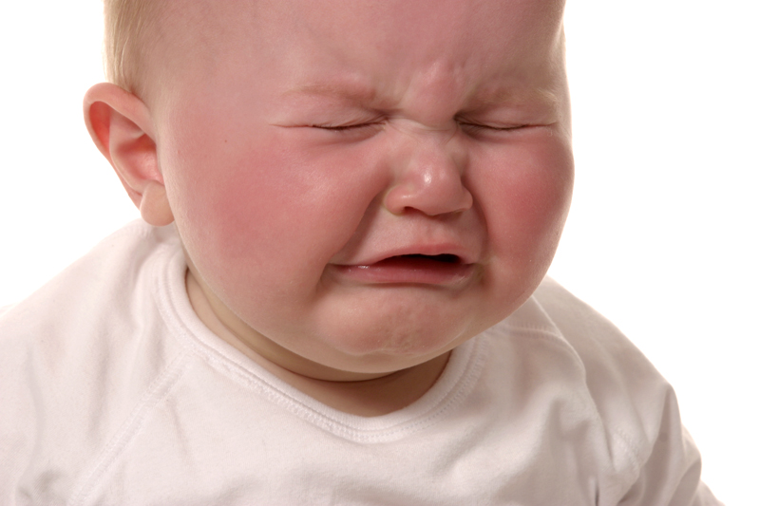
Chapter 1:
Bawl (8)
Quivering (8)
Unfathomable (10)
Rarities (11)
Savvy (17)

Slide 37

Chapter 1:
Bawl (8)
Quivering (8)
Unfathomable (10)
Rarities (11)
Savvy (17)

Slide 38

Chapter 1:
Bawl (8)
Quivering (8)
Unfathomable (10)
Rarities (11)
Savvy (17)

Slide 39
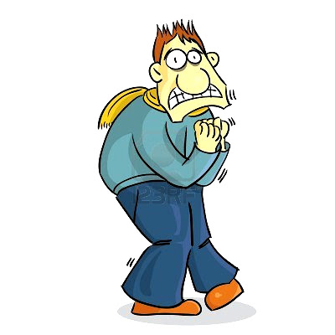
Chapter 1:
Bawl (8)
Quivering (8)
Unfathomable (10)
Rarities (11)
Savvy (17)

Slide 40
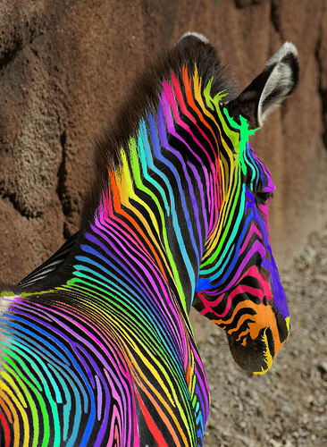
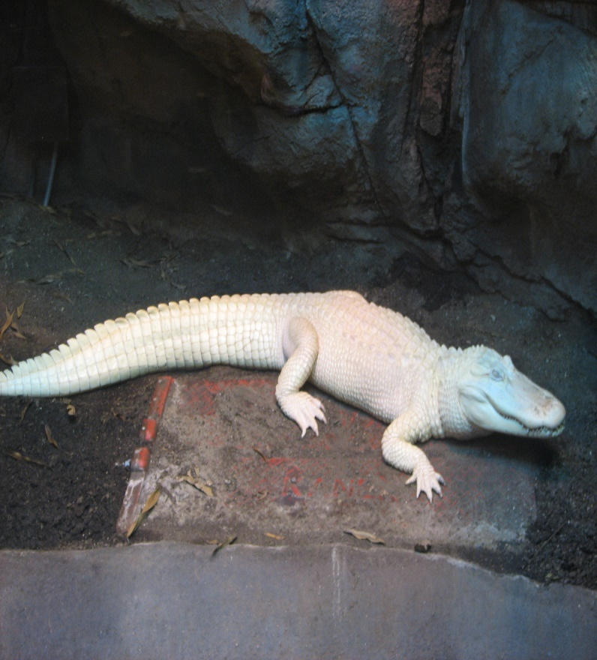
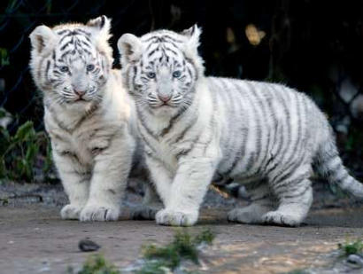
Chapter 1:
Bawl (8)
Quivering (8)
Unfathomable (10)
Rarities (11)
Savvy (17)

Slide 41
NB Entry: Unfathomable
(10 lines in 7 minutes)
Unfathomable: impossible to understand. Describe things that are unfathomable to you. You might include forces in the natural world, academic concepts, or the behavior of others. Use the word unfathomable at least three times in the entry.

Slide 42
Theme: which theme does the quote below support?
Class conflict: rich v poor
Social divisions or cliques
Appearance v reality
Honor and loyalty
Isolation and belonging
Loss of innocence
Violence begets violence
“And nobody in our gang digs movies and books the way I do. For a while there, I thought I was the only person in the world that did. So I loned it. Soda tries to understand.” (1.3)

Slide 43
Theme: which theme does the quote below support?
Class conflict: rich v poor
Social divisions or cliques
Appearance v reality
Honor and loyalty
Isolation and belonging
Loss of innocence
Violence begets violence
“I'm not sure how you spell it, but [Socs] is the abbreviation for Socials, the West-side rich kids. It's like the term greaser that's used to class all us boys on the East Side.” (1.4)

Slide 44
Theme: which theme does the quote below support?
Class conflict: rich v poor
Social divisions or cliques
Appearance v reality
Honor and loyalty
Isolation and belonging
Loss of innocence
Violence begets violence
“…we wear our hair long and dress in blue jeans and T-shirts, or leave our shirttails out and wear leather jackets and tennis shoes or boots. I'm not saying that either Socs or Greasers are better; that's just the way things are.”(1.5)

Slide 45
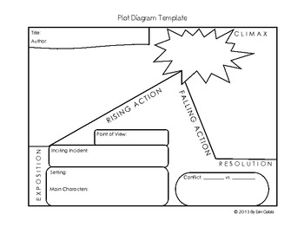
Plot
Exposition:
setting and characterization
Rising Action:
PB is jumped by the Socs and conflict is introduced

Slide 46
Think Pair Share
Some people are street savvy but not book savvy. Some people are tech savvy, meaning they are good with technology. What type of savvy are you?

Slide 47
Day 4

Slide 48
Chapter 2
You do:
Read pages 19-36
Summary
Notebook entries
Note cards with a partner
Appearance versus Reality short response
We do:
Complete Vocabulary Chart: socials and Cherry
Partner discussion
Vocabulary reinforcement
Theme discussion

Slide 49
WORD | SOURCE
Roguishly (22) | “Dally grinned roguishly.”
Incredulous (24) | “She gave him an incredulous look, and then she threw her Coke in his face.”
Nonchalantly (25) | “Okay,” I said nonchalantly, “might as well.”
Defensively (26) | ““Dally’s okay,” Johnny said defensively…”

Slide 50
WORD | DEFINITION | OTHER FORMS | SYNONYM/ANTONYM
Roguishly (22) | Behaving dishonestly (adv) | Rogue (n), Rogue (adj.) | S=Deceitfully, mischievously A=Honestly, Reliably
Incredulous (24) | Unwilling or unable to believe something (adj) Latin root: cred (believe) | Incredulously (adv) Credulous (adj) What other words have this root? | S=distrustful, doubtful A=trusting, gullible
Nonchalantly (25) | Casually, calmly (adv) | Nonchalant (adj) | S=Indifferently, Coolly A=with concern, with interest
Defensively (26) | Behaving in a way to avoid criticism (adv) | Defensive (adj) | S=Protectively A=Apologetically

Slide 51
Chapter 2: Partner Discussion
Characterization:
Three behaviors that help to earn greasers’ reputation:
1.
2.
3.
2. Three aspects of greaser moral code:
1.
2.
3.
Literary Device:
3. What is the role of flashback in this chapter?

Slide 52
Chapter 2: Partner Discussion
Characterization:
Three behaviors that help to earn greasers’ reputation:
1. Stealing, sneaking in without paying
2. Disrespectful to girls
3. Fightin
2. Three aspects of greaser moral code:
1. stick up for members of the gang no matter what (26)
2. fight fair (29)
3. Don’t get caught (29)
Literary Device:
3. What is the role of flashback in this chapter? Ponyboy’s description of Johnny being jumped gives important background information about his friend and the conflict in general.

Slide 53
Character Chart:
Character Name | Group | Background | Traits | Evidence
Socials |  | Have money and power, and unfair advantage in life but… . | Unemotional | “cool to the point of not feeling anything (3.38) “wall of aloofness (3.38)

Slide 54
Character Chart:
Character Name | Group | Background | Traits | Evidence
Cherry Valance | Soc |  | -Fiesty -sympathetic | Threw a coke in Dally’s face (2.24) “Things are rough all over” (2.35)

Slide 55
Summary
Summarize chapter 2 in 5-7 sentences using the following terms: Drive-in Theatre, Cherry, Dally

Slide 56
Theme: which theme does the quote below support?
Class conflict: rich v poor
Social divisions or cliques
Appearance v reality
Honor and loyalty
Isolation and belonging
Loss of innocence
Violence begets violence
“You take up for your buddies no matter what they do. When you're in a gang, you stick up for the members. If you don't […] it isn't a gang any more. It's a snarling, distrustful, bickering pack. “(2.26)

Slide 57
Theme: which theme does the quote below support?
Class conflict: rich v poor
Social divisions or cliques
Appearance v reality
Honor and loyalty
Isolation and belonging
Loss of innocence
Violence begets violence
“I really couldn’t see what Socs would have to sweat about—good grades, good cars, good girls, madras and Mustangs, and Corvairs—Man, I thought, if I had worries like that I’d consider myself lucky. “(2.36)

Slide 58
Plot
Rising Action:
Ponyboy meets Cherry and discusses differences

Slide 59
Exit Slip
Answer, Cite evidence, and Analyze:
Task: Analyze how the theme of appearance versus reality is developed in chapter 2. Provide two examples from the text to support your analysis (look at pages 34 through 36).
In chapter 2 of The Outsiders by S.E. Hinton, the theme of appearance v. reality is developed through the character’s dialogue. For example, …

Slide 60
Evidence
DIRECT QUOTES:
The main character is described as “stubborn” and “rigid” (4).
The protagonist asks, “Why me?” after his wife dies (3.7).
ACTIONS, EVENTS:
Joe’s reckless nature is revealed when he agrees to jump off the bridge on a dare.
Randolph’s caring nature is revealed in his treatment of his sister throughout chapter 1. He defends her against the neighborhood bullies at the playground, helps her finish her book reports, and comforts her while their parents are arguing.

Slide 61
Write 5 to 7 lines and be prepared to share!
Rows A and B: Break-in
Describe a break-in. You must use the following words: bawl, roguishly, and quivering.
Rows C and D: Conflict
Group 2: Write about a fight between a parent and child that features the following words: incredulous, defensively, and unfathomable.
Rows E and F: Thief
Describe a thief at a flea market that features the following words: nonchalantly, savvy, and rarities.

Slide 62
Partner Vocabulary Work
Notecards:
1. Create notecards for the vocabulary words. Put the word on 1 side and the definition on the other side.
2. Practice with a partner
bawl (8)
quivering (8)
unfathomable (10)
rarities (11)
savvy (17)
Roguishly (22)
Incredulous (24)
Nonchalantly (25)
Defensively (26)

Slide 63
NB Entry: “Things are rough all over”
(10 lines in 7 minutes)
In chapter 2, Cherry Valance says this to Ponyboy. Do you think life is equally rough for the greasers and the socs? What about in real life? Are things really rough all over?

Slide 64
Chapters 1-2 Check
Open book
Use notes and novel to be successful.

Slide 65
People who enjoy being unkind to others are ________________ to me.
The clerk at WaWa was _____________ when a man tried to pay with Monopoly money.
3. When I gave the boy a detention for talking, he behaved __________________.
4. I always ______________ at sad movies.
5. Some people have street _________ but they lack common sense.
6. The young boy was _________ in the dark as the clown approached.
7. I like to browse at flea markets and search for one-of-a-kind _____________.
8. After stealing a stranger’s wallet, the pickpocket _____________ strolled away.
9. The young man __________ strutted onto the subway train, looking for trouble.
bawl (8)
quivering (8)
unfathomable (10)
rarities (11)
savvy (17)
Roguishly (22)
Incredulous (24)
Nonchalantly (25)
Defensively (26)

Slide 66
Chapter 3
You do:
Read pages 37-52
Conflict Analysis
Chapter summary
Notebook entries
We do:
Vocabulary chart
Character chart
Note cards
Partner Questions
Theme discussion

Slide 67
WORD | SOURCE
Gallantly (37) | “Two-Bit gallantly offered to walk them home…”
Aloofness (38) | “Socs were always behind a wall of aloofness, careful not to let their real selves show through.”
Ornery (39) | He kicked the other horses and was always getting into trouble. “I’ve got me an ornery pony,” Soda’d tell him…”
Elite (41) | “…a few of the socially elite checkered-shirt set.”
Dumbfounded (42) | “Two-Bit said, dumfounded. “No, Ponyboy, that ain’t right…you go it wrong…”
Cunning (43) | “…Dally—wild, cunning Dally—turning into a hoodlum because he’d die if he didn’t”

Slide 68
WORD | DEFINITION | OTHER FORMS | SOURCE
Gallantly (37) | Bravely, in an attentive and chivalrous manner (adv) | Gallant (adj) Gallantry (n) | S=Courteously, Graciously A=Impolitely, Crudely
Aloofness (38) | Distant and withdrawn (noun) | Aloof (adj.) | S=Unfriendliness, Coldness A=Friendliness, Openness
Ornery (39) | Difficult, stubborn, combative (adj) |  | S=Irritable, cranky A=good-natured
Elite (41) | Superior (adj) | Elitist (noun) | S=exclusive, top-Quality A=common, average
Dumbfounded (42) | Astonished, shocked (adj) | Dumbound (v) | S=Speechless, shocked A=unsurprised
Cunning (43) | Crafty; willing to gain through trickery (adj) | Cunningingly (adv) Cunning (n) | S=Sly, tricky A=Straightforward, innocent

Slide 69
Conflicts: Internal/External
 | The Socs versus the Greasers | Darry versus Ponyboy | Society versus the Greasers | Ponyboy versus himself
Conflict | External | External | External | Internal
Describe the problem
Evidence from the text
Reasons the conflict exists

Slide 70
Conflicts: Internal/External
 | The Socs versus the Greasers | Darry versus Ponyboy | Society versus the Greasers | Ponyboy versus himself
Conflict | External | External | External | Internal
Describe the problem | Socs and greasers fight | Darry is hard on PB | Rough breaks, no opportunity, pre-judged | Identity; fitting in
Evidence from the text | 38 - Greasers feel too much/ Socs feel too little | After PB is jumped, Darry yells at him, “You don’t ever think…” (13) | ”It ain’t fair that we have all the rough breaks.” (43) | -Is alone in chap 1 -Doesn’t like Dally’s crude behavior in 2 -Can’t fit in with Socs (Cherry won’t say “hi” in hall)
Reasons the conflict exists | Different values: aloof v emotional Different class: haves/have nots | Darry is worried about losing PB if he gets in trouble | Society isn’t equal and fair; there are classes | PB is bright but his world is limited.

Slide 71
Summary
Summarize ch 3 in 5-7 sentences using the following terms: Cherry, Dally and Ponyboy’s relationship, differences between socs and greasers, blue Mustang, Johnny, park

Slide 72
Character Chart:
Character Name | Group | Background | Traits | Evidence
Socials |  | Have money and power, and unfair advantage in life but… . | Unemotional | “cool to the point of not feeling anything (3.38) “wall of aloofness (3.38)

Slide 73
Character Chart:
Character Name | Group | Background | Traits | Evidence
Cherry Valance | Soc |  | -Poor little rich girl -Aware of social divisions and accepts them to a point -Loyalty divided -Hates violence but is attracted to bad boys | “Did you ever hear of having more than you wanted?” (3.38) “…if I see you in the hall at school or someplace and don’t say hi, well, it’s not personal…” (3.45) “Maybe they won’t see us” (3.41) Says she could fall in love with Dally (3.46)

Slide 74
Character Chart:
Character Name | Group | Background | Traits | Evidence
Cherry Valance | Soc |  | -Fiesty -sympathetic | Threw a coke in Dally’s face (2.24) “Things are rough all over” (2.35)

Slide 75
Character Chart:
Character Name | Group | Background | Traits | Evidence
Bob Sheldon | Soc |  | --Dangerous -Drinker | Johnny’s reaction to Bob’s rings allows you to infer he was the one who lead the beating “You reeling and passing out…”(3.44)
Randy Adderson | Soc

Slide 76
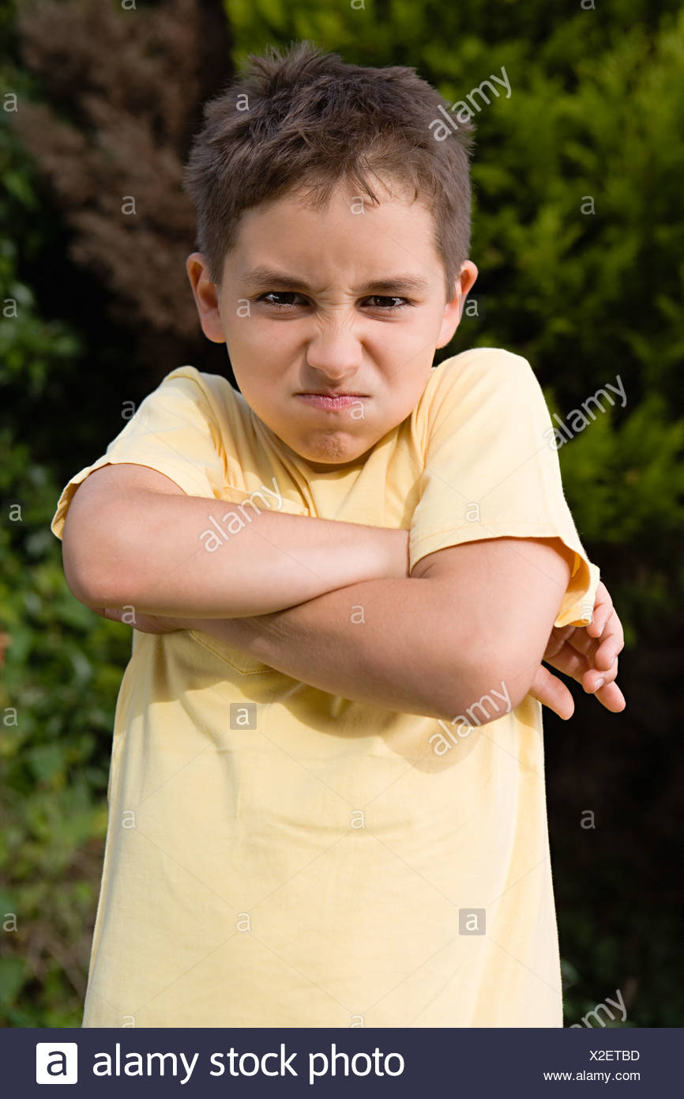

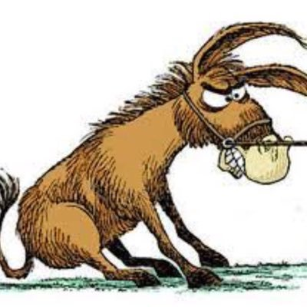
Chapter 3:
Gallantly (37)
Aloofness (38)
Ornery (39)
Elite (41)
Dumbfounded (42)
Cunning (43)

Slide 77
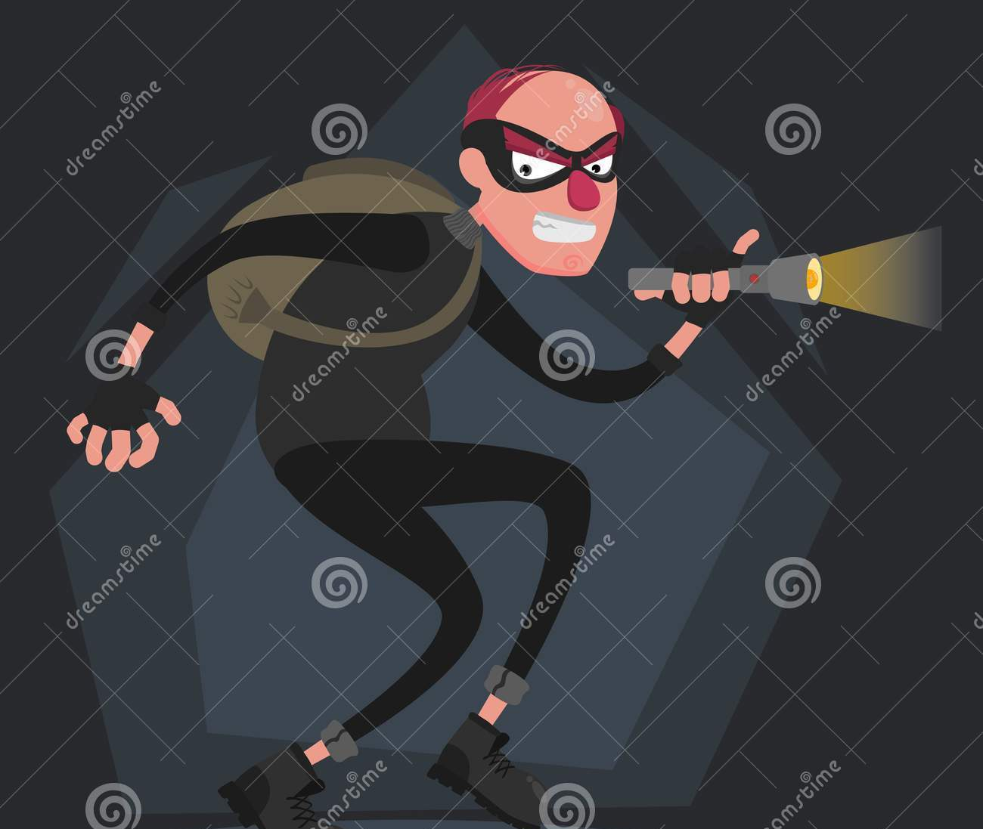
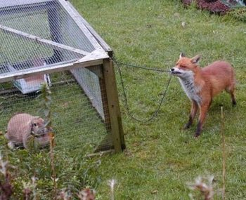
Chapter 3:
Gallantly (37)
Aloofness (38)
Ornery (39)
Elite (41)
Dumbfounded (42)
Cunning (43)

Slide 78
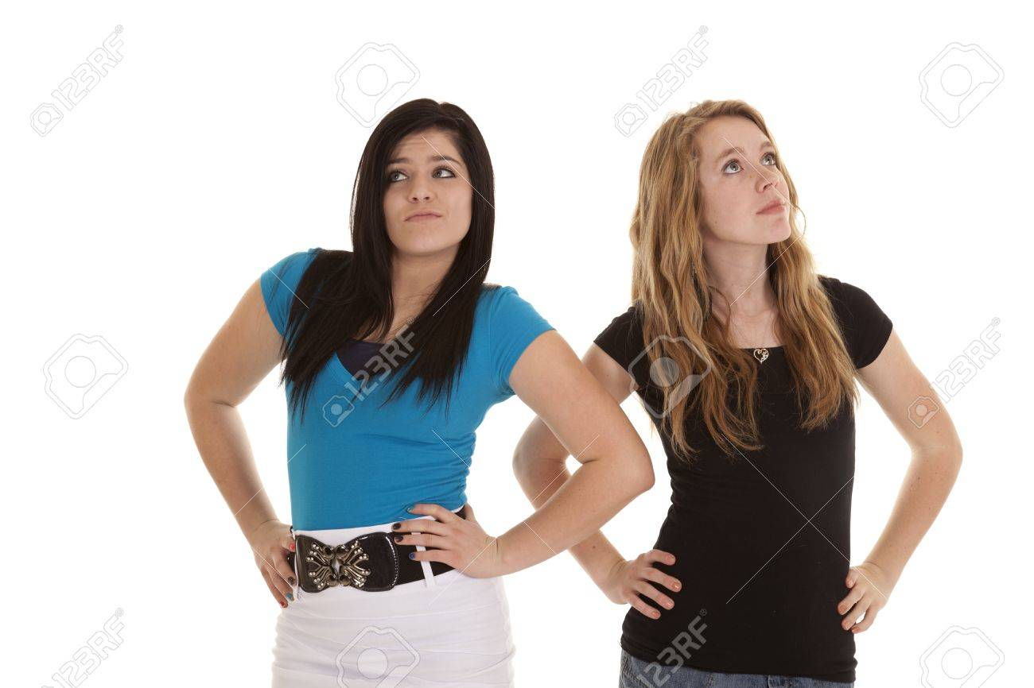
Chapter 3:
Gallantly (37)
Aloofness (38)
Ornery (39)
Elite (41)
Dumbfounded (42)
Cunning (43)

Slide 79
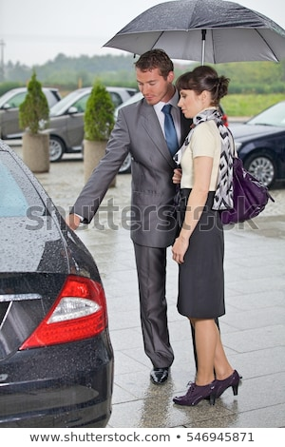
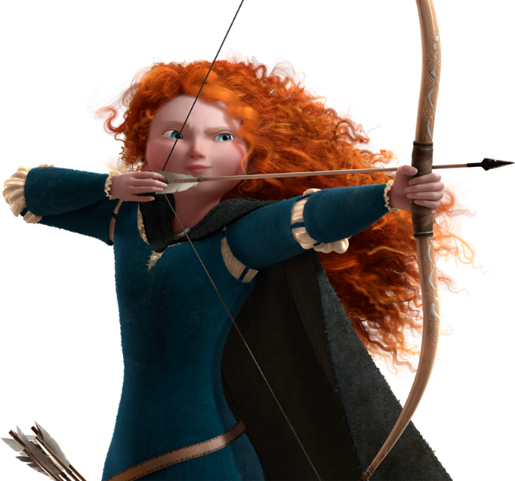
Chapter 3:
Gallantly (37)
Aloofness (38)
Ornery (39)
Elite (41)
Dumbfounded (42)
Cunning (43)

Slide 80
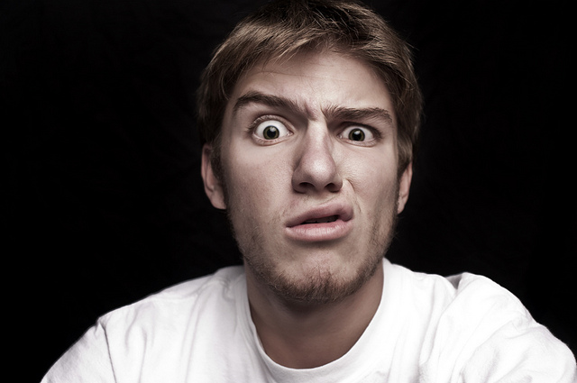
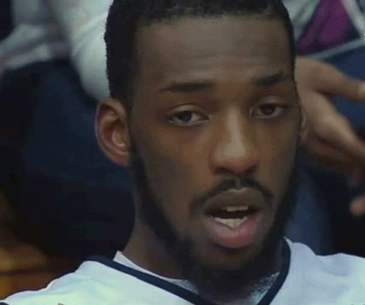
Chapter 3:
Gallantly (37)
Aloofness (38)
Ornery (39)
Elite (41)
Dumbfounded (42)
Cunning (43)

Slide 81
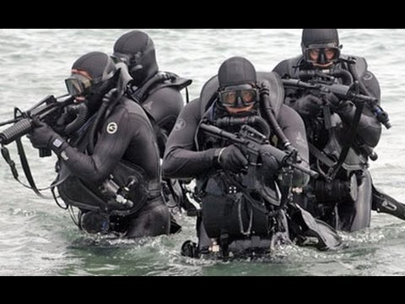

Chapter 3:
Gallantly (37)
Aloofness (38)
Ornery (39)
Elite (41)
Dumbfounded (42)
Cunning (43)

Slide 82
Round Robin Partner Questions: discuss with partner and record answers
1. Based on the conversation between Cherry and Pony, how is life rough for the Socs? Identify two issues(38).
2. Cherry observes that greasers feel too much and the Socs feel nothing (38). Which is worse?
3. What are the “rough breaks” that Ponyboy refers to on page 43? Identify at least two. Can you make a personal connection with this? Are there any rough breaks that you feel have held your or someone else back in life?
4. Cherry warns Ponyboy that she might not acknowledge him in the hallway at school (45). Is this treatment justified? Would you accept this treatment? Why or why not?
5. A symbol is an object that stands for something beyond itself. Explain the symbolism of the sunset on page 40 or the symbolism of the country on page 48. What do you think it represents? You don’t have to have the same answers.

Slide 83
Gallantly
Aloofness
Ornery
Elite
Dumbfounded
Cunning
Mrs. Mier was __________ when her period 3 class entered the room speaking fluent Spanish.
Not many students know that Mrs. Prosper is a former member of an ________ special ops team.
Older teachers like Mrs. Fava can be _______ sometimes.
Mr. Biordi _____ defended Ms. Sharp against the deranged student.
The girl’s _______ discouraged all boys from asking her to the dance.
The twelfth-graders needed great ______ to pull off their senior prank of supergluing all of the school doors shut.

Slide 84
Plot
Rising Action:
PB and Johnny confronted by Socs for being with Cherry and Marsha

Slide 85
Who is most likely to be accused of aloofness at the senior prom?
Who is most likely to make Mrs. Fava bawl before the end of the year?
Who is most likely to be accepted into an elite private school next year?
Who has the most unfathomable handwriting in the class?
Who is the most ornery member of your family?
If I were to tell you that I was an expert rock climber in my twenties, would you be incredulous or impressed?
Was anyone able to present their research nonchalantly in this class?
Which male student is most likely to engage in gallant behavior such as opening a door for Mrs. Fava?
If (add student here) decided to be quiet for an entire class, would you be dumbfounded or concerned or both?
Who is the most cunning cell phone user in class?
Who roguishly sneaks into the bathroom in between classes?
Who is not street savvy enough to find his or her way to WaWa?

Slide 86
Analogies:
Coldness is to aloofness as shocked is to ______.
Crafty is to cunning as incomprehensible is to ______________.
Stubborn is to ornery as relaxed is to ______.
Common is to elite as flexible is to______.
Cowardly is to gallant as unknowing is to ______.
Mischievously is to roguishly as distrustful is to ________.
Aloofness
bawl
elite
unfathomable
ornery
Incredulous
Nonchalantly
Gallant
Dumbfounded
Cunning
Roguishly
savvy

Slide 87
“In the Inner City”
By Lucille Clifton
in the inner city
Or like we call it
home
we think a lot about uptown
and the silent nights
and the houses straight as
dead men
and the pastel lights
and we hang on to our no place
happy to be alive
and in the inner city
or
like we call it
home
Whole Class:
How does the speaker of “In the Inner City” feel about the inner city?
How does the speaker feel about uptown?
What is the tone?
Independent:
Make a text to text connection. Analyze the writer’s attitude toward the poor and the rich in poem, “In the Inner City,” and the novel, The Outsiders. Use one example from the poem and one example from chapter 3 of the novel. Be sure to provide analysis.

