Slide 1

Intro to Aerospace
© 2024 STEM Education Toolbox

Slide 2
Engineering Basics

Slide 3
What types of engineers are there?

Slide 4
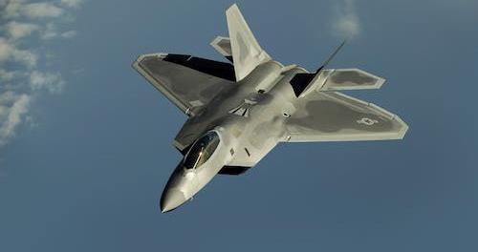
Aerospace Engineering

Slide 5

Mechanical Engineering

Slide 6

Civil Engineering

Slide 7

Environmental Engineering

Slide 8
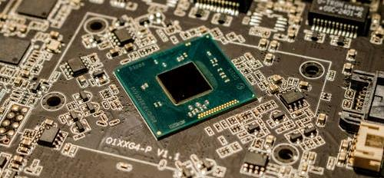
Electrical Engineering

Slide 9

Computer Science Engineering

Slide 10
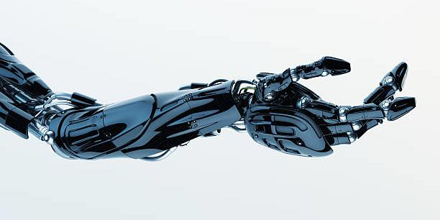
Biomedical Engineering

Slide 11

Chemical Engineering

Slide 12

Naval Engineering

Slide 13
Do you know of any other types of engineer?

Slide 14
What kind of engineer sounds coolest to you?

Slide 15
What skills can I learn from engineering?

Slide 16
Math & science are only a small part of engineering
Engineering
Math
Logic
Teamwork
Reading
Science
Writing
Speaking

Slide 17
Do I have to be an engineer to work in engineering fields?

Slide 18
Engineering companies need people with all skill sets
Writing
Operations
Manufacturing
Supply Chain
Management
Human Resources
Graphic Design
Customer Support
Finance
Advertising
Law
Safety

Slide 19
What do aerospace engineers work on?

Slide 20

Commercial Airplanes
Boeing 737

Slide 21

Satellites
Lockheed Martin OPIR

Slide 22
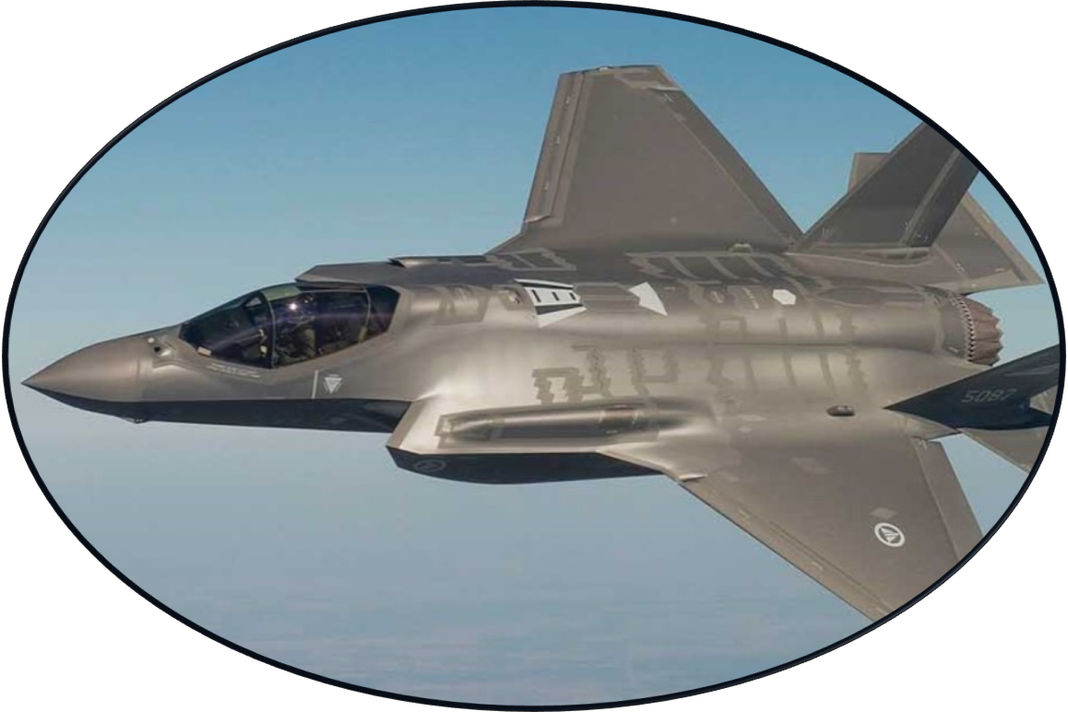
Fighter Jets
Lockheed Martin F-35

Slide 23
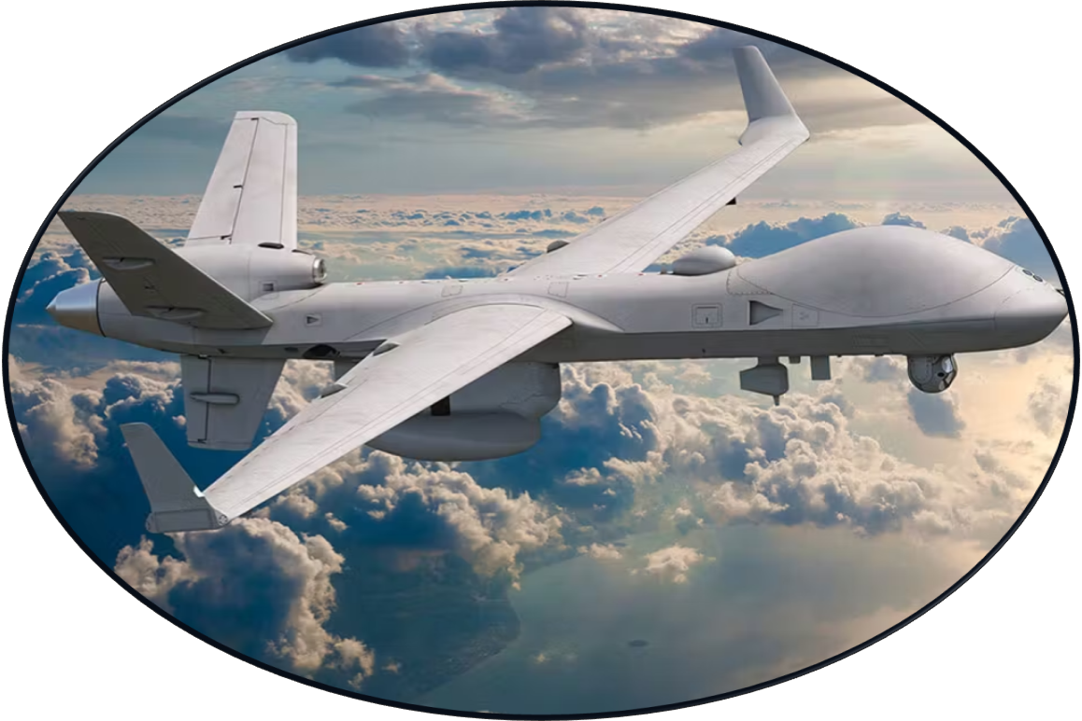
Drones
General Atomics SkyGuardian

Slide 24
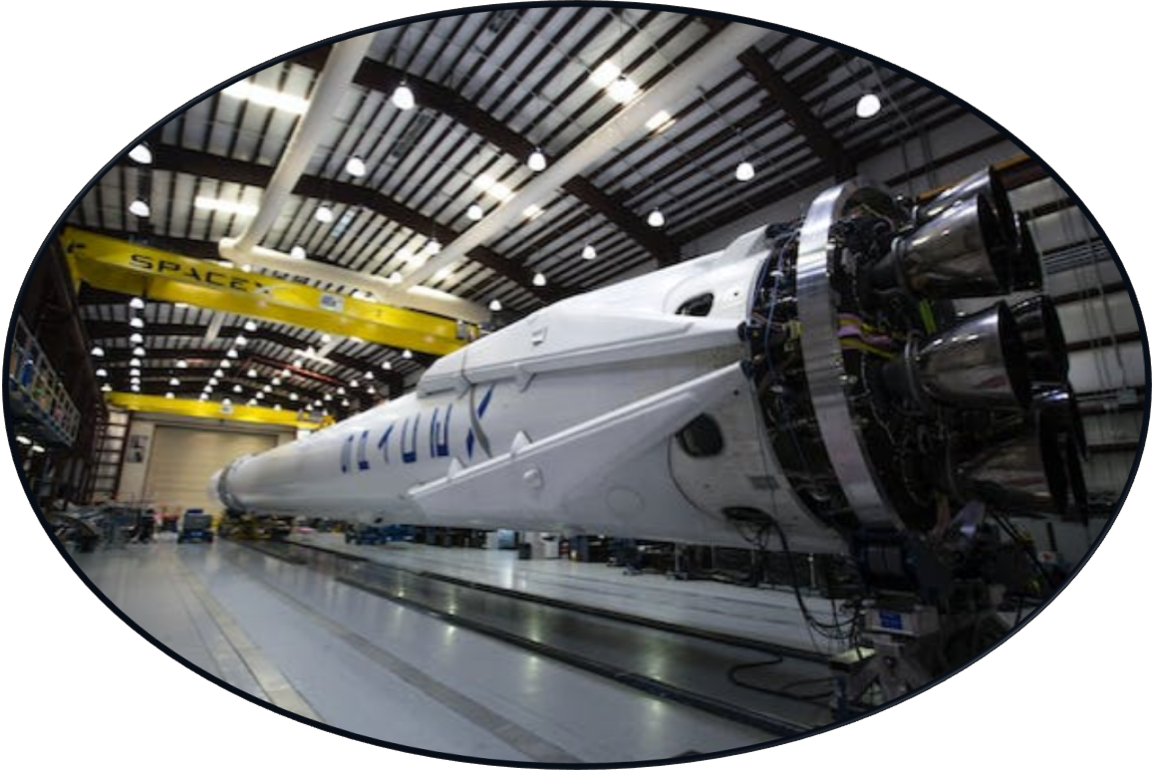
Rockets
SpaceX Falcon 9

Slide 25
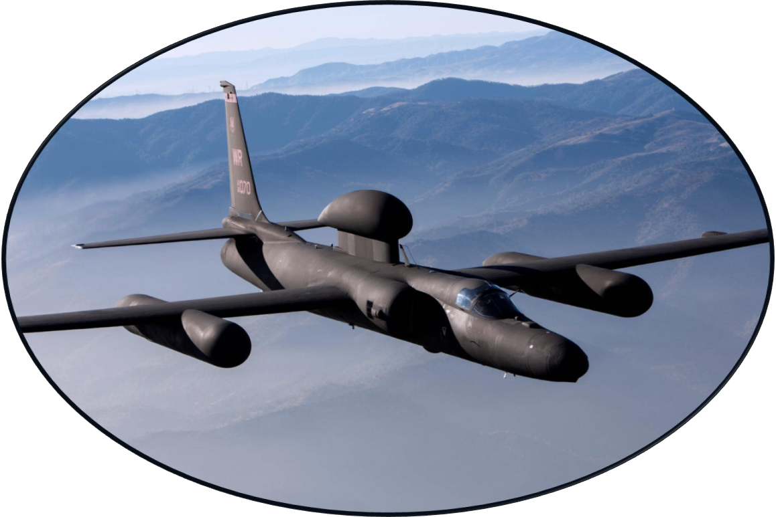
Surveillance Aircraft
Lockheed Martin U-2

Slide 26
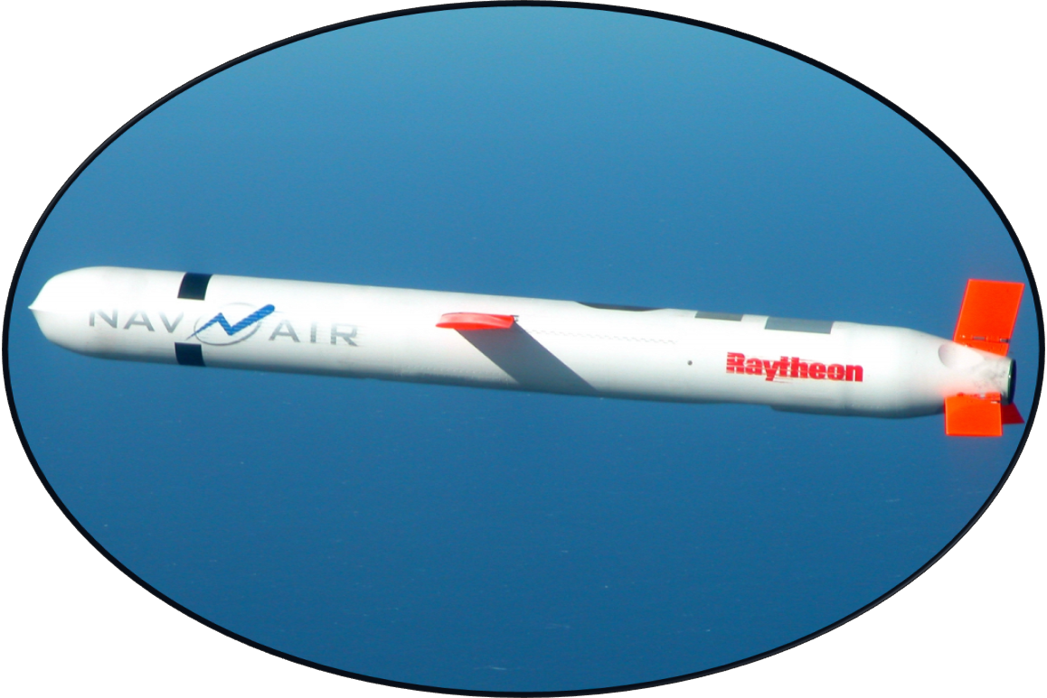
Missiles
Raytheon Tomahawk

Slide 27
What about other aerodynamic products?

Slide 28
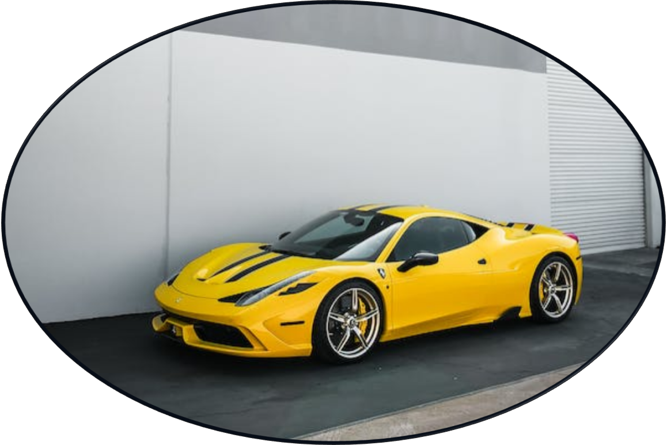
Sports Cars
Ferrari 458 Italia

Slide 29

Wind Turbines
Turbine Farm

Slide 30

Boats
Speedboat

Slide 31
Aerospace Principles

Slide 32


Airplane Components
Aileron
Rudder
Flap
Cabin
Cockpit
Elevator
Engine

Slide 33
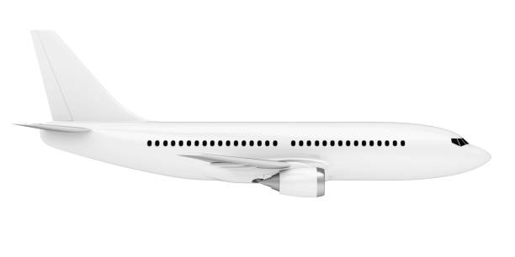
Forces of Flight
Lift
Thrust
Drag
Weight

Slide 34

Rotational Control (Steering)
Yaw
Roll
Pitch

Slide 35

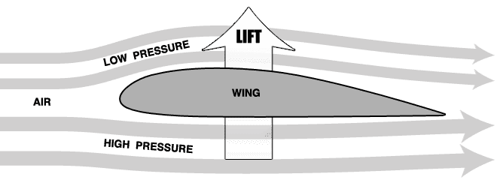
How Does It Fly?
Image Source

Slide 36
The Engineering Process
DEFINE
RESEARCH
BRAINSTORM
PLAN
CREATE
TEST
IMPROVE

Slide 37
Where to Start?

Slide 38
What do I do after high school?

Slide 39
Path to Engineering
Elementary School
Middle School
High School
???

Slide 40
Options after High School
Potential… | 4 Year College | 2 Year College | Trade School | Military | Straight to Work
Difficulty
Flexibility
Salary
Growth

Slide 41
Isn’t college really hard and expensive?

Slide 42
Isn’t It Hard?
Fear | Fact
That much school might be boring… | You get to pick what you learn in college!
I’m not smart enough for college… | Everyone is smart enough for college!
Nobody like me goes to college… | People of all backgrounds go to college!
College won’t be worth it… | There are many experiences in college, some tough and some fun, but all rewarding!
My classes might be too hard… | There are so many resources available, as long as you’re not afraid to ask for help!

Slide 43




Isn’t It Expensive?
Scholarships
Aid
Research
Tutoring
Research
Tutoring
Research
Tutoring

Slide 44
What should I do right now?

Slide 45
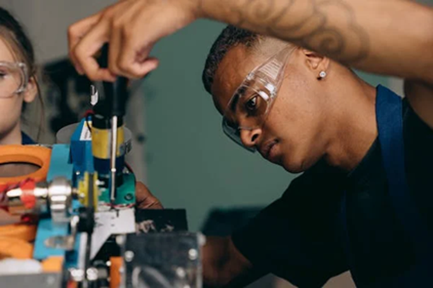

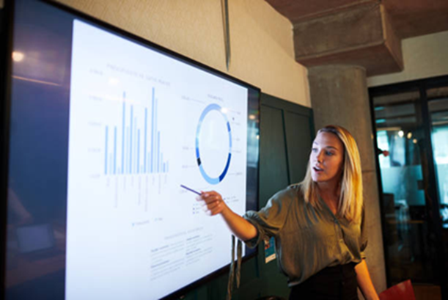

Practice Engineering Skills
Robotics
Science Fair
Research
Tutoring
Speech Club
Shop Class
Research
Tutoring

Slide 46
What Else?
Explore hobbies
Challenge yourself
Stay out of trouble
Don’t be too hard on yourself
Make friends
Do your homework
Learn new skills
Take care of yourself
Figure out what you enjoy
Practice reading and writing
Pay attention in class

Slide 47

Thank you!
Questions?
For future engagements, please contact:
Kelsey Toral
kelseytoral98@gmail.com
Or go to https://STEMEducationToolbox.com

