Slide 1
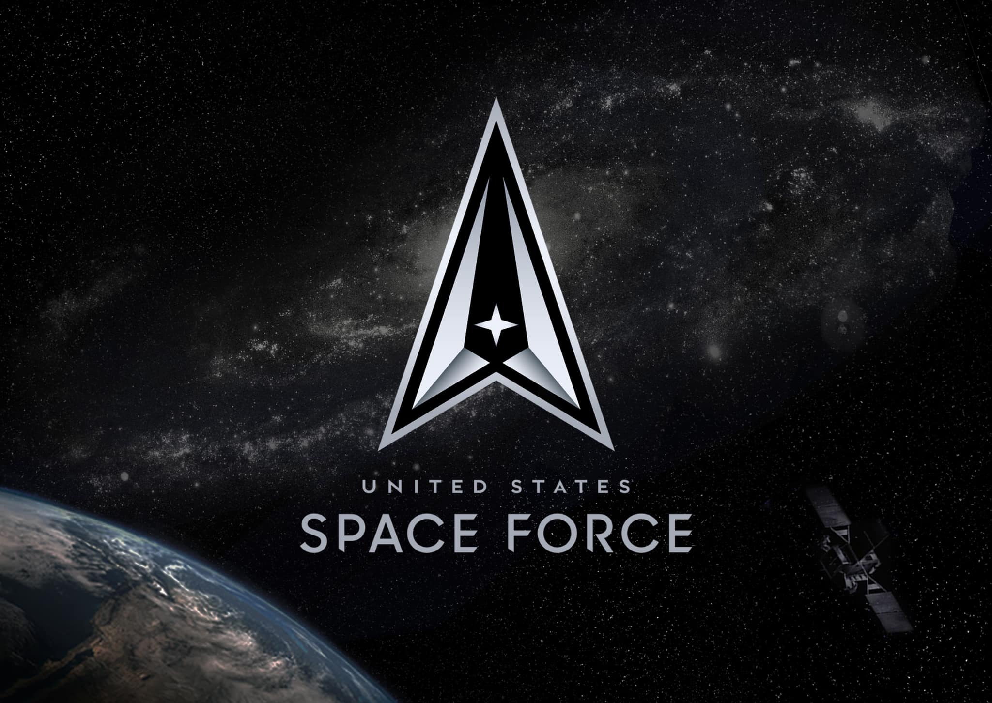

101
Semper Supra – Always Above

Slide 2
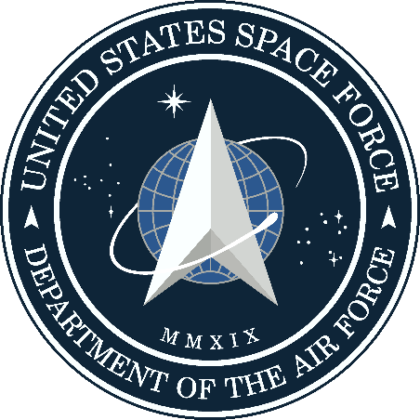
Secure our Nation’s Interests In, From and To Space
Notes:
Before we dig into details, it is important to highlight the mission of the Space Force.
Per the 2020 NDAA
‘‘§ 9081. The United States Space Force ‘‘(a) ESTABLISHMENT.—There is established a United States Space Force as an armed force within the Department of the Air Force. ‘‘(b) COMPOSITION.—The Space Force shall be composed of the following: ‘‘(1) The Chief of Space Operations. ‘‘(2) The space forces and such assets as may be organic therein. ‘‘(c) FUNCTIONS.—The Space Force shall be organized, trained, and equipped to provide— ‘‘(1) freedom of operation for the United States in, from, and to space; and ‘‘(2) prompt and sustained space operations. ‘‘(d) DUTIES.—It shall be the duty of the Space Force to— ‘‘(1) protect the interests of the United States in space; ‘‘(2) deter aggression in, from, and to space; and ‘‘(3) conduct space operations.’’.
As Guardians in the U.S. Space Force, our mission is to project spacepower that defends the Nation, protects its interests, and defeats its enemies. Competitive Endurance is the theory of success that underpins our approach to this mission.
Preserving U.S. freedom of action in an increasingly contested space domain requires military force. Our service provides the weapon systems, trained personnel, and warfighting expertise required to preserve this freedom of action in competition, crisis, and conflict. In essence, the Space Force is responsible for organizing the military force required to gain and maintain the space superiority necessary for the Joint Force to defend U.S. interests. The responsibility to execute military force, to impose the Nation’s will on an adversary, is the essence of the profession of arms and distinguishes the Space Force from other space organizations. Furthermore, it is the dedicated pursuit of contesting and controlling the space domain that separates the Space Force from other military services.

Slide 3
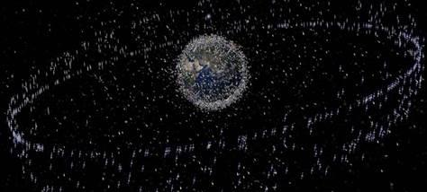
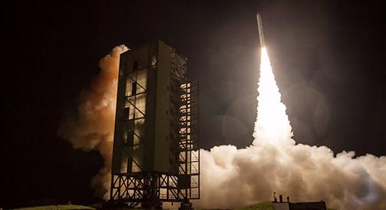
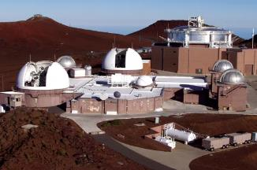
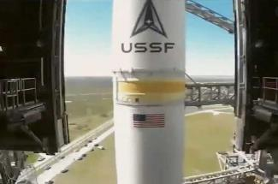
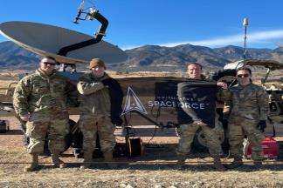

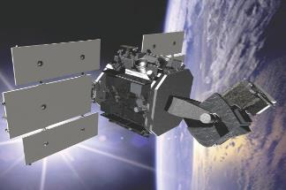
Space Force Missions
WHY
Spacepower is vital to prosperity & security
Preserve Freedom Of Action
in the Space Domain
Enable Joint Lethality and Effectiveness
Provide Independent Options
In, From, and To Space
… and five Core Competencies
HOW
Military Spacepower is employed
Space Domain Awareness
Space Mobility & Logistics
Combat Power Projection
Information Mobility
Space Security
Focused thinking, propagating an understanding of comprehensive spacepower

Slide 4

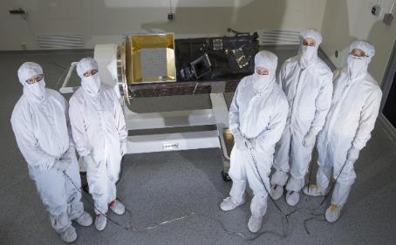
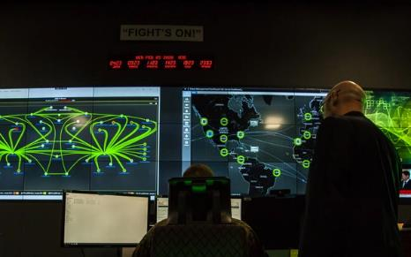
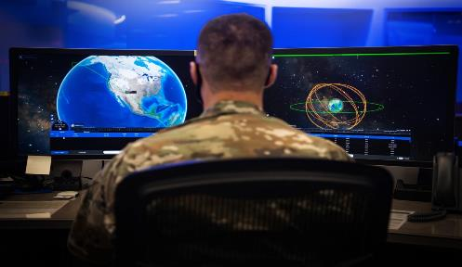
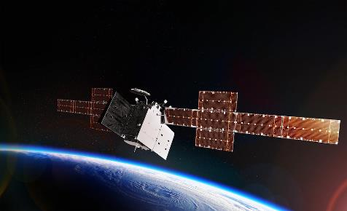


What Do Guardians Do?
Acquisitions and Engineering
Cyberspace
Intelligence
Operations
Space Force Origins Video
CIVILIANS, ACTIVE DUTY GUARDIANS, AND A VAST ARRAY OF ALLIES AND PARTNERS WORKING
SIDE BY SIDE TO KEEP THE NATION SECURE
11
Notes:
These are the core functions that were transferred to USSF. This is the nucleus that makes space power possible and our global dominance would not be sustained if not for each of you. But we cant and don’t go at it alone… (Slide)
62E/63A – Next generation launch; orbital warfare, next-gen OPIR, AFRL research, Space RCO --- Launch and OPIR
17D – Mission Defense Teams, mission cyber, space communications, DCO-Space, agile development
14N – tactical-level intelligence, future National Space Intelligence Center, Intelligence Community assignments
13S – orbital warfare, space-based or ground-based missile warning, space electronic warfare, space support --- SBIRS (1 SOPS)

Slide 5
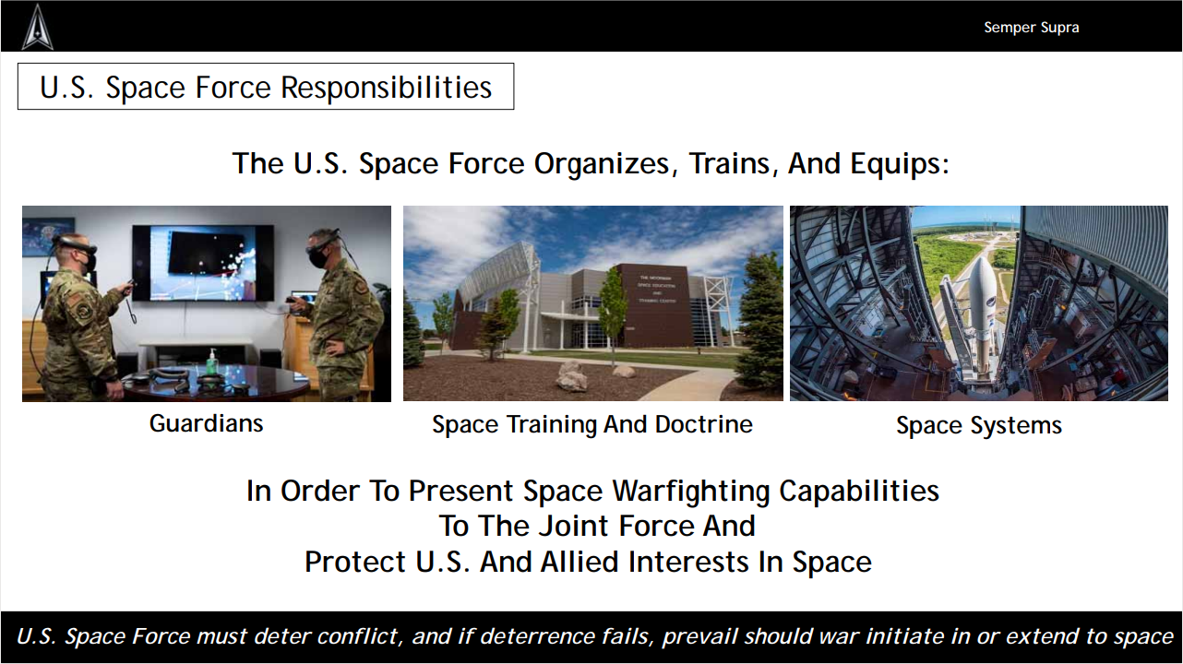
Space Superiority is Why the Space Force Exists
Space Superiority is Why the Space Force Exists
Contesting and controlling a physical domain requires …
Domain experts
    Honed concepts and tactics
Purpose built equipment
Space Superiority = Protect Friendly Capabilities + Negate Hostile Capabilities

Slide 6

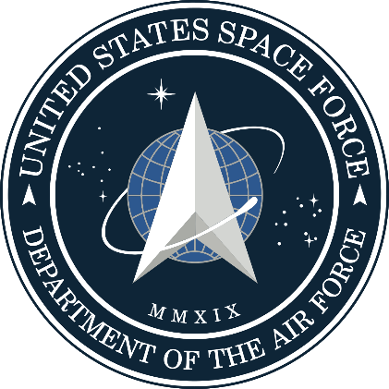
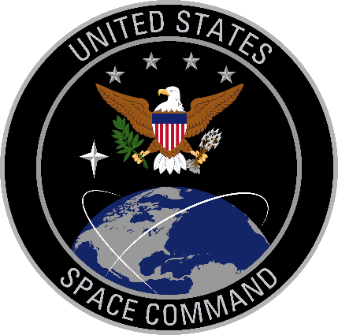
The Space Force and U.S. Space Command are Integral Partners
Builds, Presents and Executes Combat Power
Responsible for the weapon systems, equipment, personnel, expertise and operations required to accomplish assigned military objectives with space forces.
Plans and Directs the Employment of Combat Power
Authority and direction for military plans and operations in space and plans to deter or defeat potential adversaries.
Fighting today’s fight, planning for tomorrow.

Slide 7
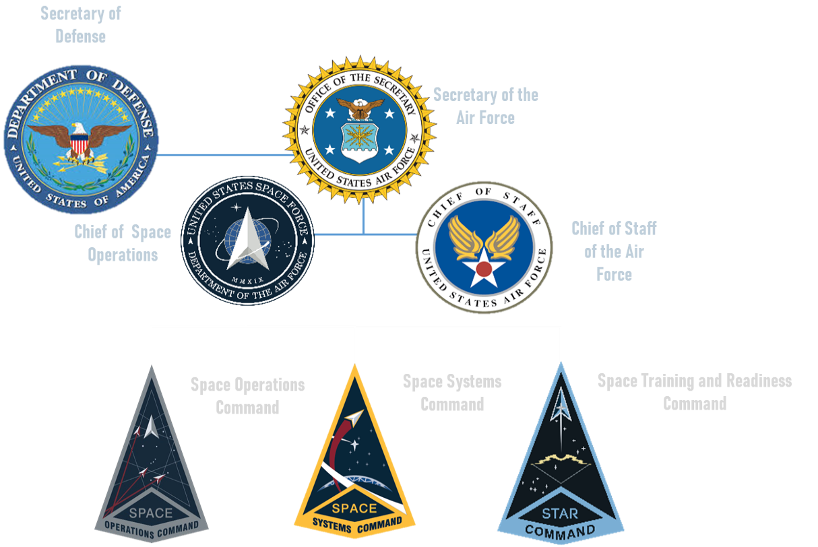
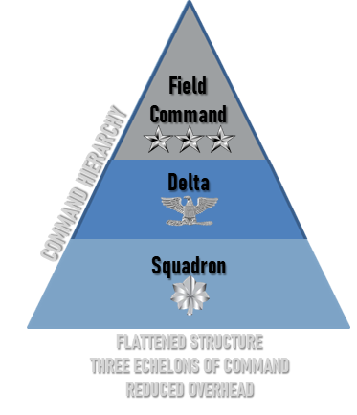



U.S. Space Force Organization
Service Components to Combatant Commands
Future: Space Futures Command Forecasts the threat environment, develops and validates concepts, conducts experimentation and wargames, and performs mission area design
Coordinates and Integrates Space Forces into Planning and Current Operations
Responsible For Organizing, Training, Equipping, and Presenting Space Forces
Develops, Acquires, Equips, Fields, and Sustains Lethal and Resilient Space Systems
Develops Combat-Ready Space Forces Via Space Warfighting Capabilities and Expertise
Complementary Functions And Streamlined Layers Of Command In The Deliberate Pursuit Of Speed And Agility
Notes:
As the Space Force races to fill the critical positions, the HQ’s, located at the Pentagon, is organized into four distinct organizations all with a tremendous amount of responsibility. These Space Force teams are lean by design, and are organized to maintain agility and flexibility in decision making.
Of note, the entire Space Force staff, even if fully manned, will still be smaller than the Air Force A3 staff.
[next slide] Next we will examine the Space Force Field Commands

Slide 8
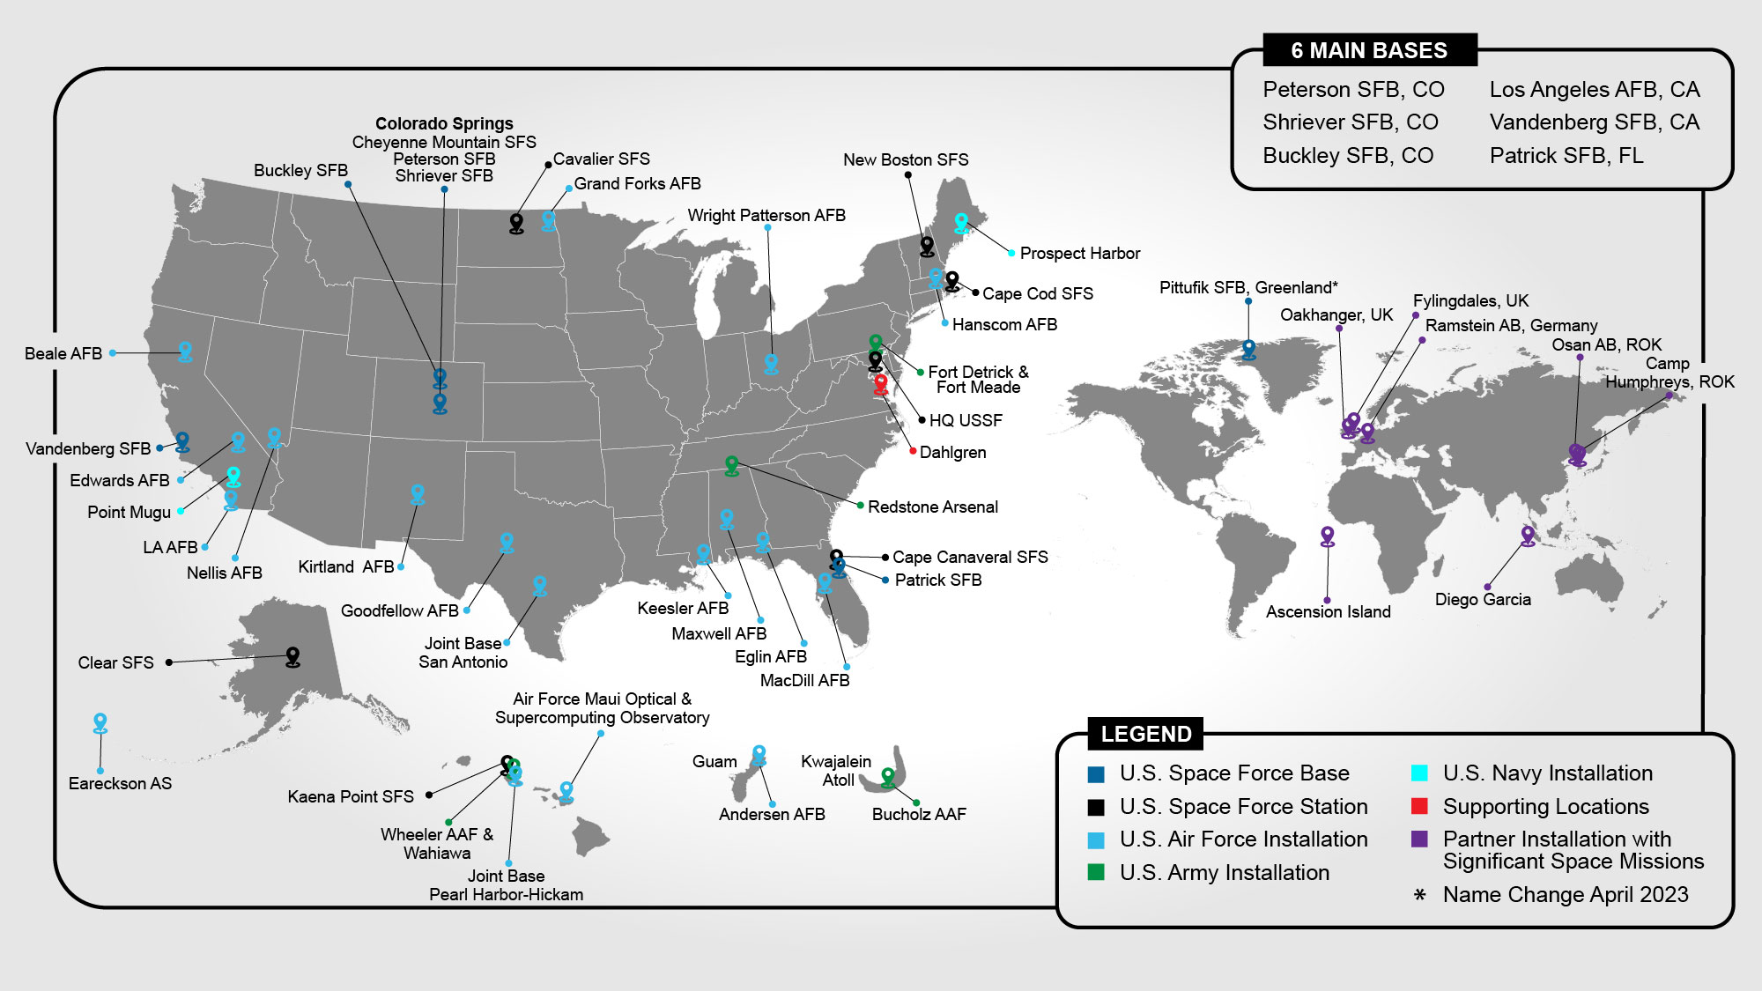
At 46 Bases & Installations, 18 States & Territories, 8 International Sites
6 MAIN BASES
Peterson SFB, CO
Schriever SFB, CO
Buckley SFB, CO
Los Angeles AFB, CA
Vandenberg SFB, CA
Patrick SFB, FL
Pittufik SFB, Greenland
Notes:
Space Force Bases
Buckley AFB, Colorado
Peterson AFB, Colorado
Los Angeles, California
Schriever AFB, Colorado
Vandenberg AFB, California
Patrick AFB, Florida
Space Force Stations
Cavalier Space Force Station
Cheyenne Mountain Air Force Station, Colorado
Cape Canaveral Air Force Station, Florida
New Boston Air Force Station, New Hampshire
Ka’ena Point Air Force Station, Hawaii
Thule Air Base, Greenland
Clear Space Force Station, Alaska
Cape Cod Space Force Station, Massachusetts

Slide 9
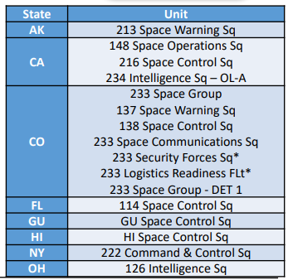
National Guard Space Units
Space Missions have been conducted by Air National Guard units for over 25 years
11% of USSF Space Professionals resident in ANG (over 1,000 personnel)
60% of USSF Offensive Space Electronic Warfare resident in ANG
Unlike Air Force Reserve space units, ANG units are equipped
ANG operates only survivable portion of the strategic missile Warning / nuclear detection capability
Pittufik SFB, Greenland
Notes:
Space Force Bases
Buckley AFB, Colorado
Peterson AFB, Colorado
Los Angeles, California
Schriever AFB, Colorado
Vandenberg AFB, California
Patrick AFB, Florida
Space Force Stations
Cavalier Space Force Station
Cheyenne Mountain Air Force Station, Colorado
Cape Canaveral Air Force Station, Florida
New Boston Air Force Station, New Hampshire
Ka’ena Point Air Force Station, Hawaii
Thule Air Base, Greenland
Clear Space Force Station, Alaska
Cape Cod Space Force Station, Massachusetts

Slide 10
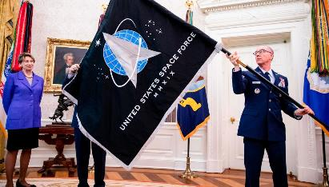
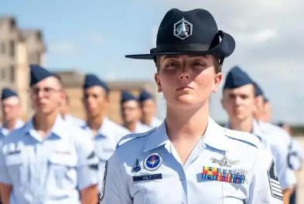
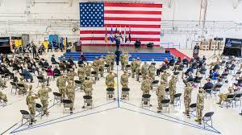
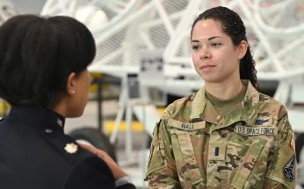
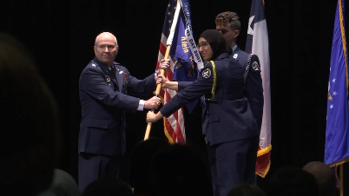
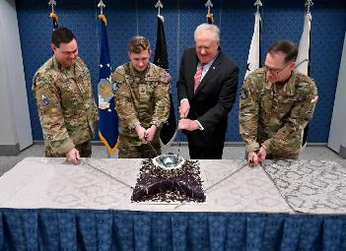
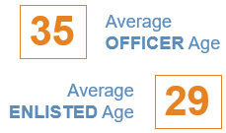

A Focused Service…
… With An Evolving Culture
Civilian
Enlisted
Officer
CAO 23 Feb
FY23 end-strength
  8,600 Active Duty
  7,000 Civilian
15,632 family members
19% women
US Air Force Integration
9,000 Active Duty
1,400 Reservists
2,000 Nat’l Guard
33
Building a Lean, Agile and Talented Space Force
  Innovating recruiting pathways
  Delivering space-related training at depth
  Rethinking holistic well-being
  Evolving into the first digital service
29
Notes:
CAO: 28 Apr 22
The Space Force is comprised of a highly diverse and skilled workforce of approximately 13,451 Guardians. As can be seen on the top left of the slide the Space Force is approximately 50% Active Duty Military and 50% Civilian. Additionally, the Space Force is the first service to have a higher number of officers than enlisted. With the recent passing of the FY22 NDAA and Budget the Space Force is working to reach an end strength of 8,436 Active Duty members and a total end strength of 16,000 by the end of the year.
In the two plus short years of Space Force standup and a heavy dose of members being transferred over from the Air Force, by the end of FY22 the Space Force is estimated to be comprised of 26% of the members who were never in the Air Force and transferred in via the Inter Service Transfer process (Army, Navy, Marines, Coast Guard, etc…) or direct ascension.
Finally the Space Force is rectuiting talent and developing numerous lanes of public integration and innovation through a series of programs to include:
11 University Partnership Programs (3 more expected in FY22)
4 JROTC aligned schools and growing
Various commissioning sources (USAFA is still the biggest)
Tailored Basic Military Training
Foundational Space Education throughout the entirety of the Professional Military Education

Slide 11
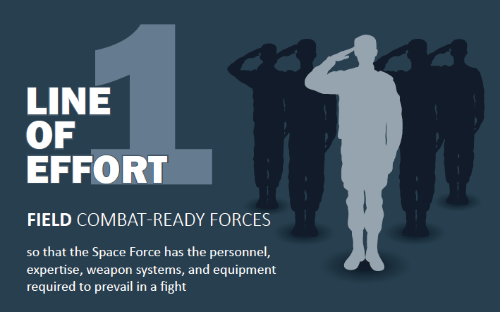
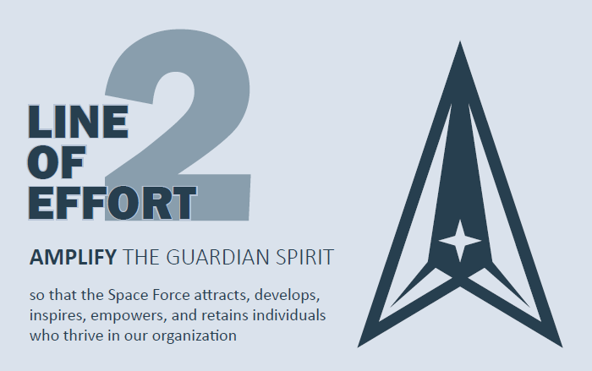

FUTURE SPACE FORCE
Lines of Effort are designed to provide the forces, personnel, and partnerships required for the USSF to preserve U.S. space superiority
FIELD
Combat-ready Forces
AMPLIFY
The Guardian Spirit
PARTNER
To Win
LOEs aligned to NDS Priorities of Mission, People, Teamwork

Slide 12

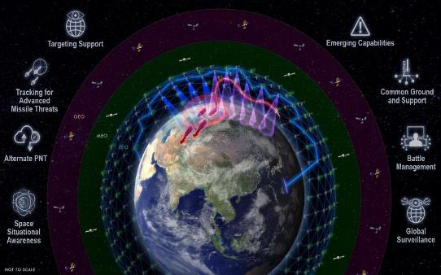
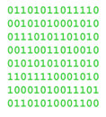

Resilient Architectures
Build
Buy
Exploit
Defend
Absorb
Recover
The Transformation to Resilient Space Architectures is Already Underway

Slide 13
Q&A

