Slide 1

Parent/guardian/youth orientation
Delta Sigma Theta Sorority, Incorporated
National Program Planning & Development
Risk management
SEPTEMBER 2020
© 2020 Delta Sigma Theta Sorority, Inc. This content is protected under US Copyright (17 U.S.C. §§ 201 et al.) and other federal law and shall not be published, reproduced, displayed or otherwise utilized by any party whatsoever without the express written consent of Delta Sigma Theta Sorority, Inc. Violation of Delta’s intellectual property rights will be prosecuted to the full extent of the law
Notes:
INTRODUCTION: Hello, my name is [insert name] and I am the [X] Chapter’s Risk Management Coordinator.
CHANGE SLIDE

Slide 2
Risk Management Coordinator
Risk Management Coordinator
Oversees Compliance
Chapter President Accountable
© 2020 Delta Sigma Theta Sorority, Inc. This content is protected under US Copyright (17 U.S.C. §§ 201 et al.) and other federal law and shall not be published, reproduced, displayed or otherwise utilized by any party whatsoever without the express written consent of Delta Sigma Theta Sorority, Inc. Violation of Delta’s intellectual property rights will be prosecuted to the full extent of the law
Notes:
SAY: In Delta Sigma Theta, each chapter is required to have a Risk Management Coordinator who is responsible for overseeing the Chapter’s compliance with Delta’s risk management policies.
SAY: Although my role is to carry out the duties of the risk management program, the Chapter President has the ultimate accountability for our Chapter’s compliance with all Delta policies and guidelines.
CHANGE SLIDE

Slide 3

Risk Management
Is . . .
the process of assessing risk and acting in such a manner, or prescribing policies and procedures, so as to minimize loss associated with such risk
Webster’s New World Law Dictionary. 2010
Wiley Publishing, Hoboken, NJ
© 2020 Delta Sigma Theta Sorority, Inc. This content is protected under US Copyright (17 U.S.C. §§ 201 et al.) and other federal law and shall not be published, reproduced, displayed or otherwise utilized by any party whatsoever without the express written consent of Delta Sigma Theta Sorority, Inc. Violation of Delta’s intellectual property rights will be prosecuted to the full extent of the law
Notes:
SAY: Risk Management is very important in our youth activities.
READ: According to Webster’s New World Law Dictionary, the 2010 edition, Risk Management is the process of assessing risk and acting in such a manner, or developing policies and procedures, to minimize risk.
CHANGE SLIDE

Slide 4
Why Do We Need A Risk Management Program?
Risk management is important because it:
  Ensures the safety of youth and volunteers
  Evaluates the allocation of resources
  Focuses on the enrichment of youth participants
  Focuses on prevention
© 2020 Delta Sigma Theta Sorority, Inc. This content is protected under US Copyright (17 U.S.C. §§ 201 et al.) and other federal law and shall not be published, reproduced, displayed or otherwise utilized by any party whatsoever without the express written consent of Delta Sigma Theta Sorority, Inc. Violation of Delta’s intellectual property rights will be prosecuted to the full extent of the law
Notes:
SAY: Risk Management is important because it:
Ensures the safety of all participants in our youth programs
Proactively evaluates the allocation of our resources
Allows us to focus on the enrichment of our youth participants, and
Focuses on prevention
SAY: Youth programs today face challenges. We want to make sure our youth and volunteers are in a safe environment. Delta’s National Risk Management Team has developed policies, guidelines and procedures to ensure a positive learning environment. Be assured our educational programs are emotionally and physically safe at all times.
CHANGE SLIDE

Slide 5

Volunteers
Includes Deltas and Non-Deltas
Volunteers must be 18 years or older
Volunteer Background Screening
Exception: One-time volunteers
  Speakers
  Vendors
  Presenters
  Single activity ONLY
© 2020 Delta Sigma Theta Sorority, Inc. This content is protected under US Copyright (17 U.S.C. §§ 201 et al.) and other federal law and shall not be published, reproduced, displayed or otherwise utilized by any party whatsoever without the express written consent of Delta Sigma Theta Sorority, Inc. Violation of Delta’s intellectual property rights will be prosecuted to the full extent of the law
Notes:
SAY: Delta recognizes that volunteers are essential if a Chapter intends to have effective youth initiatives. Delta defines volunteers as all individuals participating in youth initiatives to include Delta’s and non-Delta’s. An individual must be 18 years or older to participate as a volunteer in our youth program activities.
SAY: To ensure the safety of youth participating in our programs, Delta requires that all volunteers complete our Volunteer Candidate Background Screening process. The only exception is for one-time volunteers like speakers, vendors, or presenters who participate in a single activity only during the program year.
CHANGE SLIDE

Slide 6
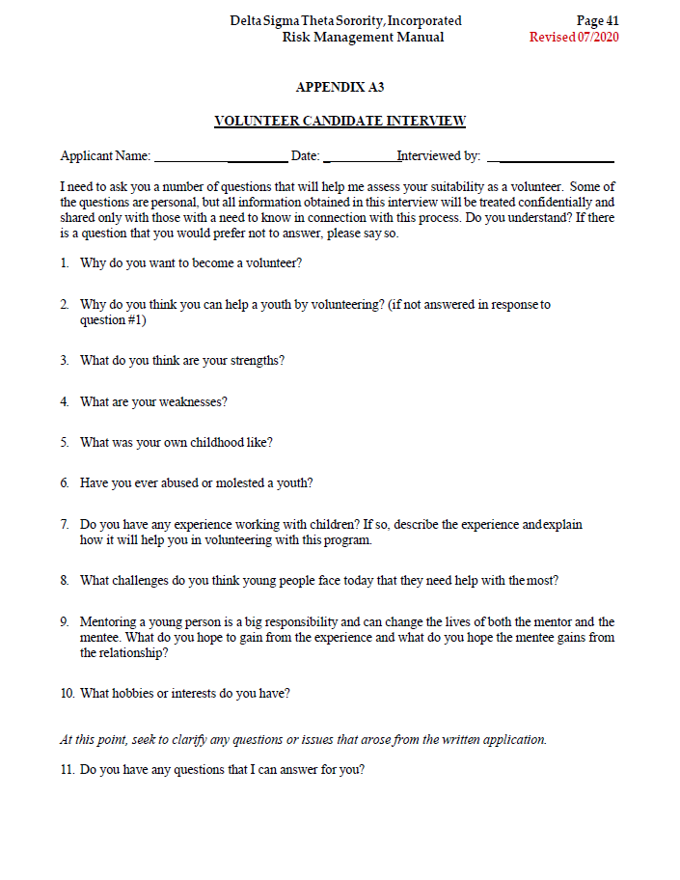
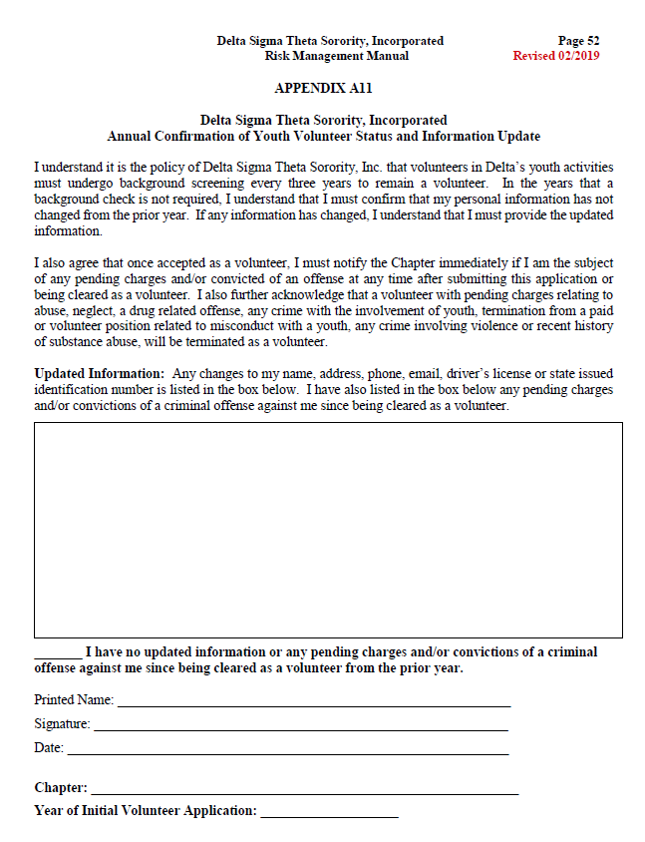
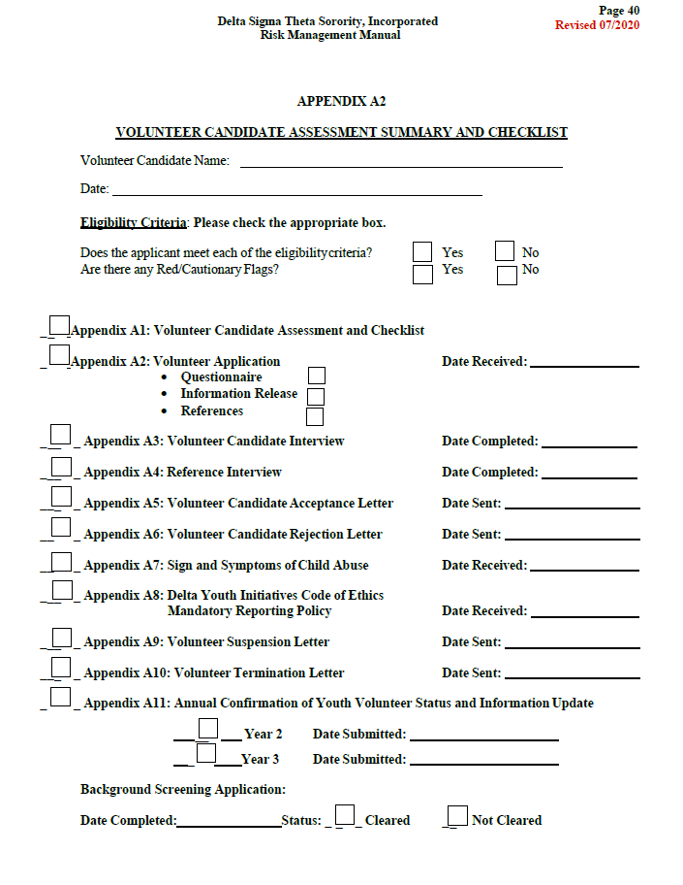
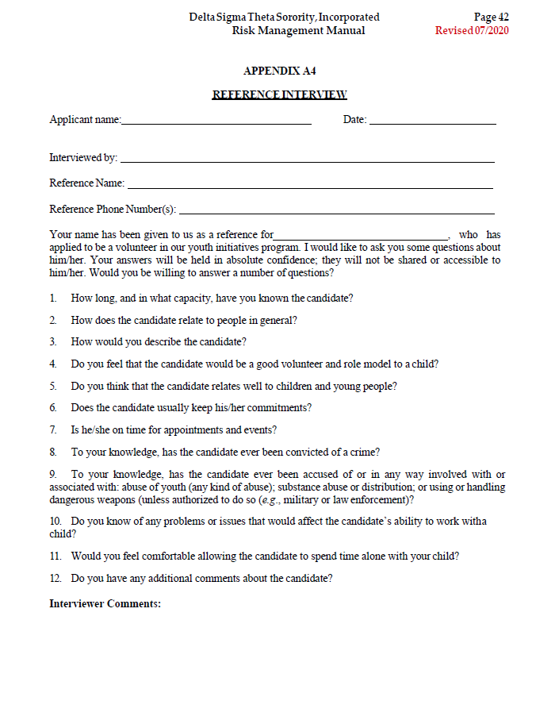
Volunteer Candidate background screening
Volunteer Application
Face-to-Face Interview
Reference Checks
  Personal
  Professional
Criminal Background Check
Review of Red Flags
Decision to Accept/Deny
Valid for three (3) years
© 2020 Delta Sigma Theta Sorority, Inc. This content is protected under US Copyright (17 U.S.C. §§ 201 et al.) and other federal law and shall not be published, reproduced, displayed or otherwise utilized by any party whatsoever without the express written consent of Delta Sigma Theta Sorority, Inc. Violation of Delta’s intellectual property rights will be prosecuted to the full extent of the law
Notes:
SAY: Delta’s screening process includes a volunteer candidate application, a face to face interview, reference checks, a criminal background check, a review of any red flags that may arise in any of the screening activities and the final decision to accept or deny the volunteer candidate. The background screening will be valid for three (3) years.
CHANGE SLIDE

Slide 7
Parent volunteers
  Anyone who has contact with youth programs beyond a one-time activity, must undergo the FULL background screening process
  Parents/Guardians of participants in Cotillion/Jabberwock and similar programs have multiple interactions with youth
  Parents/Guardians of participants in Cotillion/Jabberwock programs will receive a Volunteer Application packet
  Background check fee applies
© 2020 Delta Sigma Theta Sorority, Inc. This content is protected under US Copyright (17 U.S.C. §§ 201 et al.) and other federal law and shall not be published, reproduced, displayed or otherwise utilized by any party whatsoever without the express written consent of Delta Sigma Theta Sorority, Inc. Violation of Delta’s intellectual property rights will be prosecuted to the full extent of the law
Notes:
SAY: In programs like Cotillions or Jabberwocks, parents or guardians may be required to attend multiple rehearsal sessions, luncheons, teas, or other planned events or offsite activities. This results in interaction with youth other than their own. The interaction ranges from limited and public to meaningful and inadvertently private.
SAY: Therefore, Delta’s legal counsel recommended that parents/guardians of youth who participate in these programs undergo the full background screening process. This does not apply in the virtual environment because there is no direct contact, however when we resume in-person contact, parents or guardians of youth in Cotillion or Jabberwock programs will be asked to complete the background screening process.
SAY: A background check fee will apply and must be paid by debit or credit card at the time the background check is submitted. The average fee is $60-130, however our Chapter will reimburse you for the cost.
(Risk Management Coordinator: You Must Check With The Chapter President Ahead Of Time To Determine If The Fee Will Be Reimbursed So That You Can Include This Information Here)
SAY: Until you complete the background screening process, your interaction will be limited, however your child can start the program. Failure to complete the background screening process could significantly impact your child’s experience in the program.
SAY: When we resume in-person meetings, the Volunteer Candidate application will be sent to the impacted parents or guardians either by me or the Youth Program Lead with further instructions.
CHANGE SLIDE

Slide 8
parent participation in other youth programs
Parent Background Check Guide | Yes Background Check Required | No Background Check Required
If the program limits parental involvement to sign-in/sign-out of youth |  | X
If the parent will drop off the youth and either sit in a car or wait in a designated waiting/seating area in the program space such that at the parent does not engage the youth at any point |  | X
If the chapter is holding a workshop/program and both youth and parents are encouraged to attend, and the parents are required to sit in a designated seating area separate from the youth |  | X *Please note, this process is recommended as a best practice.
If there is a field trip and the parents are only onsite to drop-off and pick up the youth |  | X
If there is a field trip and the parent is chaperoning | X
If a parent is present in more than one youth program or on multiple occasions for the same program | X
© 2020 Delta Sigma Theta Sorority, Inc. This content is protected under US Copyright (17 U.S.C. §§ 201 et al.) and other federal law and shall not be published, reproduced, displayed or otherwise utilized by any party whatsoever without the express written consent of Delta Sigma Theta Sorority, Inc. Violation of Delta’s intellectual property rights will be prosecuted to the full extent of the law
Notes:
SAY: You may ask how does the background screening requirement apply to our other youth programs? This same rule will not apply to our Delta Enrichment programs like Delta Academy, Delta GEMS or EMBODI…UNLESS the parent/guardian becomes a volunteer for the program.
SAY: As you can see from this chart, parents/guardians who drop off & pick up the participant, remain on site, but will sit in their car or a designated waiting area in the program space, the FULL background screening is NOT required. However, if the parent/guardian participates as a chaperone for a field trip or will participate on multiple occasions like Cotillions or Jabberwocks, the FULL background screening IS required.
CHANGE SLIDE

Slide 9

Volunteer training
Volunteer training is the mechanism used to ensure that volunteers are knowledgeable of Delta’s Risk Management Policy
Volunteer training must be conducted annually
© 2020 Delta Sigma Theta Sorority, Inc. This content is protected under US Copyright (17 U.S.C. §§ 201 et al.) and other federal law and shall not be published, reproduced, displayed or otherwise utilized by any party whatsoever without the express written consent of Delta Sigma Theta Sorority, Inc. Violation of Delta’s intellectual property rights will be prosecuted to the full extent of the law
Notes:
SAY: All volunteers in Delta’s youth programs are required to complete our Volunteer Training on an annual basis for as long as they remain a volunteer. This training is the mechanism used by Delta to ensure that volunteers are knowledgeable of Delta’s Risk Management policies.
SAY: Components of the training include learning the signs and symptoms of child abuse, reviewing Delta’s policies and procedures, and our Mandatory Reporting policy and guidelines. Additionally, all youth volunteers must also sign and abide by Delta’s Code of Ethics.
SAY: All parents who must complete the full background check are also required to complete Delta’s volunteer training. Impacted parents/guardians will receive additional instructions about the training from either me or the Youth Program Lead.
SAY: Given the current COVID-19 restrictions, volunteer training will be conducted virtually. The training takes approximately 1.5 hours.
CHANGE SLIDE

Slide 10

Virtual meeting
Guidelines
© 2020 Delta Sigma Theta Sorority, Inc. This content is protected under US Copyright (17 U.S.C. §§ 201 et al.) and other federal law and shall not be published, reproduced, displayed or otherwise utilized by any party whatsoever without the express written consent of Delta Sigma Theta Sorority, Inc. Violation of Delta’s intellectual property rights will be prosecuted to the full extent of the law
Notes:
SAY: Delta’s National President & CEO, Beverly E. Smith provided direction in July 2020 that all youth programming will occur in a virtual environment until otherwise notified.
SAY: Delta’s National Risk Management team partnered with our Legal Counsel and Delta’s Technology team to develop virtual meeting policies and guidelines for conducting youth programs virtually. This will ensure that all virtual youth programs are conducted safely and consistently in all Chapters.
CHANGE SLIDE

Slide 11

Virtual meeting guidelines
Security
  All Chapters hosting Youth Initiative Programs and/or any meetings involving minors are required to adhere to Delta’s security measures for virtual meetings
© 2020 Delta Sigma Theta Sorority, Inc. This content is protected under US Copyright (17 U.S.C. §§ 201 et al.) and other federal law and shall not be published, reproduced, displayed or otherwise utilized by any party whatsoever without the express written consent of Delta Sigma Theta Sorority, Inc. Violation of Delta’s intellectual property rights will be prosecuted to the full extent of the law
Notes:
SAY: All Chapters hosting Youth Initiative Programs and/or any meetings involving minors are required to adhere to Delta’s security measures for virtual meetings.
SAY: Virtual meeting security measures include advance registration, waiting room features, random meeting IDs to prevent unwanted participation, locked meetings, requirement that cameras/mics must be turned on, removal of unwanted or disruptive participants, recording all virtual meetings and disabling private chat functions between youth participants.
CHANGE SLIDE

Slide 12

Publicity guidelines
Personally Identifiable Information (PII) will be protected
No “tagging” youth participant’s personal social media account
No livestreaming
Prior notice of publicizing youth’s photo or information
© 2020 Delta Sigma Theta Sorority, Inc. This content is protected under US Copyright (17 U.S.C. §§ 201 et al.) and other federal law and shall not be published, reproduced, displayed or otherwise utilized by any party whatsoever without the express written consent of Delta Sigma Theta Sorority, Inc. Violation of Delta’s intellectual property rights will be prosecuted to the full extent of the law
This Photo by Unknown Author is licensed under CC BY
Notes:
SAY: Next we will review Delta’s guidelines for publicizing our youth initiative programs in print, online or social media platforms. Chapters may use any of these mediums to inform the public about our youth programs.
SAY: In doing so:
Online or social media content will not contain any youth participant’s personally identifiable information or “PII”. This includes the use of photographs or videos.
Chapters or members will not tag any youth participant’s personal social media accounts or livestream any youth program activities.
Delta members are prohibited from posting any photos, videos or information regarding a youth participant’s involvement on our personal social media accounts or webpages. This rules does not apply to Delta members who are parents of youth participating in our youth programs.
Parents or guardians should not post information or photographs of any other youth participant without first obtaining consent from that youth participant's parent or guardian.
Parents and guardians will receive advance notice when a Chapter will use their child’s picture or information in a print or online publication.
CHANGE SLIDE

Slide 13
Foundational Principle
Delta does not sponsor youth initiatives for the purpose of developing or preparing participating girls to become members of Delta. Thus, it shall be a violation of Delta’s policies for any member to engage in any activity that simulates membership intake or initiation rites
(Reference: Risk Management Manual, Revised 07/2020, 2.0 Foundational Principles, pp. 5-6)
© 2020 Delta Sigma Theta Sorority, Inc. This content is protected under US Copyright (17 U.S.C. §§ 201 et al.) and other federal law and shall not be published, reproduced, displayed or otherwise utilized by any party whatsoever without the express written consent of Delta Sigma Theta Sorority, Inc. Violation of Delta’s intellectual property rights will be prosecuted to the full extent of the law
Notes:
SAY: Delta’s youth programs are based on a Foundational Principle. No member shall require or allow any youth to engage in any activities that may appear to be or resemble membership intake or initiation rites.
SAY: These activities include stepping, dressing uniformly, wearing paraphernalia, referring to members as “big sister”, or assigning special names or calls. Participants will be allowed to wear t-shirts or items that may be provided for their specific youth program.
SAY: You may ask, Why is this not allowed? The answer is that these activities are defined as or may be perceived as membership intake activities.
CHANGE SLIDE

Slide 14

Youth
Code of Conduct
© 2020 Delta Sigma Theta Sorority, Inc. This content is protected under US Copyright (17 U.S.C. §§ 201 et al.) and other federal law and shall not be published, reproduced, displayed or otherwise utilized by any party whatsoever without the express written consent of Delta Sigma Theta Sorority, Inc. Violation of Delta’s intellectual property rights will be prosecuted to the full extent of the law
Notes:
SAY: IF YOU ARE A YOUTH PARTICIPANT IN THIS YEAR’S PROGRAM, MAY I PLEASE HAVE YOUR ATTENTION?: I would like to speak with you about our Youth Code of conduct. To participate in our youth program, you will be required to sign and abide by a Code of Conduct. Raise your hand if you know what a Code of Conduct is? It’s ok if you don’t.
SAY: For Delta, the Youth Code of Conduct is a set of rules outlining the norms, responsibilities and expectations for youth participating in our programs. It is the code by which you will be expected to behave when participating in our virtual and in-person meetings and activities. Behaviors like bad language, teasing, bullying, violence and the other unacceptable activities outlined in the Code of Conduct will result in the loss of certain privileges or removal from our program.
SAY: We have two Code of Conduct documents, one for virtual meetings and another for in-person meetings. Before you can participate in our youth program, you will be required to read both Code of Conduct documents with your parent or guardian and sign them, which indicates your understanding and agreement with the rules.
SAY: We thank you in advance for your willingness to be an active participant and for making sure that our youth programs are productive and enjoyable for all.
CHANGE SLIDE

Slide 15
Supervising Adult to Youth Ratio
 | Off-Site Events or Travel
 | Two supervising adults for this number of participating youths: | Plus one additional supervising adult for each additional number of this many participating youths:
Grades K-1 | 6 | 1-4
Grades 2-3 | 12 | 1-6
Grades 4-5 | 16 | 1-8
Grades 6-8 | 20 | 1-10
Grades 9-12 | 24 | 1-12
 | Regular Meeting Venues
 | Two supervising adults for this number of participating youths: | Plus one additional supervising adult for each additional number of this many participating youths:
Grades K-1 | 12 | 1-6
Grades 2-3 | 20 | 1-8
Grades 4-5 | 25 | 1-10
Grades 6-8 | 25 | 1-12
Grades 9-12 | 30 | 1-15
Supervising adult to youth participant ratios
  Minimum # adults to specific # youth
  Supervision ratios ensure safety/health
© 2020 Delta Sigma Theta Sorority, Inc. This content is protected under US Copyright (17 U.S.C. §§ 201 et al.) and other federal law and shall not be published, reproduced, displayed or otherwise utilized by any party whatsoever without the express written consent of Delta Sigma Theta Sorority, Inc. Violation of Delta’s intellectual property rights will be prosecuted to the full extent of the law
Notes:
SAY: Delta’s National Risk Management team also worked with Delta’s Legal Counsel to create adequate supervision ratios using a risk-based model, with a declining scale for older youth.
SAY: Shown on this screen are the minimum number of adults required to supervise youth for grades K-12. Our supervision ratios were devised to ensure the safety and health of youth participants.
SAY: Next, let’s review our risk management policies for youth initiatives.
CHANGE SLIDE

Slide 16
Risk management policies
Photography and Videos
Youth in Leadership Positions
Out of Program Contact
Privacy Rights
© 2020 Delta Sigma Theta Sorority, Inc. This content is protected under US Copyright (17 U.S.C. §§ 201 et al.) and other federal law and shall not be published, reproduced, displayed or otherwise utilized by any party whatsoever without the express written consent of Delta Sigma Theta Sorority, Inc. Violation of Delta’s intellectual property rights will be prosecuted to the full extent of the law
Notes:
SAY: PHOTOGRAPHY AND VIDEOS POLICY. Photographing or video taping children involved in youth programs can put them at risk, especially when these pictures or videos are posted on the internet, websites or online publications. Delta has guidelines that prevent taking pictures or videos of children without the parent’s or guardian’s written consent. Photos or videos will never be taken in any stage of undress or in activities that are not related to a Delta-sanctioned activity.
SAY: YOUTH IN LEADERSHIP POSITIONS POLICY. Delta may assign leadership responsibilities to youth in our programs to provide them with growth opportunities or to develop leadership skills that can be applied in similar positions in other organizations. Volunteers will monitor the leadership techniques used by junior leaders to ensure that they are positive and not punitive or unreasonable. Youth leaders are not permitted to discipline other youth.
SAY: OUT OF PROGRAM CONTACT POLICY. There shall be no contact between volunteers and youth participants outside of our normal scheduled activities without the express written permission of the parent or guardian; or unless the parent or guardian is present during the outside contact.
SAY: PRIVACY RIGHTS POLICY. Volunteers should respect the privacy of youth participants within the confines of health and safety requirements. Delta has specific rules and guidelines for physical contact with youth and the protection of youths’ privacy.
CHANGE SLIDE

Slide 17
Risk management policies
First Aid Kits & Emergencies
Accident/Incident Management Procedure
Dispensing Medication
Internet Access & Social Computing
Transportation
© 2020 Delta Sigma Theta Sorority, Inc. This content is protected under US Copyright (17 U.S.C. §§ 201 et al.) and other federal law and shall not be published, reproduced, displayed or otherwise utilized by any party whatsoever without the express written consent of Delta Sigma Theta Sorority, Inc. Violation of Delta’s intellectual property rights will be prosecuted to the full extent of the law
Notes:
SAY: FIRST AID KITS/EMERGENCIES POLICY. First aid kits will be provided at all group meeting locations and be available for all activities. In the event of an emergency, The Chapter will obtain professional or medical assistance by immediately calling 911.
SAY: ACCIDENT/INCIDENT MANAGEMENT PROCEDURE. Delta has specific rules and procedures for when accidents or incidents occur. They must be reported immediately so that the Chapter President, Parents/Guardians and the proper officials can be notified as soon as possible.
SAY: DISPENSING MEDICATION POLICY. Delta recognizes that, due to certain medical conditions, dispensing medicine may be necessary. All doses administered will be recorded with the youth’s name, medication, dosage, date and time. The medication must be in the original container or packaging and should be labeled by the parent/guardian with the youth’s name and the correct dosage.
SAY: INTERNET ACCESS AND SOCIAL COMPUTING POLICY. Chapters are required to take reasonable steps to protect youth initiative participants to control internet access and social computing when using computers during a youth program activity.
SAY: TRANSPORTATION POLICY. Individual families are responsible for transporting youth to program activities. A Delta volunteer may transport a youth participant to an on-site or off-site activity; however, the parent/guardian must execute a Waiver and Permission to Transport Youth form.
Licensed youth participants who are of legal age to operate a motor vehicle are allowed to transport themselves to and from program activities if the Parent/Guardian has executed Delta’s waiver.
Delta also has strict policies for Chapters who contract with a commercial transportation carrier to transport youth participants to a program or event.
CHANGE SLIDE

Slide 18
Risk management policies
Alcohol Use
Floats/Flatbeds/Parades
Sign In & Sign Out
Overnight & Off-Site Activities
Missing Participants
© 2020 Delta Sigma Theta Sorority, Inc. This content is protected under US Copyright (17 U.S.C. §§ 201 et al.) and other federal law and shall not be published, reproduced, displayed or otherwise utilized by any party whatsoever without the express written consent of Delta Sigma Theta Sorority, Inc. Violation of Delta’s intellectual property rights will be prosecuted to the full extent of the law
Notes:
SAY: ALCOHOL USE POLICY. No member or their guests shall consume alcoholic beverages while in the presence of minors who are attending or participating in any Delta youth initiative program. This policy also applies to volunteers and parents/guardians participating in any Delta youth initiative program.
SAY: FLOATS/FLATBEDS/PARADES POLICY: Chapters can allow youth to participate in a parade in the name of the Delta Chapter, however, the Chapter will be required to obtain the appropriate event insurance from a local insurance provider.
SAY: SIGN IN/SIGN OUT POLICY. Sign-in/sign-out sheets must be used for all youth activities. Youth will not be permitted to leave without being properly signed out. The identity of the person picking up the youth must be verified with a drivers license or photo ID against the list of individuals authorized to pick up the youth participant.
SAY: OVERNIGHT AND OFF-SITE ACTIVITIES POLICY. College Tours are the only overnight activity allowed. Chapters shall ensure that volunteers are always aware of the location of all participating youth. The supervising volunteer shall have a picture and physical description of each child and the clothing worn by the child.
SAY: MISSING PARTICIPANTS POLICY. The supervising adult(s) may allow two or more participants 15 years of age or older to leave the group at an off-site activity without a volunteer; however, one of the participants must have a cell phone..
The youth will be given a designated time to return. If they have not returned by the time designated and the supervising adult cannot contact the youth, the youth will be considered missing. We will immediately contact the facility security and local police, as necessary. The Chapter President and Parent/Guardian will also be notified.
CHANGE SLIDE

Slide 19

Fundraising
GEMS, EMBODI and Delta Academy are not allowed to fundraise
Jabberwock or Debutante cotillions and other similar initiatives can solicit funds
Use of internet crowd-funding sites must be approved by the Chapter President
© 2020 Delta Sigma Theta Sorority, Inc. This content is protected under US Copyright (17 U.S.C. §§ 201 et al.) and other federal law and shall not be published, reproduced, displayed or otherwise utilized by any party whatsoever without the express written consent of Delta Sigma Theta Sorority, Inc. Violation of Delta’s intellectual property rights will be prosecuted to the full extent of the law
Notes:
SAY: Youths participating in Delta Academy, Delta GEMS or EMBODI are not allowed to participate in fundraising activities to support these programs or any other Chapter programs.
SAY: Participants in other youth initiatives where fundraising is an essential part of the program must adhere to Delta’s policies. At no time should the youth be allowed to solicit funds without being accompanied by an adult.
SAY: The use of internet crowd-funding sites for fundraising programs is permitted; however, prior approval of the Chapter President is required.
CHANGE SLIDE

Slide 20

Parent and guardian forms
© 2020 Delta Sigma Theta Sorority, Inc. This content is protected under US Copyright (17 U.S.C. §§ 201 et al.) and other federal law and shall not be published, reproduced, displayed or otherwise utilized by any party whatsoever without the express written consent of Delta Sigma Theta Sorority, Inc. Violation of Delta’s intellectual property rights will be prosecuted to the full extent of the law
Notes:
SAY: We require parents and guardians to complete and sign forms for youth to participate in our programs either virtually or in-person. The forms have been approved by Delta Sigma Theta Sorority, Incorporated, for use by all chapters.
SAY: To minimize risk and legal liability, chapters and parents/guardians are prohibited from modifying or altering these forms, except to insert the name of the chapter, youth, parent/guardian, or volunteer.
CHANGE SLIDE

Slide 21
Parent and guardian forms
Parental/Guardian Affirmation
Photograph, Media and Video Authorization Form
Youth Code of Conduct
Youth Pick-up Authorization
Waiver and Permission to Transport Youth
Parent Waiver and Permission for Teenage Driver to Transport Youth
Off-site Permission
© 2020 Delta Sigma Theta Sorority, Inc. This content is protected under US Copyright (17 U.S.C. §§ 201 et al.) and other federal law and shall not be published, reproduced, displayed or otherwise utilized by any party whatsoever without the express written consent of Delta Sigma Theta Sorority, Inc. Violation of Delta’s intellectual property rights will be prosecuted to the full extent of the law
Notes:
SAY: The forms must be returned to the chapter before your child will be allowed to participate in any youth program. The forms will be provided to you electronically by the Youth Program Lead with instructions on when and how they should be returned. Let’s review the parent/guardian forms.
SAY:
Parental/Guardian Affirmation-gives authorization for youth to participate in the program
Photograph, Media and Video Authorization Form-gives authorization for photographing/videotaping youth for the purpose of promoting or archiving the initiative
Youth Code of Conduct-affirms that the parent or guardian and the youth participant have read and understood the expectations of the youth’s behavior in the program
Youth Pick-Up Authorization-affirms who is authorized to pick youth up from the program
Waiver and Permission to Transport Youth-gives authorization for others to transport a youth participant
Parent Waiver and Permission for Teenage Driver to Transport Youth-gives authorization for youth to transport themselves and/or other youth participants to and from meetings/activities
Off-Site Permission-gives authorization for youth participants to attend activities taking place off site (outside of usual meeting place)
CHANGE SLIDE

Slide 22
Parent and guardian forms
Medical Information and Treatment Authorization Packet
Medical Authorization
Confidentiality Policy
Child Abuse Reporting Numbers
Youth Sign-In/Sign-Out Policy
Internet Use Policy
Youth Initiative Virtual Meeting/Event Participation Agreement
Youth Initiative Virtual Meeting And Publicity Code Of Conduct
Media & Publication Release
© 2020 Delta Sigma Theta Sorority, Inc. This content is protected under US Copyright (17 U.S.C. §§ 201 et al.) and other federal law and shall not be published, reproduced, displayed or otherwise utilized by any party whatsoever without the express written consent of Delta Sigma Theta Sorority, Inc. Violation of Delta’s intellectual property rights will be prosecuted to the full extent of the law
Notes:
SAY:
Medical Information and Treatment Authorization Packet-provides medical information on the youth participant and authorizes the distribution of nonprescription medication by a youth program lead or designee
Medication Authorization- must be completed by a physician and gives authorization for the distribution of prescription medication during a program meeting/activity
Confidentiality Policy-parent/guardian acknowledges that the organization will keep all personal information confidential
Child Abuse Reporting Numbers- provides Information on reporting agencies per state
Youth Sign-In/Sign-Out Policy-informs the parent/guardian of the procedures for entering and exiting the program meeting/activity
Internet Use Policy-acknowledges the policies for youth participants using the internet during a program meeting/activity
Youth Initiative Virtual Meeting/Event Participation Agreement – provides parental and guardian agreement with the virtual meeting platform and permission for youth to participate in virtual youth programming
Youth Initiative Virtual Meeting And Publicity Code Of Conduct - affirms that the parent and youth have read and understood the expectations of the youth’s behavior in Delta’s virtual programs
Media & Publication Release - provides information that your signatures on the Participation agreement indicates your complete understanding and agreement to comply with the Code of Conduct
CHANGE SLIDE

Slide 23


Parent and guardian forms
© 2020 Delta Sigma Theta Sorority, Inc. This content is protected under US Copyright (17 U.S.C. §§ 201 et al.) and other federal law and shall not be published, reproduced, displayed or otherwise utilized by any party whatsoever without the express written consent of Delta Sigma Theta Sorority, Inc. Violation of Delta’s intellectual property rights will be prosecuted to the full extent of the law
Notes:
SAY: We recognize that the information that we are requesting on the parent and guardian forms contains sensitive and personal information. Delta has internal policies and guidelines to ensure that this information is kept securely and confidentially.
SAY: As the Risk Management Coordinator, I will keep all forms in a secure location and will provide the Youth Program Leads with pertinent information on an as needed basis.
CHANGE SLIDE

Slide 24
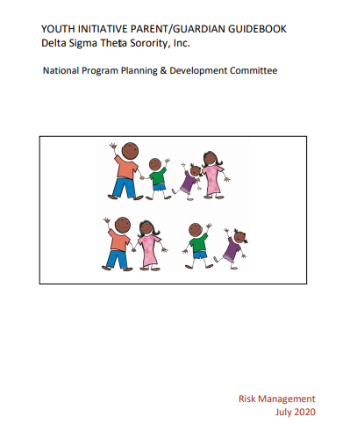
YOUTH INITIATIVE PARENT &
GUARDIAN GUIDEBOOK
© 2020 Delta Sigma Theta Sorority, Inc. This content is protected under US Copyright (17 U.S.C. §§ 201 et al.) and other federal law and shall not be published, reproduced, displayed or otherwise utilized by any party whatsoever without the express written consent of Delta Sigma Theta Sorority, Inc. Violation of Delta’s intellectual property rights will be prosecuted to the full extent of the law
Notes:
SAY: This concludes our review of Delta’s risk management principles and policies for our youth programs. Our National Risk Management team created a Youth Initiative Parent and Guardian Guidebook that each of you will receive that covers the risk management information we discussed today.
CHANGE SLIDE

Slide 25

Contact me via email at:
[email address]
© 2020 Delta Sigma Theta Sorority, Inc. This content is protected under US Copyright (17 U.S.C. §§ 201 et al.) and other federal law and shall not be published, reproduced, displayed or otherwise utilized by any party whatsoever without the express written consent of Delta Sigma Theta Sorority, Inc. Violation of Delta’s intellectual property rights will be prosecuted to the full extent of the law
Notes:
SAY: Thank you for your time and for entrusting your children to participate in our Chapter’s Youth Initiatives.
SAY: Given the time constraints for this meeting, I will be happy to answer any questions you have via email. Please email me at [give email address].
RISK MANAGEMENT COORDINATOR: GIVEN TIME CONSTRAINTS YOU MAY NEED TO TAKE THE QUESTIONS VIA EMAIL. PLEASE PROVIDE YOUR EMAIL ADDRESS SO THAT PARENTS CAN SEND THEIR QUESTIONS TO YOU.
Contact me via email at:
[email address]

