Slide 1
Technology Training
Facilitated by:
Technology Committee
Saturday, August 7, 2021
TACtical Deployment Retreat

Slide 2
Objectives
To learn how to access the Members Only Portal of the chapter’s website
To learn how to access Google drive and navigate efficiently
To learn how to utilize features of GroupMe
To learn certain features of Zoom functionality

Slide 3
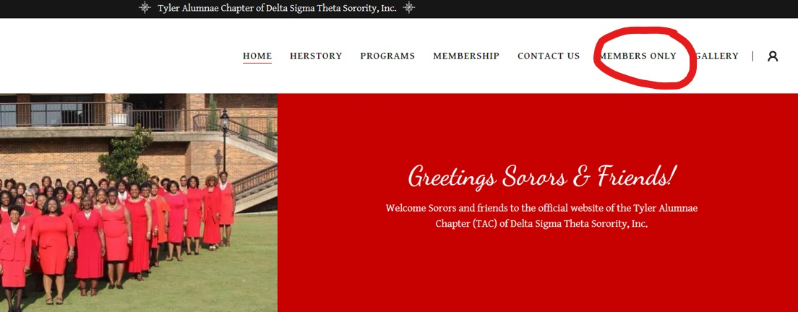
Members Only Portal
www.tyleralumnaedst.org

Slide 4
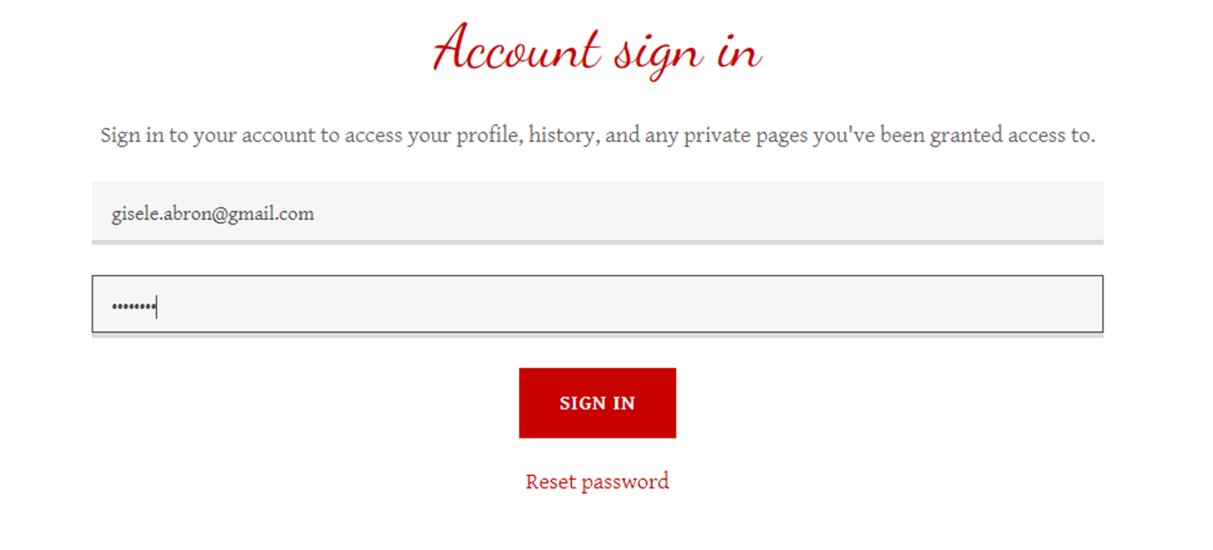


Slide 5


Slide 6



Google Drive
Presented by: Denise Pendleton

Slide 7
PURPOSE
Show chapter members how to create and access Google Drive
Explain benefits and how to navigate Google Drive

Slide 8
What Is Google Drive?
Google Drive, part of Google Workspace, is a safe place to back up and access all your files from any device.

Slide 9
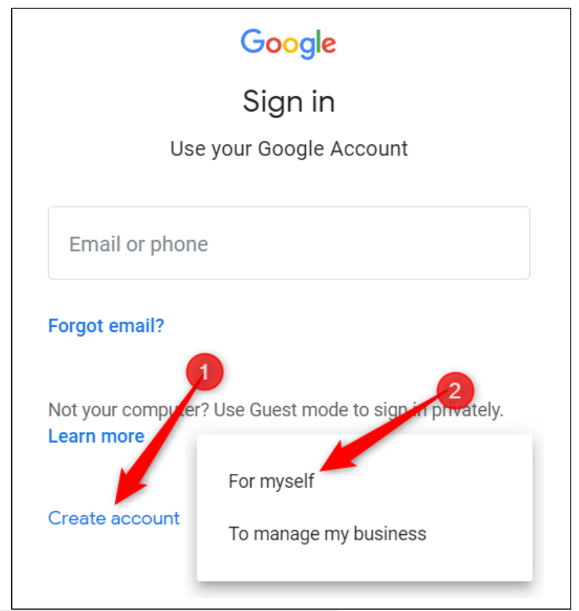

Sign Up for a Google Account
Notes:
If you do not already have a google account, you will need to create one. Go to accounts.google.com to start the process. Click create account and select for myself.
Why can’t I keep using my other email account? Well, google does allow users to share documents with non-gmail users; however, the TAC calendar cannot be shared with non-gmail users, unless the calendar is made public. Unfortunately, we will not make the TAC calendar public.

Slide 10
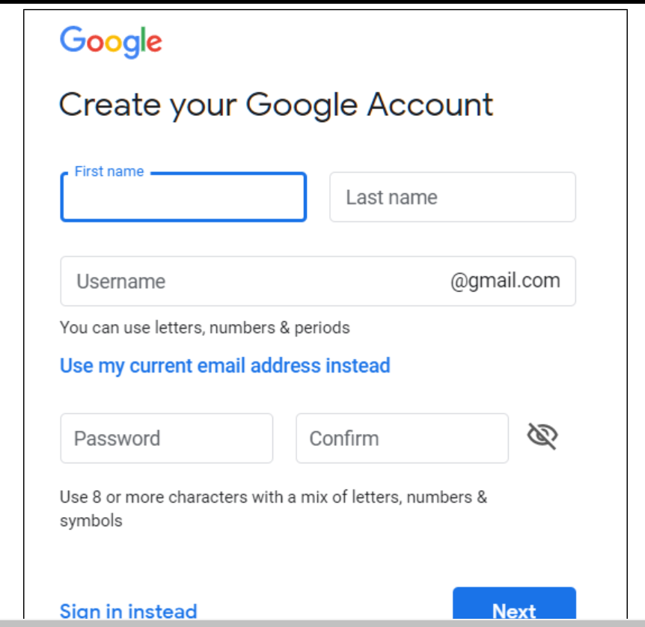

Creating a Google Account
Notes:
Fill in the information to start creating your account.

Slide 11
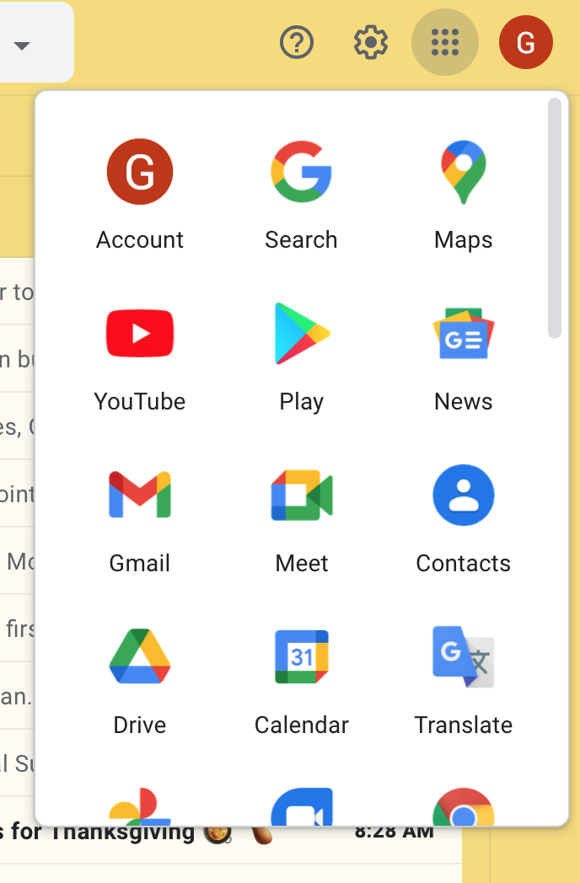

Accessing the Waffle
Click the Drive Icon
Notes:
Once you have established a google account, you have access to the entire google platform. When you open your email, at the top right-hand corner are a series of 9 dots. Click on these dots and you will see this window pane. This is another way to access to your drive while logged into your Gmail.

Slide 12
services within google drive
DRIVE
Calendars
Docs
Sheets
Slides
Photos
Google Meet
Duo
GMAIL
Youtube
News
Translate
Etc.
Notes:
Google offers many services within its platform, but the 2 we will focus on today are the drive and the calendar.
To access your drive, click on Drive.

Slide 13
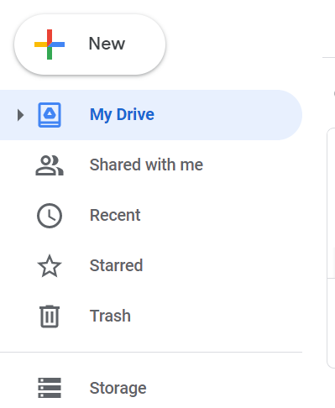
Navigating My Drive
Click the multi-colored plus sign “New” button to create or upload files
Spreadsheets, word documents, slideshow presentations, forms, drawings, photos, etc.
Notes:
During this session, we are not going to go deeper into creating documents. In the meantime, keep in mind, this is just like using Microsoft Word.
From this pane you can access your drive as well as shared files.

Slide 14
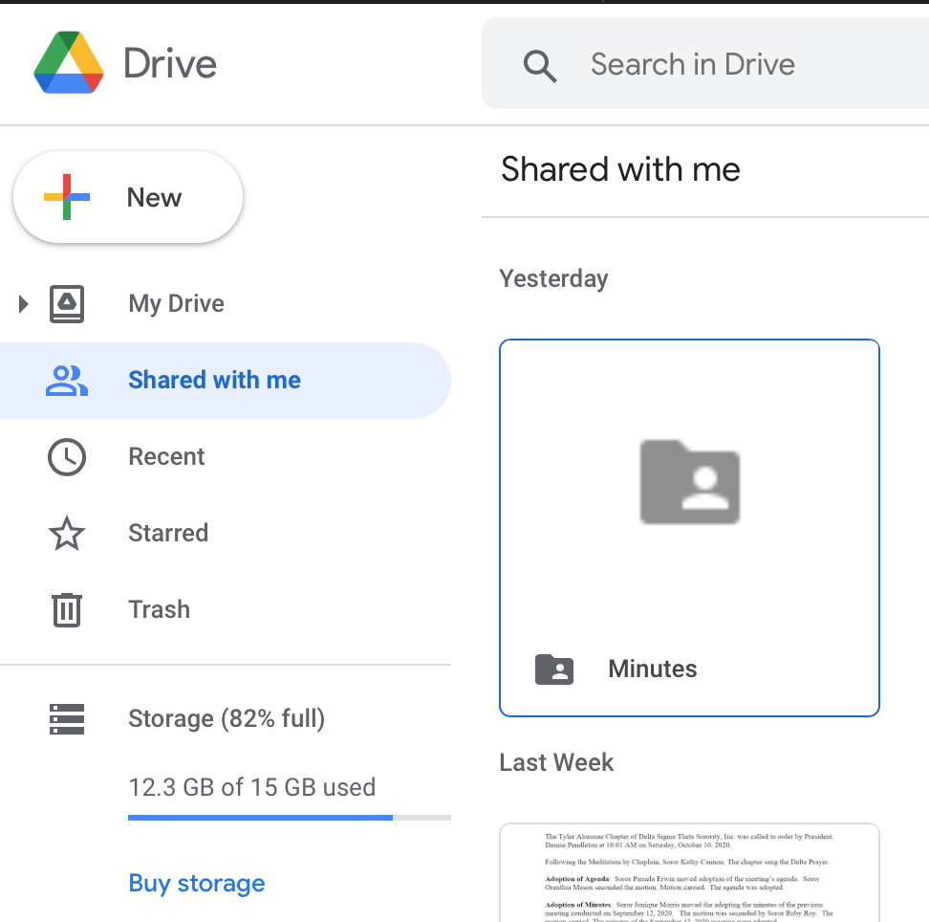
How to Access Shared Documents
Click ‘Shared with me’
All documents that are shared with you will be stored here (spreadsheets, photos, word files, powerpoints, etc)
You can make changes to a shared file and the person that shared the file will be able to see the changes
Notes:
This is what you will see next.
Shared files are good for collaborating with your committee before the document is disseminated to the chapter. You can use shared files to review committee minutes or notes before they are submitted to executive board and for the chapter meeting powerpoint. Multiple people can work in a file at the same time and you will be able to see that person in the file while you are in the file. You don’t have to worry about saving the document because they are automatically saved.

Slide 15
Benefits for tac
Financial Members have access to the chapter’s calendar
Financial Members have access to shared information
Eliminates multiple docs floating around

Slide 16


Slide 17
Groupme
Facilitated by: Hollisia Allen

Slide 18
Objectives
Learn how to set up an account
Learn how to create a specific group or send a Direct Message

Slide 19



Account set up
Download the app through your App Store (iphone) or Google Play
www.groupme.com

Slide 20
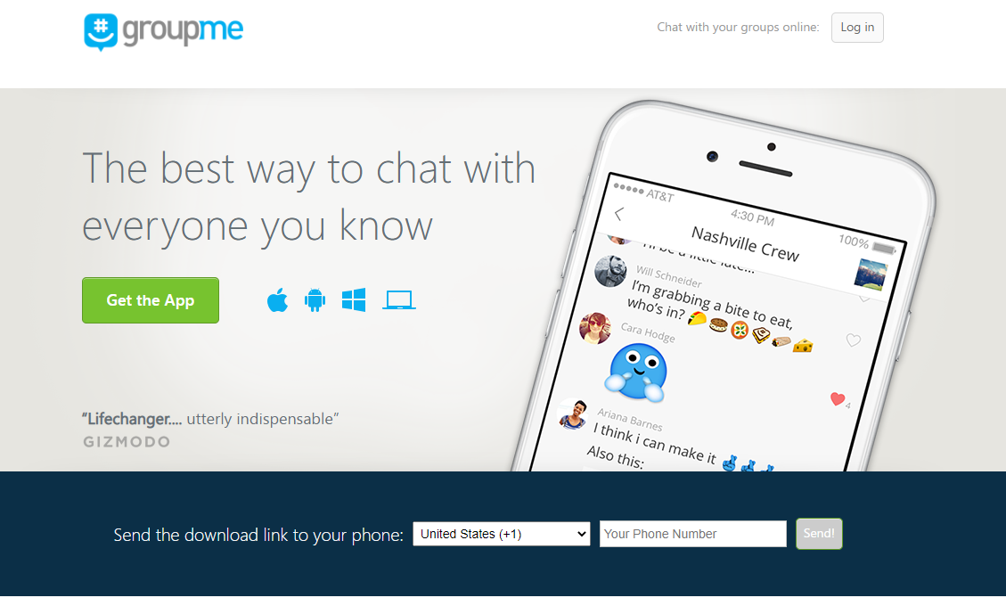
www.groupme.com
Notes:
Go to www.groupme.com via your computer. It is best to do this from your computer if you really want to see the platform on a larger scale.
Click on Log-in.

Slide 21
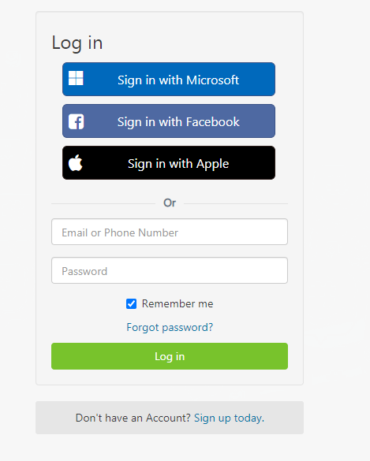

If you already have an account, you can log in through Microsoft, Facebook or Apple. Or, enter your log in email/phone number and password.
If you do not have an account, click Sign up today. (If you are currently just receiving text messages, you do not have a groupme account.)

Slide 22

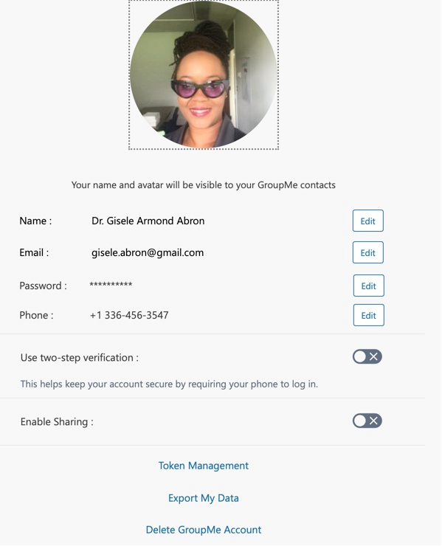
Profile
Add a picture
Edit Name
Edit Email
Edit Password
Edit Phone
Etc.

Slide 23
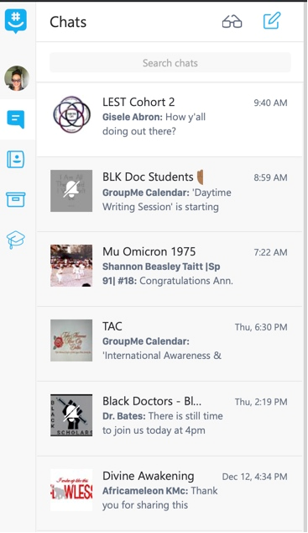
When logged in, you will see all groups in which you are a member.

Slide 24
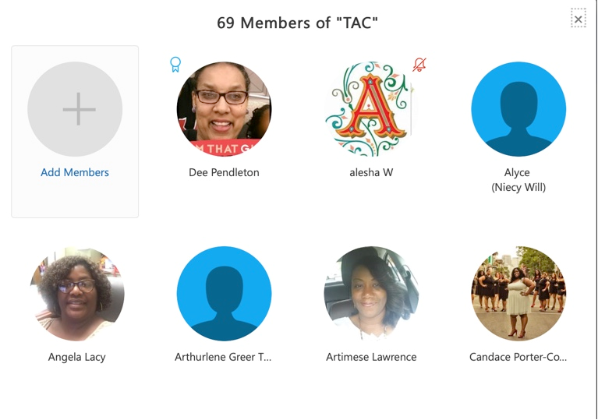

Slide 25
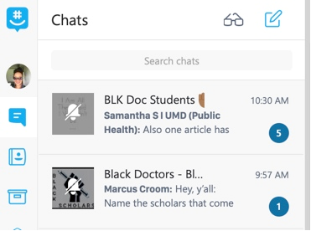
Notes:
Once you have muted the group, you will see the bell with a slash symbol.

Slide 26
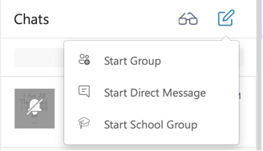
Create a Direct Message
Notes:
Committee Chairs can create committee groups by clicking this icon and selecting start group.

Slide 27


Groupme mobile app
Notes:
If you do not have the mobile application on your phone, please download the app through the App store for iphone users or Google Play for Android users. Log in using your credentials previously created on the website – OR sign up through the app to create your account. Utilize the same steps in slides 5-7.

Slide 28
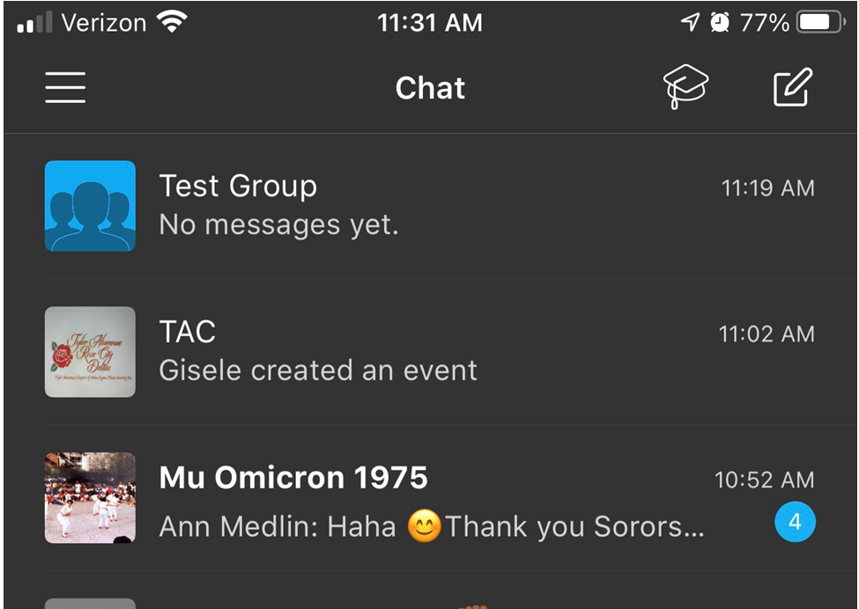
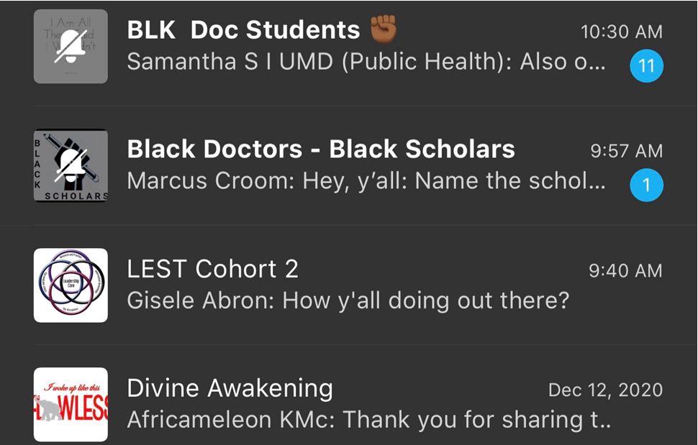
Notes:
When you log into the app, this is a view of the groups from the mobile application. I have changed my background color so don’t be distracted.

Slide 29
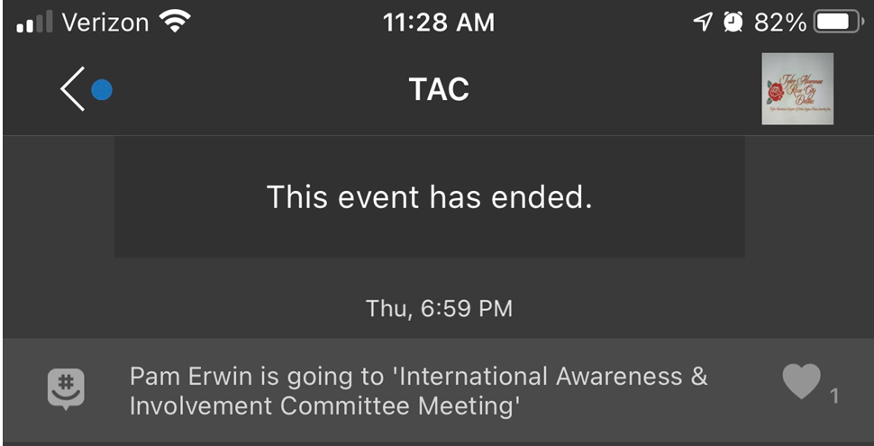
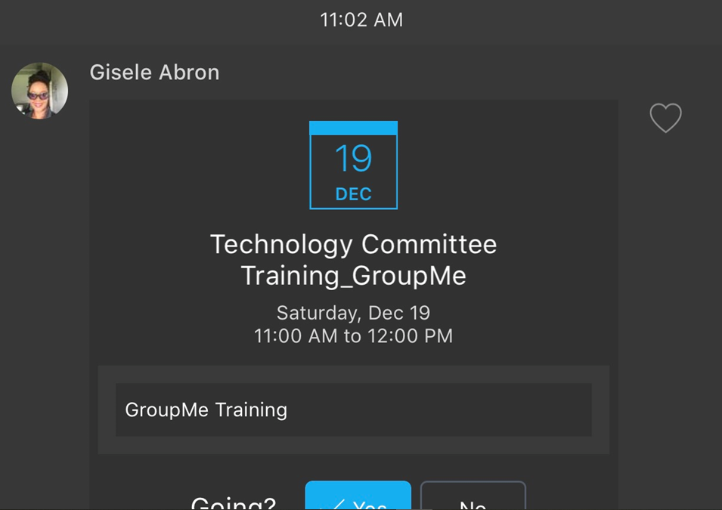
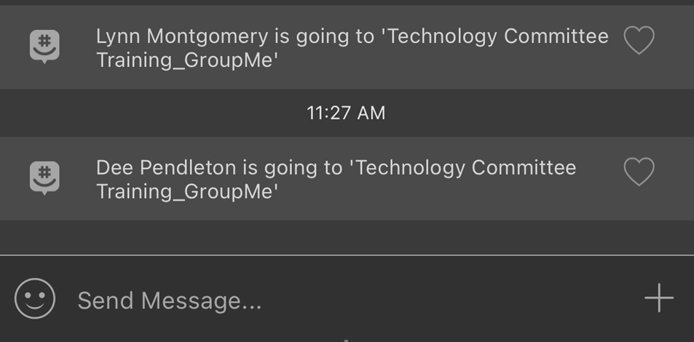
Notes:
When you open the TAC group, you will start to see the last message that you read. Scroll down to read all new messages. This screenshot shows

Slide 31




Presented by:
Jaide Williams
Notes:
Greetings Sorors! You asked and we listened! Today we are going to provide a brief overview of Google Drive. As you know, the chapter no longer utilizes yahoo groups. We have implemented the use of Google, which allows more flexibility and manageability of the chapters documents, spreadsheets, powerpoints, calendar, etc.

Slide 32

PURPOSE
Show members how to add a background on Zoom.
Show members how to change their profile picture on Zoom
Show members basic level information on how to utilize Zoom.

Slide 33

What Is Zoom?
Notes:
Zoom is a cloud-based video communications app that allows you to set up virtual video and audio conferencing, webinars, live chats, screen-sharing, and other collaborative capabilities.
You don't need an account to attend a Zoom meeting, and the platform is compatible with Mac, Windows, Linux, iOS, and Android, meaning nearly anyone can access it.
https://www.businessinsider.com/what-is-zoom-guide#what-is-zoom?

Slide 34
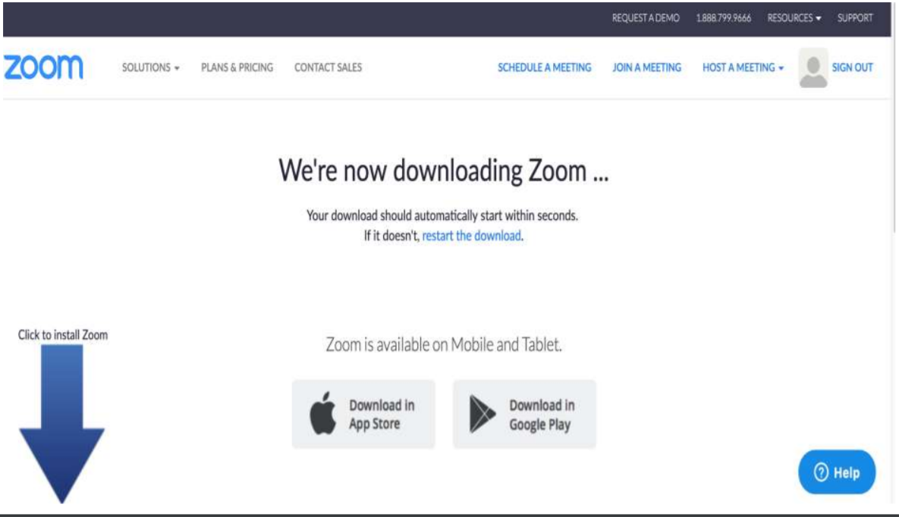
Download Desktop App
https://zoom.us/support/download
Notes:
If you do not already have a zoom account, you will need to create one. Go to https://zoom.us/support/download to start the process. Click create account and select for myself.

Slide 35
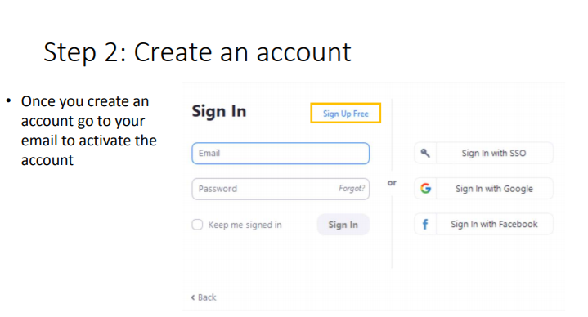
Creating a Zoom
Account
Notes:
Once you create an account go to your email to activate the account

Slide 36
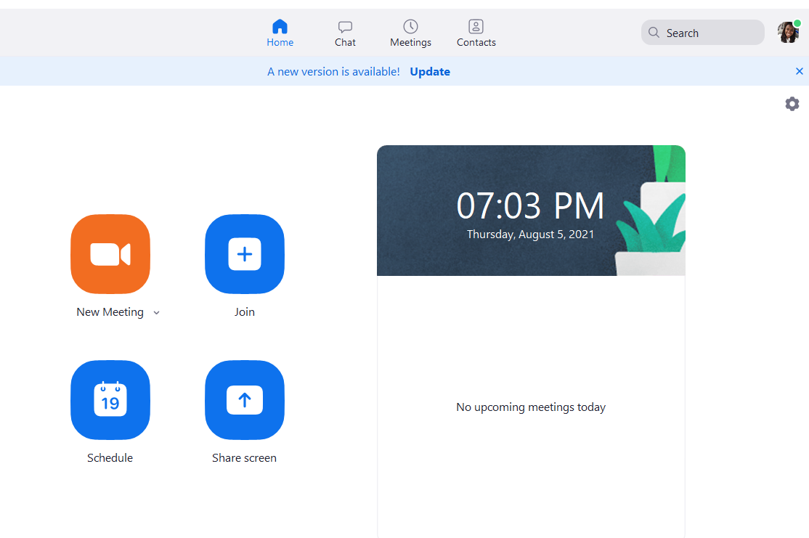
Sign into Account
Notes:
• New Meeting: Start a new meeting by clicking the downwards arrow.
• Join: Join a meeting that is in progress.
• Schedule: Setup a future meeting.
• Share Screen: Share your computer screen in Zoom Room by entering in the sharing key or meeting ID.

Slide 37
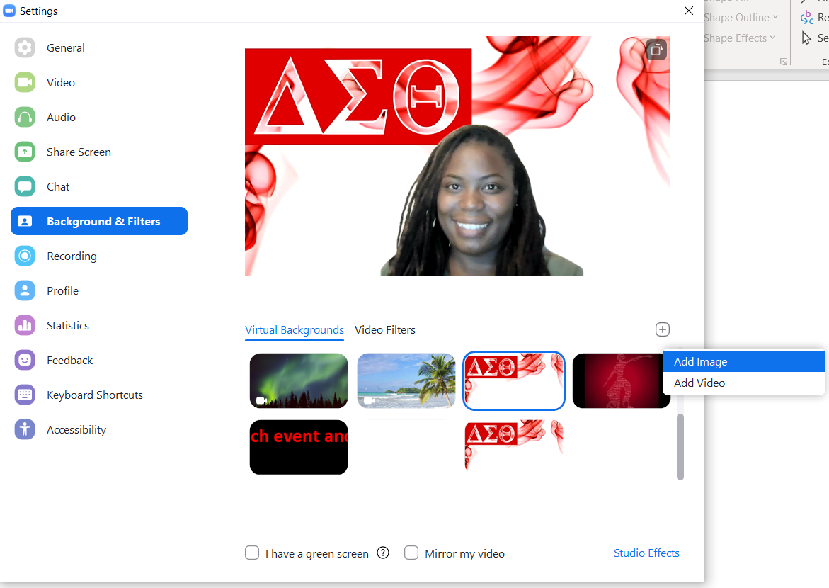
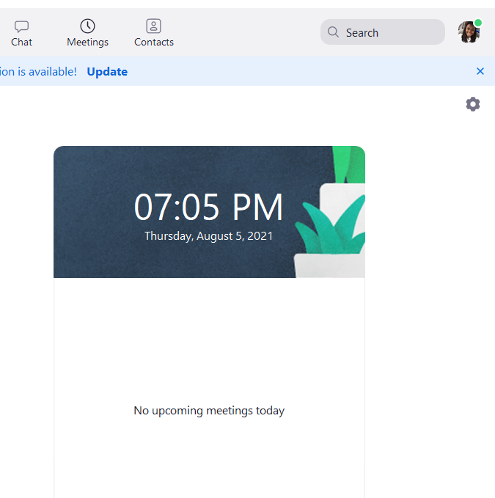
Adding a background
Notes:
Go to settings, In the right corner of your screen, then choose Background & Filters- choose appropriate backgrounds. If you do not wish to use the given backgrounds, you may add an image then select your image. Zoom backgrounds can be found in the members only section.

Slide 38
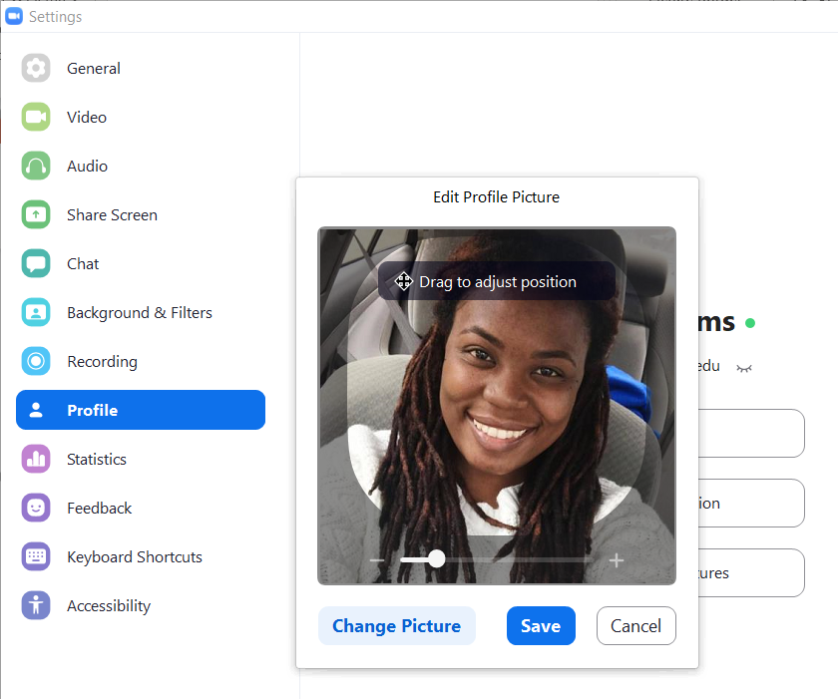
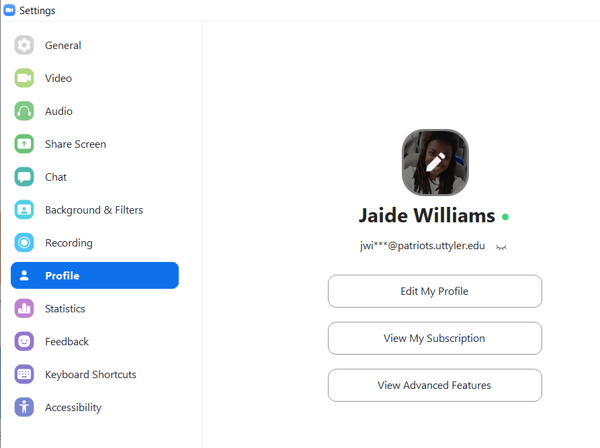
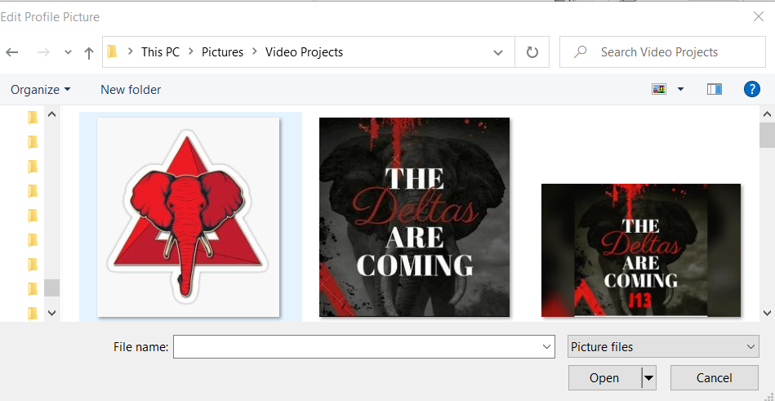
Adding a picture-desktop
Go to Settings
  Click on Profile
  Click on Picture
  Change Picture
  Select Picture, Open and Click Save

Slide 39
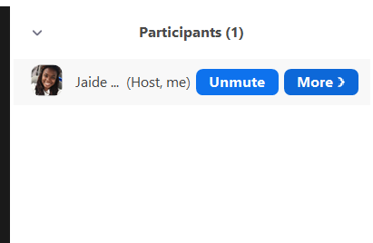
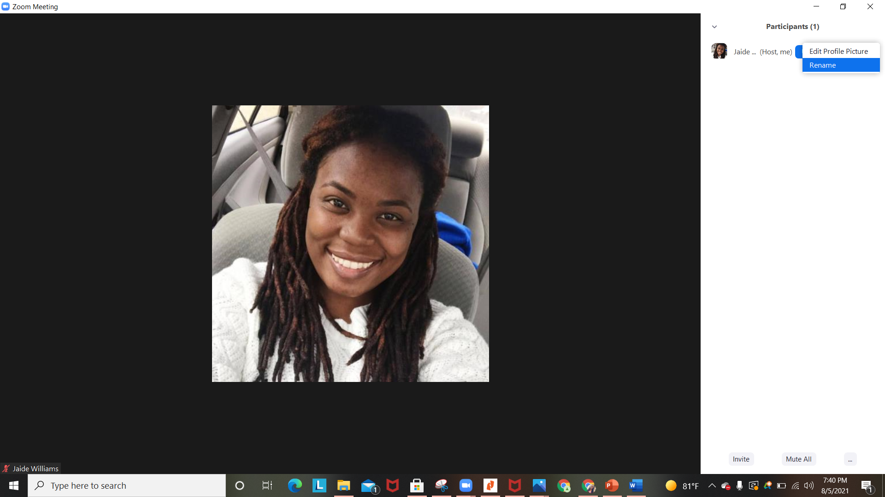
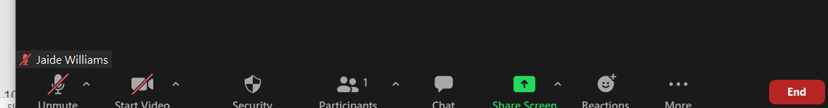
Changing your name
Click on Participants Click on Profile
  Hover over your name on the right
  Click More
  Rename
Notes:
.

Slide 40
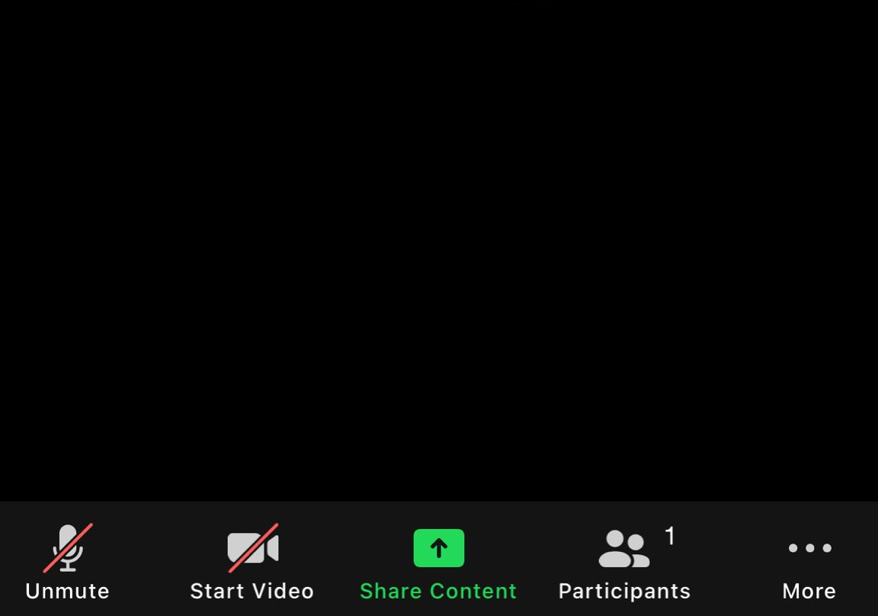
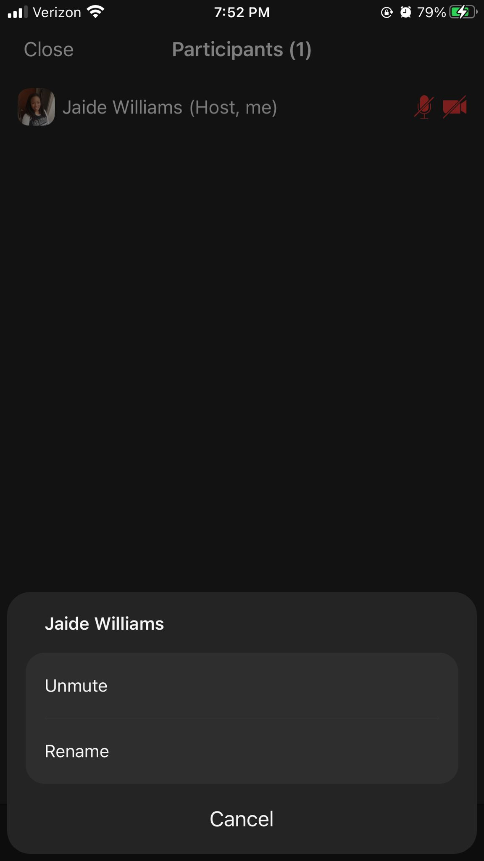
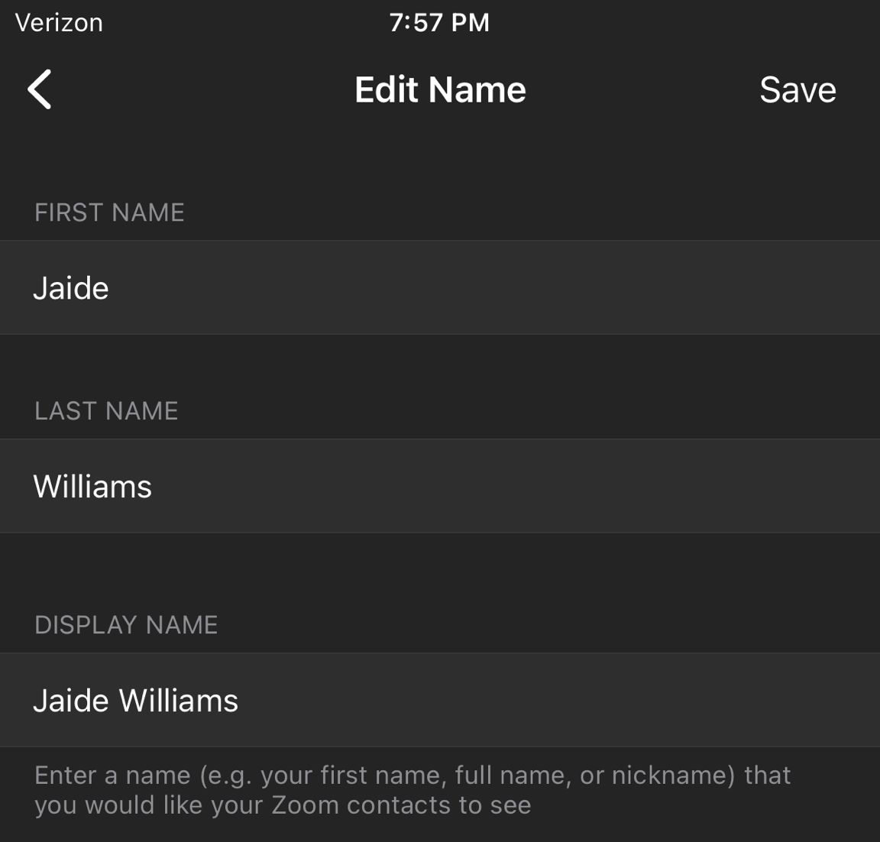
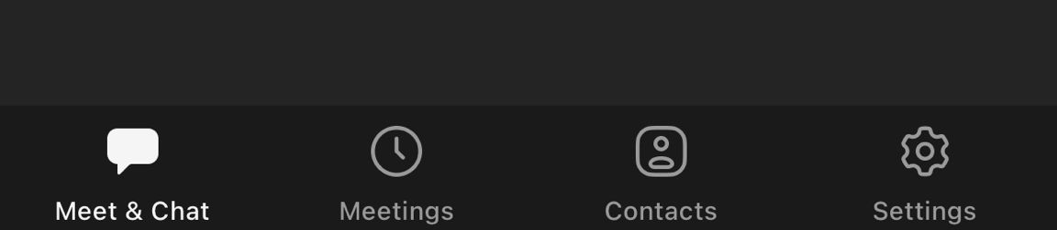
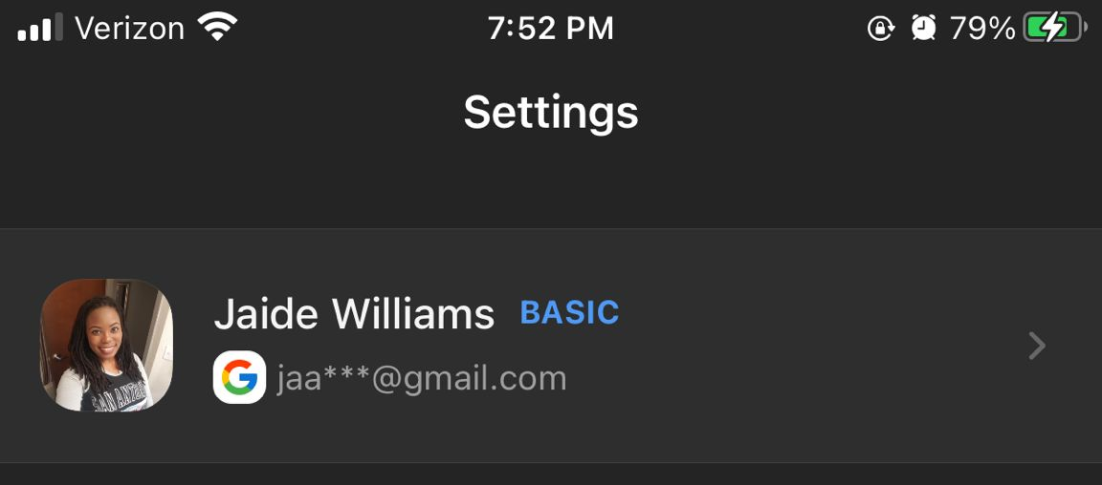
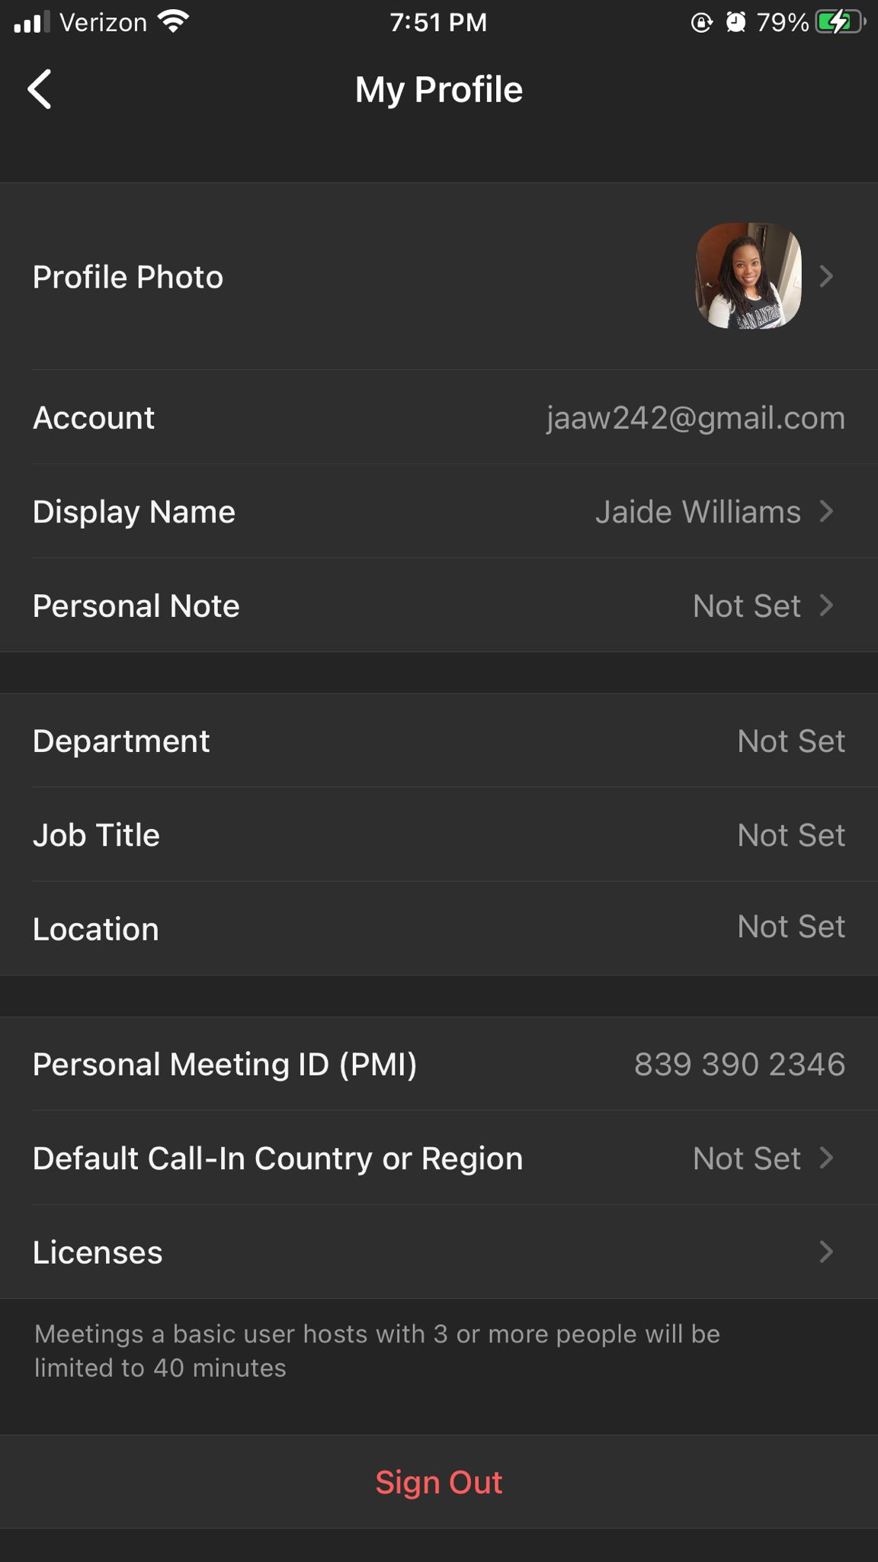
Changing your name-phone
Go to Settings
  Click on Arrow
  Click on Display Name
  Change Display Name

Slide 41

Practice makes perfect...Volunteer needed!
Walk a Soror through establishing her zoom account and changing their profile picture and background.
Notes:
***If time permits, we can allow 1-2 sorors to navigate your zoom account

Slide 42

Zoom zoom zoom
How to Schedule a Zoom Meeting https://www.youtube.com/watch?v=LE2w9tRpF4I (1 min. 16 sec)
How to Share your Screen https://www.youtube.com/watch?v=YA6SGQlVmcA
(1 min. 11 sec)
How to Use Breakout Rooms https://www.youtube.com/watch?v=jbPpdyn16sY
(3 min. 18 sec)
Notes:
let’s briefly review a few videos regarding Zoom.
By establishing a google account, you now have a Youtube account. You can search how-to videos to learn how to do anything you can possibly think of. Zoom has a channel that you can subscribe to as well.

Slide 44
References
https://www.slideshare.net/JoannaAbderholden/zoom-tutorial-164865199
https://www.businessinsider.com/what-is-zoom-guide#what-is-zoom?
Technology Committee
Zoom Youtube Channel

