Slide 1

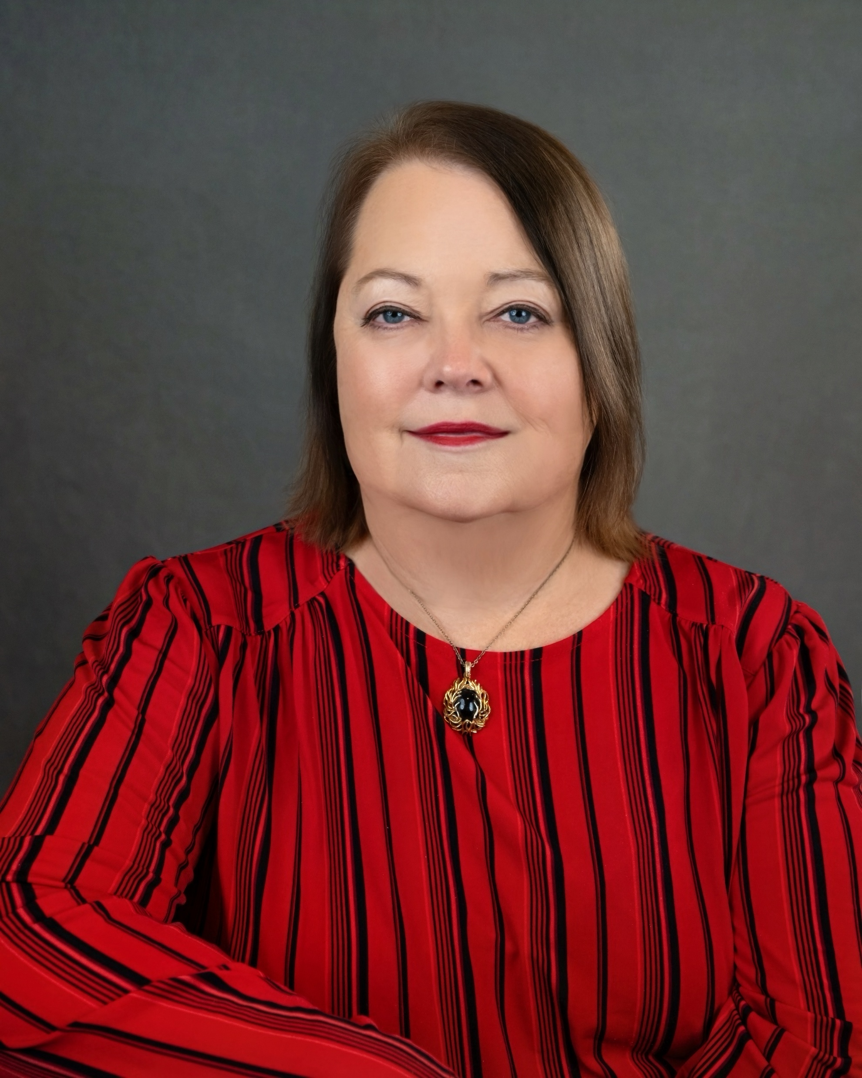
Wilson County Republican Women’s Club
June 2026
Volume 4 issue 6
TX Region 14, Senate District 21
wilsoncountytxrepublicanwomen.org | FB: @WilsonCountyRepublicanWomen’sClub
Table of Contents
President’s Pen
President’s Pen
Upcoming Meetings
Americanism/
Armed Services
Legislative
TFRW Article
6. Membership
Caring for America
Calendar of Events
RPT Convention Highlights
11. Scholarship
12. Political Activities
What’d You Say, Google Girl?
The road trip to the Texas GOP Convention was fun. Since my 2008 Dodge van has no mapping screen, I used Google Maps. Loretta Carter named the app’s voice “Google Girl.” After a few turns,
Google Girl learned my route—an example of AI adapting to users. A Lunch and Learn program, AI: Prosperity, Power, Grab or Peril?, reminded us AI is already here, often used unknowingly. It can help, but it must be controlled.
Loretta and I arrived Wednesday at Hilton Americas, the convention host hotel. With no Hilton parking garage, we used valet parking while the convention center garage was demolished for expansion before the 2028 Texas GOP and National GOP Conventions. We then picked up our credentials.
Thursday the General Session began with more than 3,300 delegates. alternates and guests from 217 counties. Wilson County was in the SD-21 delegation which held its first Senate District Caucus on Thursday, approved permanent officers, and named Rita Jordan permanent caucus chair. Afterward, we enjoyed Lt. Governor Dan Patrick’s Ice Cream Social.
Friday’s second Senate District Caucus elected Rita Jordan and Randy Purnam as SREC Committeewoman and Committeeman. Delegates also elected D’rinda Randall as Texas State Republican Chairman and David Covey as Vice Chairman. Strong Senate District support for Randall and Covey led Chairman George to concede at the Second General Session.
Saturday featured committee reports, delegate motions, and a final platform vote. Two attempts to replace Chairman George with a temporary chair were met with boos. Platform planks were voted on.
My advice: go with a friend, wear walking shoes, and have fun! P.S. The elephant pee’d on the convention floor!
Birthdays
Louise Jung-Jenschke: July 6
Betty Maultsby: July 11
Sarah Gella: July 13
Awilda Borchers: July 15
Wanda Reid: July 17
Iris Burris: July 25
Susan O Lasiter: July 29
Lauren Gaudlitz: July 30
Lynette Gray: Aug 8
Lynette Shaw: Aug 12
Heather Bales: Aug 13
Lori Hrna: Aug 16
Dawn Barnett: Aug 18
CJ Rutland: Aug 18
Kitty Phillips: Aug 27
Ruby Manen: Aug 30
Alene Quinney: Aug 31
Links
NFRW
TFRW
Anna
Anna Willis
President
Submit articles:
Sharon.a.meyer80@gmail.com 830-583-5297
Political Advertising Paid for by : Wilson County Republican Women’s Club PAC

Slide 2
Wilson County Republican Women’s Meeting
No meeting is scheduled in July. Enjoy your summer and see you in August!
Witte’s BBQ & Steakhouse 12153 US Highway 87 W La Vernia, TX
Tuesday, August 25, 2026
Doors open @ 5:30 PM
Meeting starts @ 6:00 PM
Guest Speaker:
TX House 21 Rep, Ryan Guillen
Legislative Update for New Session
Jack’s Café 507 10th St, Floresville, TX
Tuesday, September 22, 2026
Doors open @ 11:30 AM
Meeting starts @ 12:00 PM
Jon Melendez-Property Tax Reform
Meeting is open so please bring a friend or relative.
Executive Committee
President: Anna Willis
210-722-3410 /swoozie2@sbcglobal.com
First Vice President: Sarah Gella
210-275-9091/kernel100@aol.com
Treasurer: Dawn Polasek Barnett
210-744-5868/dawnpbarnett@yahoo.com
Secretary: Sarah Gella
210-275-9091/kernel100@aol.com
VP Membership: Ruby Manen
830-391-0818/rubymanen@yahoo.com
VP Legislation: Melissa Moczygemba
210-913-1355/Melricventures@gmail.com
VP Political Activities: Joyce Miller
210-827-1814/millerjab64@gmail.com
VP Awards: Sharon Meyer
830-583-5297/Sharon.a.meyer80@gmail.com
VP Americanism/Armed Services: Marguerite Griffin
210-685-3703/marmiles4d@gmail.com
Committee Chairs
Community Engagement:
Caring for America: Lori Hrna
Literacy: Ruby Manen
Chaplain: Mata Orth
Historian:
Scholarship: Loretta Carter &
Barbara Burdette
Hospitality: Kitty Phillips
TFRW President: Jill Tate
214-354-9443, president@TFRW.org
District Director: Ruby Manen
830-391-0818
rubymanen@yahoo.com
Deputy Regional President:
Karen Newton
-2-
Political Advertising Paid for by : Wilson County Republican Women’s Club PAC

Slide 3

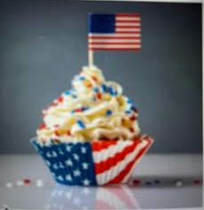
Americanism and Armed Services
A Unifying Moment
Marguerite Griffin
Americanism/Armed Forces Chair
America’s 250 can be a unifying moment – not because everyone sees
the past the same.
America 250 is the official name for the United States semi quincentennial – 250th anniversary of the founding of the nation. The centerpiece is July 4, 2026, marking exactly 250 years since the Declaration of Independence was adopted by the Continental Congress in Philadelphia in 1776.
But honestly? Some of the most meaningful celebrations won’t happen at big national events. They will happen at kitchen tables, in backyards, and in living rooms - with families who chose to make this moment count.
Why is this one special? The bicentennial in 1976 was a big event – but most of us weren’t there for it. The next semi quincentennial won’t happen until 2276. The kids who are growing up right now are living though something genuinely rare, and I think that it is worth pausing on.
Picnics, parades, and of course pyrotechnics. They evoke many wonderful memories. This year helps our kids and grandkids realize why we are celebrating not just that we celebrate. You don’t need a big event or special trip to make America 250 meaningful.
Read And Explore All 50 states - their capitals, landmarks, their histories.
Read And Explore National Parks – a living piece of American history and natural wonder.
Start a new family tradition, have those in your military family share and record their experiences/story.
Whatever it looks like for your family - even one small thing that
makes the day feel different – is worth doing.
Our world is changing, but it is time to revisit what happened
on that day in 1776 – and the years of struggle and courage that
led up to it. It’s important to our future by remembering our past.
All the lives given for our freedom shall not be in vain.
Happy Birthday America and God Bless the USA.
-3-
Political Advertising Paid for by : Wilson County Republican Women’s Club PAC

Slide 4
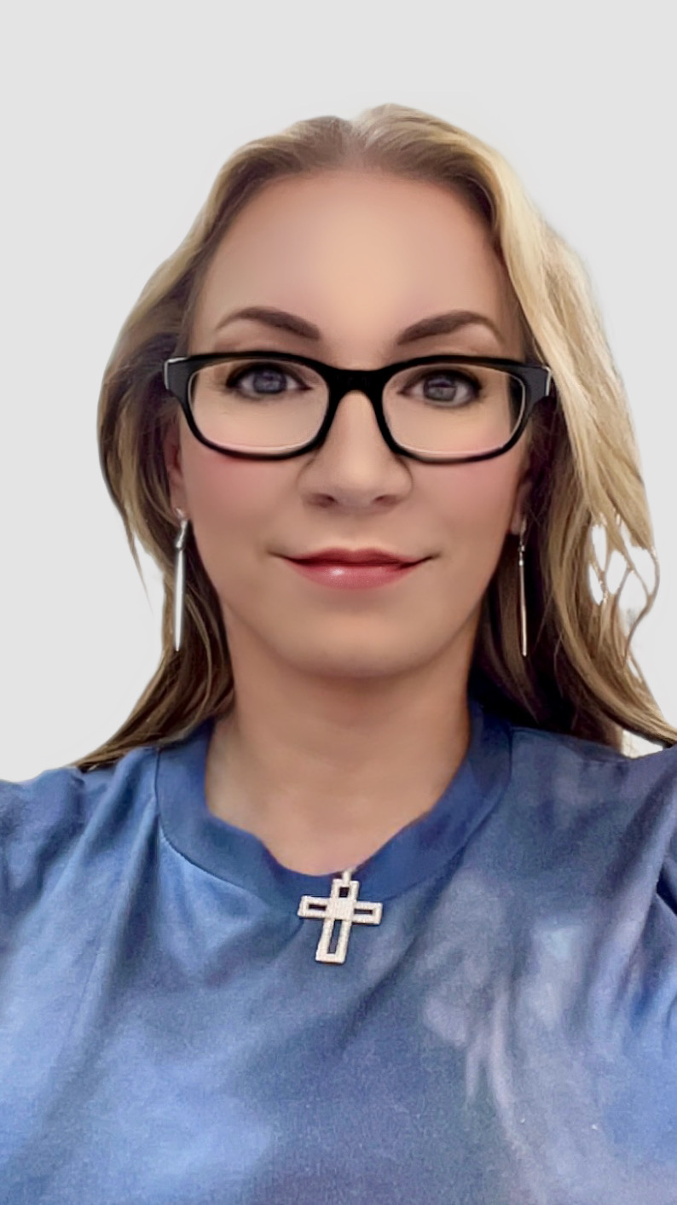
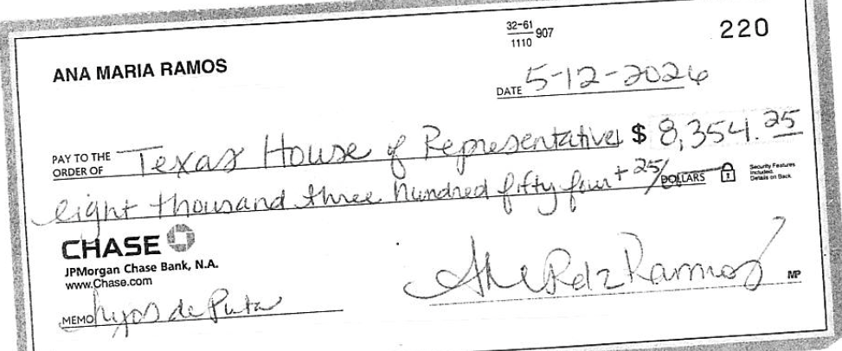
Democrats Still Have Not Paid Imposed Fines
Melissa Moczygemba
VP Legislation
Despite a May 5 deadline to pay fines for breaking quorum and running over
Congressional redistricting last year, 14 of the 53 Texas House Democrats who
absconded have failed to make the required payment.
State Representative James Talarico, who is running for the U.S. Senate; State
Representative Gina Hinojosa, who is running for Governor; and State Representative Vikki Goodwin, who is running for Lt. Governor HAVE MADE NO ATTEMPT TO PAY.
State Representatives Alma Allen, Nicole Collier, Yvonne Davis, Harold Dutton, Suleman Lalani, Ray Lopez, Terry Meza, Penny Morales Shaw, Ron Reynolds, Senfronia Thompson, and Chris Turner, also FAILED TO PAY.
Those lawmakers who failed to pay the fines imposed on them are now subject to having a portion of their official office budget withheld.
Under Rule 5, Section 3(f) of the Texas House Rules, the House Administration Committee “shall direct the House Business Office to reduce the amount of the monthly credit to the member’s operating account established under the housekeeping resolution by 30 percent in each month that any amount of a fine remains past due and owing.” Once paid the money is released.
House Rules state fines and costs cannot be paid with a member’s official office account or political contributions. Some members paid with personal bank accounts, three legislators – State Representatives Diego Bernal, Armando Walle, and Gene Wu – paid their fines with checks that appear to be drawn on bank accounts of law firm entities THEY OWN.
Several of the Democrat quorum busters paid while using the memo lines to send defiant – and obscene – messages. “B.S.”, wrote San Antonio Democrat Diego Bernal. Houston Democrat Jolanda Jones had her check reflect, “Paid subject to objection and appeal; Absence at direction of constituents; Official legislative duties.” Plano Democrat Mihaela Plesa, who represents a swing district, wrote, “A small price to pay to try to save democracy!” Ana Maria Ramos of Dallas County, one of the most outspoken liberal voices in the Texas House, wrote a vulgarity in Spanish on the memo line of her check. “Hijos de puta,” wrote Ramos. While the amounts of the fines and costs imposed on each of the quorum-busting Democrats varied due to the number of days.. $6,000 in fines and $2,354.25 in DPS costs, for a total of $8,354.25.
-4-
n
Political Advertising Paid for by : Wilson County Republican Women’s Club PAC

Slide 5
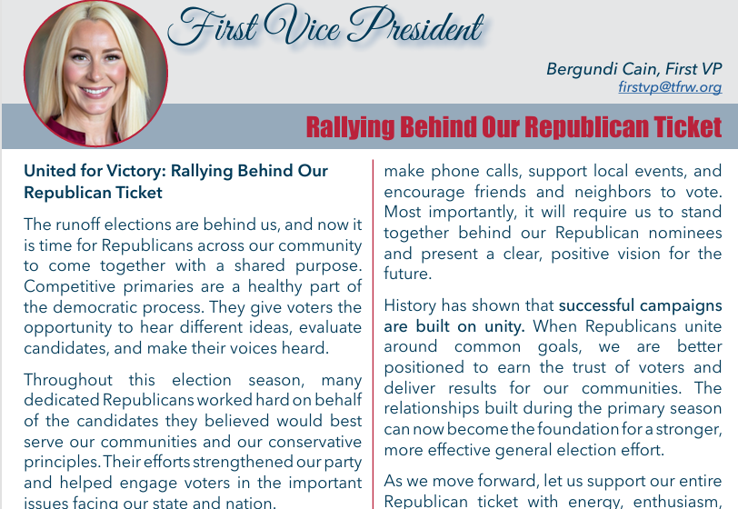
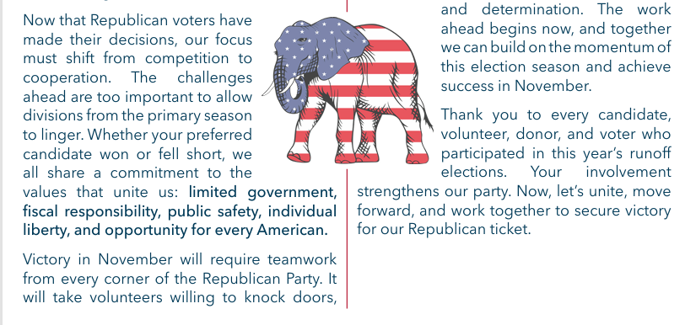
.
TFRW Today June 2026
-5-
Political Advertising Paid for by : Wilson County Republican Women’s Club PAC

Slide 6

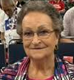



Membership
Why become a member of the Wilson County Republican Women’s Club?
Vice President J.D. Vance recently shared the following information about the
2026 midterm turnout projections. Only 61% of Republicans plan to vote in the
midterms, that means 4 in 10 Republicans say they may stay at home. If this
happens, Democrats will take back the House and the Senate--therefore, ending
President Trump’s agenda.
So, now you are probably thinking, what does this have to do with our Women’s Club
membership? It should be our driving force to increase our membership. Republican Women are the mainstay of Republican Get-Out-the-Vote efforts. Following that train of thought, if our membership is bigger, we will have more influence on turnout for the November election. Turnout is the only way for us to defeat the Democrats in November!
We have heard the phrase “this is the most important election we have ever had” for many previous elections. Well, in my opinion the General Election in November is indeed the most important election that most of us will ever experience. At stake is whether our Constitutional Republic endures or whether we become a Democrat Socialist, aka Communist, country.
Ask your family, friends and neighbors to join our Club and participate in this GOTV effort!
Ruby Manen
Membership VP
(830) 391-0818
rubymanen@yahoo.com
*Active Members: $30 for 1 year
Associate Members: $10 for 1 year
*Includes membership in Texas Federation of Republican Women (TFRW)
*Includes membership in National Federation of Republican Women (NFRW)
Meeting Schedule
August 25, 2026
September 22, 2026
October 27, 2026
-6-
Political Advertising Paid for by : Wilson County Republican Women’s Club PAC

Slide 7
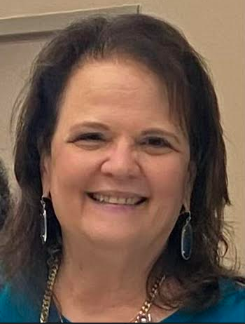
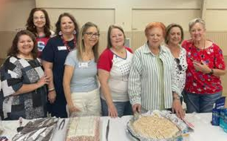
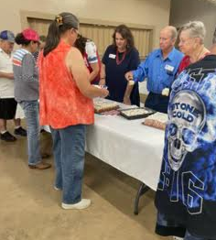
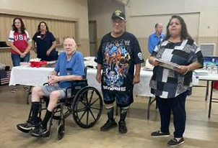


Caring for America
Tuesday, May 20, 2026
Wilson County Expo & Community Center (Show Barn)
Lori Hrna, Chairman
Veronica Arriaga, Yvonne McMurray, Lori Hrna, Delfina Matay, Anna Willis, Theresa Soberoski, Louise Jung Jenschke, Sarah Gella (Not pictured Paul Watson and Dawn Barnett
Bingo Birthday Bash
WCRW celebrating birthdays with seniors for lunch & games
.
2026 Birthday Bingo Bash dates for 2026 (All Wednesdays)
July 15, 2026 – Sarah Gella, Loretta Carter, Ginny Glowka, Yvonne McMurray, Lori Hrna, Ruby Manen
August 19, 2026 – Lori Hrna, Sharon Meyer, Mata Orth, Louise Jung-Jenschke, Yvonne McMurray, Ruby Manen
September 16, 2026 – Lori Hrna , Yvonne McMurray, more volunteers needed
October 21, 2026– Lori Hrna, Yvonne McMurray – need more volunteers
November 18, 2026 – Sarah Gella, Melissa Moczygemba, Carol Chitty, Ruby Manen, Lori Hrna, Yvonne McMurray - need more volunteers
December 16, 2026– Sarah Gella, Melissa Moczygemba, Carol Chitty, Ruby Manen, Lori Hrna, Yvonne McMurray- need more volunteers
If you haven't signed up for a month, check with Lori Hrna, 210-382-8766.
-7-
Political Advertising Paid for by : Wilson County Republican Women’s Club PAC

Slide 8
Calendar
TFRW Events July 10-11: Quarter 3 Board of Directors Meeting – Georgetown, TX Sep 17-18: Quarter 4 Board of Directors Meeting – Round Rock, TX Sep 19: Tribute to Women – Round Rock, TX
WCRW Events
July 15: Bingo Birthday Bash, Wilson County Expo Ctr. Floresville, 11:30 AM
August 19: Bingo Birthday Bash, Wilson County Expo Ctr, Floresville, 11:30 AM
August 25: Meeting, Wittie’s BBQ, La Vernia, 5:30 PM
Sept 16: Bingo Birthday Bash, Wilson County Expo Ctr, Floresville, 11:30 AM
Sept 22: Meeting, Jack’s Café, Floresville, 11:30 AM
Oct 21: Bingo Birthday Bash, Wilson County Expo Ctr, Floresville, 11:30 AM
Oct 27: Meeting, Jack’s Café, Floresville, 11:30 AM
Nov 18: Bingo Birthday Bash, Wilson County Expo Ctr, Floresville, 11:30 AM
Dec 16: Bingo Birthday Bash, Wilson County Expo Ctr, Floresville, 11:30 AM
Wilson County Republican Party Important Dates
Tuesday, July 21, 2026: CEC Bi-Monthly Meeting, 6:00 PM
Tuesday, Sep 15, 2026: CEC Bi-Monthly Meeting, 6:00 PM
Tuesday, Nov 17, 2026: CEC Bi-Monthly Meeting, 6:00 PM
TBD: Christmas Party
-8-
Political Advertising Paid for by : Wilson County Republican Women’s Club PAC

Slide 9
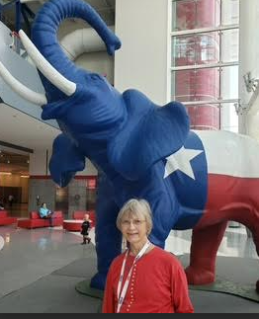
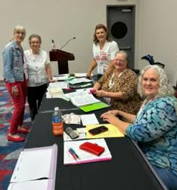
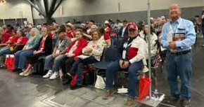
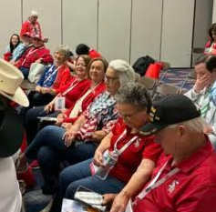
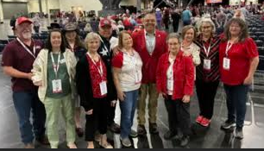
Republican Party of Texas State Convention
June 11-13, Houston, Texas
Convention 1st Timer, Susan Jaloway
The June 2026 Republican state convention was my first convention ever! Sitting around a table with friends voicing desires for the government to do things is one thing. Putting those ideas into words in a congruent manner to be presented to the State Legislature is quite another. Good knowledge of Robert’s Rules of Order and Texas State Convention Rules is a must.
During the convention, my respect for the men and women of the Republican party who are responsible for putting these ideas on paper has grown substantially. One of our objectives was to get 3000 people to take about 300 ideas and to vote on which ones we wanted to forward to Austin as Legislative Priorities and Platform Planks.
But, before we could ever get to that, we had to decide who was going to lead the Republican party at the state level and in each senatorial district for the next 2 years.
It felt good to know I was part of those people actively trying to keep Texas for the people by the people.
KEEP TEXAS RED!
-9-
Political Advertising Paid for by : Wilson County Republican Women’s Club PAC

Slide 10
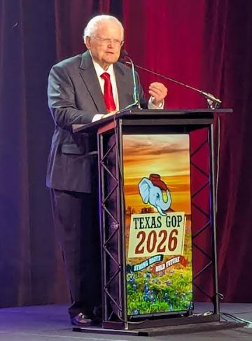
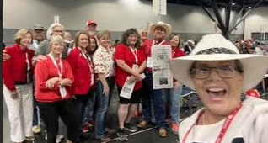
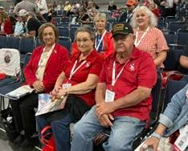
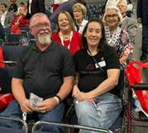
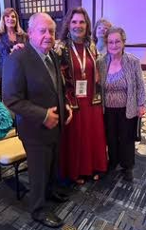
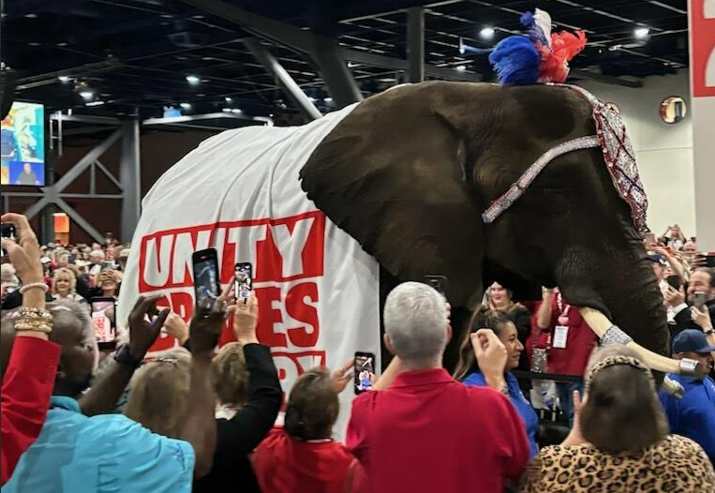
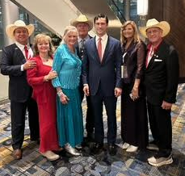
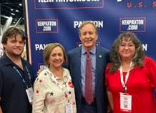
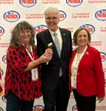
Pastor John Hagee
US Rep, Brandon Gill
Ken Paxton
Dan Partick
-10-
Political Advertising Paid for by : Wilson County Republican Women’s Club PAC

Slide 11
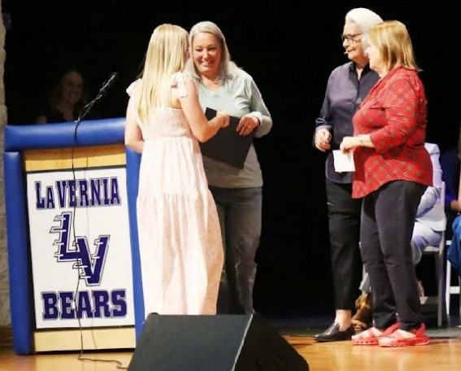
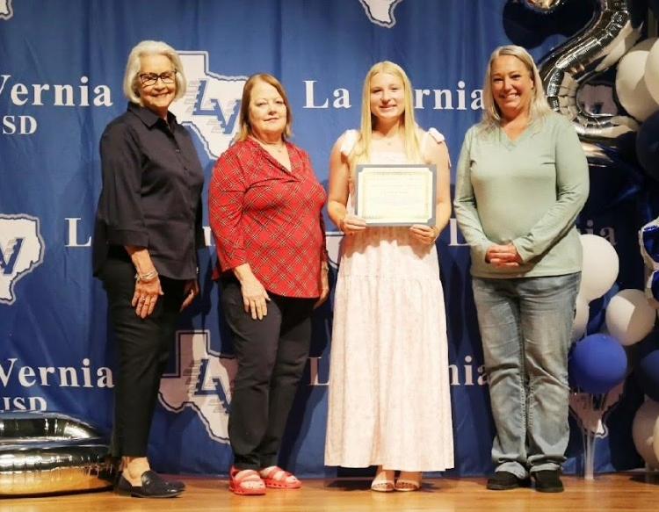
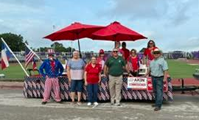
WILSON COUNTY REPUBLICAN WOMEN’S SCHOLARSHIP PROGRAM
Twelve applications were received this 2025-26 school year. Scholarship applications were received from each high school in Wilson County as follows:
La Vernia HS – 7
Floresville HS – 1
Poth HS – 3
Stockdale HS – 1
Only 11 applications were read due to the disqualification of one application. The recipient of the $1000.00 scholarship was Kylie Dodson from La Vernia HS. The scholarship was presented to Kylie at the La Vernia HS awards ceremony on May 21 by Dawn Barnett with Anna Willis and Loretta Carter. Kylie wrote an essay on the Republican party plank concerning border safety and the enforcement of immigration laws. She plans to attend Texas A &M University. A big THANK you again to the application readers Sharon Meyer, Louise Jung and Susan Jaloway for giving of their time for this important endeavor. It is always a positive reassurance when reviewing the applications that the future is in good hands.
Scholarship Co-Chairs,
Loretta Carter and Barbara Burdette
Loretta Carter, Anna Willis, Kylie Dodson, Dawn Barnett
Wilson County Republican Party float at the Stockdale Watermelon Festival Parade wins 1st Place in the Civic Division
-11-
Political Advertising Paid for by : Wilson County Republican Women’s Club PAC

Slide 12
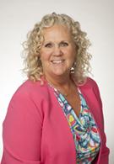
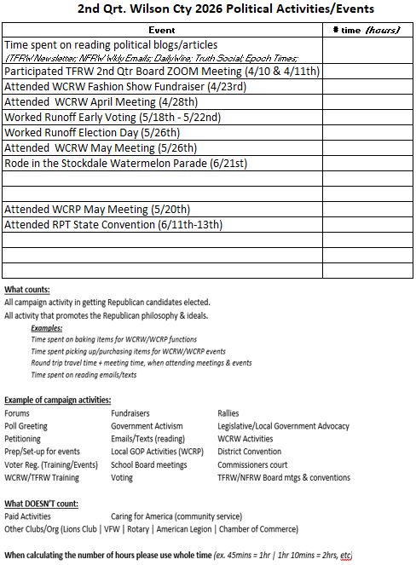
Political Activities doesn’t take a “summer break” Republican women keep plugging along
Political Activities
no matter what time of the year. 2nd Quarter deadline is June 30th, so be on the look out for my emails reminding you to submit your total number of hours and calls spanning the months of April, May and June.
Some of you may have learned at our May monthly meeting about the new Abbott Impact phone app. I have been tossing around the idea of scheduling some Get Out The Vote Messaging Parties, it would be more fun doing it together than doing it by yourself. Be on the look out for more details.
A copy of both calendar styles are provided for your convenience. As always, I am here if you have any questions. Joyce Miller – 210-827-1814
-12-
Political Advertising Paid for by : Wilson County Republican Women’s Club PAC

Slide 13
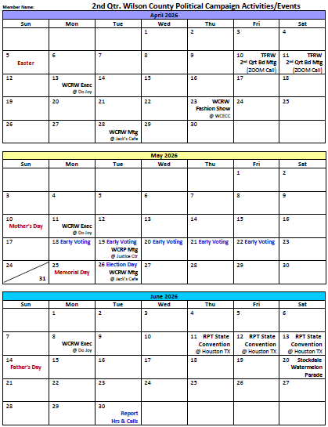
Cont’d Political Activities
-13-
Political Advertising Paid for by : Wilson County Republican Women’s Club PAC

