Slide 1

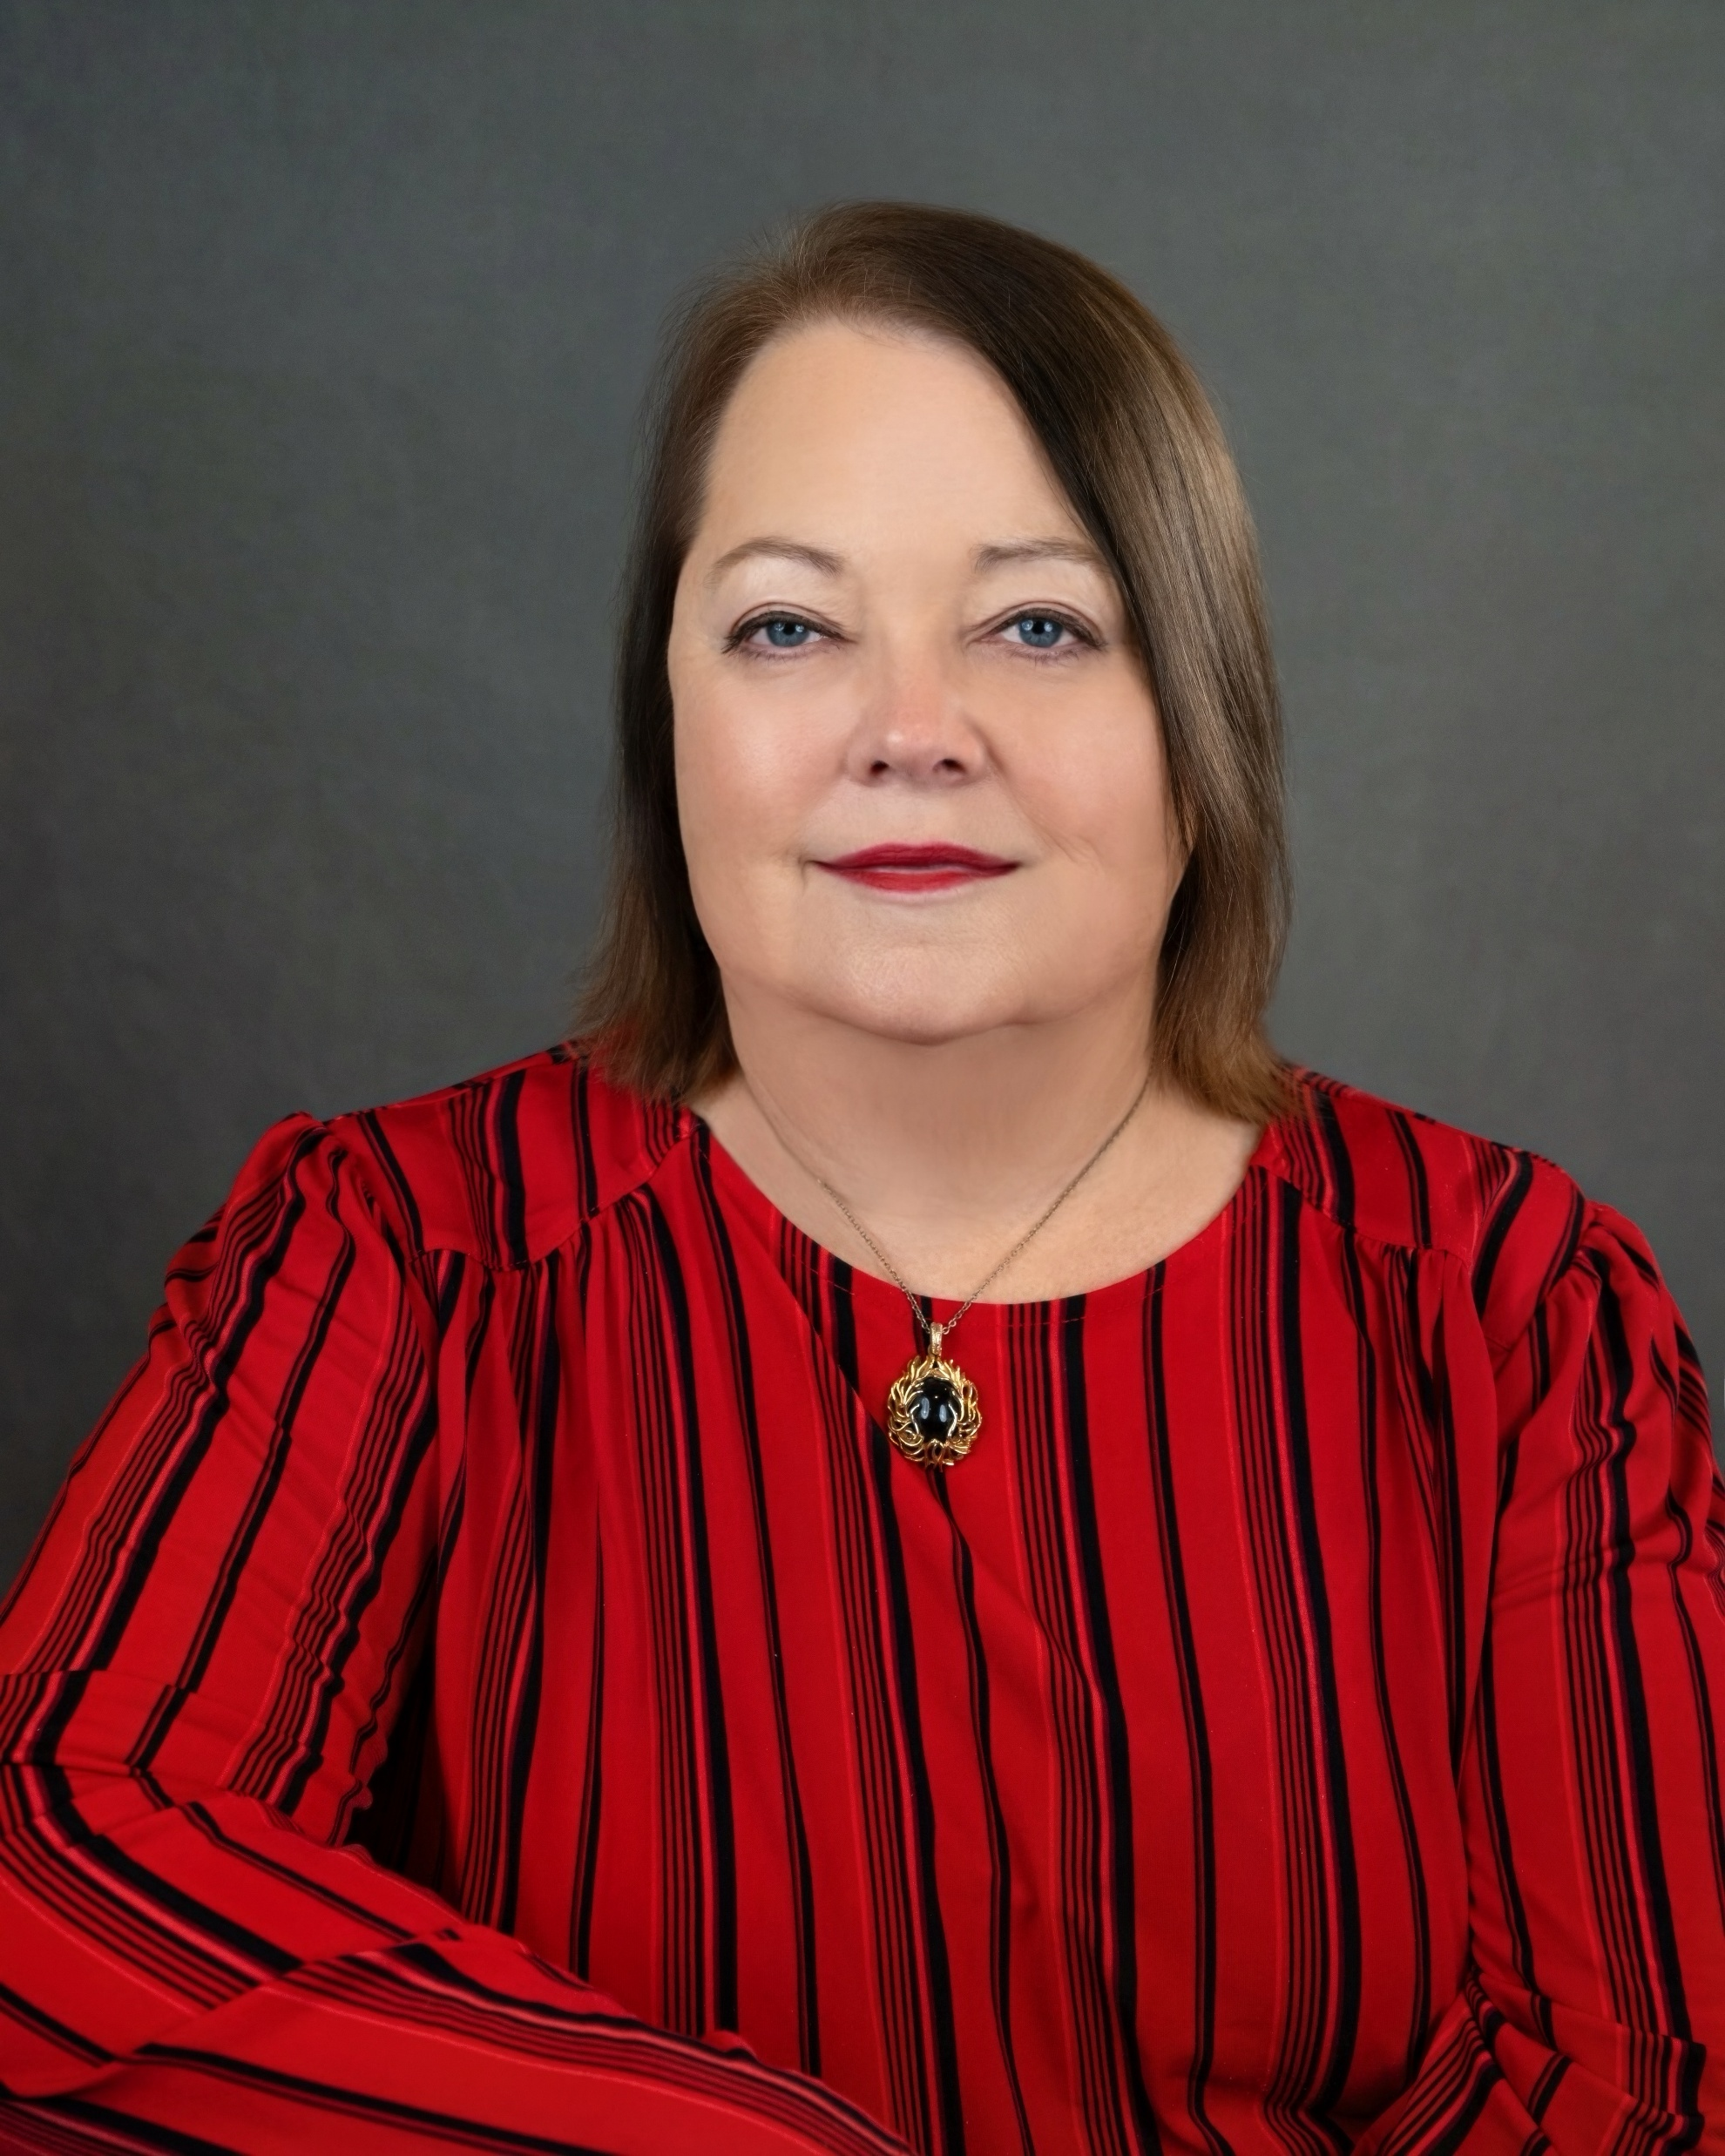
Wilson County Republican Women’s Club
August 2026
Volume 4 issue 8
TX Region 14, Senate District 21
wilsoncountytxrepublicanwomen.org | FB: @WilsonCountyRepublicanWomen’sClub
Table of Contents
President’s Pen
1 President’s Pen
3 Upcoming Meetings/
Officers
4 Americanism/
Armed Services
5 Legislative
6 TFRW Article
7 Membership
8 Caring for America
9 Calendar of Events
10 WCRW August Meeting
11 Political Activities
13 Polling Locations
14 Voters Guide
Here Comes the Judge, Here Comes the Judge!
Who remembers Sammy Davis Jr. dressed up in a gaudy judge’s robe and a white barrister-style wig on Rowan & Martin’s Laugh-In? This November 3rd we can elect 15 justices/judges
from the Texas Supreme Court to local Justice of the Peace.
The Supreme Court is composed of the Chief Justice and eight justices. The justices are elected to staggered six-year terms so that the court cannot be completely changed in one election. This is the court of last resort for civil matters in Texas. We will be voting for Supreme Court: Chief Justice, Jimmy Blacklock; Justice Place 2, James P. Sullivan; Justice Place 7, Kyle Hawkins; and Justice Place 8, Brett Busby.
Texas Court of Criminal Appeals is the highest court for criminal cases. The Court is composed of a Presiding Judge and eight Judges who are elected to staggered six-year terms. We will be voting for Judge, Court of Criminal Appeals: Place 3, Thomas Smith; Place 4, Kevin Patrick Yeary; and Place 9, John Messinger.
The Fifteenth Court of Appeals is a statewide intermediate appellate court. The Court is composed of three justices. We will be voting for 15th Court of Appeals: Chief Justice, Scott Brister; Justice Place 2, Scott K. Field; and Justice Place 3, April Farris.
The Fourth Court of Appeals has intermediate jurisdiction of both civil and criminal cases appealed from lower courts in thirty-two counties of Texas. The Fourth Court of Appeals is comprised of the Chief Justice and six judges. We will be voting
Continued on page 2
Birthdays
Eileen Schuette: Sep 14
Elsy Barreto: Sep 18
Bonnie Sario: Sep 20
Kay Finley: Sep 24
Margaret Tollefson: Sep 24
Luz Bella Serrato: Sep 27
Megan Miller Stanhope:
Sep 28
Melissa Moczygemba:
Oct 7
Monica Gutierrez: Oct 11
Carolyn Orth: Oct 14
Theresa Soberoski: Oct 16
Janet Martin: Oct 22
Marguerite Griffin: Oct 23
Viola Henke: Oct 25
Links
NFRW
TFRW
Submit articles:
Sharon.a.meyer80@gmail.com 830-583-5297
1
Political Advertising Paid for by : Wilson County Republican Women’s Club PAC

Slide 2
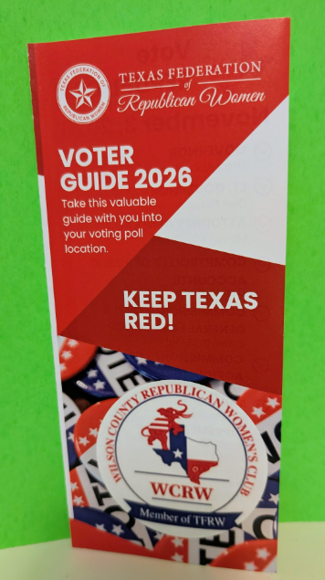
President’s Pen Continued:
for Chief Justice, 4th Court of Appeals, Bert Richardson.
The 81st Judicial District Court and 218th Judicial District Court both serve five counties, one of which is Wilson County. We will be voting for the 81st Judicial District Judge, Jennifer Ebrom Dillingham and the 218th Judicial District Judge, Russell Wilson.
Support these 13 judges by voting for every one of them. Every statewide judge has an opponent, so every vote is crucial. Also vote for our Wilson County Judge, Mike Monreal, and your local Justice of the Peace: Precinct 1, Jared Shaw; Precinct 2, Kenneth Buck Griffin; Precinct 3, Joel Bellinger; and Precinct 4, Monica Lambeck Gutierrez. Judges preserve our freedoms by upholding the rule of law and supporting the Constitution. God bless our Judges; they have loads of patience listening to people. Here Comes the Judge!
Anna
Anna Willis
President
Hot Off the Presses: Voter Guides Are Available
Wilson County Republican Women has worked with the Texas Federation of Republican Women to develop a voter guide specifically for our club. The guide lists candidates appearing on the ballot for the State of Texas and Wilson County.
Because our club is a Texas Political Action Committee—not a federal PAC—we are not permitted to endorse federal candidates, including U.S. senators and U.S. House of Representatives.
You may not use your phone inside the election polling area, but you may carry and use this voter guide. Please use it while block-walking. Take extra copies to share with family, friends, and neighbors.
Our goal is simple: place this voter guide in the hands of as many voters as possible.
Keep Texas RED!
Anna Willis
President, WCRW
2
-
Political Advertising Paid for by : Wilson County Republican Women’s Club PAC

Slide 3
Wilson County Republican Women’s Meeting Schedule
Meetings are open so please bring a friend or relative.
Jack’s Café 507 10th St, Floresville, TX
Tuesday, September 22, 2026
Doors open @ 11:30 AM
Meeting starts @ 12:00 PM
Guest Speaker: Jon Melendez
Property Tax Reform: Americans For Prosperity Team Texas.
Executive Committee
President: Anna Willis
210-722-3410 /swoozie2@sbcglobal.com
First Vice President: Sarah Gella
210-275-9091/kernel100@aol.com
Treasurer: Dawn Polasek Barnett
210-744-5868/dawnpbarnett@yahoo.com
Secretary: Sarah Gella
210-275-9091/kernel100@aol.com
VP Membership: Ruby Manen
830-391-0818/rubymanen@yahoo.com
VP Legislation: Melissa Moczygemba
210-913-1355/Melricventures@gmail.com
VP Political Activities: Joyce Miller
210-827-1814/millerjab64@gmail.com
VP Awards: Sharon Meyer
830-583-5297/Sharon.a.meyer80@gmail.com
VP Americanism/Armed Services: Marguerite Griffin
210-685-3703/marmiles4d@gmail.com
Committee Chairs
Community Engagement:
Caring for America: Lori Hrna
Literacy: Ruby Manen
Chaplain: Mata Orth
Historian:
Scholarship: Loretta Carter &
Barbara Burdette
Hospitality: Kitty Phillips
TFRW President: Jill Tate
214-354-9443, president@TFRW.org
District Director: Ruby Manen
830-391-0818
rubymanen@yahoo.com
Deputy Regional President:
Karen Newton
3
Political Advertising Paid for by : Wilson County Republican Women’s Club PAC

Slide 4


Americanism and Armed Services
Marguerite Griffin
VP Armed Services /Americanism
Purple Heart Day was on August 7 and commemorates the creation of the oldest American military decoration for military merit. The Purple Heart honors men and women who are of the Military Order of the Purple Heart. During the American Revolutionary War, the Badge for Military Merit decorated six known soldiers.
General George Washington created the Badge of Merit in 1782. Its design included a purple, heart-shaped piece of silk bound with a thin edge of silver. Across the face, the word Merit was embroidered in silver. While the badge symbolized the courage and devotion of an American Patriot, no one knows who designed the award. Until Washington’s 200th birthday, the Purple Heart persisted as a Revolutionary War footnote. Through the efforts of General Douglas MacArthur, the U.S. War Department created the Order of the Purple Heart. Today the medal bears a bust of George Washington and his coat of arms.
While an accurate and complete list of names no longer exists, National Geographic recently estimated that nearly 1.9 million service members have earned Purple Hearts since its creation. It is the oldest U.S. military honor bestowed upon service members today. Until 1944, the Purple Heart recognized service members’ commendable actions as well. Then in 1944, the requirements limited the award to only those wounded or killed in combat.
Purple Heart Day encourages us to honor everyone who has received a Purple Heart. As a group we will have the honor to ensure that every hero is remembered and honored as our support for Wreaths Across America is upon us. Through your generosity we will
be able to place more wreaths on the headstones of our nation’s veterans. Please stay tuned for more information on how to be involved in this important living tribute to honor our veterans, active-duty military, and their families.
4
Political Advertising Paid for by : Wilson County Republican Women’s Club PAC

Slide 5
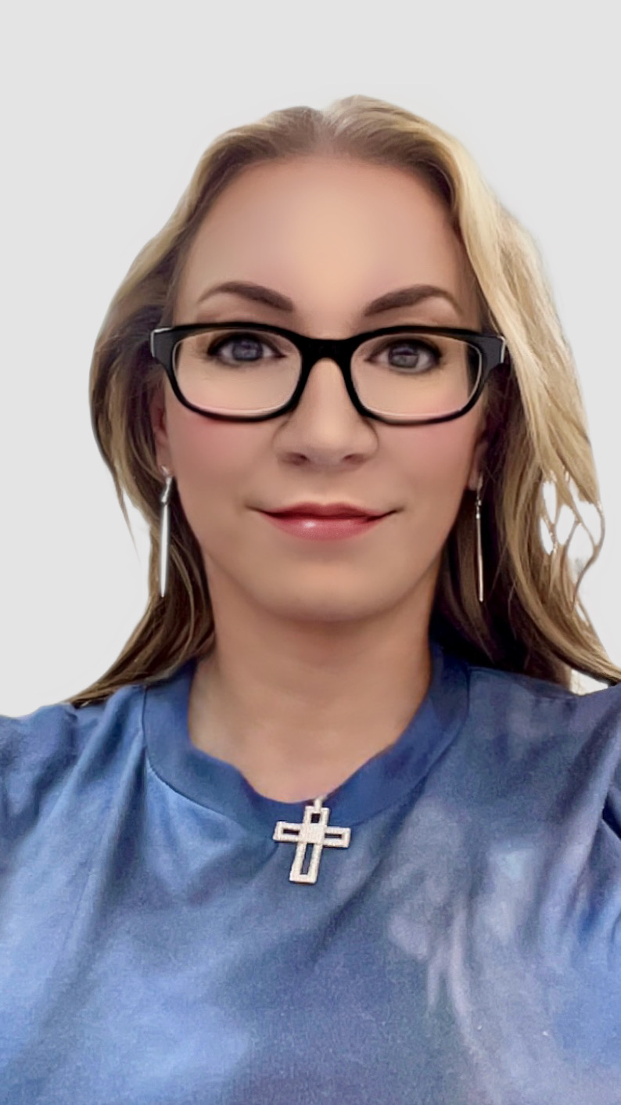
Legislature
Melissa Moczygemba
VP Legislation
In a court document filed August 10, 2026, new Texas Secretary of State Robert Howden stated his opposition to a proposal by the Republican Party of Texas and the Texas Attorney General’s Office to impose a Consent Judgment that would implement a closed Primary election. Amarillo Republican activist, Chip Hunt, filed a lawsuit seeking to have portions of the Texas Election Code that require open primaries to be held unconstitutional. In October, the Party – joined by the Texas Attorney General’s office – filed a Joint Motion for Entry of Consent Judgment that asked United States District Judge Matthew J. Kacsmaryk to “enter a final judgment declaring that: (1) the current open primary system is in violation of Plaintiffs’ First Amendment rights; (2) that the Republican Party of Texas is entitled to identify those who associate with the Party and to exclude those who do not associate with the Party from participating in a primary election selecting the Party’s nominees for the general election ballot; and (3) that Texas Election Code sections 162.002, .003, 172.001, and .002 are unconstitutional to the extent that they interfere with the rights of the Republican Party of Texas and Chip Hunt.” Howden stated, “the Secretary believes that this issue can and will be resolved by the Legislature in the coming months.” He also stated, “The Secretary continues to believe that the Legislature is the proper forum for adopting any closed primary system and thoughtfully crafting the detailed scheme that would govern it. Governor Greg Abbott, Lt. Governor Dan Patrick, and House Speaker Dustin Burrows have all indicated support for closed primary elections in recent months. At the Republican Party of Texas State Convention in June, Governor Abbott told attendees, “We are going to make clear that, in the future, only Republicans vote in Republican Primaries.”
* Texas Voice
5
n
Political Advertising Paid for by : Wilson County Republican Women’s Club PAC

Slide 6
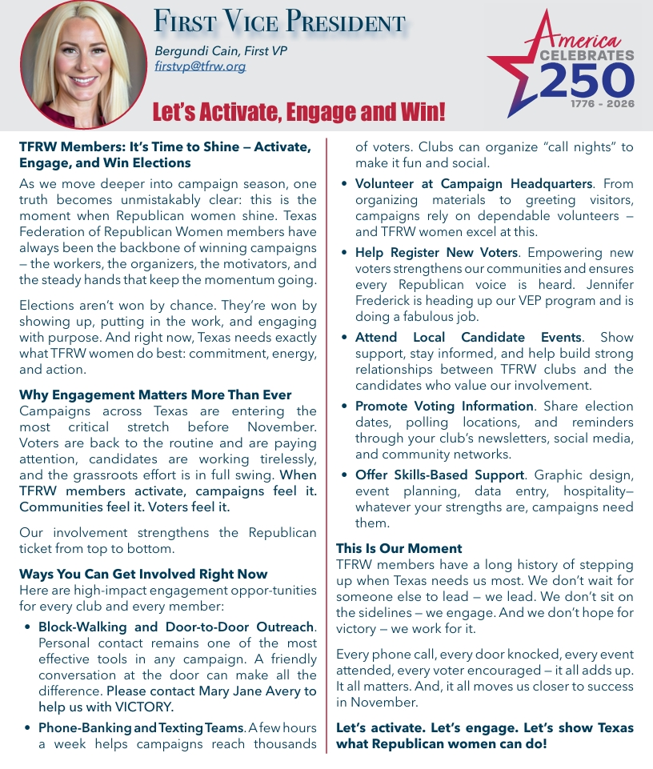
.
TFRW Today | August 2026
6
Political Advertising Paid for by : Wilson County Republican Women’s Club PAC

Slide 7

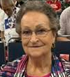
Membership
WCRW 2026 MEMBERSHIP UPDATE
Ruby Manen
Membership VP
(830) 391-0818
rubymanen@yahoo.com
Mark your calendars! The Wilson County Republican Women’s club is excited to be hosting a Membership Drive on November 14, 2026, at the Dewees-Remschel House.
As of August 21, WCRW has 75 Primary Members and 30 Associate Members. Because 2026 is an election year, we set a goal of reaching 100 Primary Members. A secondary goal was to at least match our 2025 total of 83 Primary Members. At this point, we are short of both goals.
So ever being an optimist, I reviewed membership numbers over a 5-year period to see if our statistics were truly downward trending. Results: 2022 – 65; 2023 – 74; 2024 – 82; 2025 – 83; 2026 – 75. Even with this lower number, it is not a downward trend, just a blip! (As a side note, I recently chatted with other clubs and found most were also experiencing lower numbers this year. Several voiced the opinion they thought it was because Trump wasn’t on the ballot.) Even so, the issues facing our community and country remain important, and WCRW’s work continues to matter.
WCRW is already beginning to plan for 2027, starting with a Membership Drive on November 14, 2026. We are delighted to hold the event at the Dewees-Remschel House, and it promises to be an enjoyable gathering. More information will be shared soon.
Save the date, plan to attend, and bring a friend or relative who may be interested in joining WCRW.
7
Political Advertising Paid for by : Wilson County Republican Women’s Club PAC

Slide 8
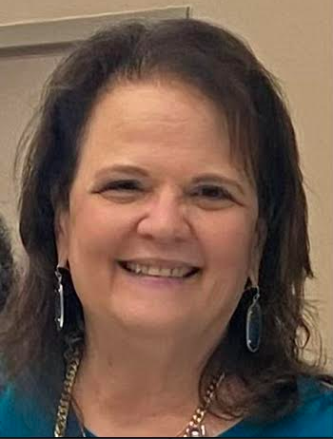
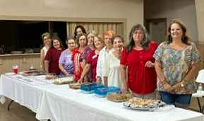
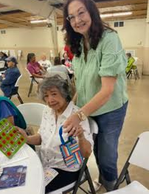
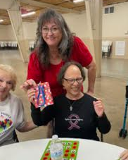
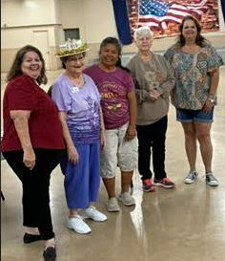
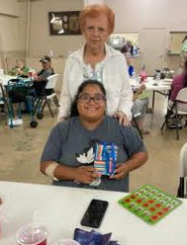
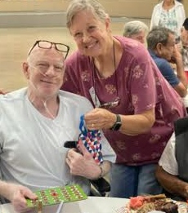
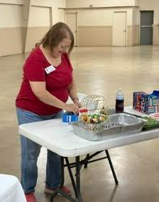


Caring for America
Wednesday, August 19, 2026,
Wilson County Expo & Community Center (Show Barn)
Lori Hrna, Chairman
Dog Days of August!
We managed to celebrate the seniors and WCRW August birthdays on Wednesday, Sept. 19th, even though it was 100+ degrees outside. We had a large group of seniors and club members, and everyone enjoyed the treats.
Bingo Birthday Bash
WCRW celebrating birthdays with seniors for lunch & games
.
2026 Birthday Bingo Bash dates for 2026 (All Wednesdays)
September 16, 2026 – Lori Hrna , Yvonne McMurray, more volunteers needed
October 21, 2026– Lori Hrna, Yvonne McMurray – need more volunteers
November 18, 2026 – Sarah Gella, Melissa Moczygemba, Carol Chitty, Ruby Manen, Lori Hrna, Yvonne McMurray - need more volunteers
December 16, 2026– Sarah Gella, Melissa Moczygemba, Carol Chitty, Ruby Manen, Lori Hrna, Yvonne McMurray- need more volunteers
If you haven't signed up for a month, check with Lori Hrna, 210-382-8766.
8
Political Advertising Paid for by : Wilson County Republican Women’s Club PAC

Slide 9
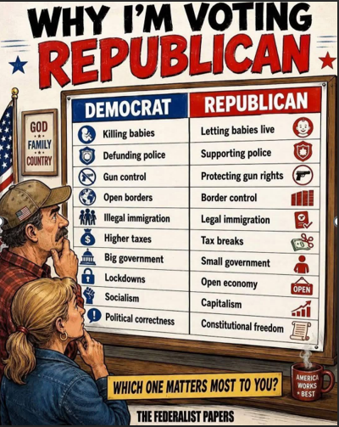
Calendar
TFRW Events Sep 17-18: Quarter 4 Board of Directors Meeting – Round Rock, TX Sep 19: Tribute to Women – Round Rock, TX
WCRW Events
Sept 16: Bingo Birthday Bash, Wilson County Expo Ctr, Floresville, 11:30 AM
Sept 22: Meeting, Jack’s Café, Floresville, 11:30 AM
Oct 21: Bingo Birthday Bash, Wilson County Expo Ctr, Floresville, 11:30 AM
Oct 27: Meeting, Jack’s Café, Floresville, 11:30 AM
Nov 18: Bingo Birthday Bash, Wilson County Expo Ctr, Floresville, 11:30 AM
Dec 16: Bingo Birthday Bash, Wilson County Expo Ctr, Floresville, 11:30 AM
Wilson County Republican Party Important Dates
Tuesday, Sep 15, 2026:
CEC Bi-Monthly Meeting
6:00 PM
800 10th St, Floresville, TX
Tuesday, Nov 17, 2026:
CEC Bi-Monthly Meeting
6:00 PM
800 10th St, Floresville, TX
TBD: Christmas Party
9
Political Advertising Paid for by : Wilson County Republican Women’s Club PAC

Slide 10
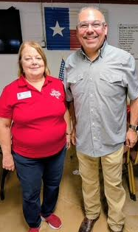
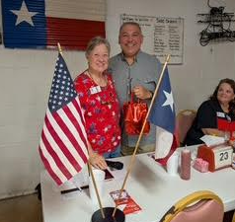
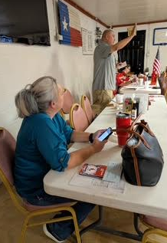
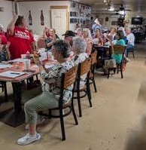
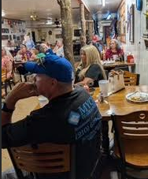
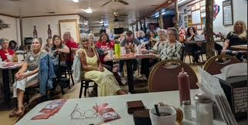
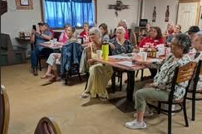
August 25, 2026, Witte’s BBQ, La Vernia, TX
Representative Ryan Guillen of Texas House District 31 was the guest speaker at the Wilson County Republican Women’s Club meeting on August 25 at Witte’s BBQ in La Vernia. A Texas A&M agriculture graduate, sixth-generation South Texas rancher, and small businessman, Rep. Guillen was elected at age 24, making him one of the youngest legislators in Texas history. He chairs the House Committee on Agriculture & Livestock and serves on the Committee on Congressional Redistricting, Select Committee on Redistricting, and Committee on State Affairs. Rep. Guillen discussed his advocacy for job creation, tax cuts, border security, education reform, and rural interests. He noted that recent legislation raised the homestead exemption to $140,000 and to $200,000 for seniors and
disabled homeowners, providing school district property tax relief. Data center development was also a major topic. Rep. Guillen said the Texas Legislature will meet in 2027 and plans to consider legislation requiring data centers to recycle water and generate their own electricity. He also supports moving to five-year property appraisals and capping appraisal increases at 3%, down from the current 10%. Rep. Guillen also holds Dairy Queen tours on the second Saturday of March, July, and November, visiting a DQ in each county he represents to hear constituents’ needs and concerns. Club members and guests enjoyed his detailed presentation of the many diverse things our State Senators and Representatives address in each legislative session.
10
Political Advertising Paid for by : Wilson County Republican Women’s Club PAC

Slide 11
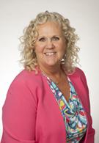
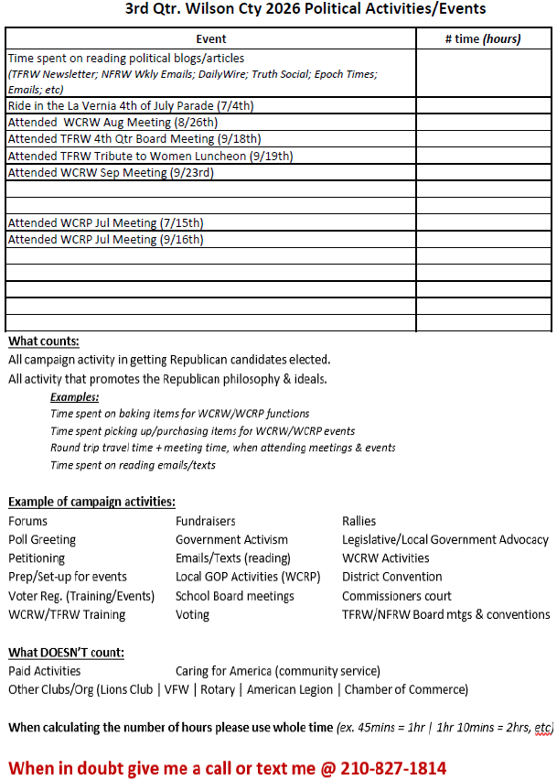
We have a little over two months before early voting begins, which starts on Monday, October
Political Activities
19th running through Friday, October 30th. In this issue you will find the two political activities calendars along with the voting information, hope you find it helpful. Since WCRW is a Texas PAC, I cannot include the federal candidates. Click the link and visit the Wilson County Republican Party – Home for their details.
We submitted another stellar performance for our second quarter political activities report; 1,304 calls and 7,270 hours. Everyone deserves a big YEEHAW!! As always, I am here if you have any questions.
Joyce Miller
210-827-1814
11
Political Advertising Paid for by : Wilson County Republican Women’s Club PAC

Slide 12
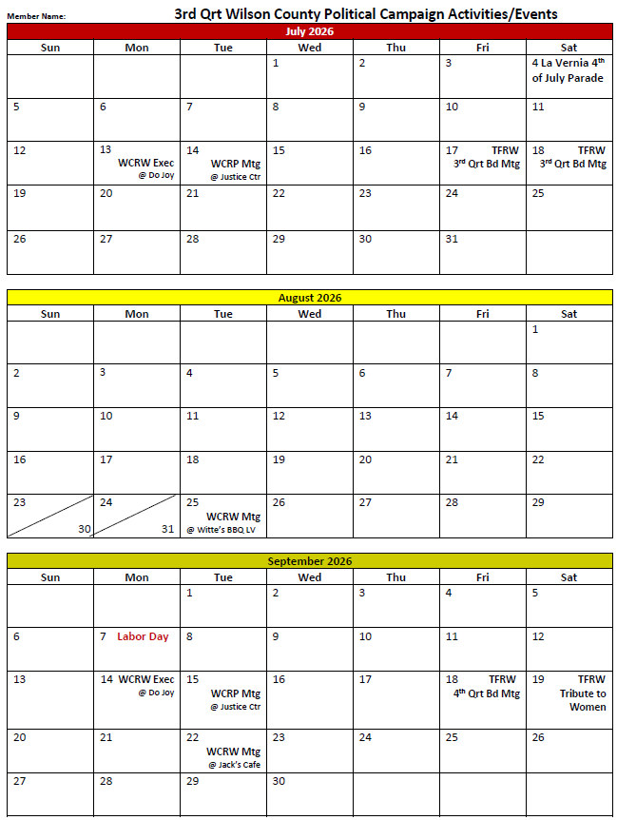
Cont’d Political Activities
12
Political Advertising Paid for by : Wilson County Republican Women’s Club PAC

Slide 13

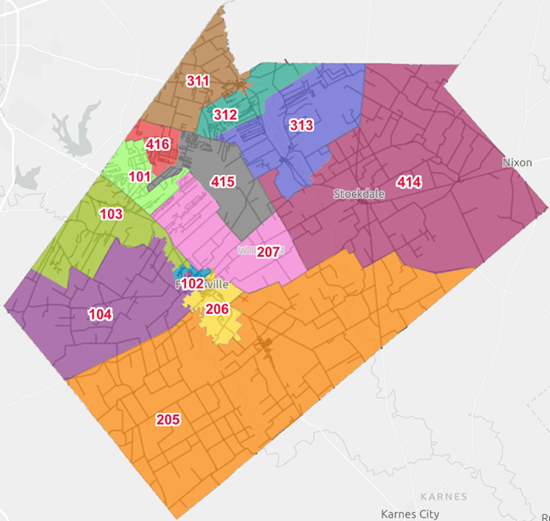


Cont’d Political Activities
Wilson County – General Election
Early Voting Polling Locations & Dates/Times
MAIN LOCATION: WILSON COUNTY COURTHOUSE ANNEX III- ELECTIONS OFFICE
1103 4TH ST. BLDG. B, SUITE 101
Monday, October 19th – Friday, October 23rd from 8:00 a.m. to 5:00 p.m.
Saturday, October 24th from 7:00 a.m. to 7:00 p.m.
Sunday, October 25th from 12:00 p.m. to 6:00 p.m.
Monday, October 26th – Friday, October 30th from 7:00 a.m. to 7:00 p.m.
BRANCH LOCATION: LA VERNIA CHURCH OF CHRIST
131 Industrial Dr., La Vernia, TX 78121
Monday, October 19th – Saturday, October 24th from 8:00 a.m. to 5:00 p.m.
Sunday, October. 25th from 12:00 p.m. to 6:00 p.m.
Monday, October 26th – Friday, October 30th from 8:00 a.m. to 5:00 p.m.
2026 NOVEMBER 3RD, ELECTION DAY – POLLING LOCATIONS
BOX 101 WILSON COUNTY ESD #2 BOX 311 LA VERNIA CHURCH OF CHRIST
WILLIAM D. “BILL” KINNEY STATION) 131 Industrial Dr., La Vernia, TX
191 Cimarron Dr., Floresville, TX.
BOX 102 SACRED HEART PARISH HALL BOX 312 S.S. WATER SUPPLY CORP.
921 3rd Street, Floresville, TX. 10393 US Hwy 87 W., La Vernia, TX.
BOX 103 SPJST HALL BOX 313 SUTHERLAND SPGS. COMMUNITY BLDG.
BOX 104 1156 FM 1303, Floresville, TX. 411 4TH St. Sutherland Springs, TX.
(1 Mile N of Intersection FM 536 & 1303) (1 block S. US Hwy 87 @ 4th & 14th streets)
BOX 205 ST. JOHN LUTHERAN EDUCATION BLDG. BOX 414 STOCKDALE COMMUNITY BLDG.
112 Titcomb, Poth, TX. 700 W. Main, Stockdale, TX.
BOX 206 AMERICAN LEGION HALL POST 38 BOX 415 LIFE CHURCH
1412 Fourth Street, Floresville, TX. 7079 FM 775, La Vernia, TX.
BOX 207 WILSON COUNTY EXPO BOX 416 WOOD VALLEY COMMUNITY CENTER
435 ST. Hwy 97 E, Floresville, TX. 715 Fuller Lane, Adkins, TX.
Wilson County, Texas – Precinct Map
13
Political Advertising Paid for by : Wilson County Republican Women’s Club PAC

Slide 14

Cont’d Political Activities
Wilson County Voter Guide
Early Voting: October 19th – 30th | Election Day: November 3rd
STATE
GOVERNOR Greg Abbott – www.gregabbott.org | JUDGE, COURT OF CRIMINIAL APPEALS, PLACE 3 Thomas Smith – www.smithfortexas.org
LIEUTENANT GOVERNOR Dan Patrick – www.danpatrick.org | JUDGE, COURT OF CRIMINAL APPEALS, PLACE 4 Kevin Patrick Yeary – www.judgeyeary.com
ATTORNEY GENERAL Mayes Middleton – www.mayesmiddleton.com | JUDGE, COURT OF CRIMINAL APPEALS, PLACE 9 John Messinger – www.messingerforjustice.com
COMPTROLLER OF PUBLIC ACCOUNTS Don Huffines – www.donhuffines.com | CHIEF JUSTICE, 15TH COURT OF APPEALS DISTRICT Scott Brister – www.justicescottbrister.com
COMMISSIONER OF THE GENERAL LAND OFFICE Dawn Buckingham – www.dawnbuckingham.com | JUSTICE, 15TH COURT OF APPEALS DISTRICT, PLACE 2 Scott K. Field – www.justicescottfield.com
COMMISSIONER OF AGRICULTURE Nate Sheets – www.natesheets.com | JUSTICE, 15TH COURT OF APPEALS DISTRICT, PLACE 3 April Farris – www.justiceaprilfarris.com
RAILROAD COMMISSIONER Bo French – www.bofrench.com | STATE SENATOR, DISTRICT 21 Julie Dahlberg – www.juliedahlberg.com/texas-senate-campaign
CHIEF JUSTICE, SUPREME COURT Jimmy Blacklock – www.jimmyblackblock.com | STATE REPRESENTATIVE, DISTRICT 31 Ryan Guillen – www.ryanguillen.com
JUSTICE, SUPREME COURT, PLACE 2 James P. Sullivan – www.judgesully.com | CHIEF JUSTICE, 4TH COURT OF APPEALS DISTRICT Bert Richardson – www.electjudgerichardson.com
JUSTICE, SUPREME COURT, PLACE 7 Kyle Hawkins – www.justicekylehawkins.com | DISTRICT JUDGE, 81ST JUDICIAL DISTRICT Jennifer Ebrom Dillingham – www.jenniferdillingham.com
JUSTICE, SUPREME COURT, PLACE 8 Brett Busby – www.brettbusby.com | DISTRICT JUDGE, 218TH JUDICIAL DISTRICT Russell Wilson – Not Available
COUNTY
COUNTY JUDGE Michael Monreal – www.monreal4wctx.com | DISTRICT CLERK Deborah Bryan – Not Available
COUNTY TREASURER Christina Mutz – Not Available | COUNTY JUSTICE OF THE PEACE, PRECINCT 1 Jared Shaw – FB: jaredshawforjp1
COUNTY CLERK Genevieve Martinez FB: genevievemartinezforwilsoncountyclerk | COUNTY JUSTICE OF THE PEACE, PRECINCT 2 Kenneth Buck Griffin FB: Kenneth-Buck-Griffin-for-Justice-of-the-Peace-Pct-2
COUNTY COMMISSIONER, PRECINCT 2 Russell King FB: RussellKingforWilsonCountyCommissionerPrecinct2 | COUNTY JUSTICE OF THE PEACE, PRECINCT 3 Joel Bellinger FB: Joel-Bellinger-for-Wilson-County-JP3
COUNTY COMMISSIONER, PRECINCT 4 John “Scott” Akin FB: Commissioner-John-Scott-Akin | COUNTY JUSTICE OF THE PEACE, PRECINT 4 Monica Lambeck Gutierrez FB: Monica-Lambeck-Gutierrez-for-Wilson-County-JP4
NOTE: Federal Candidates (U.S. Senator & U.S. House Representative) are not listed since we are a Texas PAC. If you want their information, you can click the link and visit the Wilson County Republican Party – Home
14
Political Advertising Paid for by : Wilson County Republican Women’s Club PAC

