Slide 1
Operation of Current Electricity Price Control For Sark
By
Shane Lynch
Electricity Price Controller
At Public Meeting on 6 December 2023

Slide 2
Price Control Design
2-Year Price Control from 01st April 2023 – 31st March 2025
Maximum Unit Price (p/kwh), monthly connection charge, monthly stand-by charge for own-generators.
Designed To Allow For The Recovery Of:
Historic and new capital expenditure
A return on capital,
Fixed operating costs, and
Fuel costs
Monthly Correction Mechanism for Fuel and Consumption
2-Month Lag

Slide 3
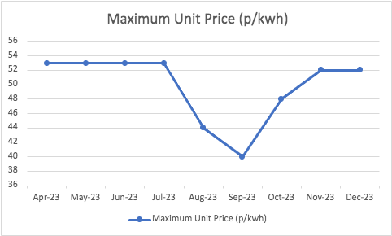
Electricity Price Trend

Slide 4
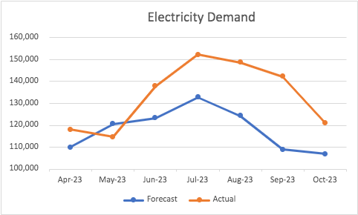
Price Drivers

Slide 5
Lack Of New Capital Expenditure
Price Control allows for new capital expenditure and takes into consideration the additional investment risk in Sark .
The Price Control required SEL to urgently submit its proposals for capital expenditure, prioritised on the basis of safety and reliability. SEL has still not made its submission.
Previous technical reports have indicated the need for a significant asset replacement and upgrade programme.
SEL has indicated its intentions to replace one of its diesel generators.
Electricity prices are artificially lower, and the risks to safety and reliability are higher due to this lack of capital expenditure.

