Slide 1
FEATURE FILM PITCH & TREATMENT
ENEMY IN THE WHITE HOUSE
An explosive political action thriller with a smoldering romantic spine.
GENRE: Action Thriller
RUNTIME: 1 Hour 27 Minutes

Slide 2
EXECUTIVE OVERVIEW
Right for the Cultural Moment
Topical Urgency
Character Engine
Media Tie-In Magnet
Political anxiety at record highs. Audiences process global tension through high-stakes narrative thrillers.
Acerbic intelligence dynamic pairing high-stakes tactical operations with romantic friction.
Built-in national news hook driving organic cross-platform commentary and brand partnerships.

Slide 3
CORE NARRATIVE ENGINE
Logline & Emotional Payload
LOGLINE
A beautiful international espionage expert joins forces with an old lover to defeat a communist takeover of the White House.
EMOTIONAL PAYLOAD
Captures the triumphant, against-all-odds American spirit of the 1980 "Miracle on Ice" victory at Lake Placid.

Slide 4
CHARACTER DOSSIERS
The Operatives: Catherine & Felix
INTELLIGENCE AGENT / ANALYST
INTERNATIONAL INTELLIGENCE AGENT
CATHERINE (Late 30s)
FELIX (Late 30s)
Specs: 5'7", 130 lbs, Blue Eyes, Reddish Auburn Hair.
Specs: 6'0", 185 lbs, Blue Eyes, Dirty Blonde Hair.
Profile: Poised under pressure, martial arts expert, multi-lingual.
Profile: Daring, focused, tactical, clear thinking under extreme fire.
Tagline: A capable woman who has seen more than most men.
Tagline: A patriot who made a difference when it mattered most.

Slide 5
SUPPORTING CAST DOSSIERS
Cherokee & The Military Patriots
CHEROKEE (Mid 40s)
GEN. THAD SPENSER (70s)
GEN. SAM LOCKE (60s)
Role: Mercenary Assassin
Role: Military Leader
Role: Military Leader
Methodical, calculated sniper who turns on corrupt handlers to back Catherine.
Barrel-chested veteran strategist ready for one last critical battle.
Straight-shooting commander who rallies troops when D.C. collapses.

Slide 6
ANTAGONIST DOSSIERS
Dmitry Melnikoff & Mohammad Ahmad
EX-KGB / VP ELECT / USURPER
POLITICAL ADVISER
DMITRY MELNIKOFF (Early 60s)
MOHAMMAD AHMAD (Early 50s)
Profile: Former Russian President turned Oligarch. Powerful, ruthless, sociopathic.
Profile: Devious, calculating strategist operating under his own hidden agenda.
Arc: Assassinates President-Elect to seize power and launch military takeover.
Arc: Serves Dmitry until heavy-handed military force threatens his spoils.
Tagline: Where Evil and Ambition meet.
Tagline: No one remembers second place.

Slide 7
SCRIPT STRUCTURE: ACT I
Infiltration & Assassination
01. OPENING
02. SETUP
03. INCITING INCIDENT
04. DEBATE
Flashback Kill
Recruiting Patriots
Pres-Elect Murdered
High-Stakes Trust
Cherokee preempts Catherine & Felix's Romanian hit from a rooftop.
Catherine identifies Russian VP threat and gathers her old team.
Dmitry kills President-Elect to claim power.
One wrong move triggers execution of all resistance players.

Slide 8
SCRIPT STRUCTURE: ACT II (RISING ACTION)
Coups, Operations & Romantic Pressure
05. BREAK INTO TWO
06. B STORY
07. FUN & GAMES
Mobilizing Agencies
Romantic Friction
Military Occupation
Catherine culls military and intelligence networks for loyal patriots.
Felix presses to renew love affair; focused Catherine resists advances.
Dmitry arrests Spenser; Felix penetrates hostile defense perimeters.

Slide 9
SCRIPT STRUCTURE: ACT II (CRISIS)
Fall of the White House & Abduction
08. MIDPOINT
09. ALL IS LOST
10. DARKNESS
White House Falls
Catherine Abducted
Torture & Search
Secret ops center burned; corrupt troops occupy civilian centers.
Catherine captured by Dmitry; Locke's forces overwhelmed in D.C.
Felix captured rescuing Catherine; room-to-room hunt for First Lady.

Slide 10
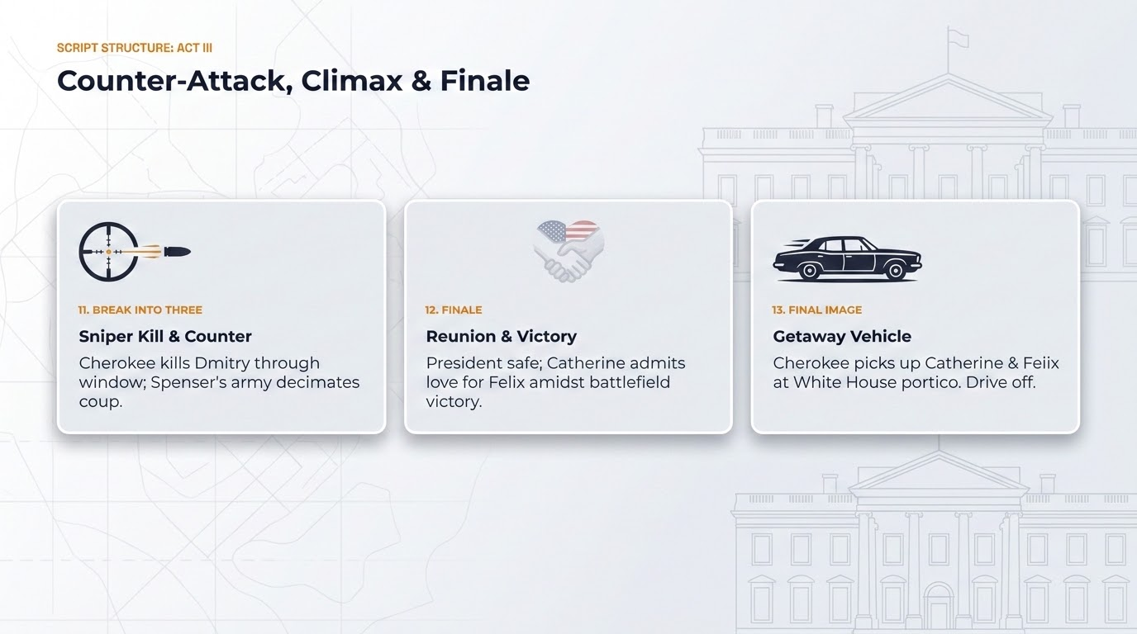

Slide 11
READY FOR DEVELOPMENT & PRODUCTION
ENEMY IN THE WHITE HOUSE
Entertaining all serious studio offers for optioning, acquisition, and co-production.
Matt Charles Stadnik & Roger Paul O’Keefe

